Slide 1
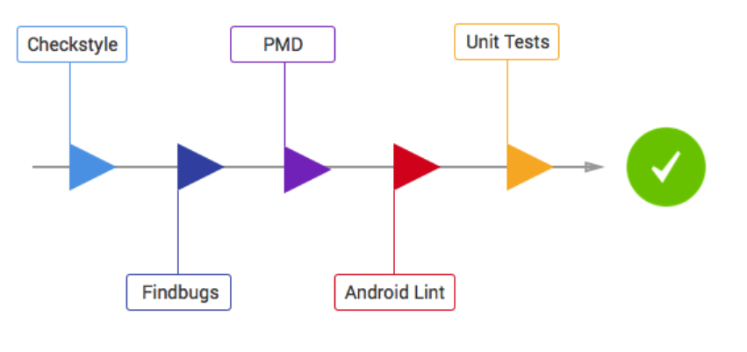
Static Analysis Flow in MMR2

Slide 2
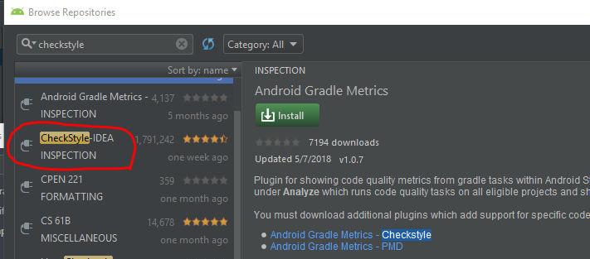
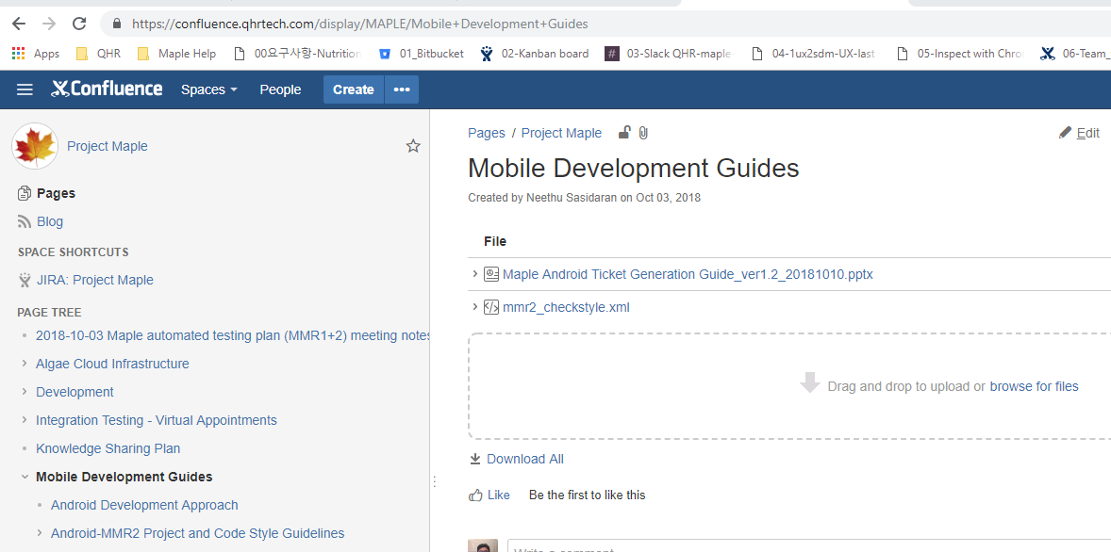
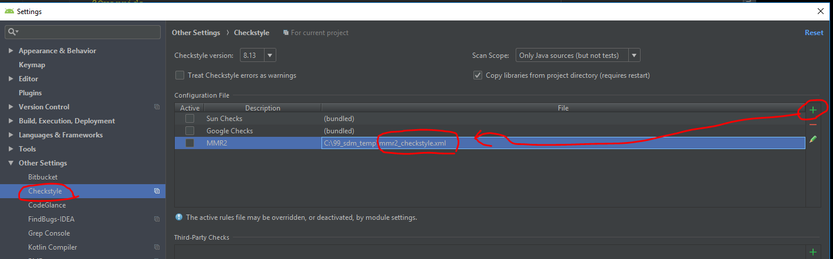
1-1. CheckStyle
1. Visit site and download ‘mmr2_checkstyle.xml’
https://confluence.qhrtech.com/display/MAPLE/Mobile+Development+Guides
Checkstyle is a development tool to help
programmers write Java code
that adheres to a coding standard.
It automates the process of checking
Java code to spare humans of this boring
(but important) task.
This makes it ideal for projects that
want to enforce a coding standard.
2. setting

Slide 3
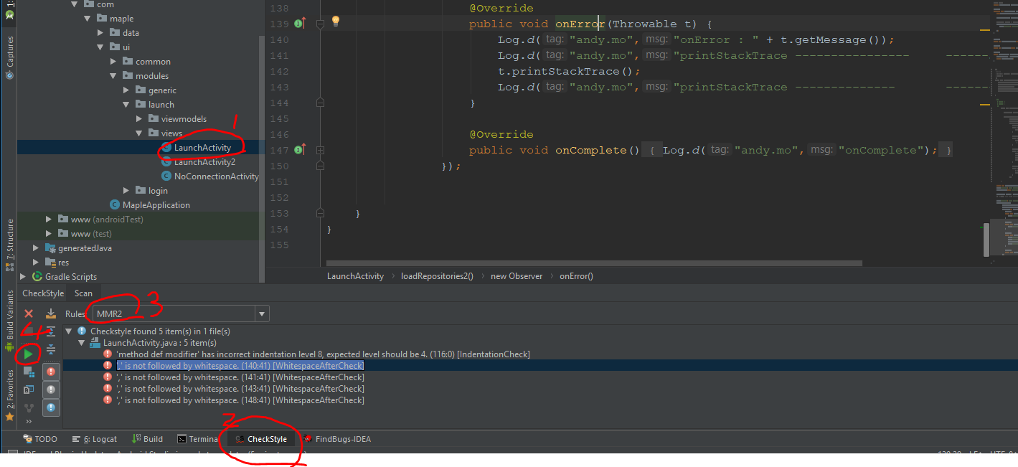
1-2. CheckStyle
3. Use check style (After development)
3-1. Select target File 3-2. Click “CheckStyle” at bottom
3-3. Select Rules “MMR2” (that is registered previous page)
3-4. Run & Check

Slide 4
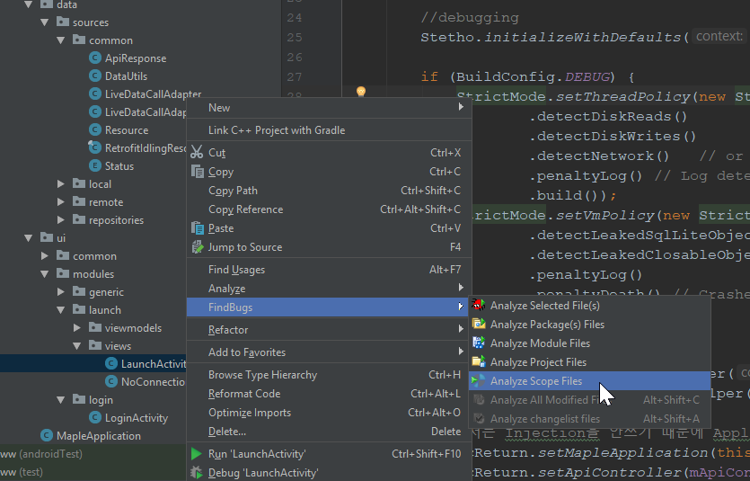
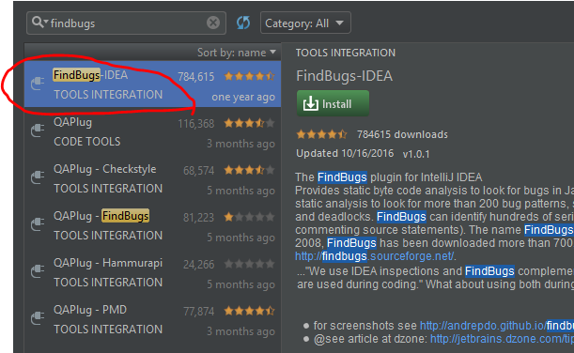
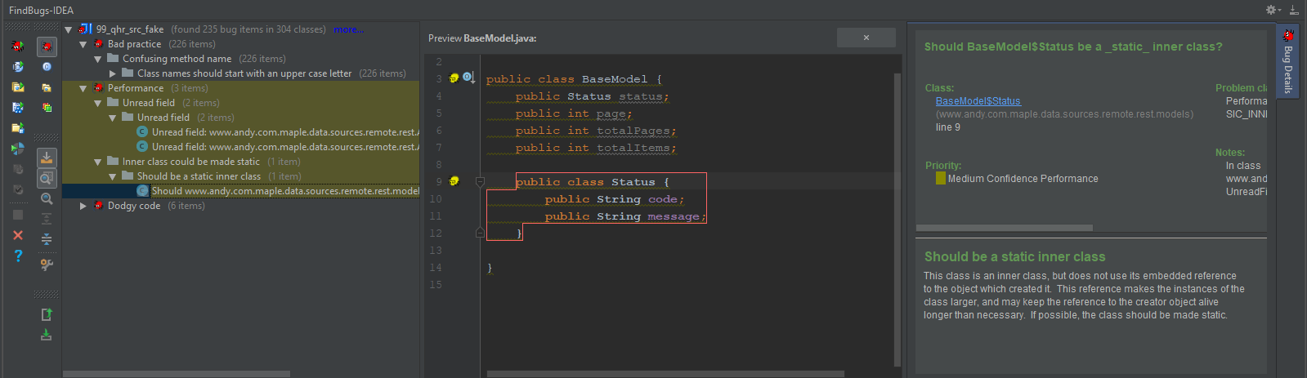
2-1. FindBugs
http://findbugs.sourceforge.net/
Analyze - Module - Project
- Scope
2. check
FindBugs, a program which uses static analysis to look for bugs in Java code.

Slide 5
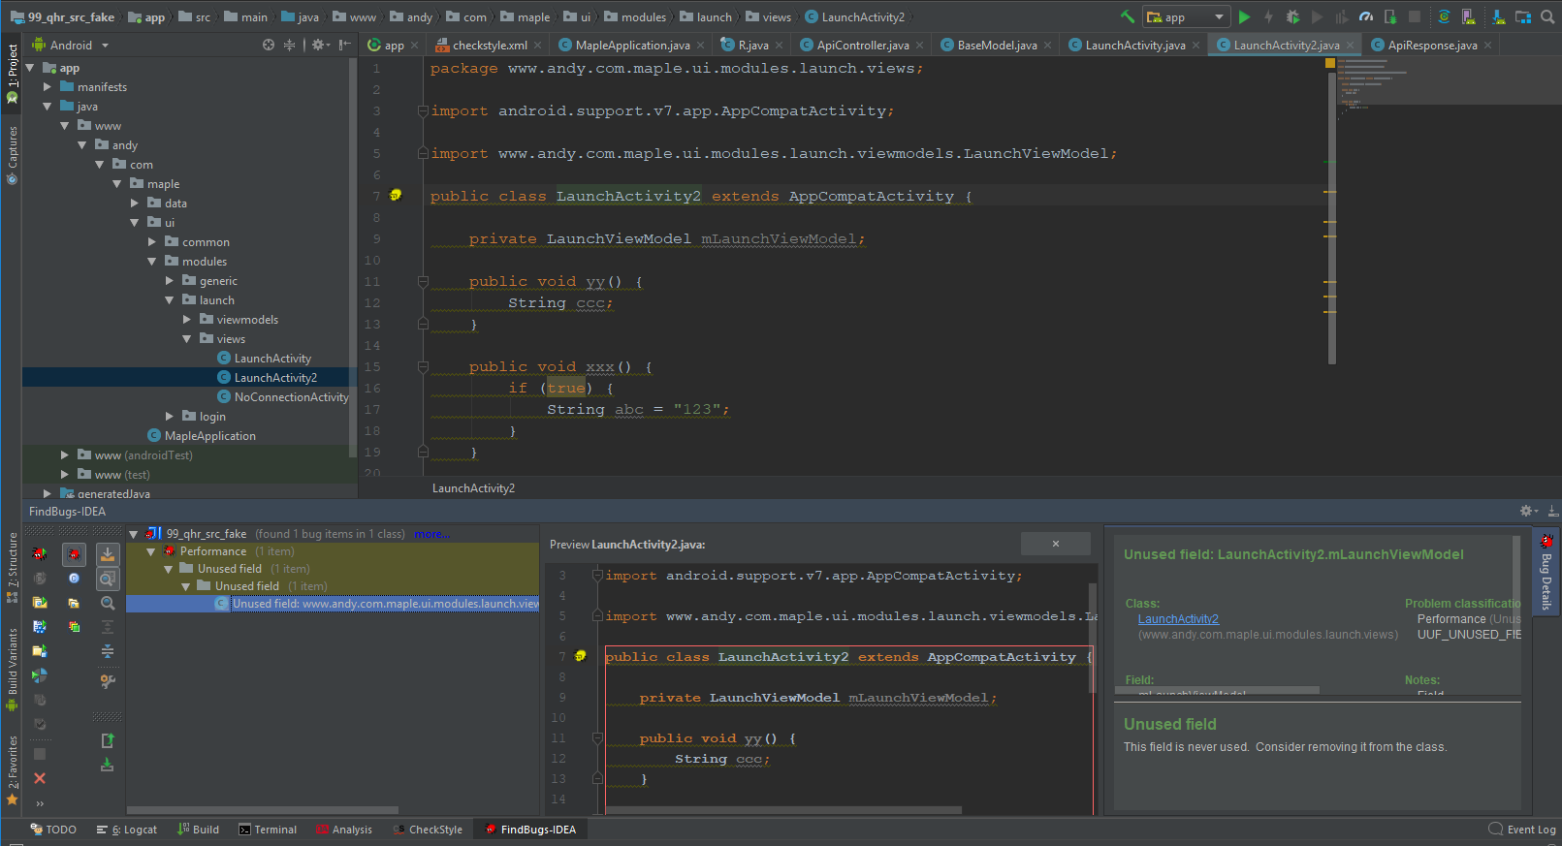
2-2. FindBugs
Select target file
Select Findbug at bottom
Run & check
1
3
2

Slide 6
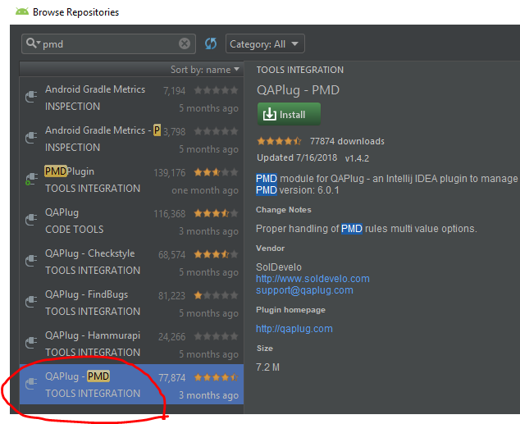
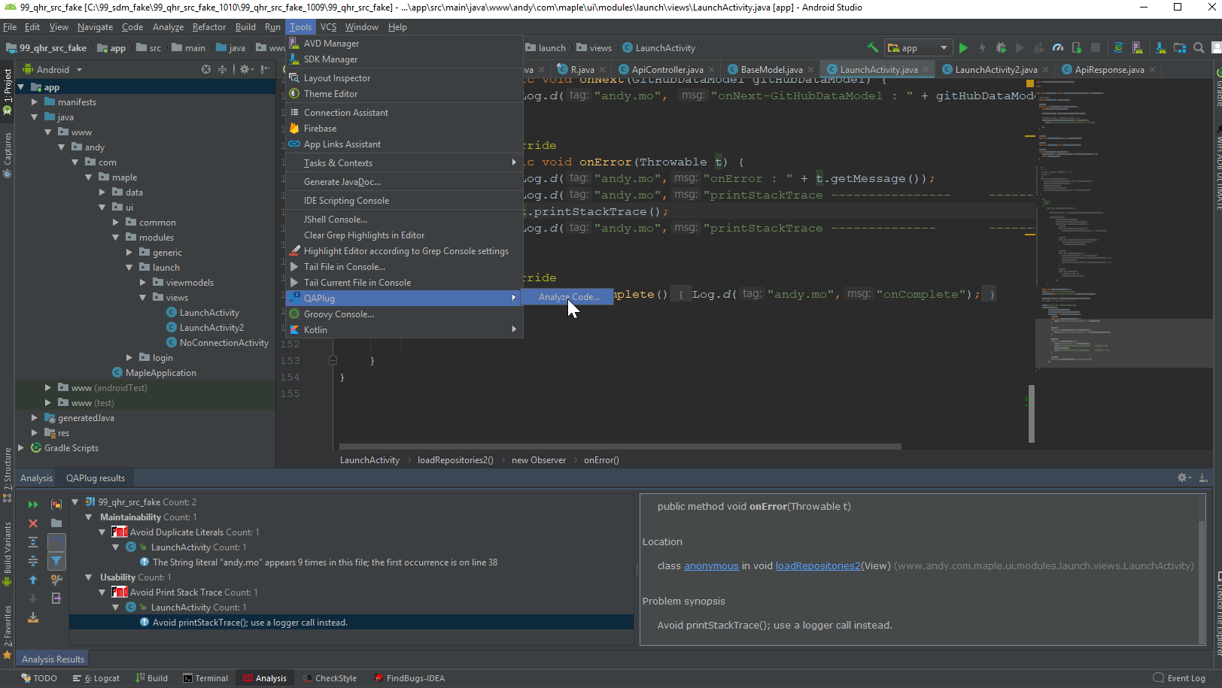
3. PMD
https://pmd.github.io/pmd-6.8.0/pmd_rules_java.html
Analyze code
- check source code - modify using recommend
2. check
PMD is a source code analyzer.
It finds common programming flaws
like unused variables, empty catch blocks,
unnecessary object creation, and so forth

Slide 7
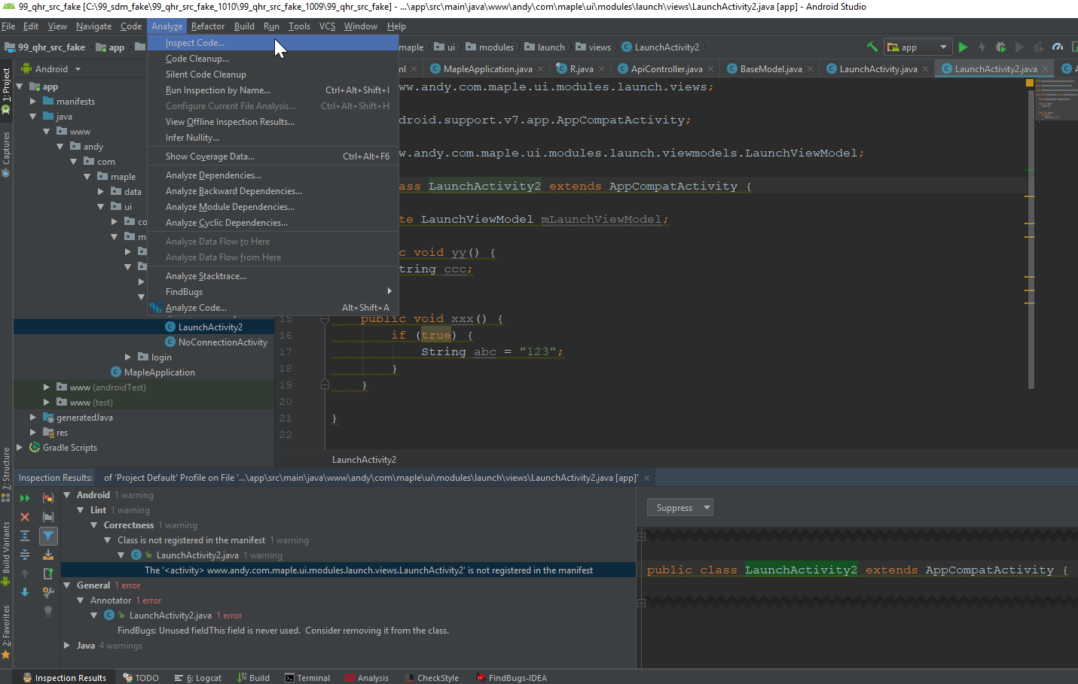
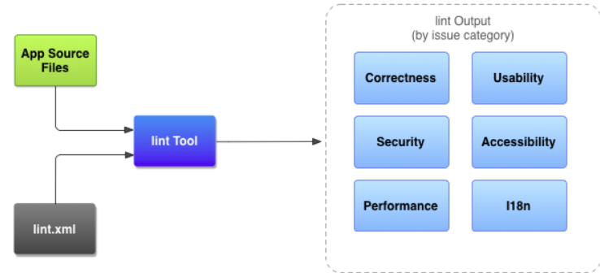
4. Android Lint
https://developer.android.com/studio/write/lint
The lint tool helps find poorly structured code can impact the reliability and efficiency of your Android apps and make your code harder to maintain.

Slide 8
Other Plugin
CodeGlan
WIFI ADB ULTIMATE D
Parcelable code generator
Android API Level
ColorManager
Grep Console

Slide 9
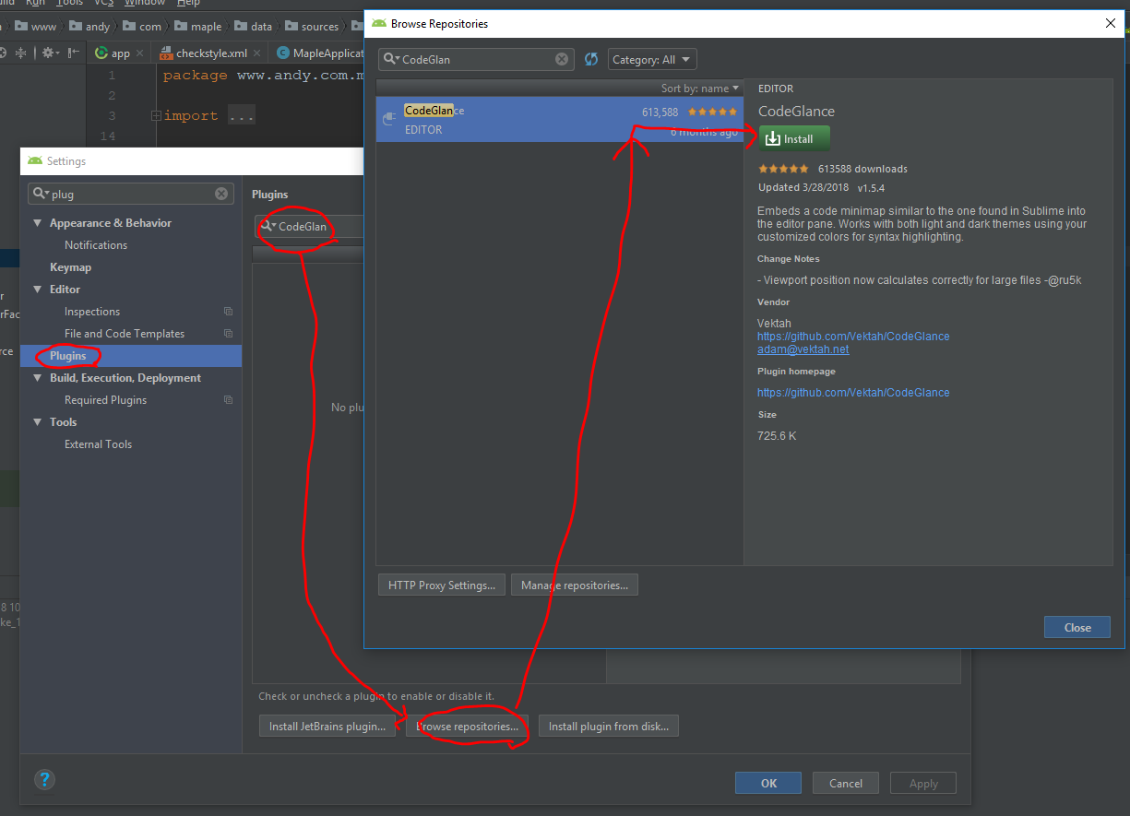
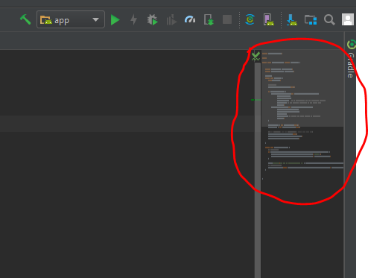
* CodeGlan – mini code tab

Slide 10
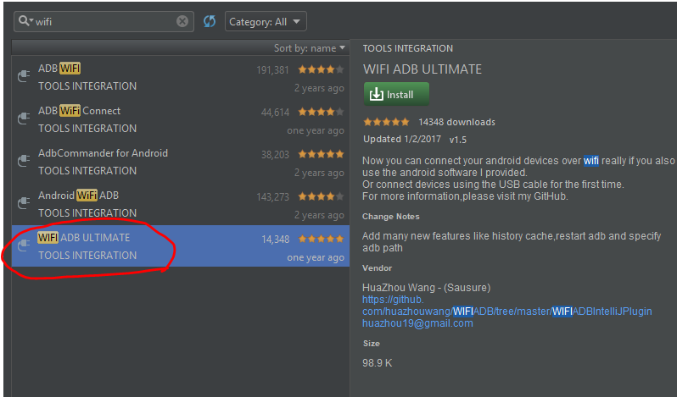
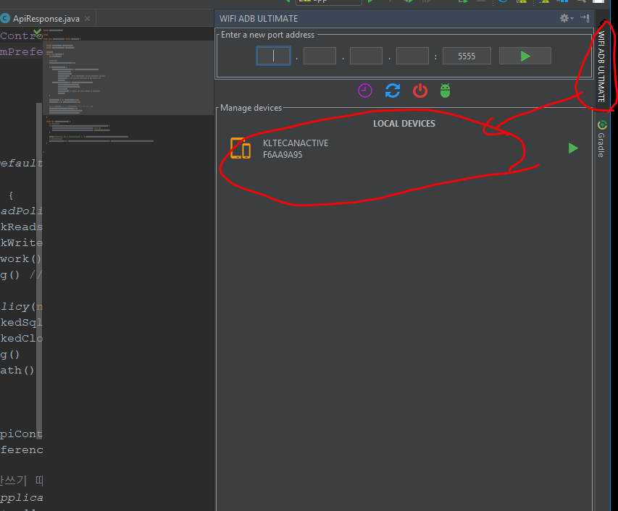
* WIFI ADB ULTIMATE – wifi-adb

Slide 11
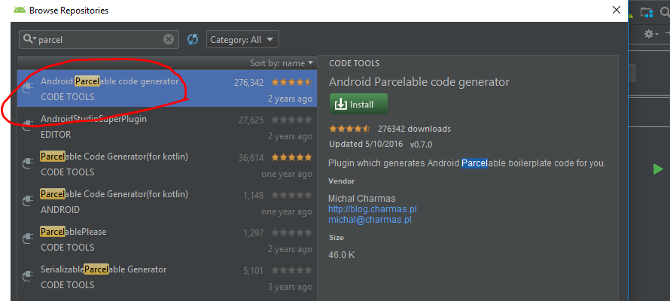
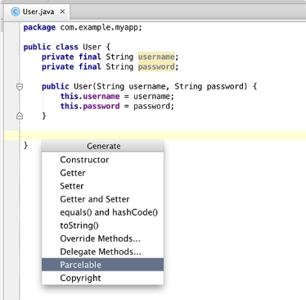
* Parcelable code generator

Slide 12
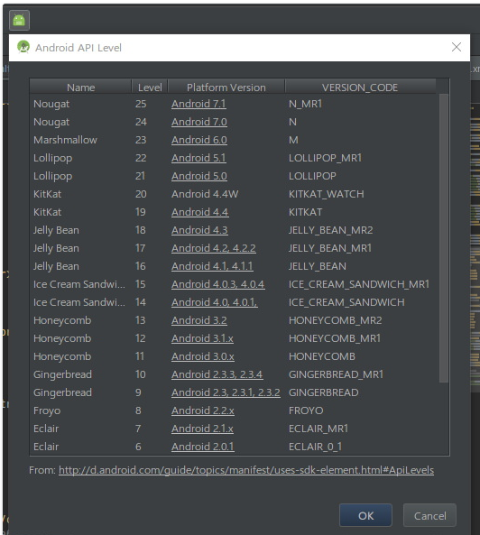
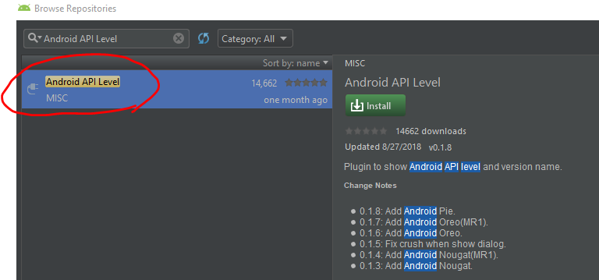
* Android API Level

Slide 13
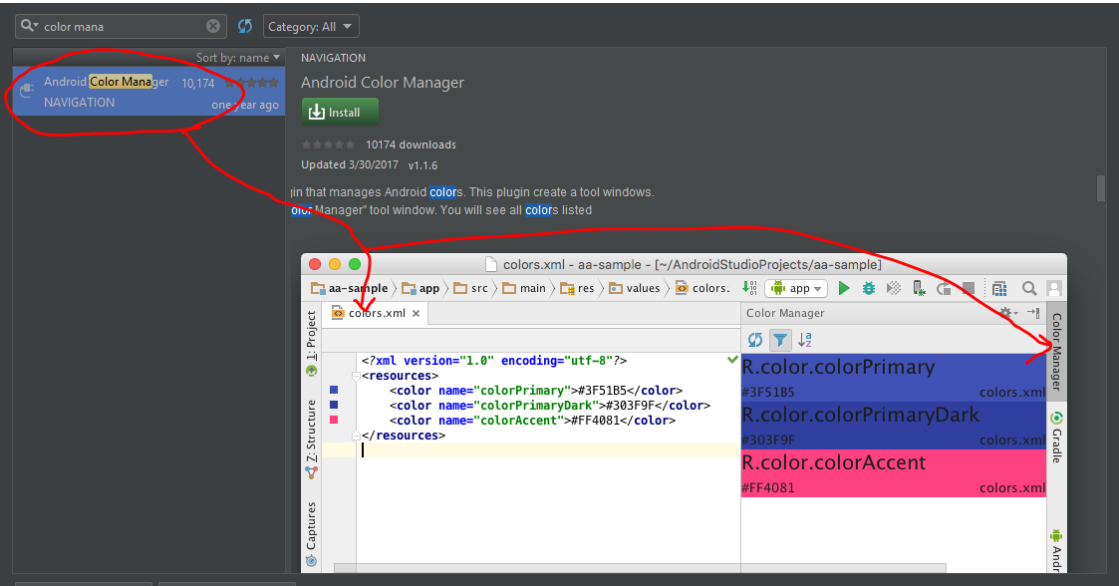
* ColorManager

Slide 14
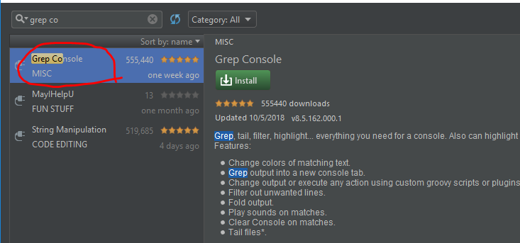
* Grep Console

