Slide 1
Bootstrap 3
Practical Hands-on workshop
2014-03-19

Slide 2
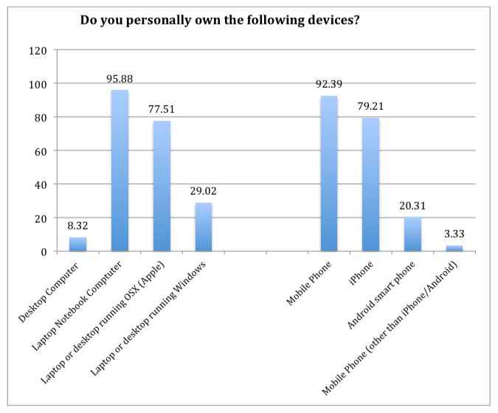
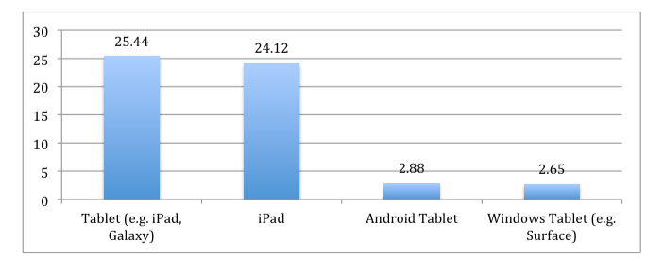
Why Mobile?
Data from 2015 MISO survey distributed to 1,000 Harvard College undergraduate students

Slide 3
Why Responsive?

Slide 4
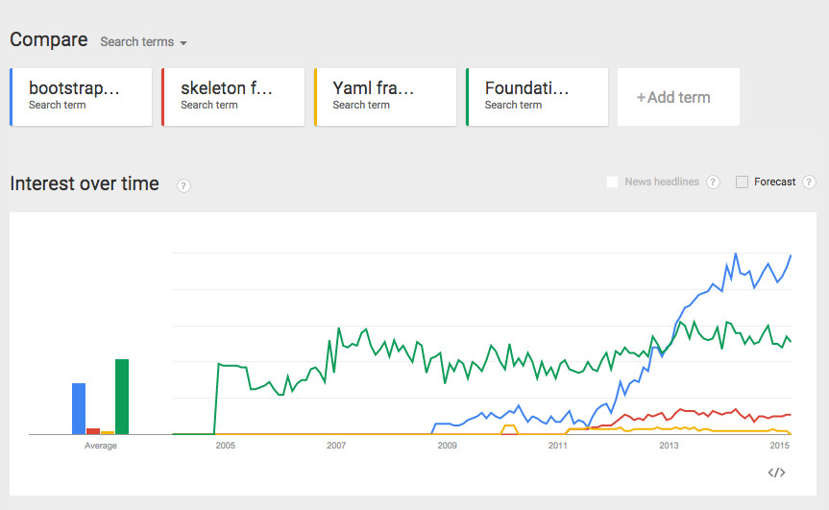
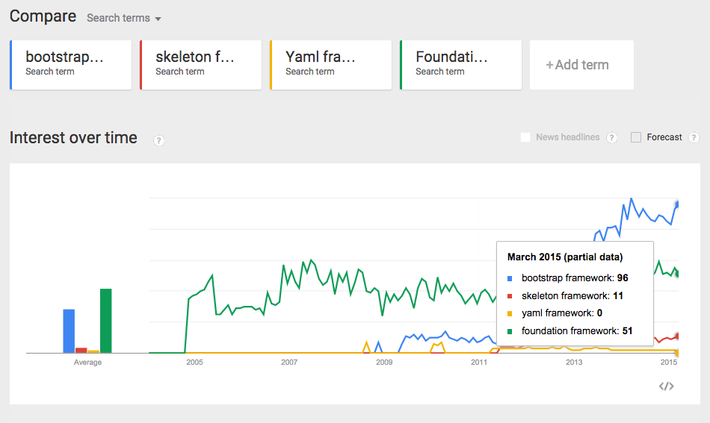
Why Bootstrap?

Slide 5
What does Bootstrap have to offer?
Responsive Grid
Glyphicons, Buttons, Alerts, Helper classes, Utilities
Responsive images
Responsive tables
Responsive navigation (hamburgers!)
Tabs, Modals, Accordions, Carousels
Less, Sass

Slide 6
What are we going to do today?
9 categories of exercises to familiarize you with the essentials
We will walk through one together, then you’ll work individually
We will circulate to assist where needed
There is plenty left for you to explore on your own!

Slide 7
Walk through

Slide 8
“When is he going to stop talking so we can get started?”

