Slide 1
STOCK PRICE PREDICTION

Slide 2
PROBLEM DEFINITION
The problem is to build a predictive model that forecasts stock prices based on historical market data
The goal is to create a tool that assists investor in making well informed decisions and optimizing their investment strategies.This project involves data collection,data preprocessing,feature engineering,model selection,training and evaluation.

Slide 3
Introduction
This project will develop a stock price prediction model using machine learning algorithms.In the world of finance, where markets are shaped by intricate dynamics and ever-changing variables, the ability to forecast stock prices accurately holds immense value. The "Stock Price Prediction" project endeavors to harness the power of data analytics and machine learning to address this

Slide 4
Objectives
The objective of this project is to develop a stock price prediction model that can be used by investors to make more informed investment decisions. The model is expected to be able to predict stock prices with reasonable accuracy, even in volatile market conditions.

Slide 5
KEY COMPONENTS
Data collection and Preprocessing
Data Sequence Preparation
Data Splitting
Feature Scaling
Model Architecture
Model Training
Validation and Hyperparameter Tuning
Model Testing
Prediction
Visualization
Post-Processing
Evaluation and Monitoring

Slide 6
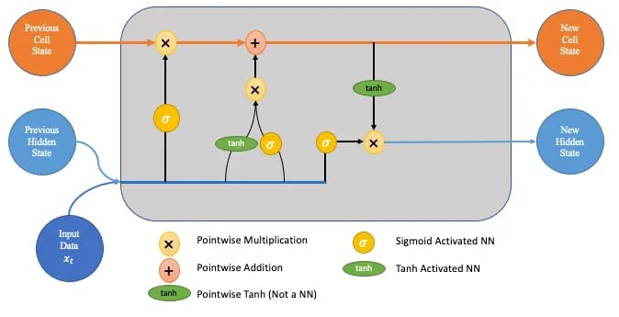
METHODOLOGY
Long Short-Term memory(LSTM) networks are a type of recurrent neural network(RNN) that are well suited for time series forecasting tasks,such as stock price prediction.
To use LSTM networks for stock price prediction,the first step is to prepare the data.
The data is typically split into two sets,
1.train set
2.test set
Once the data is prepared,the next step is to train the LSTM network.
Once the LSTM network is trained,it can be used to predict future stock prices.
Overall , LSTM networks are a powerful tool for stock price prediction.
However, it is important to use them carefully and to be aware of their limitations.

Slide 7
CHALLENGES
• Stock prices are influenced by numerous factors, making prediction inherently difficult.
• Financial markets are dynamic, and past performance does not guarantee future results.
• Data quality and the choice of features play a critical role in model accuracy.
• Overfitting, market anomalies, and unexpected events can impact the model's reliability.

Slide 8
CONCLUSION
Despite the challenges, stock price prediction models can be a valuable tool for investors. By developing a stock price prediction model using machine learning algorithms, this project aims to provide investors with a tool that can help them to make more informed investment decisions.

