Slide 1
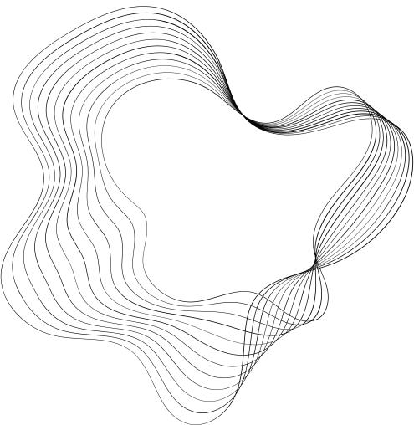


By Jebali Wafa
Professor in charge : Chebil Wiem
RNN + LSTM + GRU DEMO

Slide 2
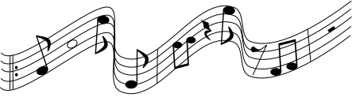
CONTENT
01
REVIEW & REINFORCE
02
PROJECT OVERVIEW
03
DATA LOADING AND INSPECTING
04
DATA PREPROCESSING
05
MODEL DEFINITIONS AND SETUP:
06
MODELS TRAINING
07
MUSIC GENERATION WITH TOP-K SAMPLING
08
ABC GENERATION RESULTS
09
GENERATING MIDI FILES FROM ABC NOTATION
10
MIDI FILES CONVERSION RESULTS
2

Slide 3


REVIEW & REINFORCE
Given an image of a ball
Can you predict where it will go next ?
?
?
?
?
3

Slide 4
REVIEW & REINFORCE
Given an image of a ball
Can you predict where it will go next ?
Given Current location + Prior moves
Can you predict where it will go next ?
4

Slide 5
REVIEW & REINFORCE
Given an image of a ball
Can you predict where it will go next ?
Given Current location + Prior moves
Can you predict where it will go next ?
5

Slide 6
REVIEW & REINFORCE
Given an image of a ball
Can you predict where it will go next ?
This type of problem, where the next step (or move) in a sequence depends on previous steps, is a sequential problem.
6

Slide 7
REVIEW & REINFORCE
Sequential modeling involves techniques that are specifically designed to learn patterns in data that follow a sequence over time. These models focus on understanding the temporal dependencies between data points.
Sequential Modeling
7

Slide 8
REVIEW & REINFORCE
Sequential modeling involves techniques that are specifically designed to learn patterns in data that follow a sequence over time. These models focus on understanding the temporal dependencies between data points.
RNN
LSTM
GRU
Sequential Modeling
8

Slide 9
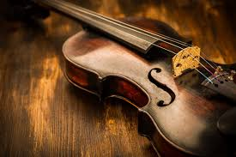



PROJECT OVERVIEW
Project Goal:
The goal of this project is to generate authentic-sounding folk music using three deep learning models: RNN, LSTM, and GRU.
Dataset:
Irish Folk Song Dataset : 817 Irish folk songs represented in ABC notation
9

Slide 10
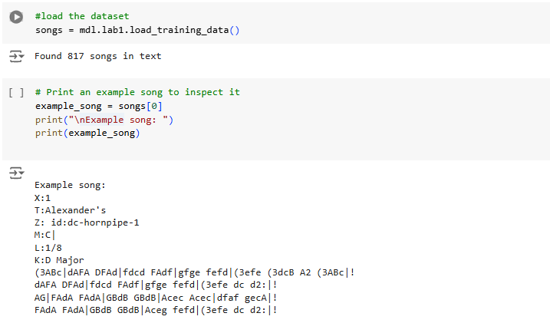
DATA LOADING AND INSPECTING
Data Loading:
load our dataset of folk songs using the load_training_data function, which retrieves 817 text-based musical scores.
Each song is represented in ABC notation, a text-based format for music.
Inspecting the Dataset:
To better understand the dataset structure and the type of musical information it contains, we examine an example song by printing it, revealing details such as musical keys, rhythms, and note sequences.
10

Slide 11
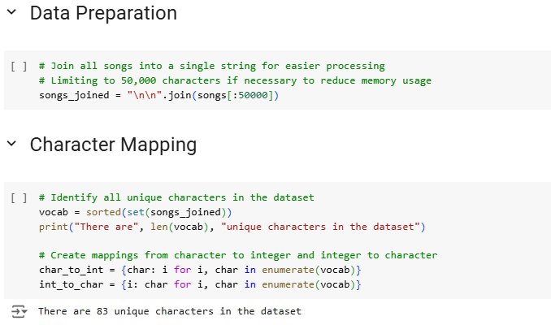
DATA PREPROCESSING
Data Preparation :Join Songs
All songs are combined into a single string (songs_joined) for efficient processing.
Limited to 50,000 characters to reduce memory usage.
Character Mapping:
Unique characters are identified in the dataset, resulting in a vocabulary of distinct musical symbols.
Created mappings:
char_to_int: Converts characters to integer indices.
int_to_char: Converts indices back to characters.
11

Slide 12
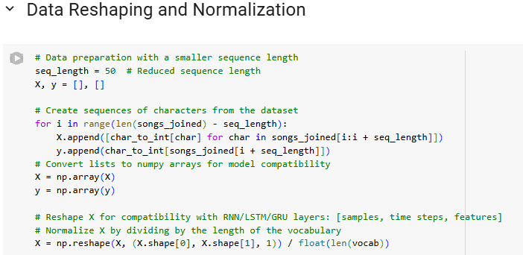
DATA PREPROCESSING
Data Reshaping and Normalization:
Defined seq_length of 50 for input sequences.
Created character sequences (X) and next-character targets (y).
Converted X and y to numpy arrays.
Reshaped X for RNN, LSTM, and GRU models: [samples, time steps, features].
Normalized X by dividing by the length of the vocabulary.
12

Slide 13
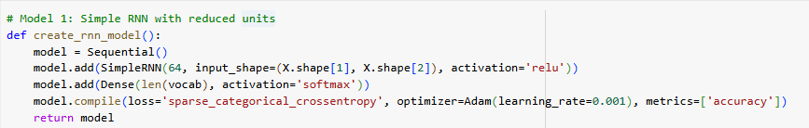
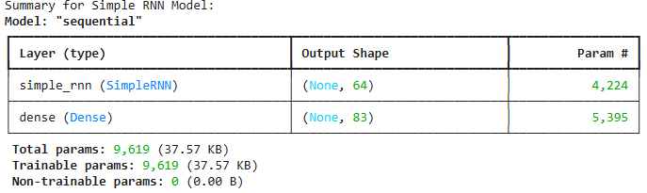
MODEL DEFINITIONS AND SETUP:
Model 1: Simple RNN
Architecture:
A single RNN layer with 64 units and ReLU activation.
Dense output layer using softmax for character probability prediction.
Compilation:
Loss function: Sparse categorical cross-entropy for multiclass character prediction.
Optimizer: Adam with a learning rate of 0.001.
Metric: Accuracy.
13

Slide 14
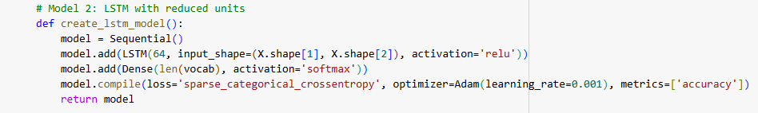
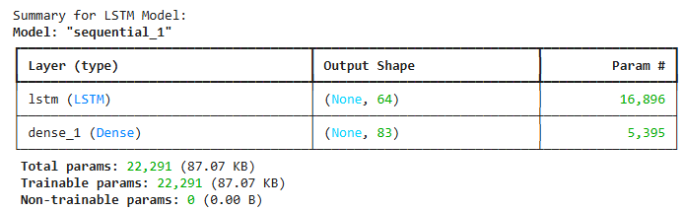
MODEL DEFINITIONS AND SETUP:
Model 2: LSTM
Architecture:
A single LSTMlayer with 64 units and ReLU activation.
Dense output layer using softmax for character probability prediction.
Compilation:
Loss function: Sparse categorical cross-entropy for multiclass character prediction.
Optimizer: Adam with a learning rate of 0.001.
Metric: Accuracy.
14

Slide 15
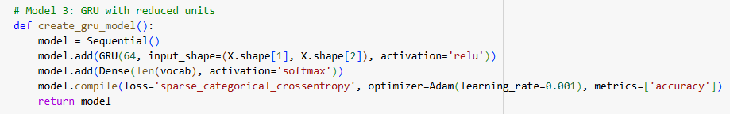
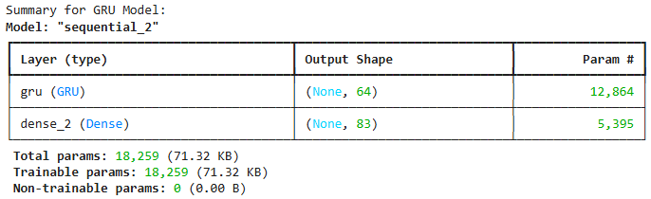
MODEL DEFINITIONS AND SETUP:
Model 3: GRU
Architecture:
A single GRUlayer with 64 units and ReLU activation.
Dense output layer using softmax for character probability prediction.
Compilation:
Loss function: Sparse categorical cross-entropy for multiclass character prediction.
Optimizer: Adam with a learning rate of 0.001.
Metric: Accuracy.
15

Slide 16

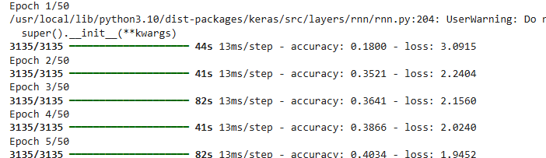
MODELS TRAINING
Trained three models: RNN, LSTM, and GRU. Chose them because they handle sequence data well.
Used 50 epochs and a batch size of 64 for training.
Dataset had 83 unique characters, which formed the vocabulary.
Data flows through preprocessing, then to the model for training, and finally generates results.
16

Slide 17
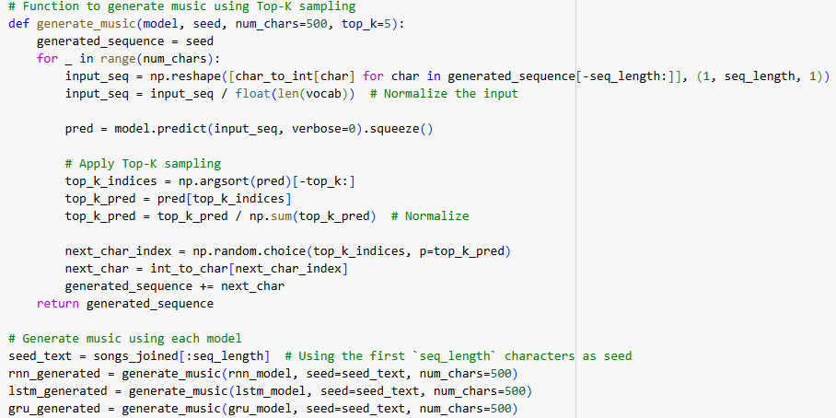
MUSIC GENERATION WITH TOP-K SAMPLING
The generate_music() function is used for generating music using the trained models by applying Top-K sampling to predict the next characters in the sequence.
Top-K sampling selects the K most probable tokens at each step, ensuring balanced and coherent outputs.
This method avoids randomness while still allowing creative variations in the generated sequence.
For music generation, Top-K is used to produce sequences of notes or chords that sound realistic and logical.
Starting with a seed, the model iteratively predicts and samples notes from the top K options to build the composition.
17

Slide 18
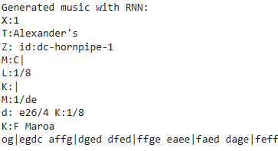
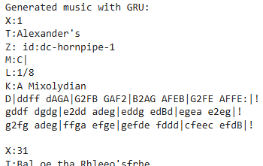
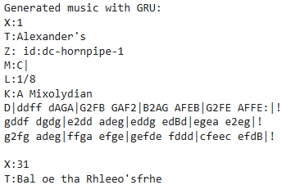
ABC GENERATION RESULTS
18

Slide 19
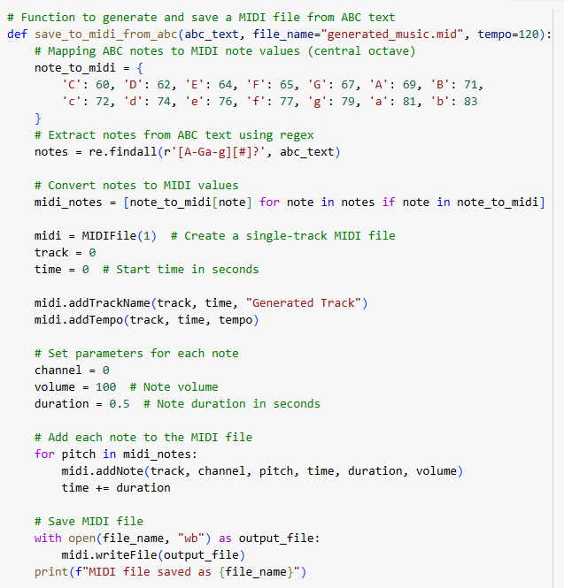
GENERATING MIDI FILES FROM ABC NOTATION
Converts ABC text into a playable MIDI file, allowing for easy music generation.
Process:
Map Notes to MIDI: Matches ABC notes (e.g., 'C', 'D', etc.) to MIDI values.
Extract Notes: Uses regex to identify notes in the input text.
Add Notes to MIDI: Creates a single-track MIDI file, assigning tempo, duration, and volume for each note.
Save File: Saves the output as a .mid file for playback.
19

Slide 20
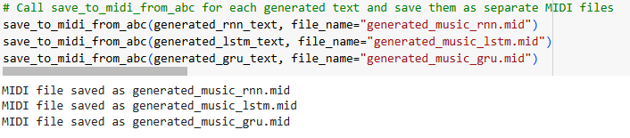


MIDI FILES CONVERSION RESULTS
RNN Music
LSTM Music
GRU Music
20

Slide 21

THANK'S FOR WATCHING
21

