Slide 1
Capstone Project
The Battle of the Neighborhoods

Slide 2
Introduction: Business Problem
Trying to find an optimal location for a restaurant
Report will be targeted to stakeholders interested in opening an restaurant in Toronto, Canada
Based on
Population of the neighbourhood
Locations that are not already crowded with restaurants
As close to city center as possible

Slide 3
Data
The data sources will be needed to extract/generate the required information
centers of candidate areas will be generated algorithmically and approximate addresses of centers of those areas will be obtained using https://en.wikipedia.org/wiki/List_of_postal_codes_of_Canada:_M
number of restaurants and their type and location in every neighborhood will be obtained using Foursquare API

Slide 4
Methodology
Collected required data like location and type of every restaurant within our latitude and longitude.
Explrored the 'restaurant density' across different areas of Toronto - we will use K- mean to identify a few promising areas close to center with low number of restaurants and their type
Explored the most promising areas and within those create clusters of locations that meet some basic requirements established in discussion with stakeholders: we will take into consideration locations with less restaurants in radius of 500 meters

Slide 5
Analysis
Data identifiaction, capturing and cleaning
Combining different data source and sorting neighborhood based on Longitude and latitude
Explore the Toronto's neighborhoods
Clustering

Slide 6
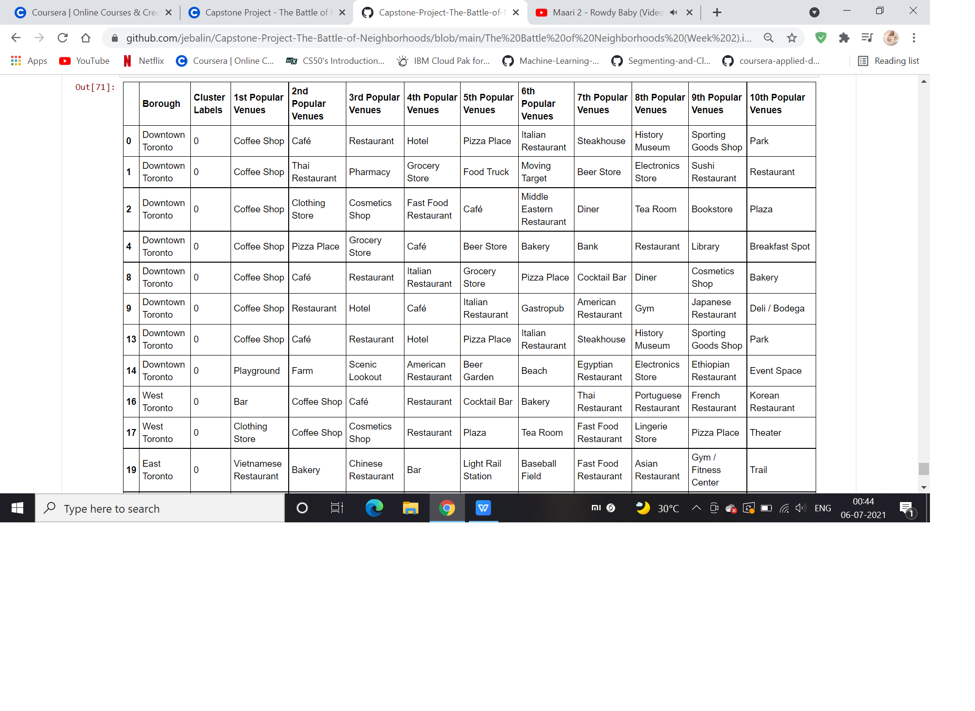
Cluster 1

Slide 7
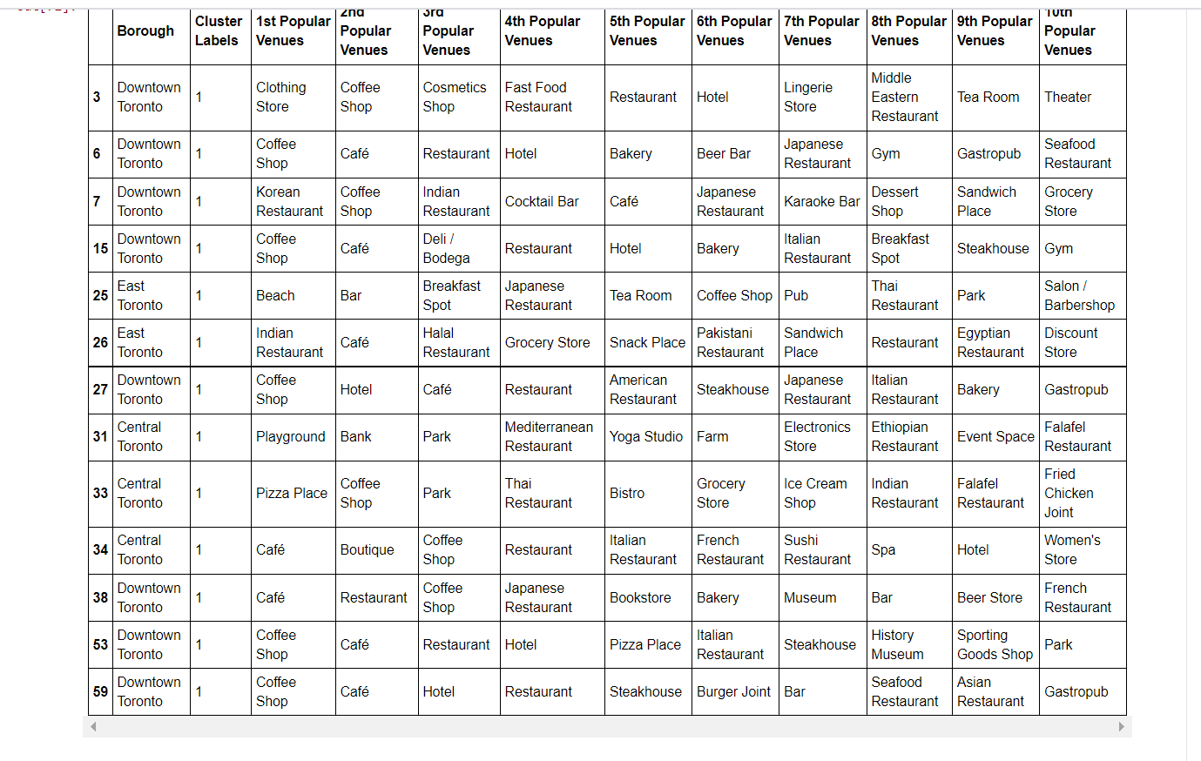
Cluster 2

Slide 8
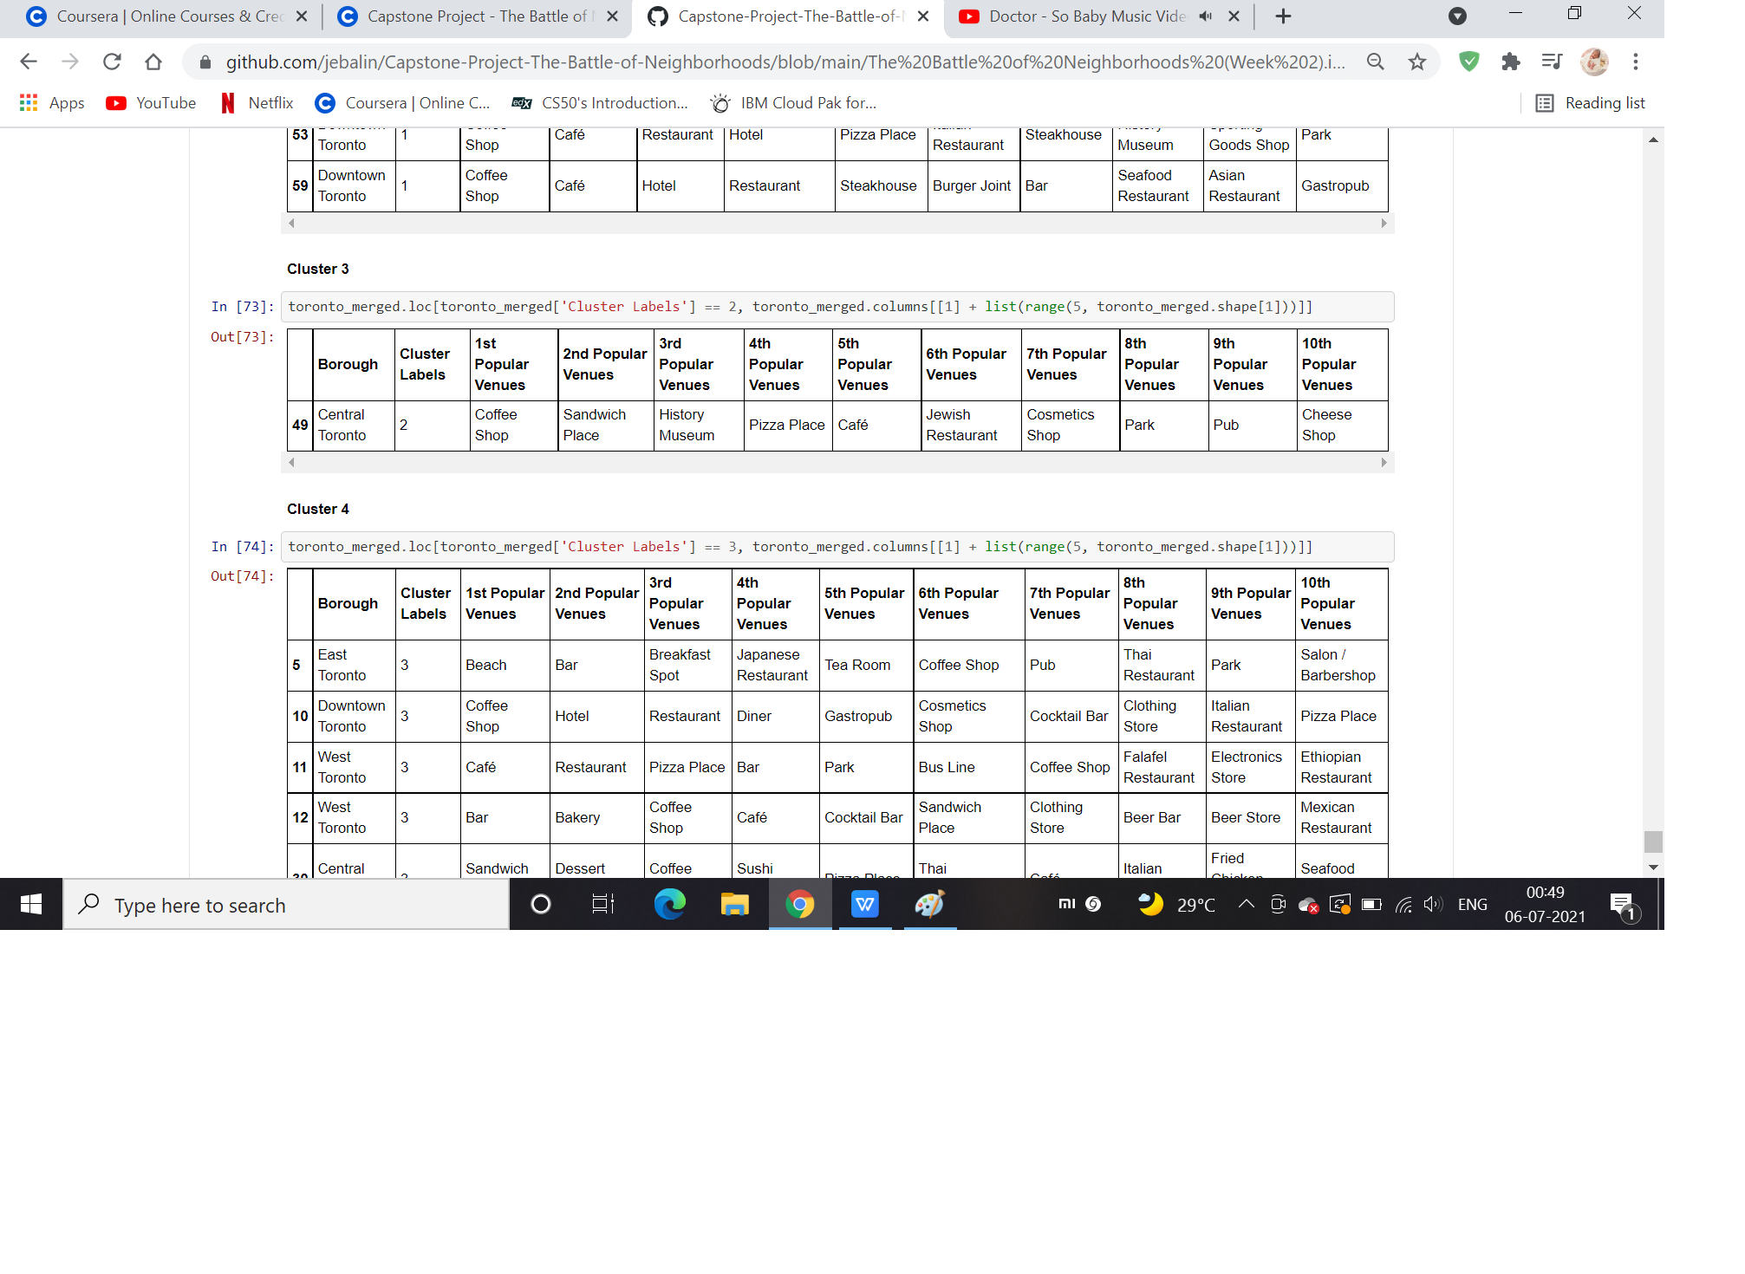
Cluster 3

Slide 9
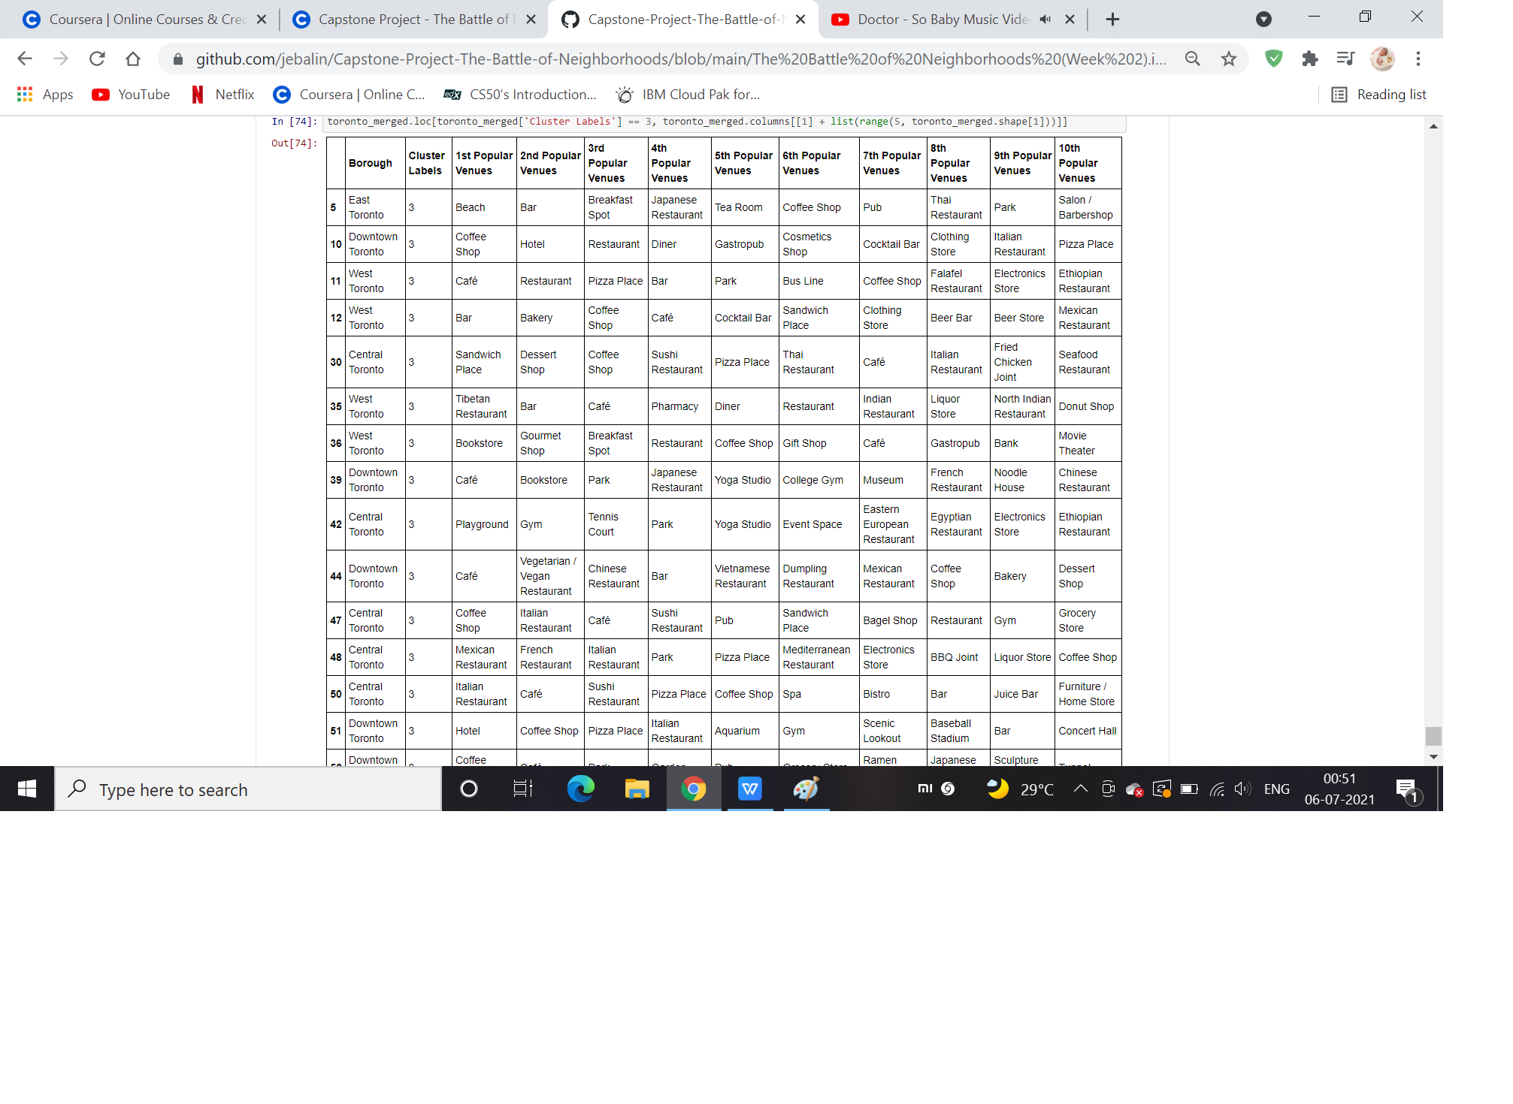
Cluster 4

Slide 10
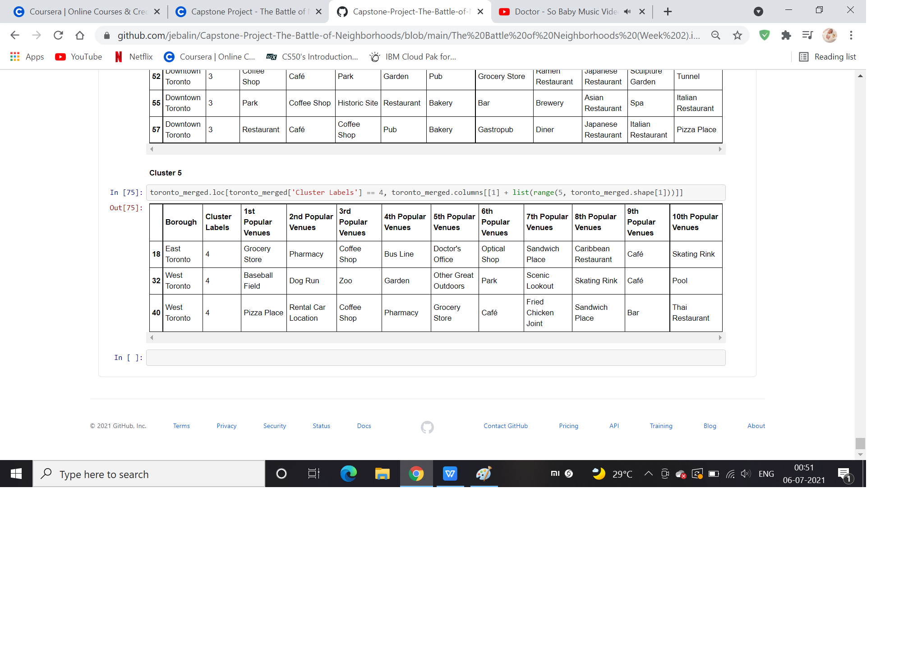
Cluster 5

Slide 11
Results
Our analysis shows that although there is a great number of restaurants in Toronto, there are pockets of low restaurant density fairly close to city center. We have 4 boroughs and 74 neighborhoods inside geograpical coordinate of 43.653963, -79.387207

Slide 12
Conclusion
The decission on optimal restaurant location will be made by stakeholders based on specific characteristics of neighborhoods and locations in every recommended zone, taking into consideration additional factors like attractiveness of each location (proximity to park or water), levels of noise / proximity to major roads, real estate availability, prices, social and economic dynamics of every neighborhood etc.

