Slide 1














CAPSTONE PROJECT
Potato Disease Classification
Final Project
Presented By
Jeban Christo R
711721244036
III BTech CSBS KGISL Institute of Technology
1

Slide 2


PROJECT TITLE
Traditional disease management methods are often inefficient and labor-intensive. Leveraging advancements in machine learning, researchers and farmers are exploring innovative solutions for early disease detection and prevention.
3/21/2024 AnnualReview
2

Slide 3



AGENDA
1.Problem Statement 2.Project Overview
3.End Users
4.Solution and Value Proposition 5.The Wow Factor in Your Solution
6.Modelling 7.Results
3

Slide 4


PROBLEM STATEMENT
Potatoes are a staple food crop worldwide, but they are susceptible to various diseases that can significantly impact yield and quality. These diseases, including late blight, early blight, and potato virus Y, pose a constant threat to potato farmers, leading to substantial economic losses and food insecurity in affected regions.
4

Slide 5

PROJECT OVERVIEW
Our project aims to develop a machine learning-based solution for potato disease prediction, leveraging advanced techniques such as Convolutional Neural Networks (CNNs). By analyzing images of potato plants and leaves, our solution will accurately identify and classify various diseases, allowing farmers to detect infections early and implement targeted interventions.
5

Slide 6
WHO ARE THE END USERS?
The primary end users of our solution are potato farmers, agronomists, and agricultural extension workers who are responsible for monitoring crop health and implementing disease management strategies.
6

Slide 7

YOUR SOLUTION AND ITS VALUE PROPOSITION
Our solution leverages state-of-the-art machine learning algorithms, particularly CNNs, to analyze images of potato plants and diagnose diseases with high accuracy. By automating the disease detection process
7

Slide 8


THE WOW IN YOUR SOLUTION
One of the standout features of our solution is its ability to analyze large volumes of image data rapidly and accurately using CNNs. By training the model on diverse datasets containing thousands of annotated images, we ensure robust performance across different geographic regions and disease scenarios.
8

Slide 9
MODELLING
Our modeling approach involves training a CNN architecture specifically tailored for image-based disease prediction in potatoes. The CNN consists of multiple convolutional and pooling layers that extract relevant features from input images, followed by fully connected layers for classification. We employ transfer learning techniques to leverage CNN models
9

Slide 10
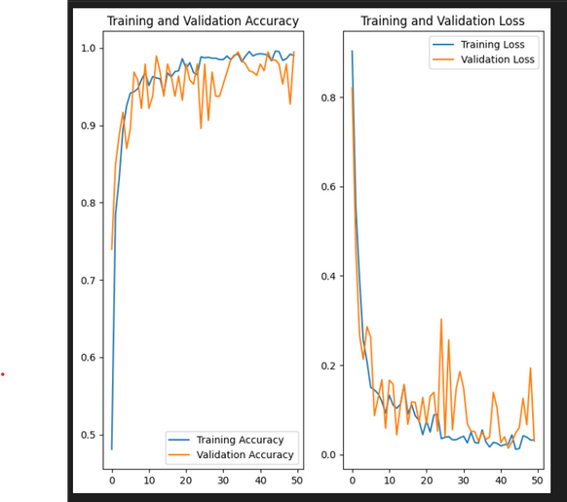
RESULTS
https://drive.google.com/file/d/1kuU64Cf8XiubBFwbzuPvMGsiAlkVriBj/view?usp=sharing
10

