Slide 1
PRESENTED BY JEBARSON CALEB D URK24CS1038
01 / 17
Team Arctozolt presents
HIRESENSE
AI-ASSISTED RESUME ANALYSIS & JOB MATCHING PORTAL
Jebarson Caleb D
URK24CS1038
Talari S Vamshi Krishna
URK24CS1025
Jasper Freddy Paul R S
URK24CS1118
Pavin Muthu G
URK24CS1017
Web Technology (23CS2048) · Division of CSE · October 2026
Notes:
Welcome everyone. We are Team Arctozolt, and our Web Technology project is HireSense, an AI-assisted resume analysis and job matching portal. It is live at hiresense.vercel.app.

Slide 2
PRESENTED BY JEBARSON CALEB D URK24CS1038
02 / 17
OUR TEAM
JC
TV
JF
PM
Jebarson Caleb D
Talari S Vamshi Krishna
Jasper Freddy Paul R S
Pavin Muthu G
URK24CS1038
URK24CS1025
URK24CS1118
URK24CS1017
Introduction, problem statement and overview
Objectives, literature survey, research gap and methodology
Architecture, database design, tech stack and modules
Application walkthrough, testing, conclusion and future work
Notes:
This is our team and how we have split the presentation. I will introduce the project and the problem, Vamshi covers objectives, literature and methodology, Jasper covers the design and technology, and Pavin shows the results and wraps up.

Slide 3
PRESENTED BY JEBARSON CALEB D URK24CS1038
03 / 17
OVERVIEW
01
Introduction
05
Architecture & Database
3
roles in one portal
Job seeker · Recruiter · Admin, all working on the same live data
02
Problem & Objectives
06
Implementation
03
Literature Survey
07
Results & Testing
04
Methodology
08
Conclusion & Future
Notes:
Here is the flow of today's presentation, eight parts from the problem to the future scope.

Slide 4
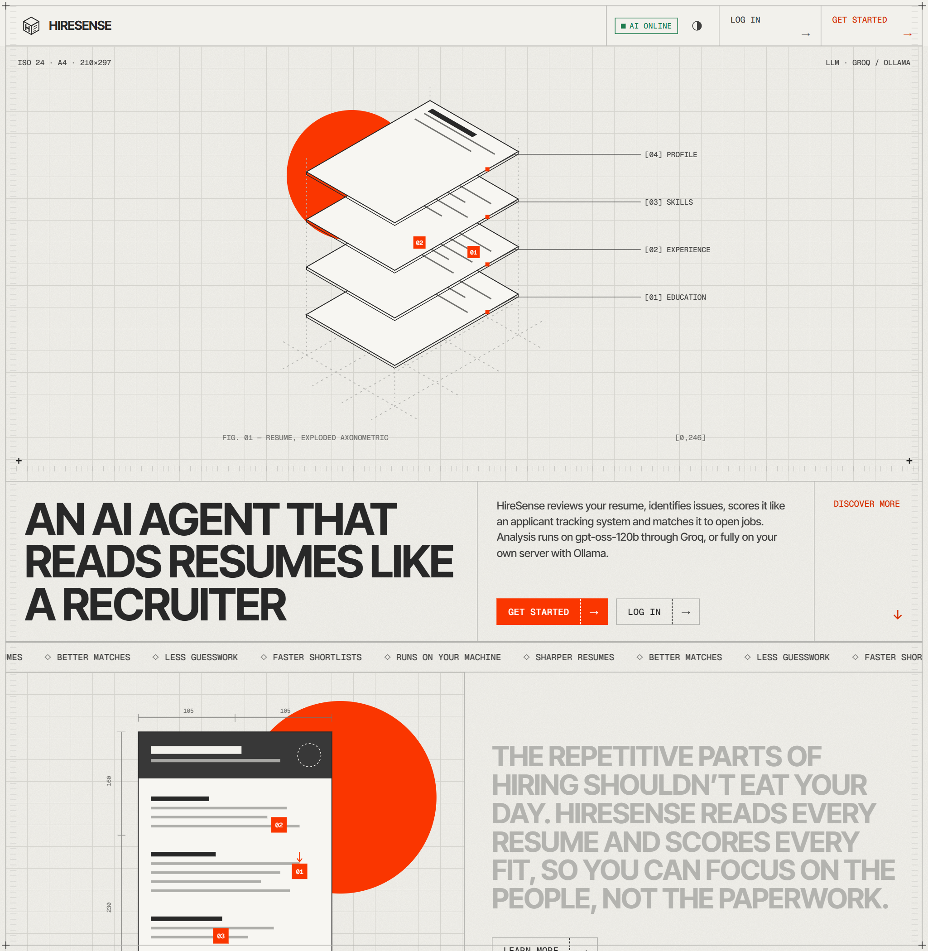
PRESENTED BY JEBARSON CALEB D URK24CS1038
04 / 17
INTRODUCTION
Applicant Tracking Systems filter resumes by keywords before a human reads them. Good candidates get rejected for wording, and recruiters still read hundreds of PDFs.
JOB SEEKERS
Can't tell how an ATS judges their resume, which skills are recognised, or which jobs truly fit.
RECRUITERS
Screen piles of unsuitable resumes; portals never explain why a candidate matches.
Notes:
Recruiting is slow on both sides. Seekers don't know how an ATS will judge their resume, and recruiters spend most of their time reading resumes that don't fit. Existing AI checkers are separate from the job board. HireSense joins the two.

Slide 5
PRESENTED BY TALARI S VAMSHI KRISHNA URK24CS1025
05 / 17
OBJECTIVES
Role-based portal
AI resume analysis
Hybrid ranking
Responsive React + Express app for seekers, recruiters and admins.
PDF / DOCX / TXT → ATS score, skills, strengths, weaknesses, fixes, roles.
Skill overlap + TF-IDF similarity + LLM fit judgement with reasons.
Persistent data
Security
Always available
Users, resumes, jobs and applications in validated, indexed MongoDB schemas.
JWT auth, bcrypt hashing, role guards, client- and server-side validation.
Rule-based fallback when the AI fails; deployed on Vercel + Atlas.
Notes:
Our six objectives: a responsive role-based portal, structured AI analysis of any resume, an explainable hybrid match score, validated MongoDB storage, proper security, and a fallback so the portal always responds.

Slide 6
PRESENTED BY TALARI S VAMSHI KRISHNA URK24CS1025
06 / 17
LITERATURE SURVEY
System | Resume analysis | Job / candidate ranking | Explains the match | Seeker + recruiter
LinkedIn Jobs | Profile-based | Yes | Partial (premium) | Yes
Naukri.com | Paid service | Keyword search | No | Yes
Indeed | No | Search / filters | No | Yes
Jobscan / Resume Worded | Yes (keywords) | One job at a time | Keyword list | Seeker only
Enterprise ATS | Parsing only | Rule-based filters | No | Recruiter only
HireSense | LLM + rules | All jobs / all candidates | AI reasoning + missing skills | Yes, plus admin
Notes:
We reviewed LinkedIn, Naukri, Indeed, ATS checkers like Jobscan and enterprise ATS products. Each covers part of the problem; none combines resume analysis, ranking with explanations, and both sides of hiring in one place.

Slide 7
PRESENTED BY TALARI S VAMSHI KRISHNA URK24CS1025
07 / 17
RESEARCH GAP
WHAT'S MISSING
HOW HIRESENSE CLOSES IT
Resume feedback and job matching are separate products
One portal: AI analysis plus live jobs ranked for that resume
Match scores are never explained
Matched and missing skills plus AI reasoning, shown to both sides
Keyword search is brittle; LLM-only is slow and can fail
Instant hybrid score, on-demand LLM, rule-based fallback
Recruiters only see people who applied
“Discover candidates” ranks every seeker on the platform
Notes:
These are the four gaps we found, and on the right how HireSense addresses each one.

Slide 8
PRESENTED BY TALARI S VAMSHI KRISHNA URK24CS1025
08 / 17
METHODOLOGY
Iterative, incremental model: each iteration shipped a tested vertical slice (e.g. “upload a resume and see its analysis”).
1
2
3
4
5
6
UPLOAD
EXTRACT
ANALYSE
VALIDATE
STORE
MATCH
PDF / DOCX / TXT
≤ 4 MB via Multer
pdfjs-dist,
mammoth, UTF-8
Groq gpt-oss-120b
JSON mode
Normalise skills;
else rule fallback
Resume + analysis
in MongoDB
Rank every open job
+ AI fit on demand
SCORING
Fast score = 0.75 × skillScore + 0.25 × TF-IDF textScore
Final score = 0.60 × skillScore + 0.40 × AI fit score
skillScore = matched ÷ required skills × 100, reduced if experience is below the job's minimum
Notes:
We built HireSense iteratively, one working vertical slice at a time. This is the core pipeline: a resume is uploaded, converted to text, analysed by the LLM in JSON mode, validated or handled by the rule-based fallback, stored, and then matched against every open job. The fast score is instant; the AI fit score is computed only when someone applies or checks fit.

Slide 9
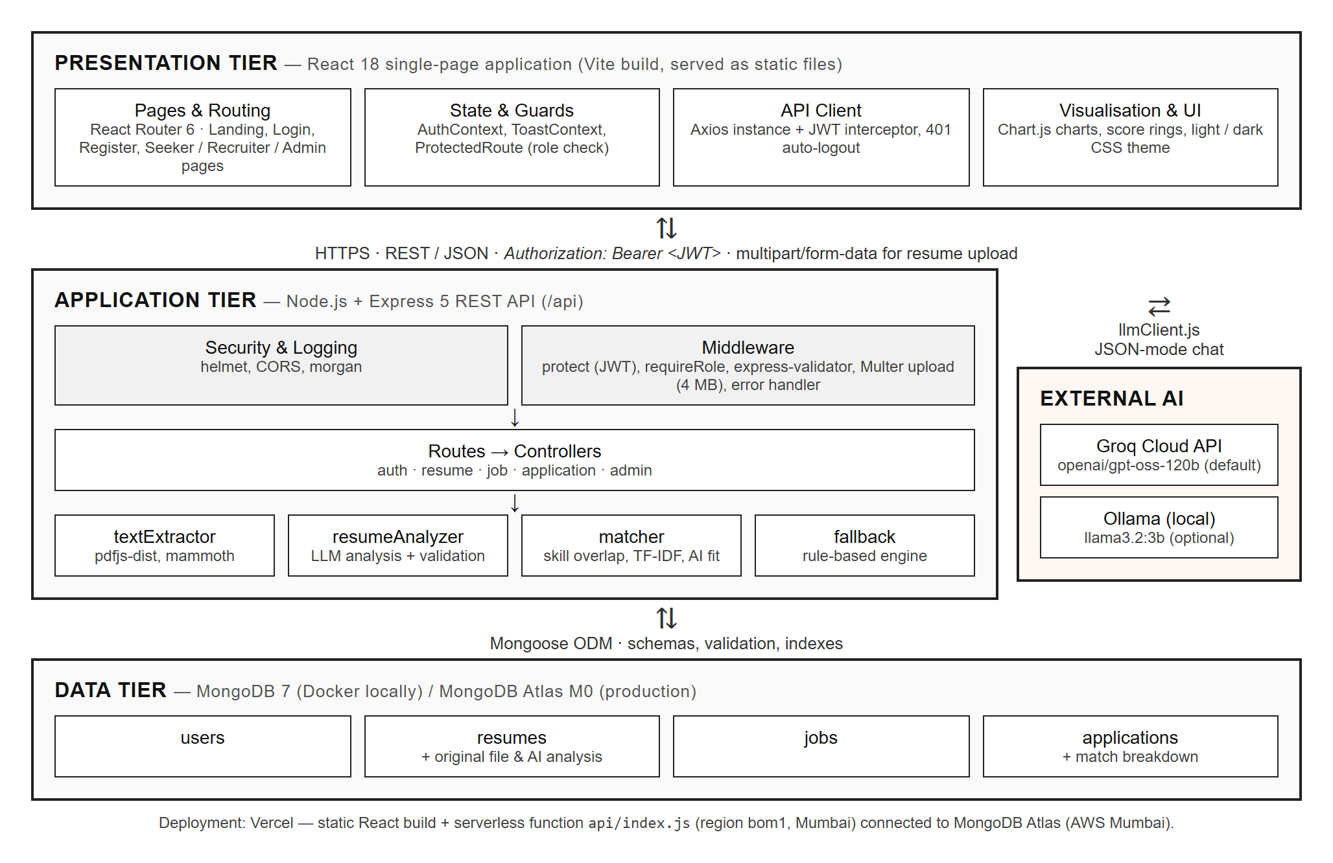
PRESENTED BY JASPER FREDDY PAUL R S URK24CS1118
09 / 17
SYSTEM ARCHITECTURE
PRESENTATION
React 18 SPA (Vite), React Router, Axios with JWT interceptor, Chart.js
APPLICATION
Express 5 REST API: helmet, CORS, JWT, role guards, validation, services
DATA
MongoDB 7 via Mongoose; Atlas M0 (AWS Mumbai) in production
EXTERNAL AI
Groq gpt-oss-120b by default, or local Ollama llama3.2
Notes:
HireSense uses a three-tier architecture. The React SPA talks to the Express API over HTTPS with a JWT. The API runs security middleware, auth, role checks and validation before the controllers and services. MongoDB stores the data through Mongoose. Only the server calls the AI provider, so API keys never reach the browser.

Slide 10
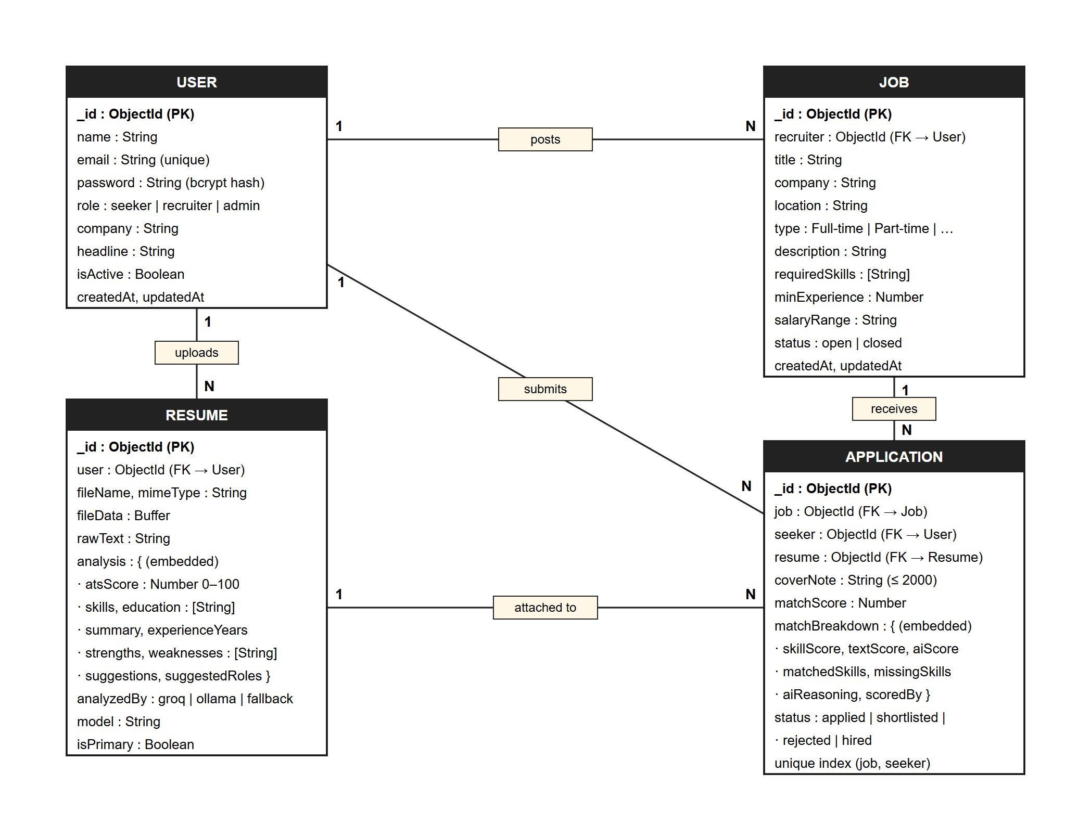
PRESENTED BY JASPER FREDDY PAUL R S URK24CS1118
10 / 17
DATABASE DESIGN
users
Unique lower-cased email · bcrypt hash · role enum · isActive
resumes
Original file (≤ 4 MB) · rawText · embedded AI analysis · analyzedBy
jobs
Recruiter ref · requiredSkills · minExperience · text index for search
applications
matchScore + breakdown · status enum · unique (job, seeker)
Notes:
We chose MongoDB because the AI analysis and match breakdown are nested documents that change shape, while the main entities still reference each other. There are four collections. Sensitive fields like password and the raw file are excluded from queries by default, and a unique compound index stops duplicate applications.

Slide 11
PRESENTED BY JASPER FREDDY PAUL R S URK24CS1118
11 / 17
TOOLS & TECHNOLOGIES
FRONT END
BACK END
DATABASE
AI & DEPLOY
React 18 + Vite 6
React Router 6
Axios (JWT interceptor)
Chart.js
HTML5 · CSS3 · ES2022
Light / dark themes
Node.js 20 + Express 5
jsonwebtoken · bcryptjs
helmet · CORS · morgan
express-validator
Multer uploads
pdfjs-dist · mammoth
MongoDB 7
Mongoose 8 schemas
Indexes & validation
Docker locally
MongoDB Atlas (cloud)
Groq gpt-oss-120b
Ollama llama3.2 (local)
Rule-based fallback
Vercel (static + serverless)
Git / GitHub · Postman
Notes:
Our stack is MERN plus an LLM. React and Vite on the front end, Node and Express 5 on the back end, MongoDB with Mongoose for data, and Groq or Ollama for AI. The app is deployed on Vercel with a serverless API in Mumbai next to the Atlas cluster.

Slide 12
PRESENTED BY JASPER FREDDY PAUL R S URK24CS1118
12 / 17
MODULES
01
Auth & Users
02
Resume & AI Analysis
03
Job Management
Register, login, JWT sessions, bcrypt, requireRole guard, deactivation
Upload, text extraction, ATS report, primary resume, re-analyse
Create, edit, close jobs; search by keyword, location, type, skills
04
Matching & Applications
05
Administration
06
AI Provider & Fallback
Ranked jobs, “Check my fit”, apply, ranked applicants, discover candidates
Platform stats & charts; manage users and moderate job posts
llmClient.js (Groq / Ollama), retries, health badge, fallback.js
Notes:
The system is split into six modules. Authentication and users; resume upload and AI analysis; job management; matching and applications, including discover candidates; administration with dashboard charts; and the AI provider module with its rule-based fallback.

Slide 13
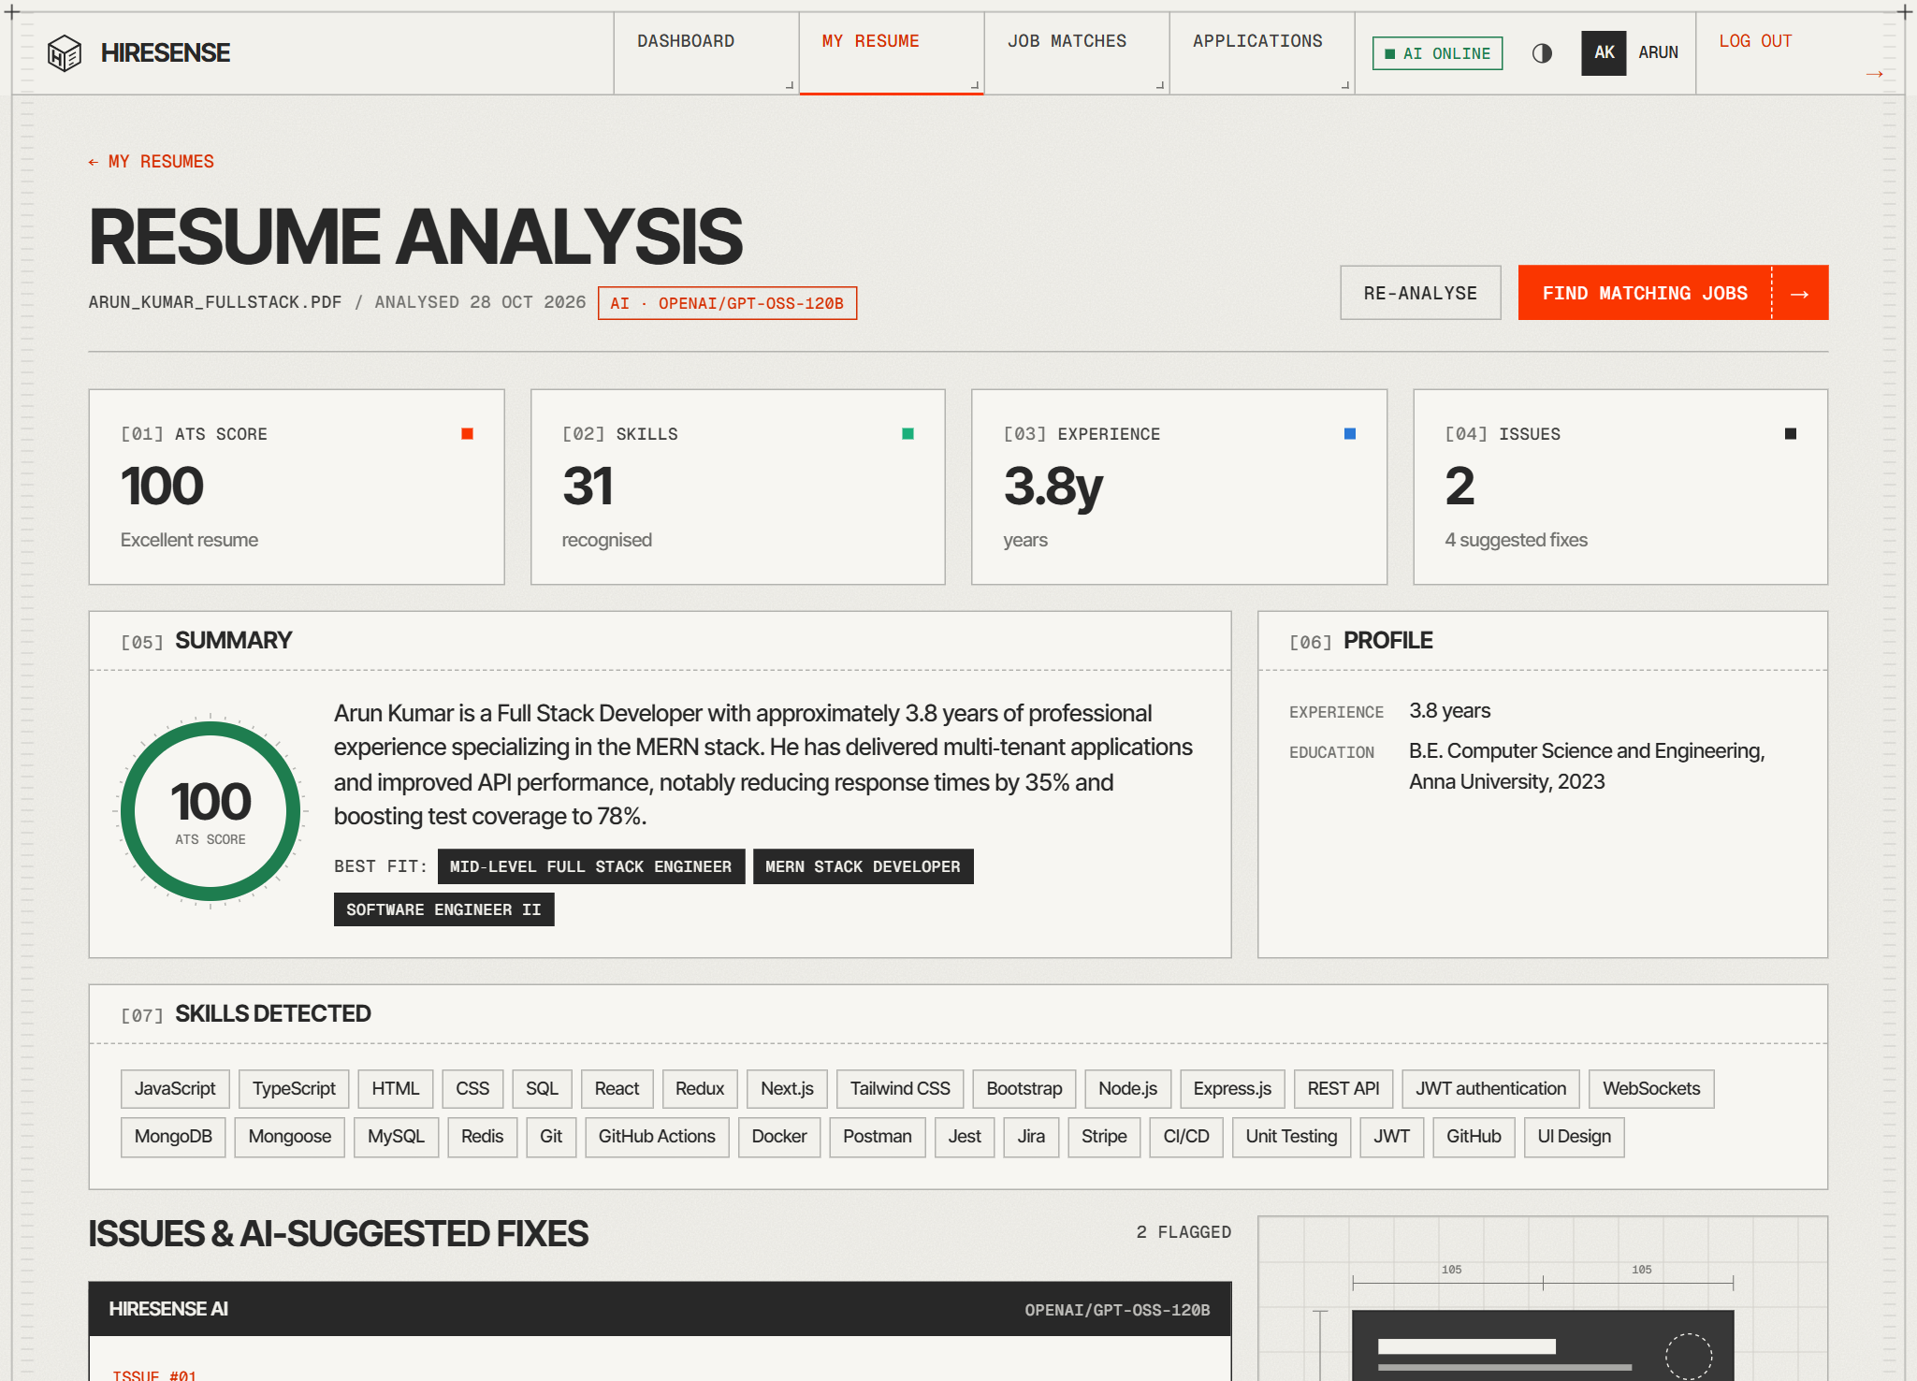
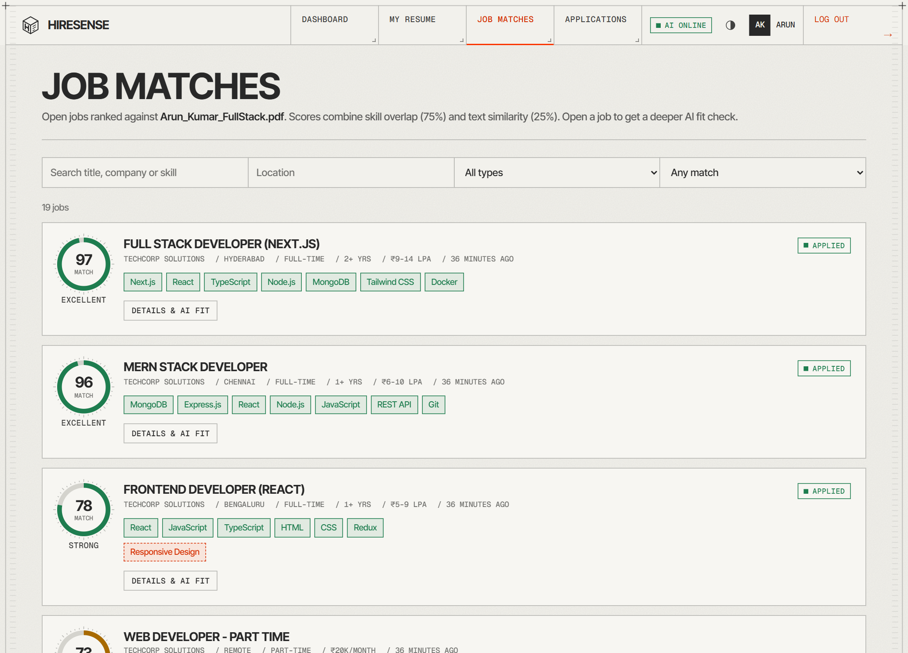
PRESENTED BY PAVIN MUTHU G URK24CS1017
13 / 17
FOR JOB SEEKERS
AI resume analysis: ATS score, skills, issues and suggested fixes
Open jobs ranked by match score for the primary resume
Notes:
Here is the job seeker side. On the left is the AI analysis report for a full-stack resume: ATS score 100, 31 skills recognised, 3.8 years of experience, and AI-flagged issues with suggested fixes. On the right, every open job is ranked for that resume by match score.

Slide 14
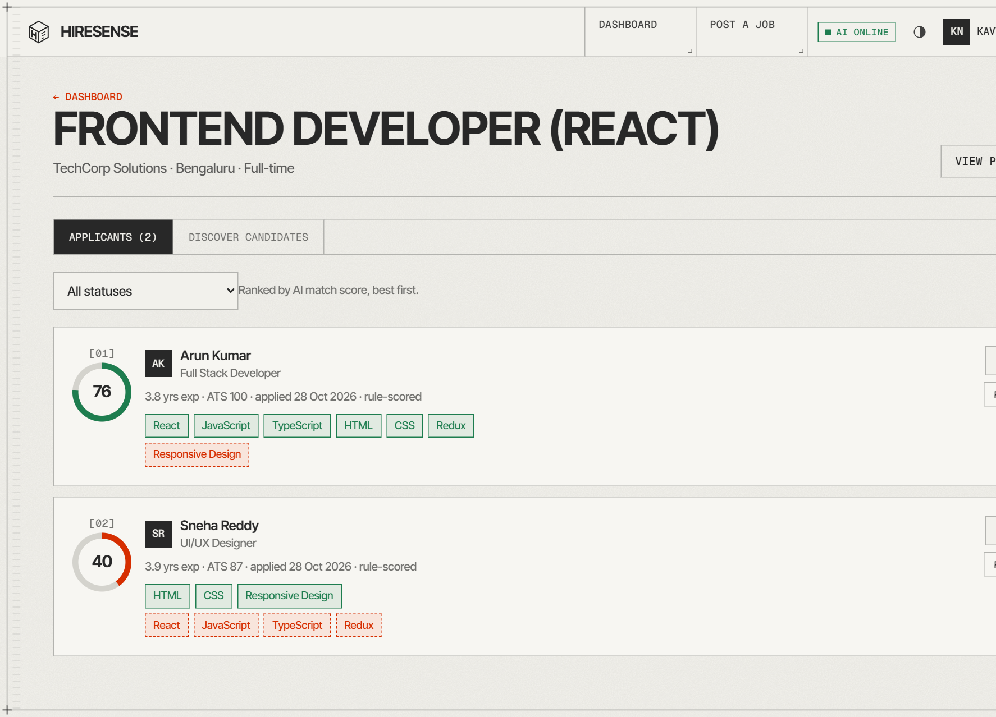
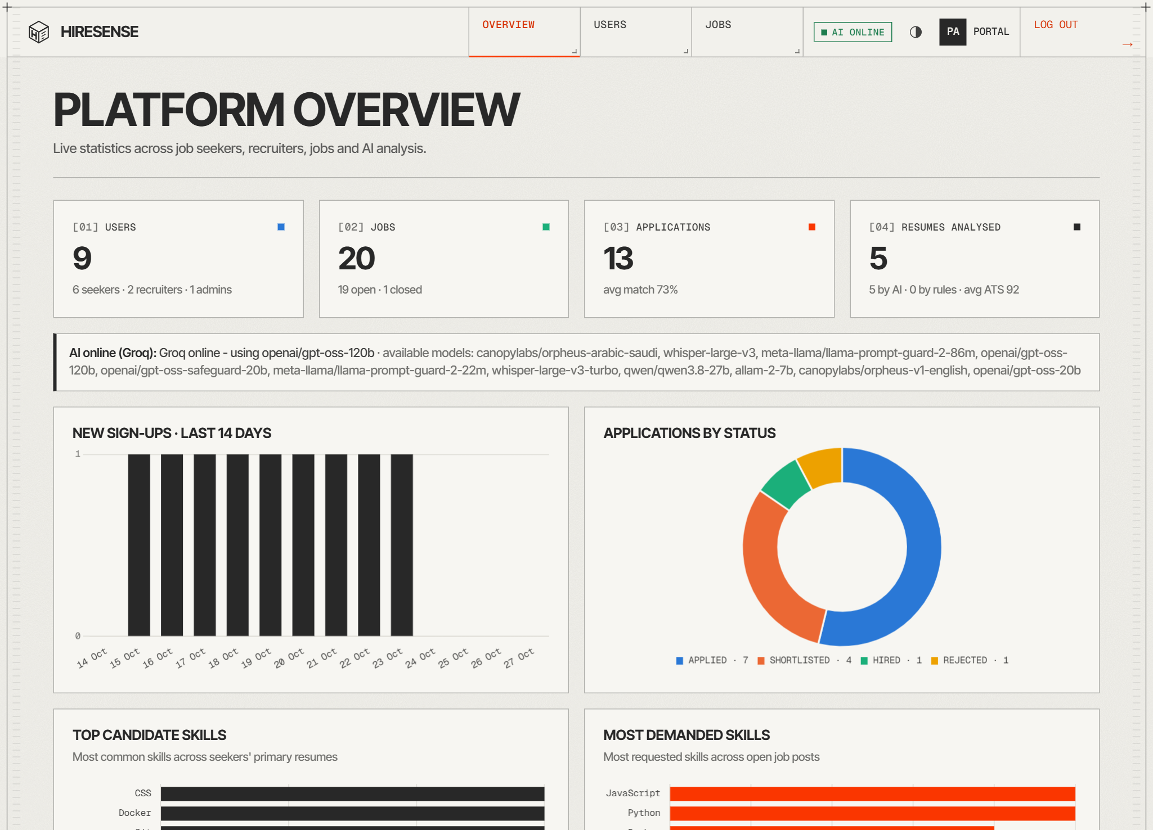
PRESENTED BY PAVIN MUTHU G URK24CS1017
14 / 17
FOR RECRUITERS & ADMINS
Recruiter: applicants ranked by AI match score
Admin: platform overview with charts
Notes:
For recruiters, applicants are ranked by AI match score with matched and missing skills, and they can shortlist, reject, hire or re-score. Admins get a platform overview with charts and can manage users and job posts.

Slide 15
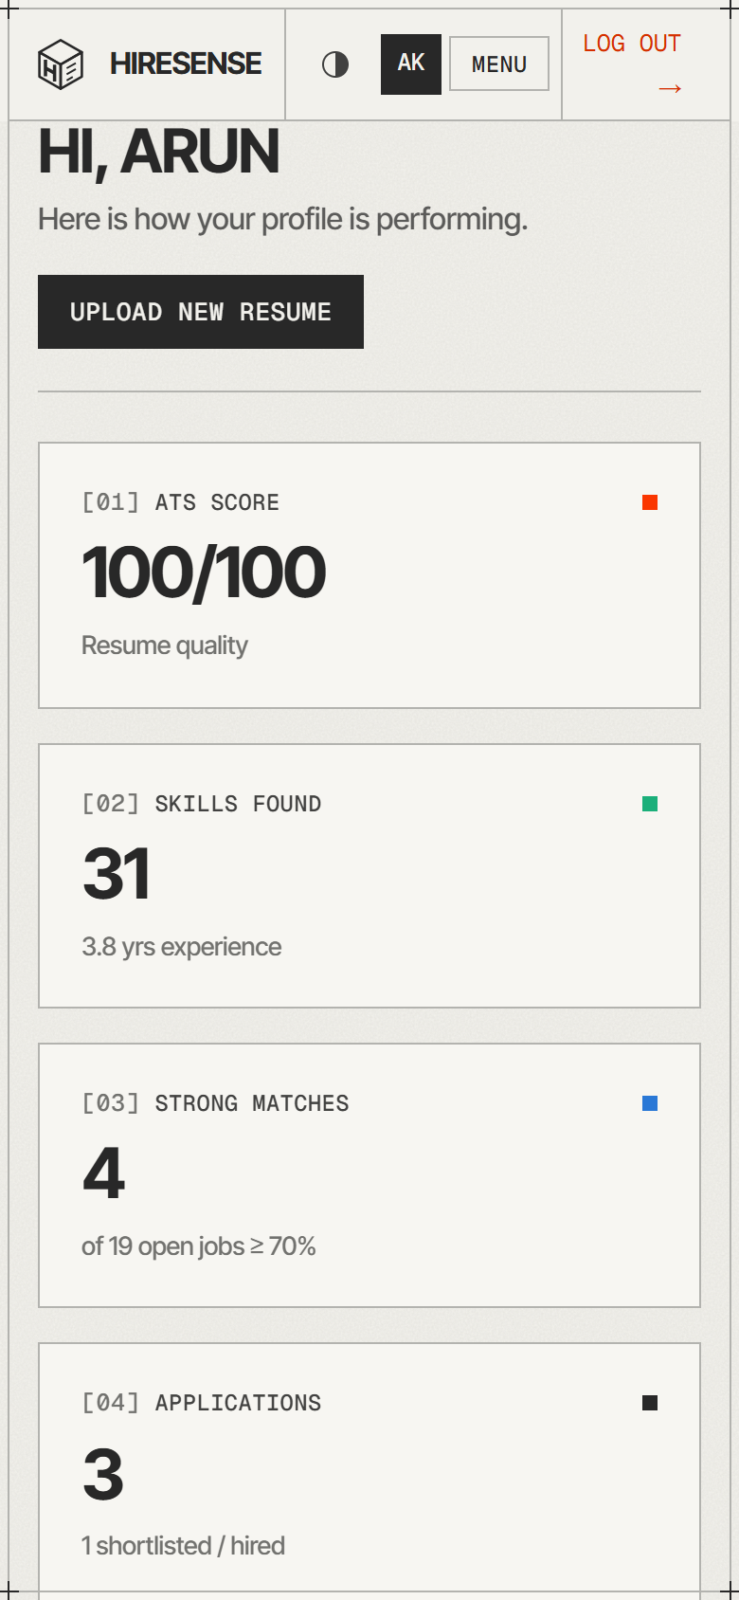
PRESENTED BY PAVIN MUTHU G URK24CS1017
15 / 17
TESTING & RESULTS
23/23
3.6 s
API test cases passed
AI resume analysis (Groq)
< 65 ms
4
all other API requests
environments: desktop, tablet, mobile, Vercel
WHAT WE TESTED
Validation 400s
Auth 401s
Role 403s
Duplicate 409s
Upload type & size
AI analysis
Mobile viewport (390 px)
Notes:
We ran 23 scripted API scenarios covering validation, authentication, authorisation, upload limits and AI analysis. All 23 returned the expected status. The AI upload took about 3.6 seconds; every other request finished within 65 milliseconds. We also checked desktop, tablet and mobile viewports in both themes.

Slide 16
PRESENTED BY PAVIN MUTHU G URK24CS1017
16 / 17
CONCLUSION & FUTURE
01
Speed + explanation
02
Both sides served
03
Secure & dependable
Instant hybrid score for every job, LLM reasoning on demand.
Seekers get actionable fixes; recruiters get an explained shortlist.
Layered validation, JWT roles and an automatic AI fallback.
FUTURE ENHANCEMENTS
OCR for scanned resumes
E-mail & in-app notifications
Atlas Vector Search embeddings
Interview scheduling
AI resume builder
Jest / Playwright CI tests
Bias & fairness auditing
Notes:
To conclude: the hybrid approach, instant scoring for every job plus on-demand LLM judgement, gives both speed and explanation. Layered validation, JWT role checks and the fallback make it secure and dependable. Next we'd like to add OCR, notifications, vector search, interview scheduling, a resume builder, automated CI tests and bias auditing.

Slide 17
PRESENTED BY PAVIN MUTHU G URK24CS1017
17 / 17
THANK YOU
TRY IT LIVE
hiresense.vercel.app
TEAM ARCTOZOLT
Jebarson Caleb D
URK24CS1038
Talari S Vamshi Krishna
URK24CS1025
Jasper Freddy Paul R S
URK24CS1118
Pavin Muthu G
URK24CS1017
Questions?
Notes:
Thank you. HireSense is live at hiresense.vercel.app if you'd like to try it. We're happy to take questions.

