Slide 1
II_2_ComponentStructure.pdf ##SIZE=[85;50]##
Component Interface
Java Interfaces
Factory Interfaces
Data Types
Exceptions
Component Implementation
Interface
Implementations
Factory
Implementations

Slide 2
II_1_TechnicalInfrastructure.pdf ##SIZE=[75;70]##
Application Layer
jMeta
Java 9 Virtual Machine (JVM)
Operating System
Physical Storage Medium

Slide 3
II_1_FunctionalArchitecture.pdf ##SIZE=[80;70]##
Application Layer (User)
Bootstrap
Extension X functions
Metadata API
Container API
Technical basis

Slide 4
II_1_ProjectStructure.pdf ##SIZE=[80;70]##
jMetaDefaultExtension<1>
…
jMetaDefaultExtension<N>
jMetaLibrary
jMetaDocs
jMetaUtility
jMetaTools

Slide 5
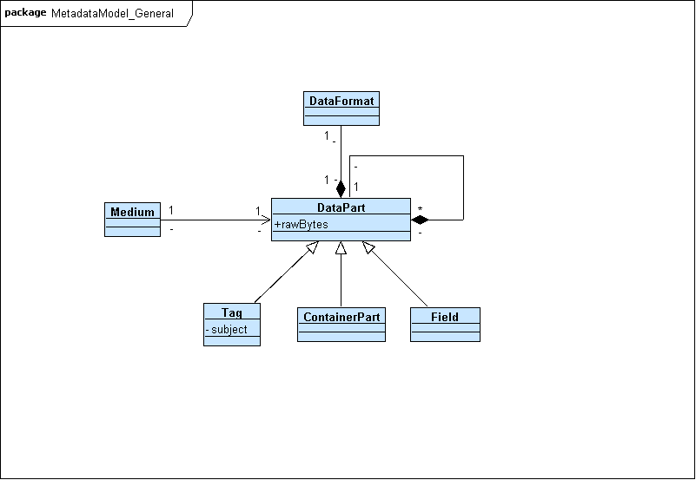
II_2_GeneralModel.pdf ##SIZE=[85;80]##

Slide 6
<part>_<chap>_Template.pdf ##SIZE=[100;100]##
…
Legend
Hallo
Hallo
<Name>
XY Byte
<field>
<field>
<field>
<field>
<field>
<field>
<field>
X Byte
XY Byte
XY Byte
XY Byte
X Byte
XY Byte
X Byte
=<Value>

Slide 7
ALT
Application Layer (User)
jMeta
Cross-functional
Core
Extensions
Library User Interface
Extension 1
Utility
…
Extension n
Component Framework
XML Framework
Medium Access

