Slide 1
GoForCode Program: Participant Orientation
March 20, 2017

Slide 2

Agenda
Welcome!
Participant Introductions
Program Overview
Manager, Mentor, and Program Check-ins
Program Objectives for Participants
Q&A

Slide 3

Welcome and Congratulations!

Slide 4

Participant Introductions
New Hampshire
Derek Rydin
Indiana
Jeb Castelo
Natalie King
Christopher Strobel
Raymond Murphy
Daniel Arsenault
Carrie Beaton
Shawn Keenan
Michelle Sullivan
Eric Hebert
Douglass Mitchell
Patrick Walker
Booth Gibson
Shannon Renaud
Michael Carrison
Kevin Fascetta
Larry Worster
Christopher Blake
Mark Brandt
Brandon Morrissette
Welcome to the GoForCode Program!
Please share with us:
Your Name & Location
Your Prior Role
Why this program caught your eye
Your Program Track

Slide 5


Why GoForCode?
To drive a cultural evolution in the way we work
To ensure our teams are prepared to meet the future needs of our organization
To drive career progression in the Software Development space
A MESSAGE FROM JAMES MCGLENNON
A large part of being innovative and adaptable is the way in which we enable our own workforce to learn new things. Outpacing the competition and staying relevant throughout industry changes will mean providing opportunities in learning emerging technologies within our organization.
Initiatives like this one are just one of the vehicles that will help us usher in a cultural evolution within the IT organization. Other toolsets, methodologies and strategies will help us arrive at our new way of working but as always – the most important components - are your thoughts and ideas as individuals.

Slide 6
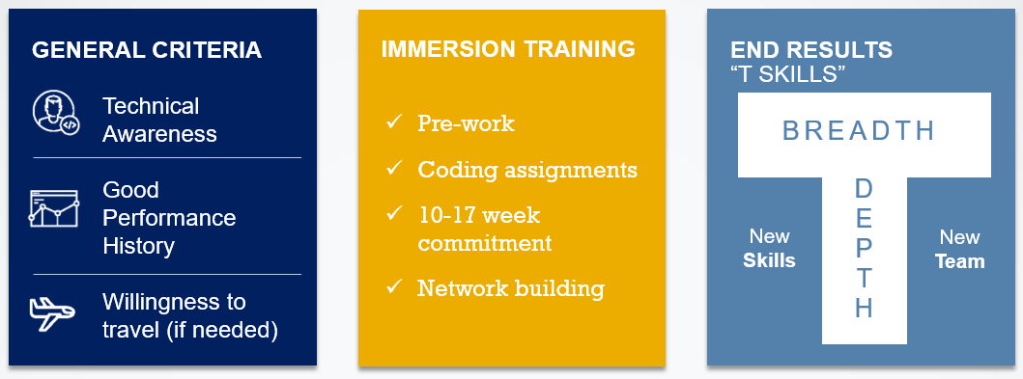
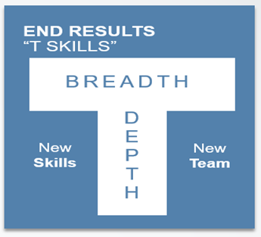




Program Design
Objective: Build the software development skills we expect to be increasingly in demand to meet the needs of our business.
HANDS-ON EXPERIENCE
~9 month assignment with an existing Software Development Team
Receive on-going coaching and feedback from Management and Technical Mentors
Ongoing training and networking
Data
Engineering
Mobile Development Objective-C, Swift
Front-End Web Engineer
HTML5/CSS3/JavaScript
Back-End Engineer
Java, C#, Python, .NET
< / >
School Tracks

Slide 7


WHAT’S IN IT FOR YOU?
DEVELOPMENT
opportunities
Observe
Ask questions
Take risks
VISIBILITY
across IT
EXPLORING
new technologies
CONTRIBUTION
to the future of GoForCode

Slide 8
Continuous Feedback and Coaching
Participant
Manager
Mentor
Development

Slide 9
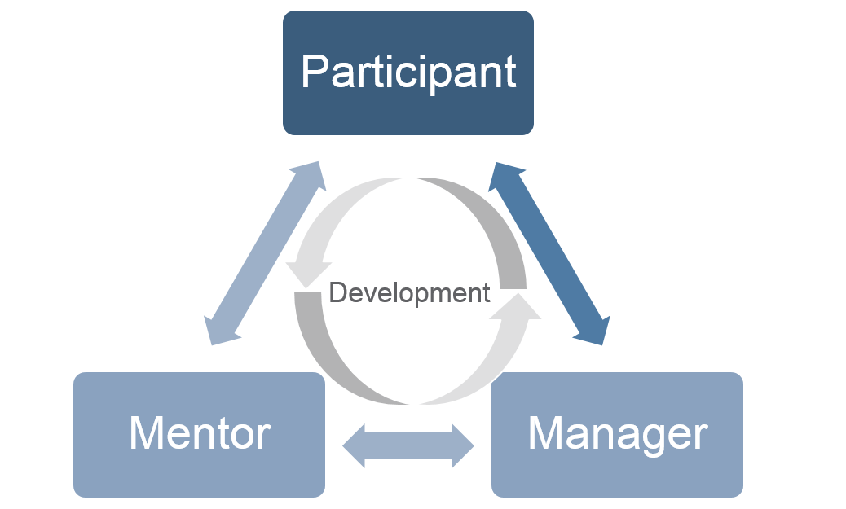
Manager and Team Introductions
One-on-one
Introductory meeting with new manager:
Meet and Greet
Introductory call/meetings with your new team
Attendance on all team huddles and other meetings following Code School
Discuss transition to Code School
Discuss project work to be done once Code School is complete*
Discuss periodic check-ins until you return from Code School
*Many of you have been assigned a temporary manager who will work with you as you transition into the program, and provide support while you’re at Code School. Your final Manager will be within the same organization as your temporary manager (CIIT or USCMIT), and will be confirmed with you prior to your return from Code School.

Slide 10
Technical Mentor Engagement
Upon your return from Code School…
Introduction
Introductory meeting/call with Technical Mentor:
Check-ins
At least once monthly (a minimum of 60 minutes per month)
Mentee and Mentor should come up with a mutually convenient and beneficial approach to check-ins, and contract around connections between formal check-ins
General Introductions
Discussion of mentoring approach, including 1:1 check-in cadence and forum

Slide 11

Next Steps

Slide 12
Timeline
3/14-3/20
3/20 – 3/31
4/3- 4/17
Offers Extended
Owner: Talent Acquisition
Enrollment in Code School
Owner: IT Training and Participant
Transition of Current Work
Owner: Participant and Current Manager
Output: Final list of participants confirmed once all offers are accepts
Output: Application completed, introductory information shared; pre-work distributed
Output: Completely transition all current duties
Pre-work Completion
Owner: Participant
Output: Complete assigned pre-work in the weeks leading up to the Code School start date
Program Start
Owner: Participant and New Manager
Output: Introduction to new org beginning 3/6/17; Begin Code School 3/20/17
IT Training will engage participants to begin the process of Code School enrollment.

Slide 13
Code School Logistics
Complete Application
Code School Pre-Work
Housing
Travel Expenses
Contact
Brad Keller from IT Training
Requirements:
IT Training will partner with you on next steps for the enrollment process
Timeline
~40 hours over 4 weeks prior to the start of Code School
Timeline
Currently in process – 2 participants
Process:
Global Mobility will identify corporate housing nearby Code School location
Once identified, Global Mobility, in partnership with Altair, will work with each of you individually to sign leases and plan for your arrival
Process:
All travel expenses will be managed through the Liberty Mutual Travel Policy
Expense reports should be completed regularly
Rental Car:
Arrangements should be made only where necessary
Meals:
Please use discretion
Feel free to begin booking travel to NH (see appendix for expense details) – Housing Units will become available as of 4/14/17

Slide 14
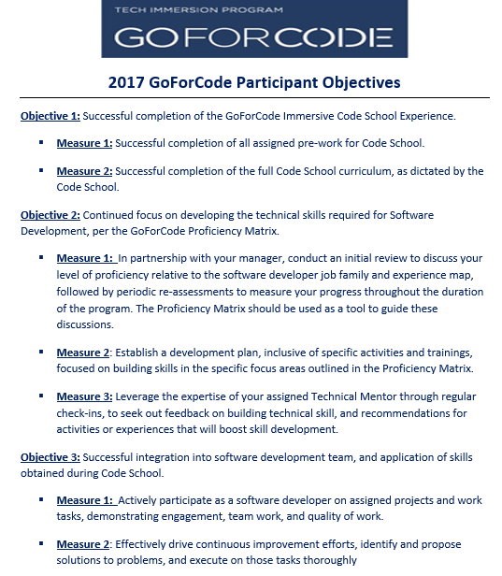
Participant Objectives
As a participant in the GoForCode Pilot, your performance will be measured in part by performance objectives
All participants will see the GoForCode objectives auto-assigned in the month of January, for the 2017 calendar year.

Slide 15
Proficiency Model
A Proficiency Model has been created to help you assess your level of proficiency in the Software Development space throughout your time in the program.
Proficiency Models provide a guideline to participants as to what skills and capabilities they need to continue to build proficiency in over time, as well as demonstrate in their work.
Proficiency Models are used as a coaching tool for managers, technical mentors, and participants to help facilitate coaching/feedback conversations on focus areas and development opportunities.
At the end of the program, the proficiency tool provides a measure proficiency within key areas, and assists in making a determination of grade level within the software development job family.

Slide 16
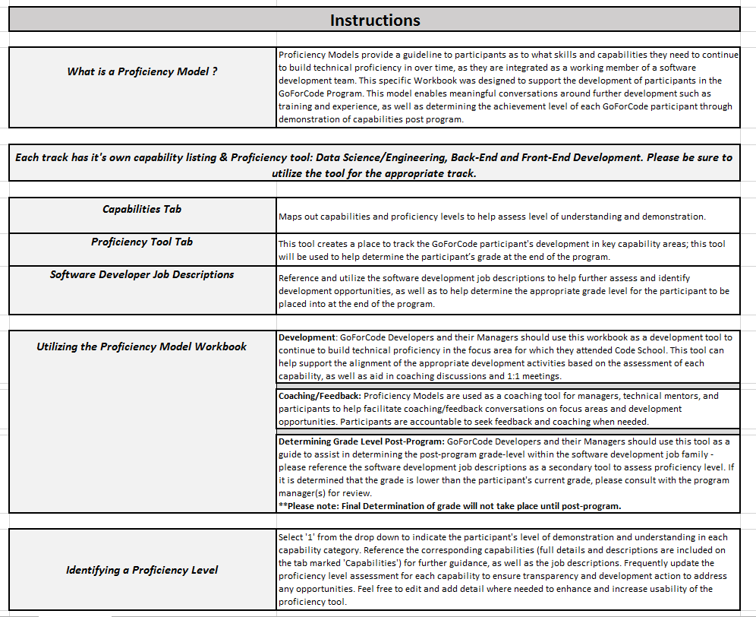
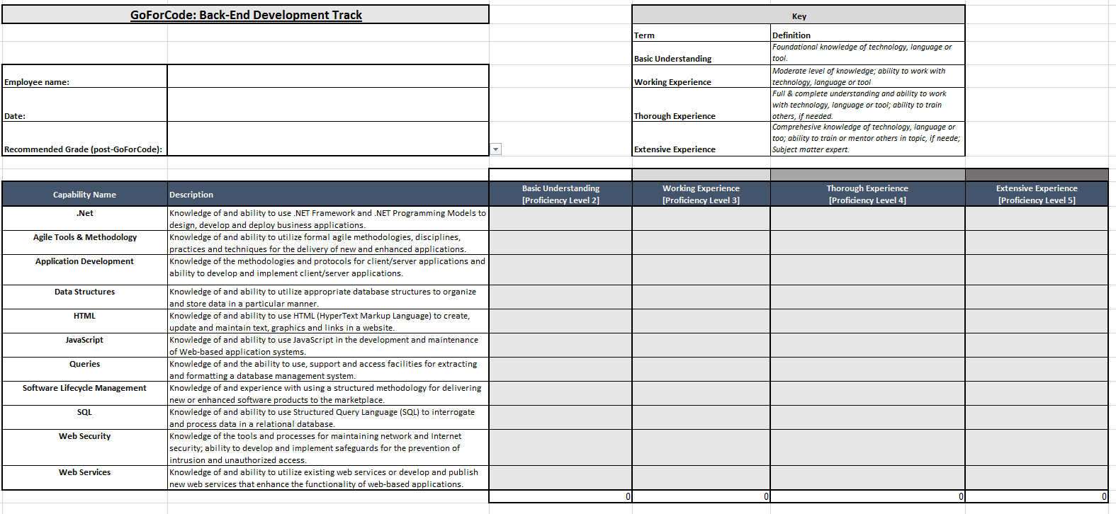
Proficiency Model
Tool creates a place to track how the GoForCode participant is doing; this can be used as a tool to help with determining the participant’s grade at the end of the program.
Utilize capabilities and proficiency levels to help assess level of understanding and demonstration.

Slide 17
Proficiency Model
Use the proficiency model as a guideline to determine where you should place your focus for skill development over the course of the program
Utilize development plan to address any development opportunities. It is recommended you meet with your manager to discuss your progress regularly throughout the year.
Utilize software developer job family descriptions as a reference to further understand the expectations of Software Developers at each grade level.
Although it will be helpful for you to become familiar with the Proficiency Model at the outset of the program, you do not need to be begin using it until you return from Code School and begin regular development discussions with your Manager and Mentor.

Slide 18
Program Resources
GoForCode Manager
Technical Mentor
Program Manager
Questions – Concerns – Feedback

Slide 19
Know Before You Go……
Is there a dress code for Code School?
Dress Code is casual for your code school attendance. You can wear jeans and sneakers, however bring some business casual for presentations. If you plan to visit a Liberty Mutual office nearby your code school, you must adhere to Liberty Mutual dress code policy.
I will be away ~12 weeks, can I check 2 bags vs the Liberty Policy of only 1?
Yes, due to the length of time you will be at code school, we have approved for 2 checked bags to expense vs 1. Note all other Liberty Travel policies apply.
What is the schedule time for code school?
Class hours for code school at Pease are typically 9AM – 4PM, however day to day may vary depending on that day’s agenda. The instructor will advise of any changes or other time requirements as needed.

Slide 20
Know Before You Go……
Can my spouse visit me over the 12 weeks?
Spouse travel is not covered under Liberty Mutual Travel Policy. However, if you have housing provided you are welcome to have guests at your corporate apartment.
Can I bring my pet with me?
Pet allowance is reviewed directly with the housing team and if allowed subject to additional fees that are your responsibility to pay.
What if I need supplies?
You should plan ahead and order what you need via BuySmart. If you need to order while at Code School, please advise your GoForCode Manager of purchases for approval. If you have questions on what is approved, contact Mary Ellen Sullivan before ordering.

Slide 21
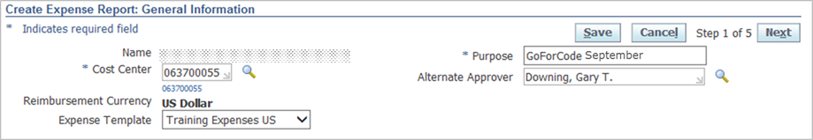

Know Before You Go…
Travel and Expenses:
How should we manage our expenses while in Code School (meals, travel, etc)?
Expenses should be managed per the Travel and Expense policy. Participants should use their discretion when booking flights and paying for meals.
Expenses incurred during Code School should be charged to IT Training, per the following instructions:
Cost Center: 063700055
Expense Template: Training Expenses US
Purpose: GoForCode X (being the month the expenses were incurred)
Alternate Approver: Dannar, Angela
Within each expense type (hotel, meals, etc.) it’s critical to input the Project Code = 01179 for each of the line items; Failure to do so will result in expense payments being rejected.

Slide 22
Know Before You Go…
Can I expense mileage or train/public transportation fare for commuting if I will not be getting a rental car?
Participants who will fly in to their Code School location should plan to use a rental car where public transportation (taxi’s, commuter rail, etc) cannot be relied upon to get to and from the airport and to and from their housing location and Code School. Participants who are within driving distance to Code School should plan to use their personal vehicle or other public transportation (bus/train). When a personal vehicle is used, mileage should be expensed per the Travel policy (i.e. if you code school is in your Office location, no mileage should be expensed). If you location has public transportation available, you can expense a monthly pass during code school.
How often can I plan to travel home? How soon in advance do I need to book out my flights?
We’re remaining flexible on travel home. Again, we would ask that participants use their best discretion, and also consider the impact frequent travel to and from home may have on their Code School work.
Flights should be booked as far in advance as possible, per the travel policy. However if emergencies or other unforeseen circumstances arise, we will remain flexible.

Slide 23
Know Before You Go…
Code School Requirements:
Devices - will we be using our Liberty Mutual devices? Will the schools be providing devices?
Each Code School has different requirements for devices. IT Training will be working to ensure each participant has access to the type of device and/or software required for their participation in Code School.
What will the expectations be for completing pre-work while also wrapping up work for our current roles?
Participants should expect to have about 40 hours of pre-work to be completed in the weeks leading up to the start of Code School. The expectation is that participants be permitted time to focus on pre-work while transitioning out of their current work. You will receive pre-work assignment from your Code School via email.
How should Clarity tracking be done for pre-work and code school?
Once assigned to the appropriate GoForCode manager, a single code will be set up in Clarity to which all pre-work and Code School time should be charged. Clarity time SHOULD NOT exceed 8 hours per day/40 hours per week.
For a Clarity tutorial, please visit: HardCard - USCMIT Clarity Time Tracking Rules and Guidelines

Slide 24
Know Before You Go…
Who do I contact with questions?
Mary Ellen Sullivan, GoForCode Program Manager
GoForCode Program
GoForCode Travel & Expense policy
Corporate/Temporary Housing – Global Mobility
Bradley Keller, GoForCode IT Training
Code School Pre-work
Equipment/setup
Learning support
Slack channels
Clarity code process

Slide 25

Q&A

