Slide 1


Divorce Rate by State
Jenny Eberling

Slide 2
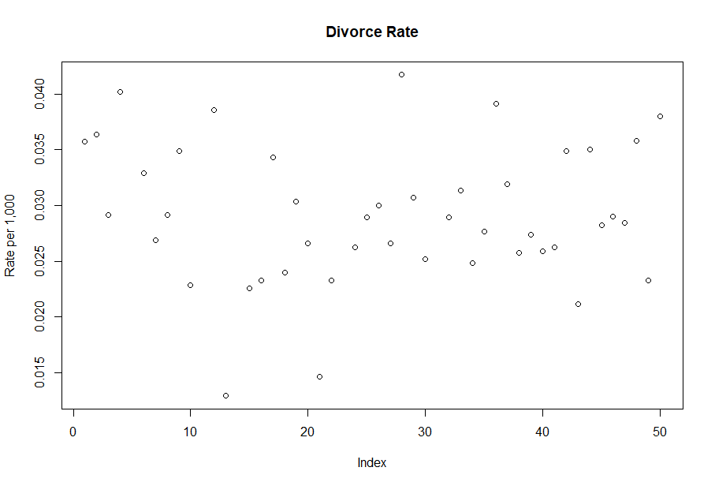
The Data
From CDC - 2019
No transformations needed
Nevada – not always citizens
Missing DR for 5 states
CA, IN, HI, MN, and NM

Slide 3
Variables
Divorce Rate

Slide 4
Proportion that
considers religion
important
Wedding Cost
Poverty Rate
Marriage Rate
Bachelor’s
Degree
Teen Birth Rate
Income
Proportion of babies born
to unmarried mothers
Age
Minimum Marriage Age
2016 Election
Result
Region

Slide 5
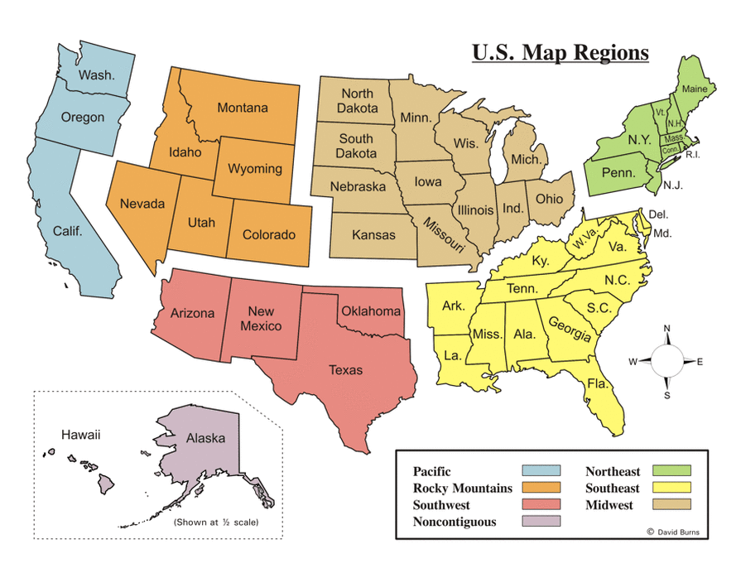

Slide 6
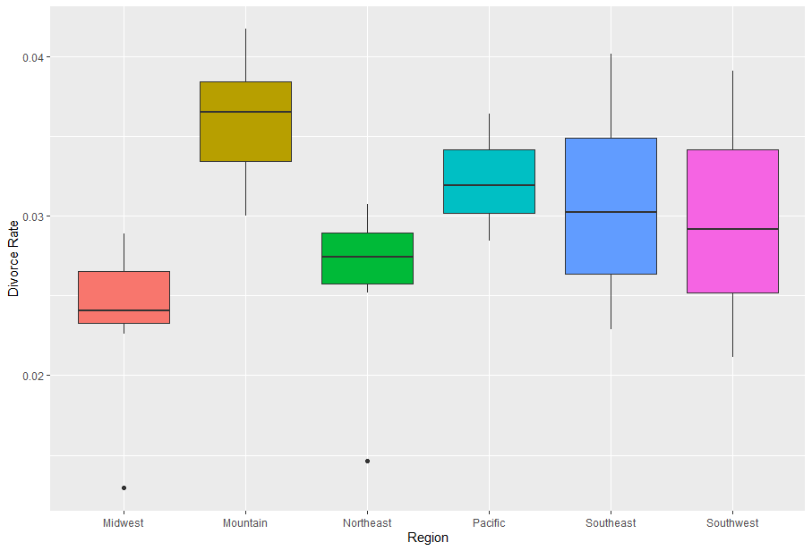
Categorical Variables

Slide 7
Numerical Variables

Slide 8
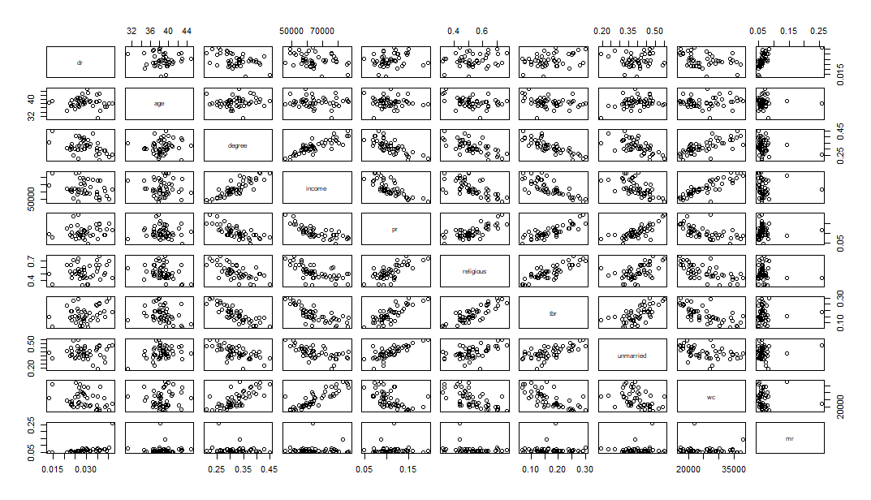

Slide 9
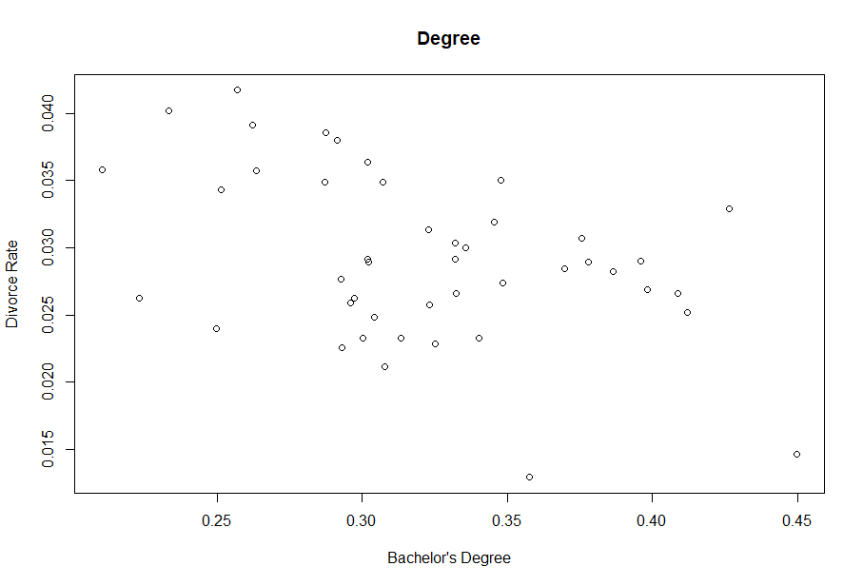
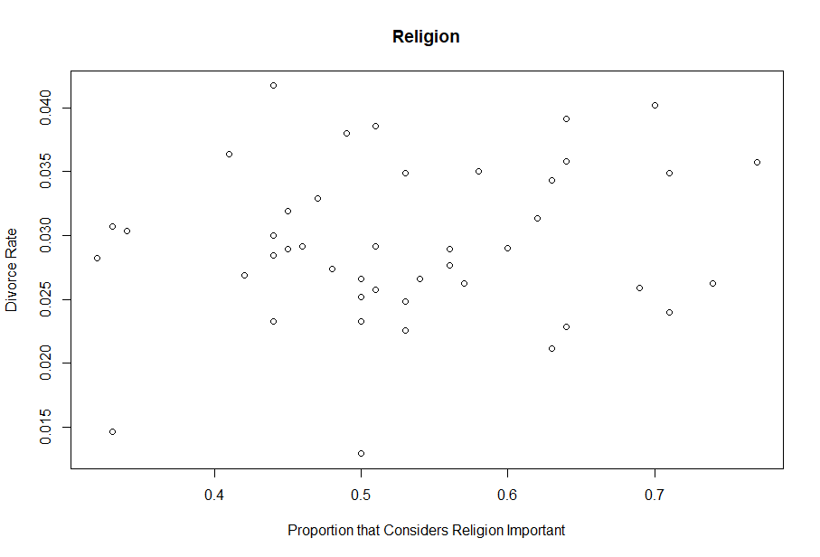
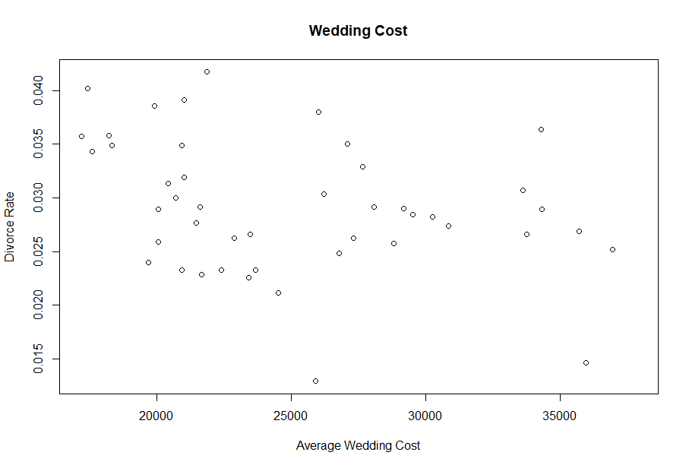
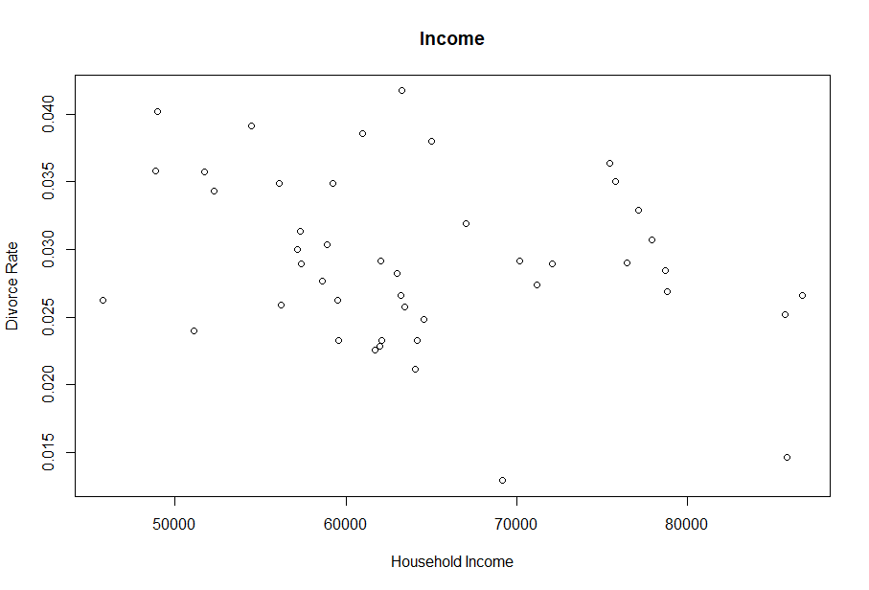

Slide 10
Creating a Model
Selection Methods (AIC)
Narrow down with p-values
(Mostly same result as Selection with P)
Check for Interaction
Add Categorical Variables
Check for Interaction

Slide 11
Exclusively Numeric
All three stepwise functions gave the same model
Marriage Rate, Degree, proportion to Unmarried, Age, Teen Birth Rate, and Income
But wait! Lots of multicollinearity and TBR is not significant
Degree, Income, and TBR have high VIF’s and correlations
I used significance level and VIF’s to narrow it down
Marriage Rate, Degree, proportion to Unmarried

Slide 12
Adding Categorical Variables
Region makes a big difference
Others not as much
Interaction had too much multicollinearity

Slide 13
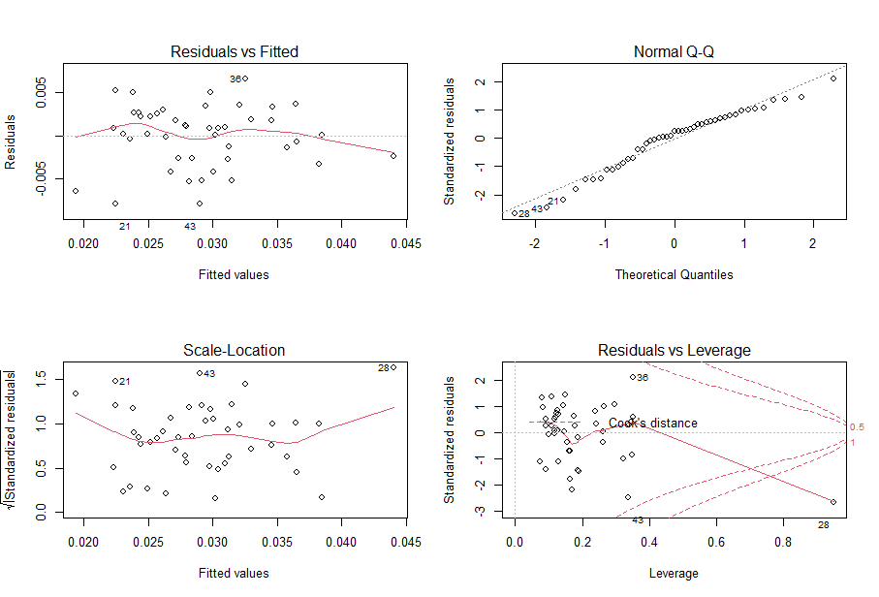



Assessing the Model
Linearity
Independence – N/A
Normality
Equal Variance
Press residuals look great
Robust looks very similar

Slide 14
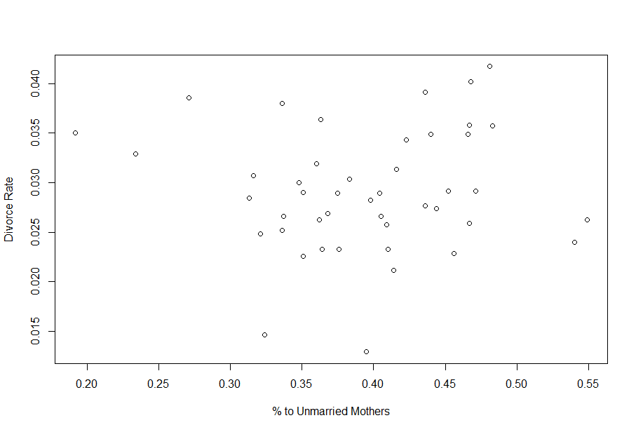
Percent of Babies Born to Unmarried Mothers

Slide 15
Estimations
STATE | WITH NV Adj R^2 = .6018 | WITHOUT NV Adj R^2 = .647 | WITH NV (Robust)
CA | .0298 | .0302 | .0300
HI | .0365 | .0717 | .0362
IN | .0250 | .0318 | .0250
MN | .0219 | .0230 | .0222
NM | .0272 | .0280 | .0285

Slide 16
In Reflection
Chosen Model (Include Nevada):
Estimated Divorce Rate = 0.062969 - .077706*degree - .049695*unmarried + .073723*mr + coef_region*1
The default region is Midwest
Mountain: 0.005867 / Northeast: 0.006865 / Pacific: 0.008314 / Southeast: 0.008678 / Southwest: 0.006928
Assumptions met
No multicollinearity
Predictions

Slide 17

Future Work
Lagged Marriage Rate
Lag all variables by 8 years
Long term partners
2015 impact? 2020?
Different “degree” or “religion”
Individuals

Slide 18

Thank You

Slide 19
Citations
Weird VIF: https://www.tandfonline.com/doi/abs/10.1080/01621459.1992.10475190#.U2jkTFdMzTo
CDC data – most of the variables:
https://www.cdc.gov/nchs/pressroom/stats_of_the_states.htm
Cost of a wedding:
https://www.fool.com/the-ascent/research/average-cost-wedding/
Census data – education levels:
https://en.wikipedia.org/wiki/List_of_U.S._states_and_territories_by_educational_attainment#cite_note-CensusData-1

Slide 20
Citations II
2017 Pew Research Survey – Religion:
https://en.wikipedia.org/wiki/List_of_U.S._states_and_territories_by_religiosity#cite_note-10
Median Age
http://www.statsamerica.org/sip/rank_list.aspx?rank_label=pop46&ct=S09
Percent in poverty using 2-year averages
https://www.census.gov/library/publications/2020/demo/p60-270.html
Region
https://www.nationsonline.org/oneworld/US-states-by-area.htm

Slide 21
Citations III
Minimum Age to get married (with parental approval)
https://en.wikipedia.org/wiki/Marriage_age_in_the_United_States
Divorce
https://www.cdc.gov/nchs/data/dvs/state-divorce-rates-90-95-99-19.pdf
Wedding price
https://www.valuepenguin.com/average-cost-of-wedding

