Slide 1
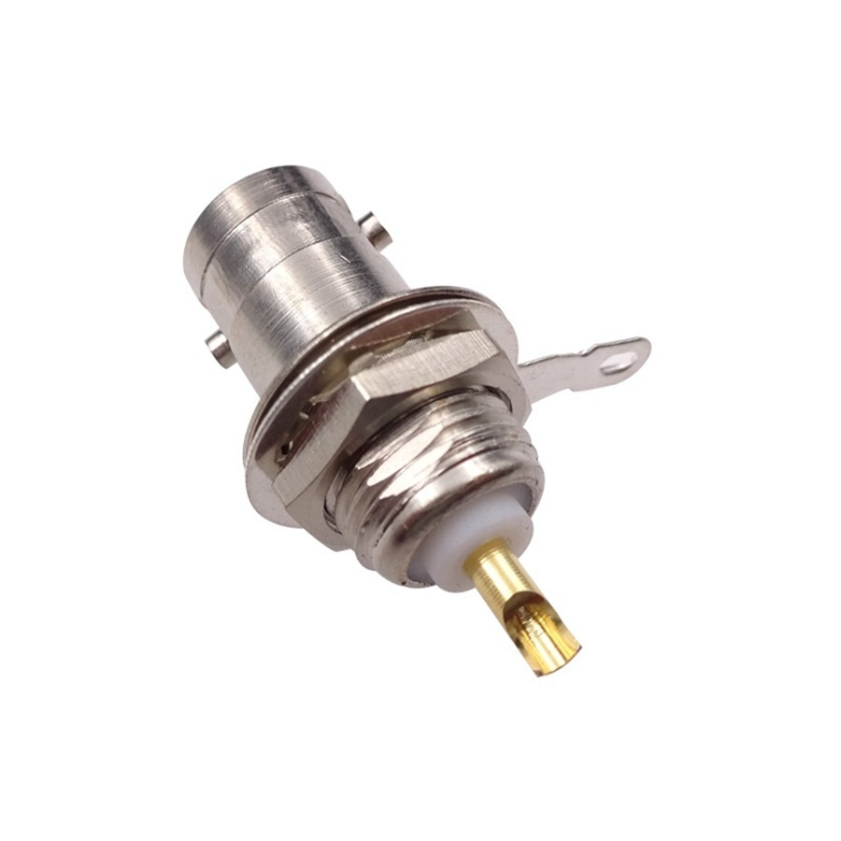
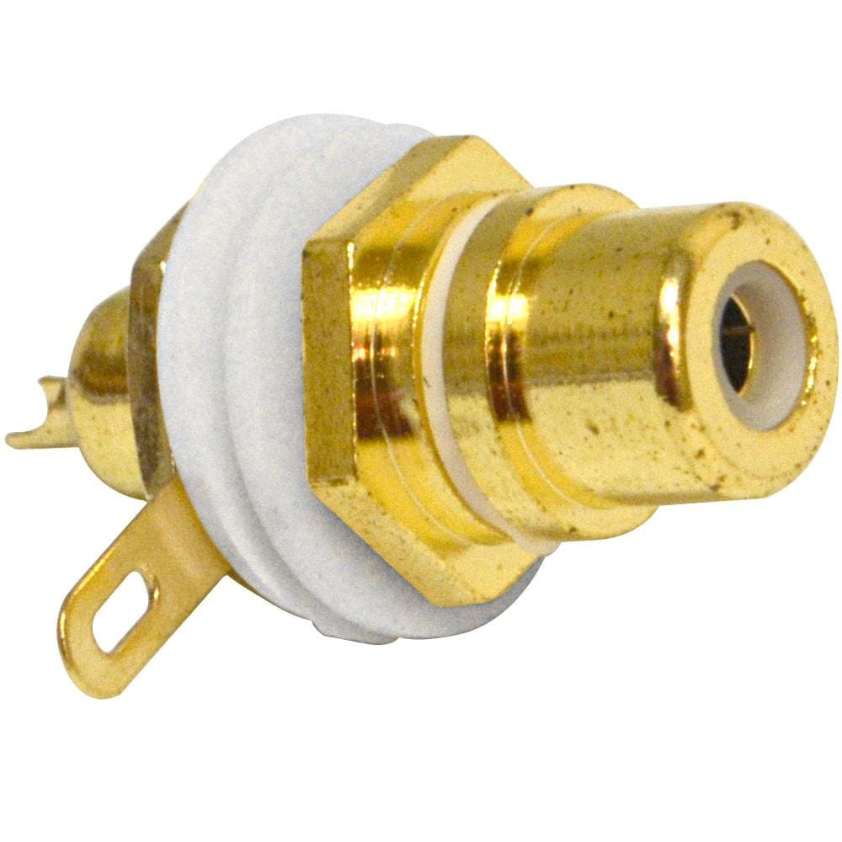

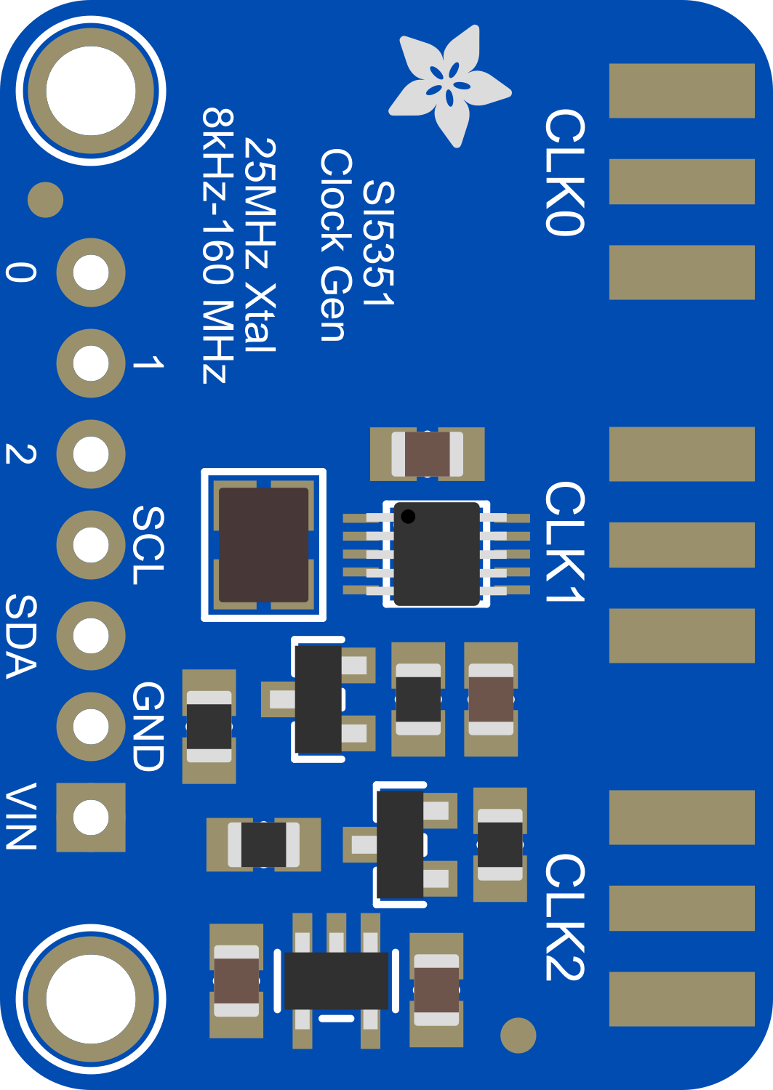

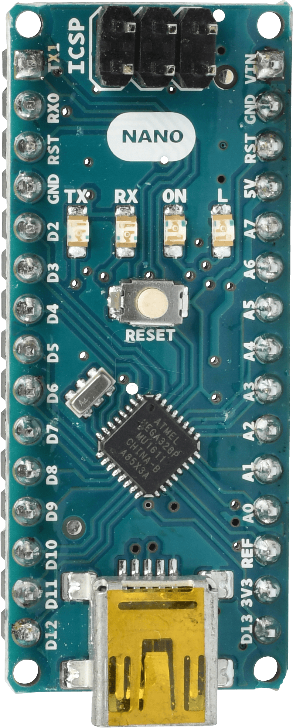
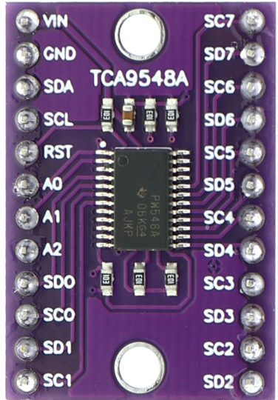
SI5351 Multi-Radio VFO
System Wiring Overview
Add 0.1uF Ceramic capacitors between all VCC pins and ground on all modules.
Add 10uF Tantalum capacitors between VCC and ground on the Arduino NANO and each SI5351 module.
RF_OUT1
GND
PTT1
GND
+5V
RF_OUT2
PTT2
RF_OUT3
PTT3
⏚
⏚
PTT4
RF_OUT4
GND
PTT5
RF_OUT5
+5V
PTT6
RF_OUT6
GND
Dark Blue = I/O
Blue = I2C
Red = +5V
Green = GND
John Bielefeld
K1JEB
Architecture Freeze Point:
SI5351_VFO_HW_v0_9_ARCHITECTURE_STABLE
GND
+5V

