Slide 1
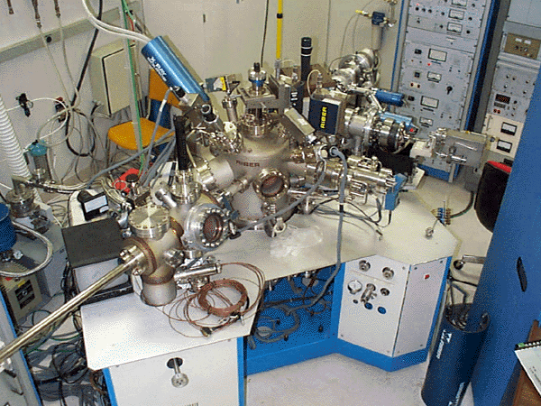
Photoelectron Spectroscopy
AKA
Photoemission Spectroscopy

Slide 2
Types of PES
X-ray Photoelectron Spectroscopy (XPS) | - using soft x-rays (with a photon energy of 200-2000 eV) to examine core-levels.
Ultraviolet Photoelectron Spectroscopy (UPS) | - using vacuum UV radiation (with a photon energy of 10-45 eV) to examine valence levels.

Slide 3
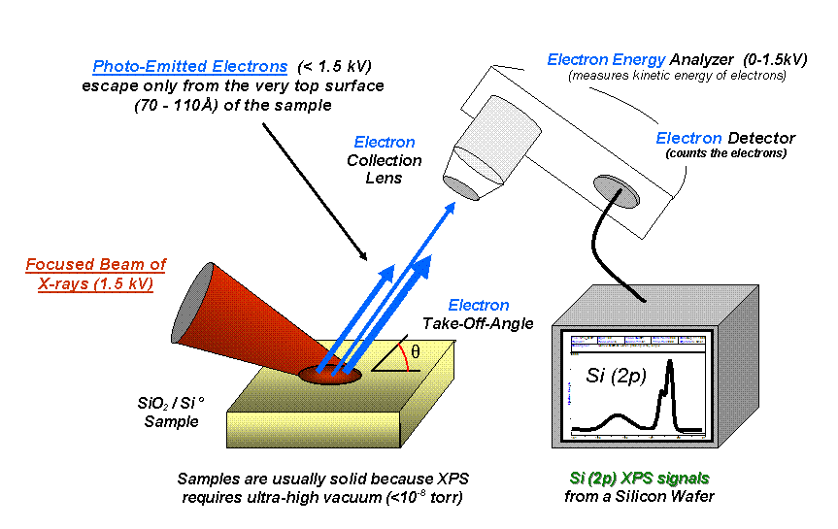
X-ray Photoelectron Spectroscopy

Slide 4
PES - Chlorine
Energy is scaled in MJ/mol. 1 megajoule = 1000 kJ
Credit to Thomas Silak for the PES Excel Spreadsheet

Slide 5
PES - Chlorine
1s
2s
1s electrons require the most energy for removal due to their proximity to the nucleus.
Credit to Thomas Silak for the PES Excel Spreadsheet

Slide 6
PES - Chlorine
1s
2s
3p peak essentially represents the first ionization energy, as an outermost electron is being removed.
Credit to Thomas Silak for the PES Excel Spreadsheet

Slide 7
Carbon and Nitrogen
1s
1s
2s
2s
2p
Removal of electrons from nitrogen requires more energy, due to a greater nuclear charge.
Credit to Thomas Silak for the PES Excel Spreadsheet

Slide 8
Oxygen and Nitrogen
2p
2p
1s
1s
2s
2s
2p electron is easier to remove in oxygen due to electron-electron repulsion is paired 2p orbital.
Credit to Thomas Silak for the PES Excel Spreadsheet

Slide 9
Sodium and Potassium
2p
2p
3p
1s
1s
2s
3s
3s
4s
Electrons are harder to remove from potassium, due to the greater nuclear charge. The first ionization energy is smaller, because the electron is farther from the nucleus, and more shielded.
Credit to Thomas Silak for the PES Excel Spreadsheet

