Slide 1

GlassCat
The JavaScript Application Server
Last update: 05/11/2018

Slide 2

Description
"An application server is a software framework that provides both facilities to
create Web applications and a server environment to run them" ^{[1]}.
GlassCat is:
  a JavaScript Application Server
  the default JEC implementation
  built over NodeJS
  written in TypeScript
GlassCat as:
  a standard for JavaScript Web apps
  a portable development environment
  an efficient alternative to Spring Boot and Java EE
  the best integrated solution for TypeScript development
[1] Wikipedia: Application server
JEC
JavaScript Enterprise Container
1

Slide 3
Positioning
GlassCat is an alternative to JAVA technologies and improves the development of NodeJS applications.
Benefits vs. Spring Boot / Java EE[**]:
non-blocking architecture
stateless support for REST APIs[**]
uniform programmatic language
short learning curve
Benefits vs. NodeJS / Express:
development standardization
portability / reusability
built-in security support
TypeScript integration
Lower infrastructure costs
Better productivity
JEC
JavaScript Enterprise Container
2

Slide 4
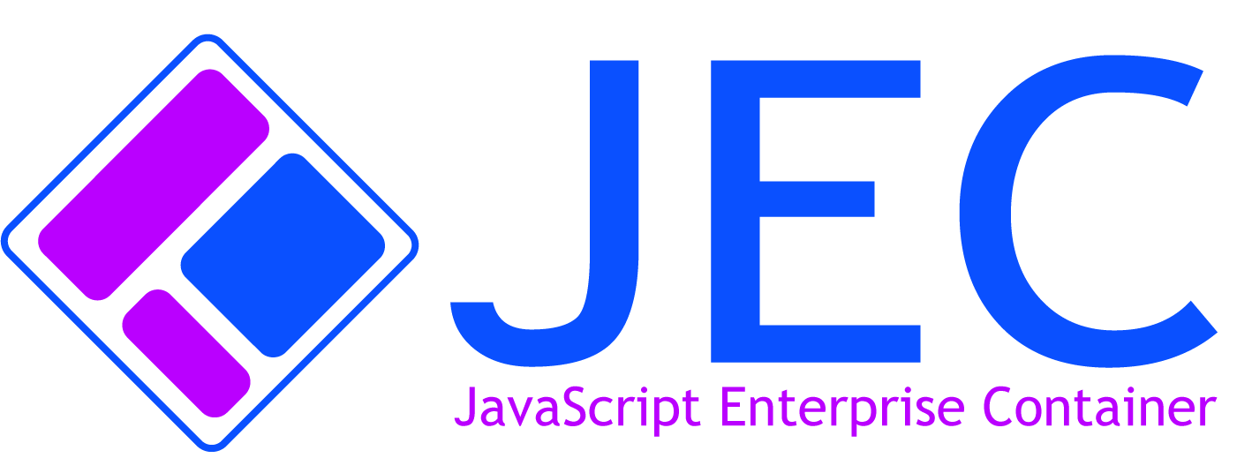
JEC Default Implementation
GlassCat is the JEC default implementation.
JEC specifications bring industrial processes to JavaScript applications development:
scalability and maintainability
portability
test driven development
IoC / Dependency Injection
container orchestration
microservice architectures
RESTful services architectures
etc.
JEC is an open source specification entirely based on abstraction layers.
JEC
JavaScript Enterprise Container
3

Slide 5
Ease-of-use
JEC ships with a command line tool that can be used if you want to quickly prototype with GlassCat.
It allows you to install and run a GlassCat server without any boilerplate code.
To install JEC-CLI, run the following in a terminal window:
$ npm install jec-cli -g
Now you can use JEC-CLI from anywhere. The commands below install a GlassCat server in a new directory and run it immediately:
$ mkdir test-server
$ cd test-server
$ jec install-glasscat
$ glasscat start
JEC
JavaScript Enterprise Container
4

Slide 6
TypeScript Integration
GlassCat is entirely written in TypeScript and supports generic types and annotations:
@WebJslet({
name: "HelloWorld",
urlPatterns: ["/say-hello"]
})
export class HelloWorldSvc extends HttpJslet {
public doGet(req:HttpRequest, res:HttpResponse, exit:Function):void {
const message:string = this.builder.sayHello();
exit(req, res.send(message));
}
@Inject({ type: MessageBuilder })
private builder:MessageBuilder;
}
TypeScript integration highly increases productivity and provides a well structured environment for designing scalable architectures.
JEC
JavaScript Enterprise Container
5

Slide 7
The Unified API
Unified APIs offers strong benefits:
  better maintainability
  lower learning curve cost
better agility integration
better information system governance
Glasscat improves the MEAN^{[1]} stack:
  standardized architecture
  built-in security layer
  built-in development tools
centralized integration
packaging support for portability
[1] MongoDB + Express + Angular + Node
JEC
JavaScript Enterprise Container
6

Slide 8
Angular Integration
Angular is :
natively integrated to GlassCat
a powerful leverage point for GlassCat massive adoption
JEC
JavaScript Enterprise Container
7

Slide 9
Solving Real World Issues
Developers have an idealized perception of the MEAN stack:
GlassCat provides business-oriented development structure beyond fad:
faster products development
better maintainability
long-term vision
Strong
Costs Reduction
JEC
JavaScript Enterprise Container
8

Slide 10
Non-blocking Architecture
Non-blocking architectures reduce infrastructure costs by mitigating performance issues due to network latency.
GlassCat is built on top of Node.js which enables support for tens of thousands of concurrent connections without incurring the cost of thread context switching^{[1]}.
[1] Wikipedia : Node.js
JEC
JavaScript Enterprise Container
9

Slide 11
URL-mapping Architecture
URL-mapping (Jslet) is based upon Servlet 3.0 specification. Jslets have the following advantages over other server extension mechanisms.
They:
are faster than other server-side scripts because a different process model is used
use a standard API
come with all of the TypeScript advantages (ease-of-development, type checking, ES6/7 support, etc.)
provide portability and platform independence
access the large set of APIs available for the JavaScript echosystem
can be used with the native JEC stateless mode
The GlassCat stateless architecture is much faster than Java stateful architectures.
JEC
JavaScript Enterprise Container
10

Slide 12
The Container Approach
JavaScript containers, as defined by JEC, are micro-architectures oriented:
JEC project unit is called Entreprise JavaScript Project (EJP)
EJPs can combine business and presentation layers (deprecated)
it is best to have only one service, or application, by EJP
JEC
JavaScript Enterprise Container
11

Slide 13
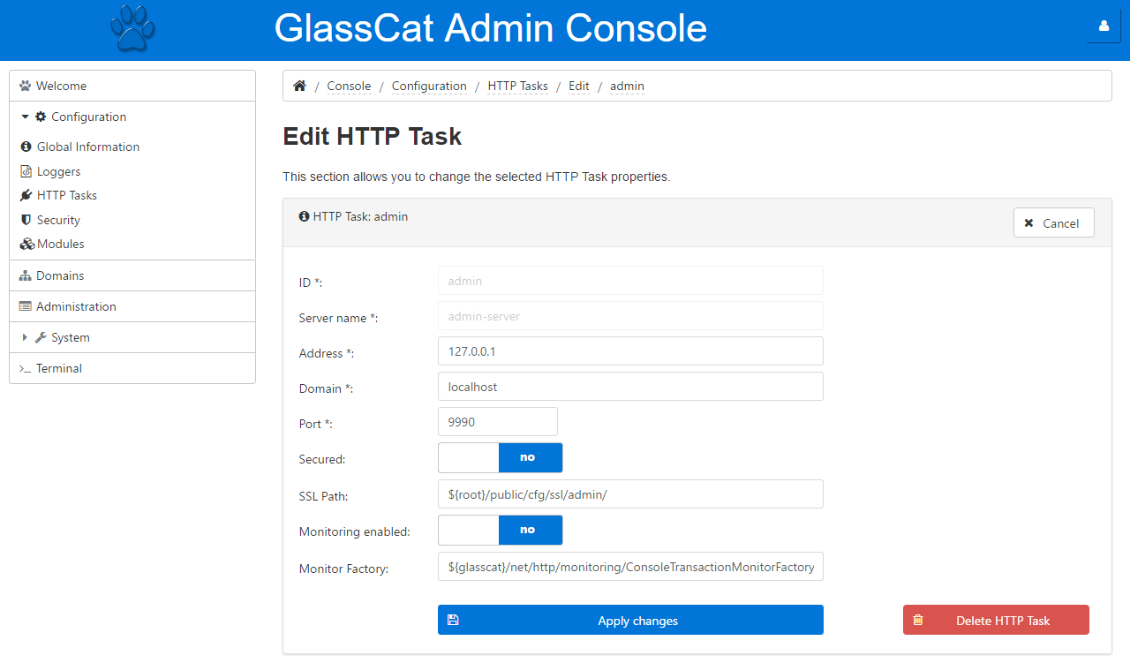
Administration Console
Administration console is an Angular application available from a standard EJP.
JEC
JavaScript Enterprise Container
12

Slide 14
GlassCat CLI
All actions available in the GlassCat Administration Console can be done by using the Command Line Interface:
$ jec create-jslet –-name=HelloWorld –-urlPatterns="/hello"
import { HttpJslet, WebJslet, HttpRequest, HttpResponse } from "jec-exchange";
import { HttpStatusCode } from "jec-commons";
@WebJslet({
name: "HelloWorld",
urlPatterns: ["/hello"]
})
export class HelloWorld extends HttpJslet {
public doGet(req:HttpRequest, res:HttpResponse, exit:Function):void {
// TODO Auto-generated method stub
exit(req, res);
}
}
JEC
JavaScript Enterprise Container
13

Slide 15
JEC Integration
GlassCat ships with the default JEC implementations:
Specification | Description | Implementation
Jslet | A jslet is a small JavaScript program that runs within a JEC server. Jslets receive and respond to requests from Web clients across HTTP. | GlassCat
JARS | The JavaScript API for RESTful Services (JARS) provides functionalities for easily creating RESTful web services. | Sandcat
JUTA | The JavaScript Unit Testing API (JUTA) allows developers to write portable unit testing based on the same kind of annotations than Junit. | Tiger
JDI | The JavaScript Dependency Injection (JDI) specification defines the API that provides the ability to inject components into an application in a typesafe way. | Sokoke
JWS | The JavaScript WebSocket (JWS) framework enables full-duplex communication in JEC applications. | Manx
EJPs can directly refer to these implementations without additional imports.
All the comming JEC specifications will be included in GlassCat.
JEC
JavaScript Enterprise Container
14

Slide 16
Integrated Development Solution
GlassCat architecture has been designed to facilitate the server administration by developers:
special attention has been paid to remove complexity
workspace is directly integrated to server
everything can be done from Visual Studio Code Editor (or any other code editor)
Portability means that:
GlassCat can be deployed over Linux, Windows and Mac OS
EJPs can easily be packaged to export, or import, projects
GlassCat has been designed to be deployed through Container Orchestration (startup time, memory footprint...)
GlassCat is great for DevOps and agility!
JEC
JavaScript Enterprise Container
15

Slide 17
Archetypes Manager
GlassCat has its own archetype manager: Wildcat.
Archetype will:
help authors create JEC project templates for users
provides users with the means to generate parameterized versions of those project templates
GlassCat provides default archetypes for building:
standard applications based on jslets
Angular apps
RESTful-based web services
Authors can create their own archetypes, accessible from any public, or private, repositories.
JEC
JavaScript Enterprise Container
16

Slide 18
Big Data Architecture Sample
JEC
JavaScript Enterprise Container
17

Slide 19
Microservice Architecture Sample
JEC
JavaScript Enterprise Container
18

Slide 20
Additional Features
GlassCat includes the following features:
server-side customizable templating API
security layer and Roles support
integrated session mechanism
projects import / export mechanism
i18n support
built-in transactions analytics
static resources serving
CSS inner references support
The features below will be included in the comming releases:
additional custom server modules
built-in timer services
built-in Data Access API
Helmet^{[1]} security integration
[1] HTTP headers security module
JEC
JavaScript Enterprise Container
19

Slide 21
Where to go from here?
For more information and documentation on GlassCat and JEC please visit:
GlassCat Project
JEC Sample Projects
JEC Youtube Channel
GlassCat is part of the JEC project:
JEC project website
JEC
JavaScript Enterprise Container
20

