Slide 1

GlassCat
Product Overview
Last update: 05/11/2018

Slide 2

Product Description
GlassCat is the first JavaScript Application Server.
An application server is a software framework that provides both facilities to create Web applications and a server environment to run them^{[1]}.
GlassCat provides:
a standardized development environment
an efficient alternative to Java EE
an integrated solution for modern Web development
The right product over the right technology at the right time.
[1] Wikipedia: Application server
JEC
JavaScript Enterprise Container
1

Slide 3
Business Objective
Make GlassCat the global reference for JavaScript Entreprise Applications.
Getting leadership over the coming Web techs by filling the gap between traditional and modern Web development.
Why focusing on server-side technologies?
Gartner predicts that front-side techs interest will decline^{[1]} by 2019-2020:
20 % of brands will abandon their mobile apps
30 % of web browsing sessions will be done without a screen
algorithms will positively alter the behavior of more than 1 billion global workers
Server-side is still the core of business!
[1] Gartner Reveals Top Predictions for IT Organizations and Users in 2017 and Beyond
JEC
JavaScript Enterprise Container
2

Slide 4
Positioning
GlassCat is the efficient alternative to Java EE and SpringBoot because it is built over Node.js.
Node.js efficiently mitigates costs!
It is expected by the segment targets.
Infrastructure costs:
  non-blocking architectures decrease infrastructure costs by reducing the number of machines to get the same result^{[1]}
Development costs:
  uniform programmatic language^{[2]} has a short learning curve, improves maintainability and deals with skills issues (HR costs reduction)
  JEC standardization provides reusability and portability to the Node.js/JavaScript ecosystem (quality costs reduction)
[1] Inevitable trend [2] JavaScript
JEC
JavaScript Enterprise Container
3

Slide 5
Market
We target every company that makes business with Web apps.
Targets needs:
stability of the modern Web ecosystems
development standardization
programmatic skills convergence
+ infrastructure costs reduction
Segments:
secured transactions (e.g. banking area)
Big Data, cloud computing
business data services (REST)
Single Page / Mobile Applications
networking for heavy workloads
Real Time Communication
GlassCat has been designed with these concerns in mind.
Development costs reduction
JEC
JavaScript Enterprise Container
4

Slide 6
Market Maturity
Companies are:
expecting to migrate their Java applications to the Node.js
waiting for stable products and strong trends (uncertain buyer choice)
Angular is:
the new Google standard for creating modern Web applications
built over the same programming language than GlassCat
natively integrated to GlassCat, which is a powerful leverage point for a massive adoption of the product
First-mover advantage (FMA) means that:
there is no equivalent product currently available over the target market
we fit all target market needs
JEC
JavaScript Enterprise Container
5

Slide 7
Marketing Mix
Product
Modern
business
Web Apps over Node.js
Open
Source
Price
Internet
(GitHub
NPM...)
- Angular,
- NodeJS,
- TypeScript
Users
Place
Promotion
JEC
JavaScript Enterprise Container
6

Slide 8
Competitive Advantages
1. FMA
  no challenger on the target market
2. Node.js-based Technology
  infrastructure costs reduction
  target market convergence
Advantage over JAVA
3. Uniform Programmatic Skils
  development costs reduction
  angular native integration
4. Standardization
  quality improvements
Advantage over MEAN^{[1]}
[1] MEAN = MongoDB + Express + Angular + Node.js
JEC
JavaScript Enterprise Container
7

Slide 9
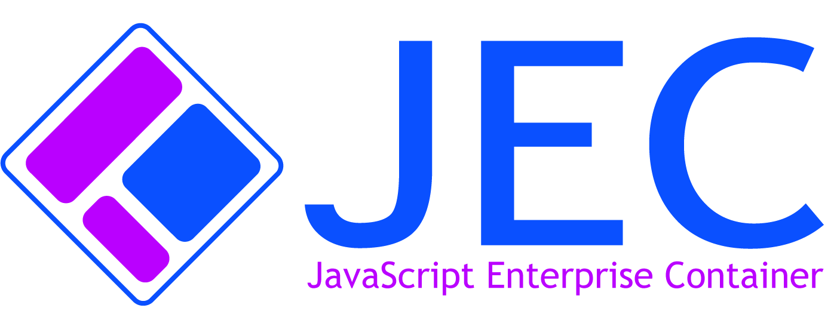
Where to go from here?
For more information and documentation on GlassCat and JEC please visit:
GlassCat Project
JEC Sample Projects
JEC Youtube Channel
GlassCat is part of the JEC project:
JEC project website
JEC
JavaScript Enterprise Container
8

