Slide 1

App Sample
Let's create a JEC modular application!
Last update: 11/02/2018

Slide 2

Objective
The aim of this presentation is to build a JEC modular application based on microservices and a SPA.
We will create a Book Library Manager from scratch, that gives users commons information about registered books and their authors.
This will show you how to:
  serve static ressources (e.g. book covers)
  access NoSQL Data Bases (MongoDB)
  expose data into an Angular app
This presentation demonstrates all the benefits of using
JEC and GlassCat
to easily build modern scalable applications.
JEC
JavaScript Entreprise Container
1

Slide 3
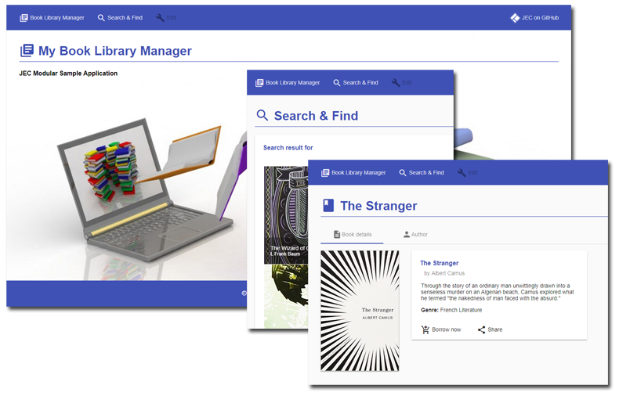
Source Code
Fully functional code of the Book Library Manager application is available at:
https://github.com/pechemann/jec-app-samples/
JEC
JavaScript Entreprise Container
2

Slide 4
App Architecture
Modular approach is the foundation of JEC apps.
JEC
JavaScript Entreprise Container
3

Slide 5
GlassCat Install
JEC-CLI is a command line tool that allows to quickly prototype with GlassCat.
Install JEC-CLI:
$ [sudo] npm install jec-cli -g
Create a directory where to install the server:
$ mkdir test-jec
$ cd test-jec
Install a GlassCat server instance in the new directory:
$ jec install-glasscat
Start the server:
$ glasscat start
JEC
JavaScript Entreprise Container
4

Slide 6
Building JEC Archetypes 1/3
Archetype will help authors create EJP templates for users, and provides users with the means to generate parameterized versions of those project templates.
GlassCat Project Model (GPM) is the JEC project templating toolkit.
To create a new project based on an Archetype, you need to call glasscat archetype goal, like the following:
$ glasscat archetype --gpm=[basic] –-projectName=[myProject]
--directory=[myDirectory] --contextRoot=[myContextRoot]
JEC provides several GPMs:
GPM | Description
basic | An archetype to generate a sample EJP.
microservice | An archetype to generate a RESTful EJP based on JARS and Sandcat.
angular | An archetype to generate an Angular application with Material dependencies.
JEC
JavaScript Entreprise Container
5

Slide 7
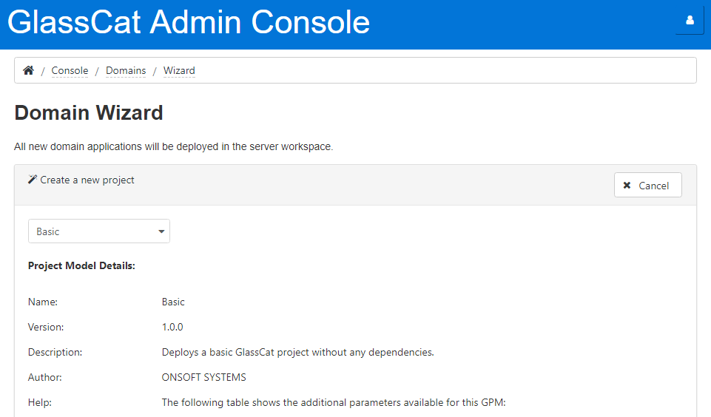
Building JEC Archetypes 2/3
All JEC archetypes can be built from the GlassCat Admin Console:
JEC
JavaScript Entreprise Container
6

Slide 8
Building JEC Archetypes 3/3
This sample application shows the use of a basic, a microservice and an angular archetype, as defined below:
GPM | Name | Directory | Contextroot
basic | sample-blm-images | sample-blm-images | sample-blm-images
microservice | sample-blm-books | sample-blm-books | sample-blm-books
angular | sample-blm-app | sample-blm-app | sample-blm-app
Each project is used for specific purpose:
Project | Description
sample-blm-images | A microservice app that serves static images.
sample-blm-books | A microservice app that provides access to books information through a REST API.
sample-blm-app | The angular app that displays information provided by both microservices.
GPM archetypes have been designed to easily build modular and scalable applications.
JEC
JavaScript Entreprise Container
7

Slide 9
Domains Separation 1/4
GlassCat application servers define each EJP as a "domain".
Contrary to JAVA EARs, domains cannot contain more than one application module.
JEC does not specify any gateway to communicate from one domain to another.
Develop faster with JEC domains:
Domains are a good way to split complex applications into microservice components.
Contrary to JAVA EE and Spring Boot, you can use a single server instance to simulate container orchestration, and/or API management, in development environments.
GlassCat architecture facilitates microservices isolation by using connectors and separating HTTP servers (see next slide).
JEC
JavaScript Entreprise Container
8

Slide 10
Domains Separation 2/4
GlassCat Architecture
JEC
JavaScript Entreprise Container
9

Slide 11
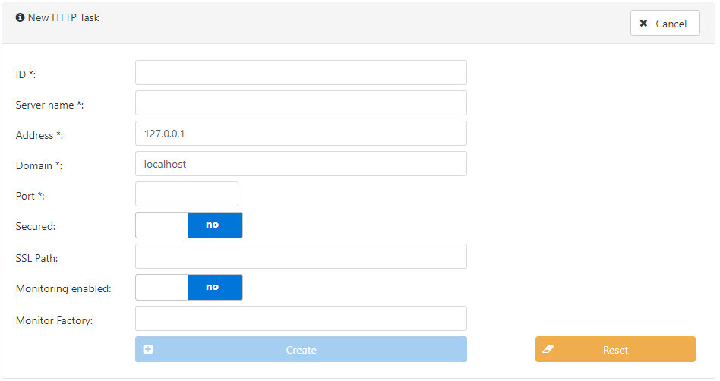
Domains Separation 3/4
You use the GlassCat Admin Console to easily create and manage HTTP tasks:
JEC
JavaScript Entreprise Container
10

Slide 12

Domains Separation 4/4
In order to deploy the sample application, we need to create 3 new HTTP tasks:
[name/ID:testServer1 – port:3001]
[name/ID:testServer2 – port:3002]
[name/ID:testServer3 – port:3003]
Each HTTP task will be associated to only one domain:
GPM | Name | Server
basic | sample-blm-images | testServer2
microservice | sample-blm-books | testServer3
angular | sample-blm-app | testServer1
By applying this concept to all new domain, this application become highly scalable.
Domain containers are stateless by default.
JEC
JavaScript Entreprise Container
11

Slide 13
Creating Microservices
Microservices is a variant of the service-oriented architecture (SOA) architectural style that structures an application as a collection of loosely coupled services.
[...] services should be fine-grained and the protocols should be lightweight.^{[1]}
JEC microservices are:
deployed trhough EJPs
wrapped within domain containers
exposed by using REST APIs
JEC microservices APIs:
jslets can respond to any type of request (including REST architectural style)
JavaScript API for RESTful Services (JARS) has been designed for building REST APIs
JEC microservices philosophy:
Expose a single resource by EJP and deploy only one EJP by server.
[1] Microservices, on Wikipedia
JEC
JavaScript Entreprise Container
12

Slide 14
Serving Static Resources 1/2
The easiest way to serve static resources is to use jslets.
Jlets:
are similar to JAVA EE servlets
support both, file config and auto-configuration
provide built-in methods to serve static files
Jslets can be used to expose static resources through a REST API.
Static resources should be:
stateless
cacheable
You can use both, admin console and CLI, to create new jslets:
$ ejp create-jslet –-name=[myJsletName] --path=[myJsletDirectory]
JEC
JavaScript Entreprise Container
13

Slide 15
Serving Static Resources 2/2
Jslets provide built-in functionalities to let developers manage HTTP responses:
import { HttpJslet, WebJslet, HttpRequest, HttpResponse } from "jec-exchange";
import { HttpHeader } from "jec-commons";
import * as path from "path";
const PATH:string = process.pwd()+ "/path/to/data/images/books/covers/";
@WebJslet({
name: "CoversJslet",
urlPatterns: ["/covers/*"]
})
export class Covers extends HttpJslet {
public doGet(req:HttpRequest, res:HttpResponse, exit:Function):void {
let filePath:string = PATH + path.basename(req.getPath());
res.setHeader(HttpHeader.ACCESS_CONTROL_ALLOW_ORIGIN, "http://localhost:3001");
res.setHeader(HttpHeader.CACHE_CONTROL, "public, max-age=31536000");
exit(req, res.sendFile(filePath), null);
}
}
JEC
JavaScript Entreprise Container
14

Slide 16
Creating REST Services 1/2
JEC default JARS implementation is provided by the Sandcat framework.
The microservice GPM includes initialization script for the Sandcat framework:
import { BootstrapScript, Bootstrap, JecContainer } from "jec-commons";
import { SandcatBuilder } from "jec-sandcat";
@Bootstrap()
export class InitApp extends BootstrapScript {
public run(container:JecContainer):void {
new SandcatBuilder().build(container)
.process((err:any)=>{});
}
}
Sandcat initialization provides support for automatic resources detection.
JEC
JavaScript Entreprise Container
15

Slide 17
Creating REST Services 2/2
microservice-GPM-projects (MS-GPM) are "lightweight" containers:
JARS API and implementation dependencies are not included in the EJP
each EJP owns a Sandcat container instance that manage its resources
MS-GPM projects start fast:
Sandcat resource detection process shares GlassCat's file pre-processor engine
Sandcat is built over the jslet specification
Do not forget to remove unused resource classes (*.ts, *.js files).
MS-GPM projects are flexible:
REST API versioning support
efficient annotations parameters
JEC
JavaScript Entreprise Container
16

Slide 18
Ease-of-use
JARS API is highly intuitive to learn and use.
It provides support for sub-routing, parameters extraction and MIME types treatment:
@ResourcePath({
path: "/books",
crossDomainPolicy: "http://localhost:3001",
produces: "application/json"
})
export class Books {
@Inject(BooksDao)
public dao:BooksDao;
@GET()
public getBooks(@Exit exit:Function):void {
this.dao.getBooks((data:any, err:any)=> {
exit(data, err);
});
}
}
JEC
JavaScript Entreprise Container
17

Slide 19
Book Search Functionality
The BLM sample application implements a basic functionality for searching books.
We use the @QueryParam decorator to easily work with HTTP queries:
export class Books {
@GET({
route: "/search"
})
public findBooks(@QueryParam token:string, @Exit exit:Function):void {
this.dao.findBooks(token, (data:any, err:any)=>{
exit(data, err);
});
}
}
To get all books written by William Shakespeare you just call the following URI:
Http://localhost:3002/blm-sample-app/books/search?token=shakespeare
JEC
JavaScript Entreprise Container
18

Slide 20
Dependency Injection
Dependency injection is:
specified by the JavaScript Dependency Injection (J_{E}DI) API
implemented through the Sokoke framework
const FILE_PATH:string = process.pwd()+ "/path/to/data/books.json";
@Injectable({
type: BooksDao
retention: "DEV"
})
export class LocalBooksDao implements BooksDao {
public getBooks(result:(data:any, err:any)=>void):void {
fs.readFile(
FILE_PATH,
EncodingFormat.UTF8,
(err:NodeJS.ErrnoException, data:string)=>{
exit(data, err);
}
);
}
}
JEC
JavaScript Entreprise Container
19

Slide 21
Creating Angular GUIs 1/3
The angular GPM (NG-GPM) builds Angular-based EJPs.
NG-GPMs include:
Angular 4 dependencies
Angular Material dependencies
NG-GPMs use Google Web Fonts as default configuration to include Material icons.
NG-GPM projects use SystemJS to manage dynamic ES modules.
The Angular application is:
packaged into the webapp/app folder
served by the jslets/AngularApp jslet
available at the http://localhost:3001/sample-blm-app/app URI
JEC
JavaScript Entreprise Container
20

Slide 22
Creating Angular GUIs 2/3
Angular HttpClient service allows to easily access to microservices APIs:
@Component({
selector: "search-find",
templateUrl: "./templates/search.html"
})
export class SearchComponent implements OnInit {
constructor(private _httpClient:HttpClient){}
public books:any[];
ngOnInit():void {
this._httpClient.get("http://localhost:3002/sample-blm-books/books")
.subscribe(
data => {
this.books = data as any[];
console.log(this.books);
},
(err:HttpErrorResponse)=> { console.log(err); }
);
}
}
JEC
JavaScript Entreprise Container
21

Slide 23
Creating Angular GUIs 3/3
Angular Material components allows to display and easily layout data returned by microservices:
<md-card class="example-card">
<md-card-header>
<md-card-title>
List of available books:
</md-card-title>
</md-card-header>
<md-card-content>
<md-grid-list cols="4" rowHeight="250px">
<md-grid-tile *ngFor="let book of books">
<img src="http://localhost:3003/sample-blm-images/covers/{{book.cover}}"
class="book-tile"
alt="{{book.title}}">
<md-grid-tile-footer>
<h3 md-line>{{book.title}}</h3>
<h4 md-line>{{book.author.name}}</h4>
</md-grid-tile-footer>
</md-grid-tile>
</md-grid-list>
</md-card-content>
</md-card>
JEC
JavaScript Entreprise Container
22

Slide 24
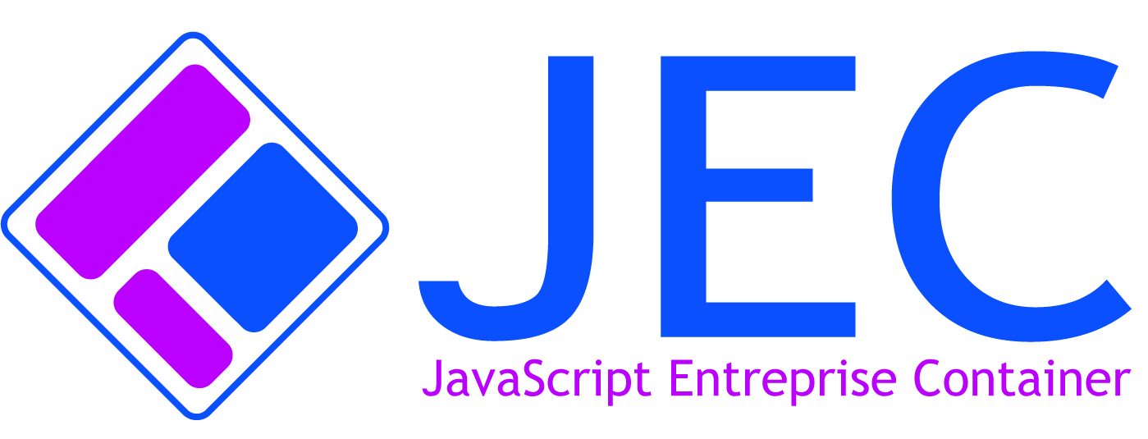
Where to go from here?
For more information and documentation on GlassCat and JEC please visit:
GlassCat Project
JEC Sample Projects
JEC Youtube Channel
GlassCat is part of the JEC project:
JEC project on GitHub
JEC
JavaScript Entreprise Container
23

