Slide 1
ChemE 485: Process Design I
Lecture 6: Introduction to Aspen
Prof. Chad Curtis
Jan. 21, 2020

Slide 2
What you will learn
Experience-based heuristics that can be used to estimate unknown parameters and validate calculated parameters used to design a chemical process.

Slide 3
What is a heuristic?
A heuristic is an experience-based shortcut calculation method or guideline useful for
Checking new process designs
Providing equipment size and performance estimates
Helping troubleshoot problems with operating systems
Verifying that the results of computer calculations and simulations are reasonable
Providing reasonable initial values for input into a process simulator required to obtain program convergence
Obtaining approximate costs for process units
Developing preliminary process layouts

Slide 4
What is a heuristic?
A heuristic is an experience-based shortcut calculation method or guideline:
A heuristic does not guarantee a solution.
It may contradict other heuristics
It can reduce the time to solve a problem.
Its acceptance depends on the immediate context instead of an absolute standard.

Slide 5
An example
You are given an assignment that involves writing a report that is to be completed and presented in two weeks. You work diligently and feel confident you have come up with a respectable solution. You present the written report personally to your director, who asks you to summarize only your final conclusions. Immediately after you provide this information, your boss declares that “your results must be wrong” and returns your report unopened and unread.
You return to your desk angry. Your comprehensive and well-written report was not even opened and read. Your boss did not tell you what was wrong, and you did not receive any “partial credit” for all your work. After a while, you cool off and review your report. You find that you had made a “simple” error, causing your answer to be off by an order of magnitude. You correct the error and turn in a revised report.
What remains is the nagging question, “How could your boss know you made an error without having reviewed your report or asked any questions?”

Slide 6
An example
Before submitting your report, you apply a heuristic that highlights an inconsistency in your initial results. You then review your calculations, find the error, and make corrections before submitting your report. Consider two possible responses:
Your boss accepts the report and notes that the report appears to be excellent and he/she looks forward to reading it.
Your boss expresses concern and returns the report as before. In this case, you have a reasoned response available. You show that your solution is consistent with the heuristic you used to check your work. With this supporting evidence your boss would have to rethink his/her response and provide you with an explanation regarding his/her concern.
In either case, your work will have made a good impression.

Slide 7
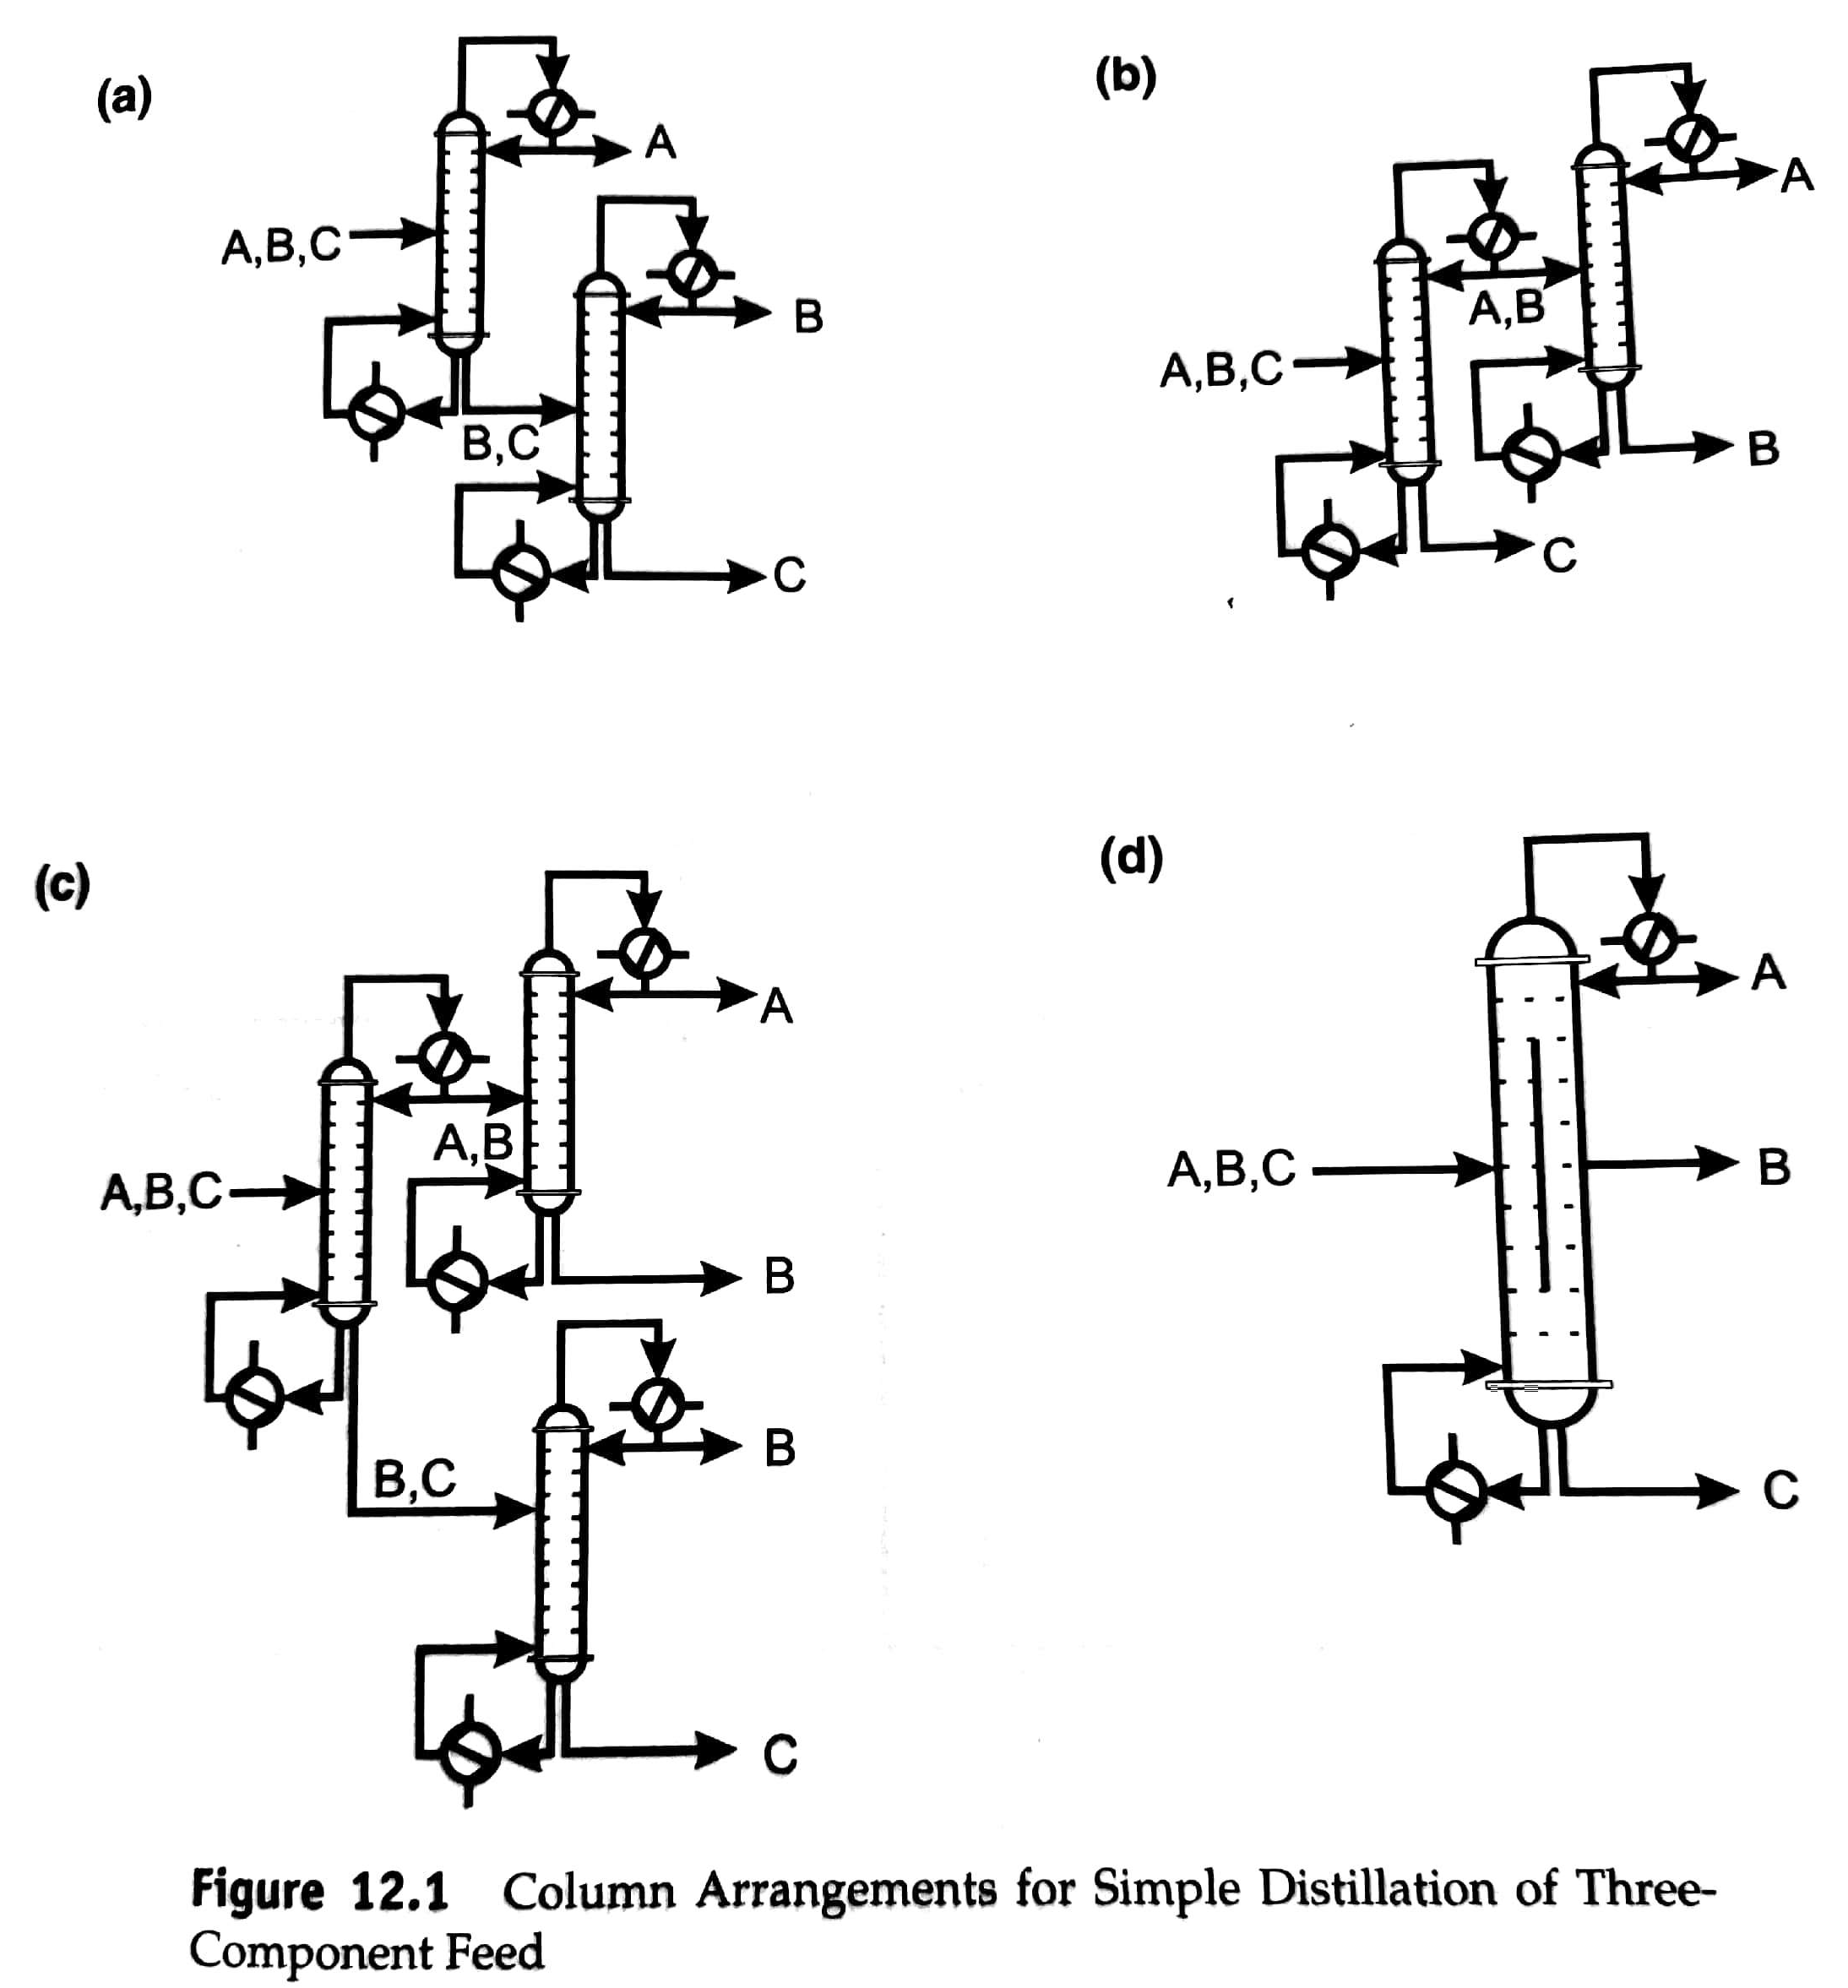
Considerations for the Separation Section
Separator goals:
A product of acceptable purity
A recycle stream of unreacted feed materials
Stream(s) of by-products
Questions to ask:
What type of units to use?
How should these units be sequenced?
Heuristic 1:
A stream with N components will require at least N-1 separation units.

Slide 8
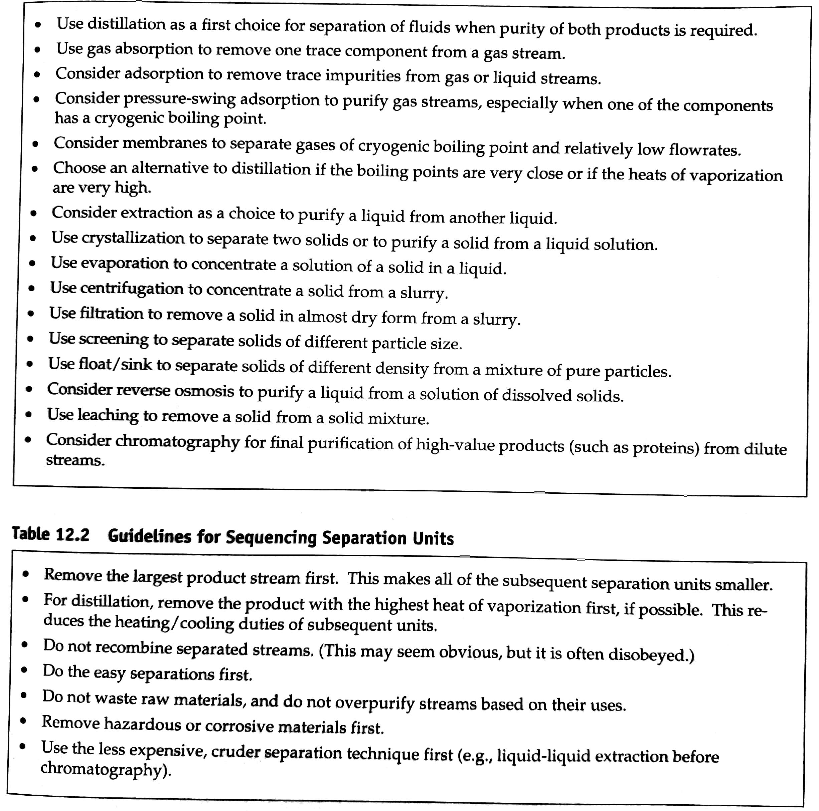
Separation Heuristics

Slide 9
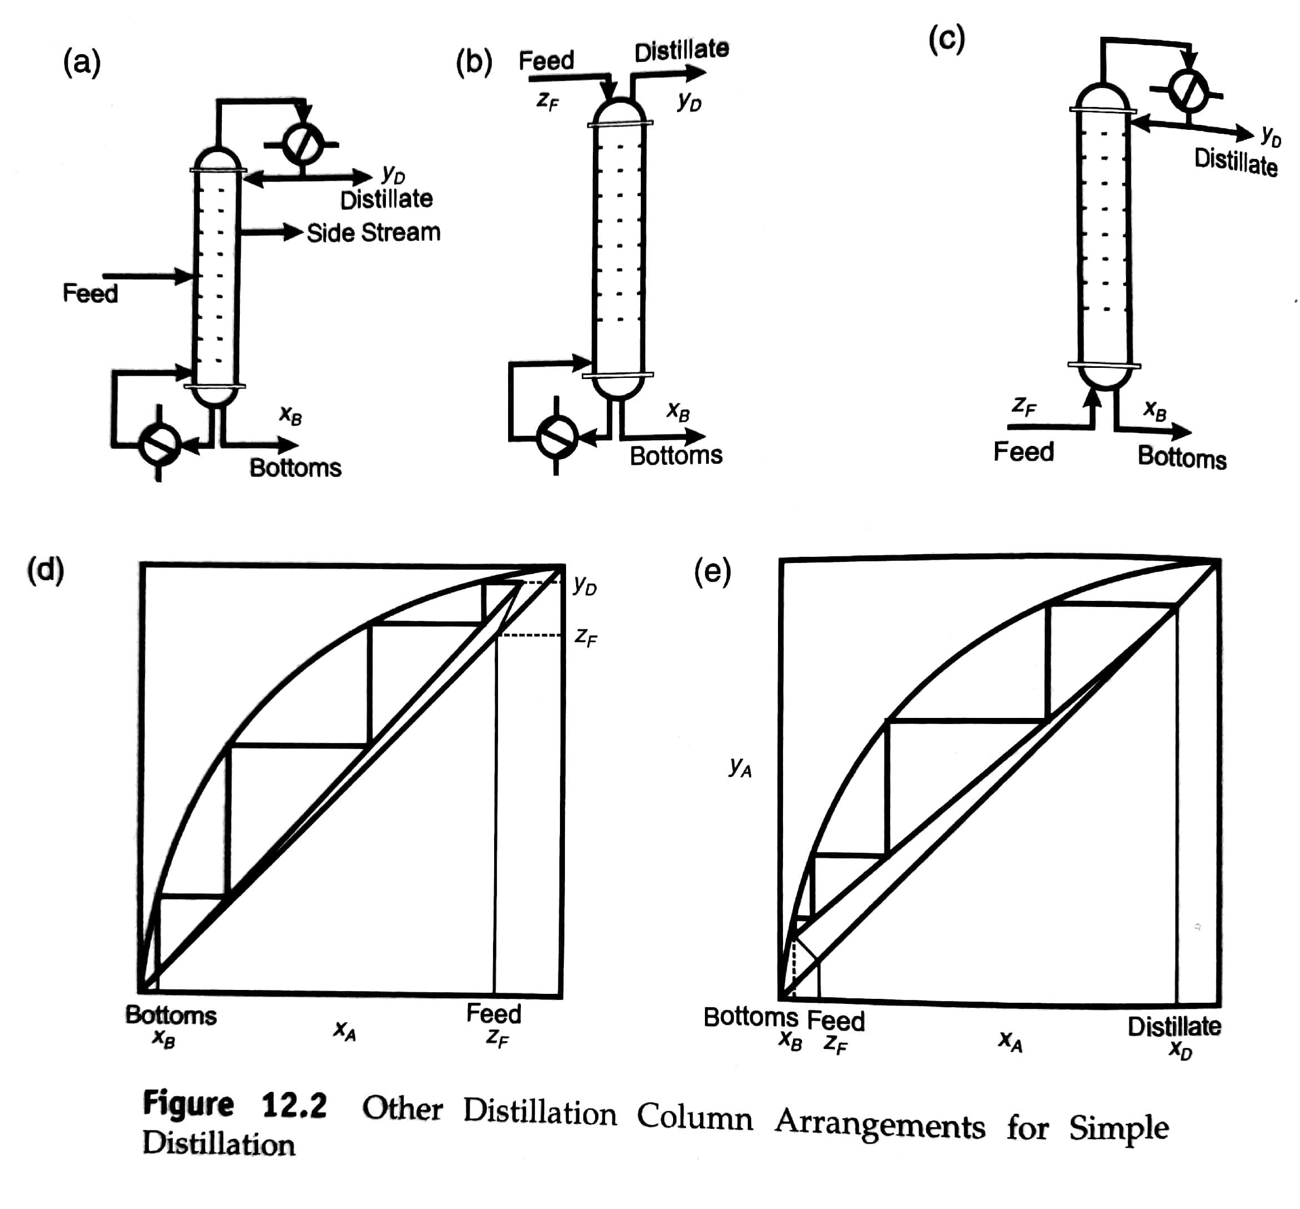
Alternate separations units
Use side streams when a mixed product is desired.
Use a stripping column when the light components are very dilute and need not be purified.
Use a rectifying column when the heavy components are dilute and need not be purified.

Slide 10
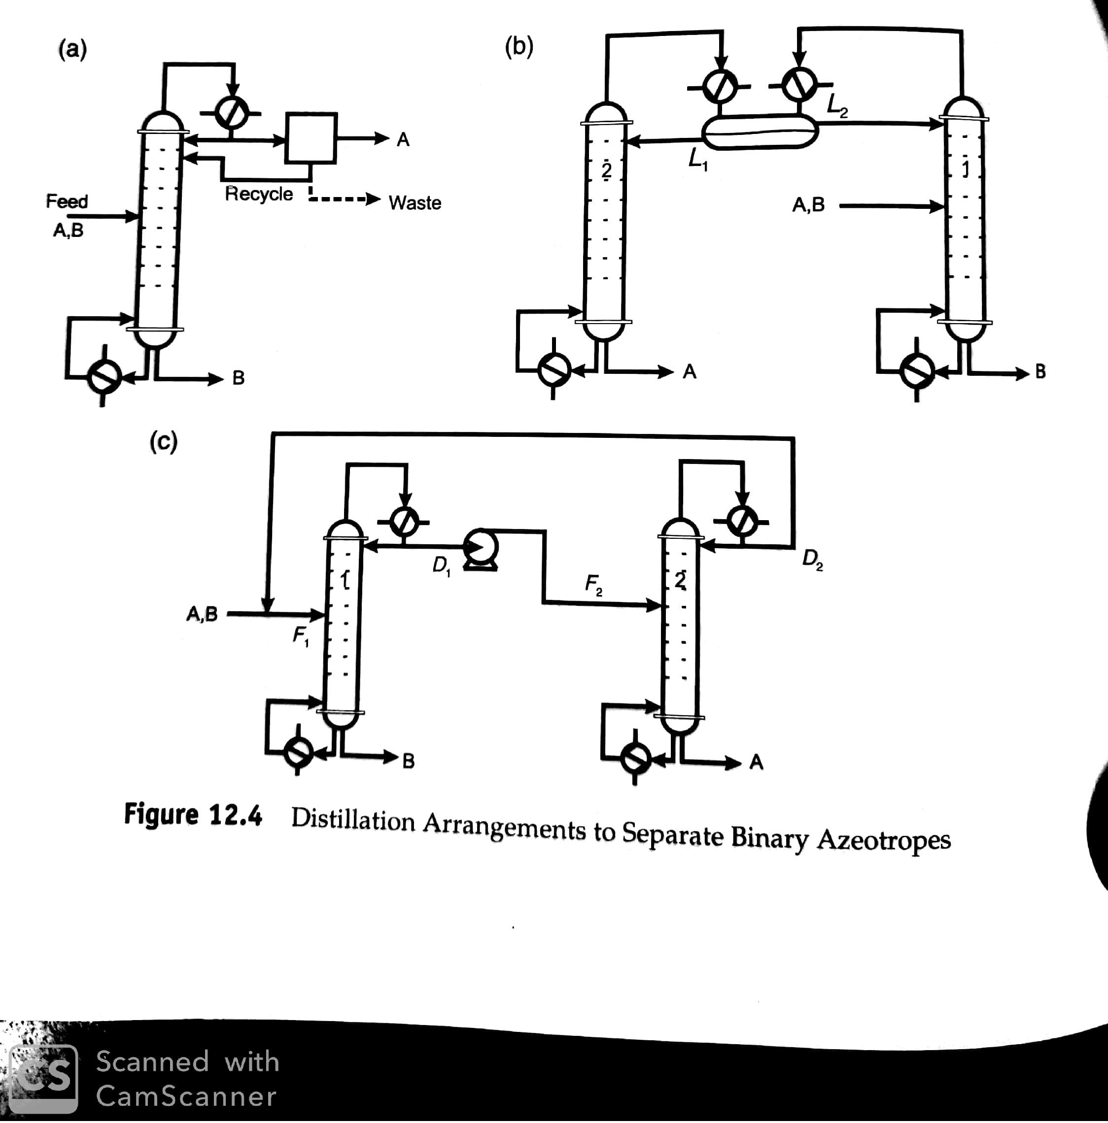
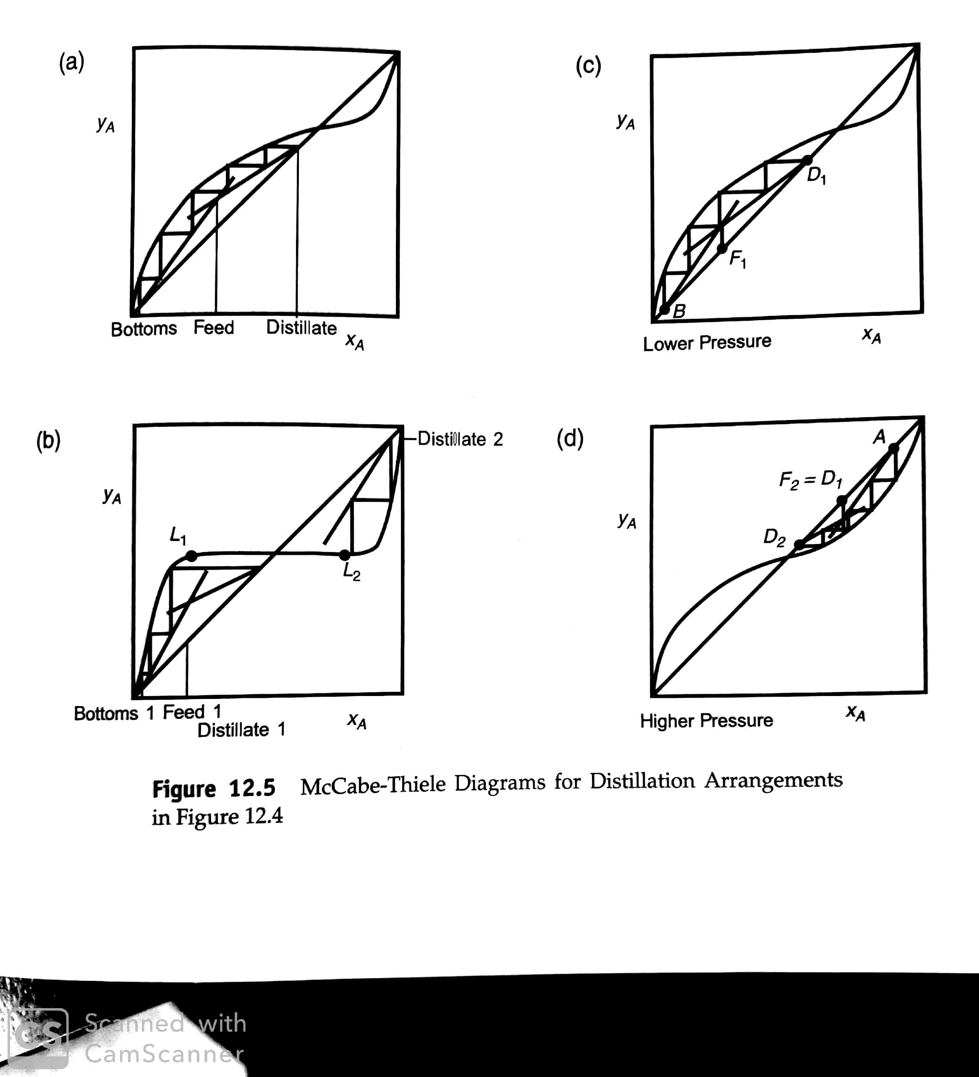
Azeotropes

Slide 11
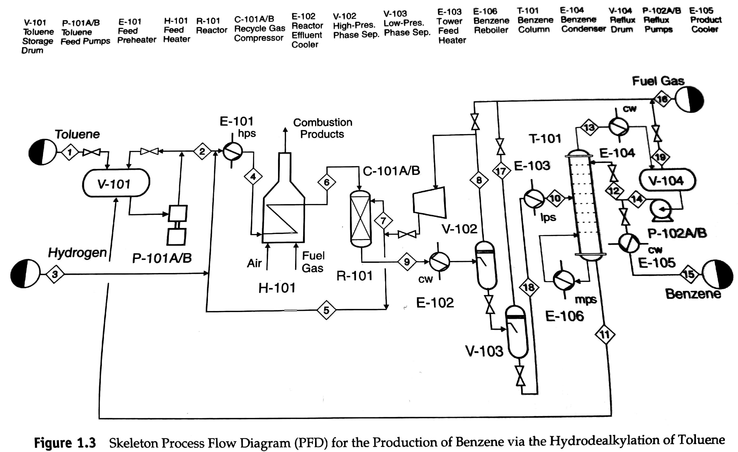
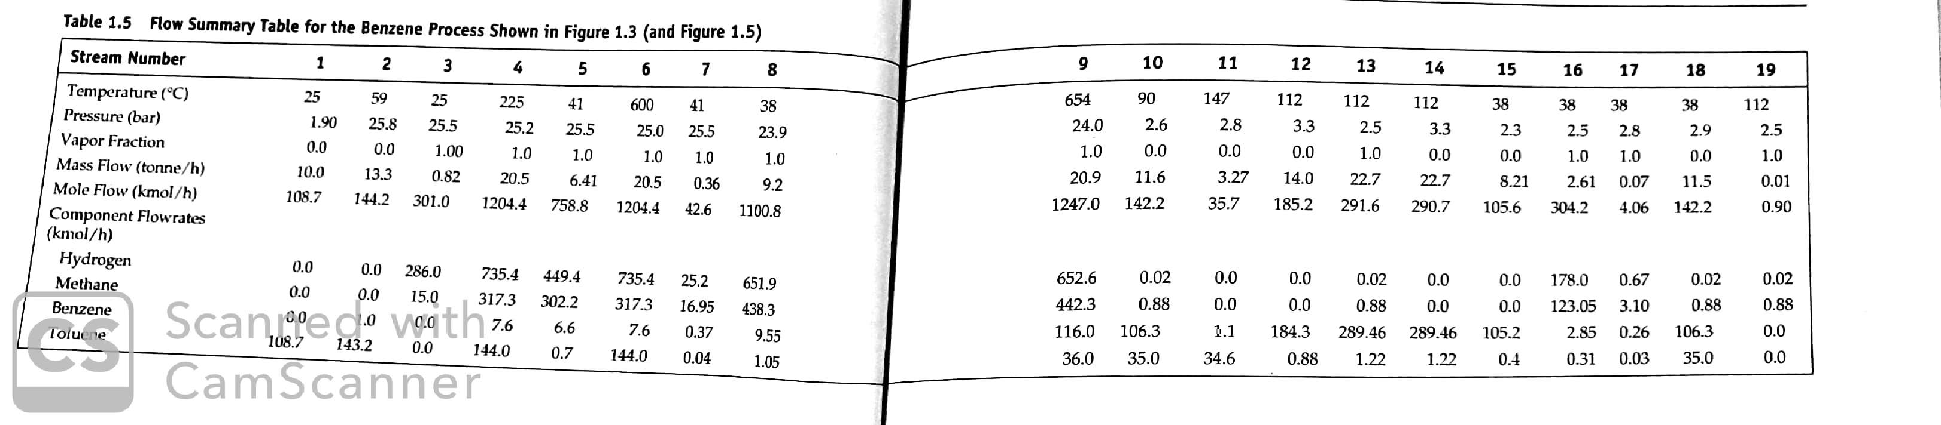
Separations for the HDA Process

Slide 12
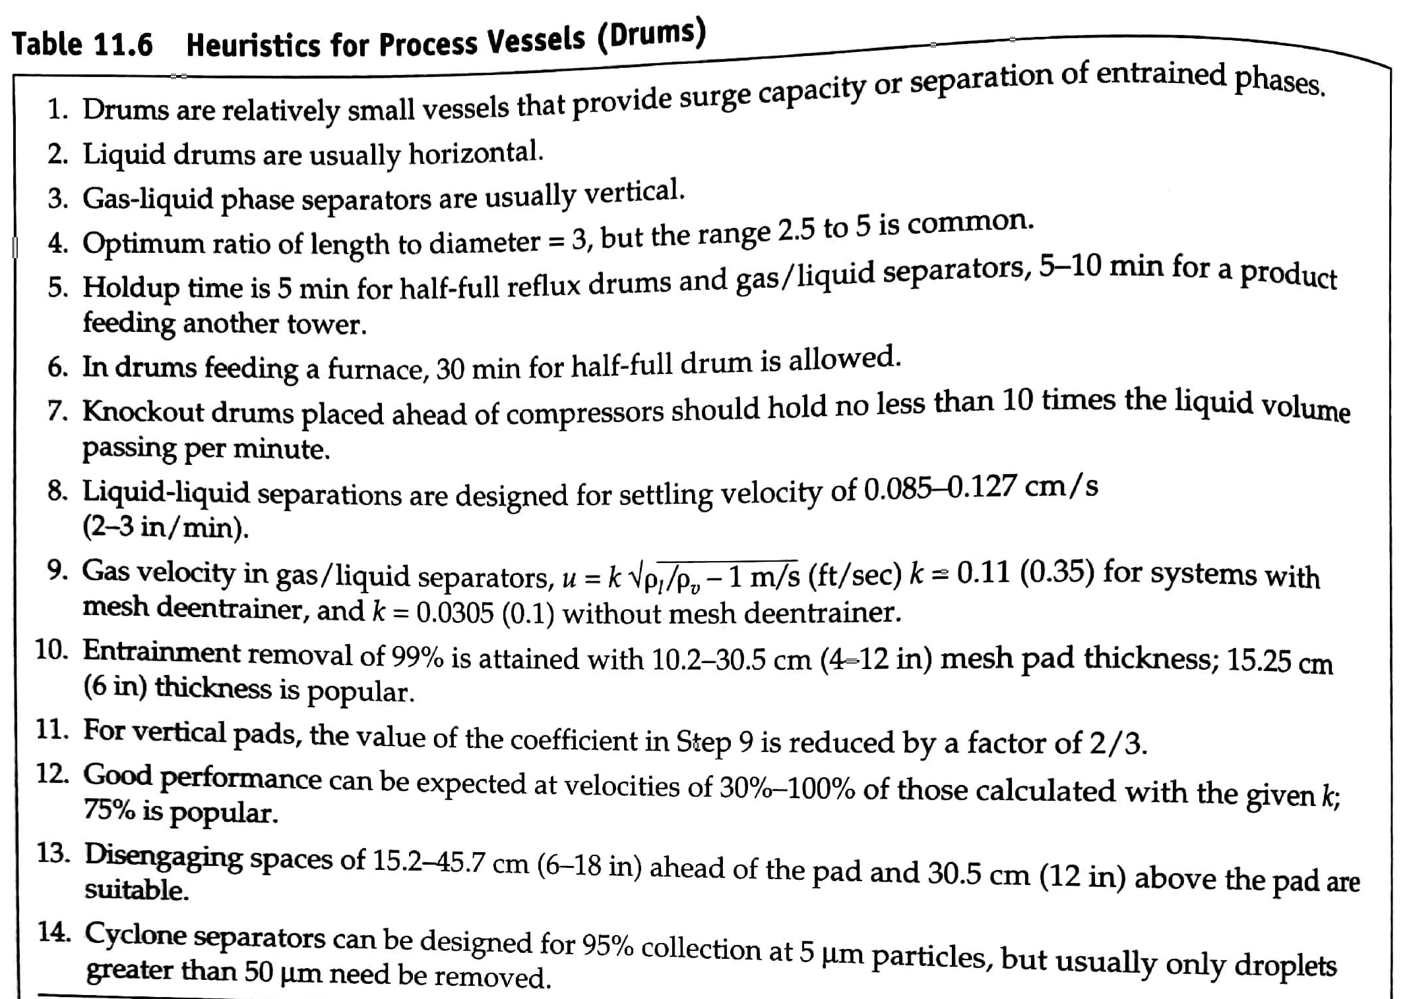
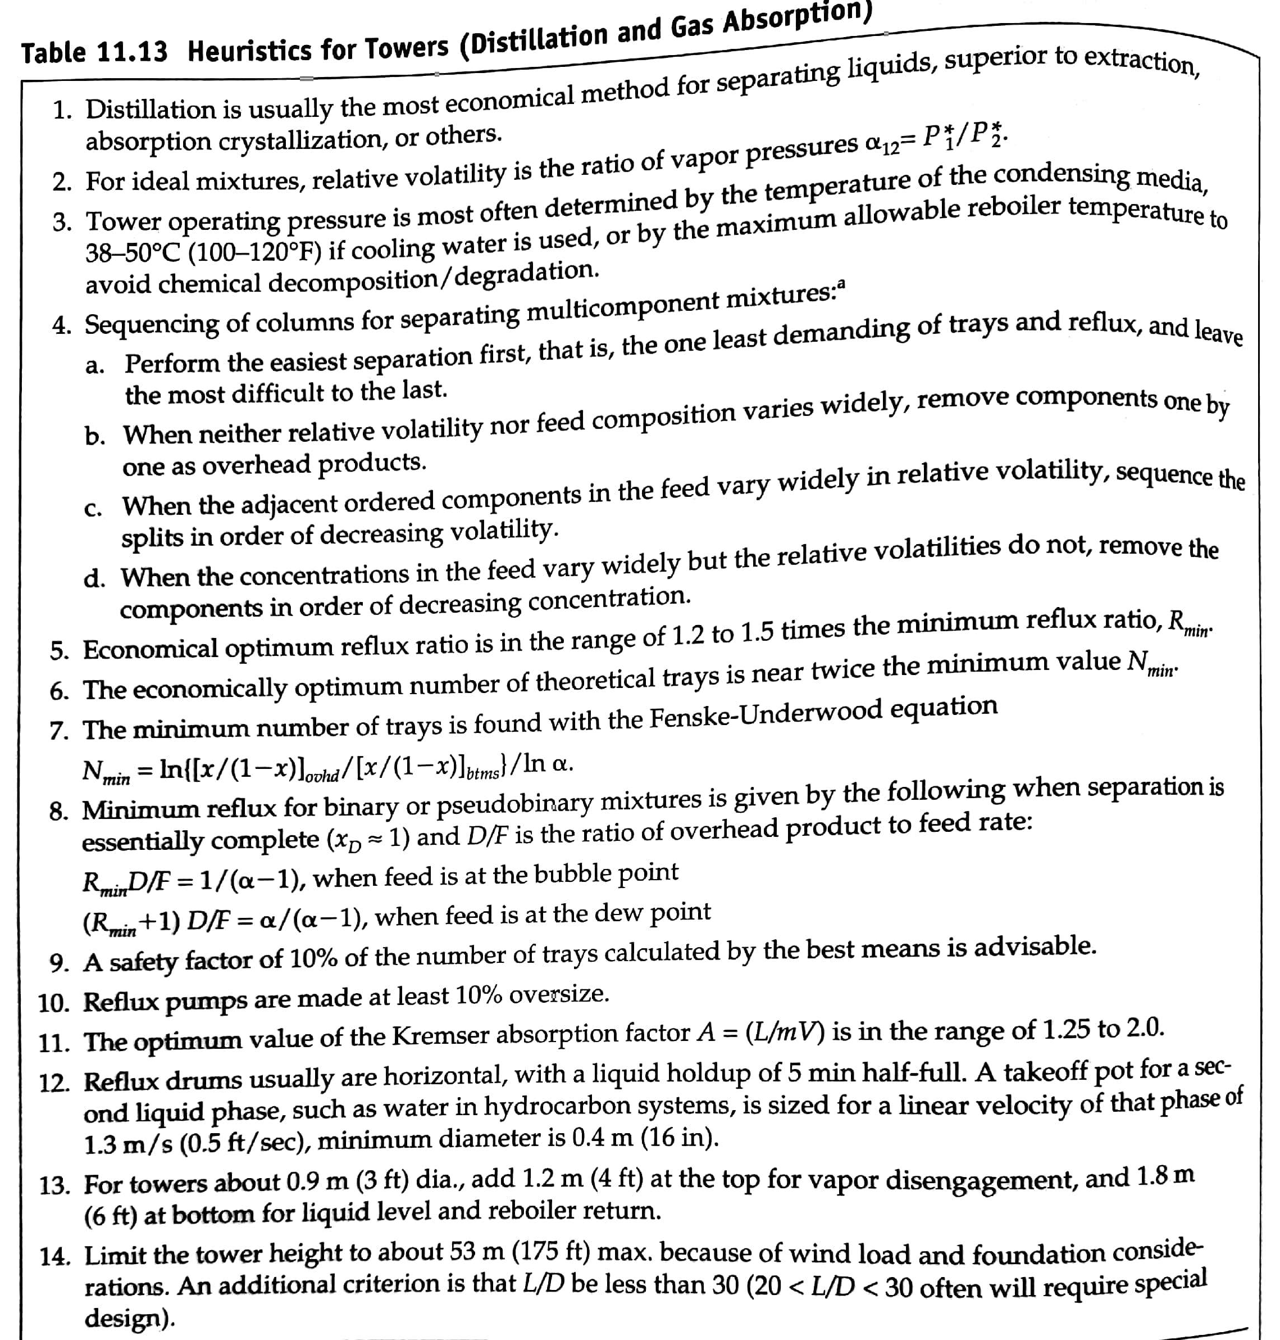
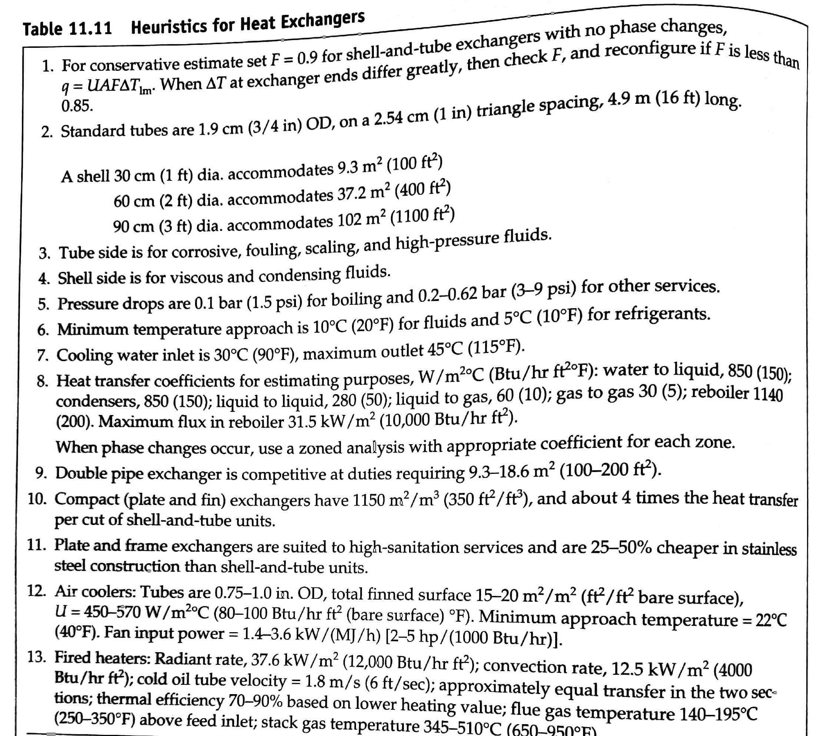
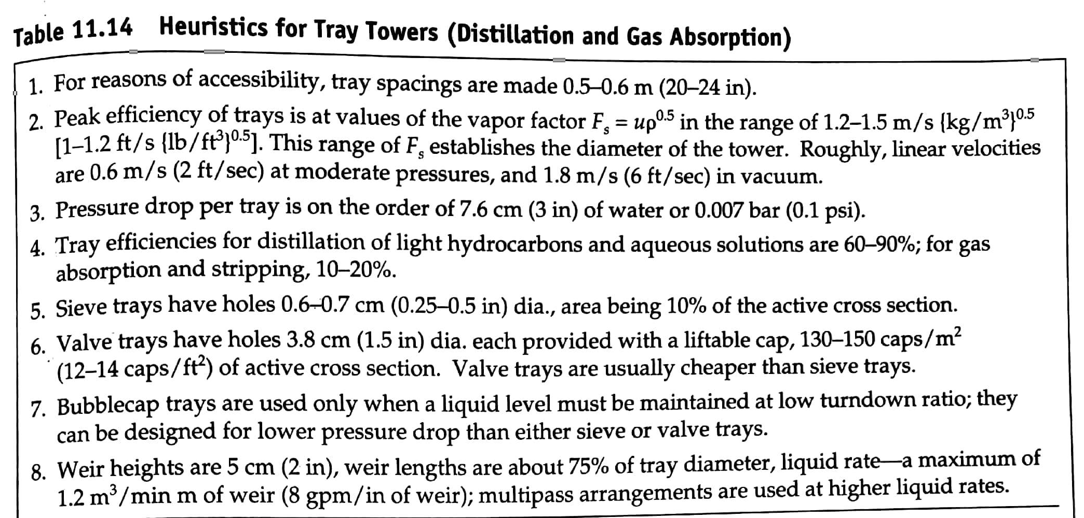
Additional Heuristics

Slide 13
Additional Heuristics
Use the design heuristics from C11 to size the following pieces of equipment:
V-102
E-105
T-101

Slide 14
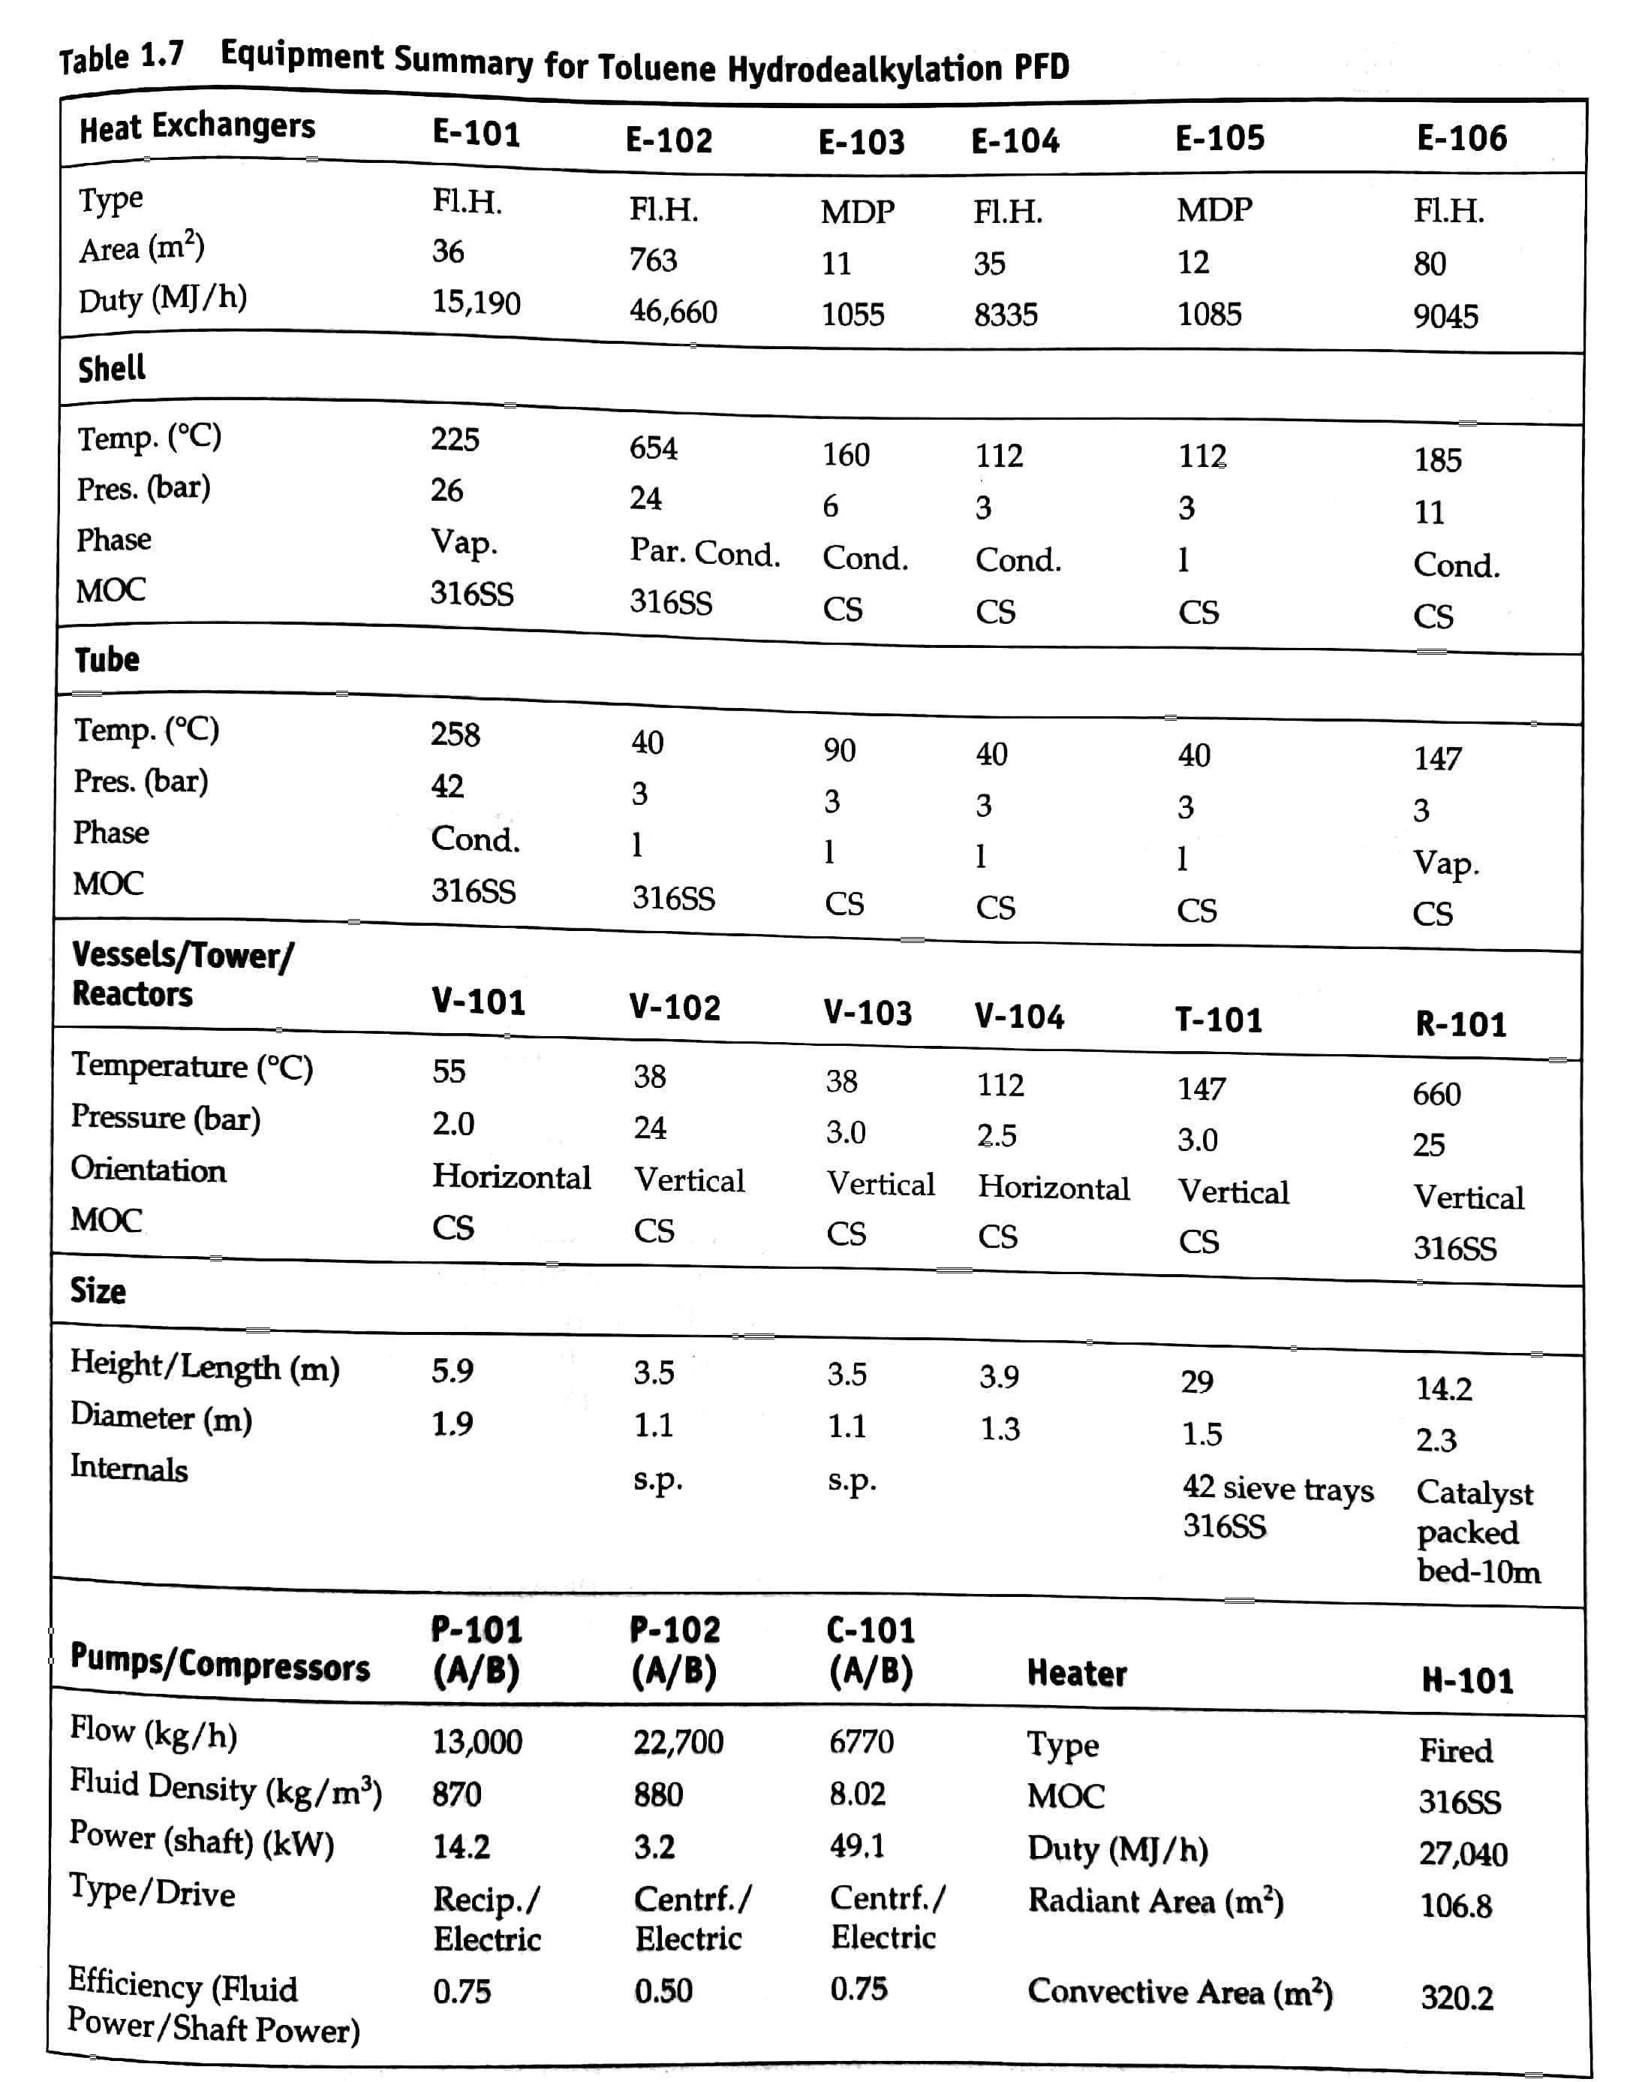
Additional Heuristics
Use the design heuristics from C11 to size the following pieces of equipment:
V-102
E-105
T-101

