Slide 1
ChemE 485: Process Design I
Lecture 6: Introduction to Aspen
Prof. Chad Curtis
Jan. 22, 2020

Slide 2
What you will learn
Process simulators are a key tool in the design of chemical processes.
All process simulators contain the same basic algorithms and require the same information, but have different user interfaces.
The correct choice of thermodynamics package is crucial for accurate simulations of chemical processes.
Simulation of highly non-ideal vapor-liquid equilibrium is supported by all process simulators.

Slide 3
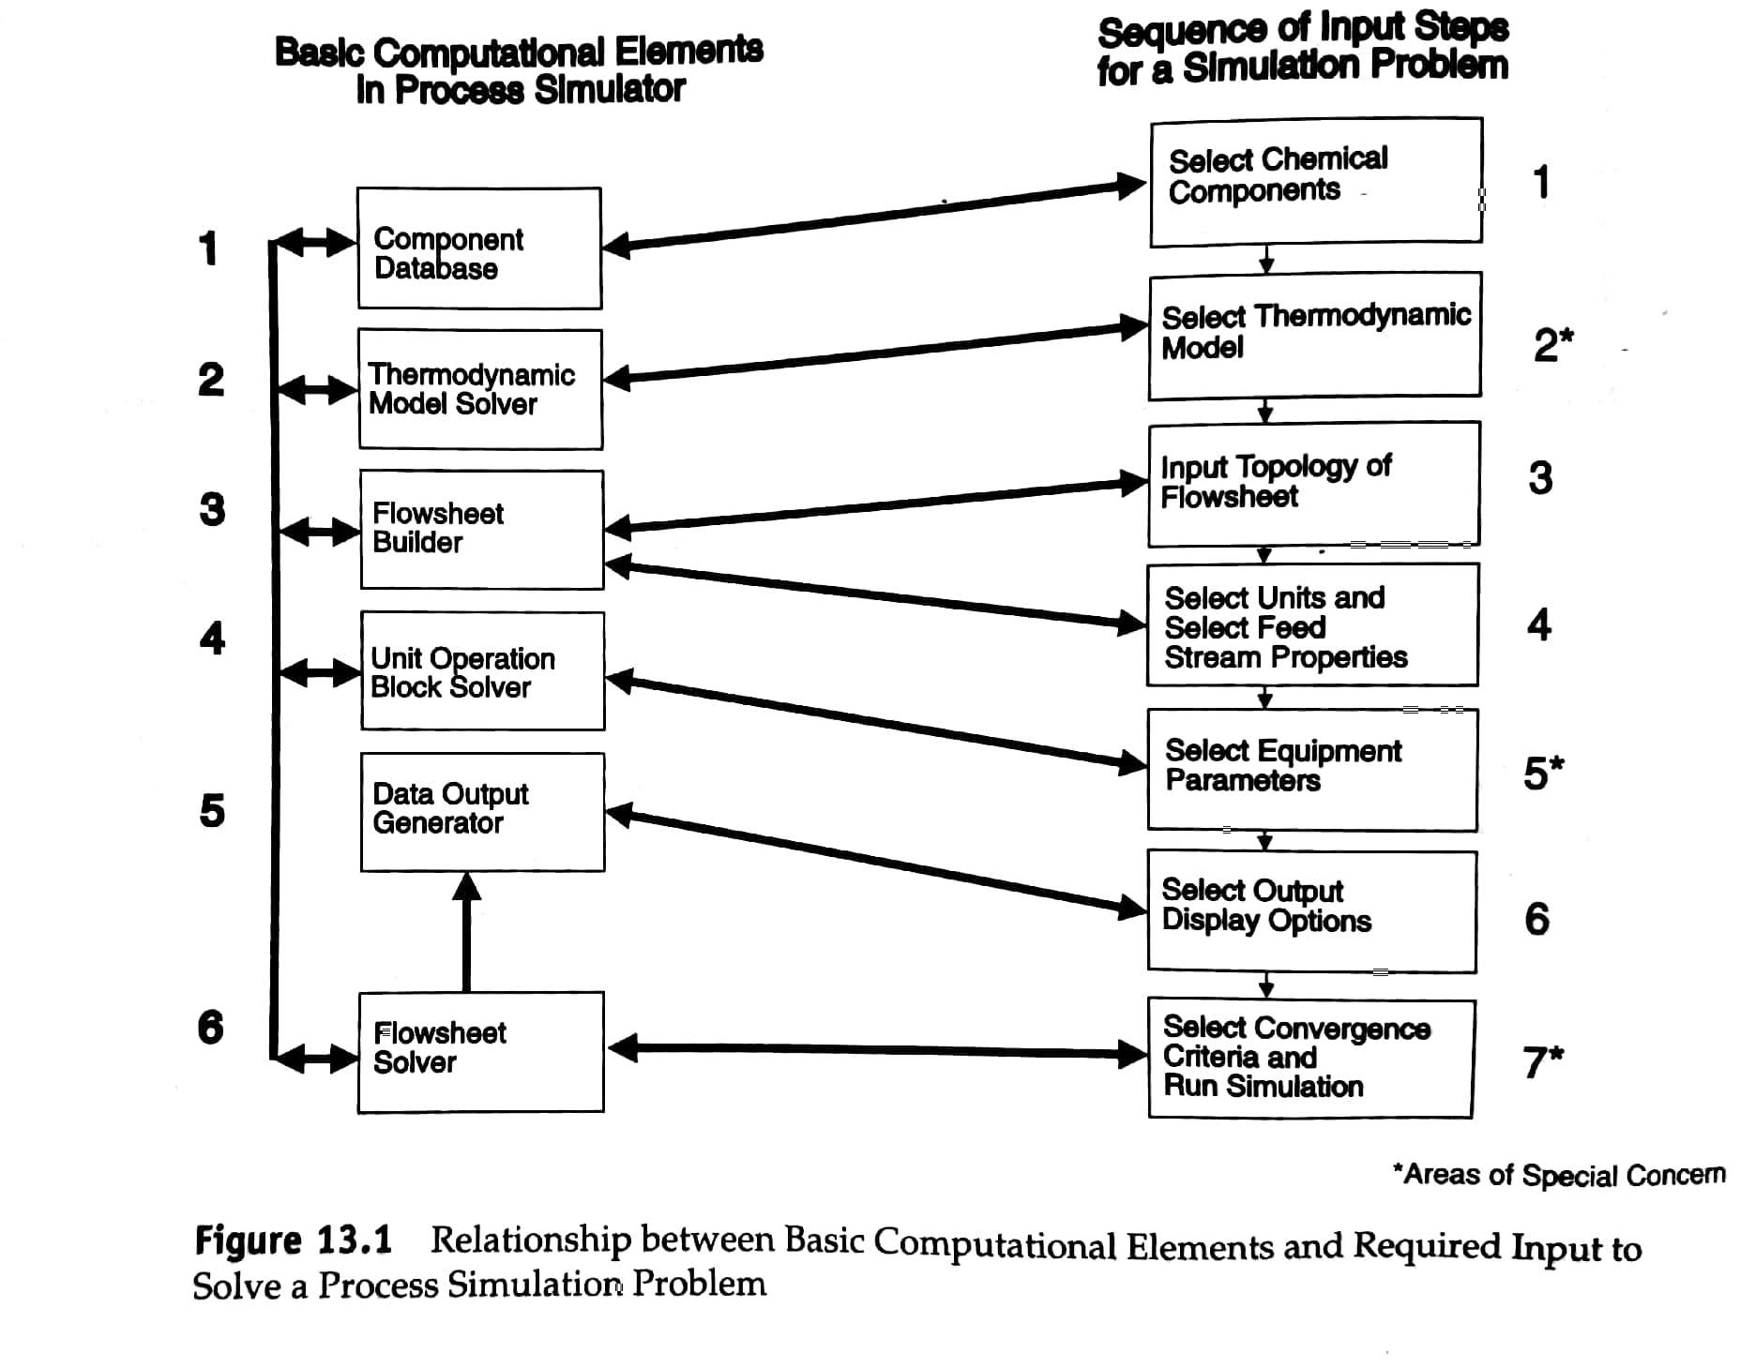
The structure of a process simulator

Slide 4
Warning
You are responsible for analyzing the results from the computer.

Slide 5
Selection of Chemical Components

Slide 6
Selection of Physical Property Models

Slide 7
Selection of Input and Flowsheet Topology

Slide 8
Selection of Feed Stream Properties

Slide 9
Selection of Equipment Parameters

Slide 10
Selection of Display Options

Slide 11
Selection of Convergence Criteria

Slide 12
Handling Recycle Streams

Slide 13
What is a heuristic?
A heuristic is an experience-based shortcut calculation method or guideline:
A heuristic does not guarantee a solution.
It may contradict other heuristics
It can reduce the time to solve a problem.
Its acceptance depends on the immediate context instead of an absolute standard.

Slide 14
An example
You are given an assignment that involves writing a report that is to be completed and presented in two weeks. You work diligently and feel confident you have come up with a respectable solution. You present the written report personally to your director, who asks you to summarize only your final conclusions. Immediately after you provide this information, your boss declares that “your results must be wrong” and returns your report unopened and unread.
You return to your desk angry. Your comprehensive and well-written report was not even opened and read. Your boss did not tell you what was wrong, and you did not receive any “partial credit” for all your work. After a while, you cool off and review your report. You find that you had made a “simple” error, causing your answer to be off by an order of magnitude. You correct the error and turn in a revised report.
What remains is the nagging question, “How could your boss know you made an error without having reviewed your report or asked any questions?”

Slide 15
An example
Before submitting your report, you apply a heuristic that highlights an inconsistency in your initial results. You then review your calculations, find the error, and make corrections before submitting your report. Consider two possible responses:
Your boss accepts the report and notes that the report appears to be excellent and he/she looks forward to reading it.
Your boss expresses concern and returns the report as before. In this case, you have a reasoned response available. You show that your solution is consistent with the heuristic you used to check your work. With this supporting evidence your boss would have to rethink his/her response and provide you with an explanation regarding his/her concern.
In either case, your work will have made a good impression.

Slide 16
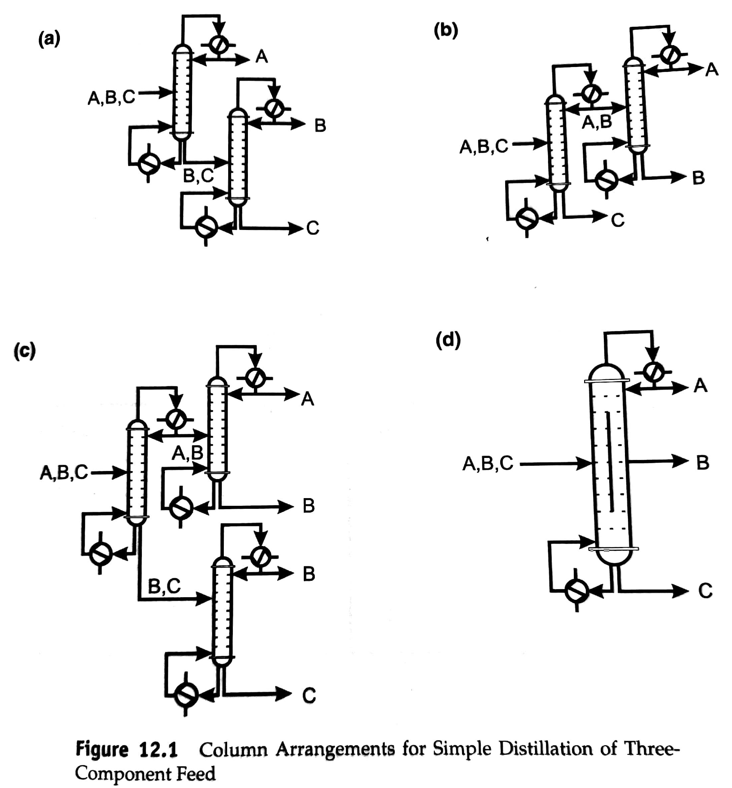
Considerations for the Separation Section
Separator goals:
A product of acceptable purity
A recycle stream of unreacted feed materials
Stream(s) of by-products
Questions to ask:
What type of units to use?
How should these units be sequenced?
Heuristic 1:
A stream with N components will require at least N-1 separation units.

Slide 17
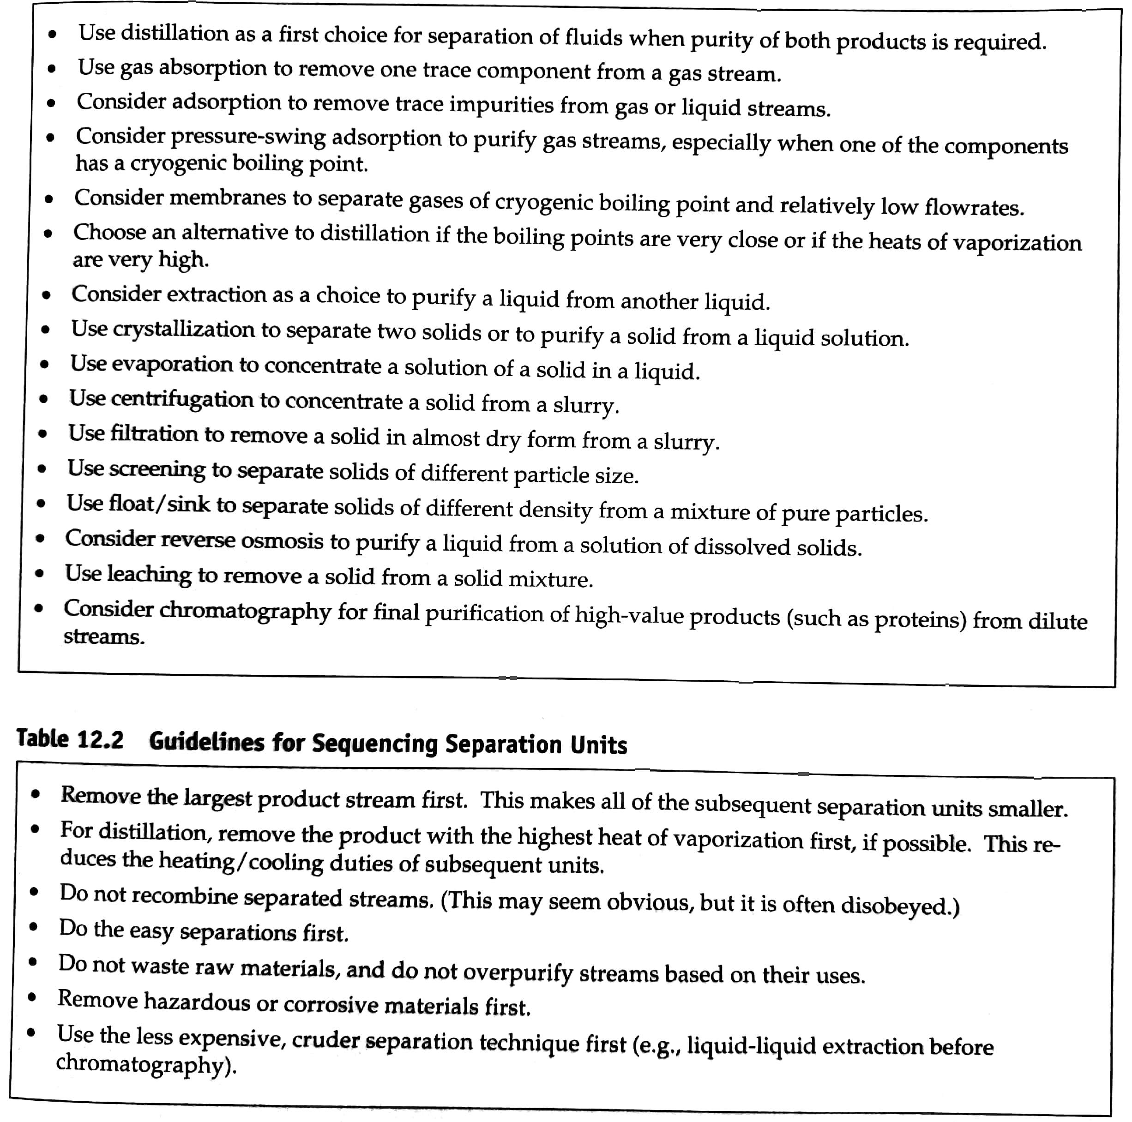
Separation Heuristics

Slide 18
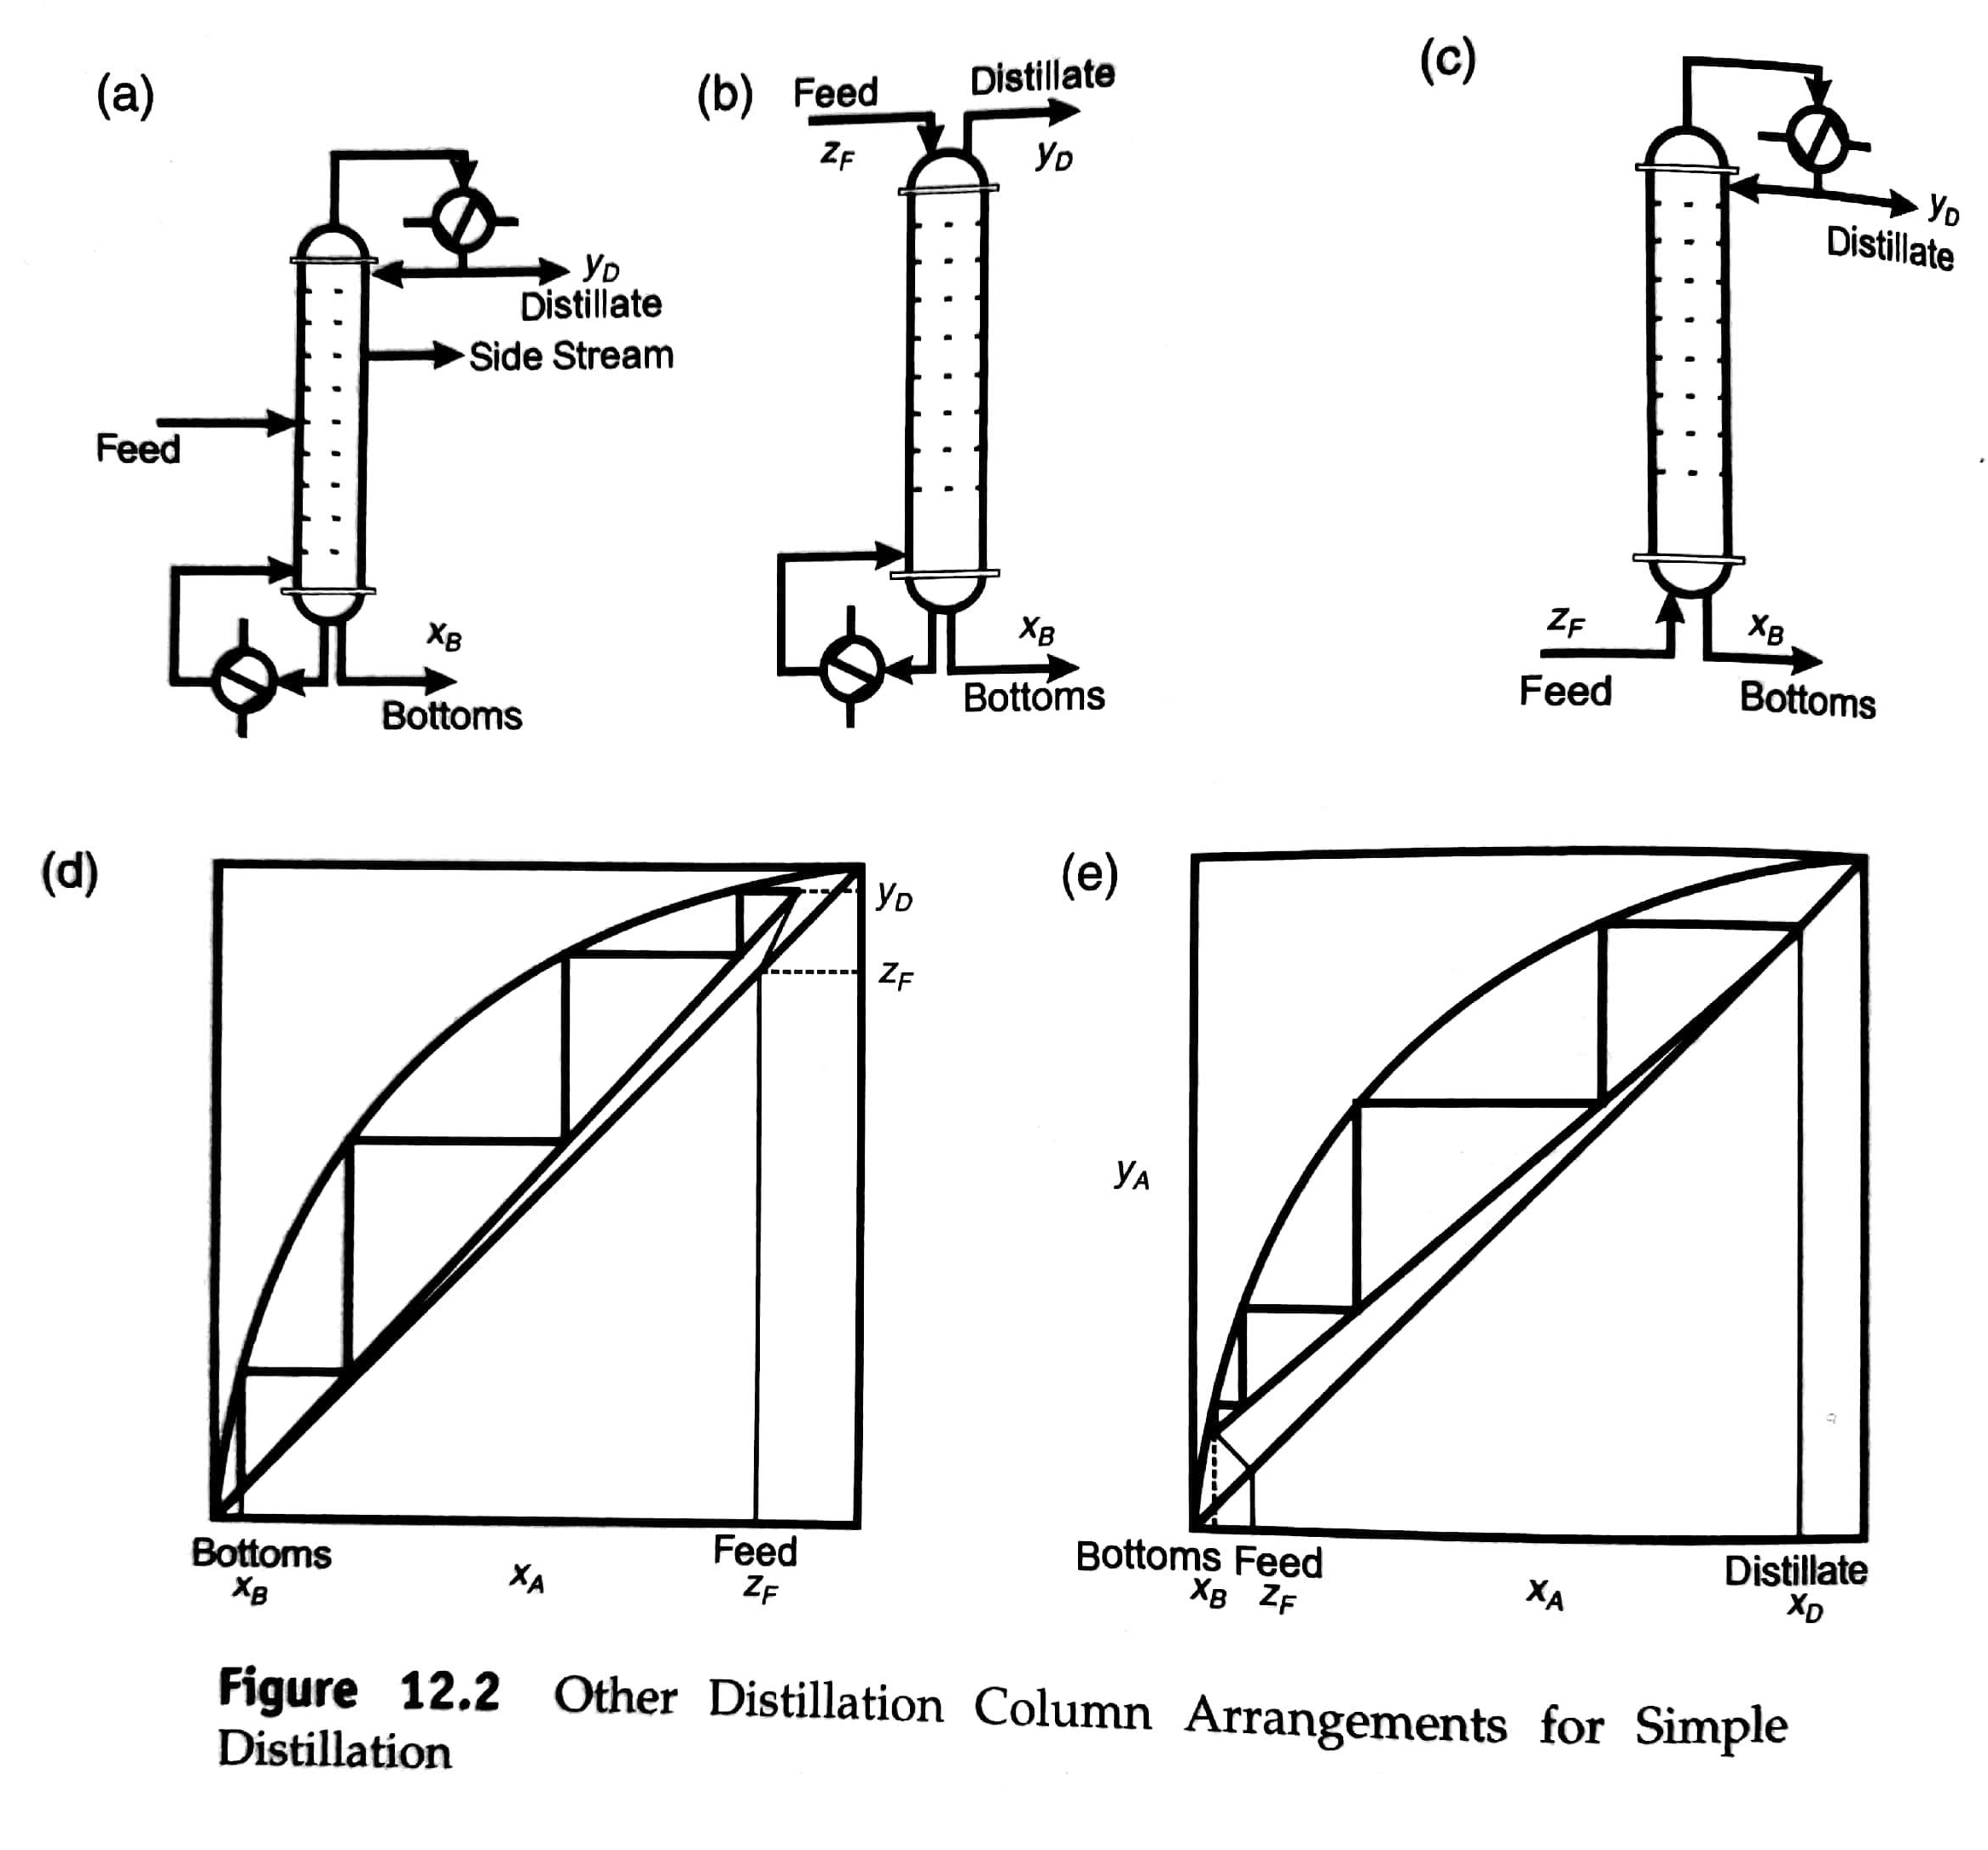
Alternate separations units
Use side streams when a mixed product is desired.
Use a stripping column when the light components are very dilute and need not be purified.
Use a rectifying column when the heavy components are dilute and need not be purified.

Slide 19
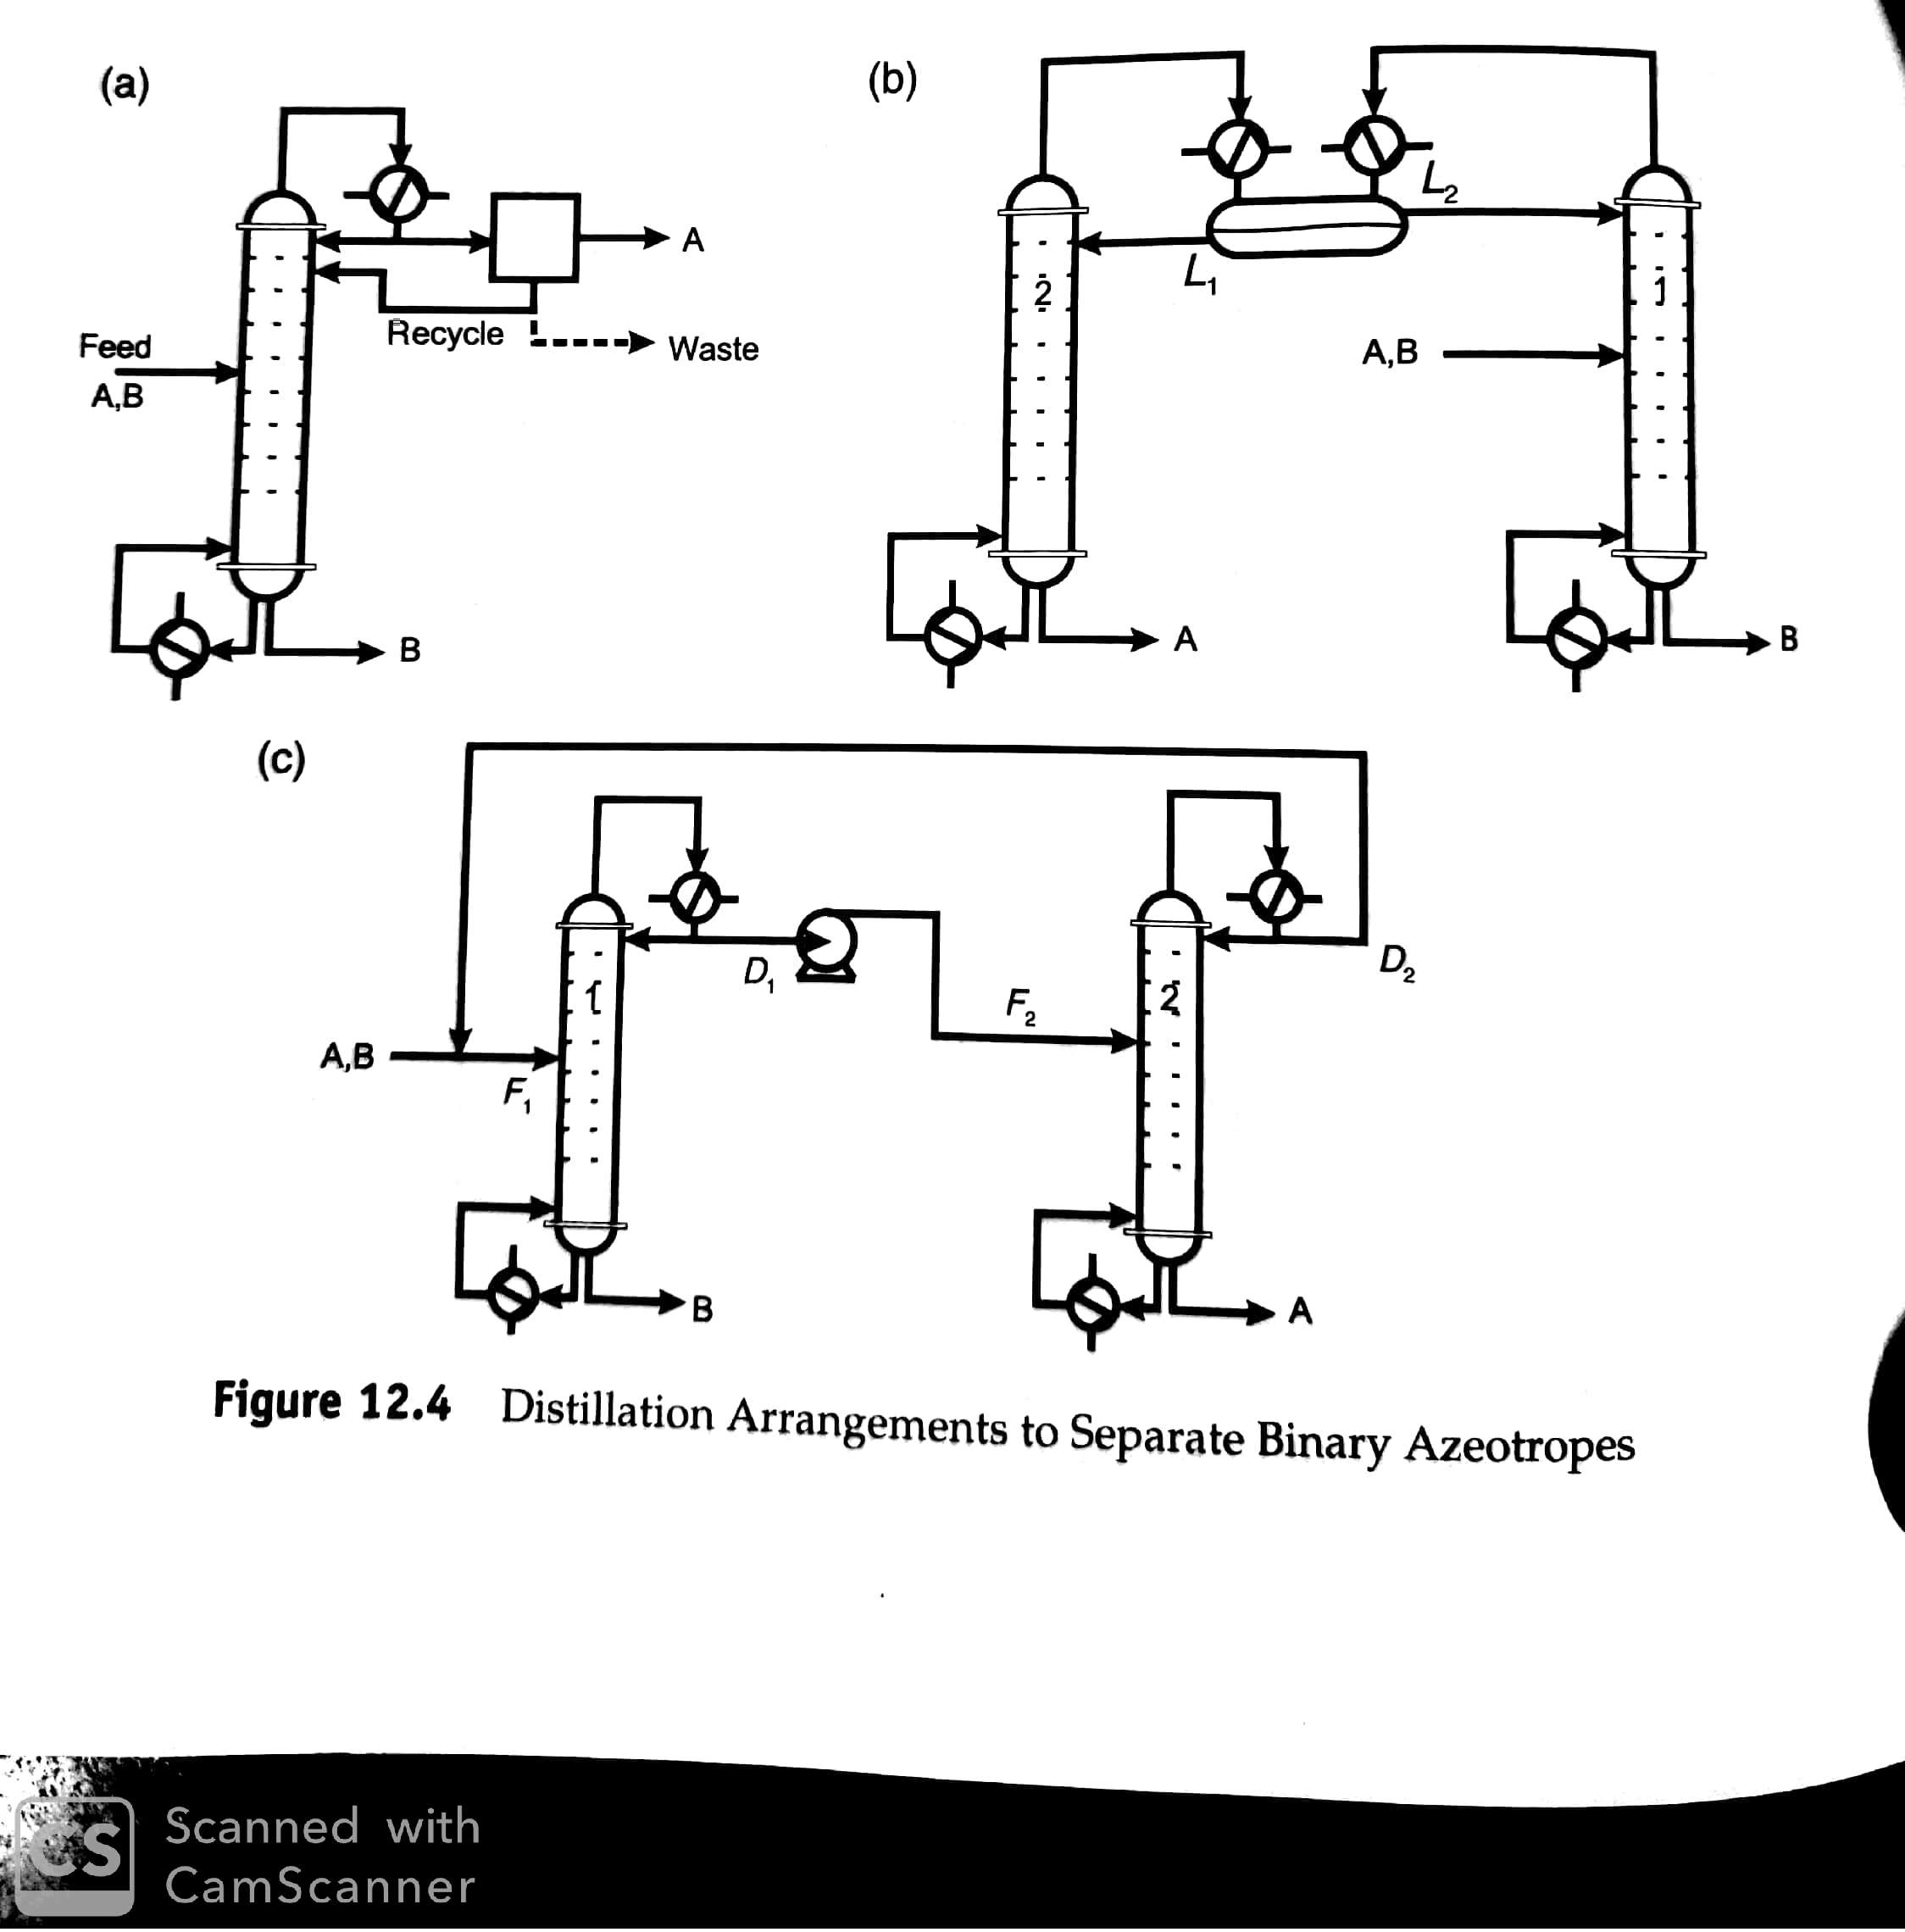
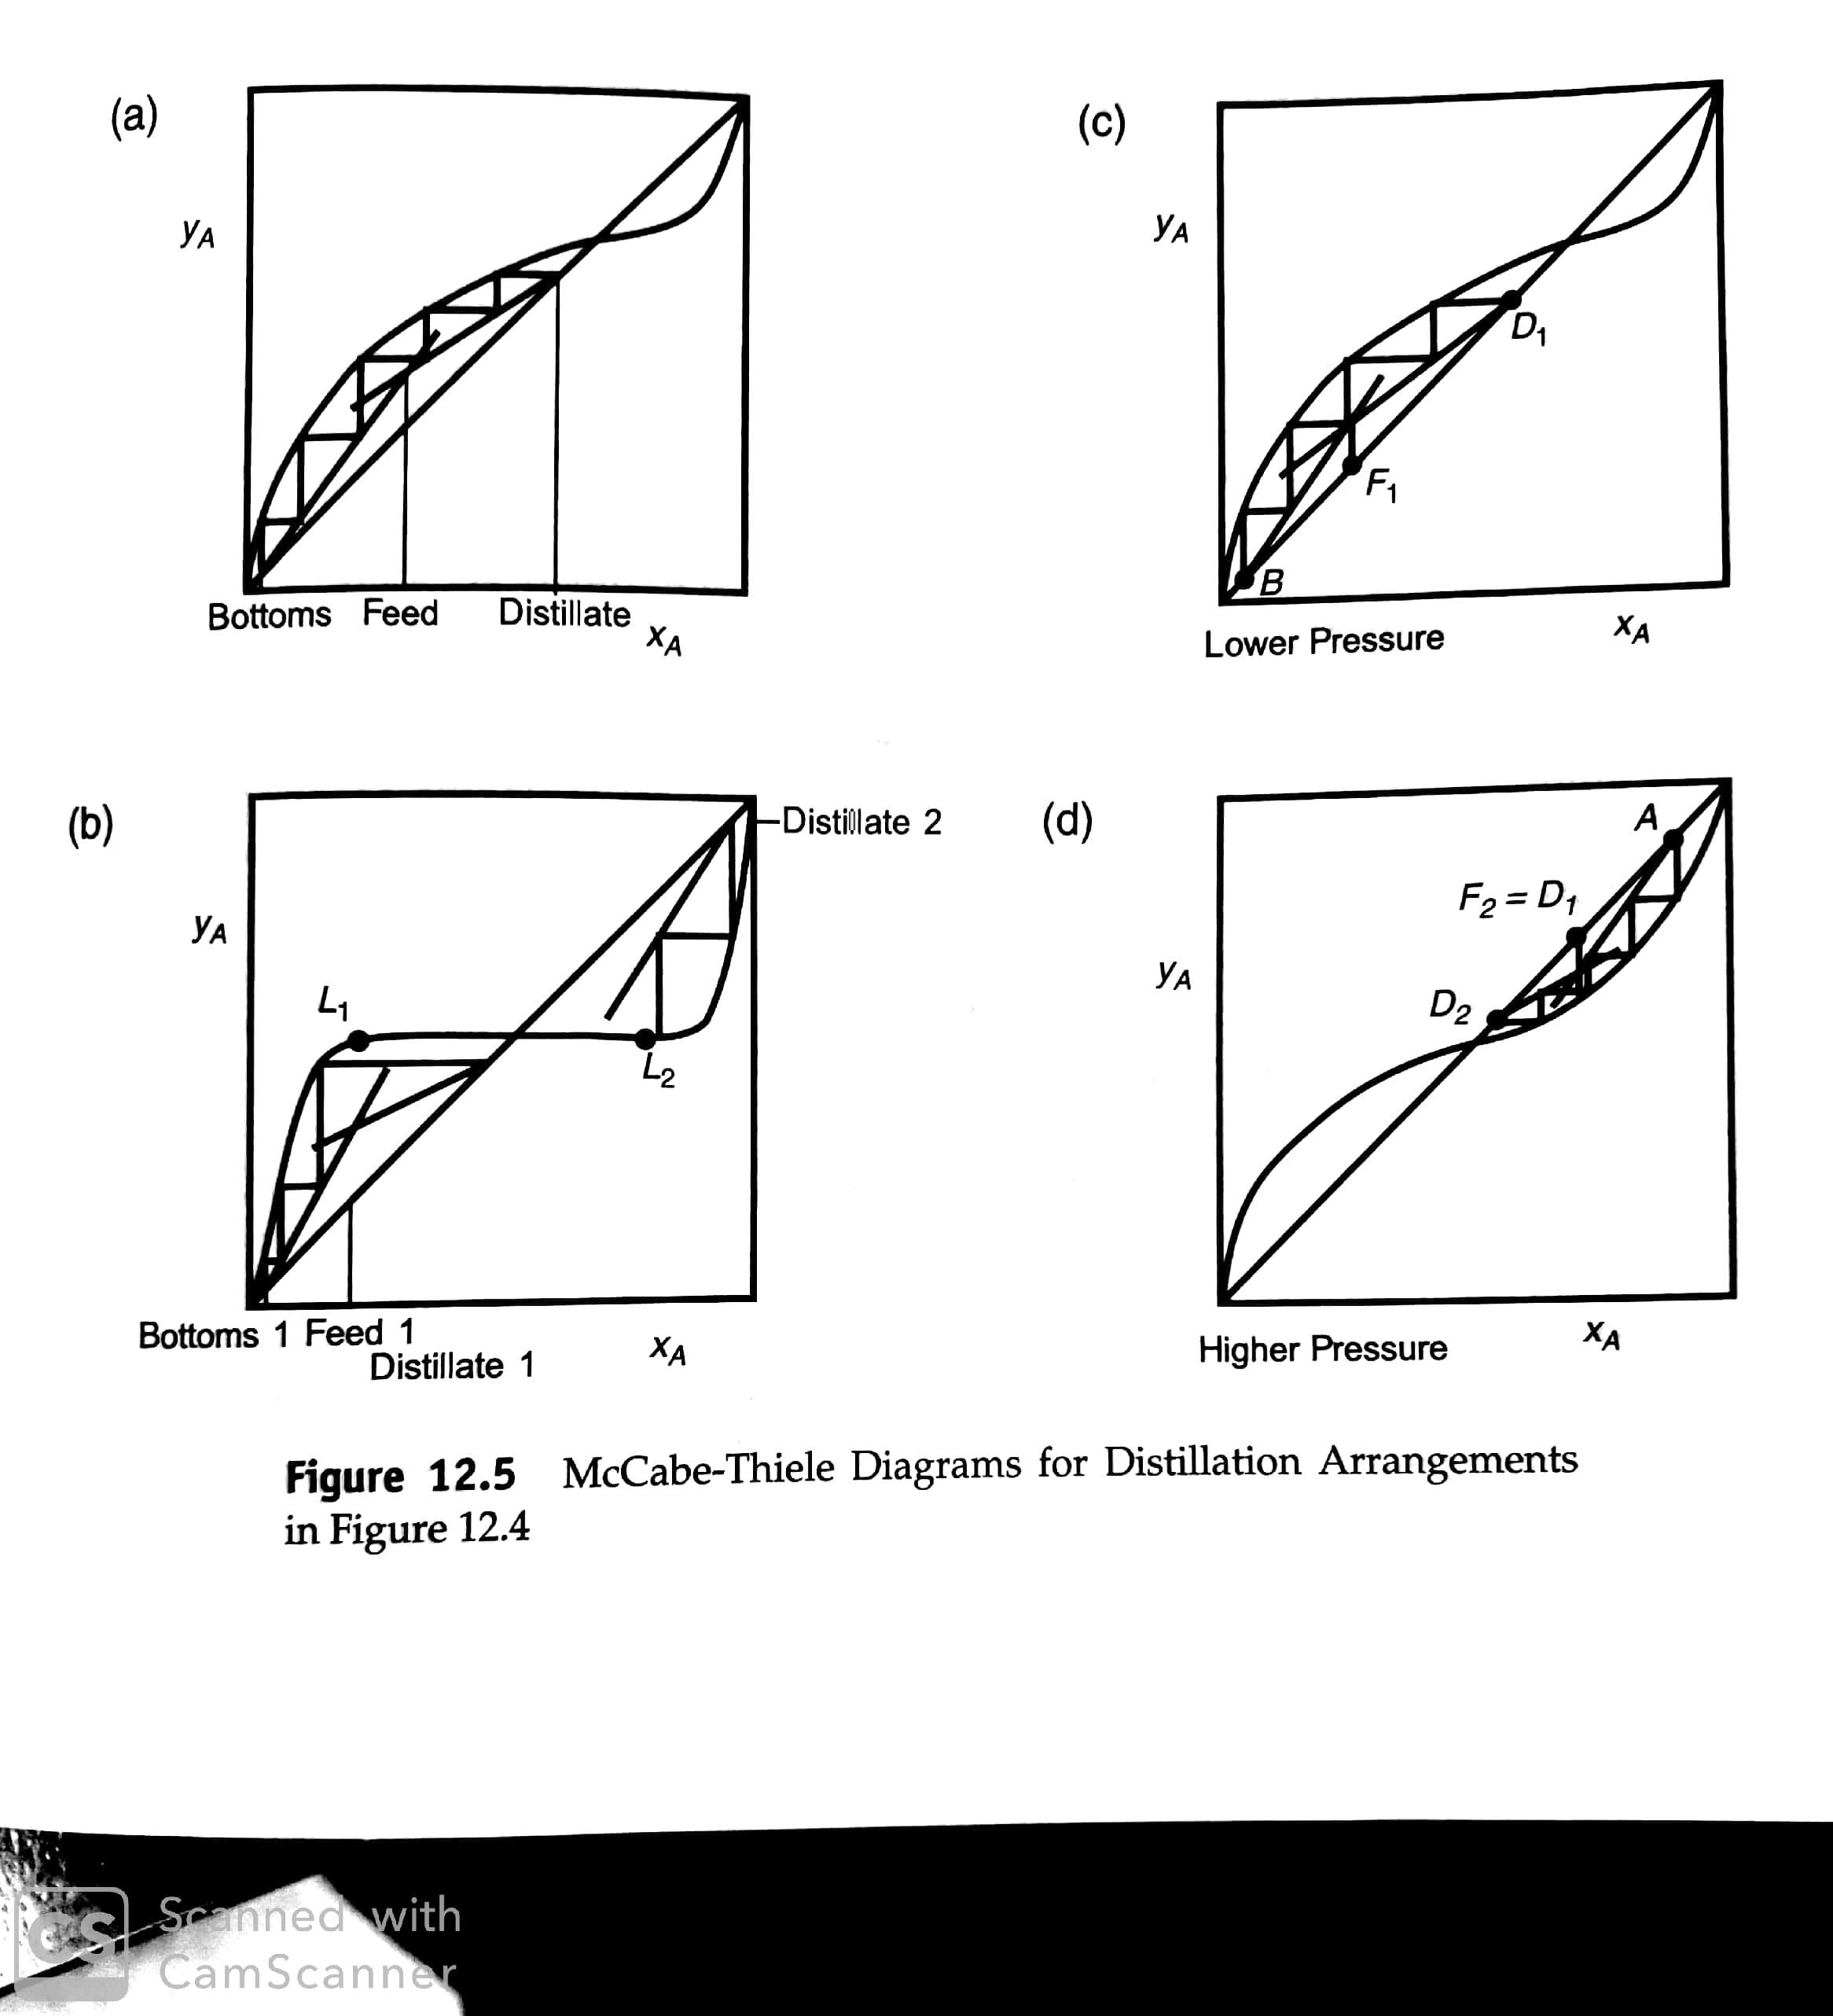
Azeotropes

Slide 20
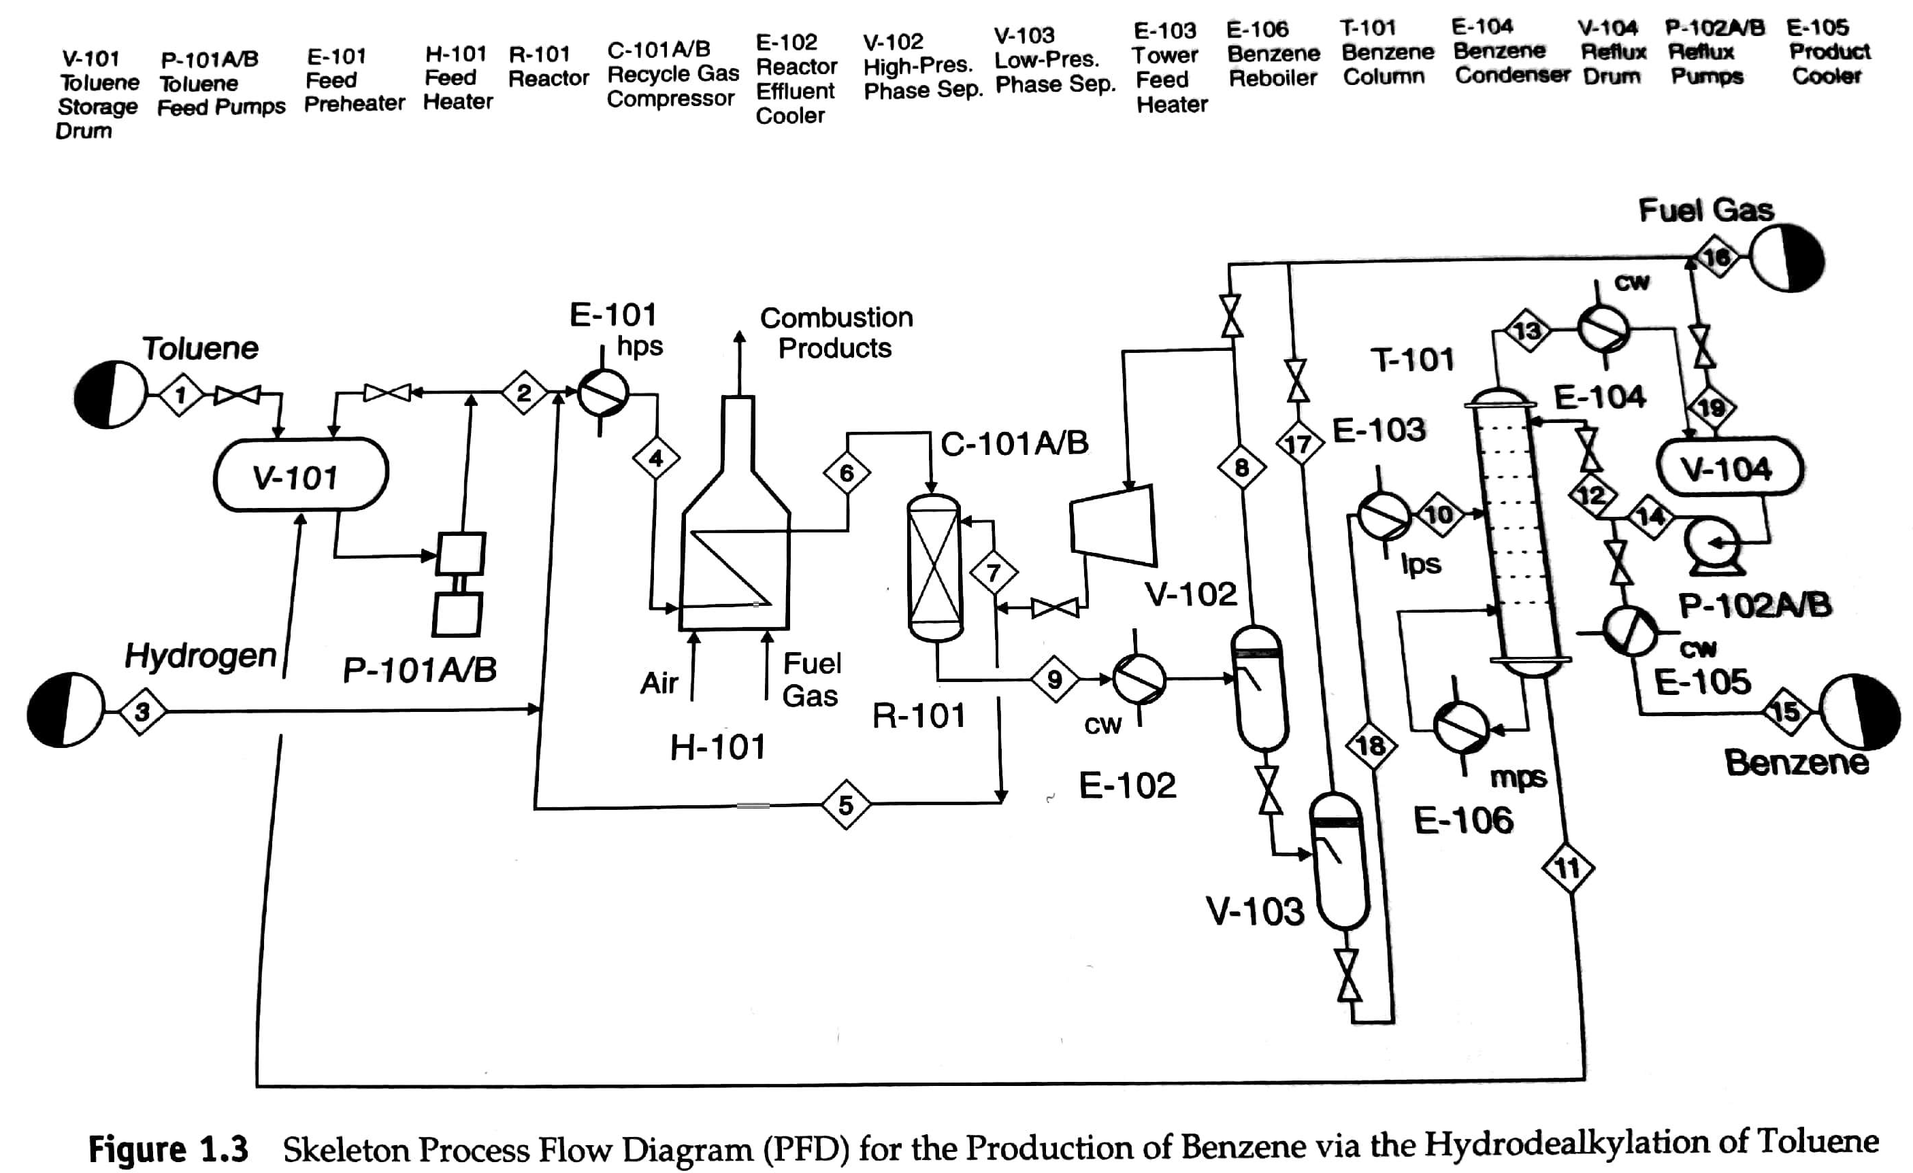
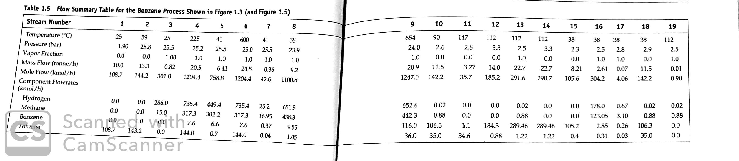
Separations for the HDA Process

Slide 21
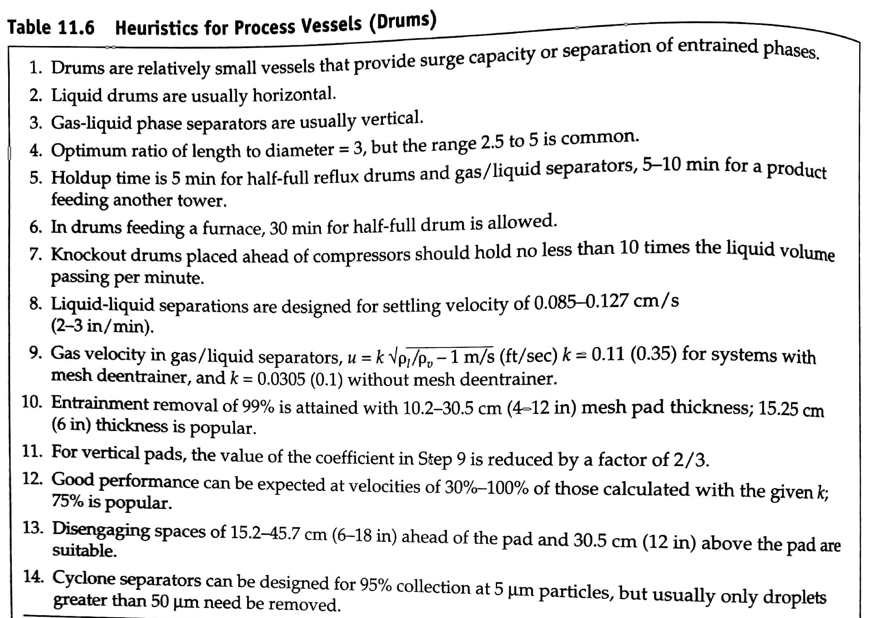
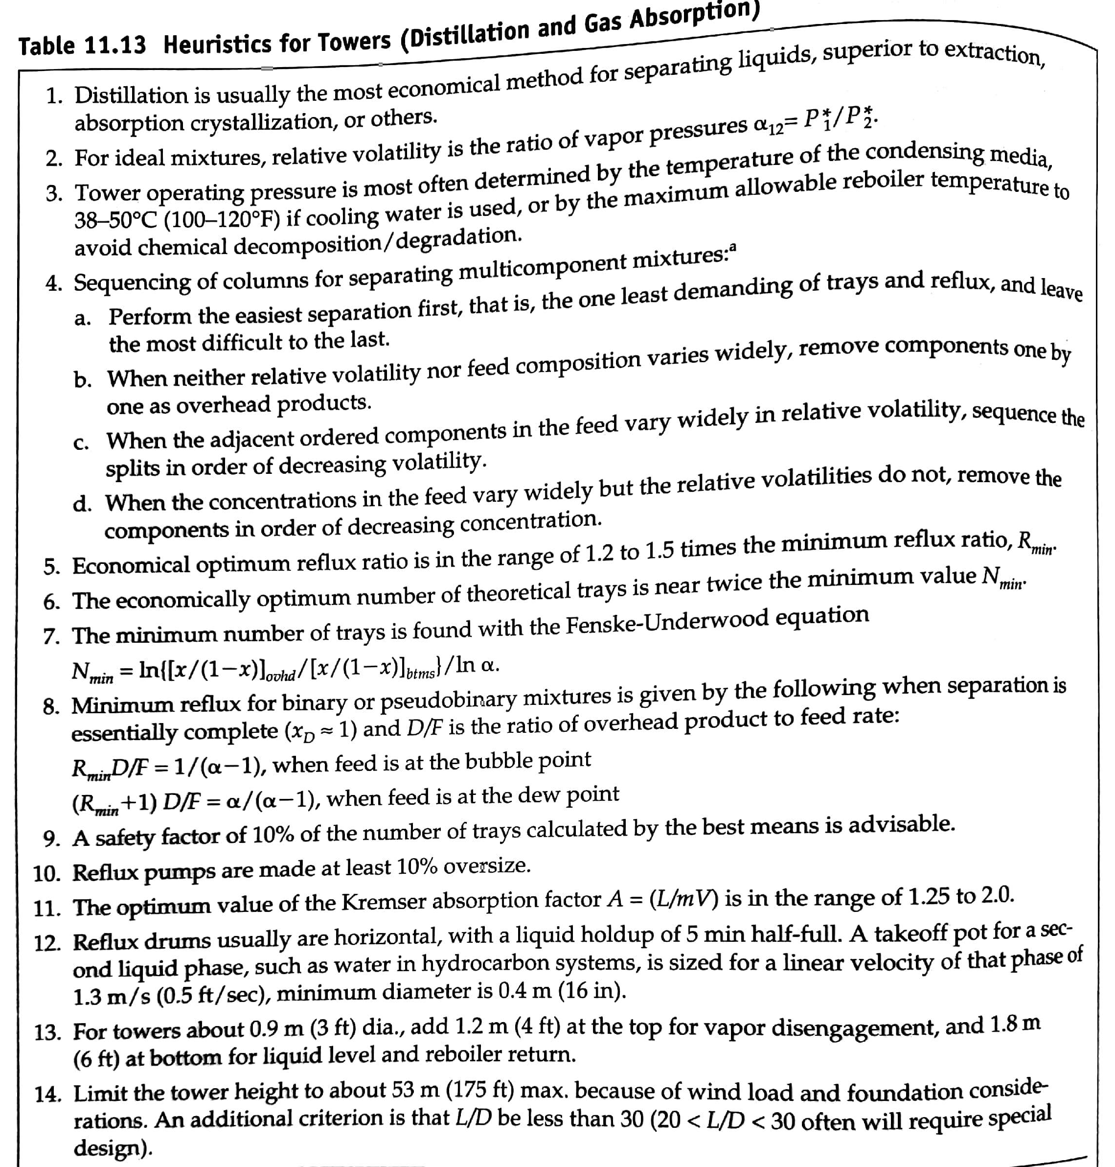
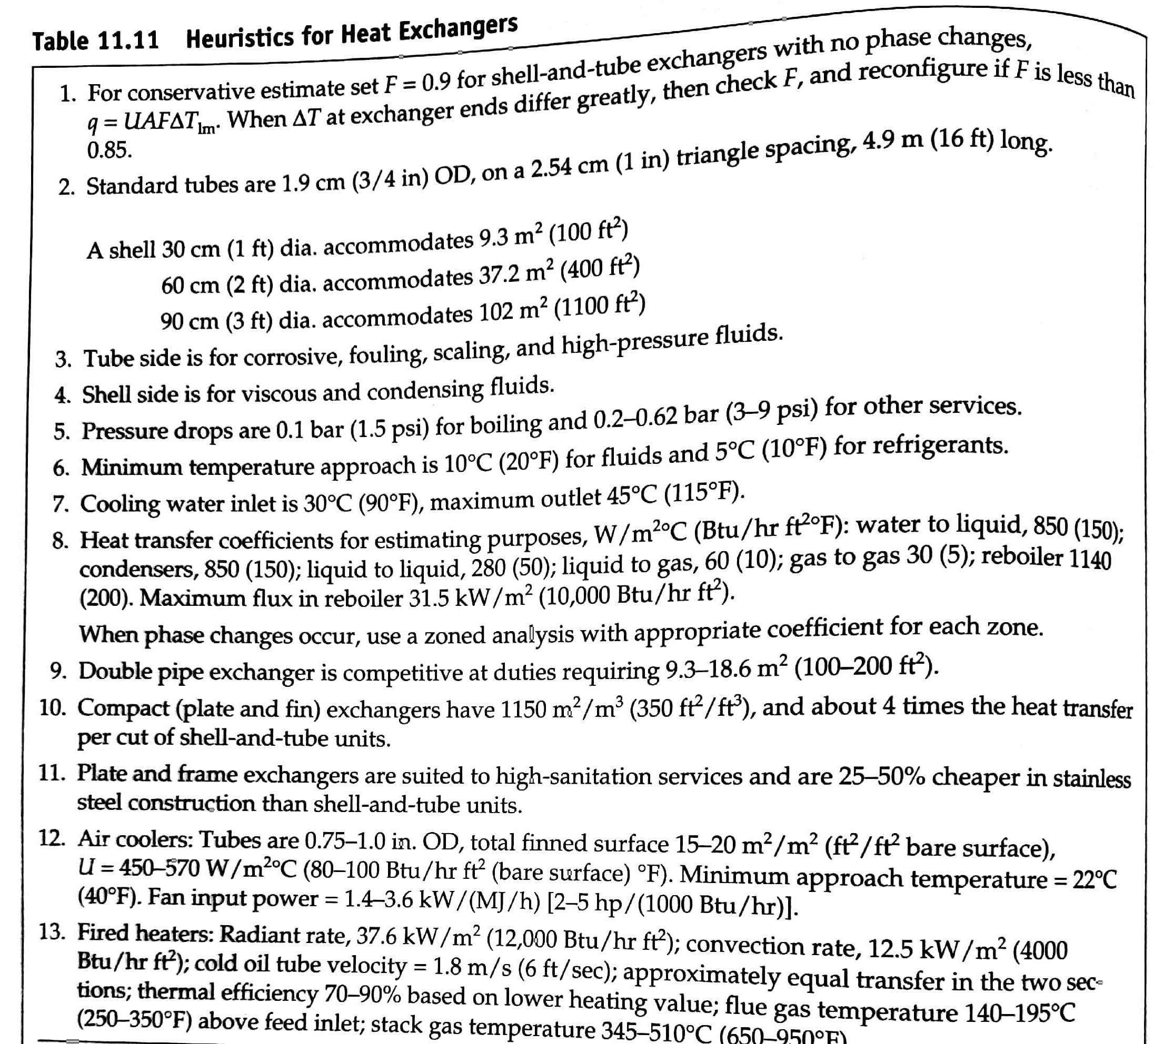
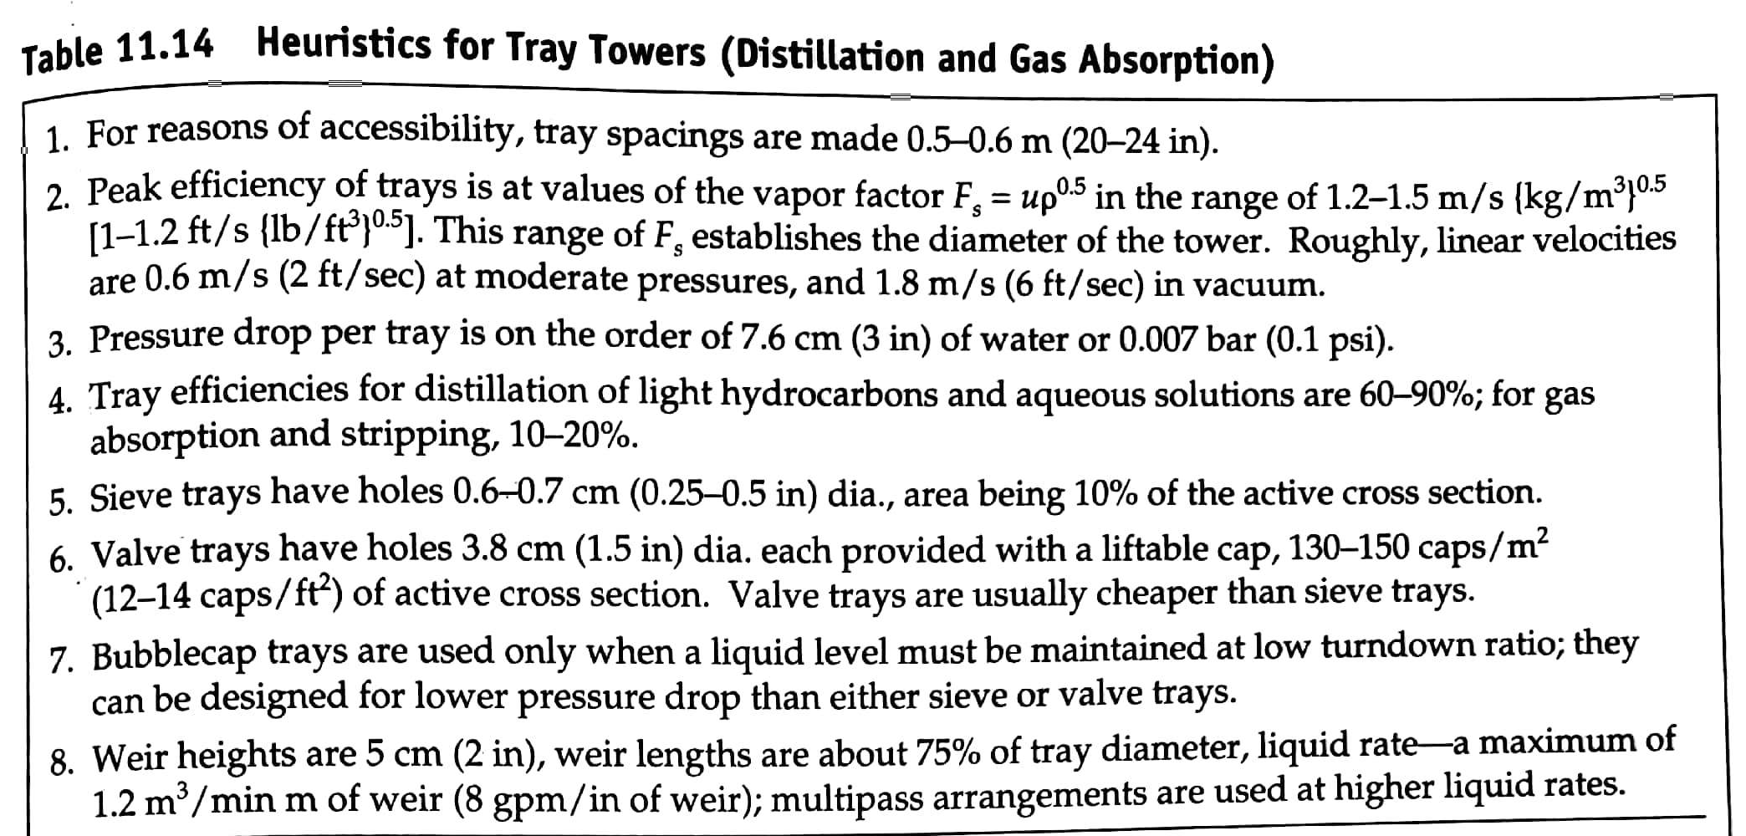
Additional Heuristics

Slide 22
Additional Heuristics
Use the design heuristics from C11 to size the following pieces of equipment:
V-102
E-105
T-101

Slide 23
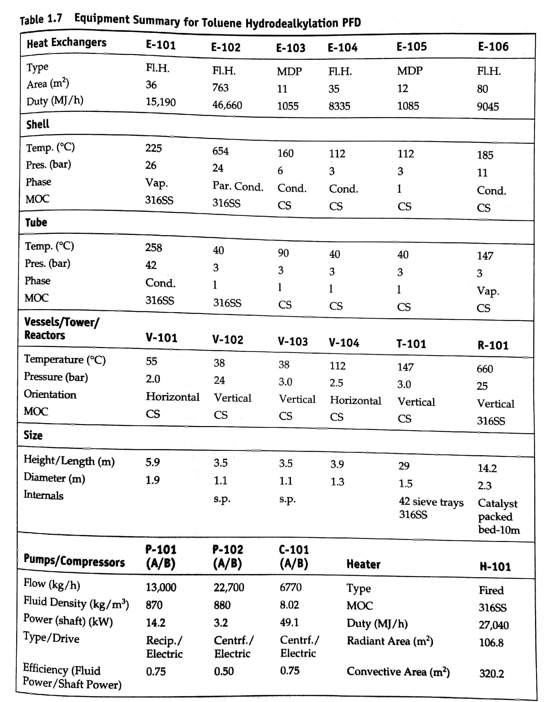
Additional Heuristics
Use the design heuristics from C11 to size the following pieces of equipment:
V-102
E-105
T-101

