Slide 1
ChemE 485: Process Design I
Lecture 1: Course Overview
Prof. Chad Curtis
Jan. 6, 2020

Slide 2
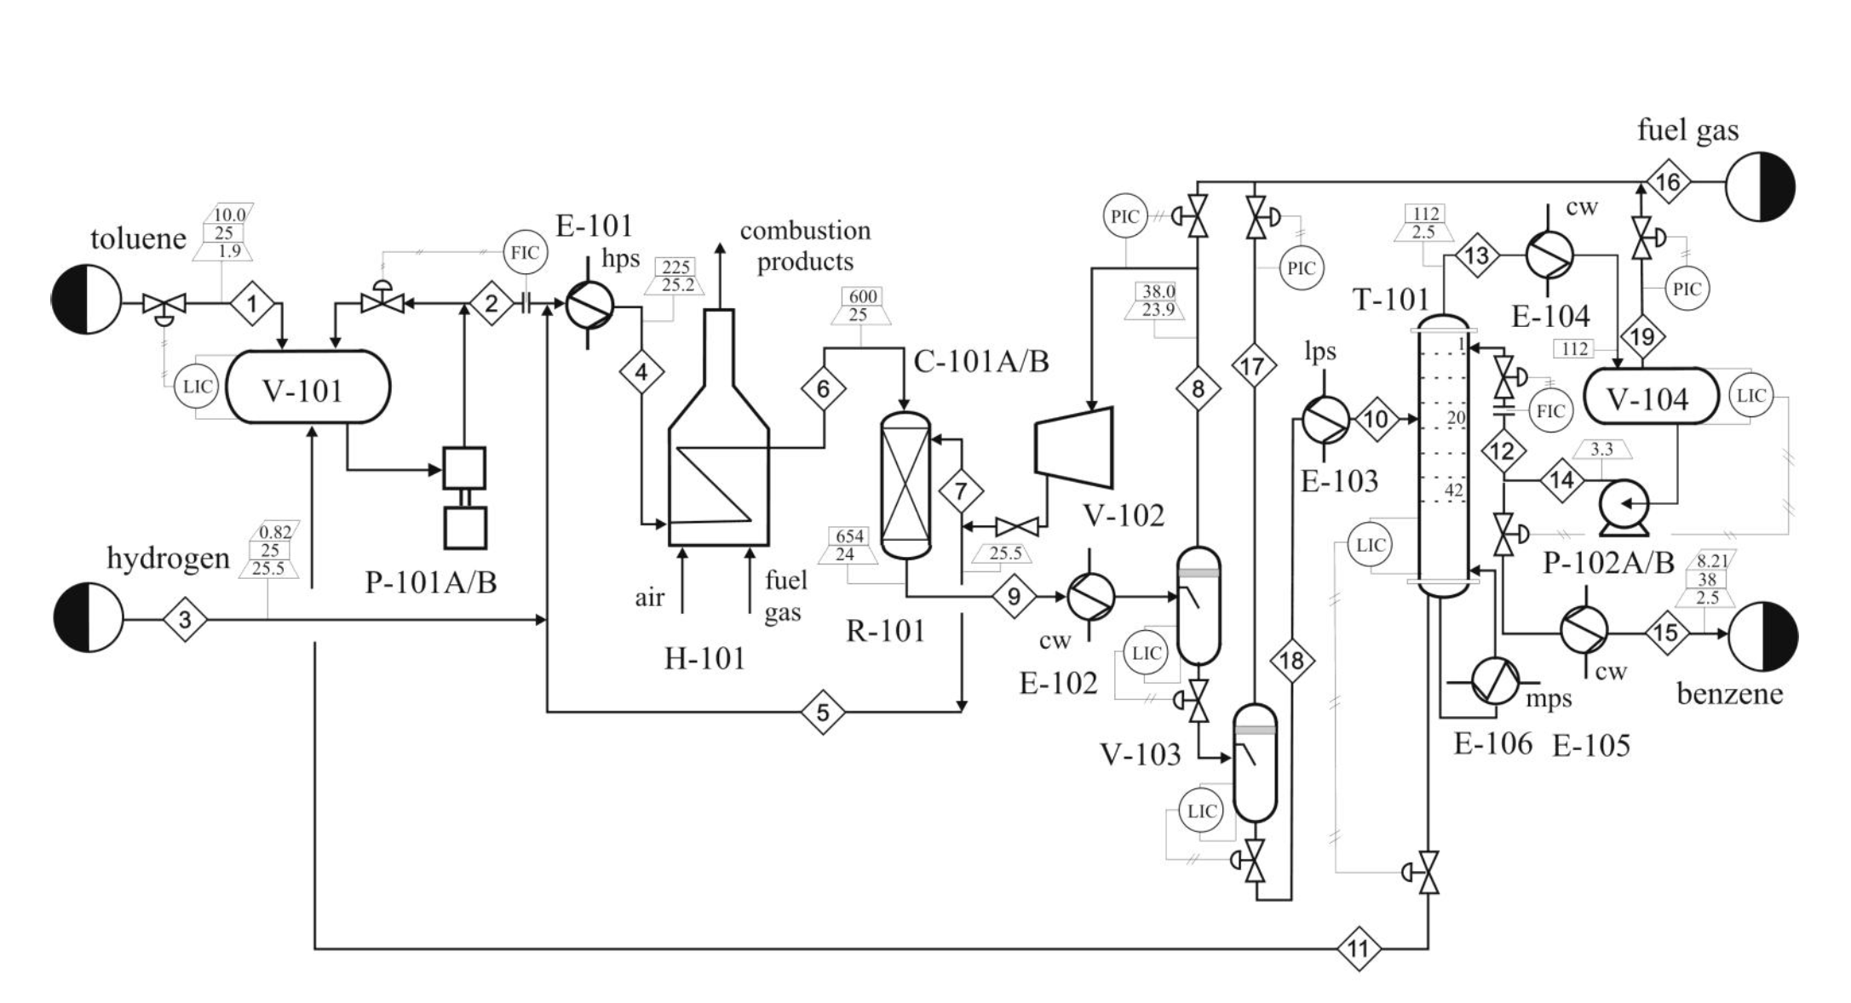
Course Objectives
1. Understand, interpret, synthesize, and create chemical processes.
2. Interpret design diagrams, including BFDs, PFDs, and P&IDs.
3. Determine operating conditions of different equipment and their impact on the economics of design.
4. Evaluate economic impact of new (or existing) chemical processes.

Slide 3
Course Objectives
5. Perform simulations of chemical processes using AspenPlus.
6. Understand legal and ethical issues at stake in the design process.
7. Understand safety issues inherent in plant design and how to account for them during the design process.

Slide 4

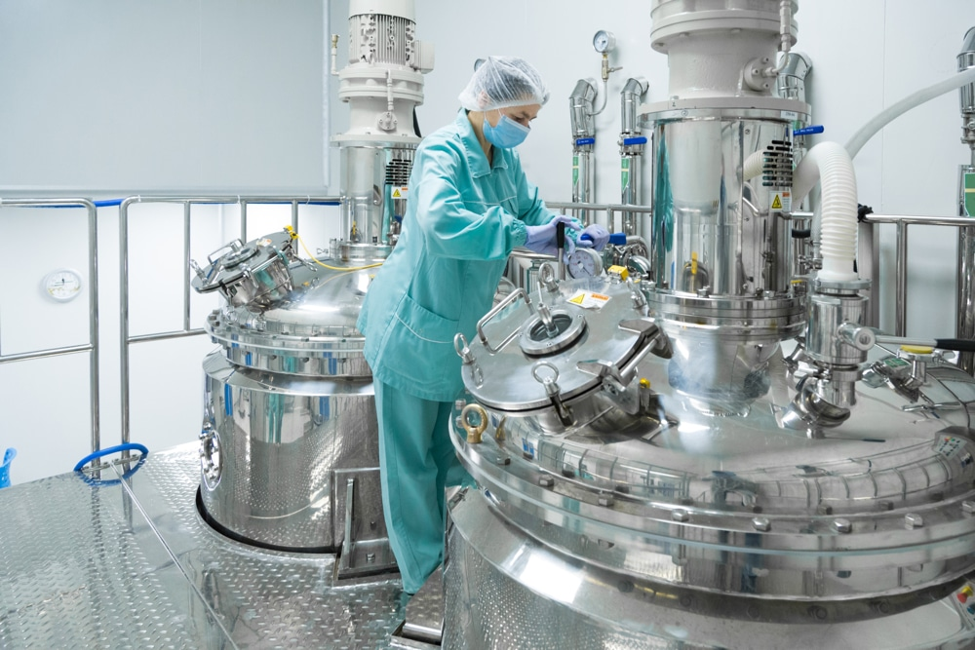
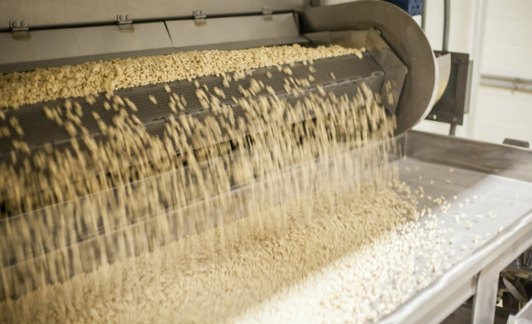
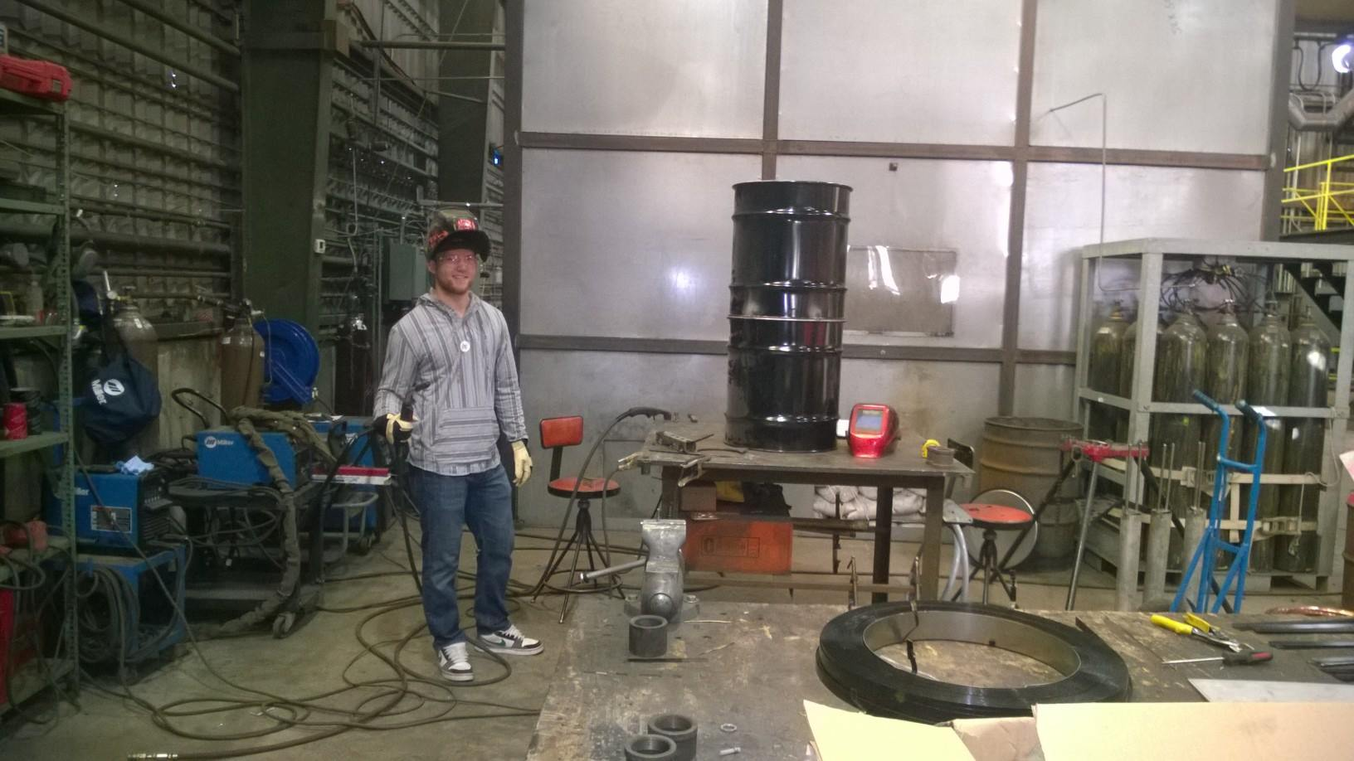
Design in the field

