Slide 1
ChemE 485: Process Design I
Lecture 11: Time Value of Money
Prof. Chad Curtis
Feb. 3, 2020

Slide 2
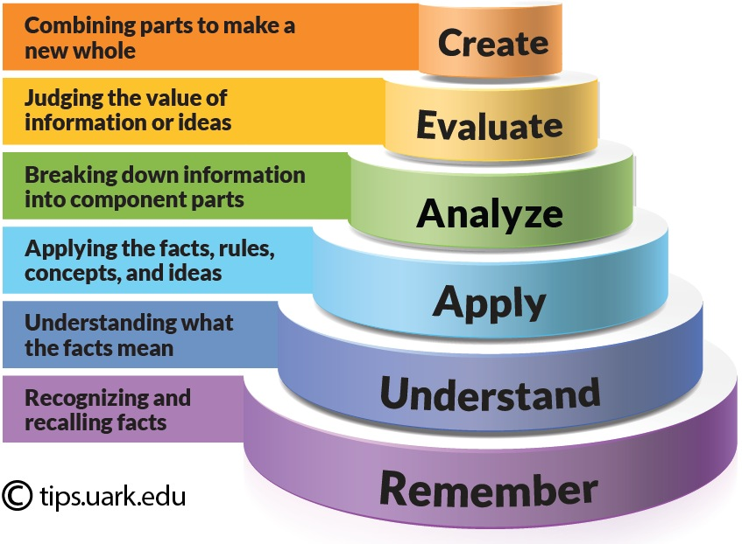
Bloom’s Taxonomy

Slide 3
What you will learn
If money is invested, it grows.
There are different types of interest.
How to do interest and investment calculations.
That there are different types of cash flow diagrams, which can be used to represent financial transactions.

Slide 4
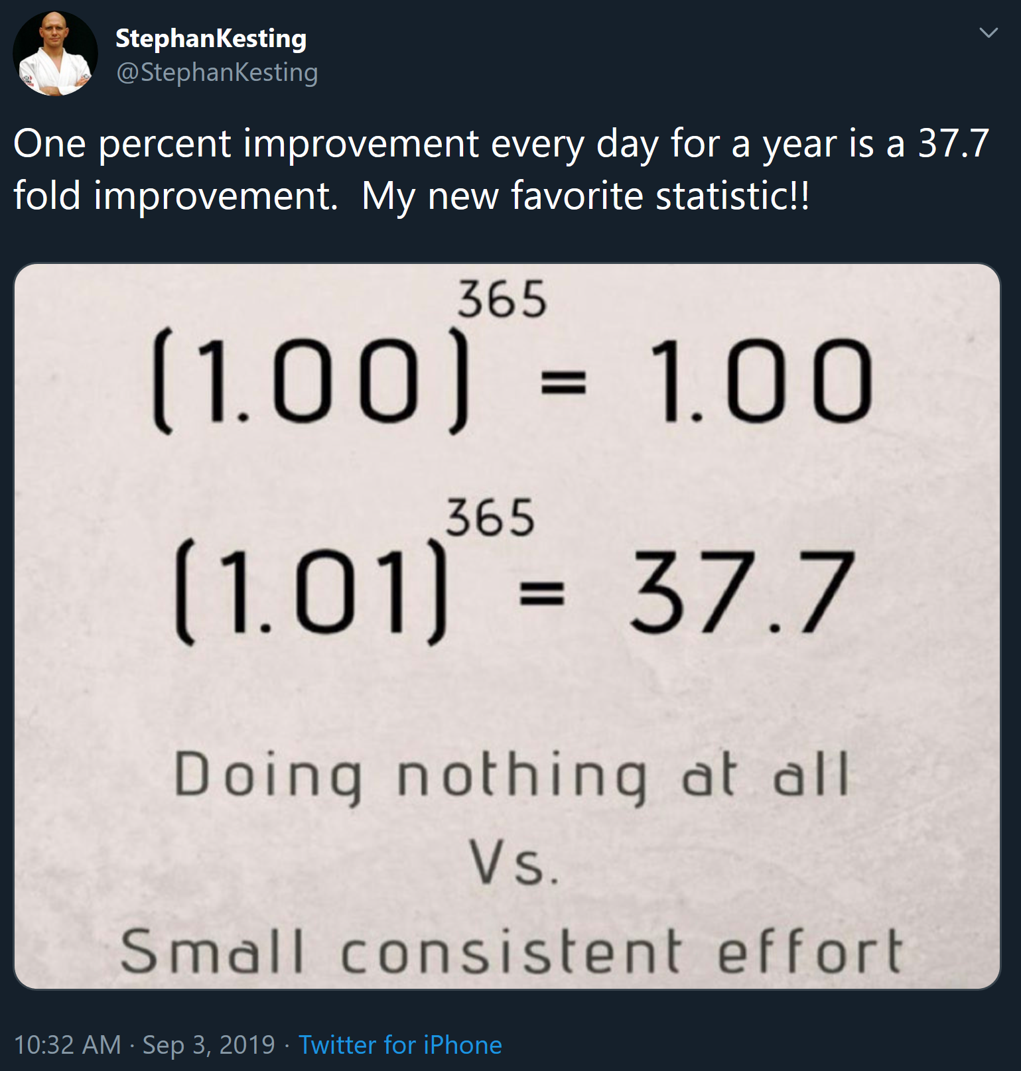
Plus: it will help you understand memes

