Slide 1

Mid-BootCamp Project
Build and deploy a Data Ingestion Pipeline - Pull
Jorge Castro DAPT NOV 2021
05 March 2022

Slide 2
Objective: Build a platform in Python to pull data from different sources, store them on a database, view it on a dashboard (Creating a dataset)

Slide 3


Data Sources:
Beijing Multi-Site Air-Quality Data Set (Time Series data)
Measurement of 6 main air pollutants at multiple sites in Beijing
API: Weather API

Slide 4





Technologies used:
Time Series Database
Amazon Elastic Compute Cloud (Amazon EC2 Linux)
Python
Docker Containers
Data Visualization Tool

Slide 5








Data Ingestion Pipeline (Pull) on AWS EC2 linux Jorge Castro DAPT NOV2021. 05.03.2022
Access to Dashboard with URL
Read Data
Writing Data with API call
Querying data
Part I
Python Ingestion of files
Database
InfluxDB (Docker)
Time Series Dataset
Grafana UI (Docker)
Data Visualization
Client PC
Pulling live data with API call
Part II
Python Integration of data
Python script scheduler every hour
Weather API

Slide 6
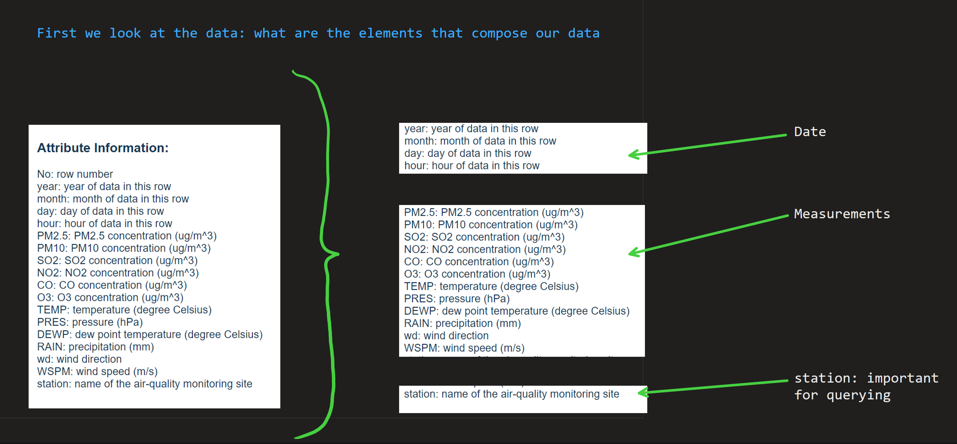
Schema Design

Slide 7
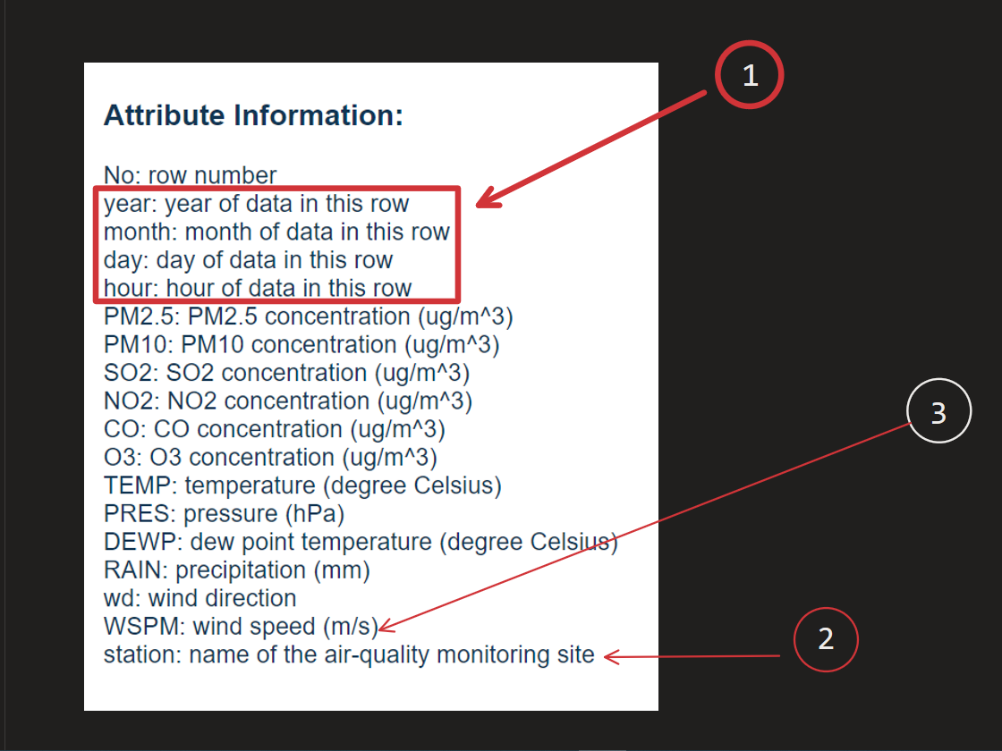
Schema Design

Slide 8
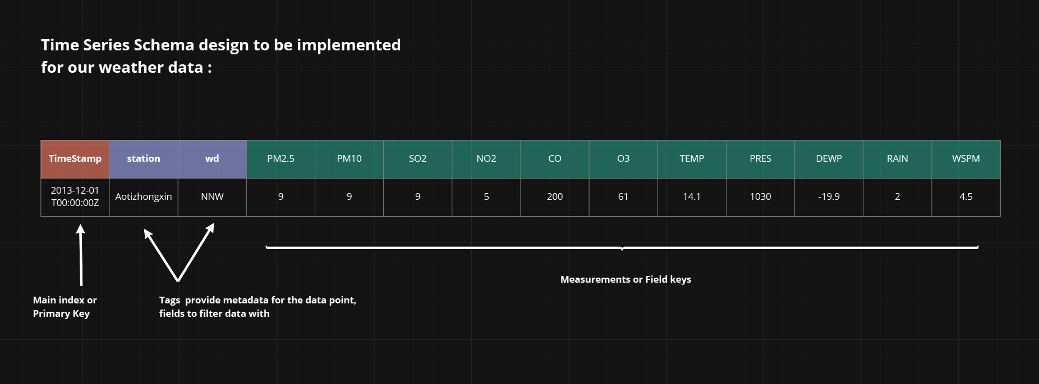
Schema Design

Slide 9
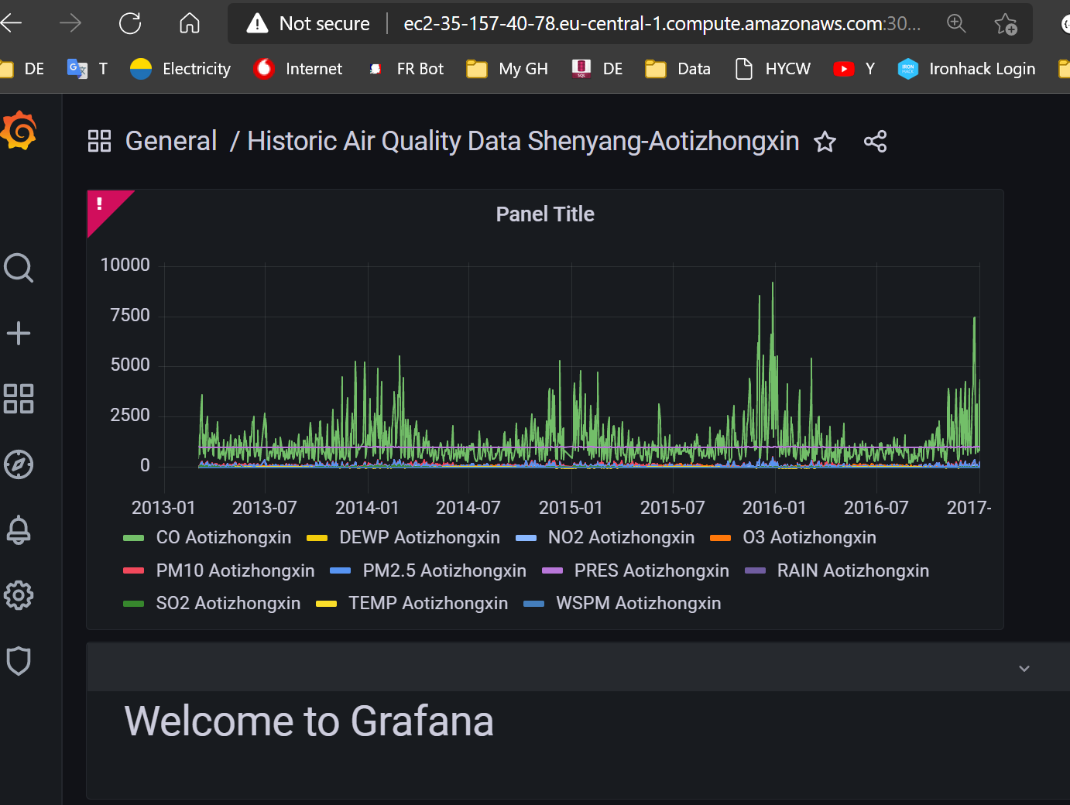
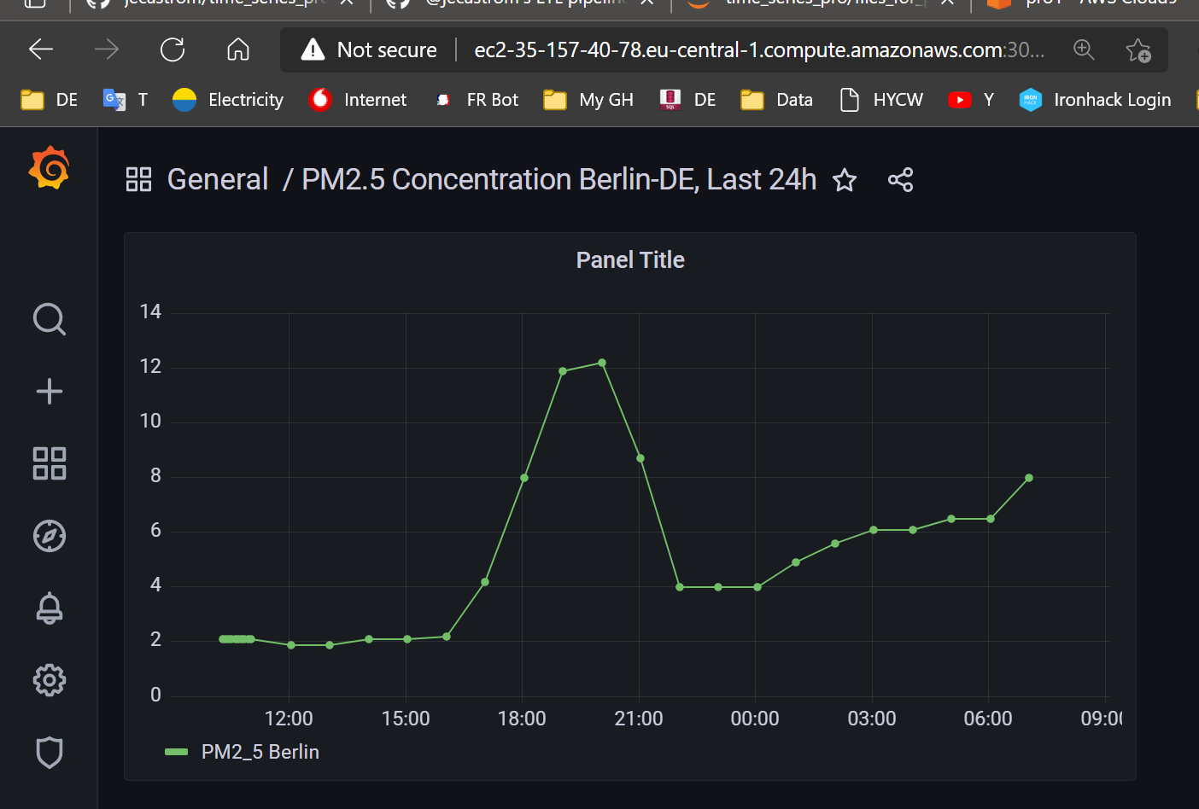
Dashboard on Grafana with weather data

Slide 10
Wrap-up Issues and blockers

Slide 11
Q&A

