Slide 1

Mid-BootCamp Project
Build and deploy a Data Ingestion Pipeline - Pull
Jorge Castro DAPT NOV 2021
05 March 2022

Slide 2
Objective: Build a platform in Python to pull data from different sources, store them on a database, view it on a dashboard (Creating a dataset)

Slide 3


Data Sources:
Beijing Multi-Site Air-Quality Data Set (Time Series data)
Measurement of 6 main air pollutants at multiple sites in Beijing
API: Weather API

Slide 4





Technologies used:
Time Series Database
Amazon Elastic Compute Cloud (Amazon EC2 Linux)
Python
Docker Containers
Data Visualization Tool

Slide 5








Data Ingestion Pipeline (Pull) on AWS EC2 linux Jorge Castro DAPT NOV2021. 05.03.2022
Querying data
Access to Dashboard with URL
Read Data
Writing Data with API call
Part I
Time series database
Front End
Visualization Tool
Python Script
Client PC
Pulling live data with API call
Part II
Python script scheduler every hour
Weather API
Python Script

Slide 6
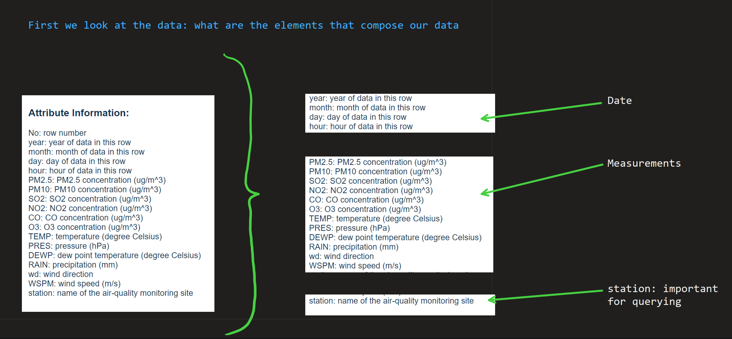
Schema Design

Slide 7
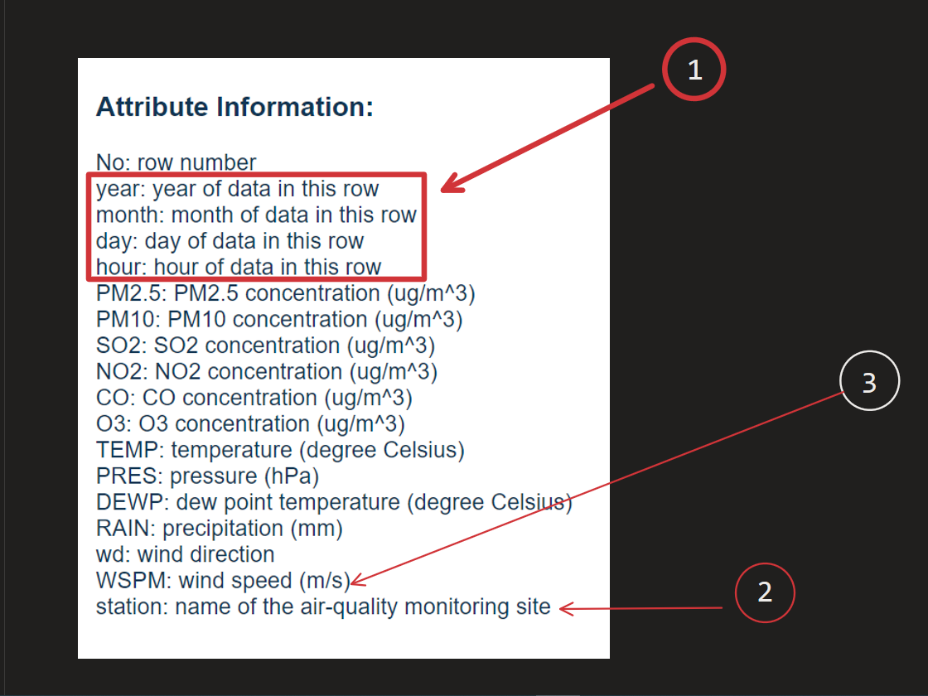
Schema Design

Slide 8
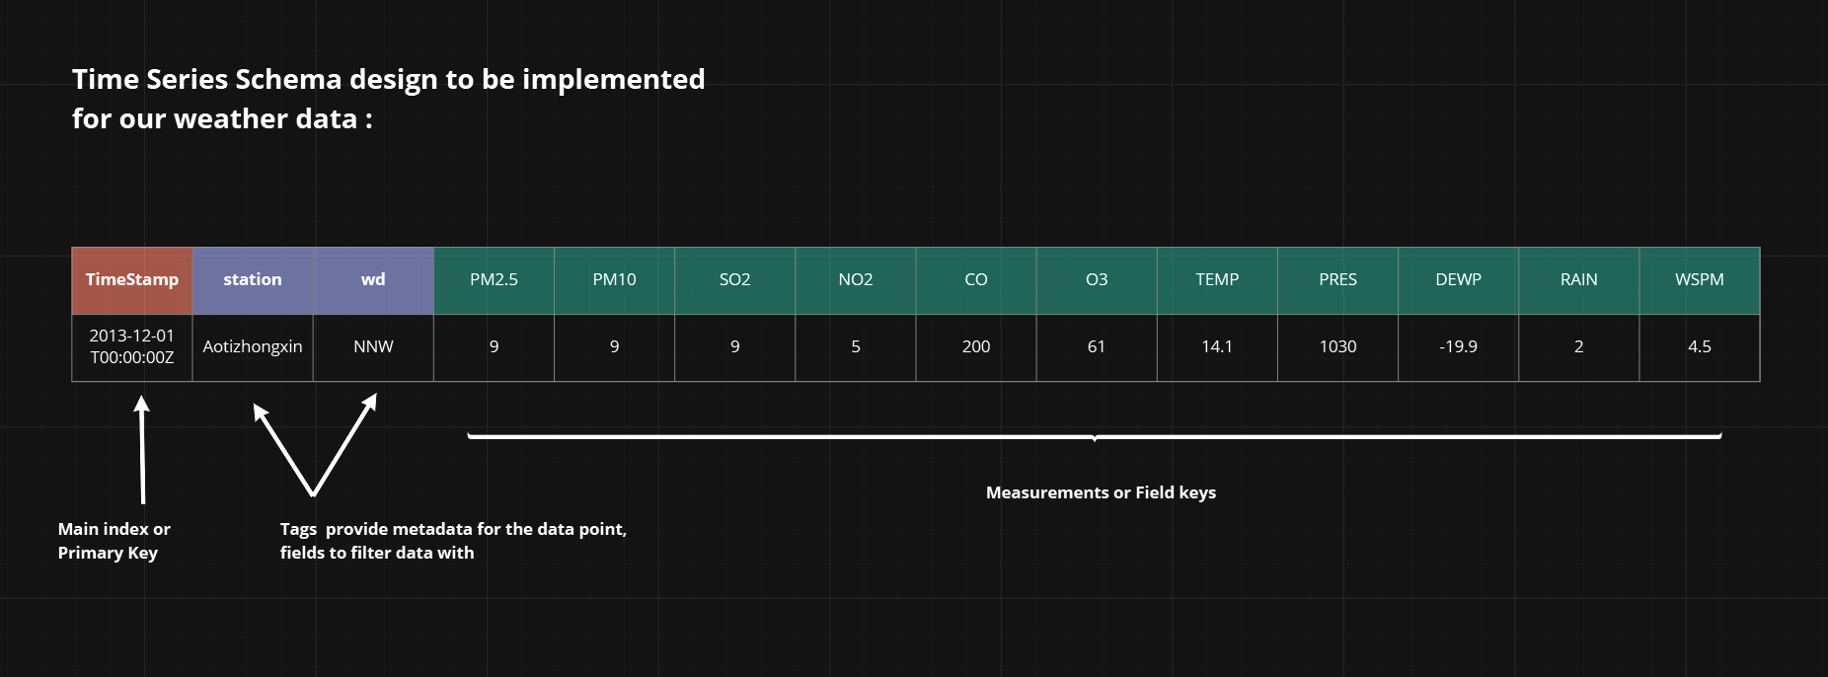
Schema Design

Slide 9
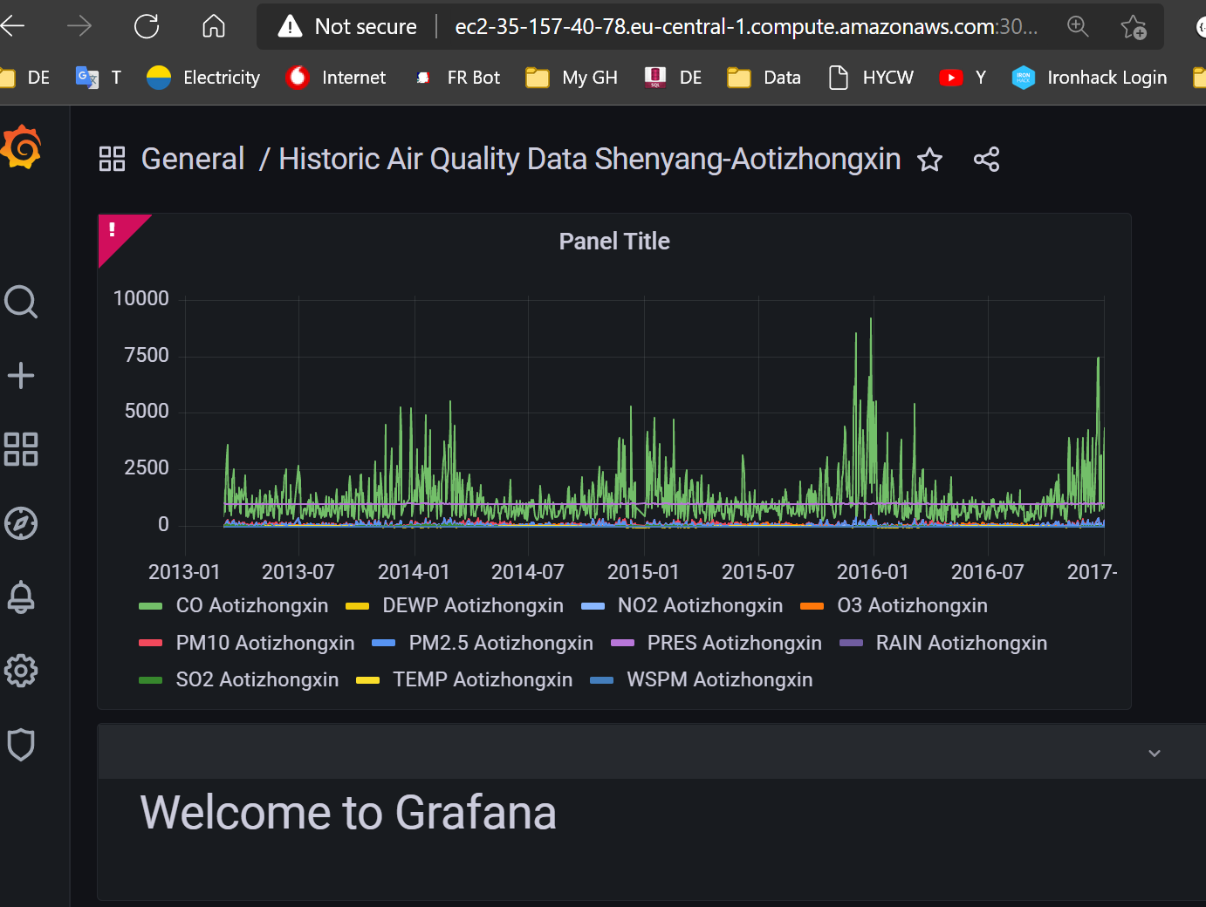
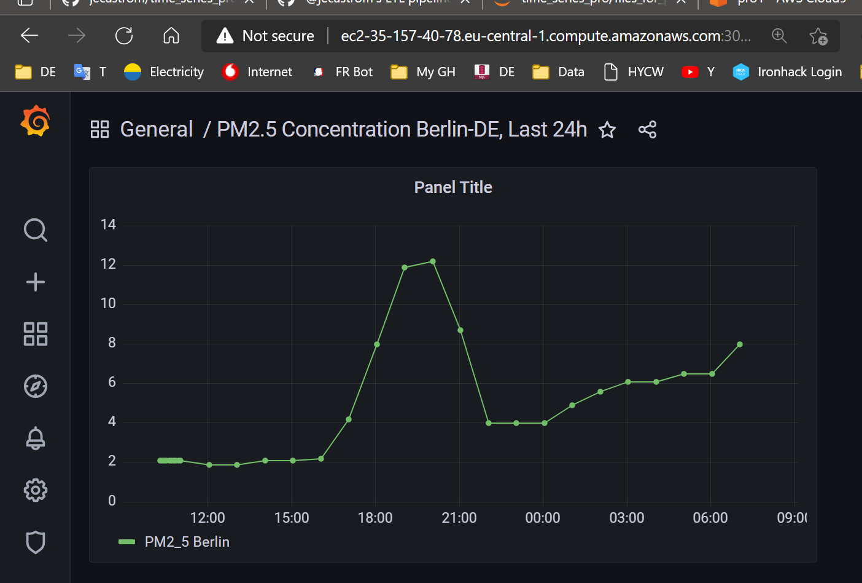
Dashboard on Grafana with weather data

Slide 10
Wrap-up Issues and blockers

Slide 11
Q&A

