Slide 1
Organic chemistry
Dr. Kama-Kama

Slide 2
Conformations

Slide 3
Conformations
Conformations are different arrangements of atoms that are interconverted by rotation about single bond.
A particular conformation is called conformer.
There are two arrangements in the way two different conformers can be represented:
In the eclipse conformation, the C-H bonds on one carbon are directly aligned with the C-H bonds of the adjacent carbon
In the staggered conformation, the C-H bonds on one carbon, bisect the H-C-H bond angle on the adjacent carbon

Slide 4
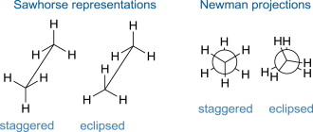
Conformations
Representations;

Slide 5
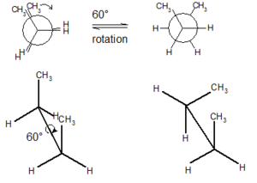
Conformations
Rotating he atoms on one carbon by 60° converts an eclipse conformation into a staggered conformation and vice versa.

Slide 6
Conformations
These conformations are often viewed end-on; that is looking directly down the carbon-carbon bond.
The angle that separates a bond on one atom from a bond on an adjacent atom is called dihedral angle.
For ethane in the staggered conformation, the dihedral angle for the C-H bonds is 60°. For eclipsed ethane, it is 0°.
End-on representations for conformations are commonly drawn using a convention called Newman projection.

Slide 7
Conformations
A Newman projection is a graphic that shows the three groups bonded to each of the carbon atoms in a particular C-C bond, as well as the dihedral angle that separates them
How to draw Newman Projection ?
Step 1. Look directly down the C-C bond (end-on), and draw a circle with a dot in the center to represent the carbons of the C-C bond.
The circle represents the back carbon and the dot represents the front carbon.

Slide 8
Conformations
Step 2. Draw in the bonds;
Draw the bonds on the front C as three lines meeting at the center of the circle
Draw the bonds on the back C as three lines coming out of the edge of the circle.
Step 3. Add the atoms on each bond.
Follow this procedure for any C-C bond.
With a Newman projection, always consider one C-C bond only and draw the atoms bonded to the carbon atoms, not the carbon atoms in the bond itself.

Slide 9
Conformations
The staggered and eclipsed conformations of ethane interconvert at room temperature but each conformer is not equally stable.
The staggered conformations are more stable (lower energy) than the eclipsed conformations.
Electron-electron repulsion between the bonds in the eclipsed conformations increases its energy compared to the staggered conformation, where the bonding electrons are farther apart.

