Slide 1
KEYLOGGER AND SECURITY
CAPSTONE PROJECT
Presented By:
1. J Ganesh– College of Engineering Guindy – Computer Science Department

Slide 2
OUTLINE
Problem Statement
Proposed System/Solution
System Development Approach
Algorithm & Deployment
Result
Conclusion
Future Scope
References

Slide 3
PROBLEM STATEMENT
In today's digital age, where cybersecurity threats loom large, one of the significant concerns is the proliferation of keyloggers, stealthy software tools designed to monitor and record keystrokes on a user's computer without their knowledge. Keyloggers pose a severe threat to individuals and organizations as they can capture sensitive information such as passwords, credit card details, and other personal data, leading to identity theft, financial loss, and privacy breaches.

Slide 4
PROPOSED SOLUTION
1. Enhanced Security Measures: Implement robust encryption techniques to safeguard logged data both at rest and during transmission. Incorporate secure authentication mechanisms to control access to the logged data, ensuring it remains protected against unauthorized access.
2. Advanced Data Analysis: Integrate algorithms for analyzing keystroke dynamics to enhance user authentication based on typing patterns. Develop filters to automatically detect and redact sensitive information such as passwords or financial data to bolster privacy protections.
3. Cross-Platform Support: Extend the keylogger's compatibility to various operating systems, including Windows, macOS, and Linux, to broaden its applicability and reach a wider user base.

Slide 5
SYSTEM APPROACH
1. System Requirements Analysis:
- Identify stakeholders and their requirements, including end-users, administrators, and legal/regulatory bodies.
- Define functional and non-functional requirements, such as logging capabilities, user interface design, security measures, and compliance with privacy laws.
2. System Architecture Design:
- Design a modular and scalable architecture that separates concerns and promotes maintainability and extensibility.
- Define components such as the user interface, keylogging engine, data storage, encryption modules, and authentication mechanisms.
- Specify interfaces and protocols for communication between components, ensuring interoperability and flexibility.
3. Security Integration:
- Integrate security measures throughout the system architecture, including encryption for logged data, secure authentication mechanisms, and access control policies.
- Conduct threat modeling and risk assessment to identify potential vulnerabilities and mitigate them through appropriate security controls.
- Implement secure coding practices to prevent common security vulnerabilities such as injection attacks, buffer overflows, and privilege escalation.

Slide 6
4.Ethical Considerations:
- Incorporate ethical considerations into the system design and development process, including user consent mechanisms, transparency about data collection practices, and safeguards against misuse.
- Provide clear documentation and guidance on ethical use and legal compliance, emphasizing respect for privacy and individual rights.
- Implement accountability measures, such as audit trails and user activity logging, to promote transparency and accountability in system usage.
5. Cross-Platform Compatibility:
- Ensure compatibility with multiple operating systems by designing platform-independent components and leveraging cross-platform development frameworks or technologies.
- Conduct thorough testing and validation across different operating environments to identify and address platform-specific issues or dependencies.
6. Performance Optimization:
- Optimize system performance through efficient data handling, resource utilization, and algorithmic optimizations.
- Employ techniques such as caching, batching, and parallel processing to minimize latency and maximize throughput.
- Monitor system performance in real-time and apply tuning adjustments as needed to maintain optimal operation under varying workloads.

Slide 7
ALGORITHM & DEPLOYMENT
Our keylogging application utilizes a simple yet effective algorithm to capture keystrokes in real-time. Here's a breakdown of how it works:
Algorithm Overview:
Keyboard Monitoring: We leverage the pynput library to monitor keyboard events, capturing key presses and releases as they occur.
Event Handling: Upon detecting a key press or release event, the corresponding callback functions (on_press and on_release) are triggered to handle the event.
Data Logging: Keystroke data is logged in two formats: a text file (key_log.txt) and a JSON file (key_log.json). This allows for easy storage and retrieval of captured keystrokes.
Deployment:
Our application is deployed using the tkinter library to provide a user-friendly interface for starting and stopping the keylogging process.
Users simply need to click the "Start" button to initiate the keylogging functionality, with the option to stop it at any time by clicking the "Stop" button.
The generated log files (key_log.txt and key_log.json) are saved locally on the user's machine, ensuring ease of access and privacy of captured data.
By combining a robust algorithm with a user-friendly deployment approach, our keylogging application offers a seamless experience for capturing and logging keystrokes.

Slide 8
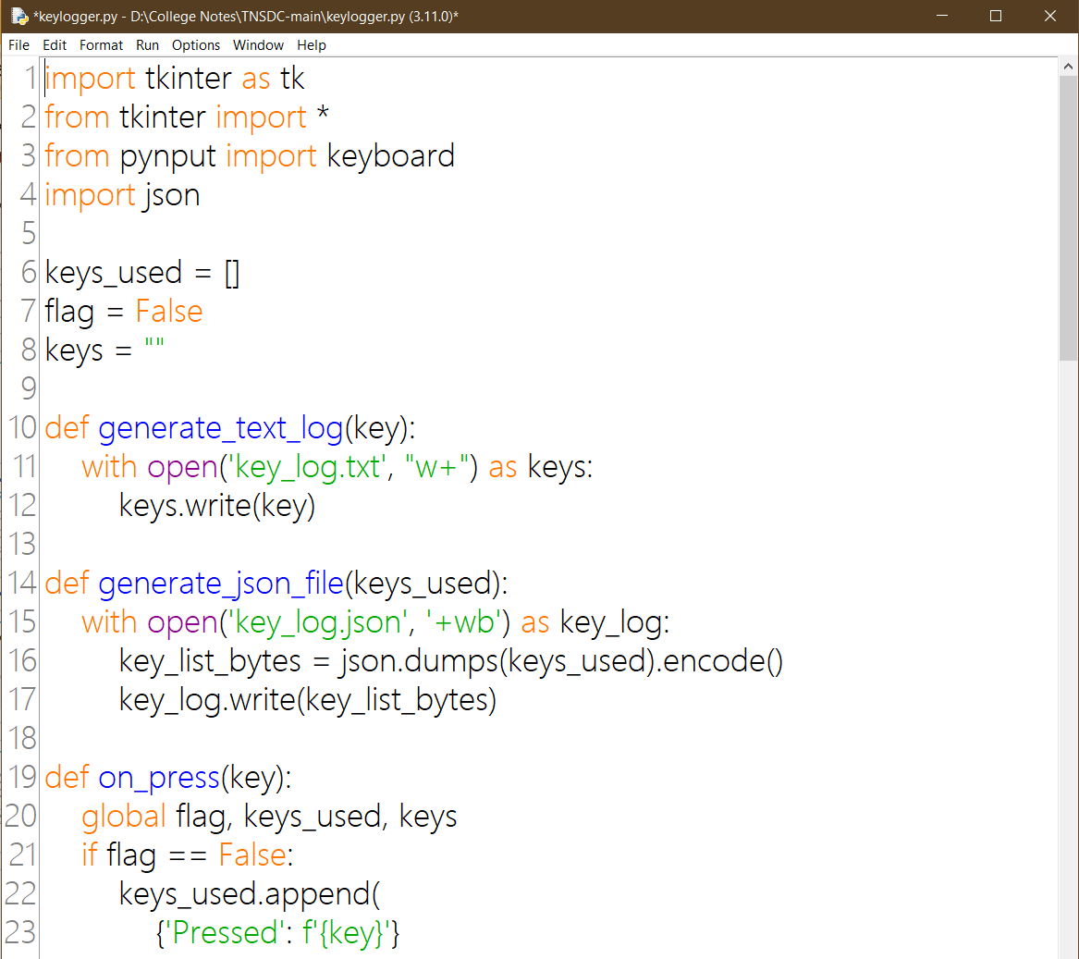
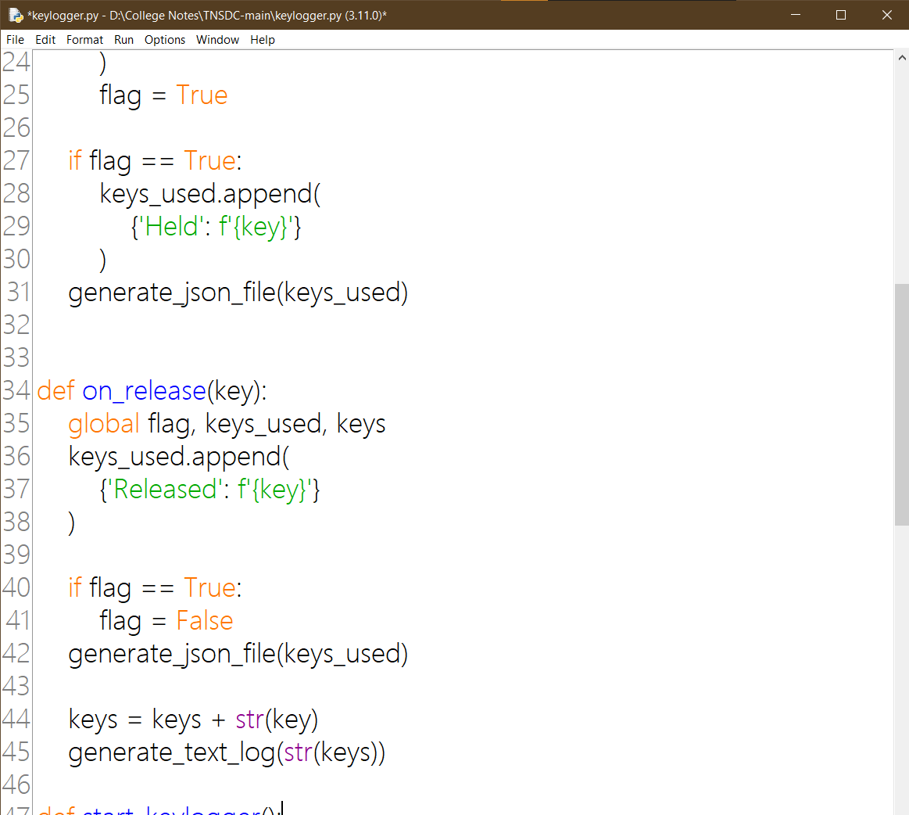
PROGRAM :

Slide 9
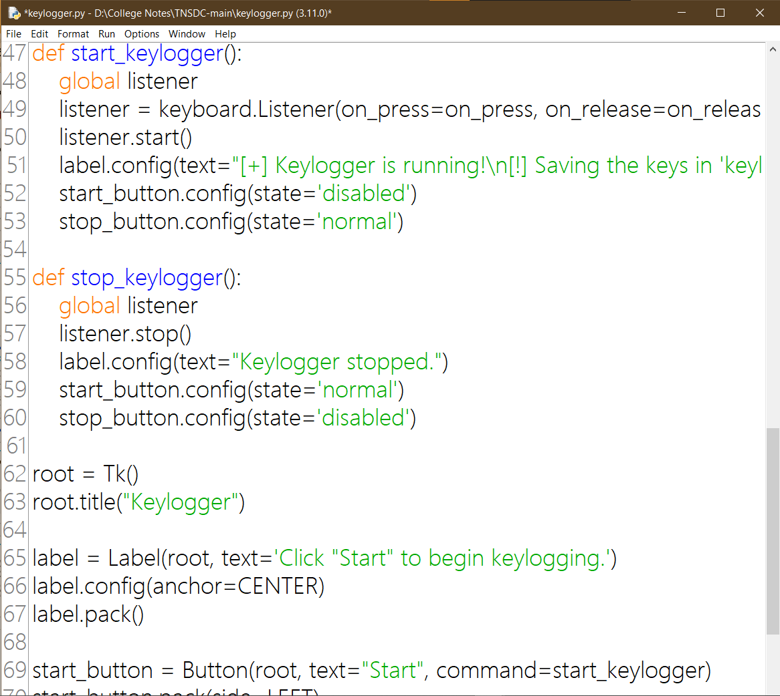
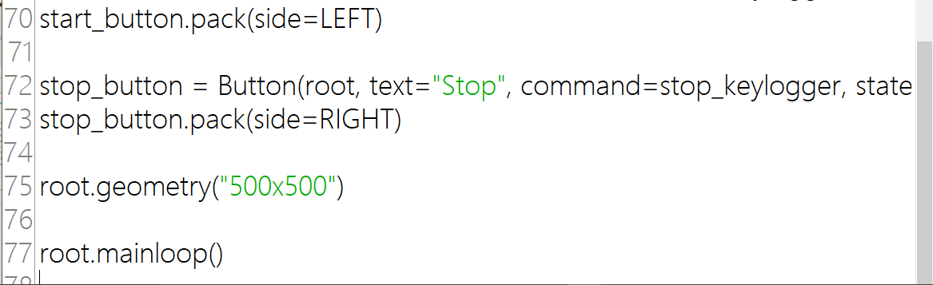
PROGRAM :

Slide 10
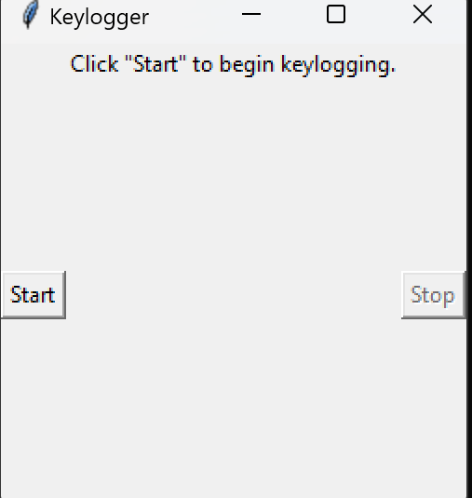
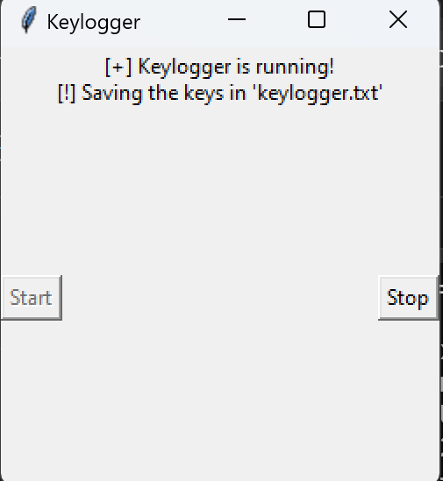
RESULT
The KeyLogger works flawlessly being able to register the keystrokes once the user starts the program from the GUI.

Slide 11
CONCLUSION
The development of a keylogger, as discussed, opens up a broad spectrum of possibilities for educational purposes, security enhancements, and system monitoring, provided it is approached with a strong ethical foundation and legal compliance. Future enhancements could significantly improve its utility, security, and efficiency, ranging from advanced data analysis and user interface improvements to enhanced security measures and cross-platform support. However, the utmost care must be taken to ensure user consent, data protection, and the ethical use of such tools to respect privacy and legal boundaries. In conclusion, while the technical advancements in keylogging present many opportunities for growth and learning, they also underscore the importance of responsible use and the protection of individual privacy.

Slide 12
FUTURE SCOPE
1.Advanced Data Filtering and Analysis
Key Stroke Analysis: Implement algorithms to analyze keystroke dynamics for purposes like user authentication based on typing patterns.
Filtering Sensitive Information: Automatically detect and filter out sensitive information like passwords or credit card numbers to enhance privacy protections.
2. User Interface Improvements
Real-time Monitoring Dashboard: Develop a more advanced GUI that provides real-time analytics, such as the frequency of certain keys or words, typing speed, and more.
Configurable Settings: Add options for users to customize what gets logged (e.g., only specific applications or key types) and how data is reported.
3. Enhanced Security Measures
Encryption: Implement strong encryption for the logged data both at rest and in transit to ensure that if the data is intercepted, it remains unreadable.
Secure Authentication: For applications where the logs might be accessed remotely, implement secure authentication mechanisms to protect access.
4. Networking Capabilities
Remote Logging: Add functionality for the keylogger to send the logged data to a remote server securely. This could be useful for remote monitoring with proper authorization and security measures in place.
Cloud Integration: Enable integration with cloud services for data storage and analysis, providing backups and the ability to access the data from any device securely.

Slide 13
REFERENCES
https://www.youtube.com/watch?v=V5-LSvv2erk
https://pypi.org/project/pynput/
https://docs.python.org/3/library/tkinter.html
Ahmad, Rashid, et al. "Anomaly detection techniques in computer network security: A review." International Journal of Computer Applications 69.22 (2013): 1-5.
This review paper provides insights into various anomaly detection techniques, which can be valuable in detecting keylogger activities as anomalies in user behavior.

Slide 14
THANK YOU

