Slide 1
Diffie-Hellman, OTR, and Signal
CSE 548 Spring 2026
jedimaestro@asu.edu

Slide 2
Basic types of crypto...
Symmetric encryption
  Assumes two parties wishing to communicate already have a shared secret
Asymmetric encryption
  Makes different assumptions (e.g., that everybody knows the public key or that the eavesdropper is passive)
  Quantum computers break current algorithms that are used in practice
Secure hash functions and message authentication

Slide 3
Symmetric Crypto
Confidentiality
Integrity
Availability
Authentication
Non-repudiation
A way to distribute the shared secret keys

Slide 4
Symmetric Crypto
Confidentiality
Integrity
Availability
Authentication
Non-repudiation
A way to distribute the shared secret keys
Diffie-Hellman will give us this one

Slide 5
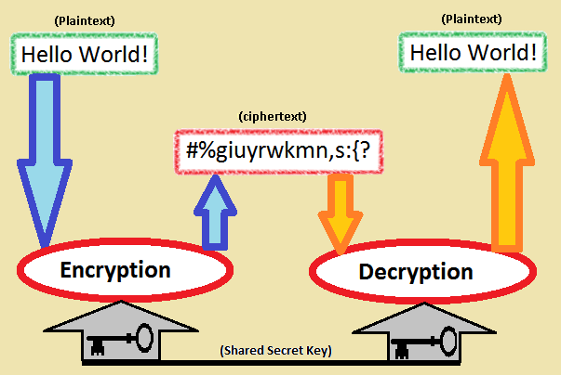
Source: Wikipedia

Slide 6
Terminology
Plaintext – before encryption, easy to read
Ciphertext – after encryption, hopefully indecipherable without the key
Key – the shared secret, typically just bits that were generated with a high entropy process

Slide 7
Alice
Eve or
Mallory
Bob
WiFi, electric path, or optical… Eve or Mallory get their own copy!
So how to Alice and Bob exchange a key?

Slide 8
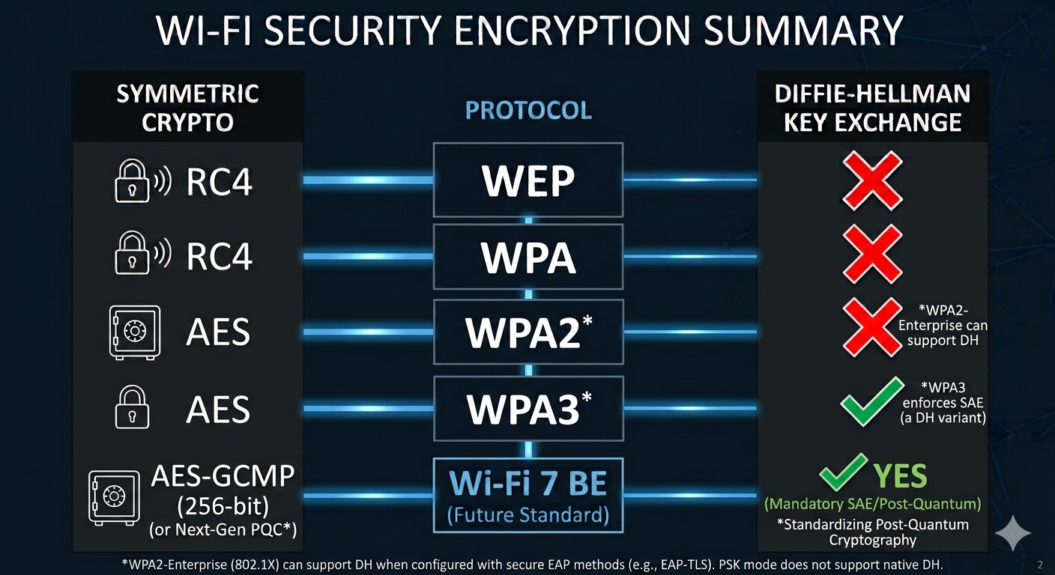

Slide 9
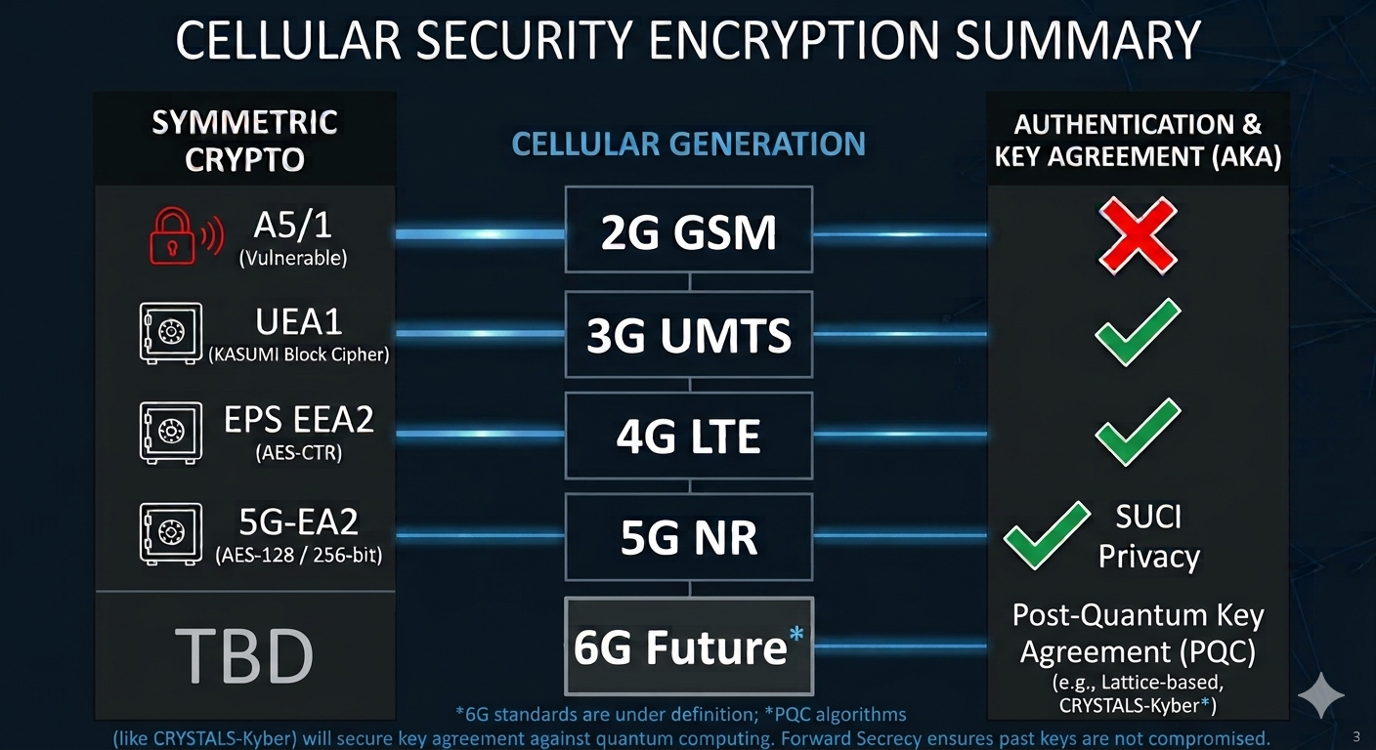

Slide 10
Symmetric

Slide 11
SUCI = Subscription Concealed Identifier
5G and before don’t have perfect forward secrecy

Slide 12

Field
Commutative
Inverse
●
●
a + b = b + a
a + -a = 0
a * b = b * a
a * a
-1
= 1
Associative
Distributive
●
●
(a + b) + c = a + (b + c)
a * (b + c) = (a * b) + (a * c)
(a * b) * c = a * (b * c)
Identity
●
0 != 1, a + 0 = a, a * 1 = a
6

Slide 13
Arithmetic modulo a prime is a finite field
6 + 4 = 3 (mod 7)
3 – 6 = 4 (mod 7)
5 * 2 = 3 (mod 7)
5 * 3 = 1 (mod 7)
3 * 5⁻¹ = 3 * 3 = 2 (mod 7)
This is called GF(7)

Slide 14
Fast modular exponentiation via repeated squaring...

Slide 15
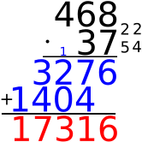
Multiplication is polynomial time in number of digits (O(n²) or O(n log n))

Slide 16
Modular exponentiation
153¹⁸⁹ (mod 251)
Naive way: multiply 153 times itself 189 times.
Won’t work for, e.g., 2048-bit numbers in the exponent

Slide 17
Better way (all mod 251)
153⁰ = 1
153¹ = 153
153² = 66
153⁴ = 89
153⁸ = 140
153¹⁶ = 22
153³² = 233
153⁶⁴ = 73
153¹²⁸ = 58

Slide 18
1. Repeated squaring
2. Don’t forget the modulus

Slide 19
Better way
189 in binary is 0b10111101
189 = 1*2⁷ + 0*2⁶ + 1*2⁵ + 1*2⁴ + 1*2³ + 1*2² + 0*2¹ + 1*2⁰
153¹⁸⁹ (mod 251) = 153⁽¹²⁸⁺⁰⁺³²⁺¹⁶⁺⁸⁺⁴⁺⁰⁺¹⁾ (mod 251)
= 153¹²⁸ * 153³² * 153¹⁶ * 153⁸ * 153⁴ * 153¹ (mod 251)
= 58 * 233 * 22 * 140 * 89 * 153 (mod 251)
= 73

Slide 20
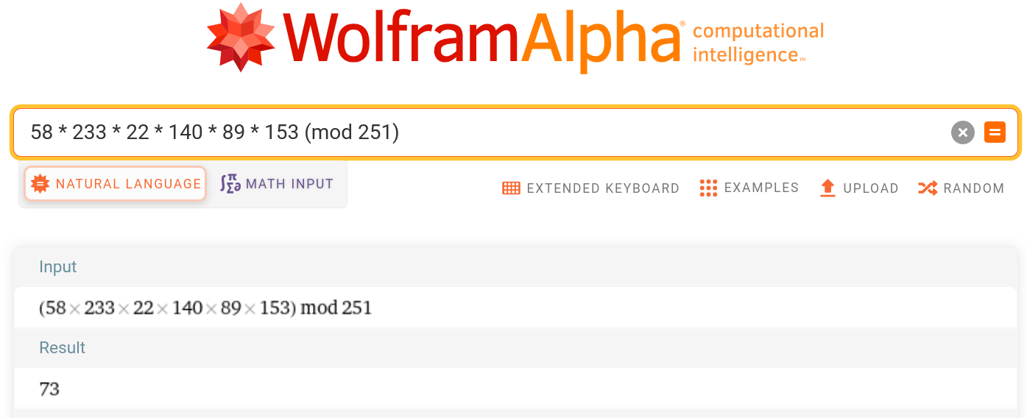

Slide 21
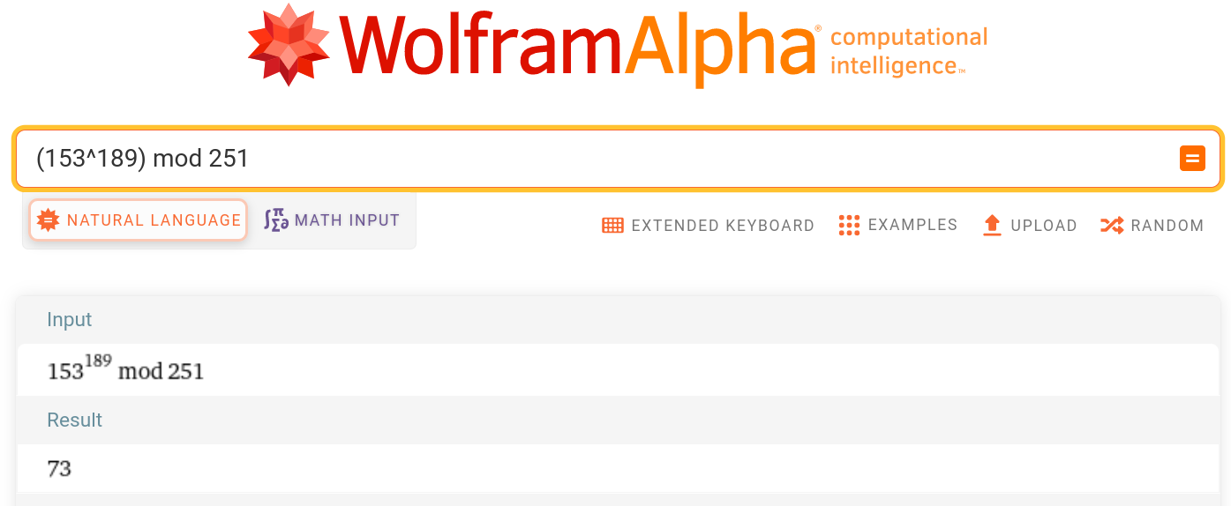

Slide 22
153¹⁸⁹ = 73 (mod 251)
189 = log153 73 (mod 251)

Slide 23
153??? = 73 (mod 251)
??? = log153 73 (mod 251)
This is called the discrete logarithm, and there is no known algorithm for solving it in the general case that is polynomial in the number of digits.

Slide 24
153¹⁸⁹ = 73 (mod 251)
153⁶⁴ = 73 (mod 251)

Slide 25
153¹⁸⁹ ≡ 73 (mod 251)
153⁶⁴ ≡ 73 (mod 251)

Slide 26
153¹⁸⁹ ≡ 153⁶⁴ ≡ 73 (mod 251)

Slide 27
An example…
3¹⁷ mod 31
17 = 16 + 1
16 = 2⁴ , (((3²)²)²)²=3¹⁶
All mod 31…
  3¹=3, 3²=9, …

Slide 28
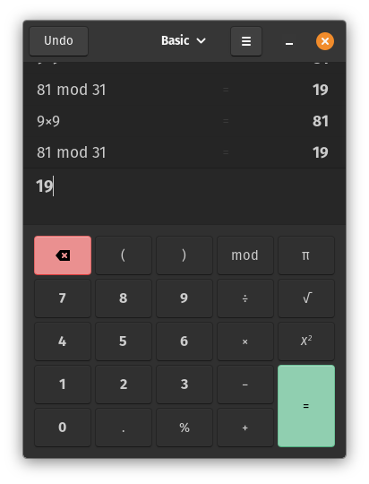

Slide 29
An example…
3¹⁷ mod 31
17 = 16 + 1
16 = 2⁴ , (((3²)²)²)²=3¹⁶
All mod 31…
  3¹=3, 3²=9, 3⁴=19, …

Slide 30


Slide 31
An example…
3¹⁷ mod 31
17 = 16 + 1
16 = 2⁴ , (((3²)²)²)²=3¹⁶
All mod 31…
  3¹=3, 3²=9, 3⁴=19, 3⁸=20, …

Slide 32


Slide 33
An example…
3¹⁷ mod 31
17 = 16 + 1
16 = 2⁴ , (((3²)²)²)²=3¹⁶
All mod 31…
  3¹=3, 3²=9, 3⁴=19, 3⁸=20, 3¹⁶=28…

Slide 34


Slide 35
An example…
3¹⁷ mod 31 = 3¹⁶3¹ mod 31 = 22
17 = 16 + 1
16 = 2⁴ , (((3²)²)²)²=3¹⁶
All mod 31…
  3¹=3, 3²=9, 3⁴=19, 3⁸=20, 3¹⁶=28…

Slide 36
17 in binary is 0b10001

Slide 37
A nice video about Diffie-Hellman
https://www.youtube.com/watch?v=YEBfamv-_do
Diffie-Hellman is asymmetric crypto

Slide 38
Darknet Diaries, Episode 83 https://darknetdiaries.com/transcript/83/
“There was no concept of doing anything cryptographic in terms of software back in the late 80s. I say this, I’m in contact with a fellow alumni from the InfoSec organization and people that were there years before I was, and I’ve asked. To the best that I have been able to figure out, what we ended up producing which was half paper pad, half key on a floppy, and a computer program that would do the encryption and decryption. That was the first foray into software-based cryptography that NSA produced.”
  --Jeff Man

Slide 39
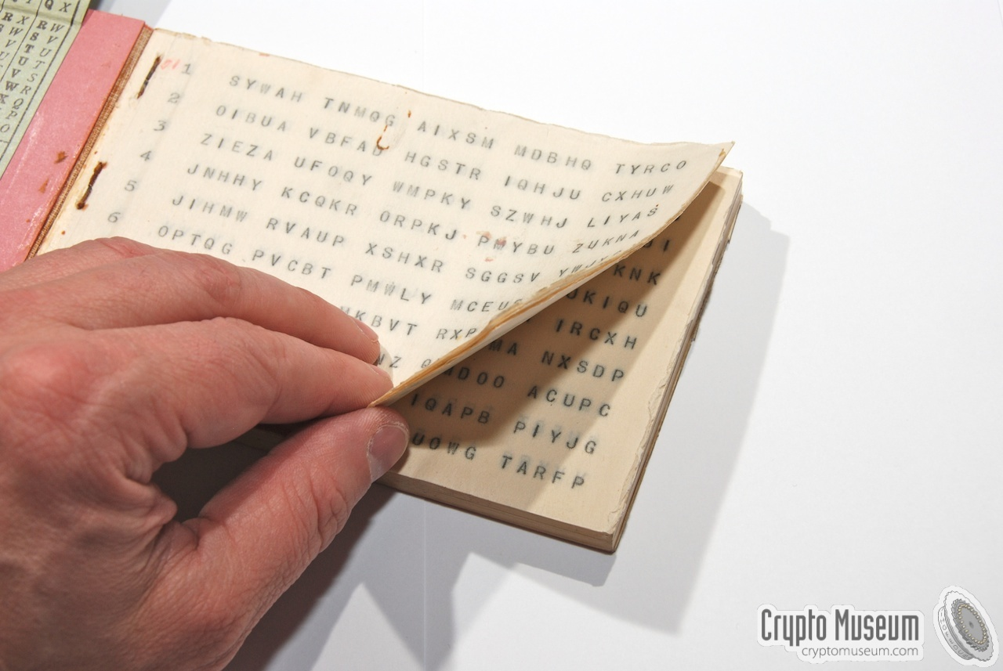

Slide 40
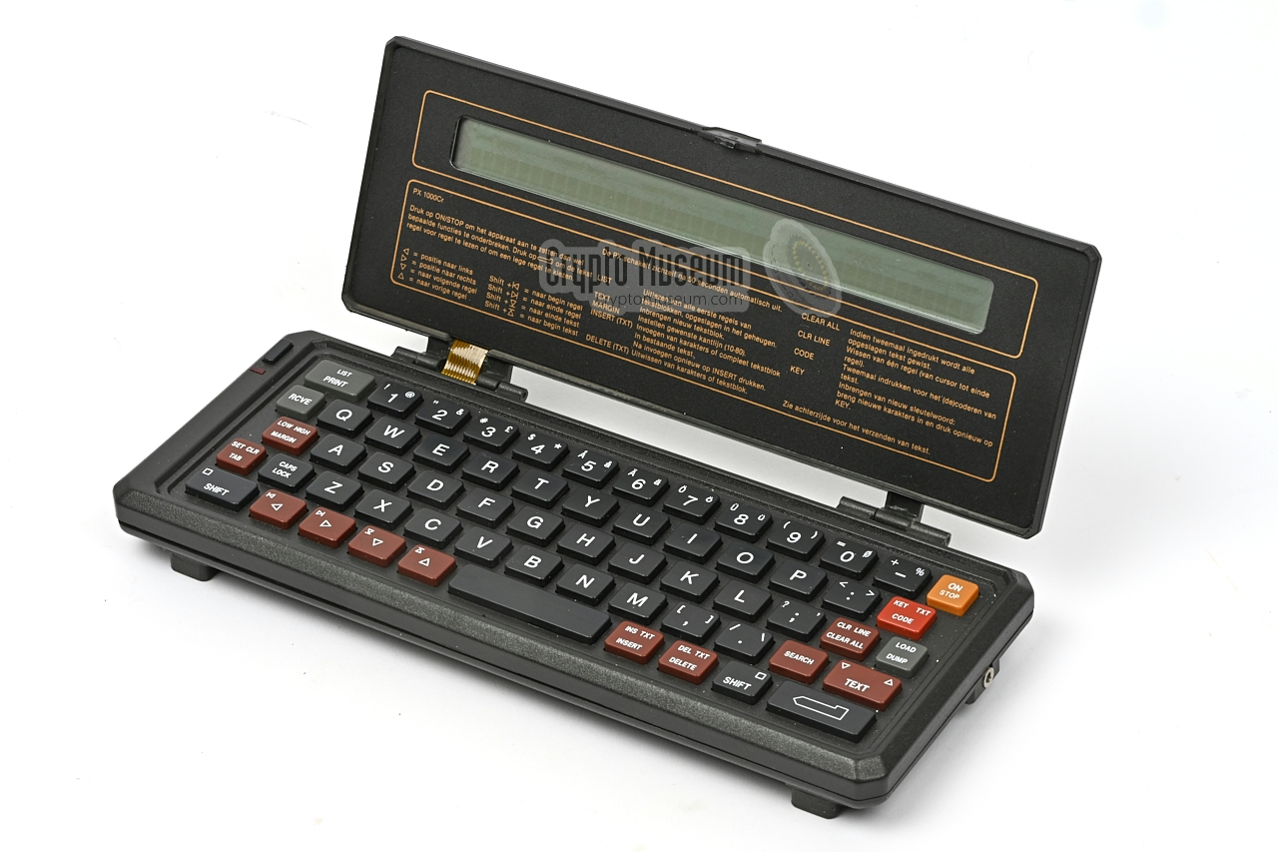

Slide 41
Couple of footnotes
Diffie-Hellman-Merkle?
Who was first?
  Diffie-Hellman conceived and then published 1976
  GCHQ version conceived 1969, published 1997

Slide 42
Basics...
https://en.wikipedia.org/wiki/Diffie%E2%80%93Hellman_key_exchange

Slide 43
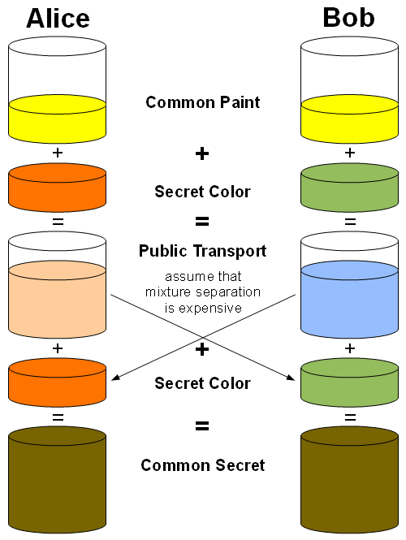

Slide 44
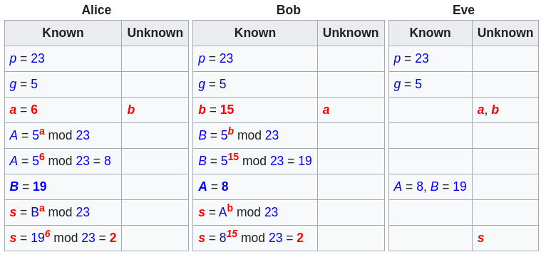

Slide 45
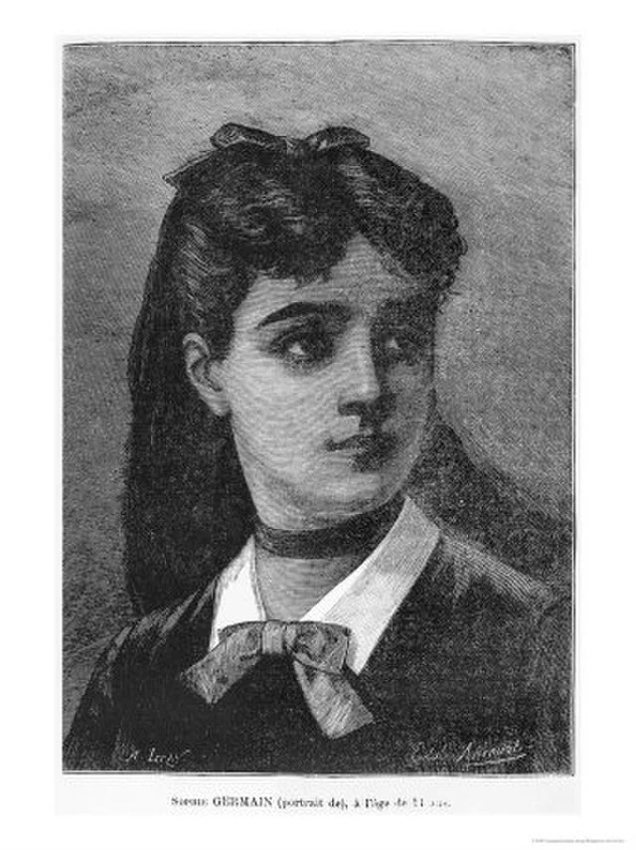
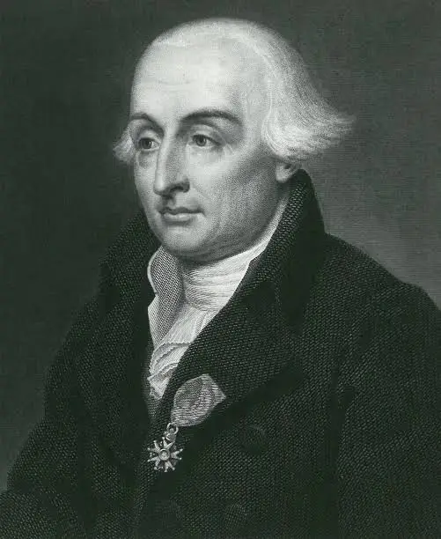
Where do the g and p come from?
p = 2q + 1 where q is also prime
  Sophie Germain safe primes
  Roughly 700,000 trials vs. roughly 700
    Prime number sieve
  Period is either q or 2q
g = 2
RFC 7919
  LOGJAM attacks (https://weakdh.org/)

Slide 46
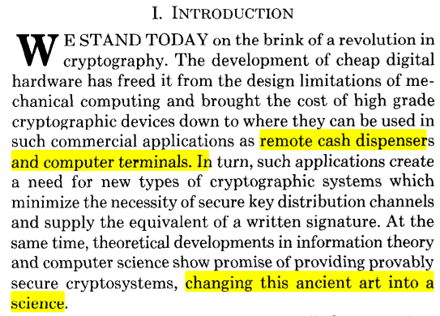
The paper...

Slide 47

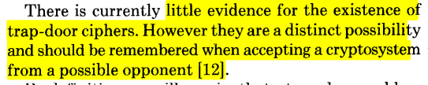
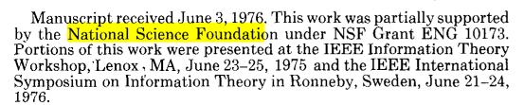

Slide 48
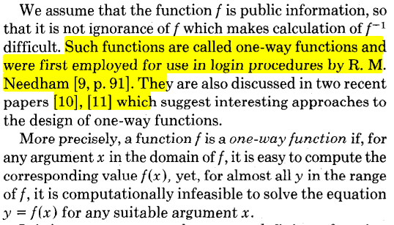
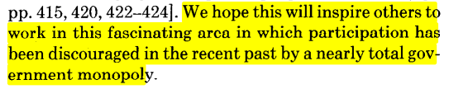

Slide 49
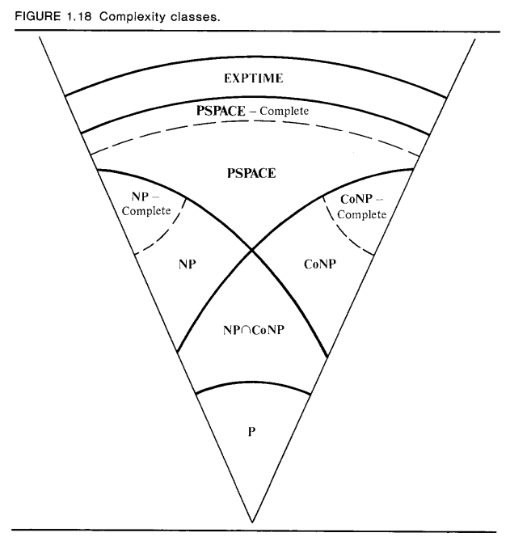
https://faculty.nps.edu/dedennin/publications/Denning-CryptographyDataSecurity.pdf

Slide 50
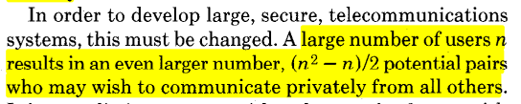
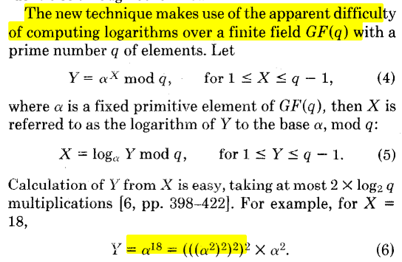

Slide 51
RSA vs. DH (preview)
Diffie-Hellman (1976)
  Key exchange
  Both sides get to choose something random
RSA (1977)
  Encryption
  Signatures

Slide 52
s = m^{d} mod p is not a good signature
If e = d⁻¹ that’s great, you can check it:
m = s^{e} mod p
But, if p is prime it’s trivial mod p to calculate d = e⁻¹ (mod p)

Slide 53
Fermat’s Little Theorem...

Slide 54
a^{p} mod p = a (mod p)
a^{p-1} mod p = 1 (mod p)
a^{p-2} mod p = a⁻¹ (mod p)

Slide 55
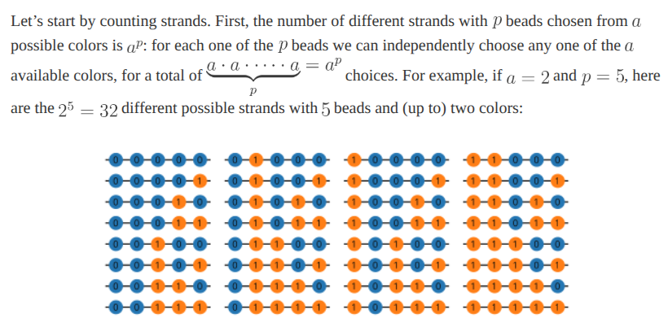
https://mathlesstraveled.wordpress.com/2017/12/12/fermats-little-theorem-proof-by-necklaces/

Slide 56
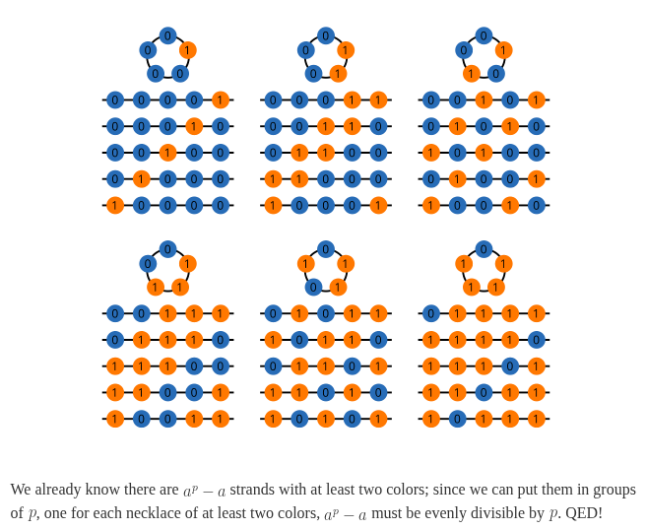
https://mathlesstraveled.wordpress.com/2017/12/12/fermats-little-theorem-proof-by-necklaces/

Slide 57
Finite fields mod p
Multiplicative inverse is just e^{p-2}
So why study the Extended Euclidean algorithm? Because we can’t do signatures with Diffie-Hellman, since Fermat’s little theorem is an easy way to find multiplicative inverses.
Preview: same is true of any finite field, so RSA uses ring theory:
  n = pq where p and q are prime, is a composite number
  φ(n) = (p – 1)(q – 1) is Euler’s totient function, which counts the numbers less than n that are co-prime to n

Slide 58
https://en.wikipedia.org/wiki/Source_(journalism)
"On the record": all that is said can be quoted and attributed.
"Unattributable": what is said can be reported but not attributed.
"Off the record": the information is provided to inform a decision or provide a confidential explanation, not for publication.

Slide 59
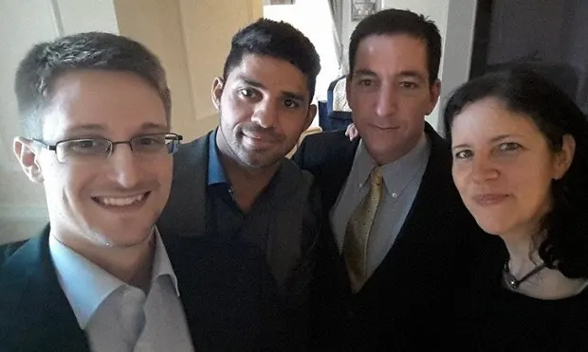
https://www.theguardian.com/film/2014/oct/11/citizenfour-review-snowden-vindicated-poitras-nsa-journalism

Slide 60
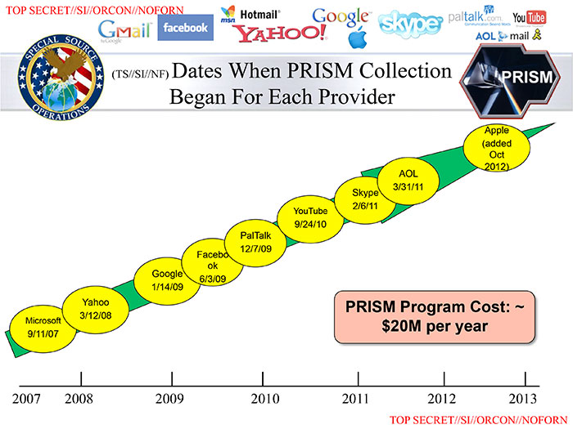

Slide 61
OTR
Off-The-Record messaging
2004, Nikita Borisov, Ian Goldberg, Eric Brewer. "Off-the-Record Communication, or, Why Not To Use PGP"
(PGP is from 1991, basically RSA for email)

Slide 62
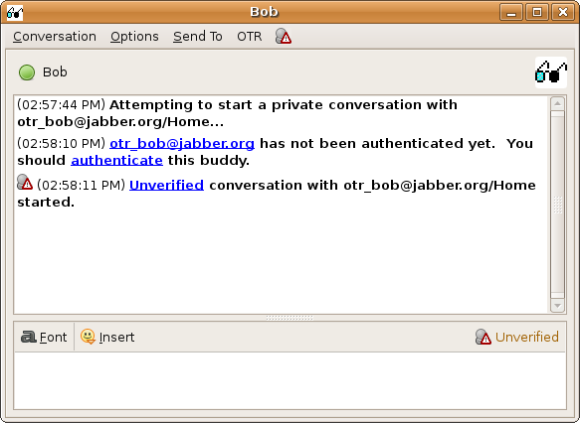
https://otr.cypherpunks.ca/help/3.2.0/authenticate.php?lang=en

Slide 63
Requirements, OTR vs. TLS...
Forward secrecy
  Both OTR and TLS care, for different reasons
Deniable authentication a.k.a. off-the-record
  TLS doesn’t care about this, OTR does
Future secrecy
  TLS doesn’t care about this, OTR does it by accident
Out-of-order messages, parties offline for long periods of time, groups…
  TLS doesn’t need to worry about any of these, nor does OTR (Signal does)

Slide 64
Off-The-Record (OTR) Messaging
Based on Diffie-Hellman and AES, and originally SHA-1
  There are new versions
Deniable Authentication
  “Off the record” in journalism
Forward secrecy
  Ephemeral key exchange
Future secrecy (not a design goal, but has it)

Slide 65
Deniable Authentication
Concept of “malleability”
Basic idea has two parts:
  Hash the decryption key for a message, use the hash digest as an authentication key
  Reveal the authentication key in the next message

Slide 66
Forward secrecy
If Alice or Bob’s key is compromised, past messages cannot be decrypted by the adversary

Slide 67

Ratchet in sailing...
https://www.westmarine.com/harken-snubbair-ratcheting-drum-19471861.html

Slide 68
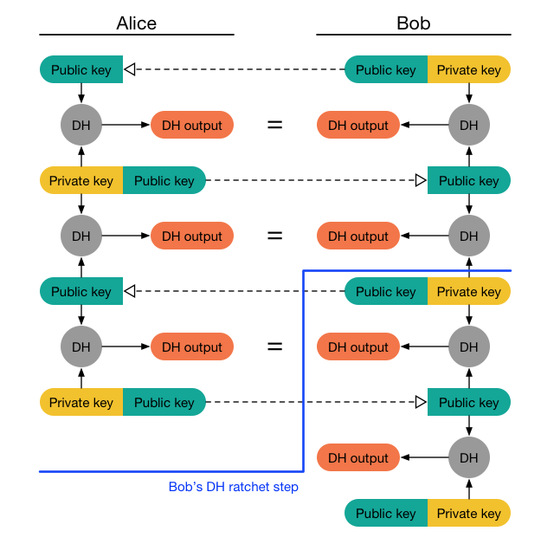
Forward Secrecy (ratchet)
https://signal.org/docs/specifications/doubleratchet/

Slide 69
Future Secrecy
Future secrecy is not the same as forward secrecy, and is in fact sometimes called backward secrecy
If a private key is compromised, the attacker needs to intercept every message thereafter or else the crypto will “self heal”
We get this for free because of the Diffie-Hellman key exchange every time we ratchet in OTR

Slide 70
Signal
Multiple devices, some or all can be offline for long periods of time
Group messages

Slide 71

https://www.cnbc.com/2021/01/12/how-to-use-signal-instead-of-whatsapp.html

Slide 72
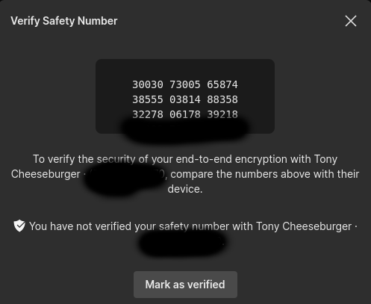
Typical authentication

Slide 73
Signal encryption basics
AES-256 in CBC mode
  Why not a stream cipher?
HMAC-256 with SHA-256 (SHA-2)
Curve25519 for key exchange and signatures

Slide 74
The following about ECC is just FYI…

Slide 75
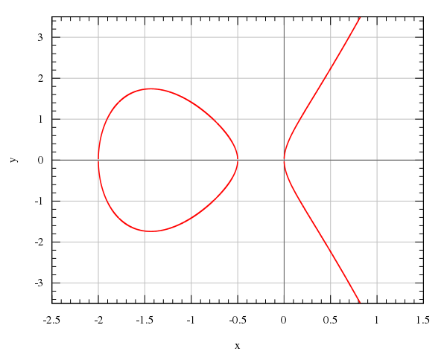
https://commons.wikimedia.org/wiki/File:Montgomery_curve2.svg
Elliptic
Curve

Slide 76
ECC background
“The use of elliptic curves in cryptography was suggested independently by Neal Koblitz[7] and Victor S. Miller[8] in 1985. Elliptic curve cryptography algorithms entered wide use in 2004 to 2005.” -- Wikipedia
SSL/TLS, Signal, LINE, WhatsApp, Viber, SSH, Matrix, WireGuard, Tor, I2P, ProtonMail, … use it

Slide 77
y² = x³ + ax + b

Slide 78
Following figures are from…
https://blog.cloudflare.com/a-relatively-easy-to-understand-primer-on-elliptic-curve-cryptography/

Slide 79
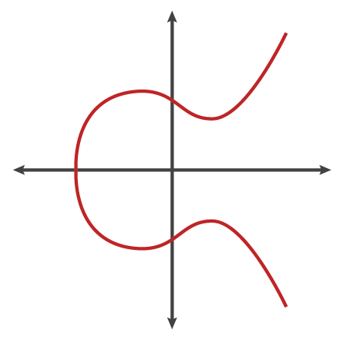

Slide 80
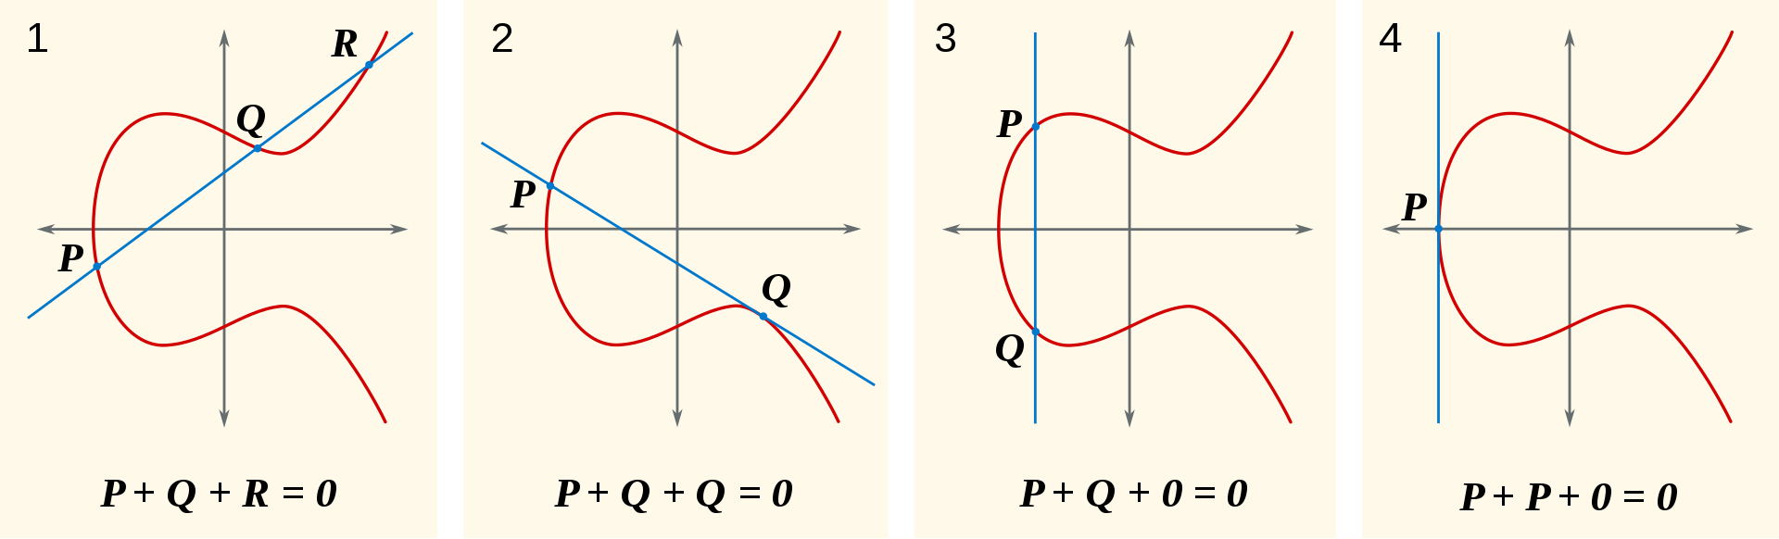
https://en.wikipedia.org/wiki/Elliptic_curve_point_multiplication#/media/File:ECClines.svg
O is point at infinity, serves as identity

Slide 81
How to calculate?
C = -A (negation)
C = 2A (doubling)
  Or, C = A + A
C = nA
  What if n is some astronomically large number?
    Double and add (like “square and multiply” for modular exponentiation) … Trap door function!

Slide 82
More figures stolen from…
https://blog.cloudflare.com/a-relatively-easy-to-understand-primer-on-elliptic-curve-cryptography/

Slide 83
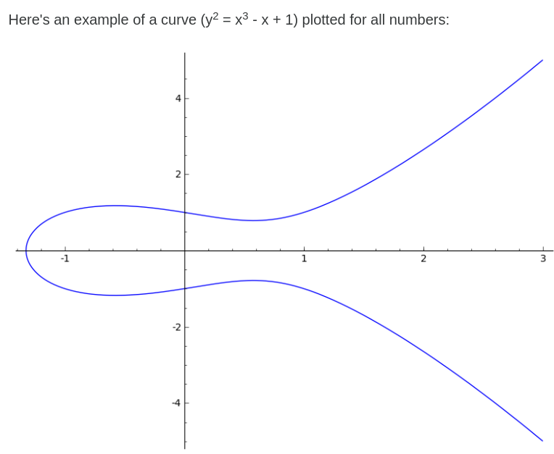

Slide 84
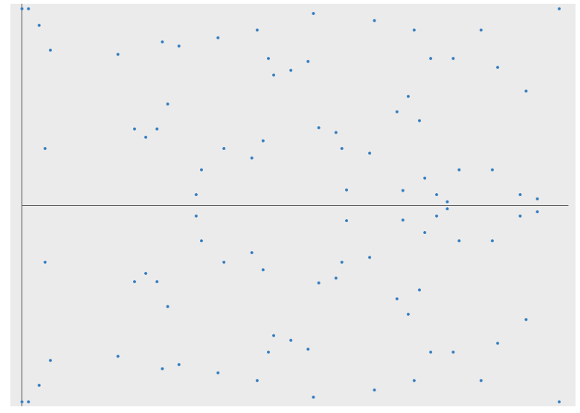

Slide 85
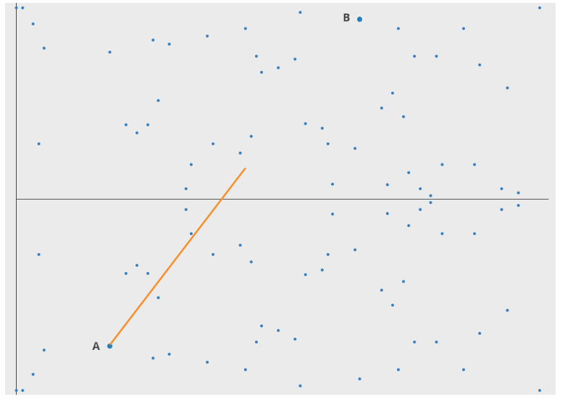

Slide 86
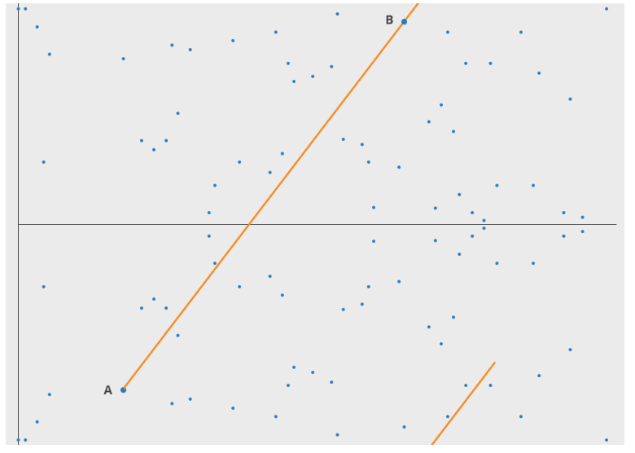

Slide 87
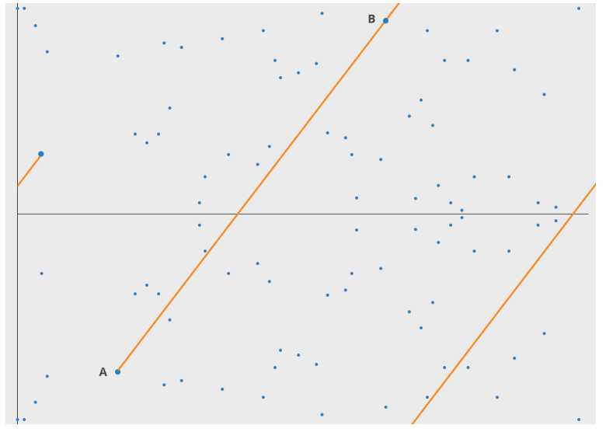

Slide 88
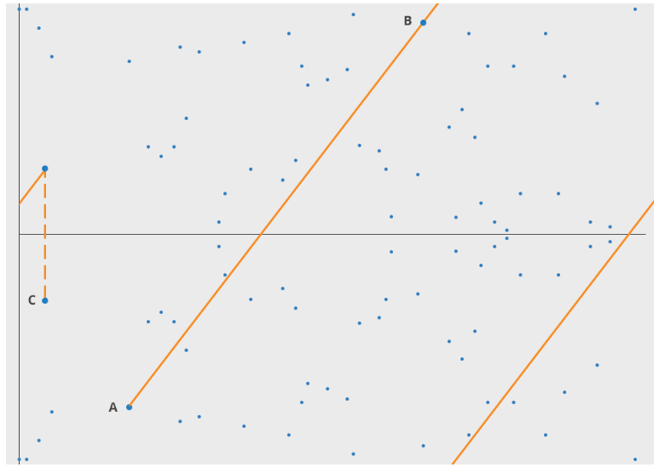

Slide 89
ECDH
https://en.wikipedia.org/wiki/Elliptic-curve_Diffie%E2%80%93Hellman

Slide 90
Can also do...
Elliptic Curve Digital Signature Algorithm (ECDSA)
  PlayStation 3 signing key leak
Elliptic Curve Integrated Encryption Scheme (ECIES)

Slide 91
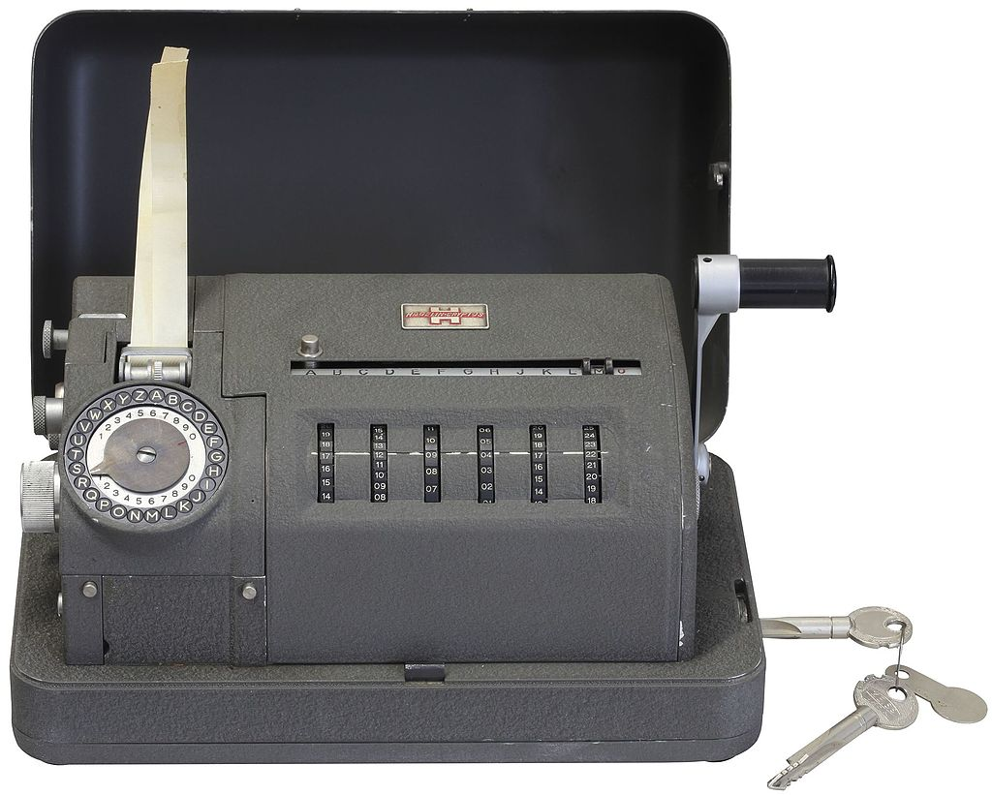
https://en.wikipedia.org/wiki/Crypto_AG#/media/File:Hagelin_CX-52-IMG_0568-white.jpg
https://malicious.life/crypto-ag-the-greatest-espionage-operation-ever-part-1/

Slide 92
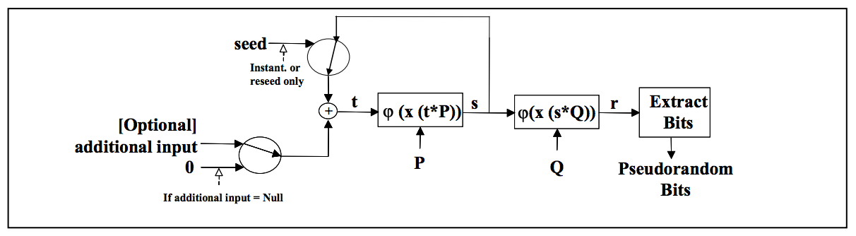
https://matthewdgreen.files.wordpress.com/2013/09/b9dec-dual_ec_diagram.png

Slide 93
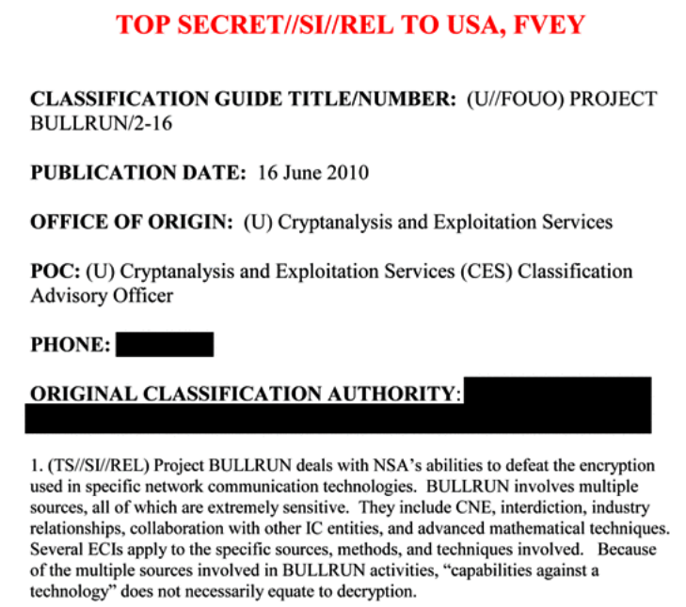
https://upload.wikimedia.org/wikipedia/commons/f/fb/Classification_guide_for_Project_BULLRUN.pdf

Slide 94
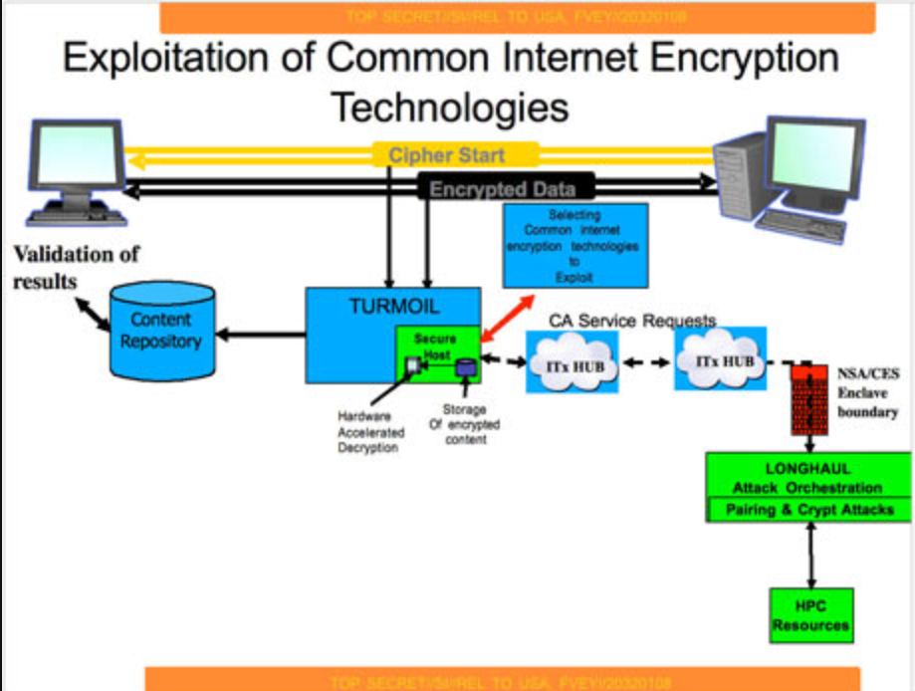
https://upload.wikimedia.org/wikipedia/commons/e/e1/NSA-diagram-001.jpg

Slide 95
Main takeaways about ECC
Common choice because it’s more efficient, does key exchange and signatures
  Not 100% immune to side channels or padding issues
  Not quantum resistant

Slide 96
If you’re interested in more…
https://www.youtube.com/watch?v=CPHLvx6jbOc

Slide 97
Back to Signal…

Slide 98
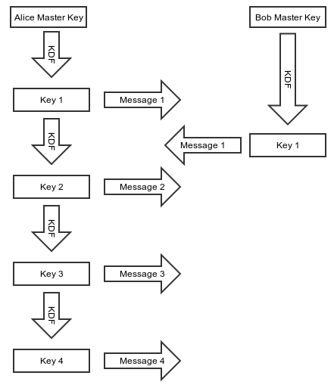
Silent Circle SCIMP ratchet

Slide 99
Tradeoffs
Both have forward secrecy, but SCIMP’s is better
  In synchronous case, can ratchet and delete old key right away if Bob acknowledges it and ratchets, too
OTR ratchet not great for multiple devices, devices that go offline
SCIMP ratchet leaves key material around for a long time if messages are lost or out of order
OTR ratchet “self heals”, i.e., future/backward sececy

Slide 100
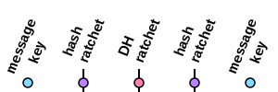
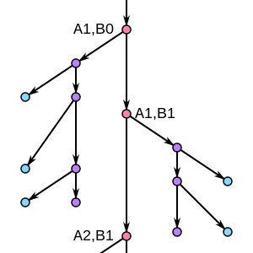
Double Ratchet
https://en.wikipedia.org/wiki/Double_Ratchet_Algorithm

Slide 101
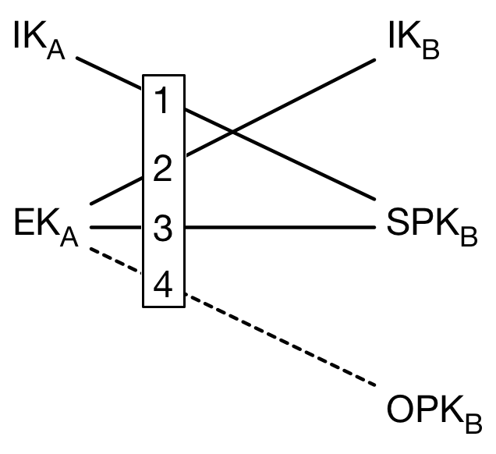
X3DH
IK = Identity Key
EK = Ephemeral Key
SPK = Signed Pre-Key
OPK = One-Time Pre-Key
SK = KDF(DH1 || DH2 || DH3 || DH4)
Alice’s first message encrypts the two on the left, authentication for Bob’s SPK comes from the signature.
Deniability?

Slide 102
Zero Knowledge Proofs
Used for forming groups in Signal
“a method by which one party (the prover) can prove to another party (the verifier) that a given statement is true while the prover avoids conveying any additional information apart from the fact that the statement is indeed true”
  https://en.wikipedia.org/wiki/Zero-knowledge_proof (also the source of the following images and examples)

Slide 103
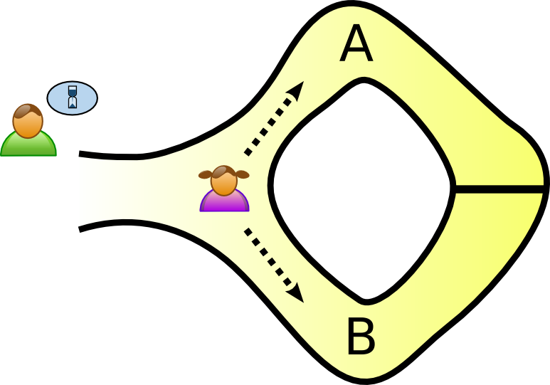

Slide 104
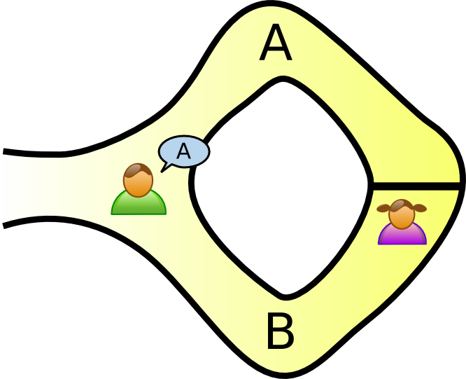

Slide 105
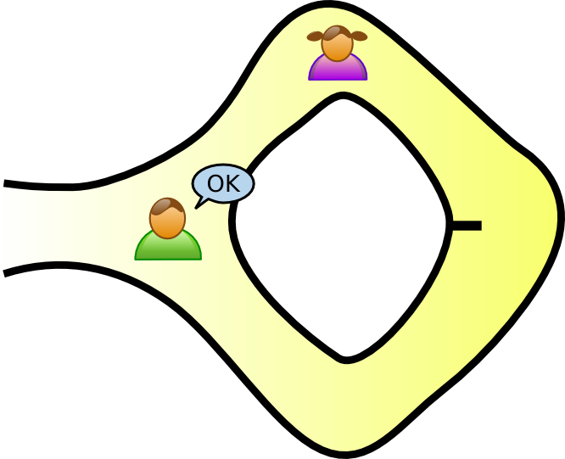

Slide 106
Example with discrete log
g^{x} mod p = y
  Peggy wants to prove she knows x
Each round, Peggy computes C = g^{r} mod p
  She generates r randomly
In each round, Victor can ask for…
  r --or--
  (x + r) mod (p – 1)
  g^{(x + r) mod (p – 1)} mod p = g^{x}g^{r} mod p = Cy mod p

Slide 107
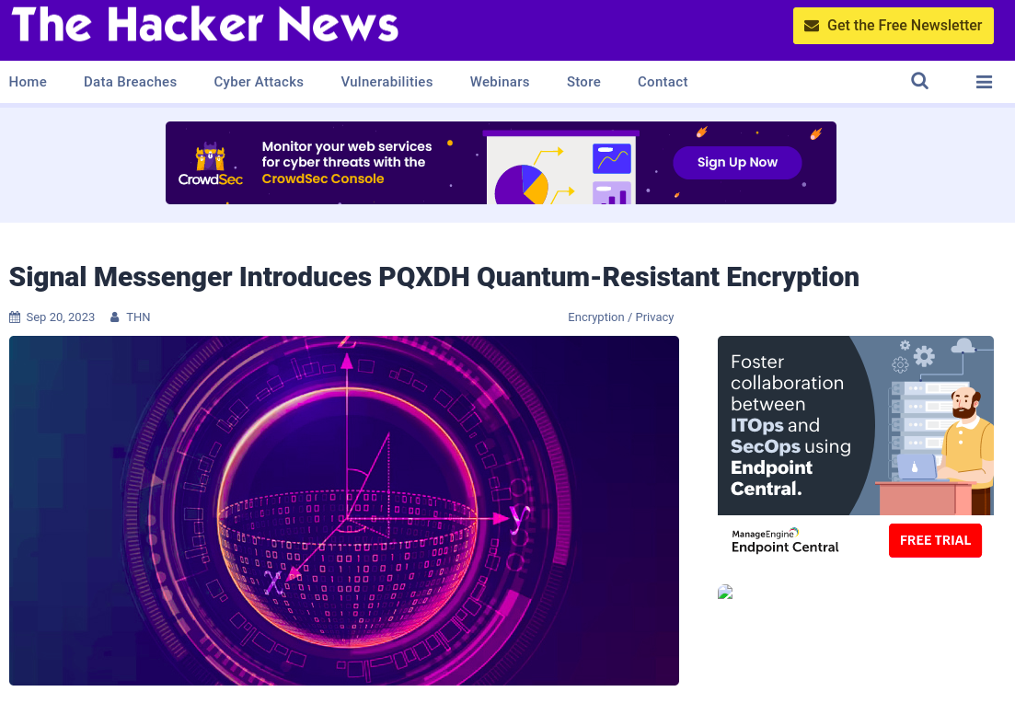

Slide 108
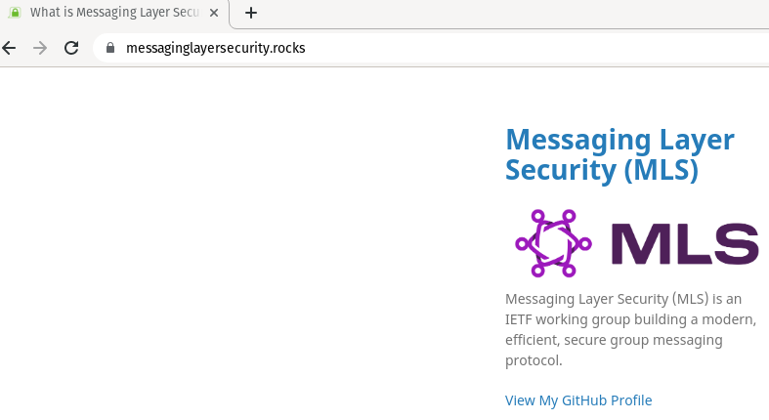
Two key differences with Signal:
-Federated
-No deniability

Slide 109
Resources
https://signal.org/blog/advanced-ratcheting/
https://en.wikipedia.org/wiki/Off-the-Record_Messaging
https://en.wikipedia.org/wiki/Double_Ratchet_Algorithm
https://signal.org/docs/specifications/doubleratchet/
https://signal.org/docs/specifications/x3dh/
https://www.youtube.com/watch?v=7WnwSovjYMs
https://en.wikipedia.org/wiki/Global_surveillance_disclosures_(2013%E2%80%93present)
https://en.wikipedia.org/wiki/Global_surveillance_disclosures_(2013%E2%80%93present)
https://thehackernews.com/2023/09/signal-messenger-introduces-pqxdh.html

Slide 110


Slide 111


Slide 112

Cryptography Engineering by Ferguson et al.

