Slide 1

ConceptDoppler: A Weather Tracker for Internet Censorship
Jedidiah R. Crandall
(crandall@cs.unm.edu)
Joint work with Daniel Zinn, Michael Byrd,
Earl Barr, and Rich East
Proceedings of CCS 2007
Notes:
I’m going to talk about research we did on the great firewall of china:
The probably most sophisticated internet censorship project that is out there.
We found out interesting things: the GFC is not a firewall in the conventional sense,
Interesting blocked words, and I will talk about all that.

Slide 2
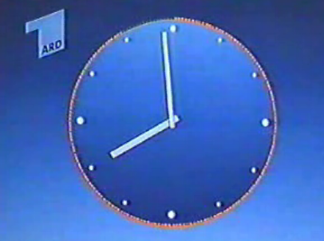
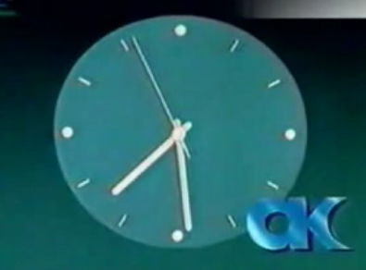
Censorship is Not New
Tagesschau
Western Germany
Aktuelle Kamera
Eastern Germany
Notes:
These are screenshots of … before the news (aktuelle Kamera and tagesschau)
- grew up …
..
So censorship is not new, but with new technologies, such as the internet it’s get interesting. Especially in China, where the internet growth is greater than in the US, today.

Slide 3
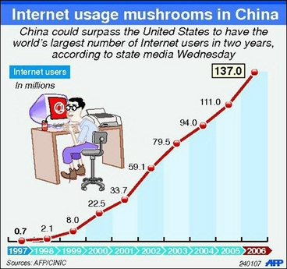
Internet Usage in China
Notes:
Number of interent users increases a lot faster in China than it does in the US
2 years: outnumber (study, article)
Already more time on the internet than US citizens
Easy access to THE WORLD’s information – never was so easy to get information,
And, not very surprisingly, it is tried to restrict some of the content by censoring.

Slide 4
Open Net Initiative
Internet Censorship
3 of 41 countries in 2002
25 of 41 countries in 2007

Slide 5
Why study censorship in other countries?
Topological and router filtering issues
DDoS and Worm defenses
Protect America Act
Surveillance on internal U.S. routers
Keyword filtering
Libraries, airlines, congress
http://www.assembly.ca.gov
Specific policy implications
Global censorship = Trade barrier issue?
Notes:
Chinese Gov, for example, claims that it is censoring p and sed
Having a list, would be good in any sort of discussion about censorship to base arguments on it
We found many, many words not related to p and sedition – some politics, but also very surprising ones
(Generalfeldmarschall -- leader of the prussian army for 30 years) 1800s

Slide 6

Internet Censorship in China
Called the “Great Firewall of China,” or “Golden Shield”
IP address blocking
DNS redirection
Legal restrictions
etc…
Keyword filtering
Blog servers, chat, HTTP traffic
All probing was performed from outside of China
Notes:
Huge project
Different mechanism: legal restrictions
Chin-chin and Cha-Cha – logo for internet police. They will pop up in internet cafes, indicating “the internet is safe now”.
Then, Keyword filtering
More targeted, fine-grainer than whole IP addresses
More dynamic (I newly created page is blocked right away)
blogs, chats, … http traffic – where we will focus on
Despite the fact that it is a more advanced technique of internet censorship, keyword blocking is in itself interesting

Slide 7
Why is Keyword Filtering Interesting?
China’s implementation offers a unique opportunity to locate the routers that are doing the filtering from outside the country
Keywords can provide insights into the causes and consequences of Internet censorship
Notes:
Chinese Gov, for example, claims that it is censoring p and sed
Having a list, would be good in any sort of discussion about censorship to base arguments on it
We found many, many words not related to p and sedition – some politics, but also very surprising ones
(Generalfeldmarschall -- leader of the prussian army for 30 years) 1800s

Slide 8
Why is Keyword Filtering Interesting?
Chinese government generally claims to be targeting pornography and sedition
The keywords provide insights into what material the government is targeting with censorship, e.g.
红色恐怖 --- Red Terror
希特勒 (Hitler), and 我的奋斗 (Mein Kampf)
多维尔 --- Deauville, a town in France
转化率 --- conversion rate
Notes:
Chinese Gov, for example, claims that it is censoring p and sed
Having a list, would be good in any sort of discussion about censorship to base arguments on it
We found many, many words not related to p and sedition – some politics, but also very surprising ones
(Generalfeldmarschall -- leader of the prussian army for 30 years) 1800s

Slide 9
Outline
Firewall or Something Else?
Where are filtering routers?
Who is doing filtering?
How reliable is filtering?
Blocked Words
Which words to select?
Which words are blocked?
Imprecise Filtering
What implications does keyword filtering have?
Notes:
In this talk, I’ll present three main results.
- gfc is not a conventional firewall (into experimental setup and show who, where, how reliable
- go into how to efficiently select words to probe if blocked
- flavor what words are blocked
- 3rd thing, a cause of keyword filtering we call ‘imprecise filtering’

Slide 10
Outline
Firewall or Something Else?
Where are filtering routers?
Who is doing filtering?
How reliable is filtering?
Blocked Words
Which words to select?
Which words are blocked?
Imprecise Filtering
What implications does keyword filtering have?

Slide 11
Firewall?
大纪元时报
大纪元时报
刘晓峰
刘晓峰
民运
民运
Notes:
Perfect: DROPs packets to port 80 ALL the time
Not the case for the GFC.
At the border, protect inside … for the GFC?

Slide 12
Where Are Filtering Routers
Different opinions about where censorship occurs:
In three big centers in Beijing, Guangzhou, and Shanghai
At the border
Throughout the country’s backbone
At a local level
An amalgam of the above
Notes:
Before I can show our specific findings, let’s have a look at how the keyword filtering is implemented.

Slide 13
Filtering With Forged RSTs
Clayton et al., 2006.
Comcast also uses forged RSTs
Common technique used by IPSs
Notes:
So, let’s see an example.

Slide 14
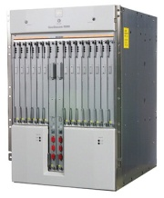



Dissident Nuns on the Net
<HTTP> … </HTTP>
GET falun.html
Notes:
Usual browsing session.
Open connection, ..
HTML GET request, travels across the internet
HTML response
What happens in the chinese internet?

Slide 15

Censorship of HTML GET Requests
RST
RST
GET falun.html
Notes:
With HTML responses

Slide 16
Censorship of HTML Responses
<HTTP> falun …
RST
RST
GET hello.html
Notes:
But where are the routers??

Slide 17

Locating Filtering Routers
ICMP Error
TTL=1 falun

Slide 18
Locating Filtering Routers
ICMP Error
TTL=1 falun
RST
RST
TTL=2 falun
Notes:
- Count the hops along our path to the culprit, router that does a little more than packet forwarding…

Slide 19
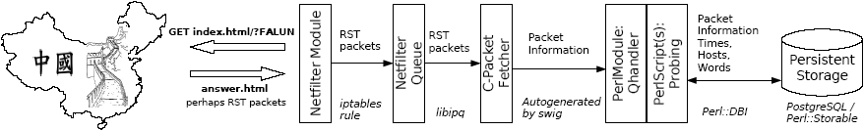
ConceptDoppler Framework
Netfilter (iptables) to capture packets
Queue module to hand packets over to user-space
Own TCP stack implementation
Scapy for constructing custom packets
Storing packets in PostgreSQL database
Scapy stored procedures in DB
Notes:
Using this whole machinery, we conducted several experiments…

Slide 20
Experimental Setup
Google “site:.cn” to find random destination sites in China
Performed TTL-Modulation
Traceroute immediately before blocking test
Whois to query ISPs
Probed over a two-week period
Result: Where are the GFC routers? Which ISP?

Slide 21
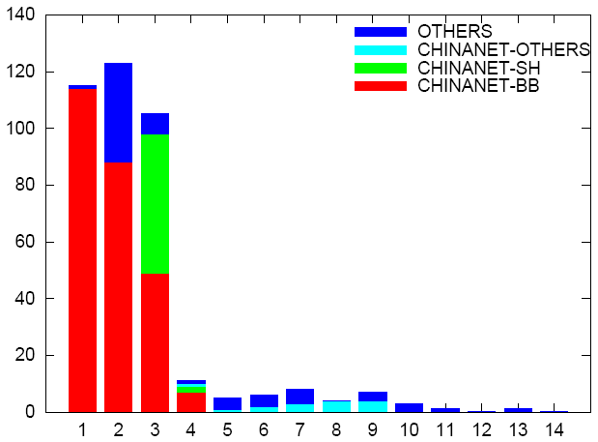
Hops into China Where Filtering Occurs
Blocked Paths
28% of paths were never filtered over two weeks of probing
# Unique Paths
Depth into China
Notes:
Who is doing the blocking:
- chinanet BB, Chinanet-SH, Chinanet-others
- AND up to 20 other smaller ISPs inside china closer to the destination
You might think chinanet is huge, so it does most of the blocking –
Yes and No.

Slide 22
First Hops
ChinaNET performed 99.1% of all filtering at the first hop (and 83% of all filtering)
Notes:
Chinanet is a major player, but it does over-proportionally more blocking than others.
28% slipped through – also experient…

Slide 23
Outline
Firewall or Something Else?
Where are filtering routers?
Who is doing filtering?
How reliable is filtering?
Blocked Words
Which words to select?
Which words are blocked?
Imprecise Filtering
What implications does keyword filtering have?
Notes:
For paths that do filter, we also looked into how reliable they do so.

Slide 24
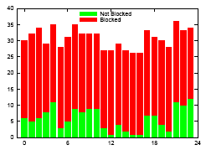
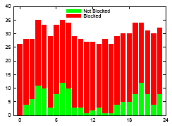
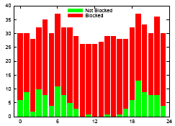
Slipping Words Through - Diurnal Pattern
Repeat
While “Falun” is not blocked
green++
red++
While “Test” is blocked
wait
Forever
Notes:
Never execute the line green++
Over three days

Slide 25
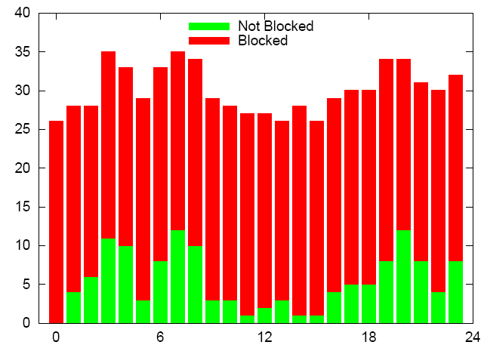
Slipping Words Through -Diurnal Pattern
# Probes
Time ( 0 = 3pm in Bejing)
Notes:
So, what does this tell us?

Slide 26
Firewall?
大纪元时报
大纪元时报
刘晓峰
刘晓峰
民运
民运

Slide 27
Panopticon
大纪元时报
刘晓峰
Imperfect filtering
Not strictly at the border
Promotes self-censorship
Good enough
Defeating a Panopticon is different than defeating a firewall
民运
Notes:
Designed to be not perfect – promotes self-censorship
Slip word through – can open a connection (SYN flags were blocked) and exploit the buffer overflow.

Slide 28
Outline
Firewall or Something Else?
Where are filtering routers?
Who is doing filtering?
How reliable is filtering?
Blocked Words
Which words to select?
Which words are blocked?
Imprecise Filtering
What implications does keyword filtering have?
Notes:
Finding the corpus of words that are blocked.
How to select words for probing?
Select randomly from a dictionary? (Or sequentially – start with A)
Invasive
Bandwidth issues
Does not scale to change detection

Slide 29
Latent Semantic Analysis (LSA)
Deerwester et al., 1988
Document summary technique to find conceptual relationships between documents and words
Notes:
Document summary technique to relate words to each other
Especially, if you don’t speak any Chinese? Yet alone being able to read it??

Slide 30
Latent Semantic Analysis (LSA)
“A is 5 furlongs away from B”
“A is 5 furlongs away from C”
“B is 8 furlongs away from C”
Notes:
Document summary technique to relate words to each other
Especially, if you don’t speak any Chinese? Yet alone being able to read it??

Slide 31
LSA in a Nutshell
A
5 5
B
C
8

Slide 32
Latent Semantic Analysis (LSA)
“A, B, and C are all three on a straight, flat, level road.”
Notes:
32
Additive Gaussian noise

Slide 33
LSA in a Nutshell
9
B
4.5 4.5
A
C

Slide 34
Chinese Version of Wikipedia
Notes:
Documents are pages, as terms we chose the links – not only a manageable size for the LSA-mathematics – but also solves the problem of having no space in chinese…
So, we have the corpus – how does LSA work?

Slide 35
LSA of Chinese Wikipedia
n=94863 documents and m=942033 terms
tf-idf weighting
Matrix probably has rank r where k<r<n<m
Implicit assumption that Wikipedia authors add additive Gaussian noise
SVD and rank reduction to rank k
Notes:
Won’t go into the details of LSA – refer to our paper and the literature. So, I will glance over this.
- big matrix how often does each term occur in each document
- COLUMN – documents
- ROW - terms
- normalize sum of the ROW
Underlying conceptspace with rank smaller than n,m
Might be some noise – author chooses terms from the concept, and we give him some freedom to choose a few unrelated words with a Gaussian distribution
SVD to get a matrix of rank k (600) in our case
What does this give us?
Transformation into conceptspace – where we can compare terms using cosine similarity.
Basically we have a distance metric for all our terms that tells us how related they are with each other.
So we could implement an incremental word discovery process…

Slide 36
10 + 2 Seed Concepts
Notes:
Start – discover, add as seeds, discover, etc.
Flavor of how one of our lists looks like:

Slide 37
Words correlated with 六四事件 – June 4th Events
1 : 六四事件 – June 4th Events
2 : 重庆高家花园嘉陵江大桥 - Chongqing high family garden Jialing River bridge
3 : 欒提羌渠 - Yu Fulo (related to Chinese Eastern Han Dynasty)
4 : 李建良 - Li Jianliang
5 : 美丽岛事件 - Gaoxiong event (violent political event 1979)
6 : 赵紫阳 - Zhao Ziyang (Name, related to China travel logistics)
7 : 統戰部 - United front activities department
8 : 陈炳德 - Chen Bingde
9 : 洛杉磯安那罕天使歷任經營者與總教練 - Los Angeles Angels of Anaheim ..
10 : 李铁林 - Li Tielin (Government official)
11 : 邓力群 - Deng Liqun (Chinese politician)
12 : 中国政治 - Chinese politics
13 : 中共十四大 - The Chinese Communist Party 14th …
14 : 改革开放 - Reform and open policy
15 : 报禁 - The newspaper endures
…. to 2500
Notes:
Then we use this list of 2500 words to discover new one. The next slide shows the effectiveness of this methods

Slide 38
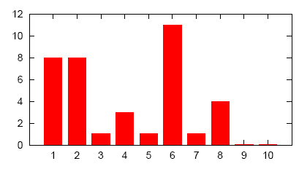
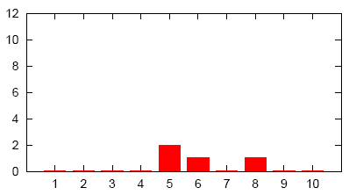
Efficient Probing
Epoch Times
Random Words
Blocked words
Blocked words
250-word-bins
250-word-bins
37
4
vs.
Notes:
Enough of all this pre-talk – which words are actually blocked:

Slide 39
Blocked Words (122 discovered)
Pornography:
色情 --- Pornography
处女卖淫案 --- Virgin prostitution law case
Politics:
反人类罪 --- Crime against humanity
专政 --- Dictatorship (party), also 群众专政, 独裁, 一党专政, 专制
红色恐怖 --- Red Terror
六四事件 --- June 4th events (1989 Tiananmen Square protests)
藏独 --- Tibet Independence Movement
Others:
封杀 --- Block
桥头电厂 --- (Qinghai) Qiaotou power plant
卢多维克·阿里奥斯托 --- Ludovico Ariosto
Notes:
Leads to the last part of the talk.

Slide 40
Outline
Firewall or Something Else?
Where are Filtering Routers?
Who is doing Filtering?
How Reliable is Filtering?
Blocked Words
Which words to select?
Which words are blocked?
Imprecise Filtering
What implications does keyword filtering have?

Slide 41
Imprecise Filtering
Filtered:
北莱茵-威斯特法伦 (Nordrhein-Westfalen – German state)
国际地质科学联合会 (International geological scientific federation)
卢多维克·阿里奥斯托 (Ludovico Ariosto – Italian Poet)
Because:
法伦
(Sounds like Falun Gong)
学联
(student federation)
多维
(multidimensional)
Notes:
Italian Poet 12 hundrets
Blocked words occur as characters in unrelated words.
Not only is there this kind of imprecise filtering, but
By censoring specific words you also end up blocking a lot more than you want to.

Slide 42
Keyword-based Censorship
Censor the Wounded Knee Massacre in the Library of Congress
Remove “Bury my Heart at Wounded Knee” and a few other select books?
Remove every book containing the keyword “massacre” in its text?

Slide 43
Massacre
Dante’s “Inferno”
“The War of the Worlds” by H. G. Wells
“King Richard III,” and “King Henry VI,” Shakespeare
“Adventures of Tom Sawyer,” Mark Twain
Jack London, “Son of the Sun,” “The Acorn-planter,” “The House of Pride”
Thousands more
Notes:
Is this just masacre?

Slide 44
More Imprecision
Crime against humanity
Dictatorship
Suppression
Block
Hitler
Strike
“The Economic Consequences of the Peace,” John Maynard Keynes
The U.S. Constitution
“Origin of Species,” by Charles Darwin
“Computer Organization and Design,” P. H.
Virtually every book about World War II
“White Fang,” “The Sea Wolf,” and “The Call of the Wild,” Jack London
Hypothetical?
Notes:
No – examples ….
Hypothetical?

Slide 45
Actually Blocked (in GET requests)
屠杀 | Massacre
反人类罪 | Crime against humanity
专政 or 专制 | Dictatorship
镇压 | Suppression
封杀 | Block
希特勒 | Hitler
罢工 | Strike
Notes:
Thousands more words, imagine Internet is a big library.
These kind of words are the reason of why we want to use a censorship weather report to keep track of the work.

Slide 46
Conclusions
Firewall vs. Panopticon
GFC implemented mostly near the borders by Chinanet, but also inner routers perform filtering
Filtering is NOT reliable:
Routes without GFC routers
Unreliable during busy periods of the days
Blocked words
More than pornography and sedition
LSA can help to increase probing efficiency
Imprecise Filtering
You block a whole lot more than you probably want to
Notes:
To conclude my talk.

Slide 47
Rumors…
“The undisclosed aim of the Bureau of Internet Monitoring…was to use the excuse of information monitoring to lease our bandwidth with extremely low prices, and then sell the bandwidth to business users with high prices to reap lucrative profits. ”
---a hacker named “sinister”

Slide 48
Rumors…
“At the recent World Economic Forum in Davos, Switzerland, Sergey Brin, Google's president of technology, told reporters that Internet policing may be the result of lobbying by local competitors.”
---Asia Times, 13 February 2007

Slide 49
Rumors…
“If someone is shouting bad things about me from outside my window, I have the right to close that window.”
---Li Wufeng

Slide 51
Future Work
ConceptDoppler – A Censorship Weather Report What words are censored today?
Track the blacklist over a period of time, to correlate with current events
Named entity extraction, online learning
Scale up (bigger corpus, more words, advanced document summary techniques)
Notes:
With the words we then can ask more interesting questions,

Slide 52
Future Work
What are the effects of keyword filtering?
What content is being targeted?
What content is collateral damage due to imprecise filtering?
Where exactly is filtering implemented?
More sources
Topological considerations
IP tunneling, IPv6, IXPs, …
Notes:
Such as … what concepts are targeted?
and what words / topics are blocked due to imprecise filtering?
Also our internet measurement results clearly have potential for interesting future research…

Slide 53
Efforts at UNM and UMich Crandall, Forrest, Saia, Lane, Page
Network tomography
Analog of the projection slice theorem (based on Fourier transform) exploiting spectral graph theory
Interpreting the keyword blacklist
Semi-supervised learning methods
Game theory
Include topological aspects of the network and architectural aspects of the routers by combining equilibrium game theory and algorithmic game theory

Slide 54
Questions?
Thank You.
http://www.conceptdoppler.org

Slide 55
11 types of info that are illegal to disseminate
Violating the constitution
State security, state secrets, etc.
Harming national interests
Inciting hatred, racism
Disrupting national policy on religion
Spreading rumors, disrupting social order
Porn, gambling, violence, etc.
Libel against 3rd parties
Other
Added in 2005
Inciting illegal assemblies
Conducting activities of an illegal organization

