Slide 1
Experiences Using Minos as a Tool for Capturing and Analyzing Novel Worms for Unknown Vulnerabilities
Jedidiah R. Crandall†, S. Felix Wu†, and Frederic T. Chong‡
†University of California, Davis
‡University of California, Santa Barbara

Slide 2
Goals
Describe Minos and its efficacy as a honeypot technology for automated response
Analyze attacks captured by Minos in order to estimate the limits of worm polymorphism
Notes:
Transition to next slide: The outline of this talk…

Slide 3
Outline
Vulnerability Landscape
Minos
Epsilon-Gamma-Pi Model
Exploits Caught by Minos
Future Work
Notes:
Transition to next slide: But first, the main contributions of this paper are…

Slide 4
Main Contributions (1)
Minos as a honeypot technology
  No false positives after 12 months of operation
  Has caught all 9 of the actual control data exploits thrown at it without any prior knowledge about the exploit or vulnerability
  Can catch control data exploits for unknown vulnerabilities in any part of the system: security products, CPL==0 exploits, passive exploits, etc.
Notes:
Should say here exactly how Minos works

Slide 5
Main Contributions (2)
Epsilon-Gamma-Pi model
  Epsilon (ε) = Exploit Vector
  Gamma (γ) = Bogus Control Data
  Pi (π) = Payload
Analysis in the paper
  NOP sleds are not needed in Windows exploits
  Quantification of how much polymorphism is possible in γ and π (ε left to future work)
Notes:
Transition to next slide: What kinds of vulnerabilities will honeypot technologies such as Minos need to address in the future?

Slide 6
Vulnerability Landscape
Laws of Vulnerabilities (Gerhard Eschelbeck of Qualys at Blackhat 2004)
  Half-life of critical vulnerabilities is 21 days
  Half of the most prevalent are replaced by new vulnerabilities every year
  Lifespan of some vulnerabilities and worms is unlimited
  80% of worms and automated exploits occur in the first two half-lives
Notes:
Patches aren’t working
Transition to next slide: With SP2, SELinux, and anti-virus becoming more popular, where should we expect to find these vulnerabilities?

Slide 7
Vulnerability Landscape (2)
Vulnerabilities in security products
  2004: 60 critical flaws in security products, almost double the 31 in 2003, 2005 up to May: 23, up 50% over 2004 (Sarah Lacy at BusinessWeek, 17 June 2005)
    Now outnumber critical Microsoft vulnerabilities
  Witty worm: ISS products, 2 days from vulnerability disclosure to the worm outbreak
  “Remote Windows Kernel Exploitation” by Barnaby Jack at eEye describes exploitation of a remote CPL==0 buffer overflow in Symantec Personal Firewall
Notes:
Many honeypot technologies only protect specific services, or even rely on these security products
Transition to next slide: CPL==0 exploits like the last example will become more common

Slide 8
Vulnerability Landscape (3)
Remote vulnerabilities in CPL==0
  eEye paper from the last slide
  14 June 2005: Remote heap buffer overflow in Microsoft Windows SMB implementation
  Much processing of network data occurs in Windows kernel space: 2/3 of LSASS exploit vector, TDIs, RPC, Mailslots, Named Pipes, etc…, even IIS 6.0 HTTP processing
  Windows (Feb 2005) and Linux (Nov 2004) both had remote SMBFS buffer overflows (but require victim to visit attacker’s SMB share)
Notes:
Using traditional IDS on the honeypot won’t work in the kernel
Transition to next slide: the last bullet is passively exploited, which is another challenge for honeypots which assume that all outgoing traffic signals an infection

Slide 9
Vulnerability Landscape (4)
Passively exploited vulnerabilities
  SMBFS flaws in Windows and Linux from the last slide
  Web browsers with buffer overflows, etc.
  P2P networks
Notes:
Traditional honeypots assume all outgoing traffic signals an intrusion
Transition to next slide: The 21-day half-life and 2-day turn-around of Witty only applies to vulnerabilities discovered by the good guys

Slide 10
Vulnerability Landscape (5)
0day vulnerabilities
  Of 13 vulnerabilities we studied, none were discovered by the software vendor
  If 3rd party researchers can discover 0day vulnerabilities, so can attackers
  May 2005: Zero-day exploits for unknown vulnerabilities in Mozilla Firefox
Notes:
Honeypot needs to be prepared for an exploit in any part of the system
Transition to next slide: What this all means is that…

Slide 11
Automated honeypot technologies must be able to analyze exploits for unknown vulnerabilities in places heretofore not considered.
Notes:
Transition to next slide: Minos honeypots are capable of catching all of these sorts of exploits. Minos is based on architecture we presented at MICRO 2004…

Slide 12
Minos
The Minos architecture was introduced in [Crandall, Chong. MICRO 2004]
Bochs emulations of Minos serve as excellent honeypots
  Linux
  Windows XP/Whistler (not as secure without kernel modifications, but good enough)
Attacks in this paper were either on 1 on-campus honeypot in the summer of 2004 or 3 off-campus honeypots between Dec 2004 and Feb 2005
Some (such as CRII, Slammer, Blaster, and Sasser) occur daily and, at times, hourly
Notes:
Transition to next slide: First, we need to define control data and be specific about what attacks Minos was designed to catch

Slide 13
What is control data?
Any data which is loaded into the program counter on control flow transfer, or any data used to calculate such data
Executable code is not control data
Minos catches control data attacks (buffer overflows, format strings, double free()s, etc.)
  Control data attacks constitute the majority of remote intrusions
  Minos has some limitations described in MICRO2004
  Minos was not designed to catch directory traversal, default passwords, high-level control flow hijacking like the Santy worm, or the attacks described in [Chen et. al., USENIX 2005].
Notes:
Basic Minos concept could be applied to any of these.
Transition to next slide: How does Minos catch control data attacks?

Slide 14
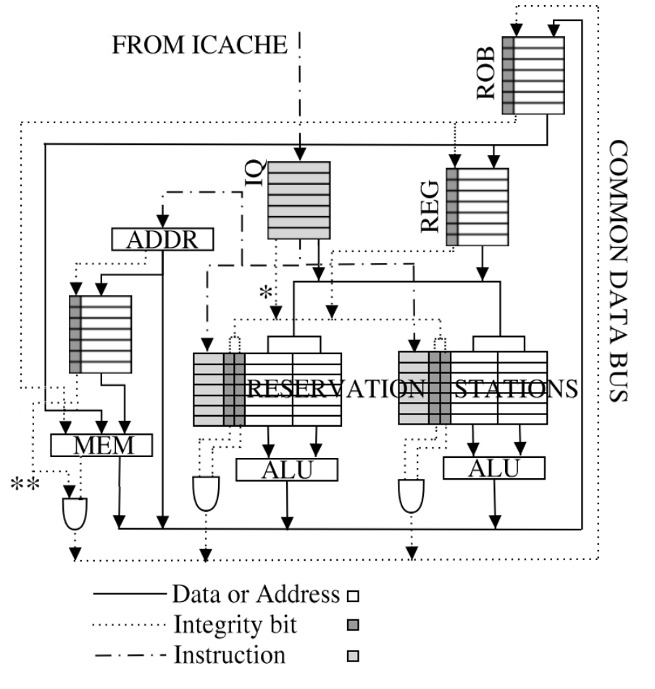
How Minos Works
Tag bit for every data word
Biba’s low-water-mark policy
8/16-bit loads/stores and immediates are low integrity
Changes to Linux kernel detailed in MICRO2004, analysis is done with gdb
No changes to Windows at all, network card port I/O is assumed low integrity, analysis done with Bochs debugger
Notes:
Transition to next slide: Now we’ll switch gears and discuss our analysis of the actual exploits Minos has captured, but first we need a model to help us be more precise in describing control flow hijacking attacks and polymorphism

Slide 15
The Epsilon-Gamma-Pi Model (1)
Main motivation for this model was to be able to discuss polymorphism more clearly and precisely
Attacks are split into three distinct phases (ε , γ, and π) because for each phase the polymorphic techniques are different
Notes:
Transition to next slide: Why mappings?

Slide 16
The Epsilon-Gamma-Pi Model (2)
Epsilon, Gamma, and Pi are mappings to capture the differences between data as it passes over the network and data as it is processed in the physical machine
  i.e. for Code Red II the row space of γ is “25 75 63 62 64 33 25 75 37 38 30 31” and the range is “d3 cb 01 78”, both representations of 0x7801cbd3
  WORM vs. WORM [Castaneda et al. WORM2004] assumed the row spaces and ranges of ε , γ, and π were disjoint sets of bytes and thus parts of the “black worm” may be left behind in the “white worm”
Notes:
Transition to next slide: This figure is the correct version of the erroneous one in the processdings

Slide 17
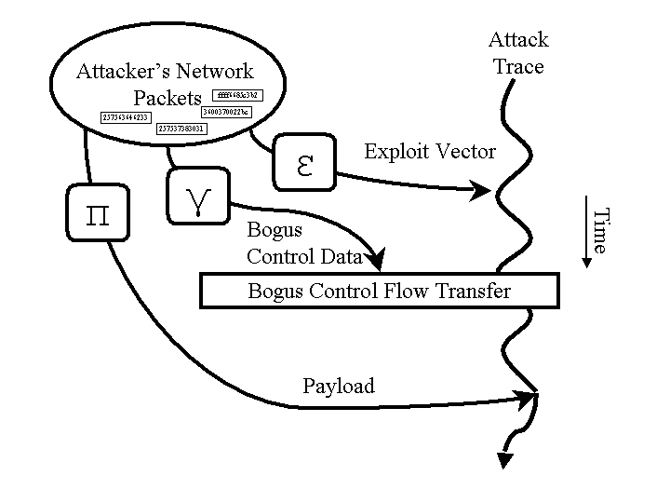
The Epsilon-Gamma-Pi Model (3)
Notes:
Note: paper is bassackwards
Transition to next slide: Now we’ll look at the attacks. Why look at exploits in detail? Because it can help us shed light on details of defense…

Slide 18
Gratuitous Von Clausewitz Quote
“Where two ideas form a true logical antithesis, each complementary to the other, then fundamentally each is implied in the other.”
--Carl von Clausewitz, On War, 1832
Notes:
Transition to next slide: For the paper we looked at 8 actual exploits in detail…

Slide 19
Actual Attacks Caught by Minos
Name | Vuln | Type | First Hop | Port
SQL Hello | SQL 2000 | Buff. Over. | Register Spring* | 1433 TCP
Slammer | SQL 2000 | Buff. Over. | Register Spring* | 1434 UDP
Code Red II | IIS 4.0-5.0 | Buff. Over. | Register Spring* | 80 TCP
DCOM (Blaster) | Windows | Buff. Over. | Register Spring | 135 TCP
LSASS (Sasser) | Windows | Buff. Over. | Register Spring* | 445 TCP
ASN.1 | Windows | Heap B.O. | Register Spring | 445 TCP
wu-ftpd | Linux | Dbl. Free() | unlink() macro* | 21 TCP
ssh | Linux | Buff. Over. | NOP sled | 22 TCP
*confirmed that NOP sled is not necessary
Since DIMVA camera-ready deadline: Unidentified on 135 TCP (RPCSS?)
Notes:
Transition to next slide: A few of the observations in the paper are…

Slide 20
Observations
NOP sleds are largely unnecessary for Windows exploits due to register springs
Register springs, among other techniques, allow for a great deal of polymorphism in γ
Simple polymorphic decryptors for π would probably range from 19 to 32 bytes long
  Short enough to evade many string matching approaches (for example in Earlybird [Singh et al. OSDI 2004], β==40)
  Abstract Payload Execution [Toth and Kruegel. RAID 2002] saw MELs in HTTP traffic of 14
Notes:
Looked at decoders
Transition to next slide: How would we totally get rid of any byte signature in pi?

Slide 21
Polymorphism in π
mov eax,030a371ech ; b8ec71a339
add eax,0fd1d117fh ; 057f111dfd
add eax,0b00c383fh ; 053f380cb0
push eax ; 50
add eax,03df74b4bh ; 054b4bf73d
add eax,0e43bf9ceh ; 05cef93be4
push eax ; 50
...
add eax,02de7c29dh ; 059dc2e702
add eax,014b05fd8h ; 05d85fb014
push eax ; 50
add eax,06e7828dah ; 05da28786e
call esp ; ffd4
Notes:
Polymorphism is w.r.t. some specific detection mechanism, not the other way around
Transition to next slide: So, pi is not a good place to look for signatures for content filtering, what about gamma?

Slide 22
Polymorphism in γ
Buttercup [Pasupulati et al. NOMS 2004]
Hundreds or thousands of register springs are usually possible (11,009 for EBX in DCOM, 353 for ESP in Slammer)
  Variance across service packs is not really a problem
Format string attacks: “%100d%100d%100d” can be rewritten as “%80p%90f%130x”
Notes:
Transition to next slide: Pi and gamma allow too much polymorphism for a good signature, which brings us to the future work in this area…

Slide 23
Future Work
Polymorphism in ε
  DACODA
  Signature generation
Minos as an active honeypot seeking passive exploits (P2P, web browser, …)
Performance (QEMU instead of Bochs?)
Notes:
Transition to next slide: Our first conclusion is that automated analysis and signature generation must capture the complexity of real attacks…

Slide 24
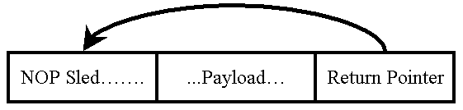
Conclusions (1)
Emphasis on the NOP sled in polymorphic worm studies may not be appropriate for Windows exploits
This figure does not capture the complexity of real exploits:
Notes:
Transition to next slide: We also conclude that…

Slide 25
Conclusions (2)
Minos is a very capable honeypot technology looking ahead to the new vulnerability landscape
Much polymorphism is available in γ and π, should look at ε instead

