Slide 1
ConceptDoppler: A Weather Tracker for Internet Censorship
Jedidiah R. Crandall
Joint work with Daniel Zinn, Michael Byrd, Earl Barr, and Rich East
This work will be presented at
CCS, Washington D.C. October 31st.

Slide 2
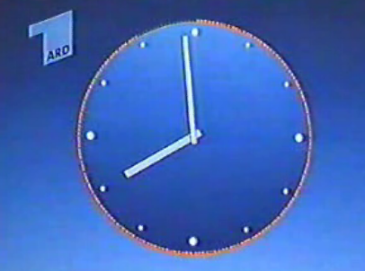
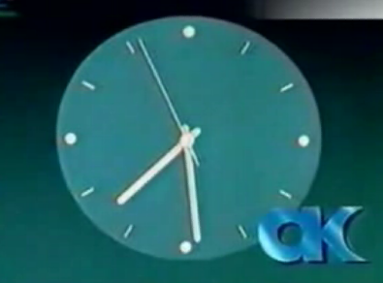
Censorship is Not New

Slide 3
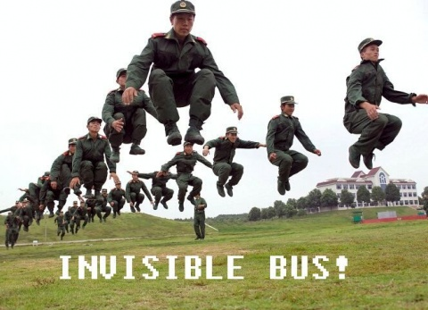
New Technologies

Slide 4
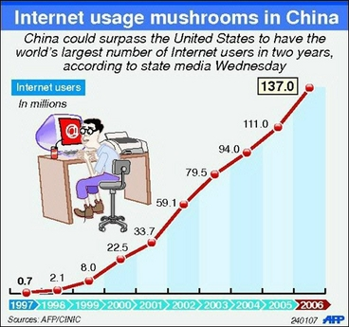
New Technologies

Slide 5

Internet Censorship in China
Called the “Great Firewall of China,” or “Golden Shield”
  IP address blocking
  DNS redirection
  Legal restrictions
  etc…
  Keyword filtering
    Blog servers, chat, HTTP traffic
All probing can be performed from outside of China

Slide 6
This Research has Two Parts
Where is the keyword filtering implemented?
  Internet measurement techniques to locate the filtering routers
What words are being censored?
  Efficient probing via document summary techniques

Slide 7
Firewall?
大纪元时报
大纪元时报
刘晓峰
刘晓峰
民运
民运

Slide 8
Outline
Why is keyword filtering interesting?
How does keyword filtering work?
Where in the Chinese Internet is it implemented?
How can we reverse-engineer the blacklist of keywords?

Slide 9
Outline
Why is keyword filtering interesting?
How does keyword filtering work?
Where in the Chinese Internet is it implemented?
How can we reverse-engineer the blacklist of keywords?

Slide 10
Keyword Filtering has Unique Implications
Chinese government claims to be targeting pornography and sedition
The keywords provide insights into what material the government is targeting with censorship, e.g.
  希特勒 (Hitler)
  中俄边界问题 (Sino-Russian border issue)
  转化率 (Conversion rate)

Slide 11
Keyword Filtering has Unique Implications
Keyword filtering is imprecise
  北莱茵-威斯特法伦 (Nordrhein-Westfalen, or North Rhine-Westphalia) - 法伦
  国际地质科学联合会 (International geological scientific federation) - 学联合会
    学联 (student federation) is also censored
  卢多维克·阿里奥斯托 (Ludovico Ariosto) - 多维 (multidimensional)
Notes:
Italian Poet, ask audience about multidimensional, these are all words we discovered

Slide 12
Keyword-based Censorship
Censor the Wounded Knee Massacre in the Library of Congress
  Remove “Bury my Heart at Wounded Knee” and a few other select books?
  Remove every book containing the keyword “massacre” in its text?

Slide 13
Massacre
Dante’s “Inferno”
“The War of the Worlds,” and “The Island of Doctor Moreau,” H. G. Wells
“Crime and Punishment,” Fyodor Dostoevsky
“King Richard III,” and “King Henry VI,” Shakespeare
“Heart of Darkness,” by Joseph Conrad
Beowulf
“Common Sense,” Thomas Paine
“Adventures of Tom Sawyer,” Mark Twain
Jack London, “Son of the Sun,” “The Acorn-planter,” “The House of Pride”
Thousands more

Slide 14
Crime against humanity
“The Economic Consequences of the Peace,” John Maynard Keynes
Thousands more?

Slide 15
Dictatorship
The U.S. Constitution
Thousands more?

Slide 16
Traitor
“Fahrenheit 451,” Ray Bradbury
Thousands more?

Slide 17
Suppression
“Origin of Species,” by Charles Darwin
Thousands more?

Slide 18
Block
“An Inquiry into the Nature and Causes of the Wealth of Nations,” by Adam Smith
“Fear and Loathing in Las Vegas,” Hunter S. Thompson
“Computer Organization and Design,” Patterson and Hennessy
“Artificial Intelligence: 4th Edition,” George F. Luger
Millions more?
Notes:
Indication the rest of the book is full of pornography and sedition

Slide 19
Hitler
Virtually every book about World War II

Slide 20
Strike
“White Fang,” “The Sea Wolf,” and “The Call of the Wild,” Jack London
Millions more?

Slide 21
Hypothetical?
屠杀 | Massacre
反人类罪 | Crime against humanity
专政 or 专制 | Dictatorship
卖国 | Traitor
镇压 | Suppression
封杀 | Block
希特勒 | Hitler
罢工 | Strike
Notes:
Thousands more words, imagine Internet is a big library

Slide 22
Outline
Why is keyword filtering interesting?
How does keyword filtering work?
Where in the Chinese Internet is it implemented?
How can we reverse-engineer the blacklist of keywords?

Slide 23
Forged RSTs
Clayton et al., 2006.
Comcast also uses forged RSTs

Slide 24

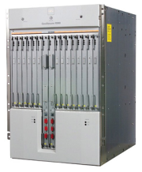
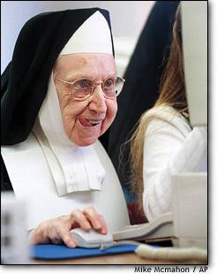
Dissident Nuns on the Net
<HTTP> … </HTTP>
GET falun.html

Slide 25
Censorship of GET Requests
RST
RST
GET falun.html

Slide 26

Censorship of HTML Responses
<HTTP> falun …
RST
RST
GET hello.html

Slide 27
Outline
Why is keyword filtering interesting?
How does keyword filtering work?
Where in the Chinese Internet is it implemented?
How can we reverse-engineer the blacklist of keywords?

Slide 28
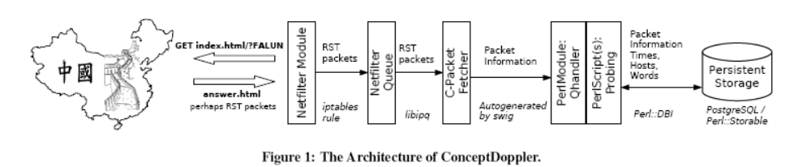
ConceptDoppler Framework

Slide 29
TTL Tomfoolery
ICMP Error
TTL=1
Notes:
Comcast

Slide 30
How `traceroute` Works
TTL=2
TTL=3
ICMP Error
TTL=1
TTL=4

Slide 31
Locating Filtering Routers
ICMP Error
TTL=1 falun

Slide 32
Locating Filtering Routers
ICMP Error
TTL=1 falun
RST
RST
TTL=2 falun

Slide 33
Rumors…
“The undisclosed aim of the Bureau of Internet Monitoring…was to use the excuse of information monitoring to lease our bandwidth with extremely low prices, and then sell the bandwidth to business users with high prices to reap lucrative profits. ”
  ---a hacker named “sinister”

Slide 34
Rumors…
“At the recent World Economic Forum in Davos, Switzerland, Sergey Brin, Google's president of technology, told reporters that Internet policing may be the result of lobbying by local competitors.”
  ---Asia Times, 13 February 2007

Slide 35
Rumors…
Depending on who you ask, censorship occurs
  In three big centers in Beijing, Guangzhou, and Shanghai
  At the border
  Throughout the country’s backbone
  At a local level
  An amalgam of the above

Slide 36
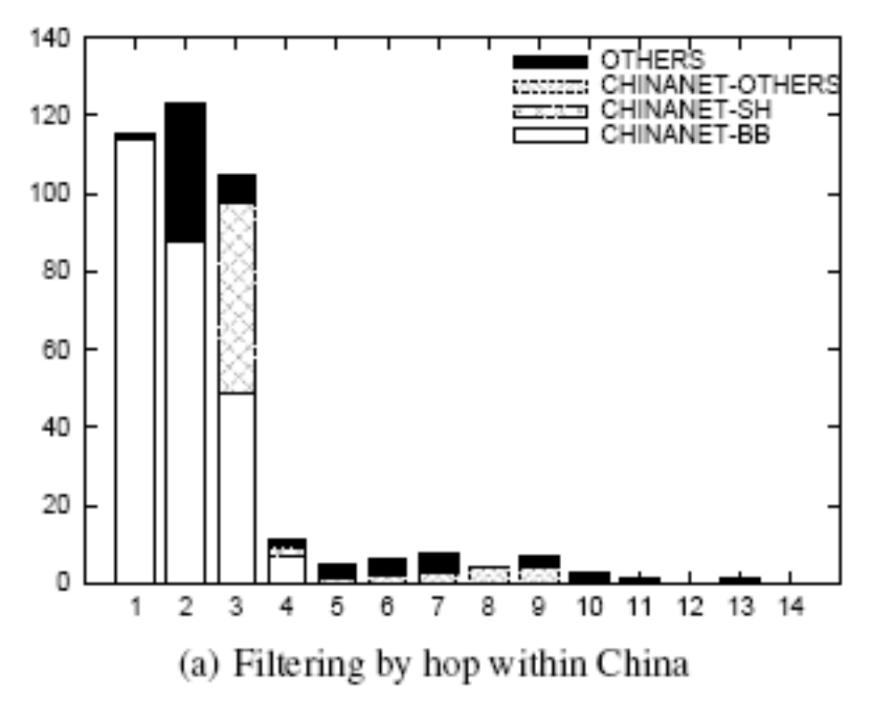
Hops into China Before a Path is Flitered
28% of paths were never filtered over two weeks of probing

Slide 37
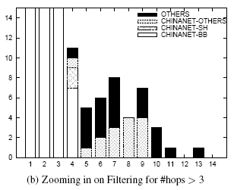
Same Graph, Different Scale

Slide 38
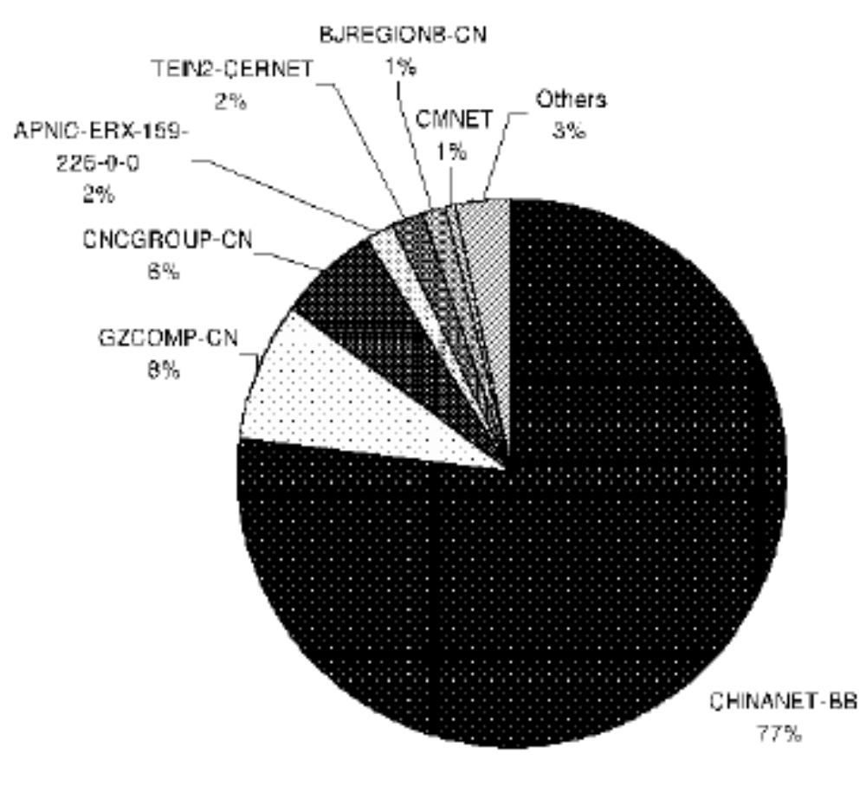
First Hops
ChinaNET performed 83% of all filtering, and 99.1% of all filtering at the first hop

Slide 39
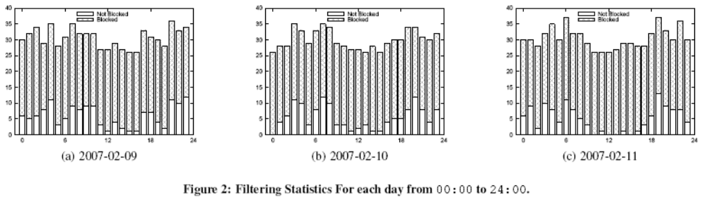
Diurnal Pattern

Slide 40
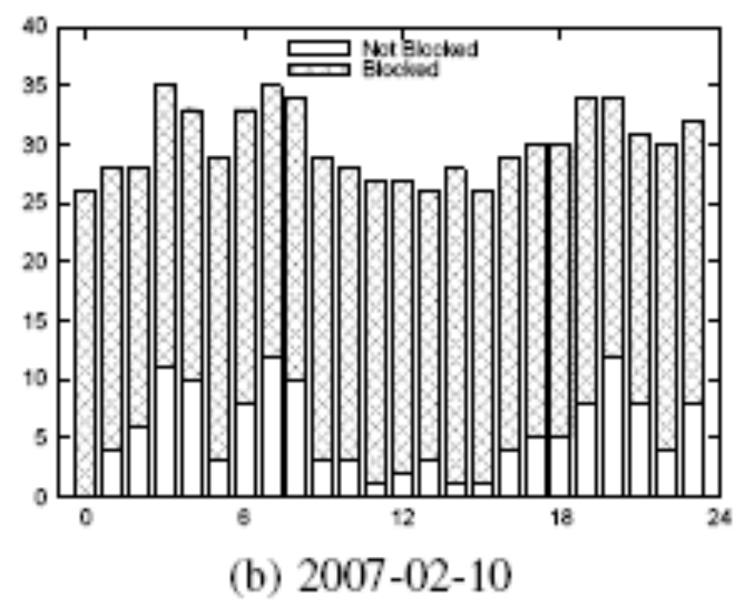
0 is 3pm in Beijing

Slide 41
Are Evasion Techniques Fruitful?
大纪元时报
大纪元时报
刘晓峰
刘晓峰
民运
民运

Slide 42
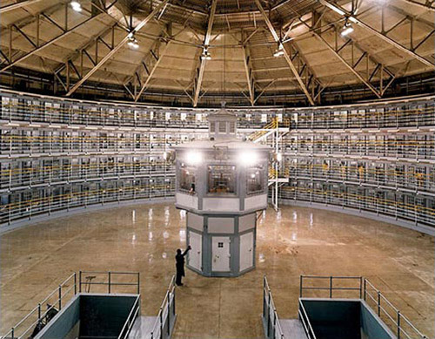
Panopticon
(Jeremy Bentham, 1791)

Slide 43
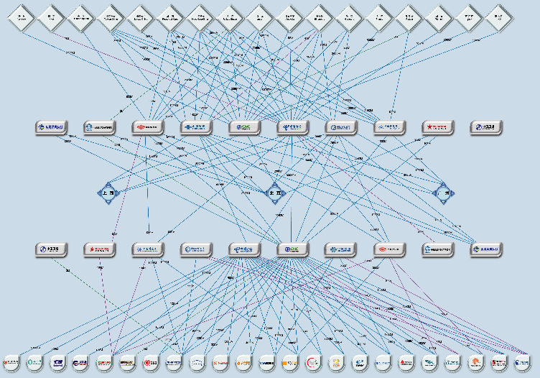

Slide 44
Outline
Why is keyword filtering interesting?
How does keyword filtering work?
Where in the Chinese Internet is it implemented?
How can we reverse-engineer the blacklist of keywords?

Slide 45
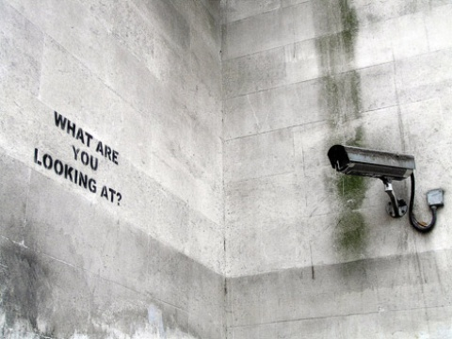

Slide 46
More rumors…
“If someone is shouting bad things about me from outside my window, I have the right to close that window.”
    ---Li Wufeng

Slide 47
Latent Semantic Analysis (LSA)
Deerwester et al., 1990
Jack goes up a hill, Jill stays behind this time
“B is 8 Furlongs away from C”
“C is 5 Furlongs away from A”
“B is 5 Furlongs away from A”

Slide 48
LSA in a Nutshell
A
5 5
B
C
8

Slide 49
Latent Semantic Analysis (LSA)
“A, B, and C are all three on a straight, flat, level road.”
Notes:
Additive Gaussian noise

Slide 50
LSA in a Nutshell
9
B
4.5 4.5
A
C

Slide 51
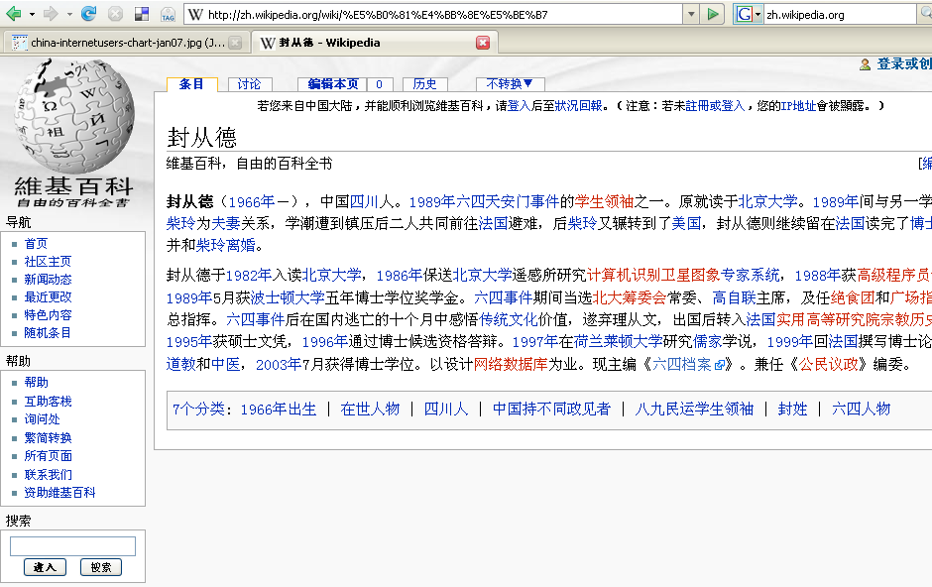
Start With a Large Corpus

Slide 52
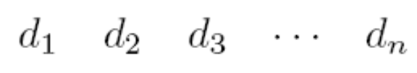
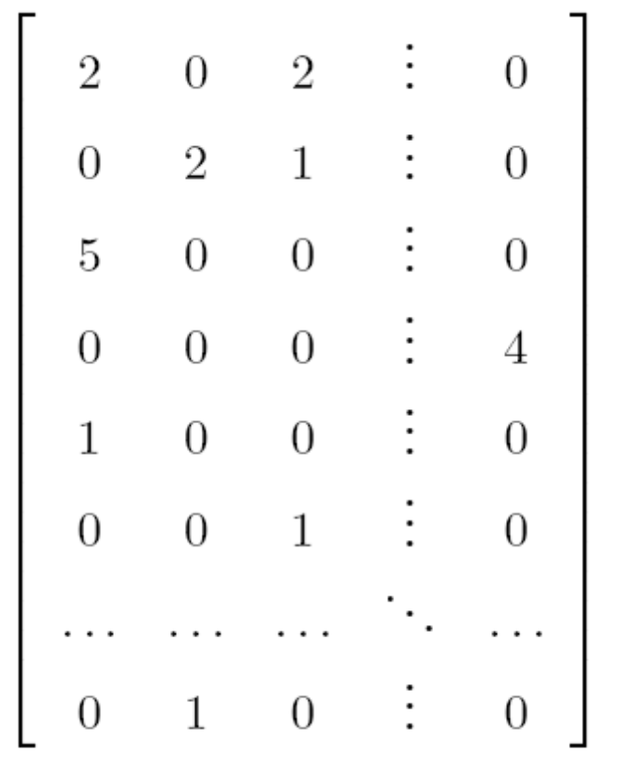
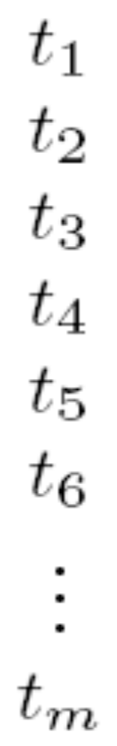
LSA of Chinese Wikipedia
n=94863 documents and m=942033 terms
tf-idf weighting
Matrix probably has rank r where k<r<n<m
SVD and rank reduction to rank k
Implicit assumption that Wikipedia authors add additive Gaussian noise

Slide 53
Correlate with 六四事件
1 : 六四事件
2 : 重庆高家花园嘉陵江大桥
3 : 欒提羌渠
4 : 李建良
5 : 美丽岛事件
6 : 赵紫阳
7 : 統戰部
8 : 陈炳德
9 : 洛杉磯安那罕天使歷任經營者與總教練
10 : 李铁林
11 : 邓力群
12 : 中国政治
13 : 中共十四大
14 : 改革开放
15 : 报禁
…. to 2500
Deng Liqun

Slide 54
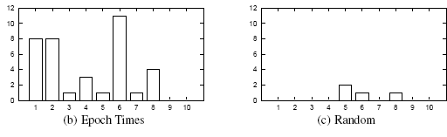
Efficient Probing

Slide 55
Future Work
Doppler Radar: Understanding of the mixing of gases led to effective weather reporting
ConceptDoppler
  Scale up (bigger corpus, more words, advanced document summary techniques)
  Track the blacklist over a period of time, to correlate with current events
    Named entity extraction, online learning

Slide 56
Future Work
Where exactly is filtering occuring?
  More sources
  Topological considerations
  IP tunneling, IPv6, IXPs, …
What are the effects of keyword filtering?
  What content is being targeted?
  What content is collateral damage due to imprecise filtering?

Slide 57
Conclusions
GFC ≠ Firewall
GFC ≈ Panopticon
With lots of computation/analysis here and a little bit of probing of the Chinese Internet, we can determine
  What content is being targeted with keyword-based censorship?
  What are the unintended consequences of keyword-based censorship?

Slide 58
Questions?
Thank you.
Thanks also to open source software developers and the organizers of and contributors to Wikipedia.

