Slide 1
CBC padding oracle attacks

Slide 2
CBC padding oracle attack examples
Serge Vaudenay published the original attack in 2002
  Applied to web frameworks like Ruby on Rails, ASP.NET, and JavaServer Faces
  https://www.iacr.org/cryptodb/archive/2002/EUROCRYPT/2850/2850.pdf
POODLE (published by Google in 2014) exploited SSLv3 that is still widely used by web servers and browsers
  https://security.googleblog.com/2014/10/this-poodle-bites-exploiting-ssl-30.html

Slide 3
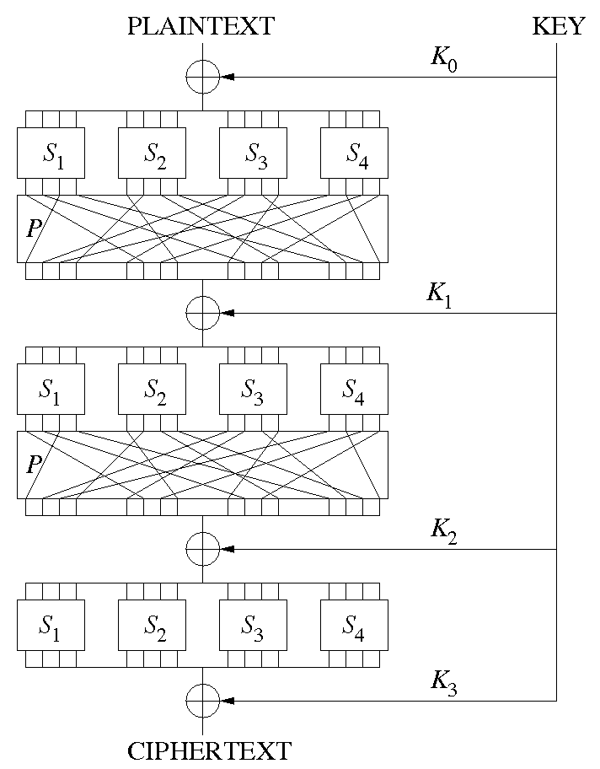
Review: AES is a block cipher and is symmetric
Source: Wikipedia

Slide 4

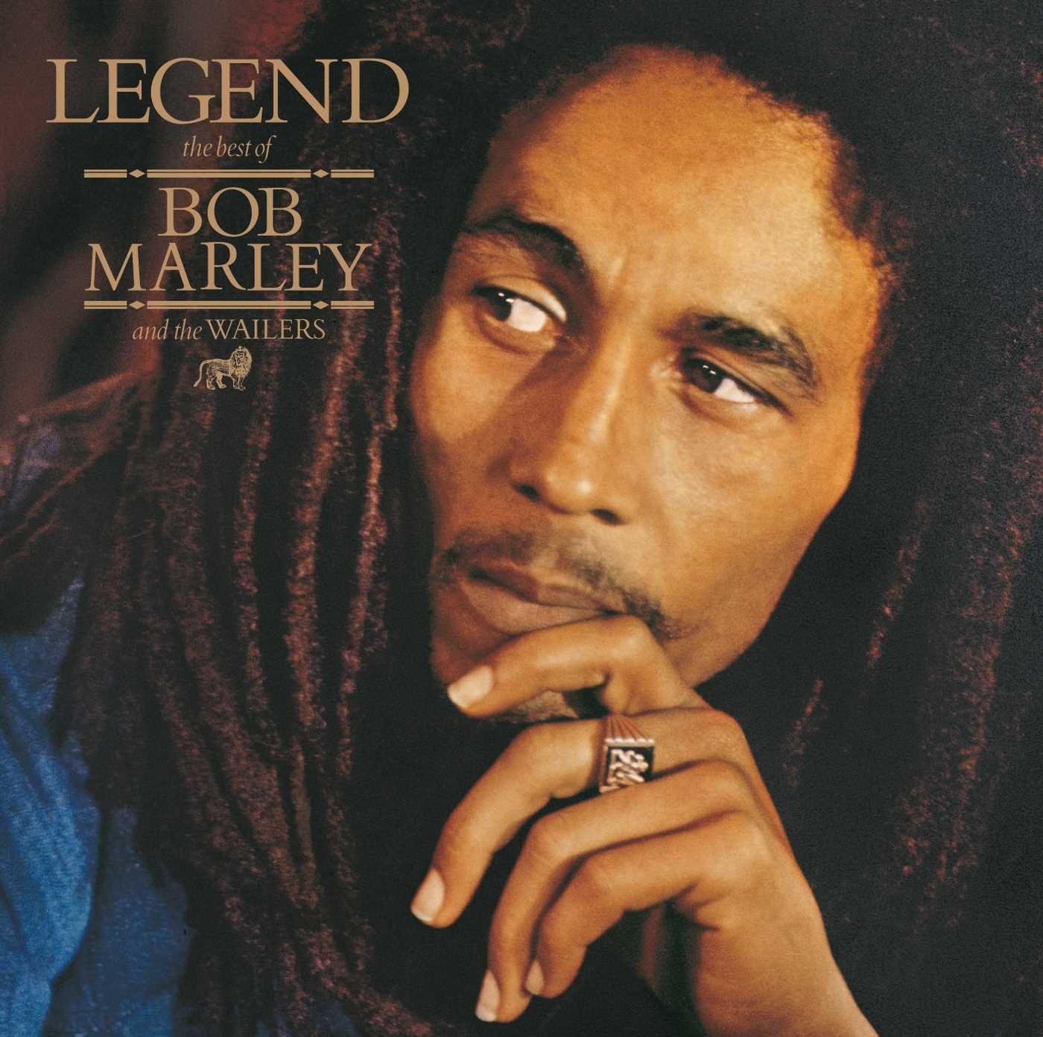

Alice and Bob have a shared secret key
Eve makes a copy of the ciphertext as it is transmitted from Alice to Bob.

Slide 5
Alice and Bob have a shared secret key
Eve re-plays modified copies of the encrypted message and learns information about the plaintext from Bob's behavior (e.g., Bob throws an exception for padding error)

Slide 6
PKCS#7 padding
AES always encrypts in 128-bit blocks
  128 bits == 16 bytes
If you fill up blocks, that's great
  The last block might not be full
Need an “unambiguous” way to pad the last block so the decrypting party knows the padding to throw out
  E.g., PKCS#7 (PKCS == Public Key Cryptography Standards)

Slide 7
 |  |  |  |  |  |  |  |  |  |  |  |  |  |  | 01
 |  |  |  |  |  |  |  |  |  |  |  |  |  | 02 | 02
 |  |  |  |  |  |  |  |  |  |  |  |  | 03 | 03 | 03
 |  |  |  |  |  |  |  |  |  |  |  | 04 | 04 | 04 | 04
 |  |  |  |  |  |  |  |  |  |  | 05 | 05 | 05 | 05 | 05
 |  |  |  |  |  |  |  |  |  | 06 | 06 | 06 | 06 | 06 | 06
 |  |  |  |  |  |  |  |  | 07 | 07 | 07 | 07 | 07 | 07 | 07
 |  |  |  |  |  |  |  | 08 | 08 | 08 | 08 | 08 | 08 | 08 | 08
 |  |  |  |  |  |  | 09 | 09 | 09 | 09 | 09 | 09 | 09 | 09 | 09
 |  |  |  |  |  | 0A | 0A | 0A | 0A | 0A | 0A | 0A | 0A | 0A | 0A
 |  |  |  |  | 0B | 0B | 0B | 0B | 0B | 0B | 0B | 0B | 0B | 0B | 0B
 |  |  |  | 0C | 0C | 0C | 0C | 0C | 0C | 0C | 0C | 0C | 0C | 0C | 0C
 |  |  | 0D | 0D | 0D | 0D | 0D | 0D | 0D | 0D | 0D | 0D | 0D | 0D | 0D
 |  | 0E | 0E | 0E | 0E | 0E | 0E | 0E | 0E | 0E | 0E | 0E | 0E | 0E | 0E
 | 0F | 0F | 0F | 0F | 0F | 0F | 0F | 0F | 0F | 0F | 0F | 0F | 0F | 0F | 0F
10 | 10 | 10 | 10 | 10 | 10 | 10 | 10 | 10 | 10 | 10 | 10 | 10 | 10 | 10 | 10

Slide 8
When last block is decrypted
Check last byte of the last block, that's the number of bytes of padding
  Call it N
There should be N N's on the end
  If not, throw a padding error
  If so, remove them, they're padding
    Might remove the whole last block if N = 16 (or 10 in hex)

Slide 9
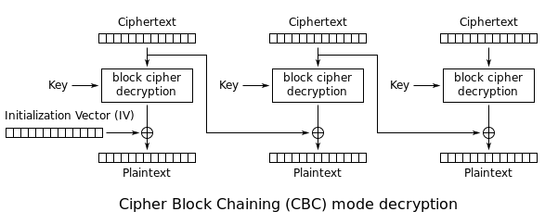
By WhiteTimberwolf (SVG version) - PNG version, Public Domain, https://commons.wikimedia.org/w/index.php?curid=26434095

Slide 10
Requirements for attack
Ability to modify ciphertexts and replay them
  Chosen ciphertext attack
A padding oracle
  I.e., something that tells you whether the corresponding plaintext (for any ciphertext you send) has valid padding or not

Slide 11
Example plaintext (we don't know the plaintext yet before the attack)
H | e | l | l | o | 20 | W | o | r | l | d | ! | \n | 03 | 03 | 03

Slide 12
Example protocol for a client to send an encrypted message to a server
N | u | m | b | l | k | s | : | 1 | K | e | y | I | D | : | A3
00 | 00 | 00 | 00 | 00 | 00 | 00 | 00 | 00 | 00 | 00 | 00 | 00 | 00 | 00 | 00
98 | CC | BE | 01 | FF | 26 | 39 | 97 | 85 | A1 | 02 | 1E | BC | A5 | 7E | 98

Slide 13
Example protocol for a client to send an encrypted message to a server
Number of blocks Which key?
N | u | m | b | l | k | s | : | 1 | K | e | y | I | D | : | A3
00 | 00 | 00 | 00 | 00 | 00 | 00 | 00 | 00 | 00 | 00 | 00 | 00 | 00 | 00 | 00
98 | CC | BE | 01 | FF | 26 | 39 | 97 | 85 | A1 | 02 | 1E | BC | A5 | 7E | 98

Slide 14
Example protocol for a client to send an encrypted message to a server
N | u | m | B | l | k | s | : | 1 | K | e | y | I | D | : | A3
00 | 00 | 00 | 00 | 00 | 00 | 00 | 00 | 00 | 00 | 00 | 00 | 00 | 00 | 00 | 00
98 | CC | BE | 01 | FF | 26 | 39 | 97 | 85 | A1 | 02 | 1E | BC | A5 | 7E | 98
IV is randomly chosen but visible on the wire and known to you, won't be 0 like in this illustration

Slide 15
Example protocol for a client to send an encrypted message to a server
N | u | m | B | l | k | s | : | 1 | K | e | y | I | D | : | A3
00 | 00 | 00 | 00 | 00 | 00 | 00 | 00 | 00 | 00 | 00 | 00 | 00 | 00 | 00 | 00
98 | CC | BE | 01 | FF | 26 | 39 | 97 | 85 | A1 | 02 | 1E | BC | A5 | 7E | 98
Ciphertext is what you want to decrypt, you will recover the plaintext without needing to know the key!

Slide 16
Server response is visible to you
“Message decrypted successfully”
---or---
“Padding error during decryption”

Slide 17
You can record a client message and replay it to the server
N | u | m | b | l | k | s | : | 1 | K | e | y | I | D | : | A3
00 | 00 | 00 | 00 | 00 | 00 | 00 | 00 | 00 | 00 | 00 | 00 | 00 | 00 | 00 | 00
98 | CC | BE | 01 | FF | 26 | 39 | 97 | 85 | A1 | 02 | 1E | BC | A5 | 7E | 98
Try every value of this byte from 00 to FF

Slide 18
By WhiteTimberwolf (SVG version) - PNG version, Public Domain, https://commons.wikimedia.org/w/index.php?curid=26434095

Slide 19
Suppose two values give valid padding
00 gives valid padding, this is just confirmation that the original plaintext has valid padding
02 also gives valid padding
  Can recover one byte of plaintext:
  Q XOR 02 == 01, so... Q == 01 XOR 02 == 03
  Q is the byte of plaintext we're trying to guess

Slide 20
WTF?
N | u | m | b | l | k | s | : | 1 | K | e | y | I | D | : | A3
00 | 00 | 00 | 00 | 00 | 00 | 00 | 00 | 00 | 00 | 00 | 00 | 00 | 00 | 00 | 02
98 | CC | BE | 01 | FF | 26 | 39 | 97 | 85 | A1 | 02 | 1E | BC | A5 | 7E | 98
H | e | l | l | o | 20 | W | o | r | l | d | ! | \n | 03 | 03 | 01
“Information only has meaning in that it is subject to interpretation”

Slide 21
01 XOR 02 = 03
N | u | m | b | l | k | s | : | 1 | K | e | y | I | D | : | A3
00 | 00 | 00 | 00 | 00 | 00 | 00 | 00 | 00 | 00 | 00 | 00 | 00 | 00 | 00 | 01
98 | CC | BE | 01 | FF | 26 | 39 | 97 | 85 | A1 | 02 | 1E | BC | A5 | 7E | 98
H | e | l | l | o | 20 | W | o | r | l | d | ! | \n | 03 | 03 | 02
Now attack here

Slide 22
Discussion
You still don't know the key, and probably never will
It doesn't matter how secure AES is or the size of the key
CBC is probably the most commonly used mode
What if a byte is already what it needs to be?
What if there is more than one block?

Slide 23
References
https://grymoire.wordpress.com/2014/12/05/cbc-padding-oracle-attacks-simplified-key-concepts-and-pitfalls/

