Slide 1
Crypto review...
Jed Crandall, jedimaestro@asu.edu

Slide 2
Administrativia
Course website and syllabus
Update: Wireshark + general.asu.edu + a programming environment is good enough

Slide 3
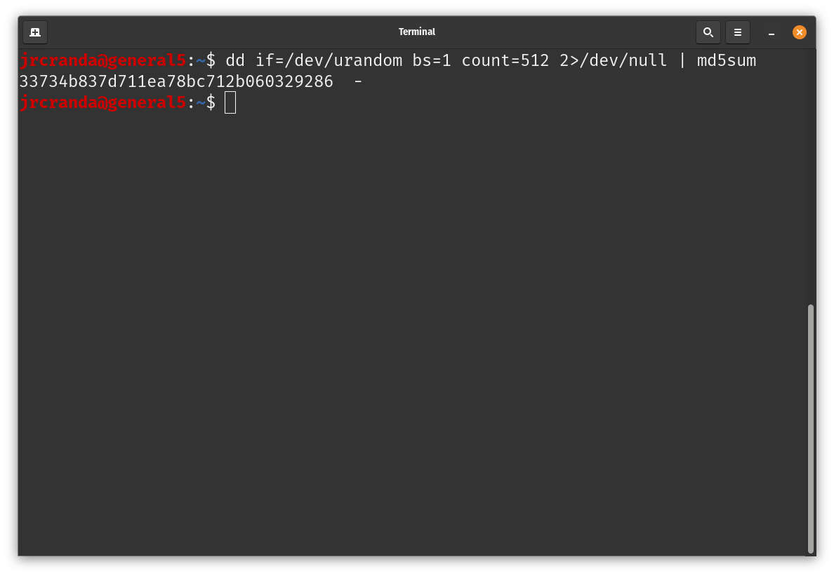
Example

Slide 4
This should be review if you took CSE 365. If you need more review:
https://www.youtube.com/watch?v=KqqOXndnvic
https://www.youtube.com/watch?v=SkJcmCaHqS0
https://www.youtube.com/watch?v=QgHnr8-h0xI
https://www.youtube.com/watch?v=-dsKYoqwjT0

Slide 5
Review 1/3: Cryptographic hash functions...

Slide 6

Why hash functions?
Speed
Error detection (e.g., checksum)
Security and privacy

Slide 7
Why cryptographic hash functions?
Unique identifier for an object
Integrity of an object
Digital signatures
Passwords
Proof of work

Slide 8
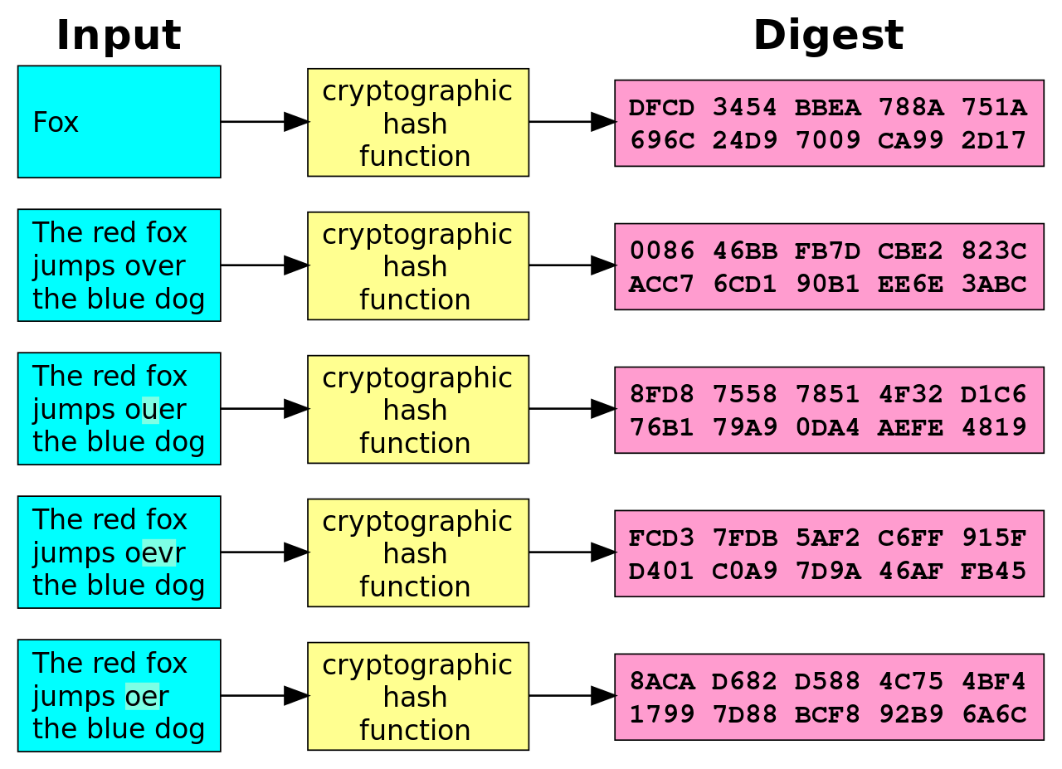
Example
By User:Jorge Stolfi based on Image:Hash_function.svg by Helix84 - Original work for Wikipedia, Public Domain, https://commons.wikimedia.org/w/index.php?curid=5290240

Slide 9
What makes a hash function cryptographic?
One-way function
Deterministic (same input, same output)
Infeasible to find message that digests to specific hash value
Infeasible to find two messages that digest to the same hash
Avalanche effect (small change in message leads to big changes in digest---digests seemingly uncorrelated)
Still want it to be quick

Slide 10
Algorithms
MD5: 128-bit digest, seriously broken
SHA-1: 160-bit digest, not secure against well-funded adversaries
SHA-3: 224 to 512 bit digest, adopted in August of 2015
CRC32: not cryptographic, very poor choice

Slide 11
Property #1
Pre-image resistance
Given h, it should be infeasible to find m such that h = hash(m)

Slide 12
Property #2
Second pre-image resistance
Given a message m₁, it should be infeasible to find another message m₂ such that...
hash(m₁) = hash(m₂)

Slide 13
Property #3
Collision resistance
It should be infeasible to find two messages, m₁ and m₂ such that...
hash(m₁) = hash(m₂)

Slide 14
Attacks
Pre-image attack
Collision attack
Chosen-prefix collision attack
Birthday attack

Slide 15
Chosen-prefix collision attack
Given two prefixes p₁ and p₂, find m₁ and m₂ such that hash(p₁||m₁)=hash(p₂||m₂)
p1 and p2 could be domain names in a certificate, images, PDFs, etc. … any digital image.
This is one of the two ways MD5 is broken (other is plain old collision resistance), and is how we generated the two images with the same MD5 sum for the example from the Citizen Lab report

Slide 16
Birthday attack
Probability of collision is 1 in 2^{n}, but the expected number of hashes until two of them collide is sqrt(2^{n})=2^{n/2}
  Why? Third try has two opportunities to collide, fourth has three opportunities, fifth has six, and so on...

Slide 17
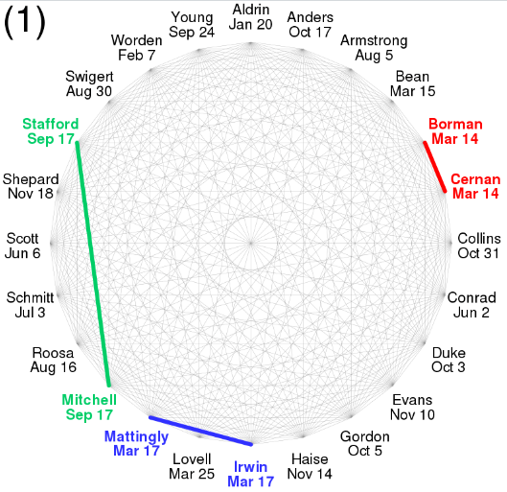
24 people, same birthday?
https://commons.wikimedia.org/wiki/File:Birthday_attack_vs_paradox.svg

Slide 18
Think of a “random” 3-digit number
lg(999) is a little under 10, so a 10-bit number
sqrt(2¹⁰)=2⁵=32
You’re going to say it out loud
  We’ll go around the room, go fast
  Don’t use your bank PIN, etc.
  Raise your hand and yell if someone says your
  number

Slide 19
Review 2/3: Symmetric crypto

Slide 20
Symmetric crypto: same key on both sides
Confidentiality
Integrity
Authentication
  Compare to non-repudiation in asymmetric crypto

Slide 21
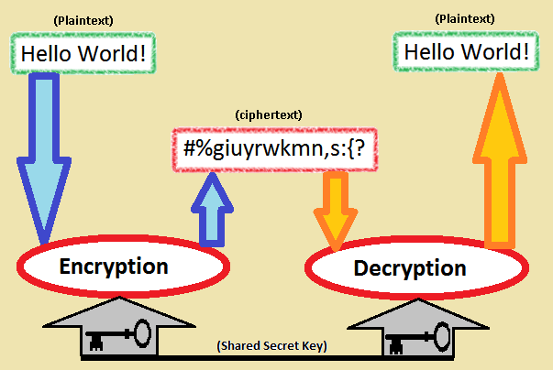
Symmetric
Source: Wikipedia

Slide 22
Review on your own...
Caesar Cipher
Viginere Cipher and related attacks

Slide 23
Modern crypto
Mostly:
  Substitution
  Permutation
  XOR

Slide 24
Substitution
HELLO WORLD
TNWWX DXPWE

Slide 25
Permutation
ABCD ABDC ACBD ACDB ADBC ADCB
BACD BADC BCAD BCDA BDAC BDCA
CABD CADB CBAD CBDA CDAB CDBA
DABC DACB DBAC DBCA DCAB DCBA

Slide 26
Bitwise XOR
00101010b
⊕10000110b
=10101100b

Slide 27
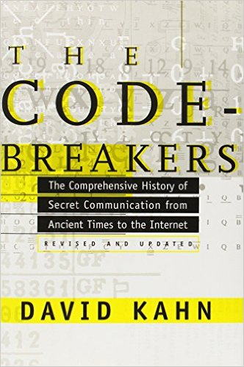
2000+ years of history...

Slide 28
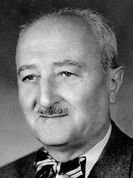
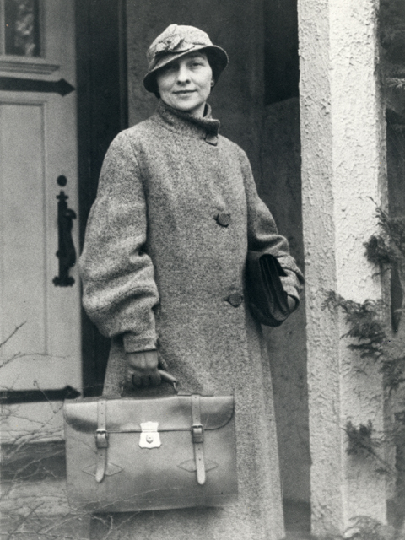
William and Elizabeth Friedman
Met while analyzing Shakespeare ciphers at Riverbank Laboratories (“William Friedman wrote Shakespeare's plays”)
Elizabeth solved ciphers of alcohol and drug smugglers, then German ambassadors in South America (three enigma machines)
William led a team that solved PURPLE

Slide 29
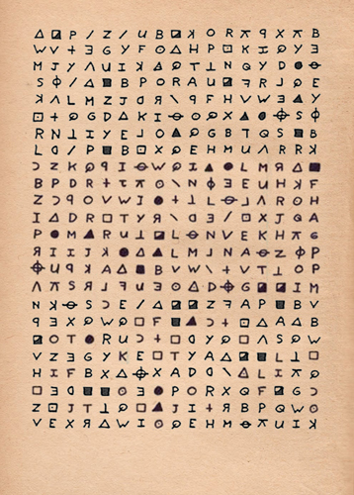
Zodiac cipher
Image from wikia

Slide 30
Bitwise XOR as a cipher itself
Typically used by malware, 8 or 32 bits
  WEP attack uses these properties
(B xor K) xor K = B
(A xor K) xor (B xor K) = A xor B
(0 xor K) = K
(K xor K) = 0
Frequency analysis or brute force

Slide 31
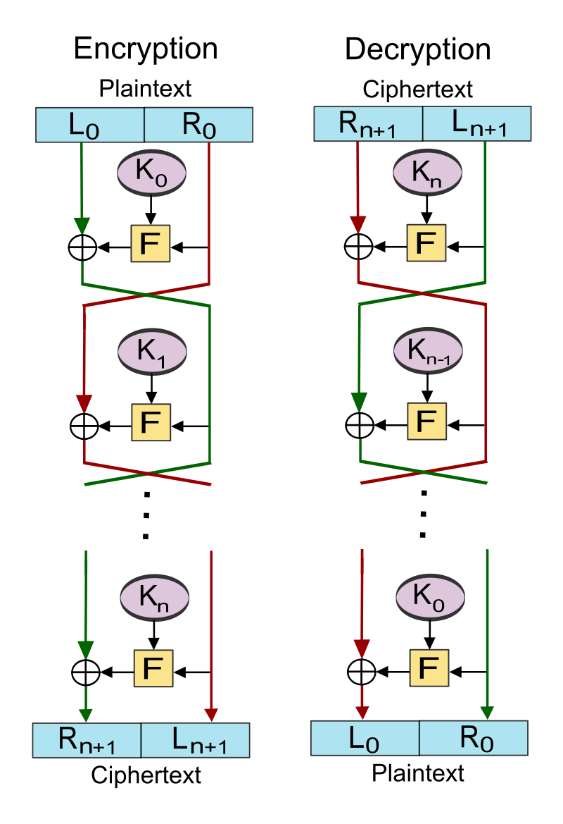
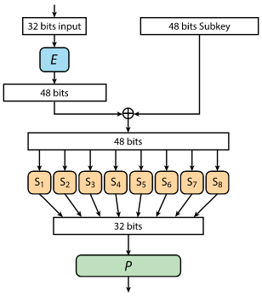
DES (16 rounds, 64-bit blocks, 56-bit key)

Slide 32
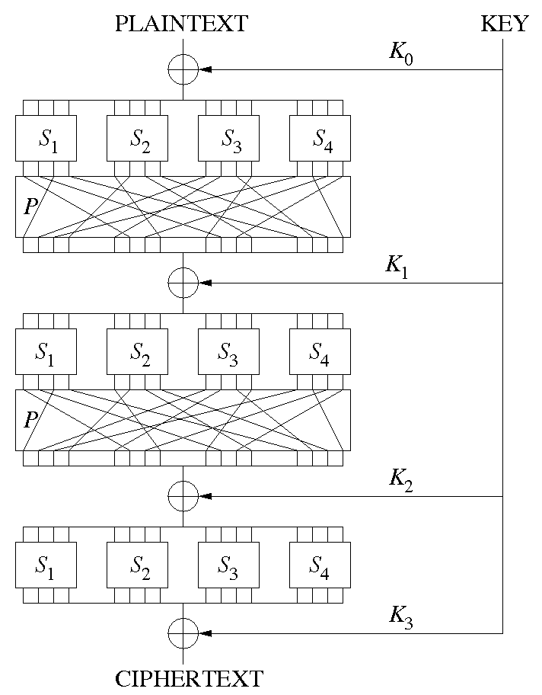
Substitution Permutation Network e.g., AES 128-bit blocks, (128-, 192-, 256-)bit key, (10, 12, 14) rounds

Slide 33
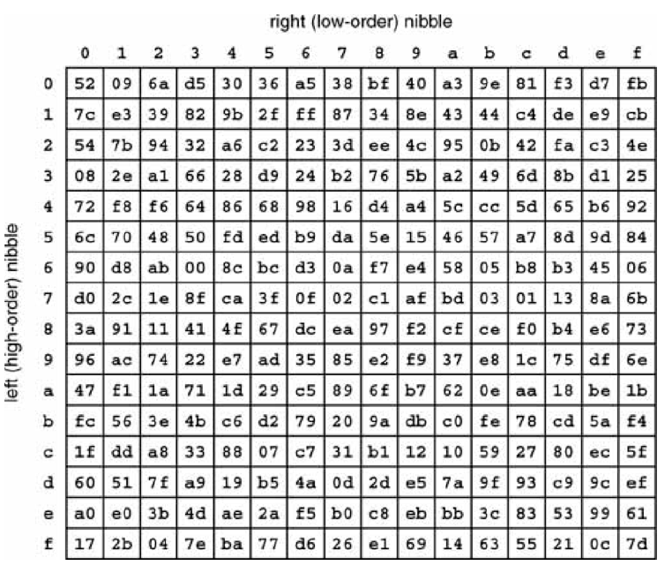
An AES S-Box...
https://crypto.stackexchange.com/questions/55975/aes-s-box-input-and-output-question

Slide 34
Block cipher vs. stream cipher
Block cipher: break bits up into fixed-size chunks (pad if necessary)
Stream cipher: Generate a pseudorandom key stream, combine it with the plaintext (typically using XOR)

Slide 35
Cipher modes
ECB, CBC discussed on next slides
Also Counter Mode, Galois Counter Mode, Cipher Feedback, Output Feedback
  Parallelization and other features

Slide 36
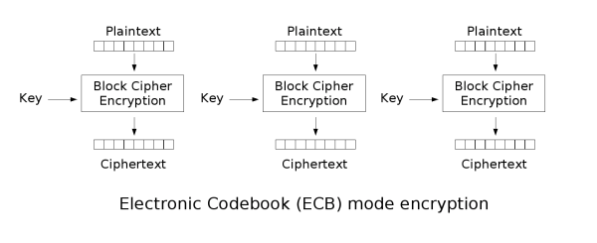
Electronic Codebook (ECB)
Image stolen from Wikipedia

Slide 37
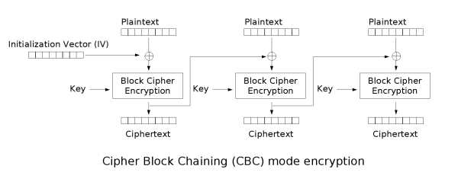
Cipher Block Chaining (CBC)
Image stolen from Wikipedia

Slide 38
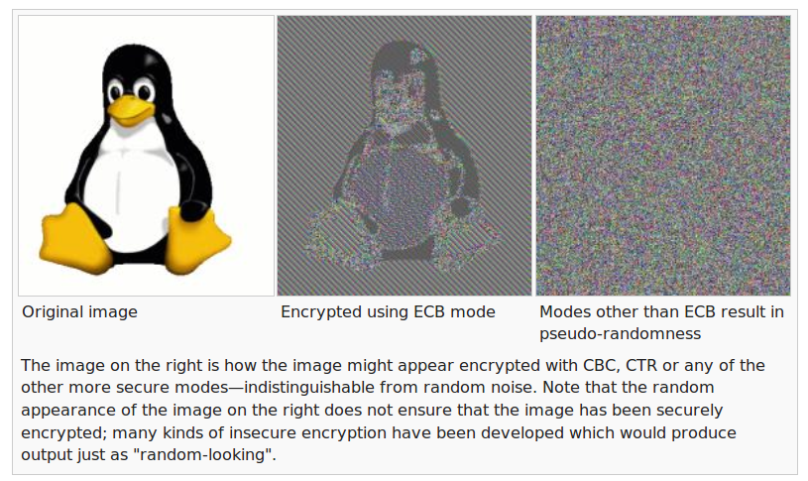
ECB is generally bad
Image stolen from Wikipedia

Slide 39
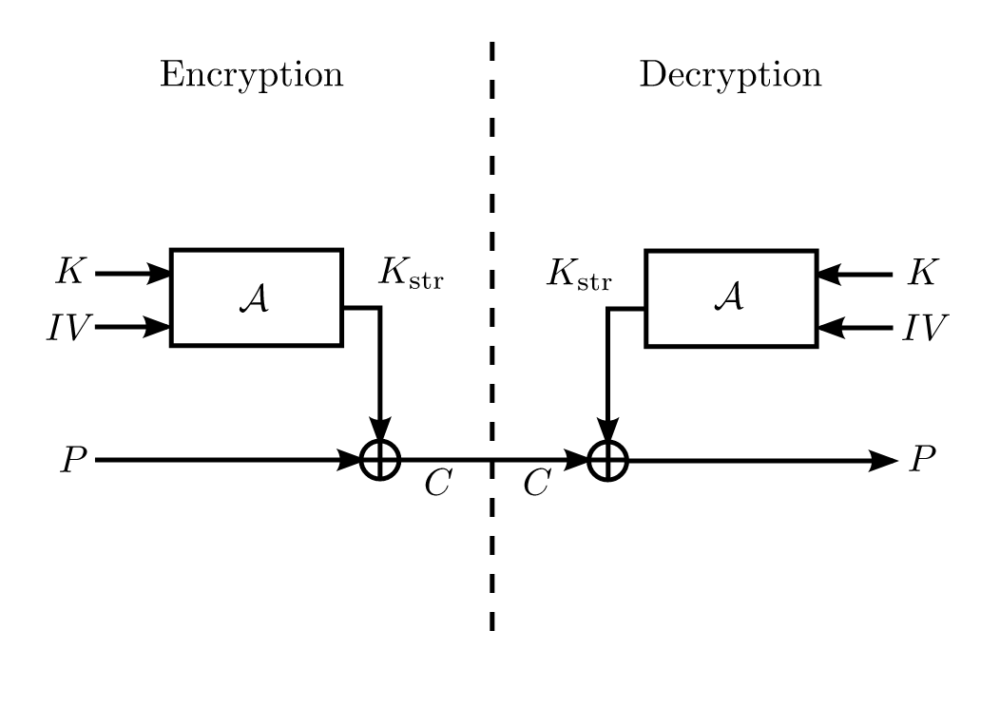
Stream cipher...

Slide 40
Review 3/3: Asymmetric crypto… stay tuned

Slide 41
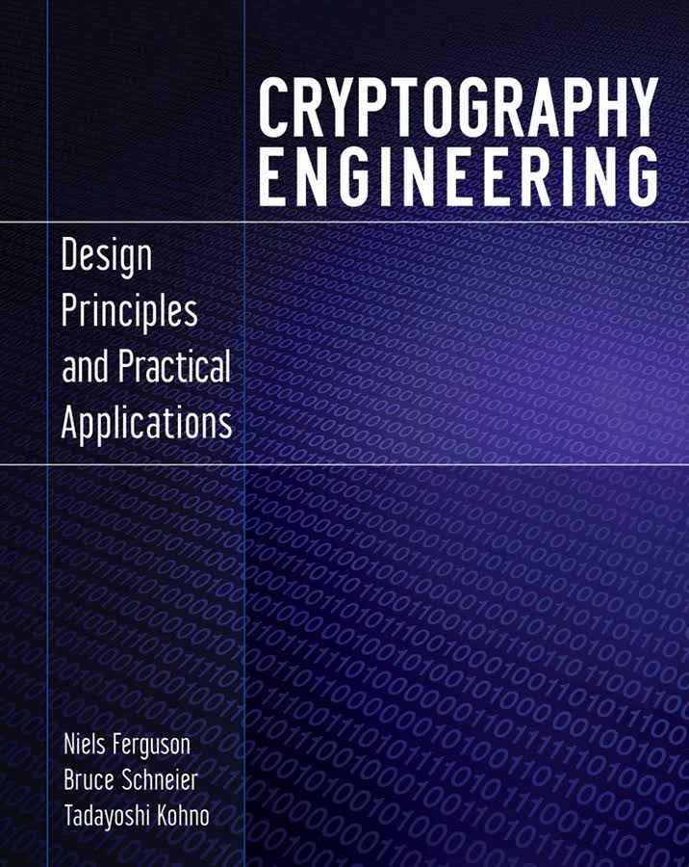
Cryptography Engineering by Ferguson et al.

Slide 42
Coming up...
CBC padding oracle attack
  Similar to RSA padding oracle attack from CSE 365
RC4, WEP w/ attacks, WPA3
Assymetric crypto, forward secrecy, Signal
Transport Layer Security (TLS) and certificates
Crypto FAILS

Slide 43
(Unless otherwise noted, all images are from Wikipedia)

