Slide 1
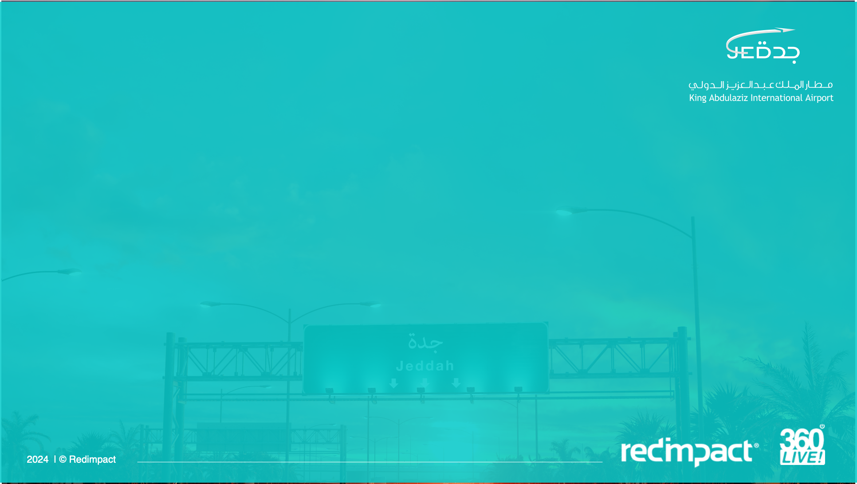
Sense of Place
Master Artworks

Slide 2
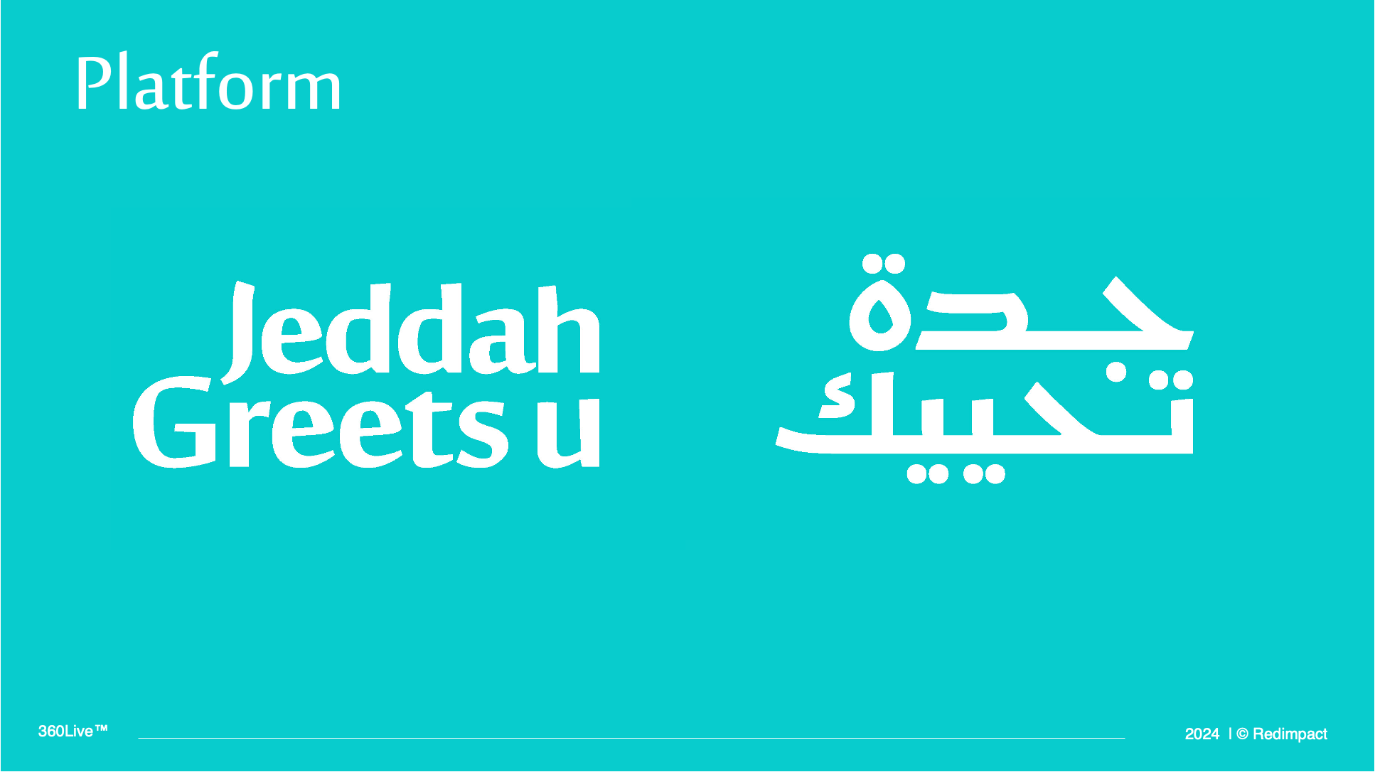
Sense of Place

Slide 3
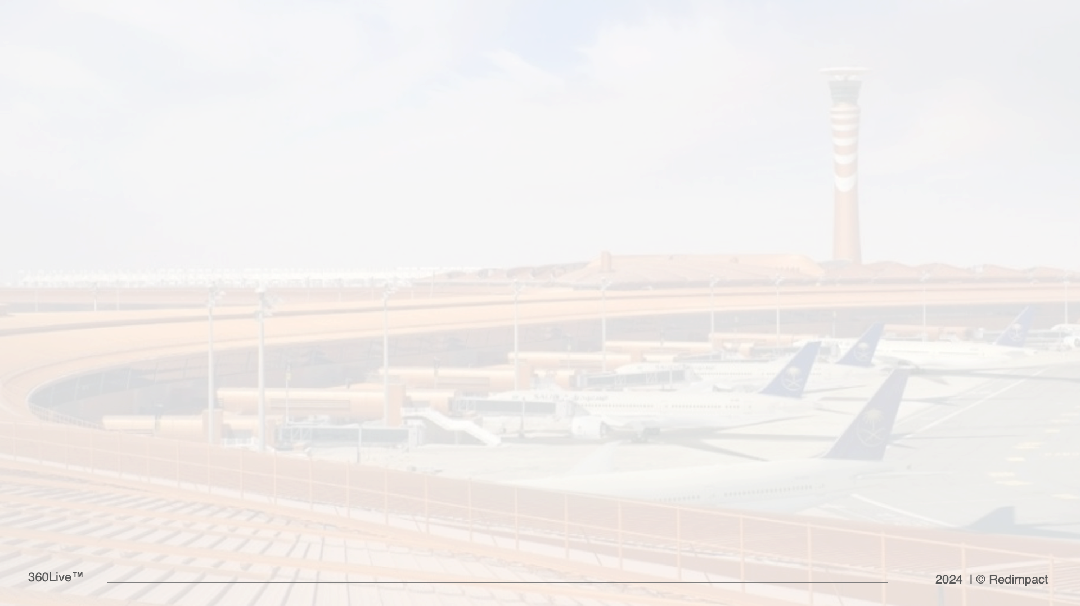
English Messages
While creating the themes, we used the branding icon. We divided the icon into different categories to ensure that each element fits and connects seamlessly with the respective theme.

Slide 4
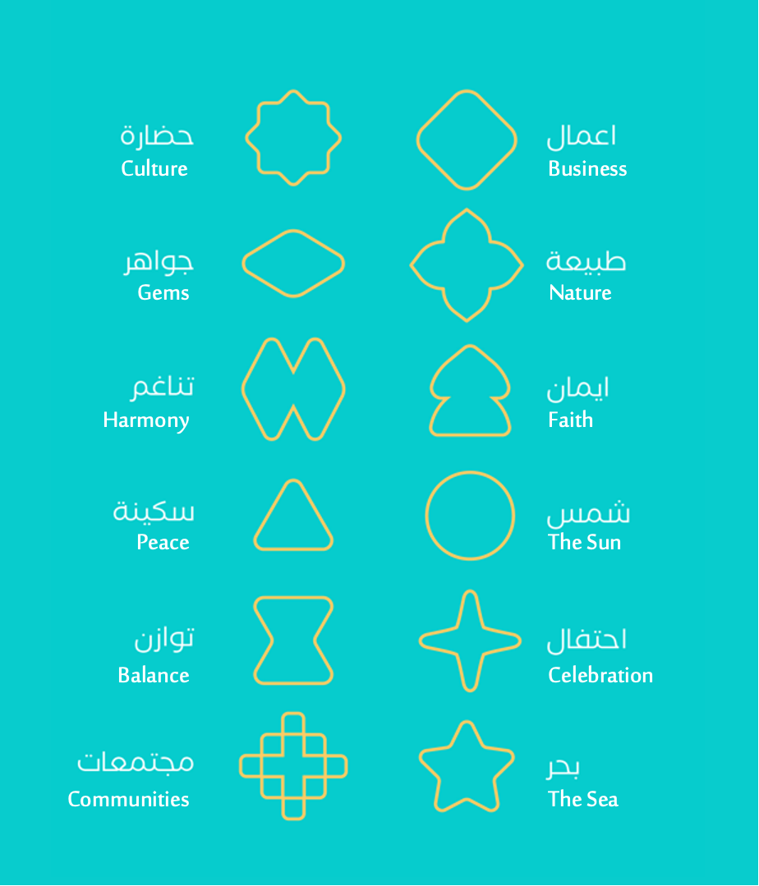
Brand
Icons

Slide 5
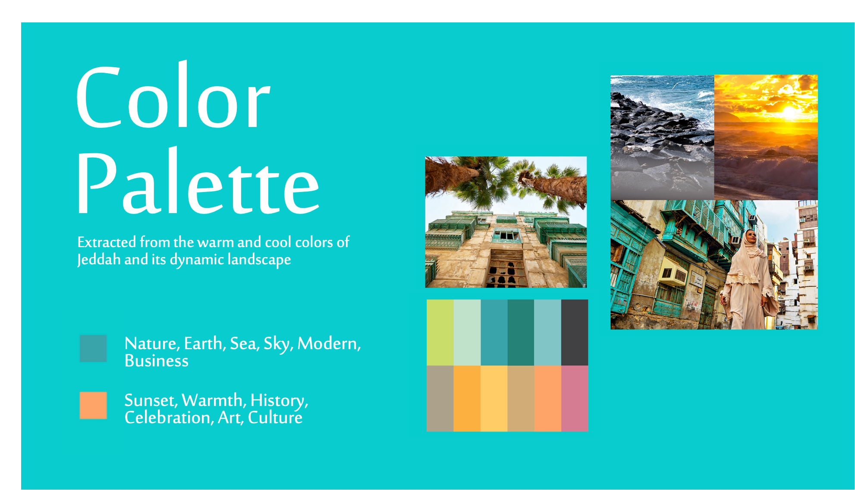

Slide 6

Theme Key
Messages

Slide 7
Number | Theme | Visual Message English | Visual Message Arabic
1 | Business | Dynamic Collaboration | —--------
2 | Art/ Music | Graceful Harmony | تطرب كل ما فيك
3 | History | Majestic Heritage | عراقة تثريك
4 | Sea | Vibrant Sea | —------
5 | Religion | Radiant Soul | سكون يحتويك
6 | Cuisine | Satisfying Taste | مذاق يرضيك
7 | Sun | Warming Sun | شمس تدفيك
8 | Nightlife/Going out | Lively Nights | ايام وليالي تحييك
9 | Sports | Uplifting Activities | —-------
10 | Culture/Local | —-------- | تعزك وتغنيك
11 | Arrival | Welcome | أهلاً بكم
12 | Departure | Goodbye | رافقتكم السلامة

Slide 8
Visual
Implementation

Slide 9
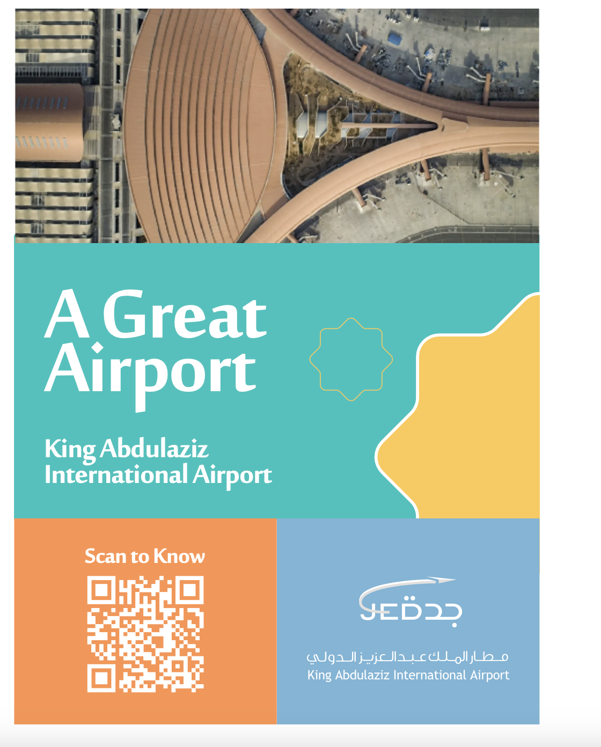

Slide 10
Business
1- Business

Slide 11
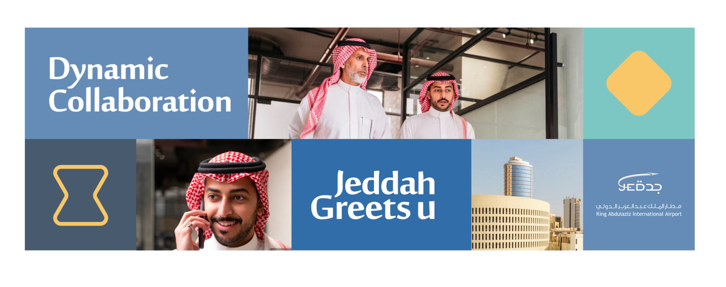

Slide 12
Business
2- Art/ Music

Slide 13


Slide 14
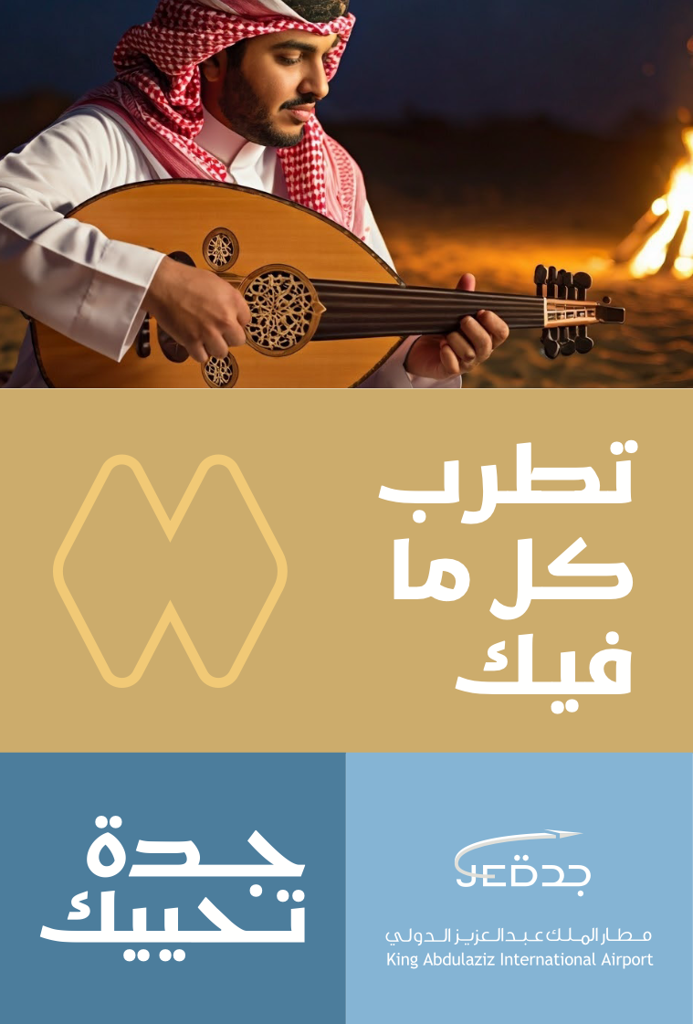

Slide 15
Business
3- History

Slide 16


Slide 17


Slide 18
Business
4- Sea

Slide 19


Slide 20
Business
5- Religion

Slide 21
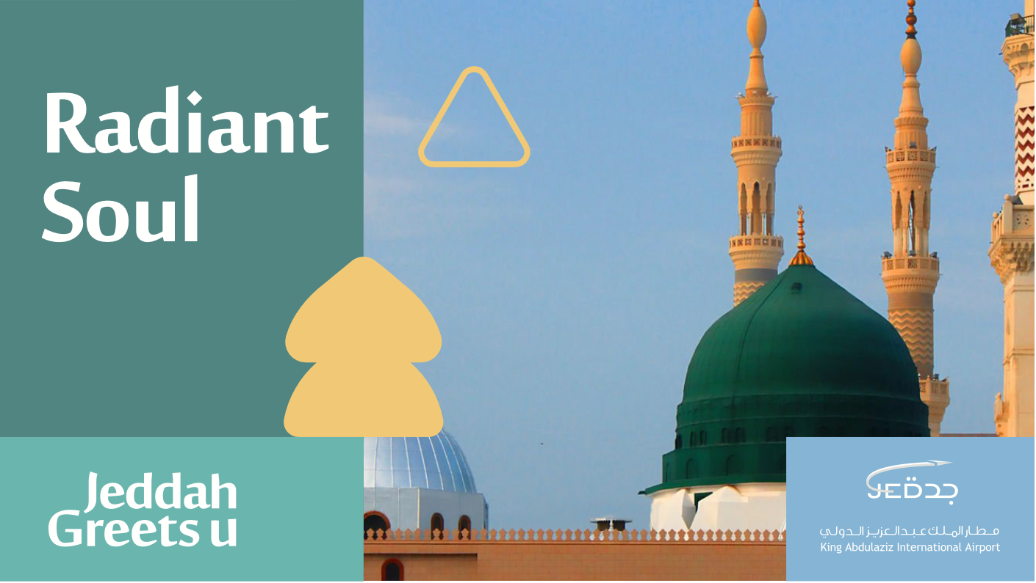

Slide 22
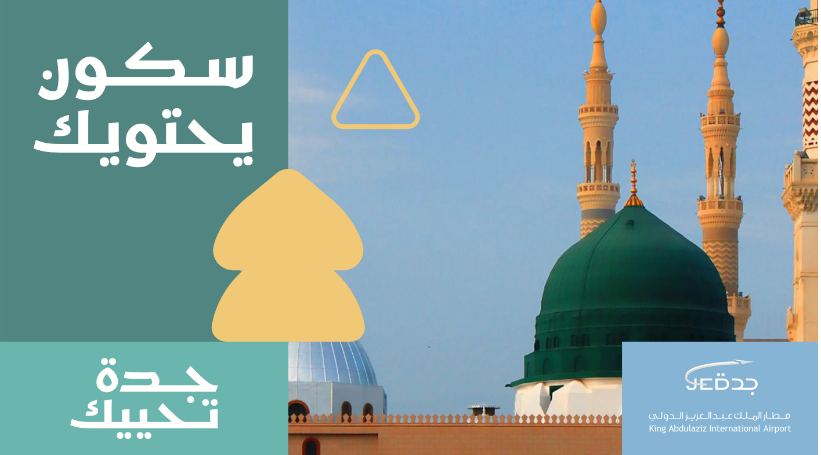

Slide 23
Business
6- Cuisine

Slide 24
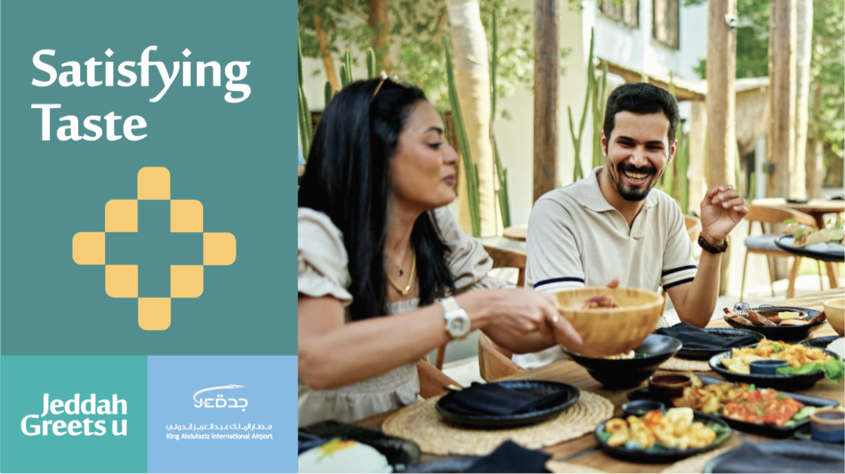

Slide 25
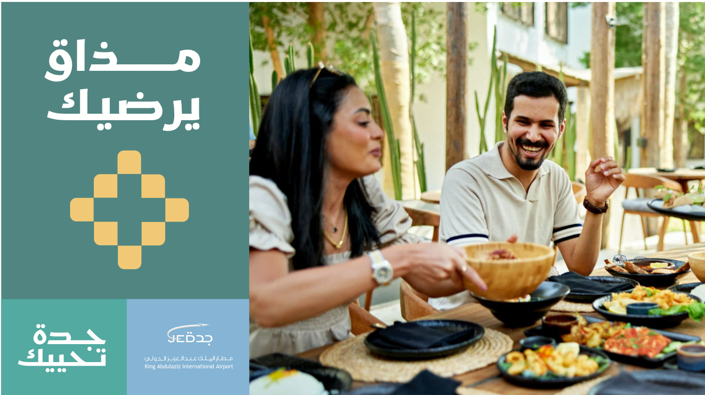

Slide 26
Business
7- Sun

Slide 27
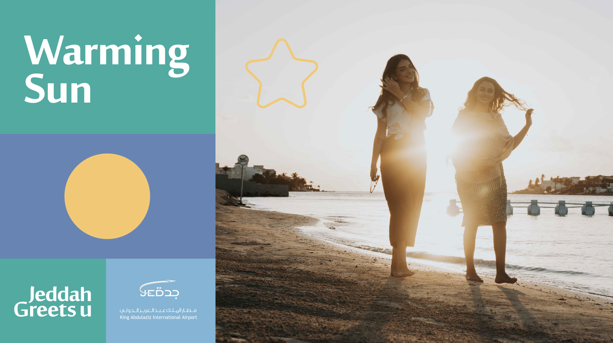

Slide 28
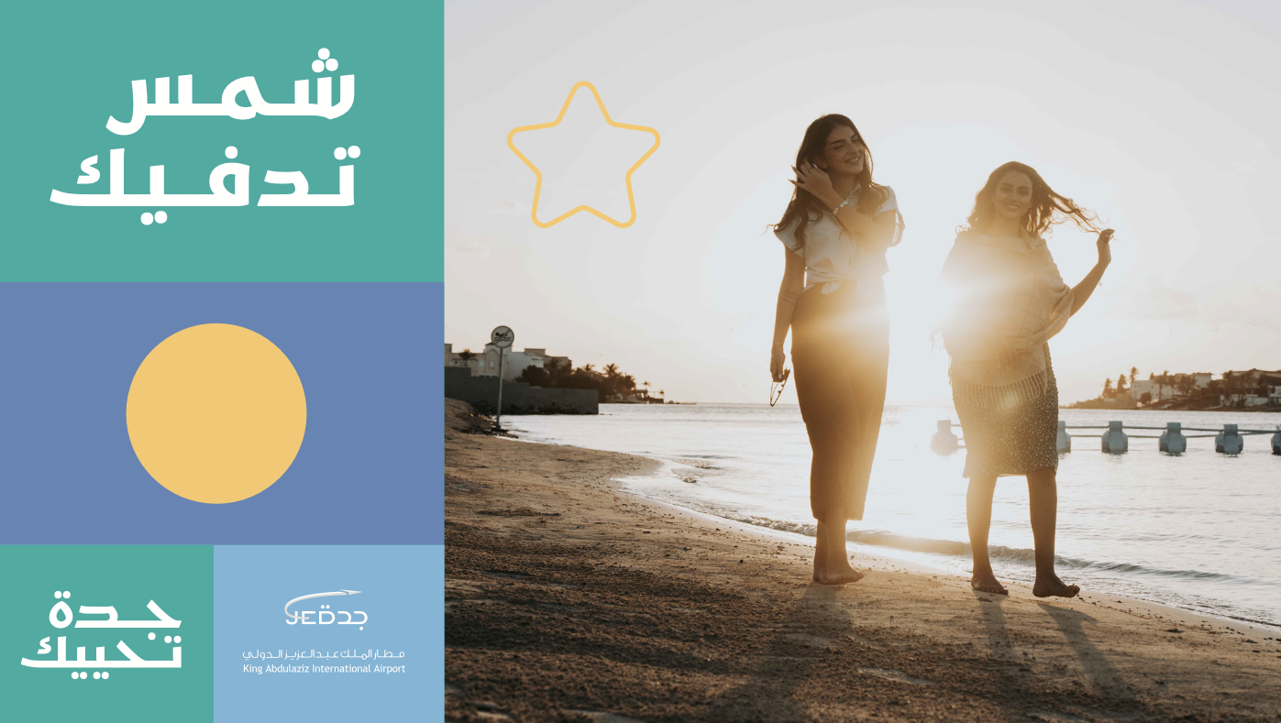

Slide 29
Business
8- Nightlife/Going out

Slide 30
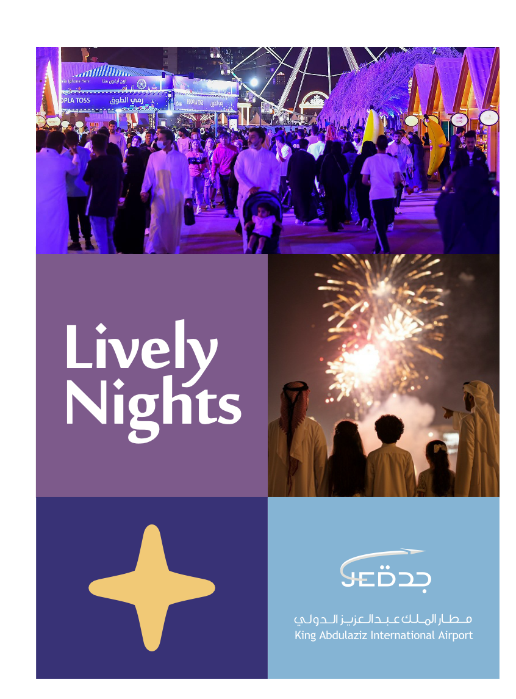

Slide 31
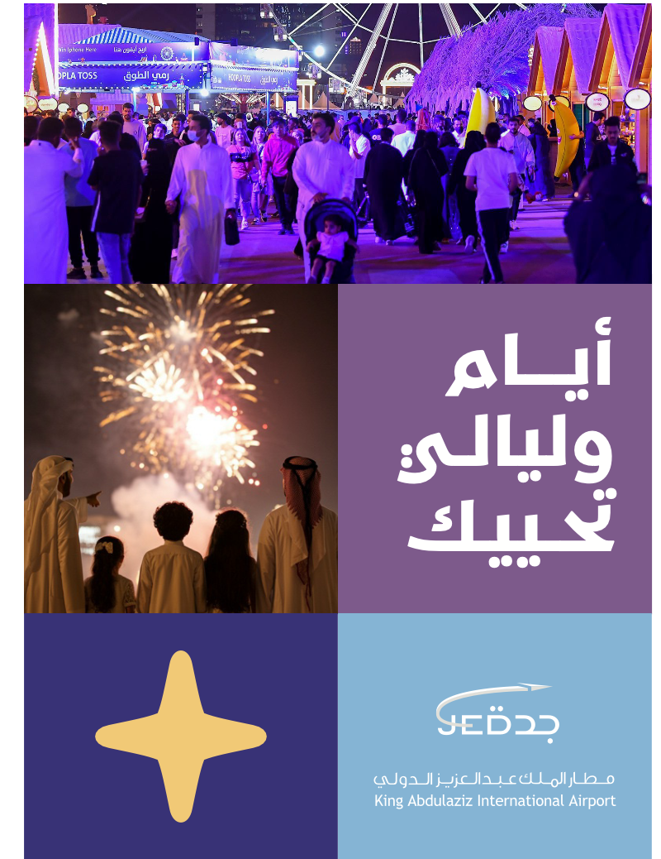

Slide 32
Business
9- Sports

Slide 33


Slide 34
Business
10- Culture/Local

Slide 35
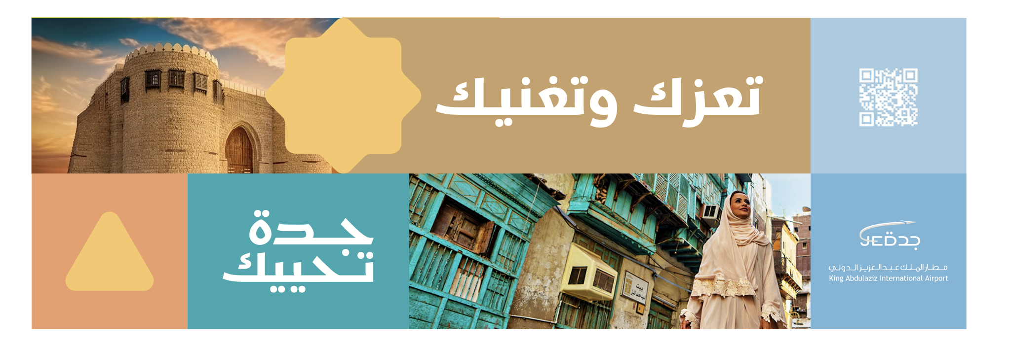

Slide 36
Business
11- Arrival

Slide 37
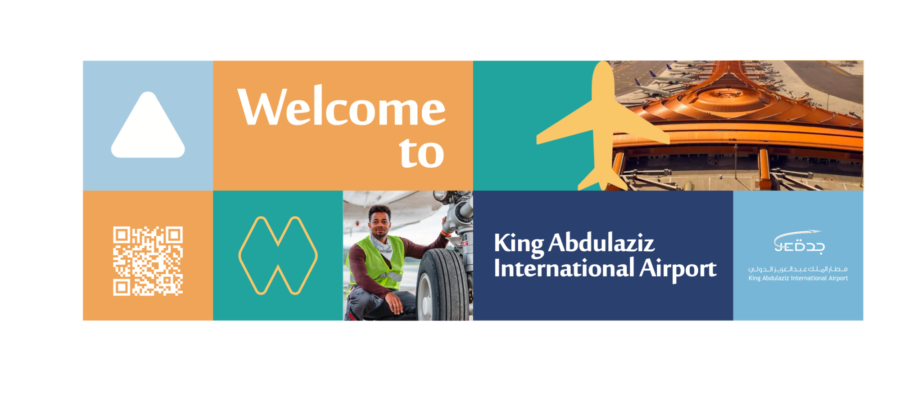

Slide 38
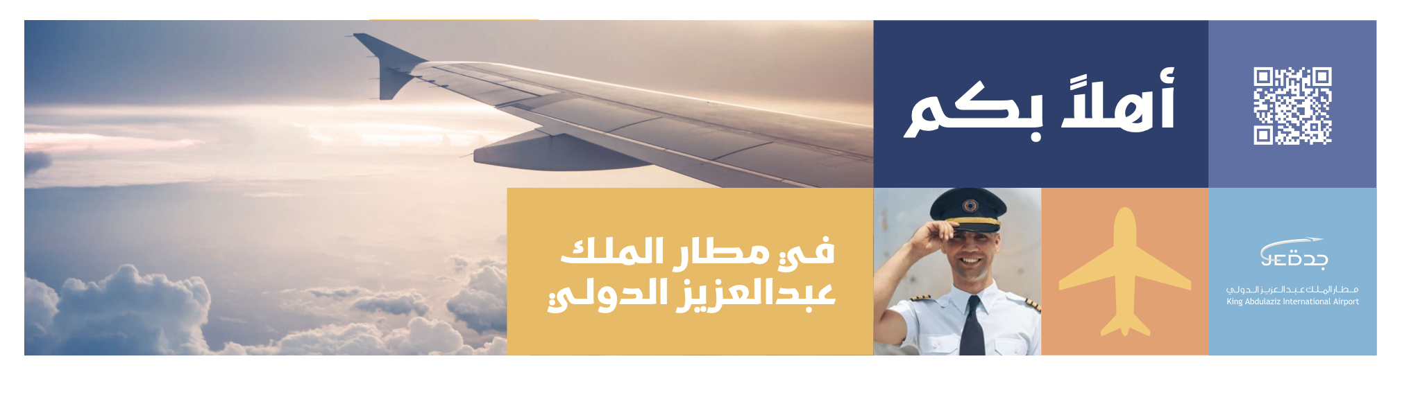

Slide 39
Business
12- Departure

Slide 40


Slide 41


Slide 42

Recommendations of the message by Area
We will deliver our recommendation on which of the themes/messages will fit into each of the 51 areas, in Excel Sheet.

