Slide 1
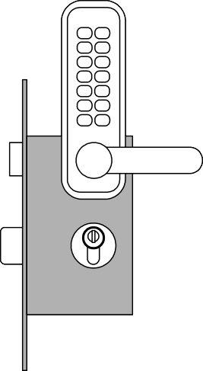
New User Story Requirements
Safe Home Access
Identifier | User Story | Size
REQ-1 | As a user, I can be sure that the doors by default will be locked. | 4 points
REQ-2 | As a user, I will be able to unlock the doors using a mobile phone | 7 points
REQ-3 | An intruder will not be able to unlock the doors by using his own mobile phone; the system will block when it detects multiple lock-phone pairing failures | 7 points
REQ-4 | As a user, I can be sure that the doors will be automatically locked at all times. | 6 pts
REQ-5 | The door keypad will be backlit when dark for visibility. | 3 pts
REQ-6 | Anyone will be able to lock the doors on demand. | 3 pts
REQ-7 | As a user, I will be able to manage additional user accounts (in terms of user mobile device info, e.g., phone number) | 10 pts
REQ-8 | As a user, I will be able to view the history of accesses to my home. | 6 pts
REQ-9 | As a user, I will be able to configure the preferences for how my household devices will be activated on my arrival. | 6 pts
Changes: the authentication is based on detecting the proximity of user’s phone using the Bluetooth network.
3

Slide 2
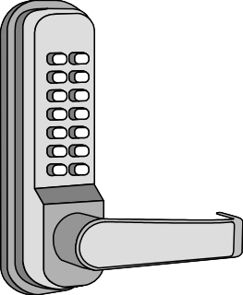
Deriving Use Cases from System Requirements
1
2
3
4
5
X Y
 | Initiator | Initiator’s Goal | Participants | Use Case Name
 | Tenant | Unlock and enter home. | Lock, Household Devices, Database, mobile phone | Unlock (UC-1)
 | Tenant | Lock the door. | Lock, Household Devices, Database | Lock (UC-2)
 | Landlord | Create a new user account and allow access to home. | Tenant, Database | AddUser (UC-3)
 | Landlord | Retire an existing user account and disable access. | Database, mobile phone | RetireUser (UC-4)
 | Tenant | Review the history of home accesses. | Database | ViewHistory (UC-5)
 | Tenant | Configure the operational preferences for household devices. | Database | SetDevicePrefs (UC-6)
 | Visitor | Visit a resident’s home. | Lock, Database | AuthenticateUser (UC-7)
Initiating actors (“users”) are already identified in user stories
Participating actors identified as part of use case analysis

Slide 3
Use Case 1: Unlock
Use Case UC-1:
Unlock
Related Requirem’ts:
Initiating Actor:
Actor’s Goal:
Participating Actors:
REQ1, REQ3, REQ4, and REQ5
Any of: Tenant, Landlord
To disarm the lock and enter, and get space lighted up automatically.
LockDevice, LightSwitch, Timer, Mobile phone
The set of mobile phones stored in the system database is non-empty.
The system displays the menu of available functions; at the door keypad the menu choice is “Lock” ; The unlock button is displayed on the phone menu
The auto-lock timer has started countdown from autoLockInterval.
Preconditions:
Postconditions:
Flow of Events for Main Success Scenario:
® 1. Tenant/Landlord arrives at the door, connects Bluetooth and select unlock
2. include::AuthenticateUser (UC-7)
System (a) signals to the Tenant/Landlord the lock status, e.g., “disarmed,” (b) signals to
¬ 3.
¬ 4. System signals to the Timer to start the auto-lock timer countdown
® 5. Tenant/Landlord opens the door, enters the home [and shuts the door and locks]
LockDevice to disarm the lock, and (c) signals to LightSwitch to turn the light on

Slide 4
Use Case 1: RetireUser
Use Case UC-4:
RetireUser
Related Requirem’ts:
Initiating Actor:
Actor’s Goal:
Participating Actors:
REQ7 and REQ8
Landlord
Retire an existing user account and disable access.
.
LockDevice, Mobile phone
Existing tenant users exist in the database
The landlord's phone displays all tenant entries and shows the RETIRE button
The tenant entry was deleted from the database
Preconditions:
Postconditions:
Flow of Events for Main Success Scenario:
® 1. Landlord selects the menu item “ManageUsers” in his mobile phone
2. Landlord identification: Include Login (UC-8)
¬ 3. System (a) displays the options of activities available to the Landlord (including “Add User” and “Remove User”), and (b) prompts the Landlord to make selection
® 4. Landlord selects the activity, such as “Remove User”
¬ 5. System (a) delete a tenant's entry in the database, and (b) signals completion

Slide 5
Acceptance Test Case for UC-1 Unlock
Test-case Identifier: TC-1 Use Case Tested: UC-1, main success scenario, and UC-7 Pass/fail Criteria: Input Data: Bluetooth , door identifier
Test Procedure: | Expected Result:
Step 1. Connect an incorrect Bluetooth to the phone and try to open the door Step 2. Connect a correct Bluetooth to your phone and try to open the door | System beeps to indicate failure; records unsuccessful attempt in the database; prompts the user to try again System flashes a green light to indicate success; records successful access in the database; disarms the lock device
The test passes if the user has successfully connected to Bluetooth and the phone information is in the database and is less than the maximum number of pairing attempts

Slide 6
Acceptance Test Case for UC-4 RetireUser
Test-case Identifier: TC-2 Use Case Tested: UC-4 Pass/fail Criteria: Input Data: Bluetooth , door identifier
Test Procedure: | Expected Result:
Step 1. The user did not delete the tenant information and the tenant tried to open the door using Bluetooth on the phone Step 2. The user deleted the tenant's information and the tenant tried to open the door using Bluetooth on the phone | System flashes a green light to indicate success; records successful access in the database; disarms the lock device System beeps to indicate failure; records successful attempt in the database; prompts the user to try again
The test passes if the user successfully deleted a tenant’s mobile phone information, the tenant can not use the cell phone Bluetooth unlock

