Slide 1
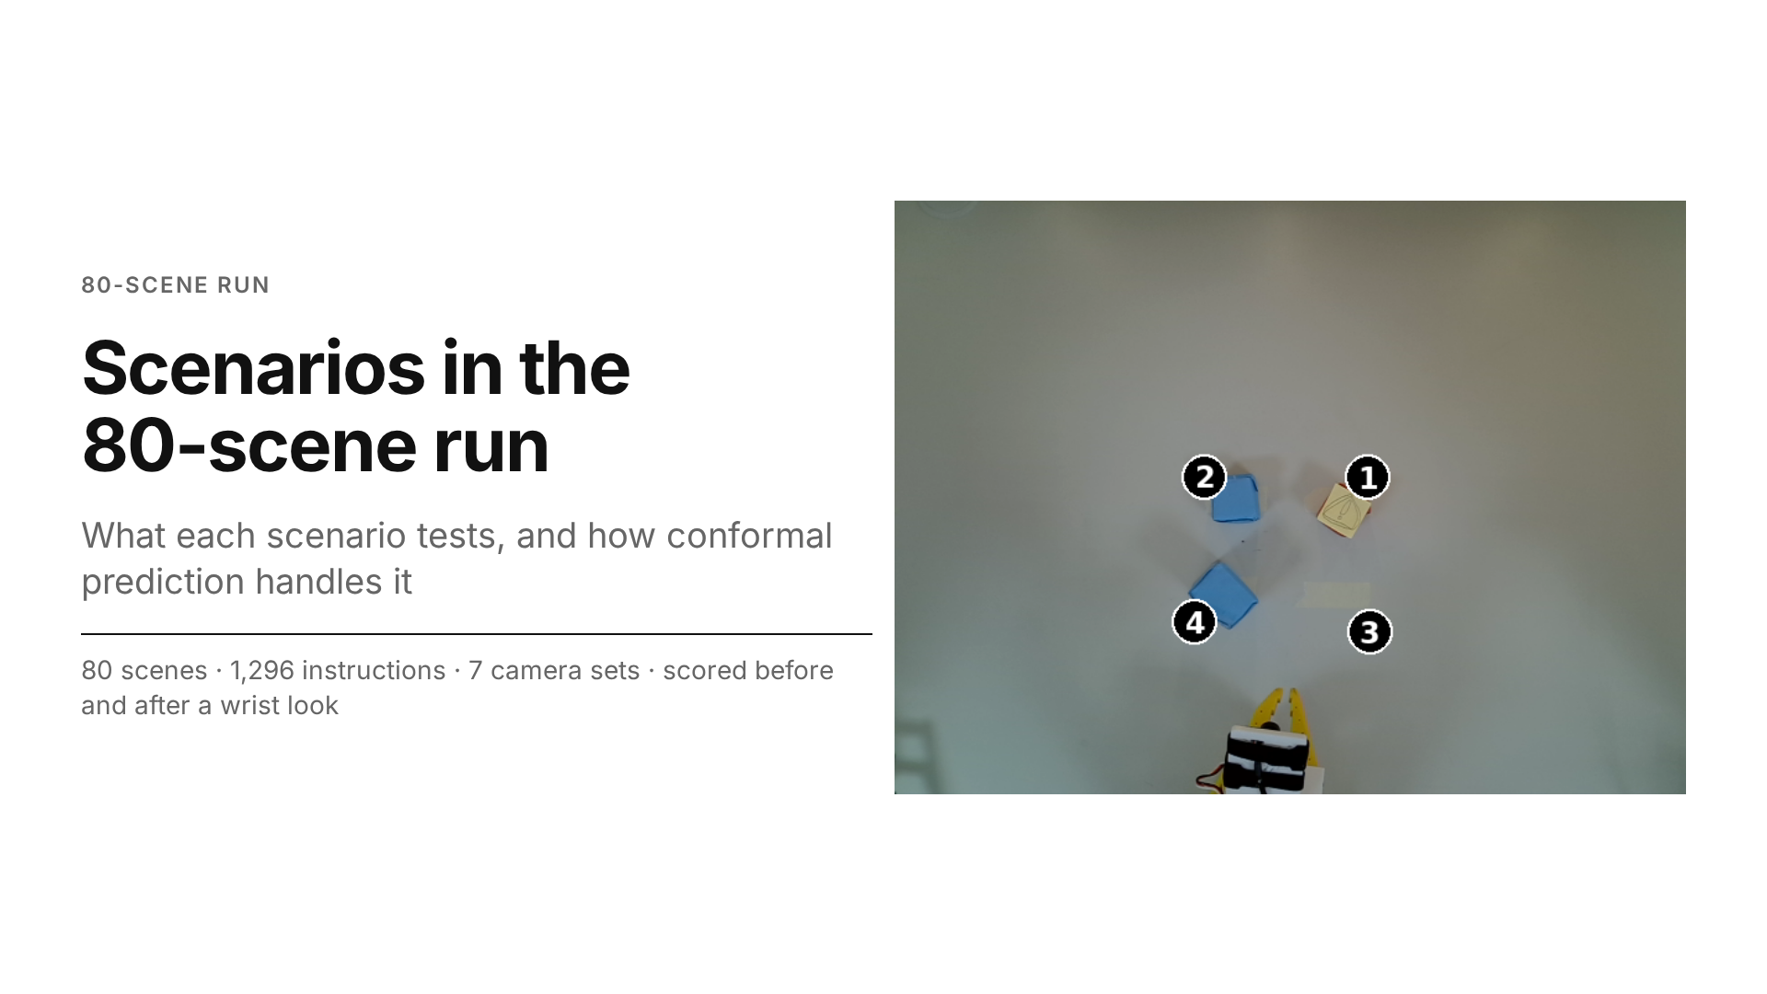
Notes:
Every trial is one scene × one instruction × one set of cameras, scored twice: with the external cameras only, and again after a wrist look. Source document: 80-run-unique-scenario.md; numbers computed by scenarios.py (output scenarios.json).

Slide 2
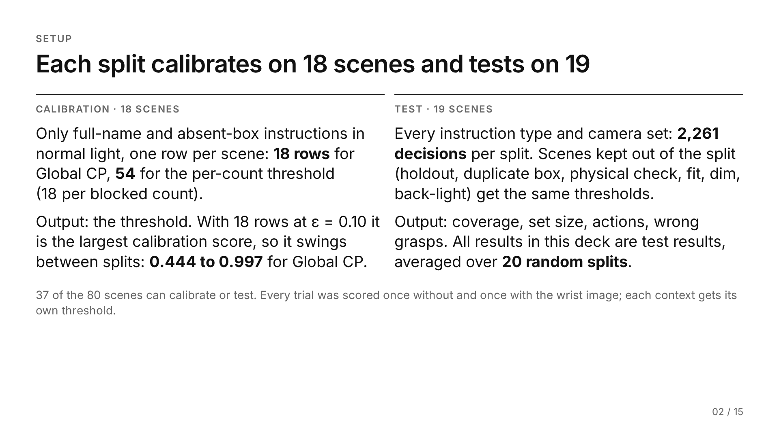
Notes:
Test population: the test half of each split, i.e. scenes from the standard and absent-box pools, normal light, no holdout scenes, all instruction types. 2,261 is the "all" row's n in the instruction-type table of 80-run-unique-scenario.md.

Slide 3
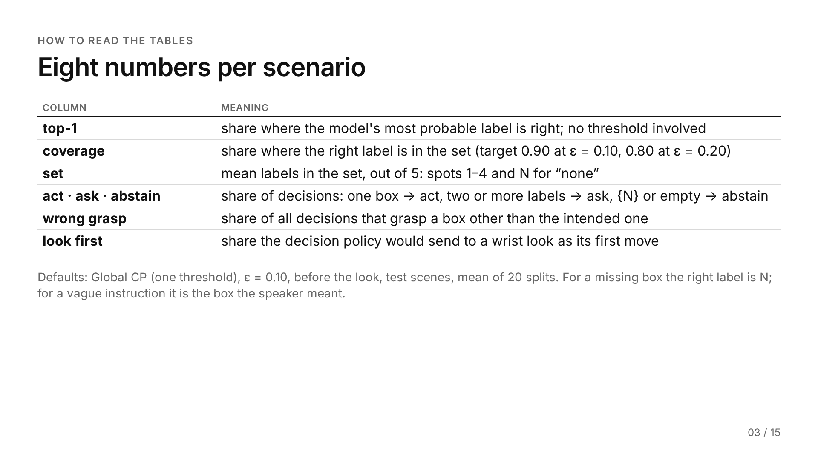
Notes:
Wrong grasp, in full: for a missing box, any grasp counts as wrong. The source tables also carry n (test decisions per split, mean over 20 splits); the slides drop it as a column and keep it here and in the source.

Slide 4
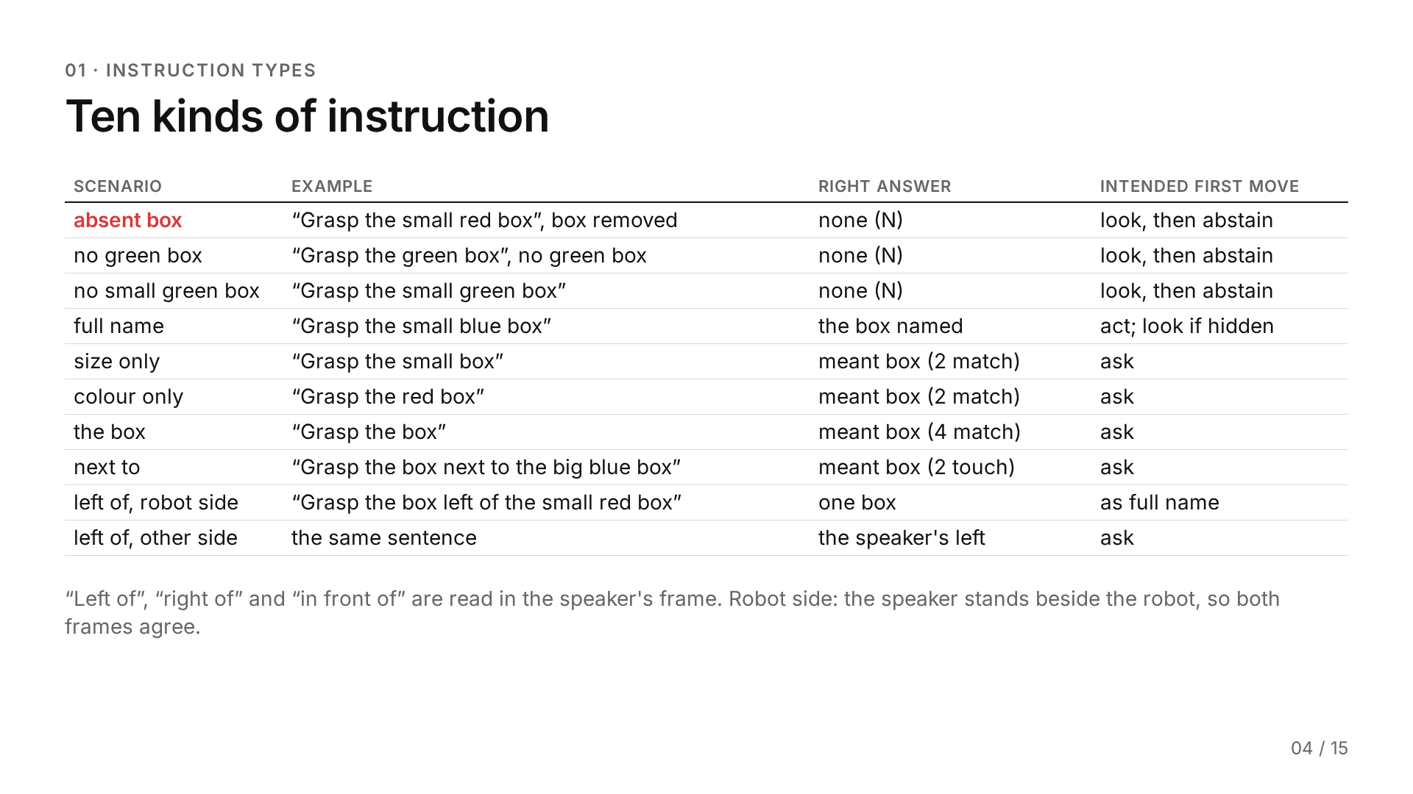
Notes:
The source report codes these kinds L0–L4: L0 names a box that is not on the table (absent box, no green box, no small green box), L1 names one box fully (full name), L2 and L3 match two or four boxes (size only, colour only; the box), L4 refers to a box through another one (next to; left of). The face uses the plain names only. For “left of, other side”, the right answer is the box on the speaker's left, a side no image shows.

Slide 5
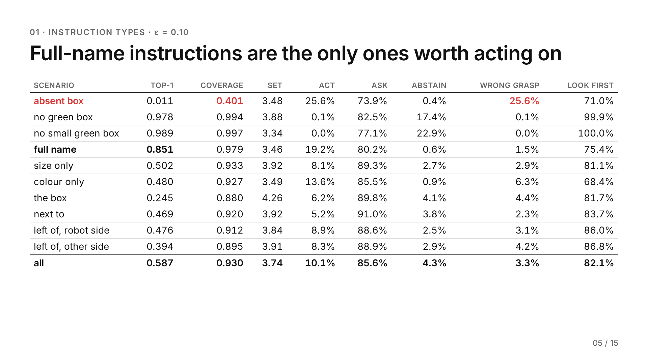
Notes:
Source: 80-run-unique-scenario.md §1, "Results, ε = 0.10". Test decisions per split (n), in row order: 30, 133, 133, 502, 266, 266, 133, 266, 122, 410; all 2261. The ε = 0.20 and after-the-look versions of this table stay in the source; slides 7 and 8 carry their findings.

Slide 6
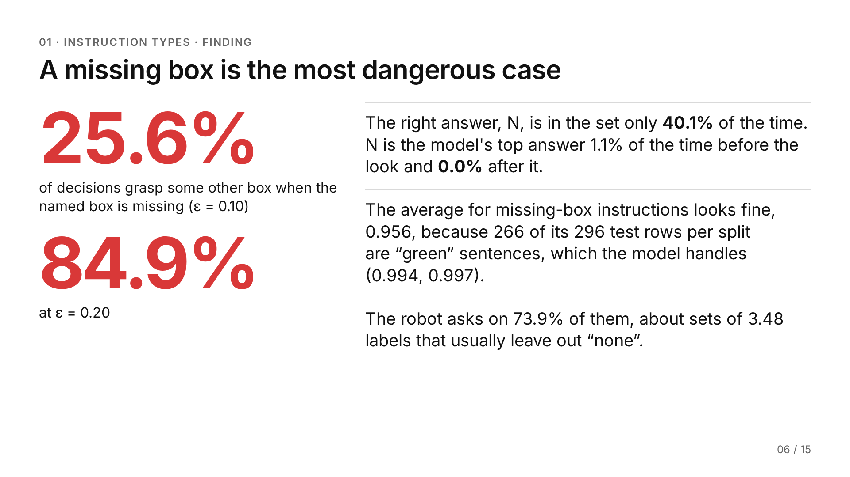
Notes:
Source: 80-run-unique-scenario.md §1, "What it shows". At ε = 0.20 coverage for the absent box falls to 0.046 with sets of 1.35 labels. The 0.956 average is the L0 coverage reported earlier for all missing-box instructions together.

Slide 7
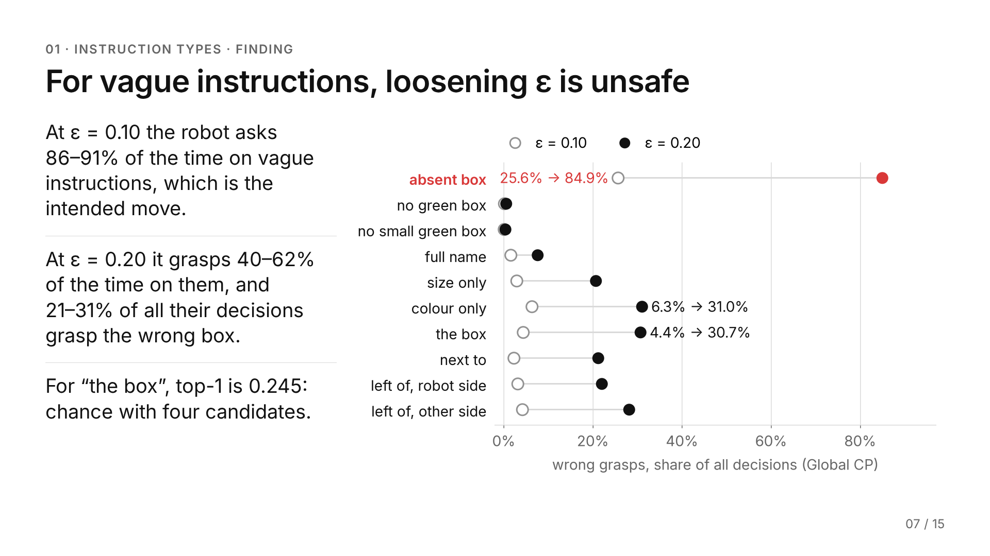
Notes:
Ranges come from the six vague rows (size only through left of, other side; L2–L4 in the source) of the ε = 0.20 table in 80-run-unique-scenario.md §1 (act 40.0–62.2%, wrong grasp 20.7–31.0%). Chart: ε = 0.10 open circles, ε = 0.20 filled; the absent-box row is red because it is the failure case.

Slide 8
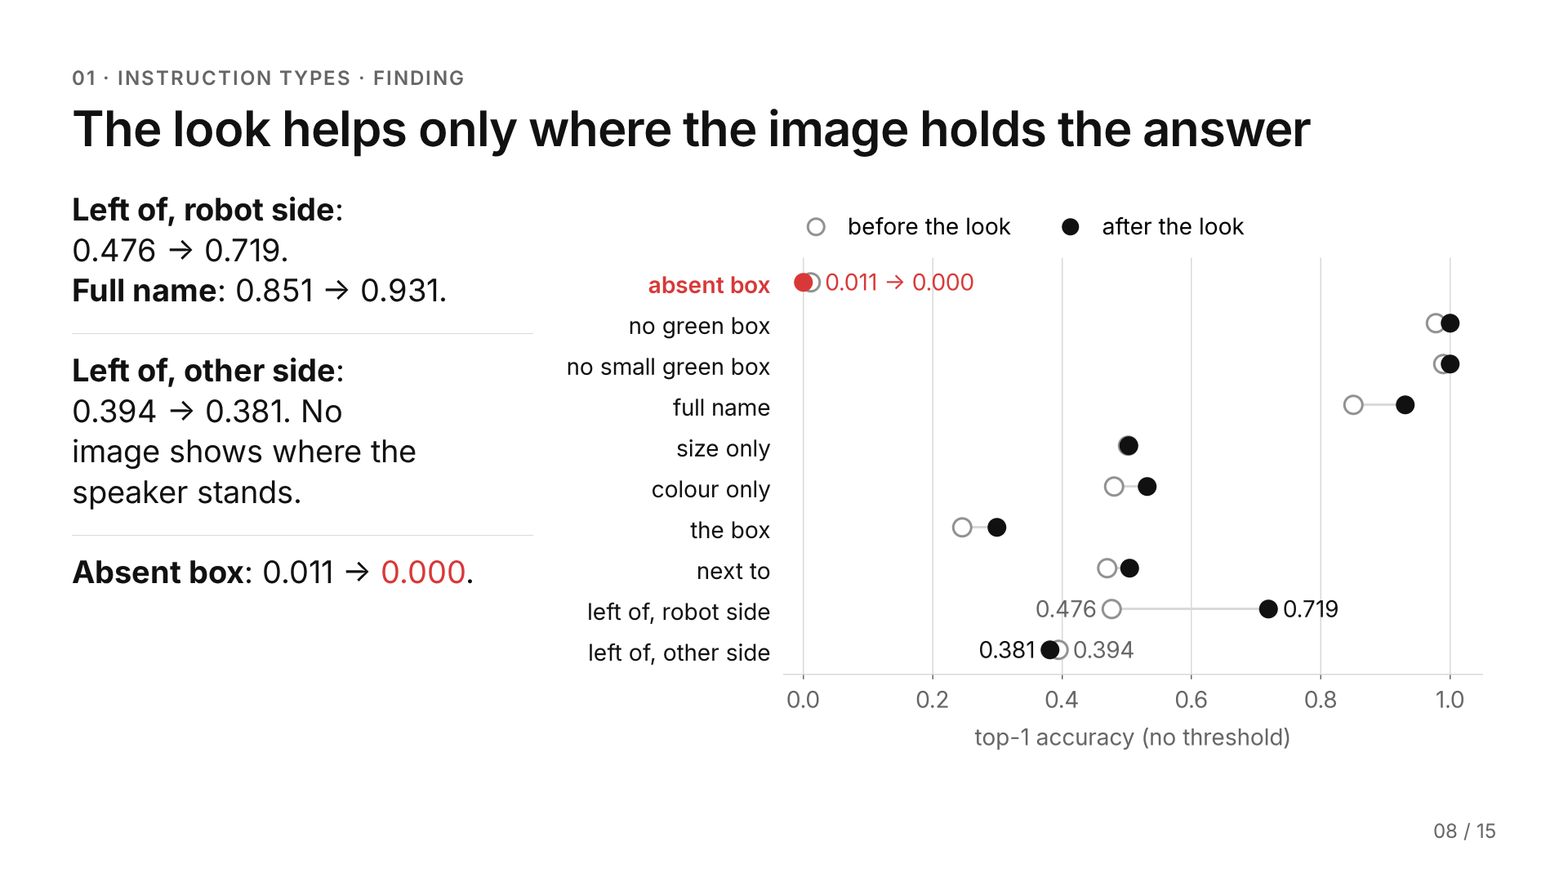
Notes:
Top-1 before vs after the wrist look, ε-independent (no threshold). Source: 80-run-unique-scenario.md §1, "After the wrist look, ε = 0.10".

Slide 9
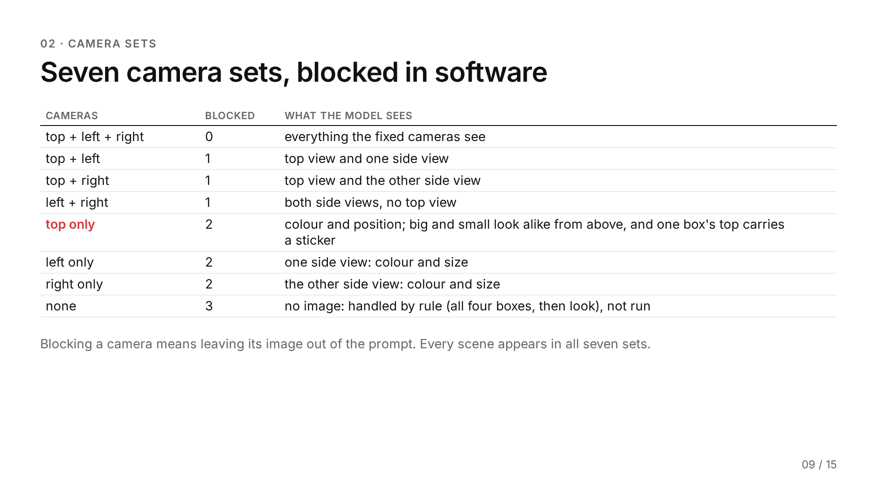
Notes:
Source: 80-run-unique-scenario.md §2. The no-camera case is a rule of the decision policy, not a measured condition.

Slide 10
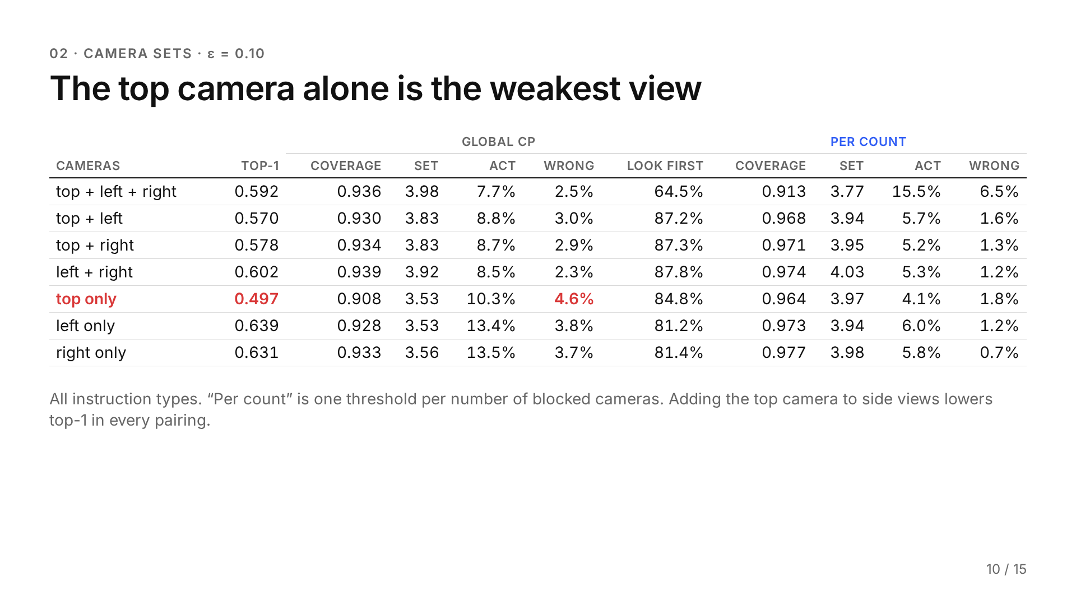
Notes:
Source: 80-run-unique-scenario.md §2, "Results, ε = 0.10, all instruction types"; n = 323 per camera set. Caveat: these rows cover all instruction types; results restricted to the calibrated instructions (full name and absent box) show higher coverage. The ε = 0.20 table stays in the source.

Slide 11
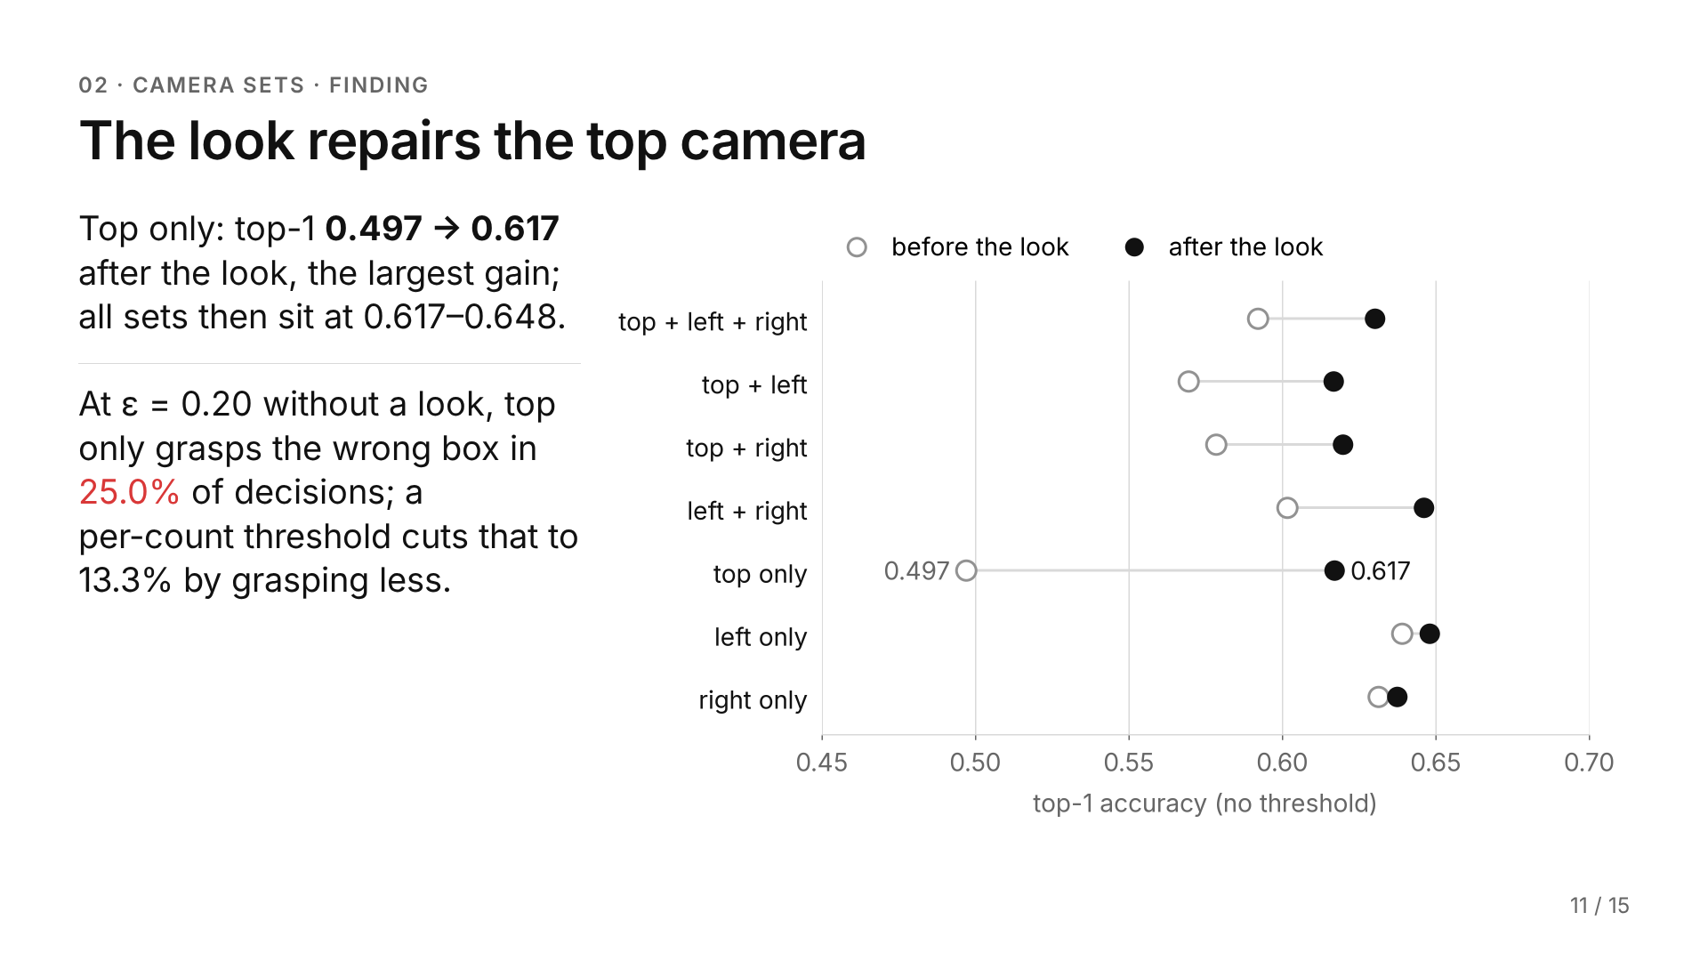
Notes:
Source: 80-run-unique-scenario.md §2. Per count at ε = 0.20, top only grasps 28.3% of the time against 49.7% under Global CP; it does the same for left only and right only, which did not need it.

Slide 12
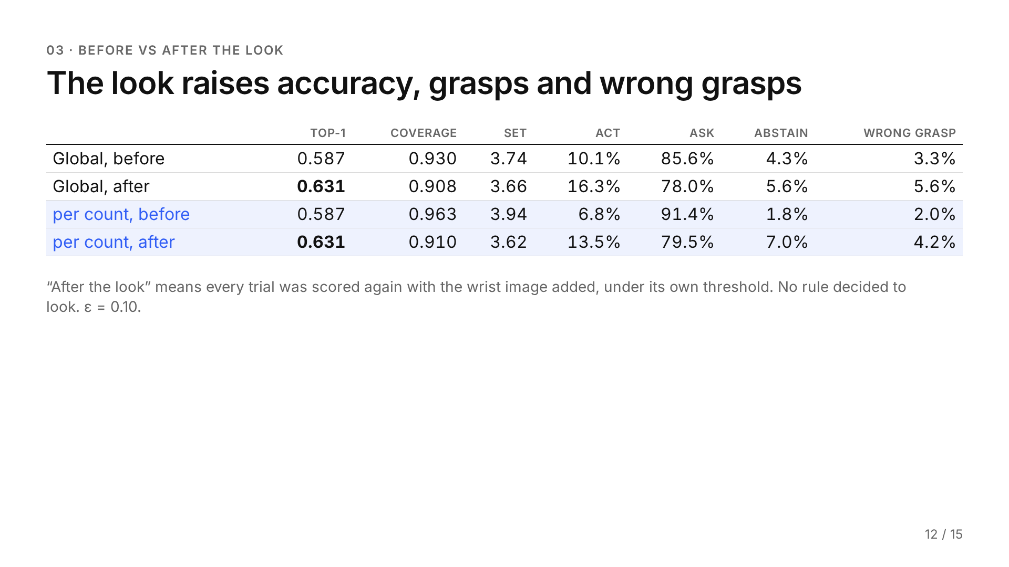
Notes:
Source: 80-run-unique-scenario.md §3. Post-look scores use temperature T = 4.5, with a threshold calibrated on post-look scores.

Slide 13
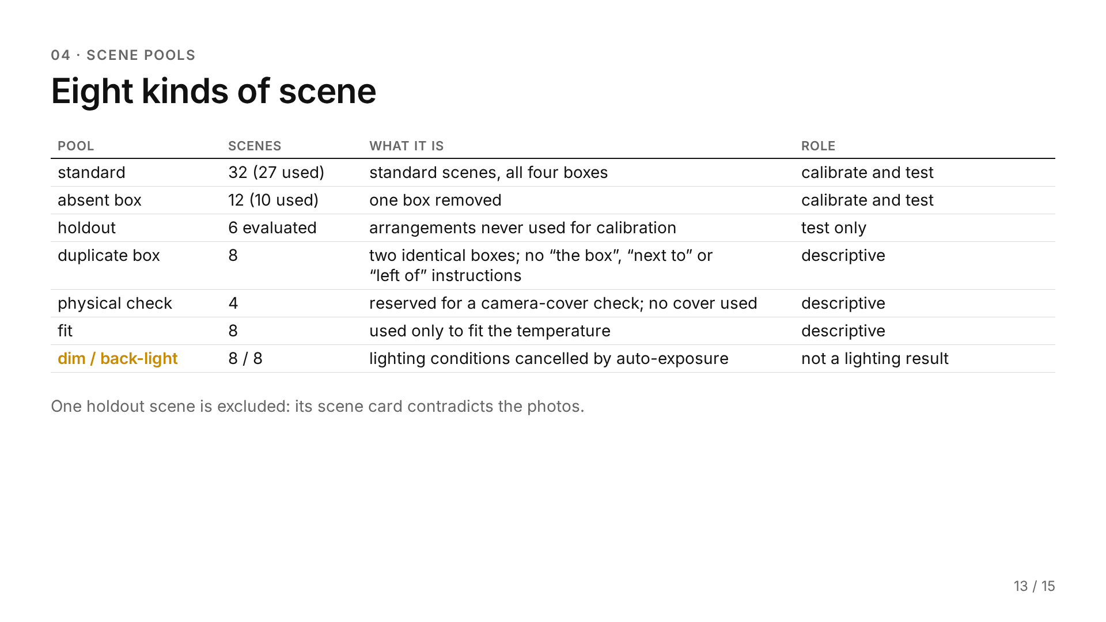
Notes:
Source: 80-run-unique-scenario.md §4. Holdout: 7 scenes, 6 evaluated. Duplicate-box scenes hold an ambiguity no camera can resolve. Amber marks a caveat: the dim and back-light rows read as more ordinary scenes, not as a lighting result.

Slide 14
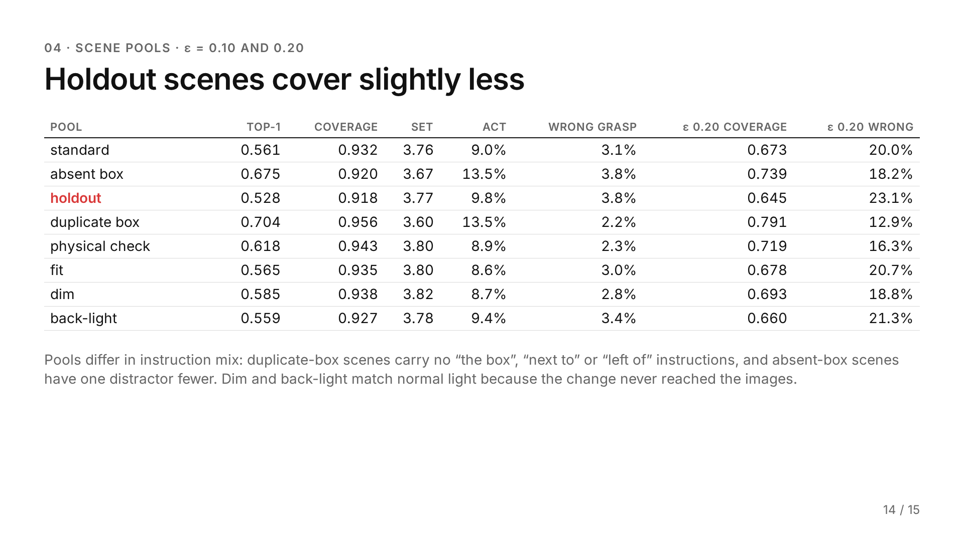
Notes:
Source: 80-run-unique-scenario.md §4. n per pool: 1749, 512, 714, 504, 476, 952, 952, 952. For pools outside the split (holdout, duplicate box, physical check, fit, dim, back-light), n counts all their trials, which see a new threshold in each split.

Slide 15
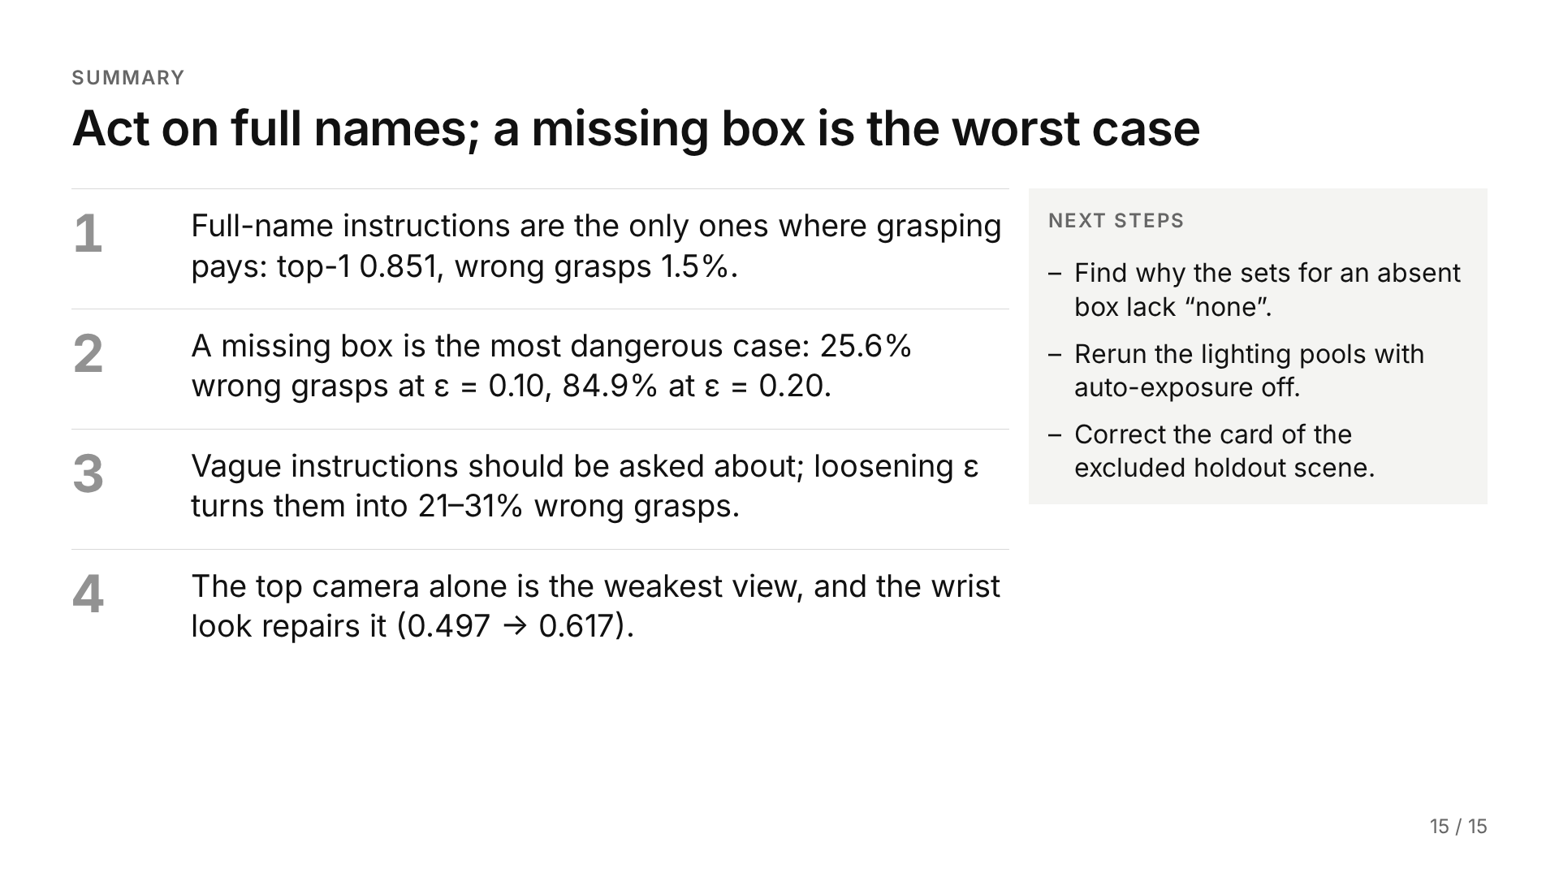
Notes:
Each statement restates one finding slide, in the order shown: 5, 6, 7, 11. Next steps come from the deck itself: the first from slide 6 (sets of 3.48 labels that usually leave out “none”), the second from slides 13 and 14 (auto-exposure cancelled the lighting change, so dim and back-light say nothing about lighting), the third from slide 13 (one holdout scene is excluded because its scene card contradicts the photos).

