Slide 1
MasterMind
SW design specification

Slide 2
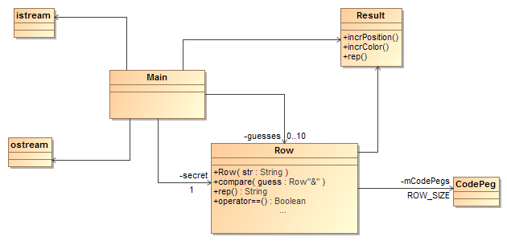
Class diagram

Slide 3
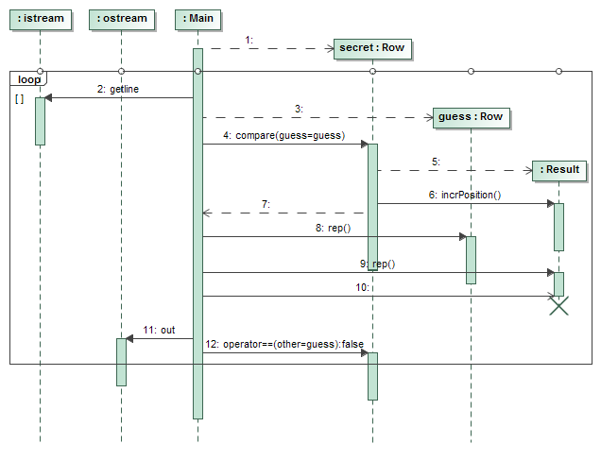
Sequence diagram

