Slide 1
CTEC 651 · DIGITAL REPOSITORY PROJECT 1
GreenHouseWatch
From sensor simulation to a local IoT digital repository.
Smart greenhouse climate and soil monitoring
Python · MQTT / HiveMQ · SQLite · Matplotlib · Streamlit
Instructor: Prof. F. Njeh · Student: IPMC BIT · Demo date: 28 September 2026

Slide 2
GREENHOUSEWATCH · 02
PROBLEM AND USE CASE
Plants fail quietly when nobody is watching the climate.
The problem
The use case
The outcome
Temperature spikes, dry soil, and overnight humidity drift kill greenhouse crops. Paid cloud IoT platforms are more than a class-scale house needs.
A simulated greenhouse node (GH-SENSOR-01) streams temperature, humidity, soil moisture, and light into a local SQLite repository.
Charts and alerts show when to irrigate, vent, or heat — using only free tools required by the assignment.
Mirrors real systems in smart agriculture, healthcare monitoring, smart cities, and industrial automation.
CTEC 651 · Prof. F. Njeh · Due 28 September 2026

Slide 3
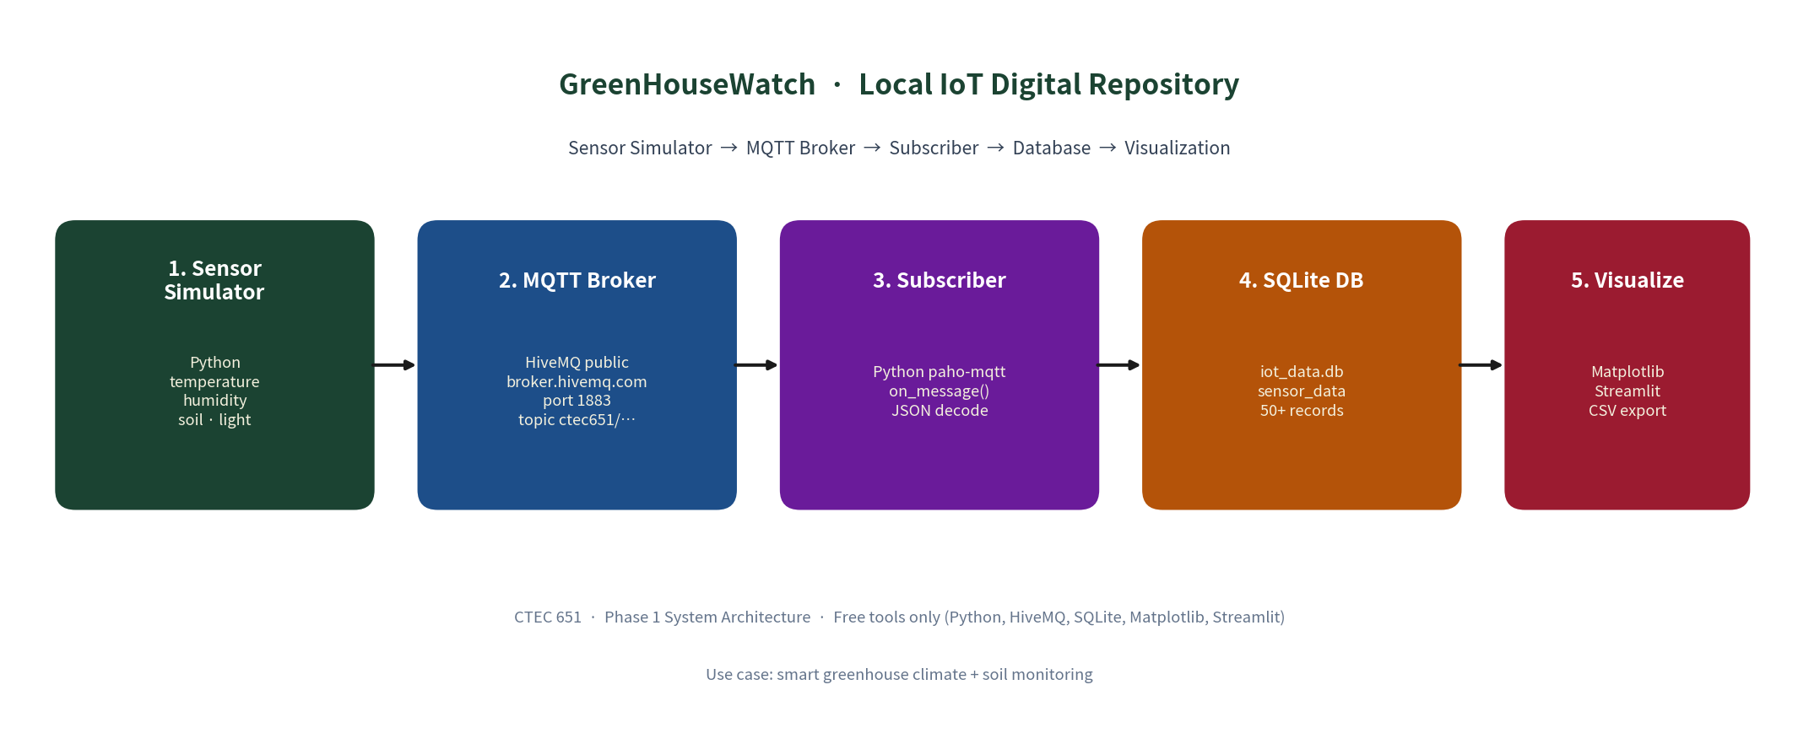
GREENHOUSEWATCH · 03
SYSTEM ARCHITECTURE
Assignment pipeline: Sensor Simulator → MQTT Broker → Subscriber → Database → Visualization. All tools are free.
Broker broker.hivemq.com:1883 Topic ctec651/greenhousewatch/ipmcbit Store data/iot_data.db
CTEC 651 · Prof. F. Njeh · Due 28 September 2026

Slide 4
GREENHOUSEWATCH · 04
DATA FIELDS
Field | Type | Meaning
timestamp / iso_time | REAL / TEXT | Unix time + UTC clock
device_id | TEXT | Sensor node (GH-SENSOR-01)
temperature_c | REAL | Air temperature, °C
humidity_pct | REAL | Relative humidity, %
soil_moisture_pct | REAL | Root-zone moisture, %
light_lux | REAL | Ambient light (day / night)
alert_flag / alert_reason | INTEGER / TEXT | 1 if a safe-band limit is broken
CTEC 651 · Prof. F. Njeh · Due 28 September 2026

Slide 5
GREENHOUSEWATCH · 05
SIMULATION AND MQTT
Phase 2 — Simulator
Phase 3 — MQTT
src/simulator.py generates JSON with a day/night solar curve, soil dry-down, an irrigation bump, and a few anomalies so the charts are readable — not white noise.
Two scripts talk through HiveMQ:
Terminal A python subscriber.py
Terminal B python publisher.py --count 20
The subscriber decodes JSON and INSERTs into SQLite. Change the topic in src/config.py if the public broker is busy.
python simulator.py --count 20
Sample output is in samples/phase2_sample_output.txt (20 records).
CTEC 651 · Prof. F. Njeh · Due 28 September 2026

Slide 6
GREENHOUSEWATCH · 06
DATA STORAGE
SQLite digital repository · data/iot_data.db
80
7
4
0
stored records
(min. required: 50)
alert rows
(dry soil, humidity, cold)
sensor channels
plus alert metadata
paid services
SQLite is built in
Schema lives in docs/table_schema.md. Rebuild anytime with python seed_database.py --reset --n 80. Live MQTT rows append on top of the seed.
CTEC 651 · Prof. F. Njeh · Due 28 September 2026

Slide 7
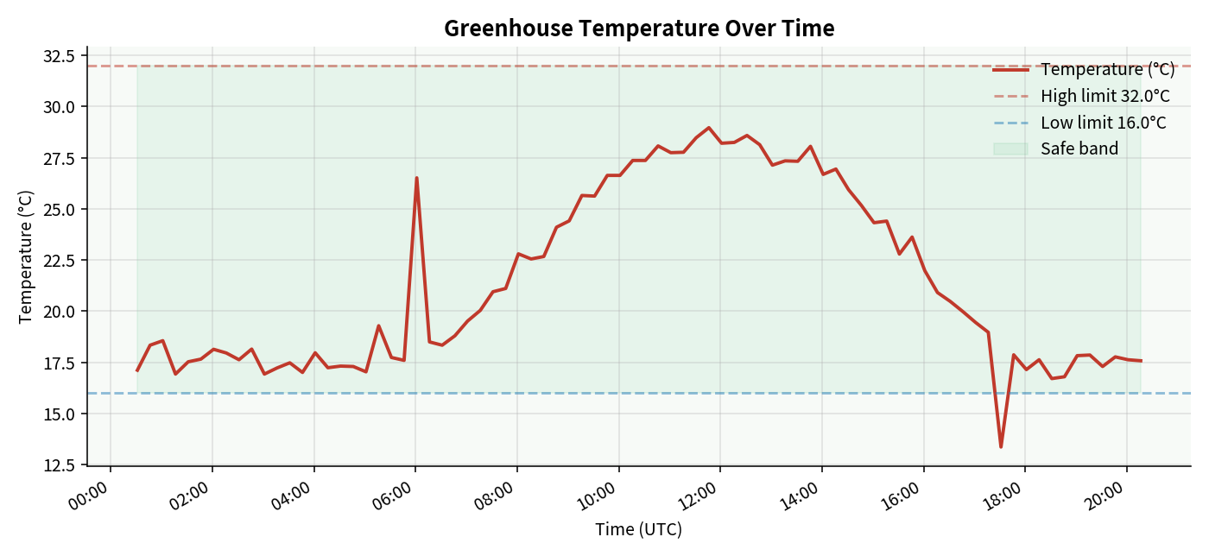
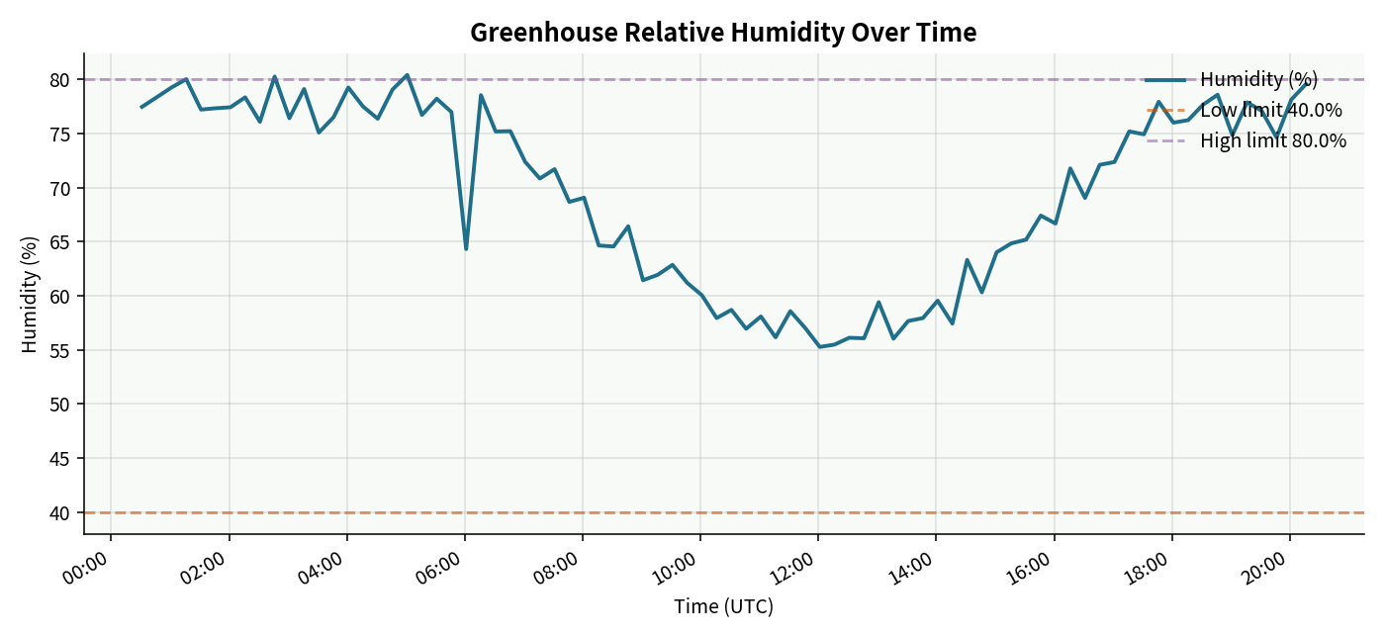
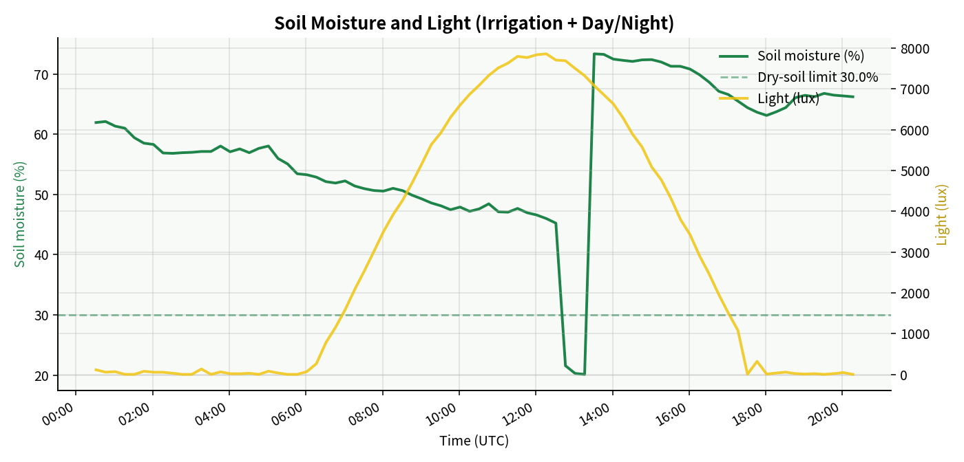
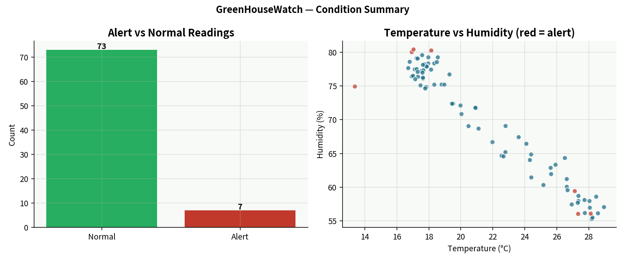
GREENHOUSEWATCH · 07
VISUALIZATIONS
CTEC 651 · Prof. F. Njeh · Due 28 September 2026

Slide 8
GREENHOUSEWATCH · 08
KEY INSIGHTS
What 80 greenhouse readings actually say
01
Climate mostly stayed safe
Temperature peaked near 29 °C — under the 32 °C heat limit. The house did not overheat in this series.
02
The real risks were drought and damp nights
Three mid-day soil readings fell to ~20 % (dry_soil). Three night readings crossed 80 % humidity. One dawn dip hit 13.4 °C.
03
Light proves the clock is real
Lux follows a clean day/night curve. Humidity moves opposite temperature. That inverse pair is what a working greenhouse looks like.
04
Alerts sit on the edges, not the middle
7 of 80 rows flagged. Operators would irrigate at noon, vent at night, and protect against a short cold snap — not redesign the whole house.
CTEC 651 · Prof. F. Njeh · Due 28 September 2026

Slide 9
GREENHOUSEWATCH · 09
LIVE / RECORDED DEMO
Two ways to show the system working
Preferred — live MQTT
Fallback — no internet
1. pip install -r requirements.txt
2. Terminal A: python src/subscriber.py
3. Terminal B: python src/publisher.py --count 15
4. python src/db.py (row count grows)
5. python src/visualize.py (refresh charts)
6. streamlit run src/dashboard.py
Campus Wi-Fi sometimes blocks port 1883. If HiveMQ will not connect:
python src/offline_pipeline.py
Same database, same CSV, same four charts. Publisher and subscriber source are still submitted.
CTEC 651 · Prof. F. Njeh · Due 28 September 2026

Slide 10
GREENHOUSEWATCH · 10
BONUS AND CLOSE
What is already in the folder
Phase 1
Phase 5
Proposal + architecture diagram
Four charts + written interpretation
Phases 2–3
Phase 6
Simulator, publisher, subscriber
Streamlit dashboard (bonus)
Phase 4
Phase 7
SQLite file with 80 rows
These slides + demo script
Questions? Run the demo from the README. Replace “IPMC BIT” with your name before you submit.
CTEC 651 · Prof. F. Njeh · Due 28 September 2026

