Slide 1
BOWIE STATE UNIVERSITY · CTEC 651
GreenHouseWatch
Local IoT Digital Repository
From sensor simulation to data visualization
Smart greenhouse climate and soil monitoring
Python · MQTT / HiveMQ · SQLite · Matplotlib · Streamlit
Instructor: Dr. Felix Njeh
Student: Jerry Diabor
Final presentation: 28 September 2026

Slide 2
GREENHOUSEWATCH · 02
AGENDA
What this presentation covers
01
Problem and use case
05
Visualizations and key insights
02
System architecture
06
Live / recorded demo path
03
Data model and simulation
07
Summary and learning outcomes
04
MQTT transmission and SQLite storage
Bowie State University · CTEC 651 · Dr. Felix Njeh · Jerry Diabor · 28 September 2026

Slide 3
GREENHOUSEWATCH · 03
PROBLEM AND USE CASE
Retain greenhouse observations without a paid cloud platform
Problem
Use case
Scope
Temperature spikes, dry soil, and overnight humidity drift can damage crops when nobody is watching. Commercial IoT platforms are paid and often cloud-locked.
A single virtual greenhouse node (GH-SENSOR-01) publishes temperature, humidity, soil moisture, and light as JSON over MQTT into a local SQLite repository.
Educational prototype for CTEC 651. It demonstrates monitoring and analysis; it does not control a real greenhouse or claim physical measurements.
Bowie State University · CTEC 651 · Dr. Felix Njeh · Jerry Diabor · 28 September 2026

Slide 4
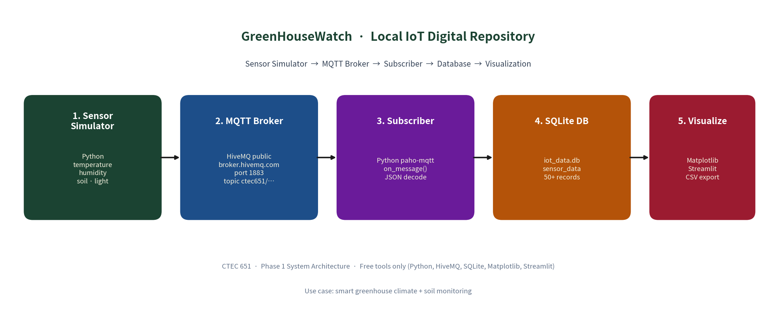
GREENHOUSEWATCH · 04
SYSTEM ARCHITECTURE
Required pipeline: Sensor Simulator → MQTT Broker → Subscriber → Database → Visualization
Broker: broker.hivemq.com:1883 · Topic: ctec651/greenhousewatch/ipmcbit · Store: data/iot_data.db · All free tools
Bowie State University · CTEC 651 · Dr. Felix Njeh · Jerry Diabor · 28 September 2026

Slide 5
GREENHOUSEWATCH · 05
DATA MODEL
SQLite table sensor_data - fields stored for every reading
Field | Type | Purpose
timestamp / iso_time | REAL / TEXT | Unix time + human-readable UTC
device_id | TEXT | Virtual node id (GH-SENSOR-01)
temperature_c | REAL | Air temperature (°C)
humidity_pct | REAL | Relative humidity (%)
soil_moisture_pct | REAL | Root-zone moisture (%)
light_lux | REAL | Ambient light (lux)
alert_flag / alert_reason | INTEGER / TEXT | 1 if any demonstration threshold is breached
Demo thresholds: temperature 16–32 °C · humidity 40–80% · soil moisture ≥ 30%. Light is recorded but does not raise alerts.
Bowie State University · CTEC 651 · Dr. Felix Njeh · Jerry Diabor · 28 September 2026

Slide 6
GREENHOUSEWATCH · 06
SIMULATION AND MQTT
Phase 2 - Simulation
Phase 3 - MQTT
src/simulator.py produces JSON with four measurements, UTC timestamps, device id, and alert metadata.
• Live mode: ~2-second interval
• Historical series: 15-minute steps, soil dry-down, irrigation recovery, injected anomalies
• Sample: samples/phase2_sample_output.txt (20 records)
Publisher and subscriber use HiveMQ public broker.
Terminal A:
python src/subscriber.py
Terminal B:
python src/publisher.py --count 20
Subscriber decodes JSON and INSERTs into SQLite via db.py. QoS 0; topic is configurable in config.py.
Bowie State University · CTEC 651 · Dr. Felix Njeh · Jerry Diabor · 28 September 2026

Slide 7
GREENHOUSEWATCH · 07
DATA STORAGE
SQLite repository · data/iot_data.db
80+
7
4
0
stored records
(assignment min: 50)
alert rows
dry soil · humidity · cold
sensor channels
+ alert metadata
paid services
SQLite is built-in
Historical seed uses 15-minute spacing. Live MQTT batches use ~2-second spacing and append to the same table. CSV export matches ordered database rows. Schema: docs/table_schema.md.
Integrity: SQLite PRAGMA integrity_check = ok on the submitted database snapshot.
Bowie State University · CTEC 651 · Dr. Felix Njeh · Jerry Diabor · 28 September 2026

Slide 8
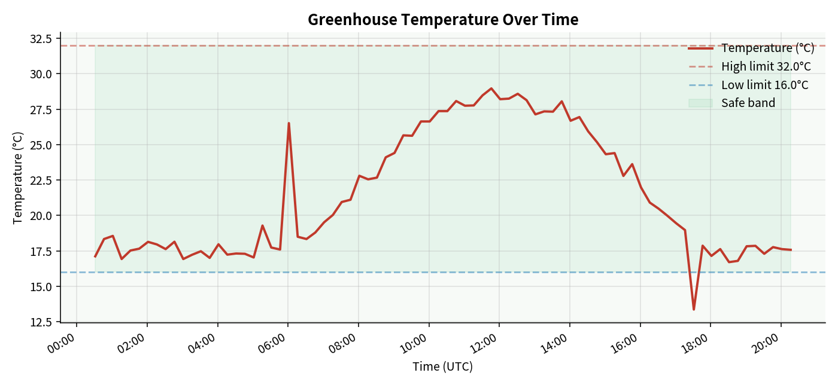
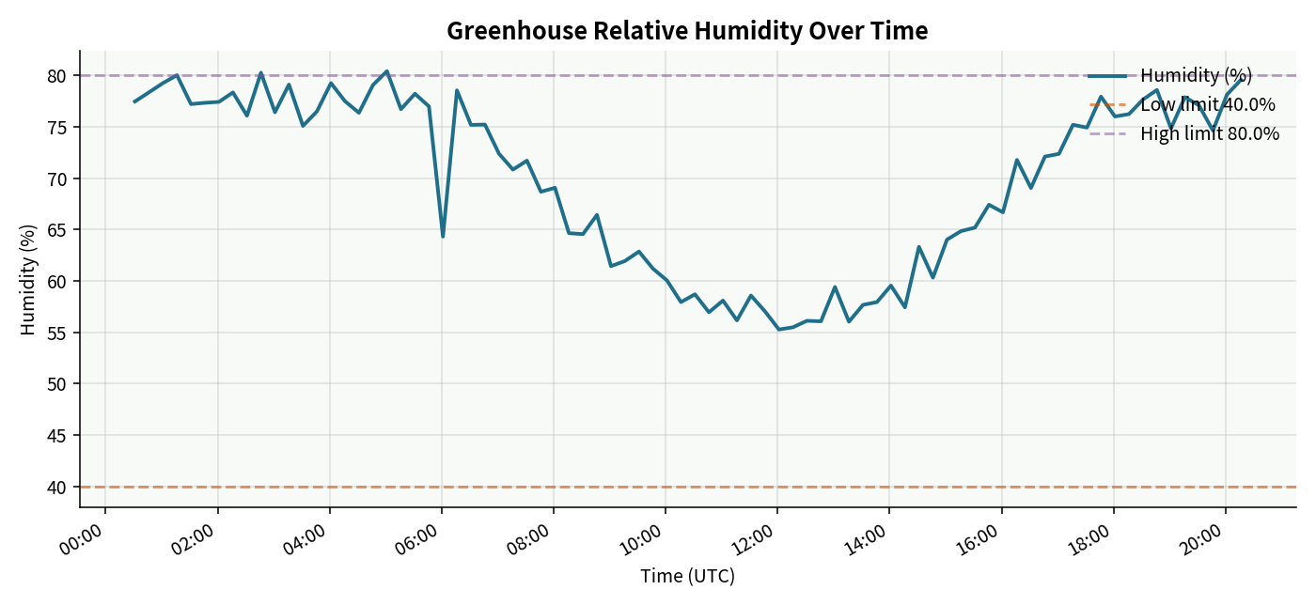
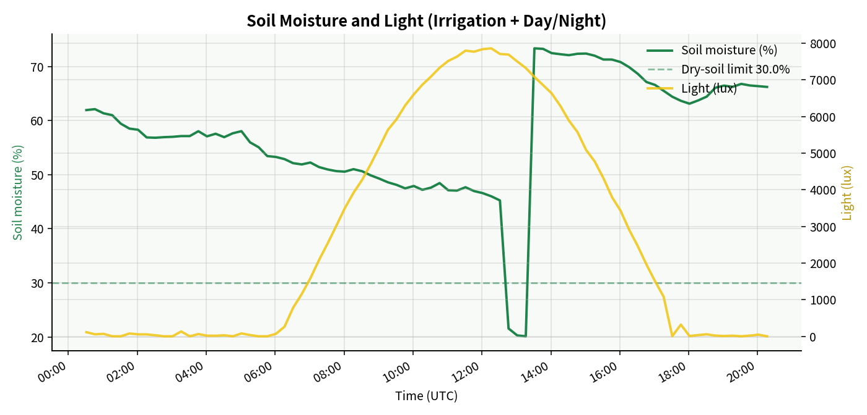
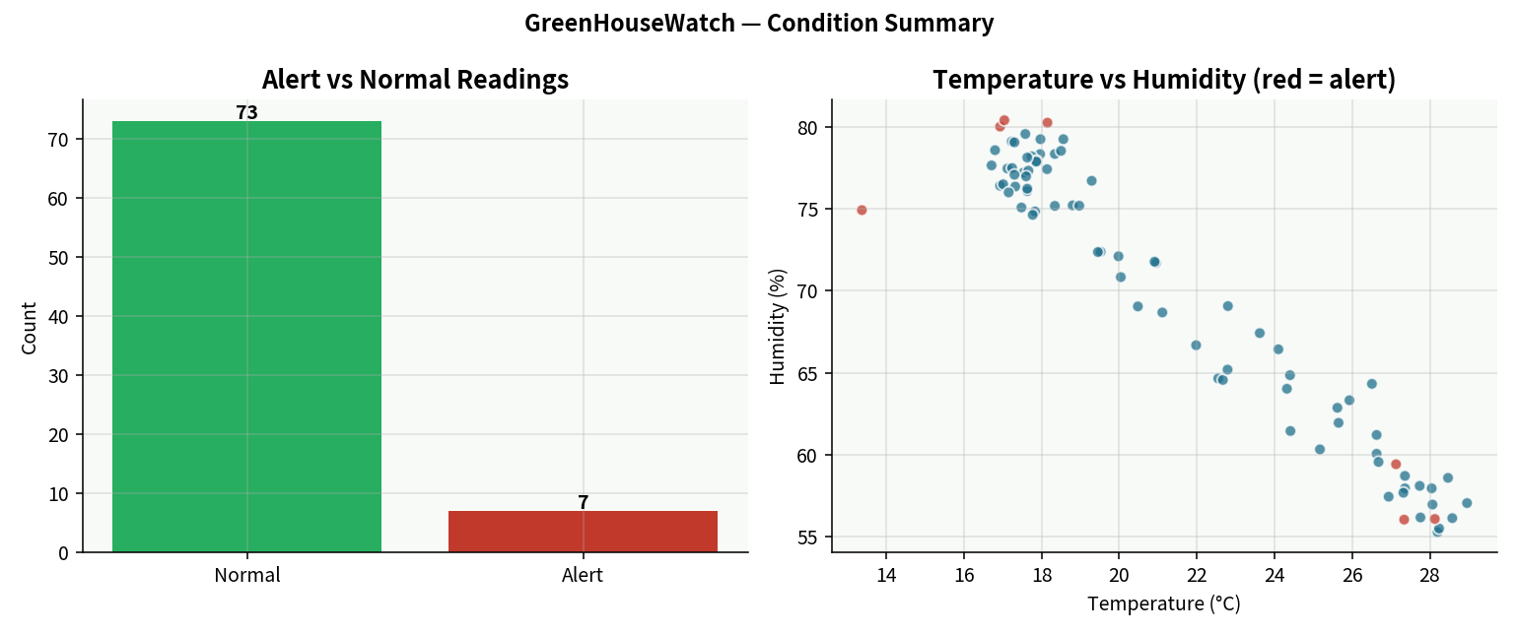
GREENHOUSEWATCH · 08
VISUALIZATIONS
Bowie State University · CTEC 651 · Dr. Felix Njeh · Jerry Diabor · 28 September 2026

Slide 9
GREENHOUSEWATCH · 09
KEY INSIGHTS
What the stored repository shows (simulated data)
01
Temperature stayed under the heat limit
Range 13.37–28.96 °C. No stored value exceeds 32 °C. One injected low-temperature event (13.37 °C) is flagged — a demonstration cold anomaly, not a measured dawn reading.
02
Drought and damp nights are the visible risks
Three mid-series dry_soil alerts near 20% moisture, then modeled irrigation recovery. Three high_humidity readings just above 80%. Humidity moves opposite temperature as programmed.
03
Alerts are sparse and explainable
7 of 80 seed records flagged (~9%): 3 dry_soil, 3 high_humidity, 1 low_temperature. Thresholds fire on the edges of the data, not at random in the middle.
04
Repository purpose, not physical proof
Charts make threshold events visible for education. Results illustrate the pipeline; they do not validate a real greenhouse clock or crop safety recommendations.
Bowie State University · CTEC 651 · Dr. Felix Njeh · Jerry Diabor · 28 September 2026

Slide 10
GREENHOUSEWATCH · 10
DEMO PATH
How to show the end-to-end system
Preferred - live MQTT
Fallback - offline
1. Activate venv; pip install -r requirements.txt
2. Terminal A: python src/subscriber.py
3. Terminal B: python src/publisher.py --count 15
4. python src/db.py (row count grows)
5. python src/visualize.py
6. streamlit run src/dashboard.py
Save actual terminal output as Phase 3 evidence.
If broker.hivemq.com is blocked:
python src/offline_pipeline.py
Seeds (if needed), exports CSV, rebuilds four charts.
Still submit publisher.py and subscriber.py. Pair offline charts with a retained MQTT log or recording when possible.
Bowie State University · CTEC 651 · Dr. Felix Njeh · Jerry Diabor · 28 September 2026

Slide 12
GREENHOUSEWATCH · 11
LEARNING OUTCOMES
Mapped to course objectives
IoT architecture
Five-stage pipeline implemented end-to-end
Simulate sensor data
Four channels + JSON + 20-record sample
MQTT communication
Publisher / subscriber on HiveMQ public broker
Store time-series data
SQLite with time index; ≥50 rows required, 80+ present
Visualize for insight
Four PNG charts + written interpretation
Present the system
This deck + live or recorded demo
Bowie State University · CTEC 651 · Dr. Felix Njeh · Jerry Diabor · 28 September 2026

Slide 13
GREENHOUSEWATCH · 12
SUMMARY
GreenHouseWatch in one line
Simulated greenhouse sensor data can be transmitted with MQTT, stored locally in SQLite, and visualized with free tools - a complete local IoT digital repository.
Design
Code
Data
Demo
Proposal + architecture
Simulator · pub/sub · DB · charts
80+ rows · 7 alerts · CSV
Live MQTT or offline path
Questions? · Jerry Diabor · CTEC 651 · Dr. Felix Njeh
Bowie State University · CTEC 651 · Dr. Felix Njeh · Jerry Diabor · 28 September 2026

