Slide 1
BOWIE STATE UNIVERSITY · CTEC 651
GreenHouseWatch
Local IoT Digital Repository
From sensor simulation to data visualization
Smart greenhouse climate and soil monitoring
Python · MQTT / HiveMQ · SQLite · Matplotlib · Streamlit
Instructor: Dr. Felix Njeh
Student: Jerry Diabor
Final presentation: 28 September 2026

Slide 2
GREENHOUSEWATCH · 02
AGENDA
What this presentation covers
01
Problem and use case
05
Visualizations and key insights
02
System architecture
06
Live / recorded demo path
03
Data model and simulation
07
Summary and learning outcomes
04
MQTT transmission and SQLite storage
Bowie State University · CTEC 651 · Dr. Felix Njeh · Jerry Diabor · 28 September 2026

Slide 3
GREENHOUSEWATCH · 03
PROBLEM AND USE CASE
Retain greenhouse observations without a paid cloud platform
Problem
Use case
Scope
Temperature spikes, dry soil, and overnight humidity drift can damage crops when nobody is watching. Commercial IoT platforms are paid and often cloud-locked.
A single virtual greenhouse node (GH-SENSOR-01) publishes temperature, humidity, soil moisture, and light as JSON over MQTT into a local SQLite repository.
Educational prototype for CTEC 651. It demonstrates monitoring and analysis; it does not control a real greenhouse or claim physical measurements.
Bowie State University · CTEC 651 · Dr. Felix Njeh · Jerry Diabor · 28 September 2026

Slide 4
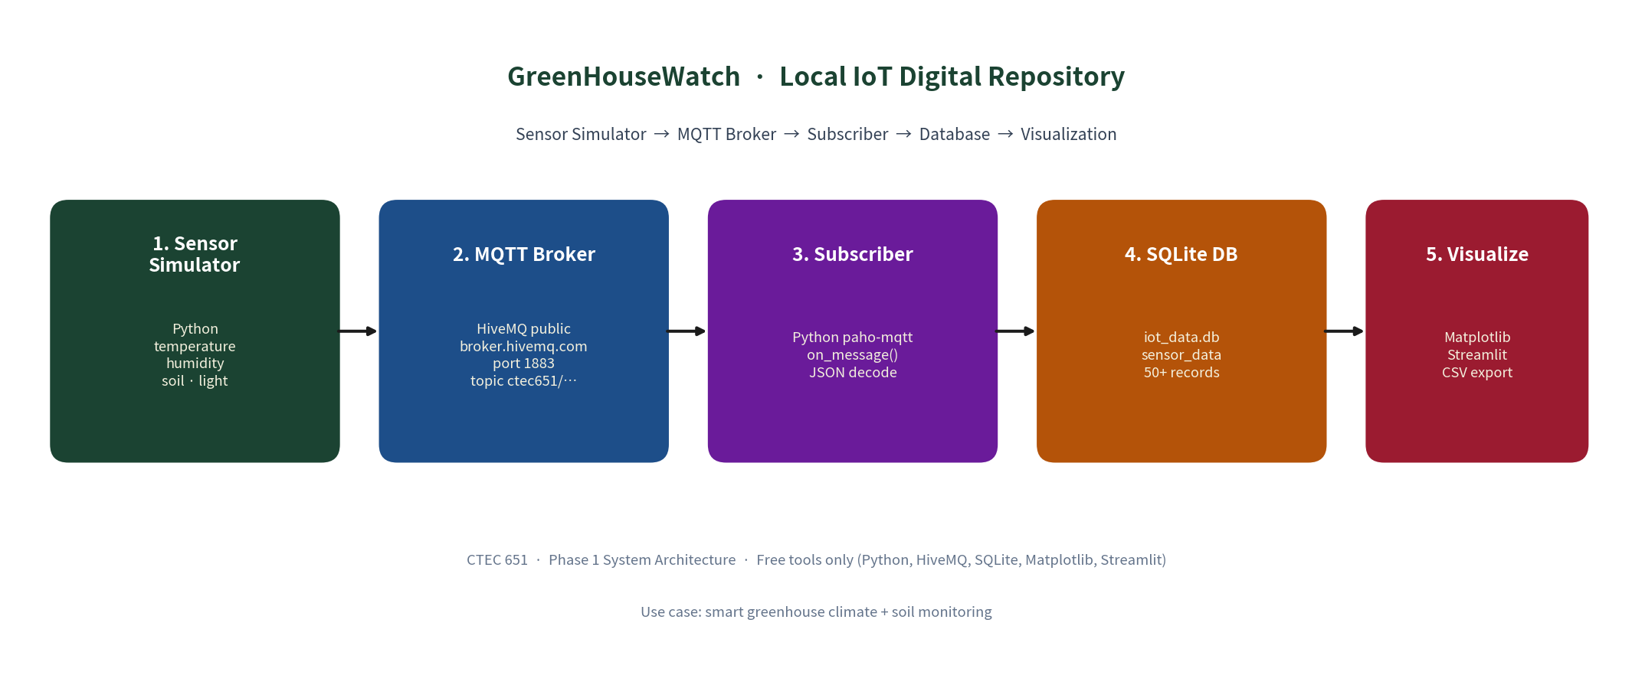
GREENHOUSEWATCH · 04
SYSTEM ARCHITECTURE
Required pipeline: Sensor Simulator → MQTT Broker → Subscriber → Database → Visualization
Broker: broker.hivemq.com:1883 · Topic: ctec651/greenhousewatch/ipmcbit · Store: data/iot_data.db · All free tools
Bowie State University · CTEC 651 · Dr. Felix Njeh · Jerry Diabor · 28 September 2026

Slide 5
GREENHOUSEWATCH · 05
DATA MODEL
SQLite table sensor_data - fields stored for every reading
Field | Type | Purpose
timestamp / iso_time | REAL / TEXT | Unix time + human-readable UTC
device_id | TEXT | Virtual node id (GH-SENSOR-01)
temperature_c | REAL | Air temperature (°C)
humidity_pct | REAL | Relative humidity (%)
soil_moisture_pct | REAL | Root-zone moisture (%)
light_lux | REAL | Ambient light (lux)
alert_flag / alert_reason | INTEGER / TEXT | 1 if any demonstration threshold is breached
Demo thresholds: temperature 16–32 °C · humidity 40–80% · soil moisture ≥ 30%. Light is recorded but does not raise alerts.
Bowie State University · CTEC 651 · Dr. Felix Njeh · Jerry Diabor · 28 September 2026

Slide 6
GREENHOUSEWATCH · 06
SIMULATION AND MQTT
Phase 2 - Simulation
Phase 3 - MQTT
src/simulator.py produces JSON with four measurements, UTC timestamps, device id, and alert metadata.
• Live mode: ~2-second interval
• Historical series: 15-minute steps, soil dry-down, irrigation recovery, injected anomalies
• Sample: samples/phase2_sample_output.txt (20 records)
Publisher and subscriber use HiveMQ public broker.
Terminal A:
python src/subscriber.py
Terminal B:
python src/publisher.py --count 20
Subscriber decodes JSON and INSERTs into SQLite via db.py. QoS 0; topic is configurable in config.py.
Bowie State University · CTEC 651 · Dr. Felix Njeh · Jerry Diabor · 28 September 2026

Slide 7
GREENHOUSEWATCH · 07
DATA STORAGE
SQLite repository · data/iot_data.db
80+
7
4
0
stored records
(assignment min: 50)
alert rows
dry soil · humidity · cold
sensor channels
+ alert metadata
paid services
SQLite is built-in
Historical seed uses 15-minute spacing. Live MQTT batches use ~2-second spacing and append to the same table. CSV export matches ordered database rows. Schema: docs/table_schema.md.
Integrity: SQLite PRAGMA integrity_check = ok on the submitted database snapshot.
Bowie State University · CTEC 651 · Dr. Felix Njeh · Jerry Diabor · 28 September 2026

Slide 8
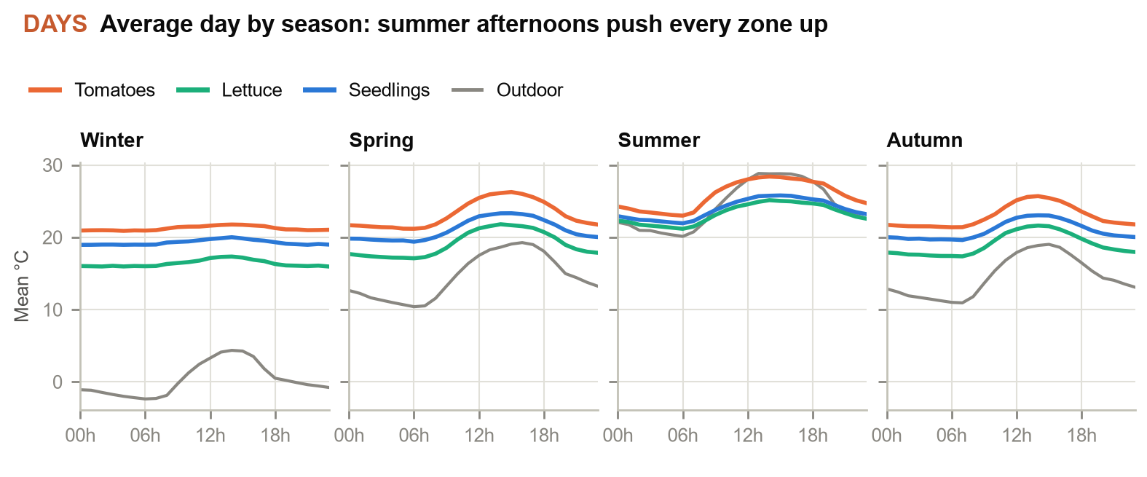
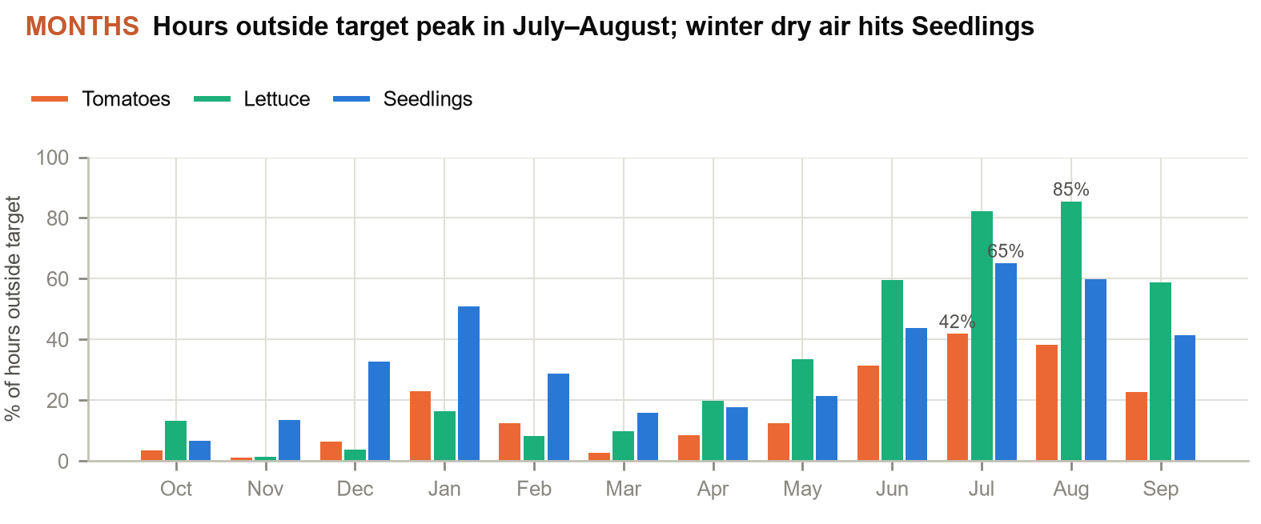
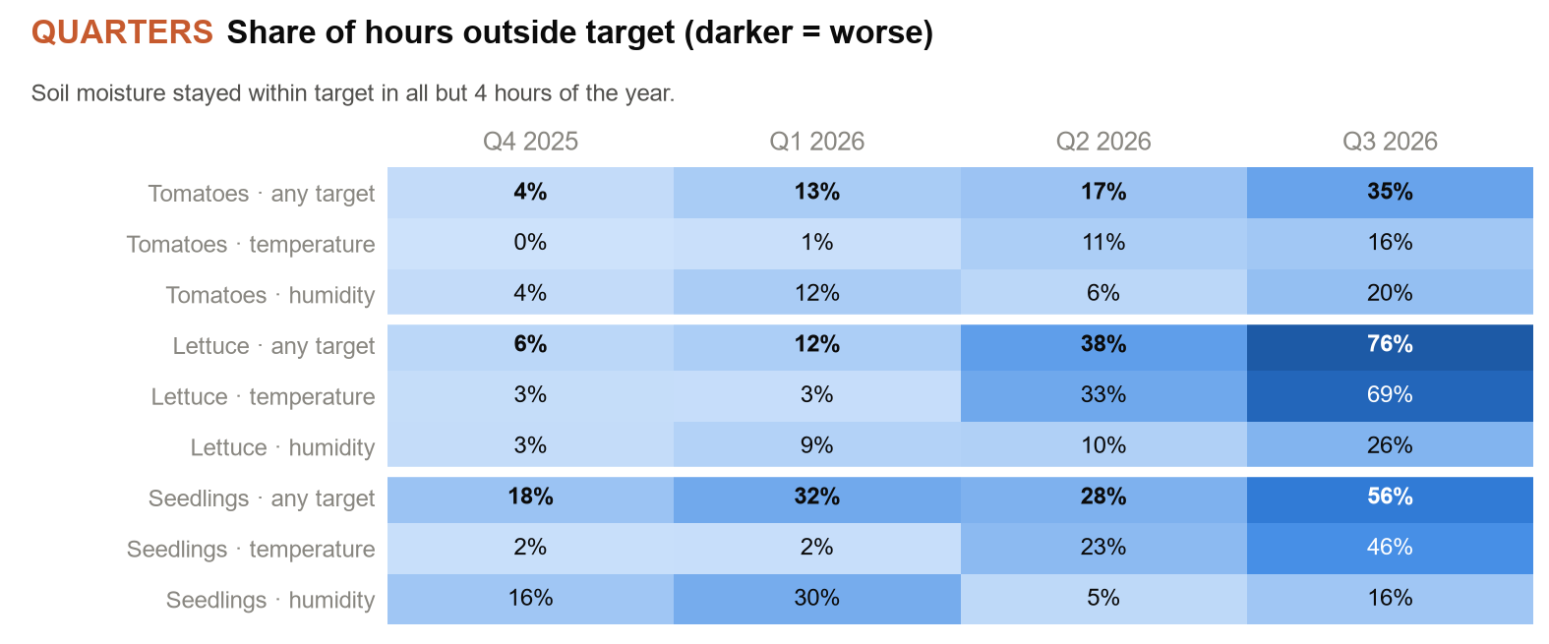
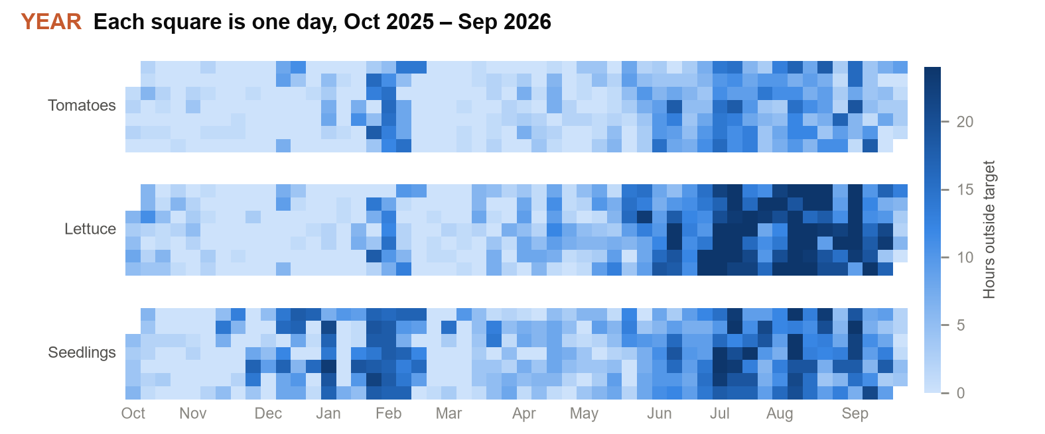
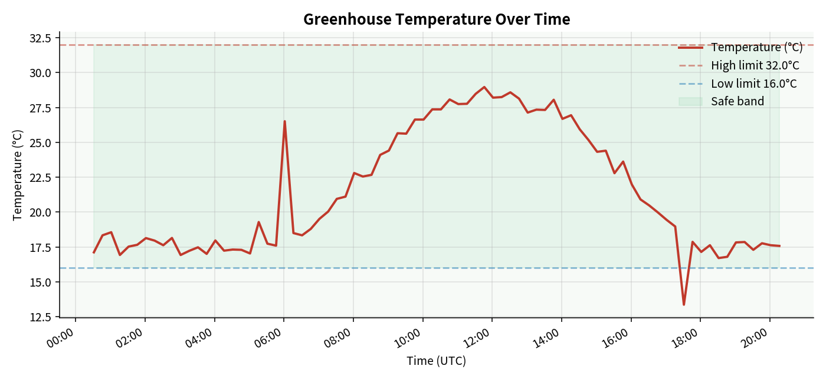
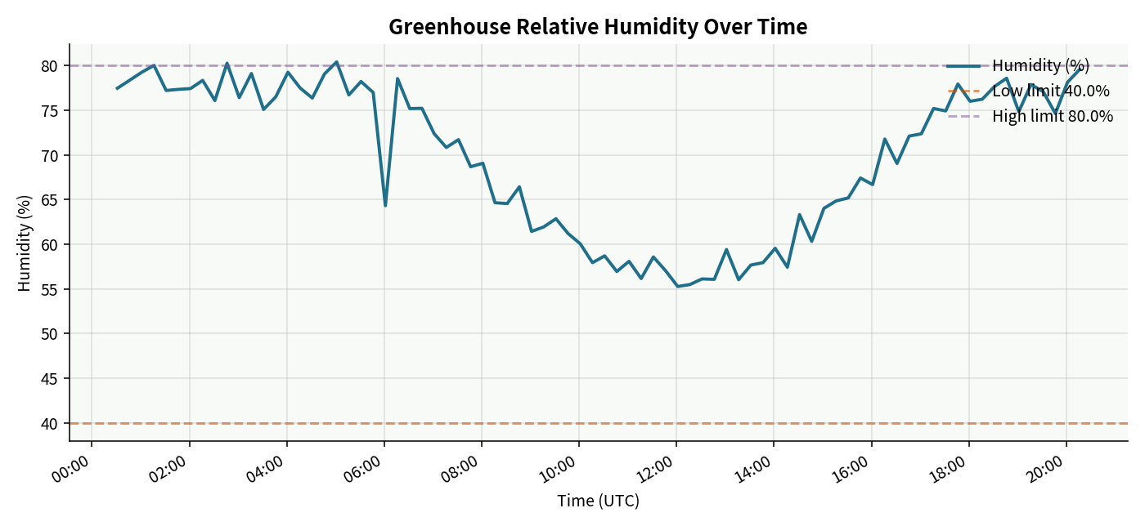
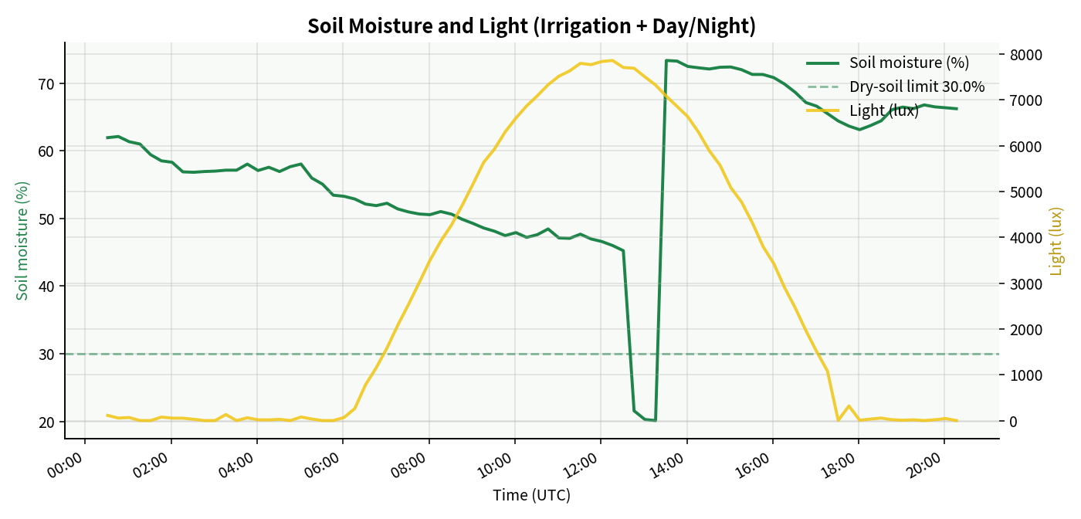
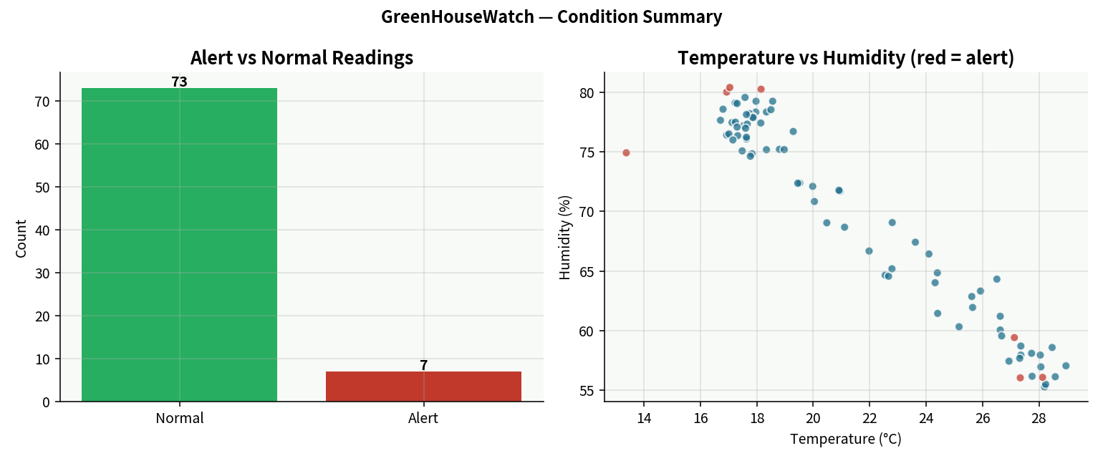
GREENHOUSEWATCH · 08
VISUALIZATIONS
One year of Bowie weather · days, months, quarters, year
Outdoor weather: real hourly Bowie, MD data (Open-Meteo archive), 1 Oct 2025 – 26 Sep 2026. Indoor values are modelled per zone from that weather. Full chart set: outputs/01–07.
Bowie State University · CTEC 651 · Dr. Felix Njeh · Jerry Diabor · 28 September 2026

Slide 9
GREENHOUSEWATCH · 09
KEY INSIGHTS
What a year of Bowie weather shows (indoor values modelled)
01
Lettuce is a cool-season crop in this house
Within target 94% of hours in Q4 2025 but only 24% in Q3 2026: humid summer heat beats pad cooling (85% of August hours outside target). Grow it October–April; switch to a heat-tolerant crop for summer.
02
Winter dry air is the Seedlings’ risk
Heating dries the air: Seedlings fall below their 65% humidity minimum in 30% of Q1 hours (51% of January hours outside target). Added fogging or propagation covers is the cheapest fix.
03
Tomatoes fit best; irrigation is not the constraint
Tomatoes are outside target 17% of the year, mostly summer afternoons. Soil stayed in range in all but 4 hours. Heating fell short only at −17.7 °C outdoors (30 Jan): Tomatoes dipped 2.3 °C below minimum.
04
Real weather, modelled greenhouse
Outdoor data is real hourly Bowie, MD weather (Open-Meteo, Oct 2025 – Sep 2026). Indoor values model a typical controlled greenhouse; live MQTT readings are stored separately with their own source label.
Bowie State University · CTEC 651 · Dr. Felix Njeh · Jerry Diabor · 28 September 2026

Slide 10
GREENHOUSEWATCH · 10
DEMO PATH
How to show the end-to-end system
Preferred - live MQTT
Fallback - offline
1. Activate venv; pip install -r requirements.txt
2. Terminal A: python src/subscriber.py
3. Terminal B: python src/publisher.py --count 15
4. python src/db.py (row count grows)
5. python src/visualize.py
6. streamlit run src/dashboard.py
Save actual terminal output as Phase 3 evidence.
If broker.hivemq.com is blocked:
python src/offline_pipeline.py
Seeds (if needed), exports CSV, rebuilds four charts.
Still submit publisher.py and subscriber.py. Pair offline charts with a retained MQTT log or recording when possible.
Bowie State University · CTEC 651 · Dr. Felix Njeh · Jerry Diabor · 28 September 2026

Slide 11
GREENHOUSEWATCH · 11
LEARNING OUTCOMES
Mapped to course objectives
IoT architecture
Five-stage pipeline implemented end-to-end
Simulate sensor data
Four channels + JSON + 20-record sample
MQTT communication
Publisher / subscriber on HiveMQ public broker
Store time-series data
SQLite with time index; ≥50 rows required, 80+ present
Visualize for insight
Four PNG charts + written interpretation
Present the system
This deck + live or recorded demo
Bowie State University · CTEC 651 · Dr. Felix Njeh · Jerry Diabor · 28 September 2026

Slide 12
GREENHOUSEWATCH · 13
PROJECT REFLECTIONS
What the implementation revealed
End-to-end integration
The hardest part was not one tool, but keeping simulator, MQTT, SQLite and dashboard behavior consistent.
Evidence matters
Console counters alone do not prove delivery; retained subscriber logs and matching database rows provide stronger evidence.
Data meaning matters
Simulated readings, stale values and outdoor forecasts must be labeled clearly so the dashboard does not overstate what was measured.
Visualization improved understanding
Explicit units, gaps, freshness and alert markers made the repository easier to interpret and defend during a demo.
Testing changed the project
Validation and chart regression tests exposed issues that were not obvious from simply opening the dashboard.
Scope stayed realistic
The system demonstrates monitoring and analysis; it does not claim physical greenhouse coverage or automatic irrigation control.
Bowie State University · CTEC 651 · Dr. Felix Njeh · Jerry Diabor · 28 September 2026

Slide 13
GREENHOUSEWATCH · 14
LESSONS LEARNED
Technical and project lessons from GreenHouseWatch
Validate before storage
Numeric, finite and physically valid values should be checked before database insertion; alert metadata should be normalized.
Separate transport from proof
MQTT transmission, storage and offline processing are different stages; an offline pipeline cannot by itself prove broker communication.
Design for missing data
Optional nutrient and pH readings may be absent, so the UI should show missing measurements rather than invent values.
Time handling is critical
UTC storage with clearly labeled display time prevents confusion when comparing charts, logs and live status.
Aggregations need context
Record-weighted summaries and equal-zone averages answer different questions and should be explained to the audience.
Build for graceful failure
Broker outages, stale sources and forecast/API issues should degrade visibly without crashing the entire application.
Bowie State University · CTEC 651 · Dr. Felix Njeh · Jerry Diabor · 28 September 2026

Slide 14
GREENHOUSEWATCH · 15
SUMMARY
GreenHouseWatch in one line
Simulated greenhouse sensor data can be transmitted with MQTT, stored locally in SQLite, and visualized with free tools - a complete local IoT digital repository.
Design
Code
Data
Demo
Proposal + architecture
Simulator · pub/sub · DB · charts
80+ rows · 7 alerts · CSV
Live MQTT or offline path
Questions? · Jerry Diabor · CTEC 651 · Dr. Felix Njeh
Bowie State University · CTEC 651 · Dr. Felix Njeh · Jerry Diabor · 28 September 2026

