Slide 1
Credit Card User Clustering
Data 201 Capstone III
Jed Hsu

Slide 2
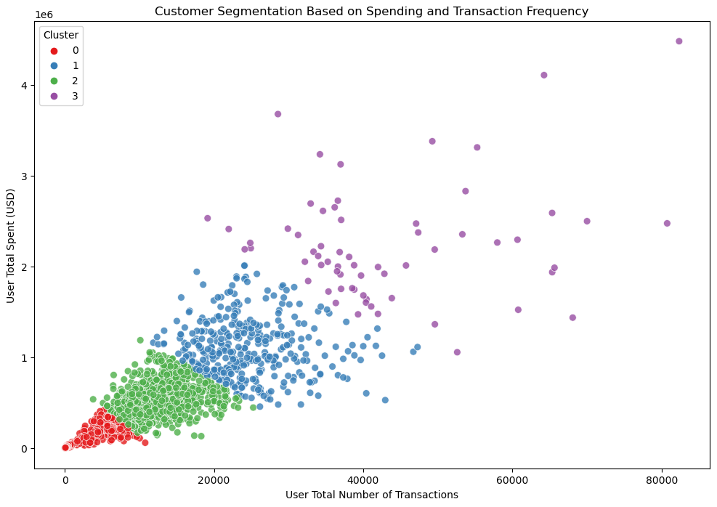
Summary
Question: What is a good method to cluster credit card users?
Results: K-means clustered customers based on total spending and number of transactions with a silhouette score of 0.514.
Customer clustering with K-means

Slide 3
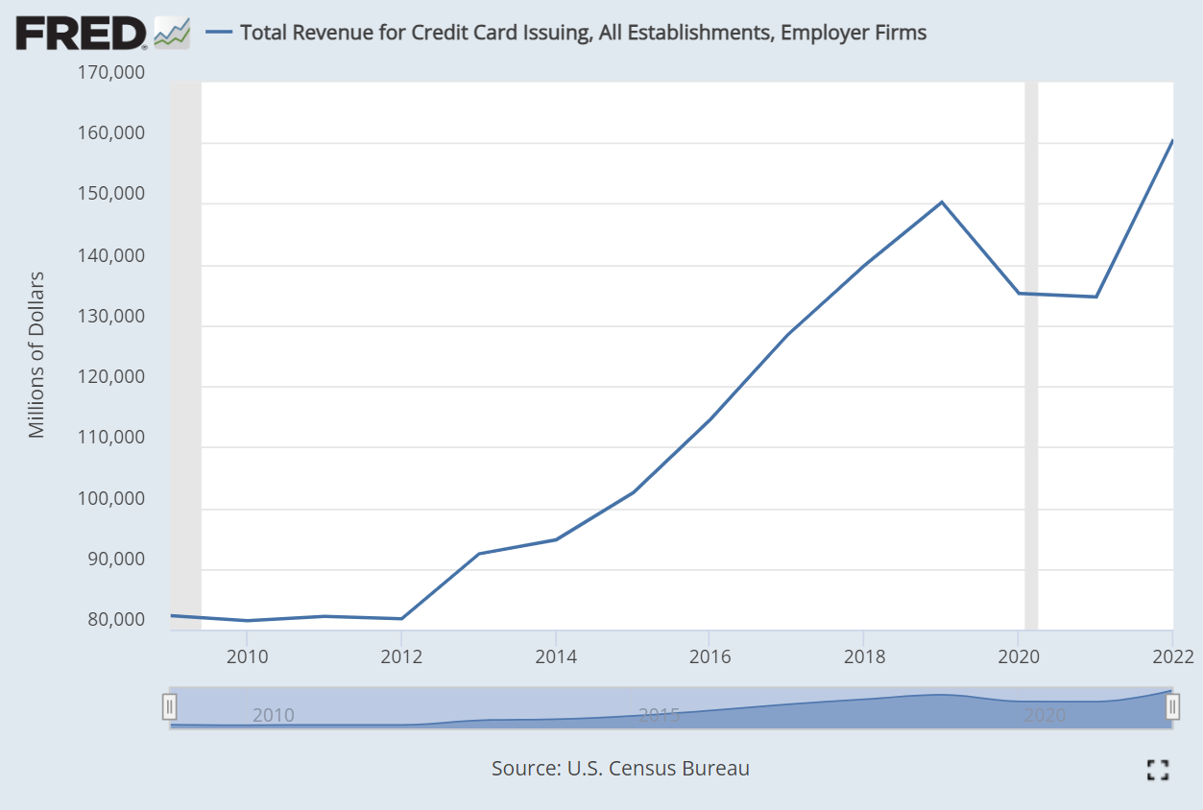
Background
Total Revenue for Credit Card Companies Over Time³
Credit card companies are profitable and a large part of culture in the United States
Credit card companies made $105 billion in interest in 2022¹
82% of U.S. Adults had a credit card in 2022.²
Companies may want to segment its users to maximize engagement and profit
Question: What is a good method to cluster credit card users?
¹ Source: https://www.forbes.com/advisor/credit-cards/credit-card-statistics/
² Source: https://www.consumerfinance.gov/about-us/blog/credit-card-interest-rate-margins-at-all-time-high/ ³ Source: https://fred.stlouisfed.org/series/REVEF52221ALLEST

Slide 4

Exploratory Data Analysis (EDA): Data Cleaning
The data set has 2000 fictioning customers resident in the United States but occasionally travel the world.
More than 24 million transactions
Data generated by IBM
15 features
66 duplicate rows removed
Multiple missing values in Merchant State, ZIP, and Errors.
Countries outside the United States will not have a Merchant State or ZIP code
Missing Error means there was no error in the data entry
Converted Year, Month, Day into dataframe Date format

Slide 5
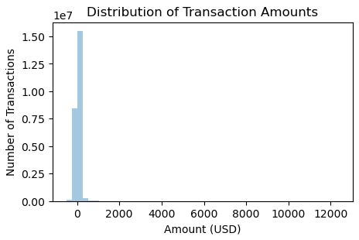
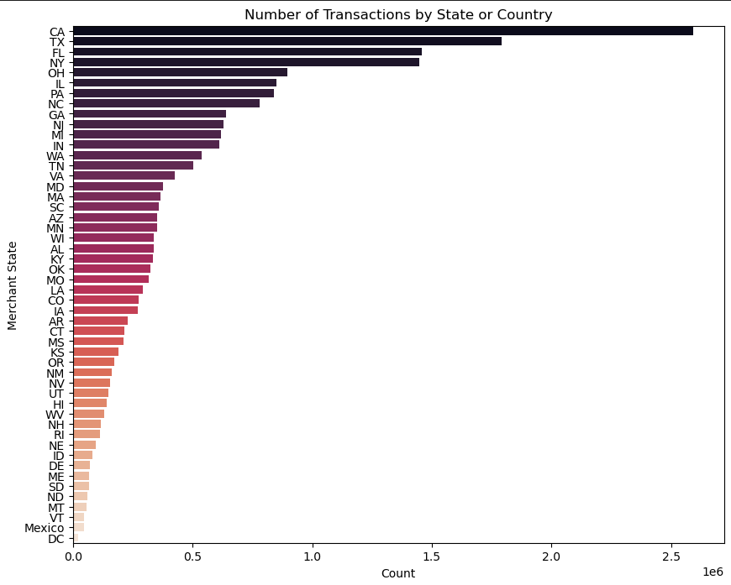
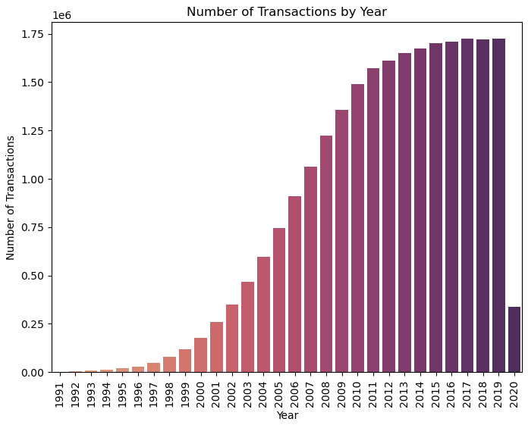
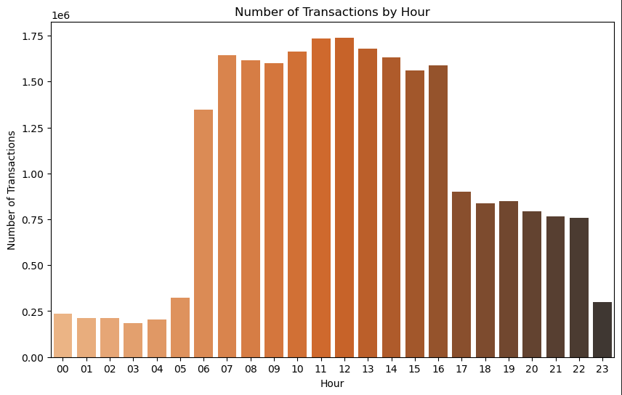
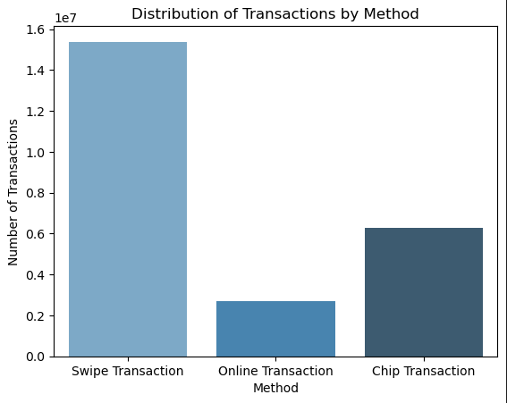
EDA: Data Exploration
Explored distributions of features
Histogram of transaction amounts: Most of the transactions are amounts less than $200. Negative amounts indicate returns.
Histogram of transactions by year: The number of transactions increased over time. The transactions are low in 2020 when the data creation stopped.
Histogram of transactions by hour: More transactions occurred between 0600 to 1600 local time.
Histogram of transactions by state: California and Texas had the highest number of transactions.
Histogram of transactions by method: Most of the transactions were swipe transactions.

Slide 6
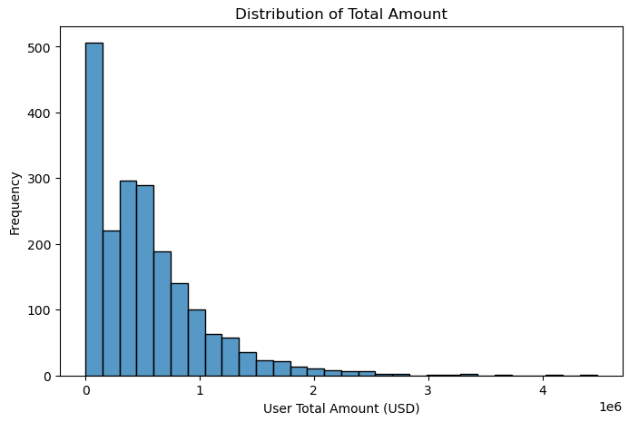
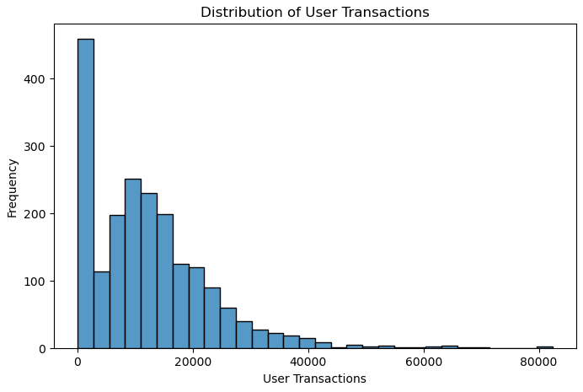
Feature Engineering
The credit card user total amount spent and the total number of transactions in the dataset were examined.
These features may prove useful to credit card companies in segmenting their customers.
Histogram of user total amount spent
Histogram of user total transactions

Slide 7
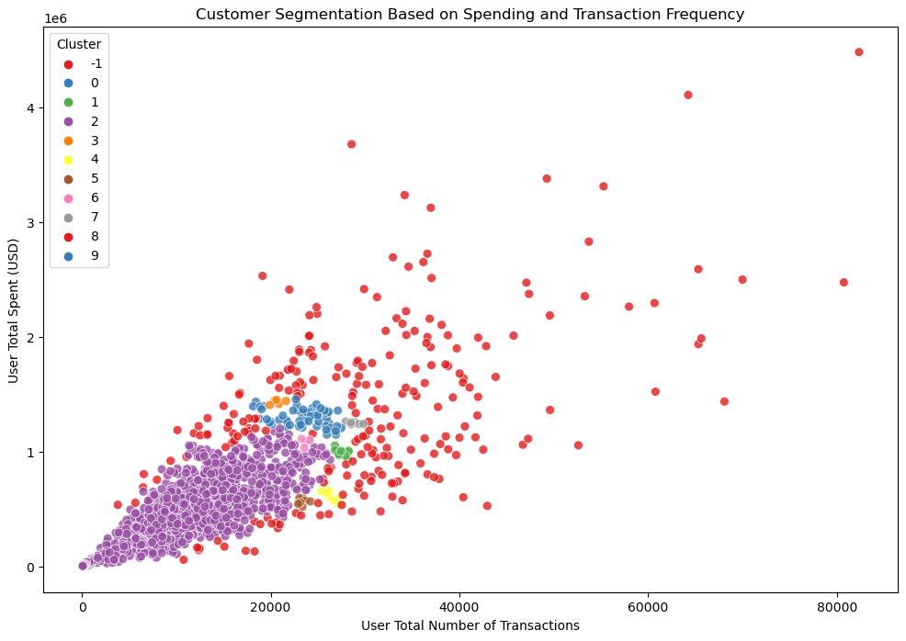
Data Modeling
K-Means and DBSCAN clustering methods were used to cluster the customers.
In K-Means, the number of clusters was varied from 2 to 5 in steps of 1.
In DBSCAN, epsilon was varied from 0.05 to 2.45 in steps of 0.1.
Even though DBSCAN had a higher silhouette score, the clustering from DBSCAN is not realistic or beneficial.
K-Means clustered the customers more realistically. The outliers were clustered into one group which lowered the silhouette score.
K-Means clustering results
Clustering Method | Best Silhouette Score
K-Means | 0.514
DBSCAN | 0.834
K-Means had better results in segmenting the customers based on amount spent and transaction frequency.
DBSCAN clustering results

Slide 8

Applications and Next Steps
This model can be utilized in credit card companies that want to segment their customers to increase business efficiency.
Applications:
Give bonuses and incentives to different segments. For example, the customers that spend more money and more frequently can accumulate more points.
Forecast customer spending per segment to prepare for future budgeting and promotions.
Hypothesize which segment new customers would fit in.
Next steps:
Cluster users based on other features such as spent amount per year or transactions per year
Combine this model with other models such as predicting credit card fraud.

