Slide 1
Identifying Disaster Tweets with NLP
Jed Hsu

Slide 2

Summary
Goal: Determine if a tweet is discussing a real disaster
Results: The DistilBERT model from KerasNLP produced an F1 score of 0.79 on the validation data set.

Slide 3


Background
X (previously Twitter) can be utilized as a useful communication method for emergencies.
However, it may be difficult for a machine to determine if a tweet is describing a real emergency.
For example, a tweet may say “This beach party is on FIRE”. A machine may think there is a fire from the word “FIRE” in the tweet instead of a metaphor.
vs.

Slide 4
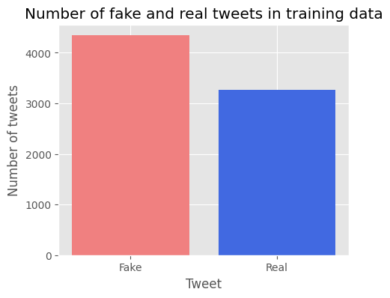
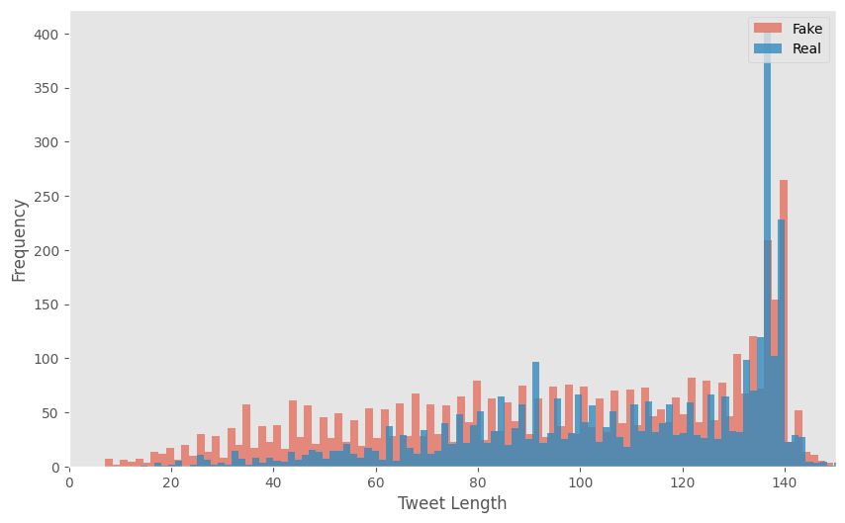
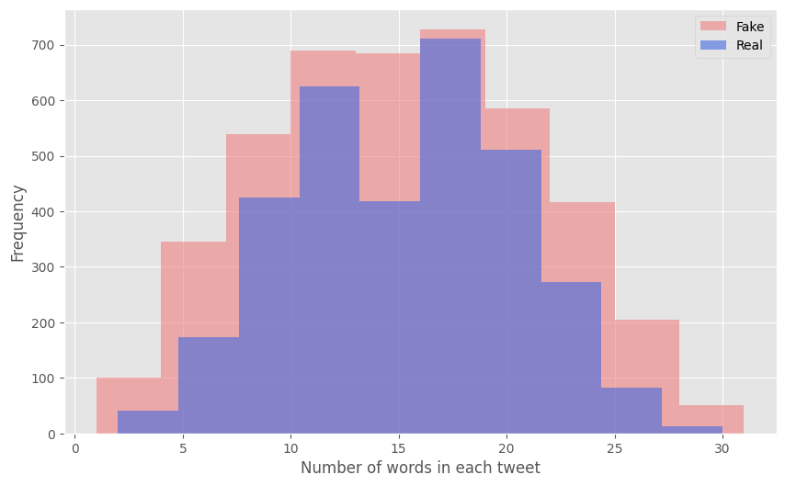
Exploratory Data Analysis
Reviewed class balance, tweet length, number of words in each tweet
Histogram of Tweet Length
Histogram of Number of Words In Each Tweet

Slide 5


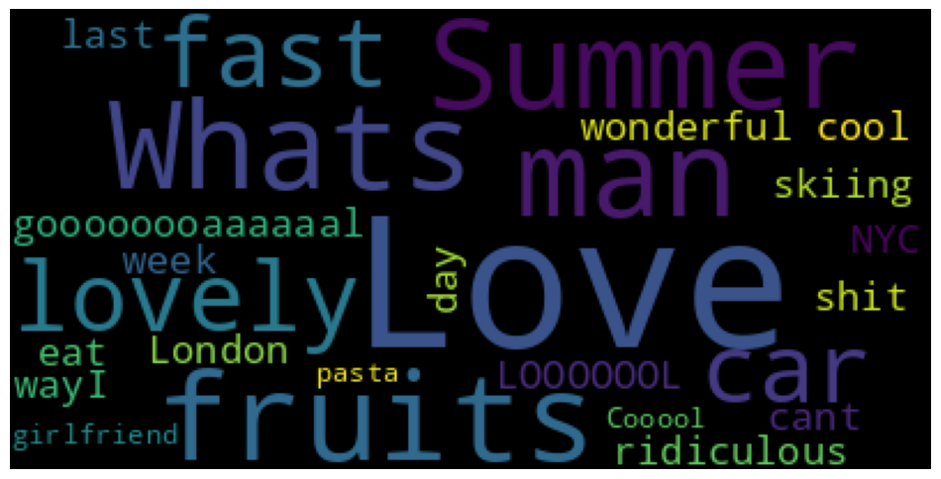
Exploratory Data Analysis
Data cleaning: Stop words, HTML tags, emojis, and punctuation marks were removed
Word clouds were created after data cleaning
Word cloud for real disasters
Word cloud for fake disasters

Slide 6

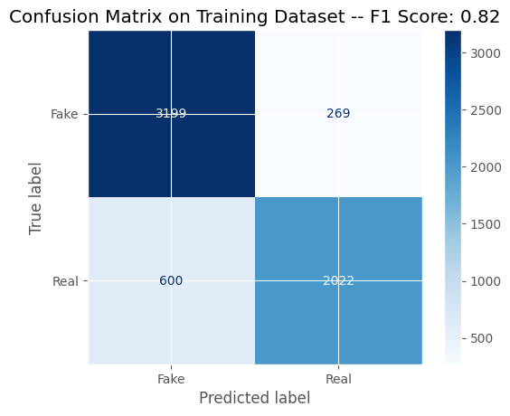
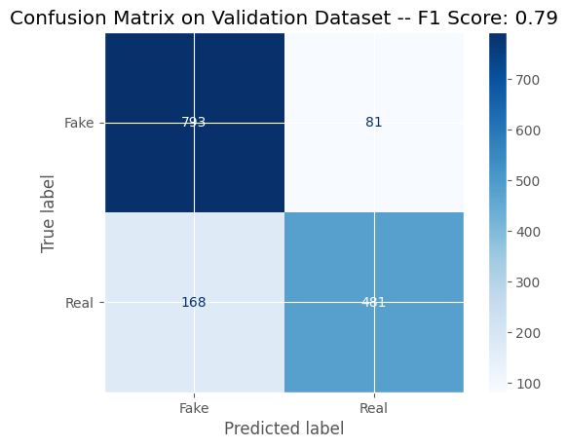
Data Modeling
DistilBERT with KerasNLP was used to model and predict the tweets.
Recommended standard parameters by the Keras team were used.
F1 score is the main metric used for the Kaggle competition and this model
The F1 score was 0.82 for the training set and 0.79 for the validation set.
Conclusion: The DistilBERT model produced an F1 score of 0.79 on the validation data set.

Slide 7


Applications and Next Steps
This model can be utilized by organizations that monitor disasters such as news agencies or disaster relief.
Next steps:
Optimize model parameters because the F1 score is lower than desired.
Review data cleaning and see if additional cleaning is required
Top right image source: https://www.habitatforhumanity.org.uk/what-we-do/natural-disaster-response/, Retrieved February 28, 2025

Slide 8
Backup

Slide 9
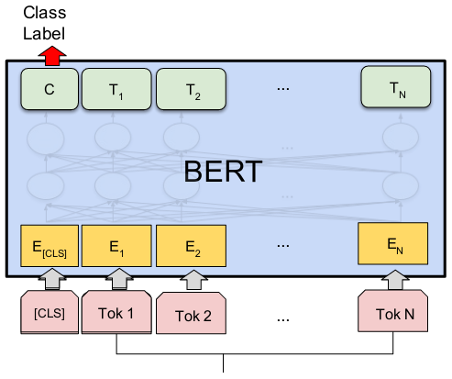
DistilBERT with KerasNLP
DistilBERT is a distilled form of the Bidirectional Encoder Representations from Transformers (BERT) model.
BERT computes vector-space representations of NLP in deep learning models.
BERT uses the Transformer encoder architecture to process each token of text in the full context of all tokens before and after (bidirectional)
References:
https://www.kaggle.com/code/alexia/kerasnlp-starter-notebook-disaster-tweets, Retrieved February 28, 2025
https://keras.io/keras_hub/getting_started/ Retrieved February 28, 2025
https://arxiv.org/abs/1910.01108 Retrieved February 28, 2025

