Slide 1
Movie and TV Show Recommender
Data 201 Capstone IV
Jed Hsu

Slide 2

Summary
Goal: Create a movie or TV show recommendation system utilizing Netflix data.
Results: Artificial neural network was successful with a root mean squared error of 0.91.

Slide 3
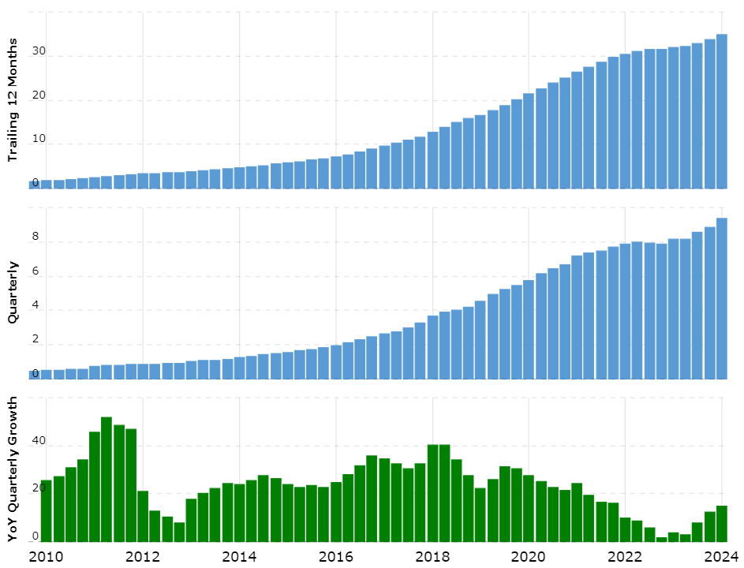
Background
Netflix Revenue Over Time⁴
In June 2024, Netflix was one of the largest media companies in the world and had a revenue of 9.56 billion dollars.¹
Netflix believes it could lose 1 billion dollars every year without their recommendation engine.²
Netflix creates original content from their recommendation engine with 93% of their original content being renewed.³
Units in Millions USD
Year
¹ Quarterly Earnings, Netflix. Accessed 28 July 2024, https://ir.netflix.net/financials/quarterly-earnings/default.aspx
² Nathan McAlone, Business Insider website. Accessed 28 July 2024, https://www.businessinsider.com/netflix-recommendation-engine-worth-1-billion-per-year-2016-6 ³ How Netflix used big data and analytics to generate billions, Selerity. Accessed 28 July 2024, https://seleritysas.com/2019/04/05/how-netflix-used-big-data-and-analytics-to-generate-billions/
⁴ Netflix Revenue. Macrotrends. Accessed 17 Aug 2024. https://www.macrotrends.net/stocks/charts/NFLX/netflix/revenue

Slide 4

Exploratory Data Analysis: Data Cleaning
The data set has millions of user ratings.
For computational power purposes, 24 million data points were used (¼ of the entire dataset)
Features include user ID, movie title, and user rating
Movie titles had bad data that required formatting while importing
Removed 4499 missing rating rows
Note: For this analysis, “movie” can refer to a movie or TV series.

Slide 5
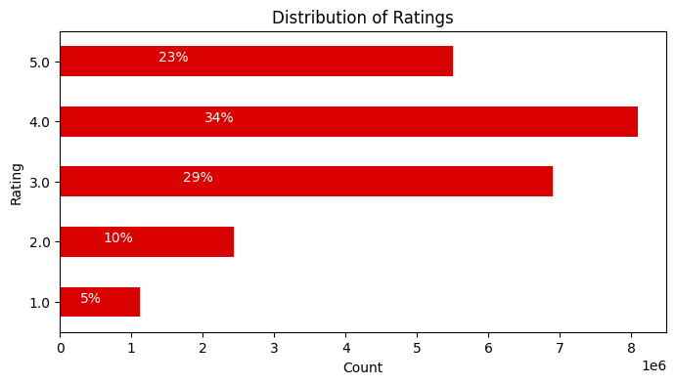
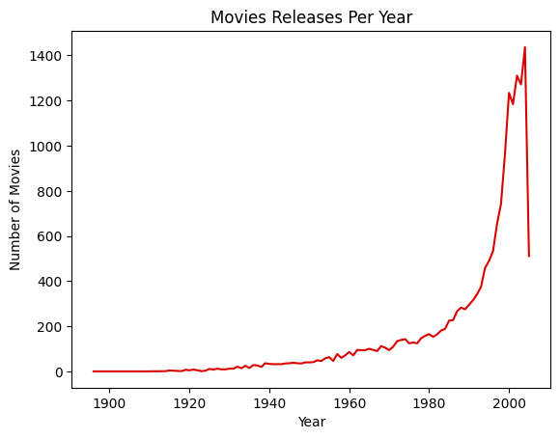
Exploratory Data Analysis: Data Exploration
Reviewed distribution of ratings
Plotted movie releases per year

Slide 6
Data Modeling
Movie or Show Title | Predicted Rating
The Simpsons: Season 6 | 4.551415
The Simpsons: Season 3 | 4.38682
Lord of the Rings: The Fellowship of the Ring | 4.373515
Six Feet Under: Season 4 | 4.369019
The Godfather Part II | 4.347314
Finding Nemo (Widescreen) | 4.346714
The Simpsons: Treehouse of Horror | 4.340303
The Sixth Sense | 4.30543
The Best of Friends: Vol. 4 | 4.293063
The Simpsons: Season 1 | 4.279273
Set minimum User rating threshold > 200
Set minimum Movie rating threshold > 8000
Used Keras neural network
Utilized embedding for user IDs and movie titles
Created two models
2 layers, Adam (Adaptive Moment Estimation) optimizer
3 layers, SGD (Stochastic Gradient Descent) optimizer
Used mean squared error as loss
Conclusion: The model with Adam optimizer gave an RMSE of 0.91
Example recommender output

Slide 7

Applications and Next Steps
This model can be utilized by entertainment companies to recommend movies, TV shows, books, or other media to customers.
Next steps:
Utilize the entire data set for the model
Tune minimum user ratings and movie ratings threshold
Try other methods for recommendations, such as cosine similarity for movie descriptions
θ

Slide 8
Backup

Slide 9
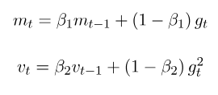
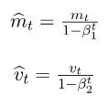

Keras Optimizers
Gradient descent - optimization algorithm that minimizes cost function
SGD - Gradient Descent with momentum
Used default learning rate = 0.01
Momentum starts at 0
w = w + momentum * velocity - learning rate * g
Adam - (Adaptive Moment estimation). Stochastic gradient descent that is based on adaptive estimation of first-order and second-order moments
Uses exponential moving averages on the gradients.
Combination of SGD and RMSprop.

