Slide 1
Predicting Heart Disease
Data 201 Capstone II
Jed Hsu

Slide 2
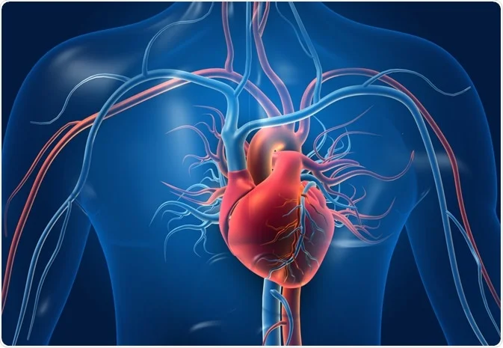
Summary
Question: Can cardiovascular disease be predicted from other human features?
Results: Logistic regression predicted cardiovascular disease with 86% recall and 83% accuracy
Graphical depiction of a heart¹
¹Image source: https://www.news-medical.net/health/Structure-and-Function-of-the-Heart.aspx

Slide 3
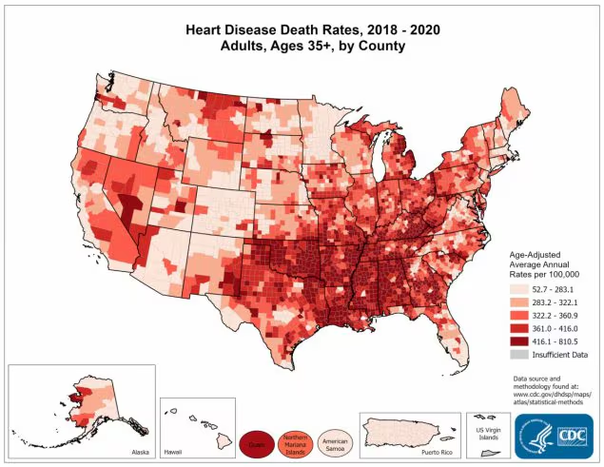
Background
Cardiovascular disease in most racial groups is the leading cause of death in the United States during 2018-2021.²
Studies exist on both preventing and predicting cardiovascular disease using several risk factors ^{3,4}
This capstone project reviews patient data from 5 sources for a total of 918 data points to predict patients with heart disease
Heart Disease Death Rates, 2018-2020 for Adults, Ages 35+, by County²
² Source: Centers for Disease Control and Prevention. Retrieved from https://www.cdc.gov/heart-disease/data-research/facts-stats/index.html
³ Source: Harvard Medical School. Retrieved from https://www.health.harvard.edu/heart-health/a-new-tool-to-predict-heart-disease-risk
⁴ Source: National Heart, Lung, and Blood Institute. Retrieved from https://www.nhlbi.nih.gov/research/coronary-heart-disease

Slide 4
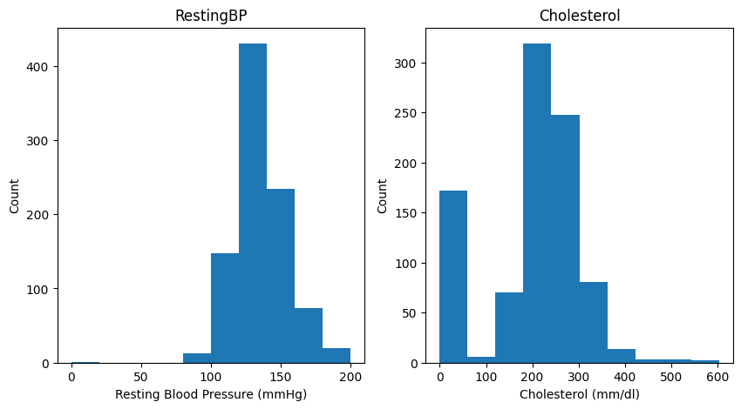
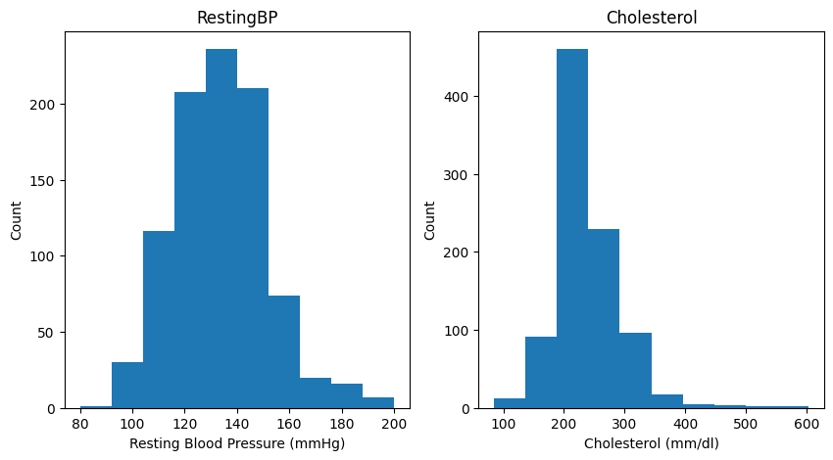
Exploratory Data Analysis (EDA): Data Cleaning
11 features
No missing values
No duplicate values
Incorrect values:
Resting blood pressure had 1 entry with “0” value
Cholesterol had 172 entries with “0” value
These are incorrect because humans cannot have a resting blood pressure or cholesterol of “0”
These “0” values were replaced with the average value for each feature.
Histogram of resting blood pressure and cholesterol before replacing zeros with average
Histogram of resting blood pressure and cholesterol after replacing zeros with average

Slide 5
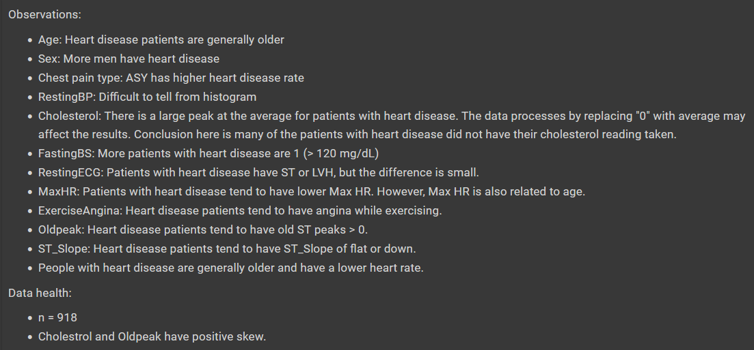
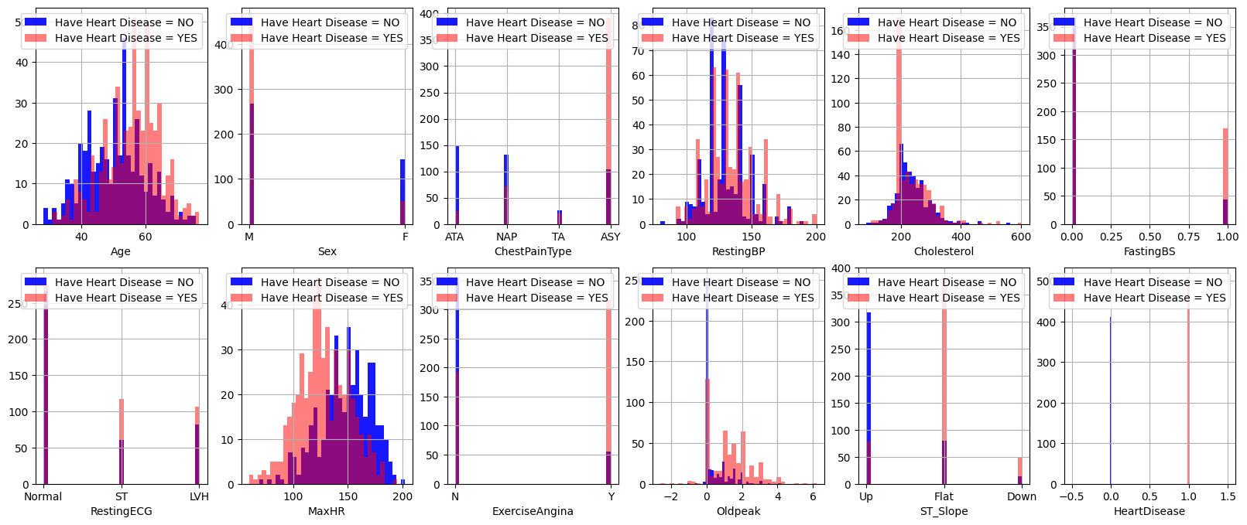
EDA: Data Exploration
Used one hot encoding for categorical features
Explored histograms of features
Data observations from the histograms
Histograms of features comparing patients with and without heart disease

Slide 6
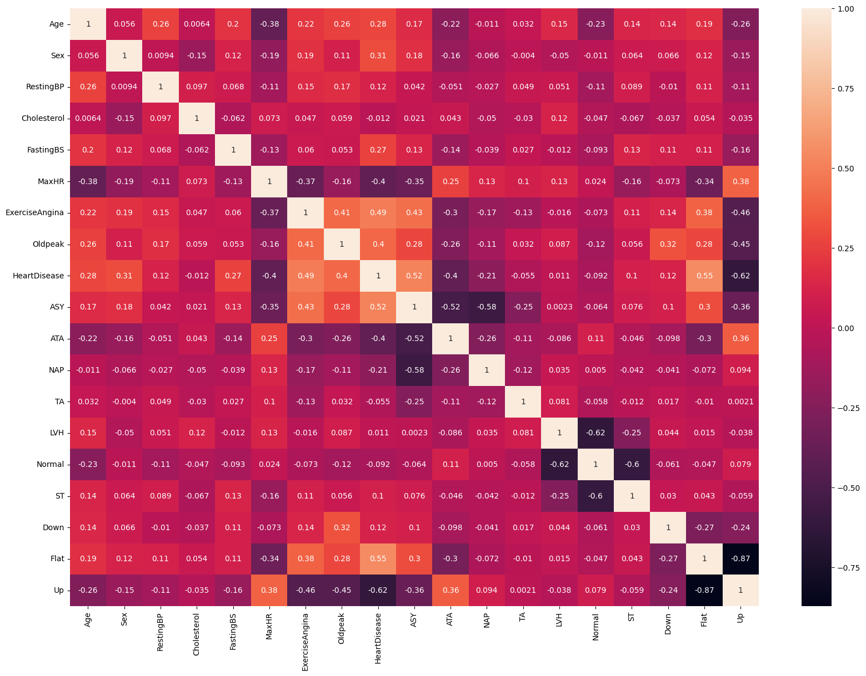
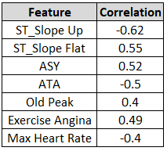
EDA: Data Exploration
Evaluated correlation for quantitative features
Features with the highest correlation magnitude
Correlation matrix of the features and target variable

Slide 7
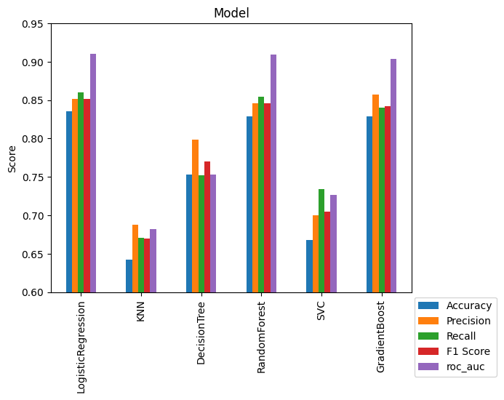
Data Modeling
Proceeded with all features for modeling
Used 6 models with cross-validation
Metrics used: Accuracy, Precision, Wecall, F1 Score, ROC AUC.
Results were graded mainly on accuracy and recall
Recall is important for medical modeling because it includes false-negatives.
Summary of metrics for the 6 models

Slide 8
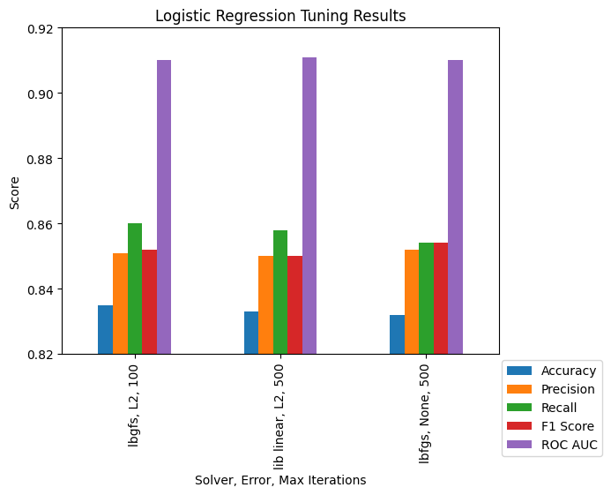
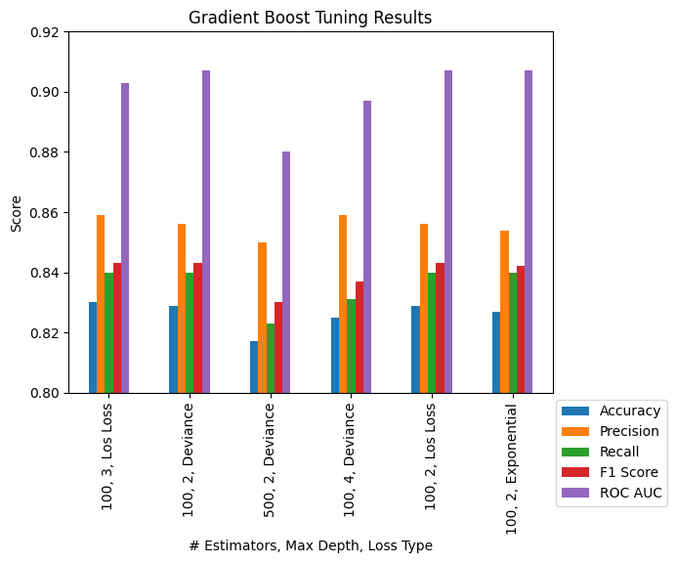
Model Tuning
Gradient boost and Logistic regression were tuned, but the models did not improve.
The Logistic Regression model performed the best overall.
The Gradient Boost model had higher precision and scored close to Logistic Regression on the other metrics.
Summary of metrics for Logistic Regression model tuning
The Logistic Regression model delivered the best results with an 86% recall and 83.5% accuracy
Summary of metrics for Gradient Boost model tuning

Slide 9

Applications and Next Steps
This model can be utilized in medical offices to predict if a patient has heart disease.
Interactions with the features can be input in the model.
Example: max heart rate times age can be used as a feature to include this biological interaction.
If new patient data is published, the model can be updated with the new data.

Slide 10
Backup

Slide 11
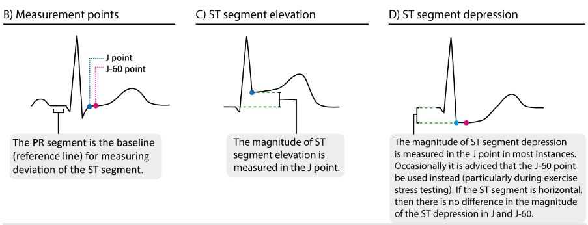
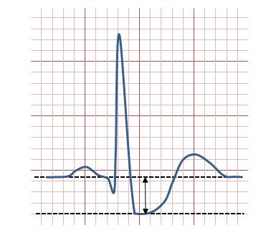
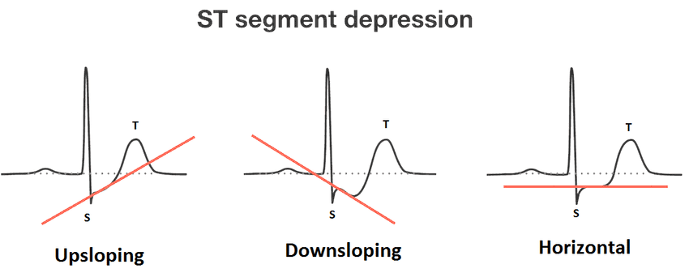
Definitions
ST Depression Definition
ChestPainType: chest pain type
TA: Typical Angina
ATA: Atypical Angina
NAP: Non-Anginal Pain
ASY: Asymptomatic
RestingBP: resting blood pressure [mm Hg]
Cholesterol: serum cholesterol [mm/dl]
FastingBS: fasting blood sugar [1: if FastingBS > 120 mg/dl, 0: otherwise]
RestingECG: resting electrocardiogram results
[Normal: Normal,
ST: having ST-T wave abnormality (T wave inversions and/or ST elevation or depression of > 0.05 mV),
LVH: showing probable or definite left ventricular hypertrophy by Estes' criteria]
MaxHR: maximum heart rate achieved [Numeric value between 60 and 202]
ExerciseAngina: exercise-induced angina [Y: Yes, N: No]
Oldpeak: oldpeak = ST [Numeric value measured in depression]
ST_Slope: the slope of the peak exercise ST segment
Up: upsloping
Flat: flat
Down: downsloping
Source: https://ecgwaves.com/st-segment-normal-abnormal-depression-elevation-causes/
Oldpeak: Measurement of ST depression
Source: https://en.wikipedia.org/wiki/ST_depression
Flat
source: https://litfl.com/st-segment-ecg-library

