Slide 1
Xpath &
Functions
ACIT4850
Mar 25, 2019

Slide 2
Xpath ...
1. Definition
2. Example
3. Nodes
4. Axes
5. Node tests
6. More examples
7. Operators
8. Functions
9. Variables

Slide 3
1. What is XPath?
The XML Path Language (XPath) provides a syntax for locating and selecting specific parts (e.g. elements or attribute ) of an XML document effectively and efficiently.
It is a string-based language of expressions used by other XML technologies such as XSLT.

Slide 4
Logical Structure
In XPath, an XML document is viewed conceptually as a tree in which each part of the document is represented as a node.
XPath expressions are used to select nodes or node sets
Similar to tree structured file system paths
Large function library for things like strings

Slide 5
Generalized Location Paths
Location path
  Expression specifying how to navigate XPath tree
  Composed of location steps separated by slashes
    Each location step can be composed of
      Axis
      Node test
      Predicate

Slide 6
2. Xpath Example
<?xml version="1.0"?>
<?xml-stylesheet type='text/xsl' href='xpath.xsl'?>
<ROOT>
<AA property="no">AA element within the ROOT
<BB property="YES">BB element within AA
<CC property="no">CC element within BB and AA
</CC>
</BB>
</AA>
<AA property="yes">2nd AA element within the ROOT
<BB>2nd BB element within 2nd AA
</BB>
<CC property="NO">CC element within 2nd AA
</CC>
</AA>
<BB property="NEVER">BB element within ROOT
<CC>CC element within BB element
</CC>
</BB>
</ROOT>

Slide 7
<xsl:stylesheet version="1.0" xmlns:xsl="http://www.w3.org/1999/XSL/Transform">
<xsl:template match="/">
<HTML><HEAD><TITLE></TITLE></HEAD>
<BODY>
XPath is: /ROOT/AA/BB <BR/>
<!-- select each element BB child of element AA child of element ROOT -->
<xsl:for-each select="/ROOT/AA/BB" >
<xsl:value-of select="." /><BR/>
</xsl:for-each>
<BR/>
</BODY>
</HTML>
</xsl:template>
</xsl:stylesheet>

Slide 8
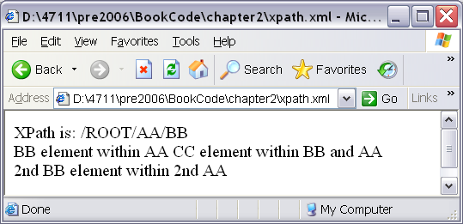
Output From This Selection

Slide 9
Difference Between Examples
Last example uses an absolute path
  Searches elements starting at the root
Next example uses a "relative" path
  Finds all elements that match the pattern regardless of their absolute location in the tree
  More of an everywhere path

Slide 10
<xsl:stylesheet version="1.0" xmlns:xsl="http://www.w3.org/1999/XSL/Transform">
<xsl:template match="/">
<HTML><HEAD><TITLE></TITLE></HEAD>
<BODY>
XPath is: //BB <BR/>
<!-- select each element BB found anywhere-->
<xsl:for-each select="//BB" >
<xsl:value-of select="." /><BR/>
</xsl:for-each>
<BR/>
</BODY>
</HTML>
</xsl:template>
</xsl:stylesheet>

Slide 11
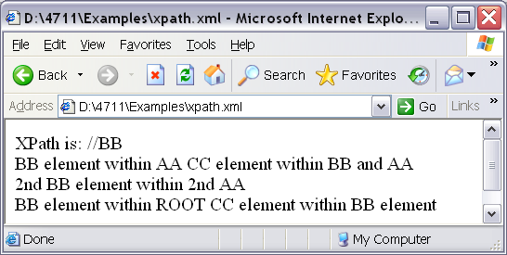
Output from Second Example

Slide 12
3. Nodes
XPath has seven node types:
    Root
    Element
    Attribute
    Text
    Comment
    Processing instruction
    Namespace

Slide 13
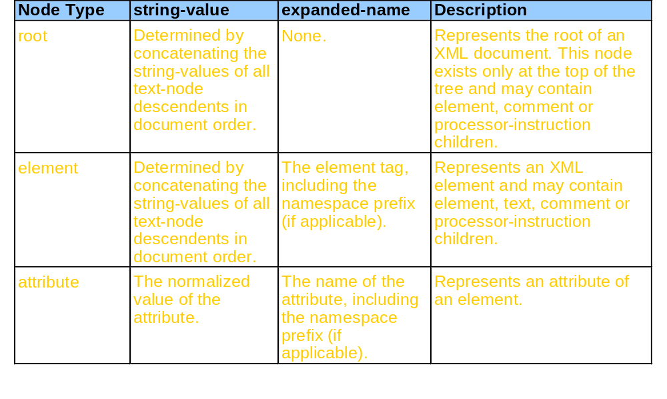
XPath node types

Slide 14
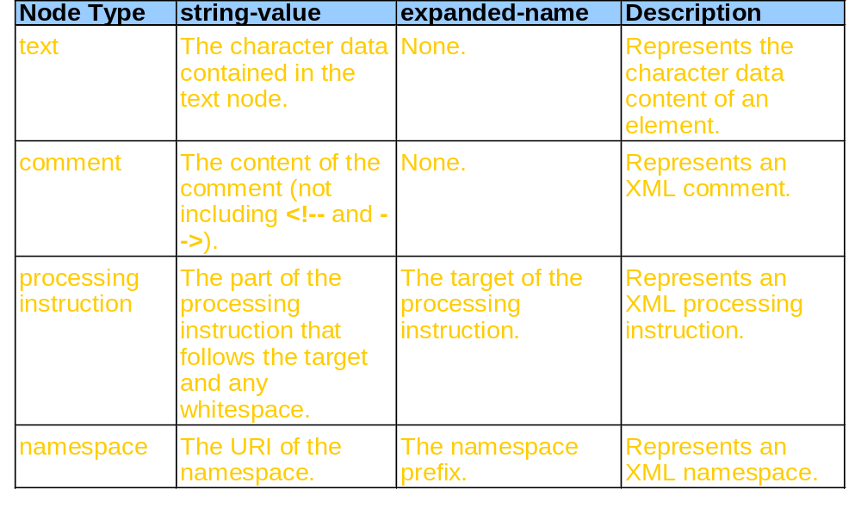
XPath node types. (Part 2)

Slide 15
4. Axes
XPath searches are made relative to context node
Axis
  Indicates which nodes are included in search
    Relative to context node
  Defines node set relative to current node
  Dictates node ordering in set
    Forward axes select nodes that follow context node
    Reverse axes select nodes that precede context node

Slide 16
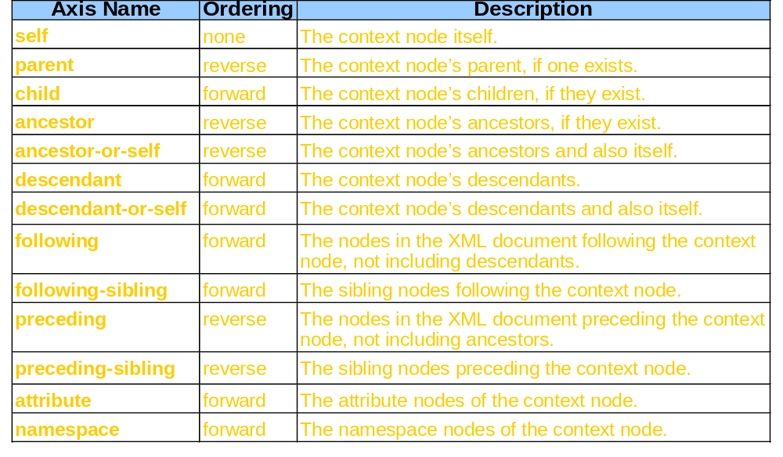
XPath axes.

Slide 17
5. Node Tests
Node tests
  Refine set of nodes selected by axis
    Rely upon axis’ principle node type
      Corresponds to type of node axis can select

Slide 18
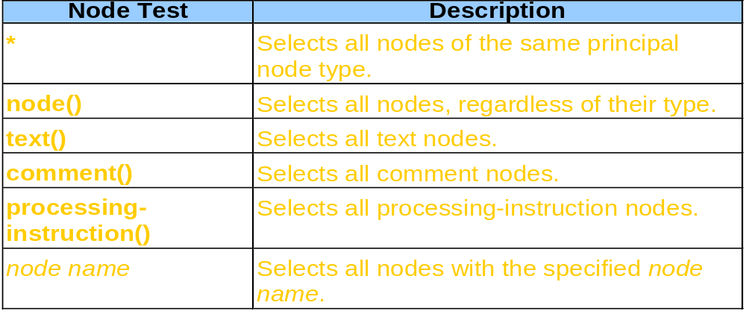
Some XPath node tests.

Slide 19
Location Paths Using Axes & Node Tests
Location step
  Axis and node test separated by double colon (::)
  Optional predicate enclosed in square brackets ([])
  Some examples:
    Select all element-node children of context node
    child::*
    Select all text-node children of context node
    child::text()
    Select all text-node grandchildren of context node
    child::*/child::text()

Slide 20
Example with Predicate
/mydoc/section[@security="public"]/para[7]
Selects
  mydoc from root
  Each section of mydoc
  That has a security attribute
  That has the value public
  para from section
  Number 7

Slide 21
Predicate Notes
Predicates have precedence in evaluation
A/B[3] selects the third B element inside A
(A/B)[3] selects the third element of the B elements inside A elements
Indexing with predicates is base 1
  Except when using Javascript!

Slide 22
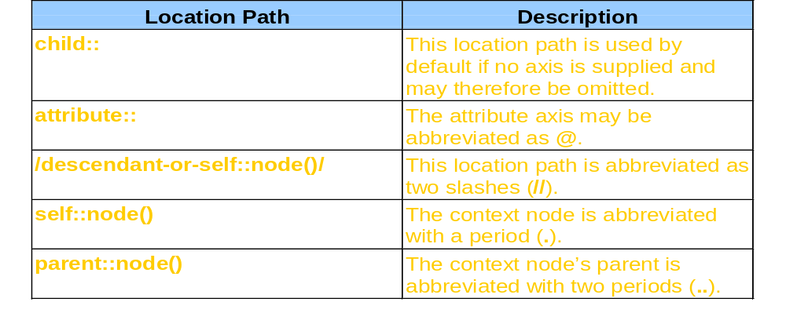
Some location-path abbreviations.

Slide 23
XML document that marks up book translations.
<?xml version = "1.0"?>
<!-- XML book list -->
<books>
<book>
<title>Alice in Wonderland</title>
<translation edition = "1">Spanish</translation>
<translation edition = "1">Chinese</translation>
<translation edition = "1">Japanese</translation>
<translation edition = "2">French</translation>
<translation edition = "2">Japanese</translation>
</book>
<book>
<title>Around the world in 80 days</title>
<translation edition = "1">Korean</translation>
<translation edition = "2">French</translation>
<translation edition = "2">Spanish</translation>
<translation edition = "3">Italian</translation>
<translation edition = "3">Japanese</translation>
</book>
</books>
books.xml

Slide 24
6. XPath tree for books.xml
Other
nodes…
Continued from …
Element
book
Element
title
Text
Alice in Wonderland
Element
translation
Attribute
edition 1
Element
translation
Attribute
edition 1
Text
Japanese
Text
Spanish
Element
translation
Attribute
edition 2
Element
translation
Attribute
edition 1
Text
French
Text
Chinese
Element
translation
Attribute
edition 2
Text
Japanese
Continued to …
Other
nodes…

Slide 25
Which books have Japanese translations?
Use root node of XPath tree as context node
Use predicate
  Boolean expression for filtering nodes from search
  Compare string value of current node to string ‘Japanese’
/books/book/translation[. = ‘Japanese’]/../title

Slide 26
Which books have Japanese translations - XSL
<?xml version = "1.0"?>
<!-- books1.xsl -->
<xsl:stylesheet version = "1.0"
xmlns:xsl = "http://www.w3.org/1999/XSL/Transform">
<xsl:template match = "/">
<html><body>
<p>List of books with Japanese translations:</p>
<ul>
<xsl:for-each select = "books/book/translation">
<xsl:if test = ". = 'Japanese'">
<li>
<strong><xsl:value-of select = "../title"/></strong>
- Edition:
<strong><xsl:value-of select = "@edition"/></strong>
</li>
</xsl:if>
</xsl:for-each>
</ul>
</body></html>
</xsl:template>
</xsl:stylesheet>
books.xsl

Slide 27
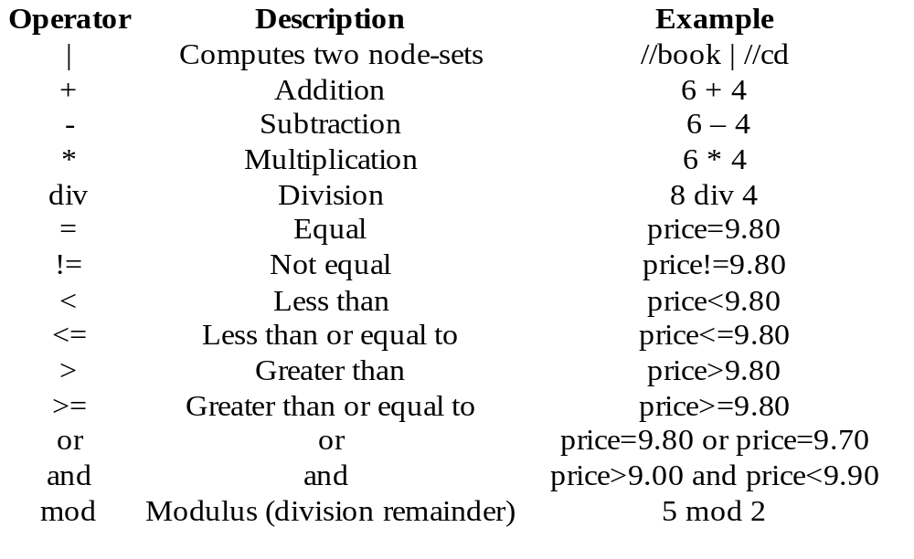
7. Xpath Operators

Slide 28
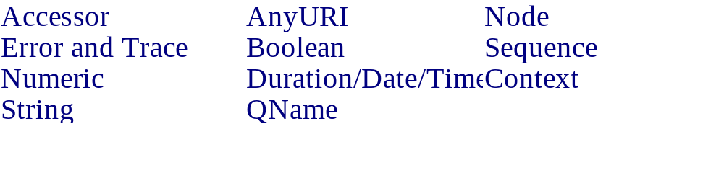
8. Xpath Functions

Slide 29
Xpath Functions...
Numeric:
Number
Abs
Ceiling
Floor
Round
round-half-to-even
Aggregate:
Count
Avg
Min
Max
Sum

Slide 30
9. Xpath Variables
Define
  <xsl:variable name=”xxx”>
  yada yada
  </xsl:variable>
  <xsl:variable name=”xxx”
  select=”yadayada” />
Use
  <xsl:copy-of select = “$xxx”/>
  <xsl:value-of select=”$xxx”/>
First form for blocks of text to copy
Second form as a conventional variable to hold subtotals or calculation results, etc

Slide 31
XSL/Xpath Keys
Way to build indices within an XML document
<xsl:key name=”xxx” match=”yyy” use=”zzz”/>
Use the key(which,value) function to return nodes/nodesets
Xxx is the variable name
Yyy is a pattern matching nodes
Zzz is an expression returning a value to use as a key

