Slide 1
XSL Stylesheets
ACIT4850
Mar 18, 2019

Slide 2
XSL Stylesheets
XSL...
Stylesheets
Transforming
XSL Internals
Filtering & Sorting
Templates

Slide 3
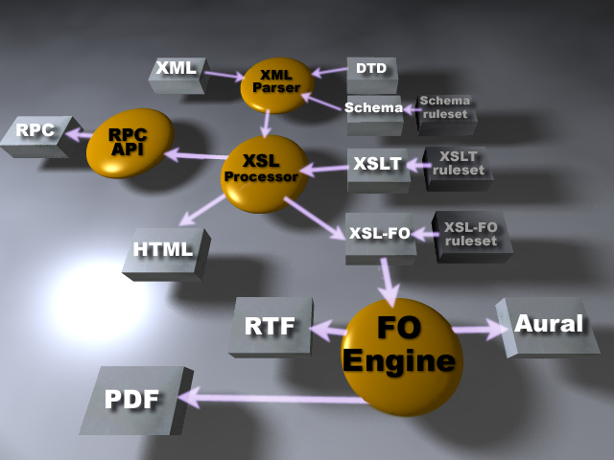

Slide 4
1. Intro to XSL
XSL can:
  transform XML to HTML, PDF, etc.
  filter/sort XML data
  address parts of an XML document
  format XML data based on the data value
  output XML to different devices

Slide 5
Languages
XSL has 3 sub-components to it:
  XSLT to transform XML (transforming)‏
    Transforms XML into other types of documents (or other XML documents)‏
  XPath defines XML parts or patterns (defining)‏
    Addresses parts of an XML document
    Designed to be used by XSLT
  XSL Formatting Objects define XML display (formatting)‏

Slide 6
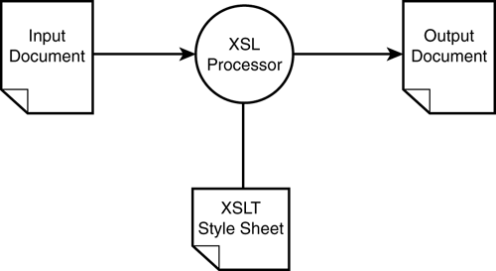
XSLT
T is for Transformations

Slide 7
2. What Are Style Sheets
Describe how documents are presented for:
  Computer screen, printer, displayed on a cell phone, pronounced
Separate presentation from content
Define presentation rules once & reuse
  One external ‘style page’ referenced
  Many content pages use the style page
  NOT CSS!

Slide 8
3. Transforming (1/2)‏
Most important part of XSL standard
Example of XSLT transforming XML to HTML:
  Each XML element = 1 HTML element
  Can also:
    create completely new elements
    remove elements
    rearrange & sort elements
    test & make decisions about which elements to display

Slide 9
Transforming (2/2)‏
Simple description:
  XSL uses XSLT to transform an XML source tree to an XML result tree
Process:
  XSLT uses XPATH to define parts of the source document
  Do the parts match 1 or more predefined templates?
  Transform matching part of source doc into result doc
  Anything left over is not transformed

Slide 10
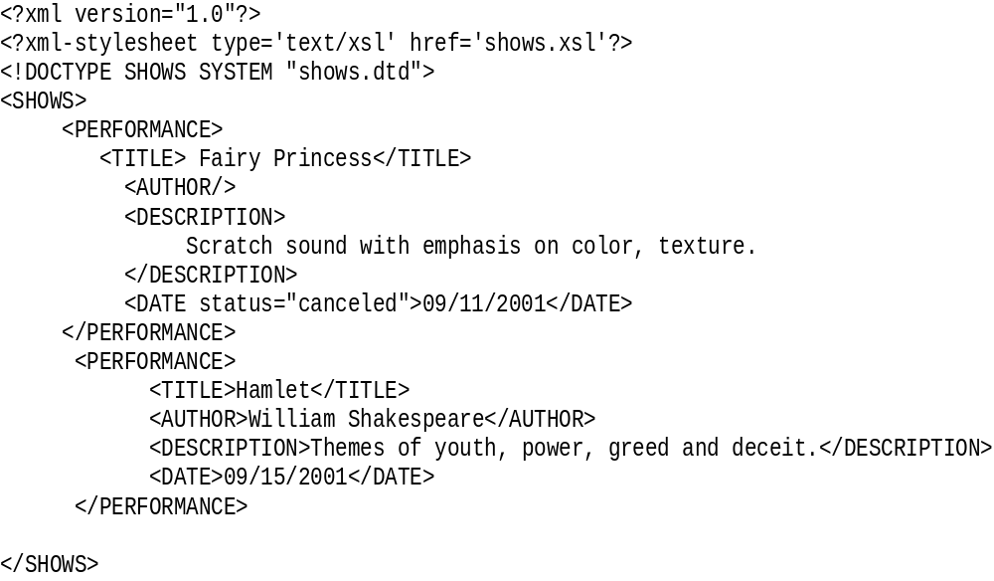
XML Document
Where to find it
Type of Stylesheet

Slide 11
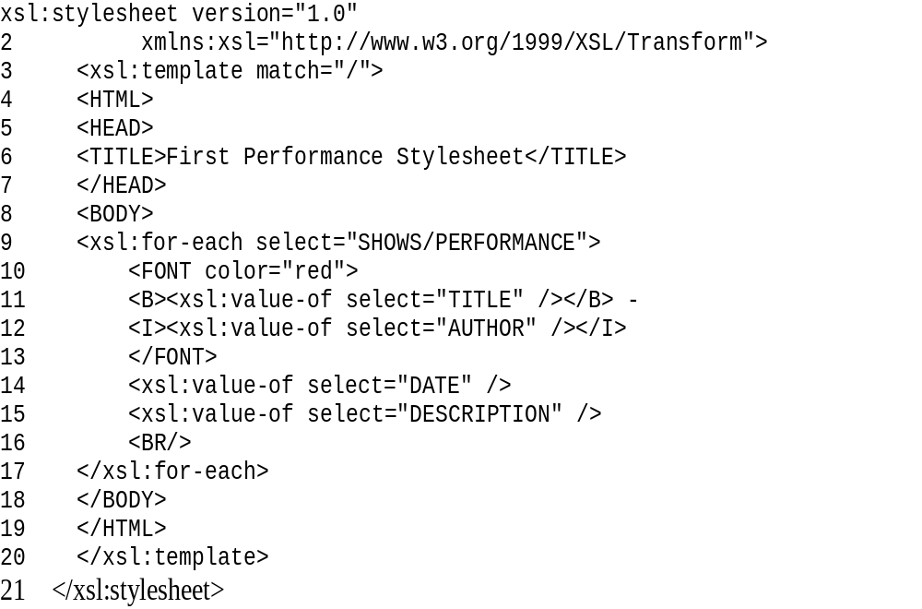
XSL Document

Slide 12
4. Root Element
xsl:stylesheet is always the first Element
<xsl:stylesheet version="1.0" 2 xmlns:xsl="http://www.w3.org/1999/XSL/Transform">
Root Element spans two lines
Note the attribute: xmlns:xsl
xsl is a namespace

Slide 13
Select Element to format
<xsl:template match="/">
namespace
The “/” is the root element so entire document is transformed
template tag
Attribute “match” tells the XSL stylesheet which elements of the XML document to format or transform.

Slide 14
Some HTML
<<HTML>
<HEAD><TITLE>First Performance Stylesheet</TITLE></HEAD>
<BODY>
…
This HTML will be output to the browser
Start Body

Slide 15
XSL:for-each select attribute
<xsl:for-each select="SHOWS/PERFORMANCE">
Attribute value is Element to select
for-each-select attribute like simple for statement

Slide 16
XSL:value-of select attribute
<xsl:for-each select="SHOWS/PERFORMANCE">
<FONT color="red">
<B><xsl:value-of select="TITLE" /></B> -
<I><xsl:value-of select="AUTHOR" /></I>
</FONT>
<xsl:value-of select="DATE" />
<xsl:value-of select="DESCRIPTION" />
<BR/>
</xsl:for-each>
Formatting / Style
Display the value of this Element
Select the value of the given Element

Slide 17
Transformed Document - HTML
<HTML>
<HEAD> <TITLE>First Performance Stylesheet</TITLE>
</HEAD>
<BODY>
<FONT color="red">
<B>Fairy Princess</B> - <I></I>
</FONT>
09/11/2001
Scratch sound with emphasis on color, texture.
</BODY>
</HTML>
Data replaces xsl tags

Slide 18
New Example
Look at the files cdcatalog.xml and cdcatalog.xsl
Look at the output
Goes through all of the cd nodes in the catalog node and outputs the value of the title and the artist nodes
Example #1

Slide 19
Transforming Using Javascript?
Bottom line: DON'T DO IT!

