Slide 1
Fall 2024 Co-op Term Wrap-up
GAM Digital
Jediel Antalan, Software Developer
Notes:
How did the documents help? What did they do?
Problems and solutions slide
Adjusted schedule
HOW did I make an impact
Cool you learned it, so what?

Slide 2
At a Glance
Key Highlights
Vulnerability reduction
Angular version updates
Documentation & knowledge sharing
Notes:
So at a glance, some key highlights I was able to deliver during my 4 months here was
Vulnerability reductions the ICP0 application
Angular version updates for frontend applications
Documentation and knowledge sharing with current and new onboarding team members.

Slide 3
At a Glance
Advancements
IAP-frontend: Ready for production
Institutional-frontend: Vulnerability free
Helios on Actions Migration
Notes:
And for some general advancements I was able to help deliver was:
For iap-frontend, me and Serhii with the help of Reza, were able to get it ready and waiting in production.
For institutional frontend, me and Serhii were also able to clean up all its vulnerabilities
With Reza’s help I was also able to advance the frontend applications to GitHub Actions.

Slide 4
Contributions to ICP0 team
Learned, documented and shared the iap-frontend and iap-backend local setup and deployment
Learned, documented and ran the iap and icp frontend manual and automated tests
Authored multiple confluence documents to help new team members with onboarding and share gained knowledge
Help progress the migration of application from PCF to OCP4
IAP local setup
ICP0 frontend testing
ICP0 PCF token renewal
ICP0 - Restarting IAP PCF Instance
Notes:
So during the 4 months I was onboarded to the ICP0 team/project, and here I helped progress the applications migration from PCF to OCP4
As one of the first members of the ICP0 team I took on the responsibility of starting up the application for the first time in a while. With the help of previous team members who worked on the project, I was able to learn the process of starting it up and documented all the things I learned in the process.
Furthermore, I was able to do the same with the testing process for ICP0, learning it and documenting.
And here are some of the confluence pages I was able to create and share with team members to share this new gained knowledge.

Slide 5
Problems & Solutions
Problems
Solutions
Lots of information regarding ICP0 bottled necked with offshore developers
  Startup: Roman Buta, Anna Myropolska
  Testing: Rhiddhi Gupta
Adjusted schedule to account for time zone difference
Created confluence pages to allow information to be easily shared with others
Notes:
During this learning process it was not all sunshine and rainbows, there were a few problems along the way, with the main one being the bottleneck of information. Or in other words, how accessible the information was. In short it was not accessible at all as the information regarding ICP0 was only known by a few developers, with barely any documentation available
For example, during the startup process I would reach out to Roman Buta and Anna Myropolska, as they were the last ones to work on the application.
And for the testing I would reach out to Rhiddhi Gupta and Paresh
And this was a problem for a few reasons, I had to gain a lot of information from just 3 people, and these people are busy people with their own projects and things to work on. And these people were also offshore in a different time zone, 6-8 hours ahead of us; which meant I did not have that much time to connect with them to learn these things.
So to account for this I had to adjust my schedule to start a earlier at 8 most days to schedule meetings and calls with them as they had free time during those hours.
And to solve this bottle necking of information, as mentioned earlier, I documented everything I learned so that everyone can easily access this information instead of relying on a single person

Slide 6
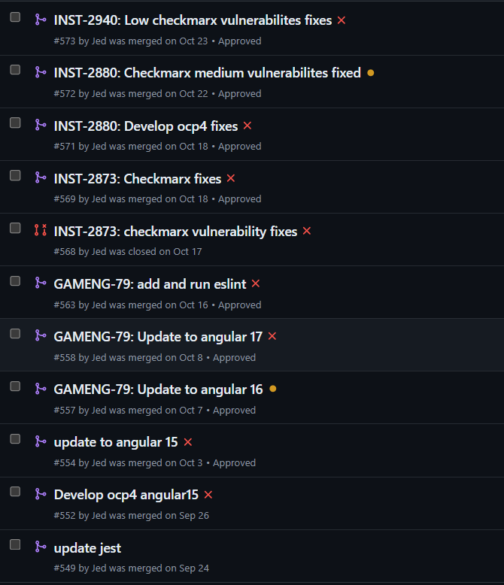
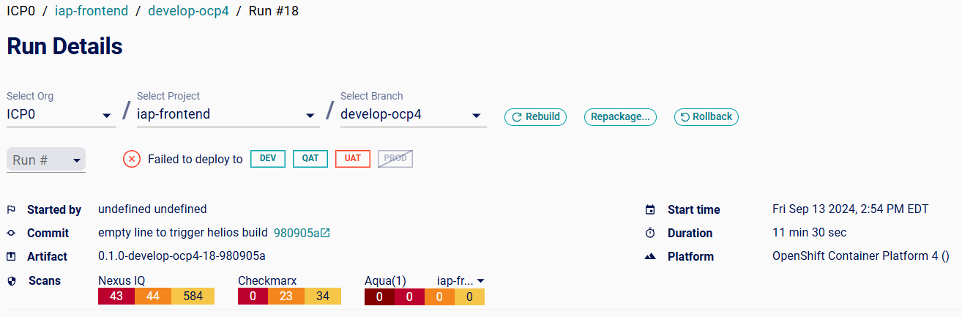
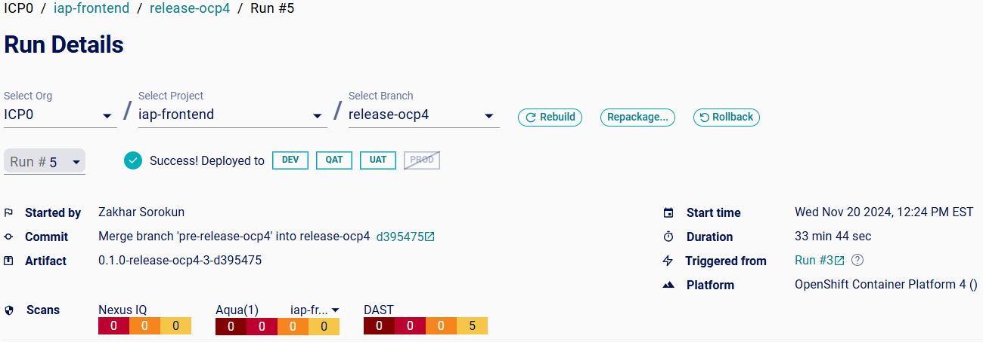
Contributions to iap-frontend
Contributed to the version update of Angular, going from v10 → v17
  Version by version update
  Resolved build issues for each version
  Updated/removed incompatible packages
Removed and replaced deprecated API’s
Removed critical 40+ critical/high, and over 500+ low NexusIQ vulnerabilities
Migrated deprecated TSLint to ESLint, enforcing clean & readable coding practices
Notes:
To resolve the build issues, extensive research and debugging was done to fix it. This also included looking at package compatibilities, removing the ones that were compatible and updating the ones that was compatible with the newer Angular version, and rewriting incompatible code components into compatible syntax.

Slide 7
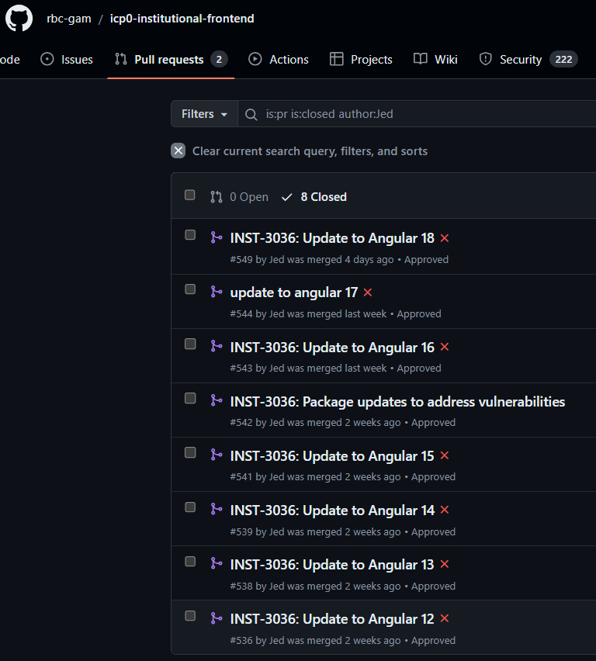
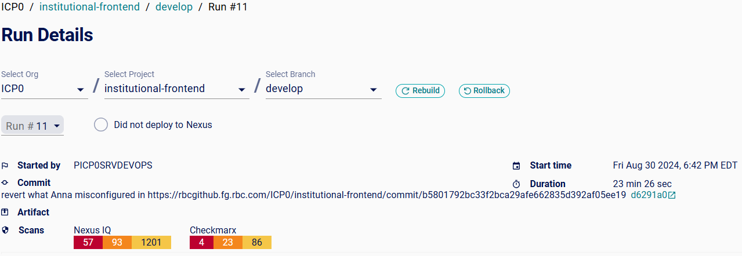
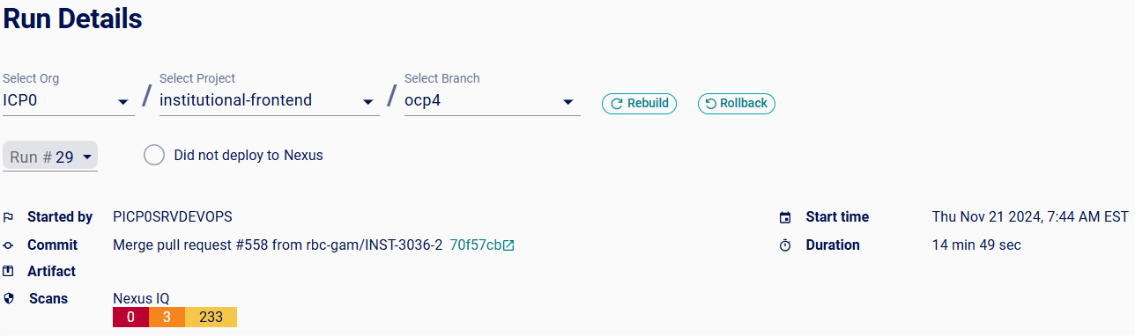
Contributions to institutional-frontend
Updated Angular version; going from v10 → v18
  Version by version update
  Resolved build issues for each version
  Updated/removed incompatible packages
Removed and replaced deprecated API’s
Resulted in a decrease of 57 critical, 90 medium & over 900+ low Nexus IQ vulnerabilities
Added ESLint scripts allowing project to be linted; resulting in clean and readable code
Migrated repo to GitHub Actions
  Resolving artifactory issues on Jenkins
  Allowing faster build & scan process
Notes:
To resolve the build issues, extensive research and debugging was done to fix it. This also included looking at package compatibilities, removing the ones that were compatible and updating the ones that was compatible with the newer Angular version.
Modifying scripts and added custom agents from previous projects to update node versions and ultimately fix helios build issues moving it up the pipeline.

Slide 8
How does this help?
Now on a LTS Angular version (v2 to v15 are no longer supported)
More secure applications
Less susceptible to attacks that can compromise user data
Advanced the migration of ICP0 frontend applications to OCP4
Notes:
https://dev.to/this-is-angular/the-importance-of-upgrading-frameworks-a-case-for-angular-5c91
https://blog.angular.dev/introducing-angular-v17-4d7033312e4b

Slide 9
What did I learn?
The full software development process (not just development)
Code quality & security
Devops (Helios, Jenkins, GitHub Actions)
Automated and regression testing
Importance of documentation

Slide 10
Thank You!

