Slide 1
BATTLESHIP 1/17/2020
2-PLAYER WEB-BASED GAME

Slide 2

SOLO adjective · adverb for or done by one person alone; unaccompanied. ”idiotic” “an ill-advised endeavor” “a lot of work”
Jed, senior team member and possible demented…..

Slide 3
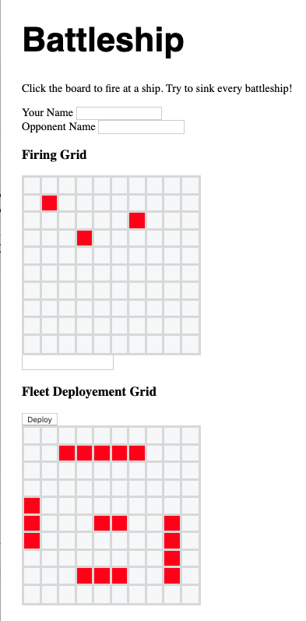
Battleship concept:
A Two player version of the original board game, web-hosted
10x10 Firing grid
Click on grid square to fire, red means hit, blue miss.
10x10 Fleet Deployment grid
Click for ship positions:
5 squares: Carrier
4 squares: Battelship
3 squares: Cruiser, Submarine
2 squares: Destroyer
Players alternate Firing, server responds with hit or miss
First player with 17 hits wins game

Slide 4
Resources to utilized (so far…):
HTML 5
CSS 3
Node
Nodemon
Express
Socket
MySql

Slide 5
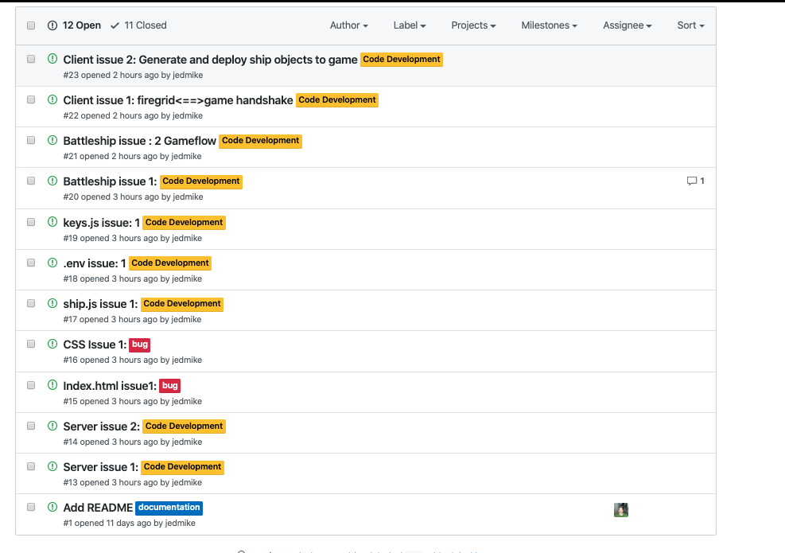
What is not working: (so far…):

Slide 6
What is working:
Server.js
Client(s).js
Index.html static/active
Socket Connection/Communication
Chat
Active Grid Element Generation/Element Modification
Object Constructor

Slide 8
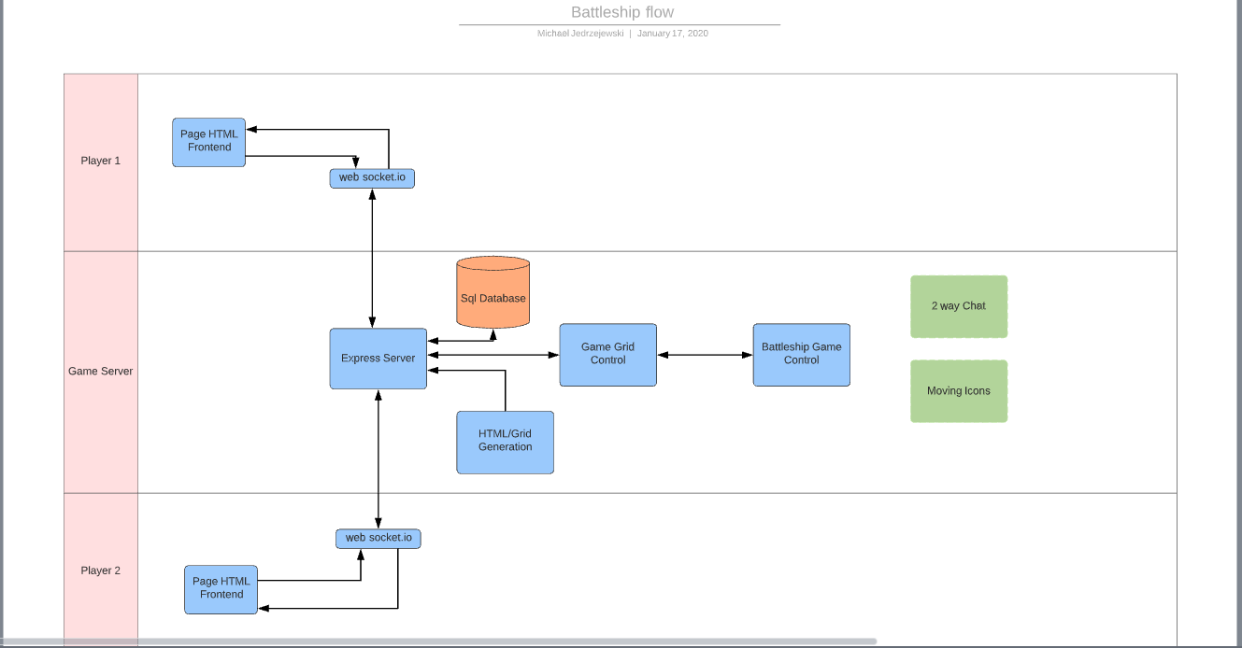
Control/Data Flow: (

