Slide 1
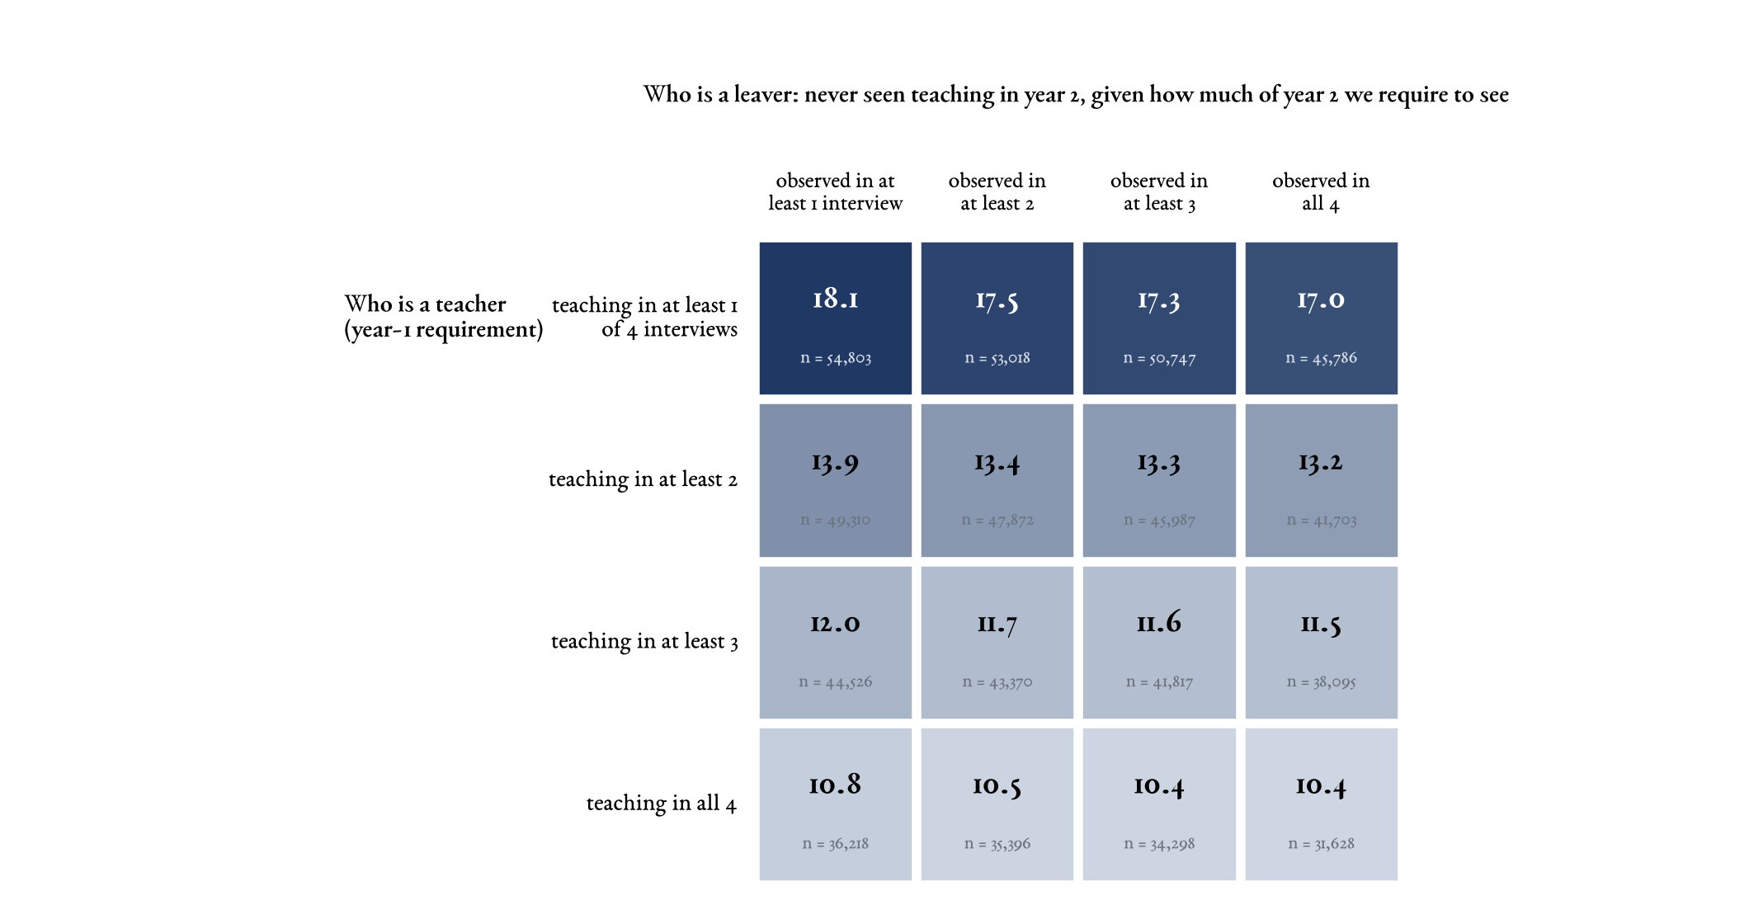
Every combination of the two definitions
Pooled 2005–2024, weighted; a leaver is always a person never seen teaching in year 2. The rate falls steeply with the year-1 teaching requirement and barely moves with the year-2 evidence requirement. Single, Pair, Triple and Strict are the second column.
☞ Back

