Slide 1
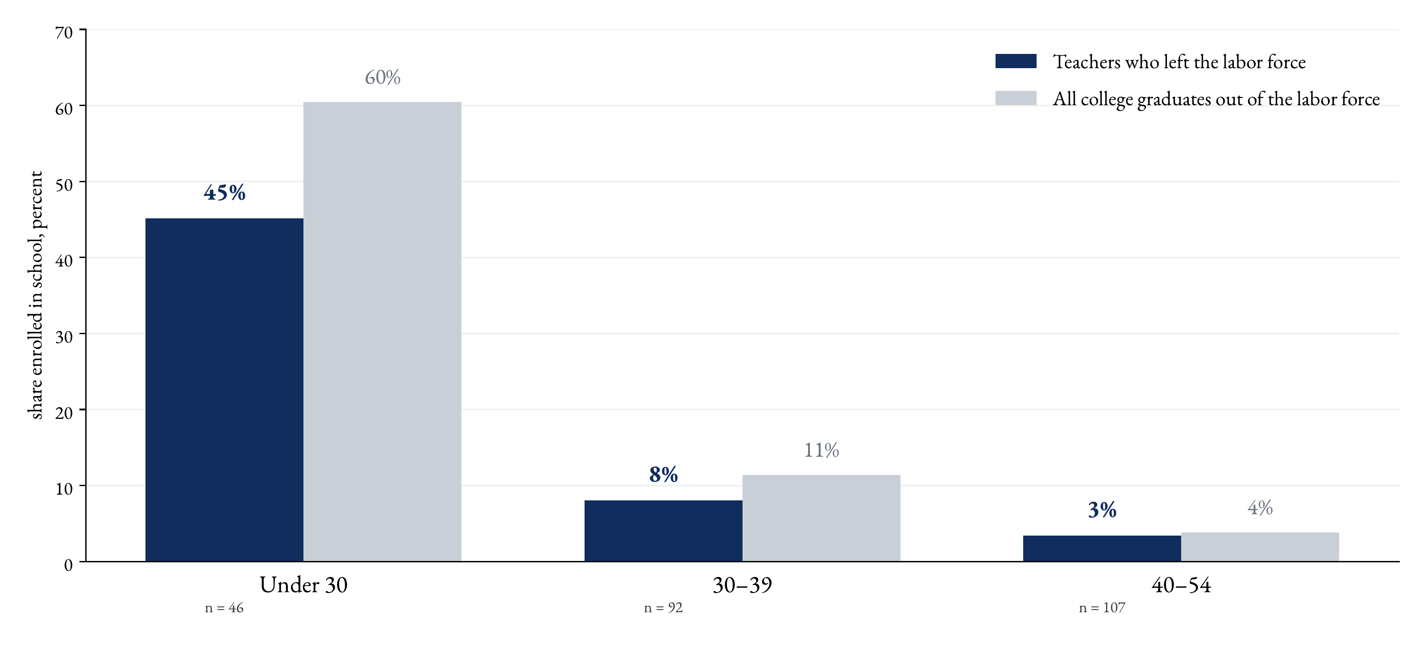
And the youngest of them leave to study
Key message. Leaving to study follows age, and teacher leavers mirror the typical graduate out of the labor force: 45% of those under 30 are enrolled in school, next to 60% among all graduates. After 40, almost none study.

