Slide 1

Directorate for Education and Skills
Who Leaves Teaching, and Why?
The Anatomy of Teacher Attrition in the United States, 1997–2024
José Elías Durán Roa
University of Alicante · OECD · July 2026
oecd.org · Education and Skills
Notes:
One question, one instrument, twenty-eight years. The exodus is the claim, the anatomy is the answer.

Slide 2
Motivation
Measuring teacher attrition is hard as it requires following the same teachers over time.
In the US, the official source is the NCES Teacher Follow-up Survey. It runs every four to five years, on small samples, and its microdata are not public.
Researchers found a creative solution, the CPS, the largest longitudinal survey in the US. Harris & Adams (2007) and Aldeman & Yi (2025) used it to show that teacher attrition is similar to that of comparable professions.
Contribution
I build the longest measurement of teacher attrition in the US, twenty-eight consecutive years (1998–2025) from a single instrument, and characterize who leaves, where they go, what leaving pays, who returns, and what moves the rate, from a new baby to the business cycle.
Notes:
Two literatures, one gap. The follow-up surveys have depth but no frequency, and the CPS papers have frequency but stop at the level. I take the instrument all the way down: routes, prices, profiles, and the margins that move the rate.

Slide 3
Data
The Current Population Survey (CPS) is the main household survey in the US, used to compute the country’s official employment statistics.
I pool all its rounds from 1998 to 2025 into a single file and turn it into a tool for following teachers.
Each March, respondents report the longest job held last calendar year and their occupation today. Whoever taught last year and no longer teaches has left the profession within the year.
My final dataset holds 5 million individual records, with 104,545 teachers, around 3,700 per year.
Notes:
The instrument sees professions, not schools. One question asked the same way for twenty-eight years beats any patchwork of administrative sources. Calendar 2025 enters the series the day the Census releases the 2026 supplement in the fall.

Slide 4
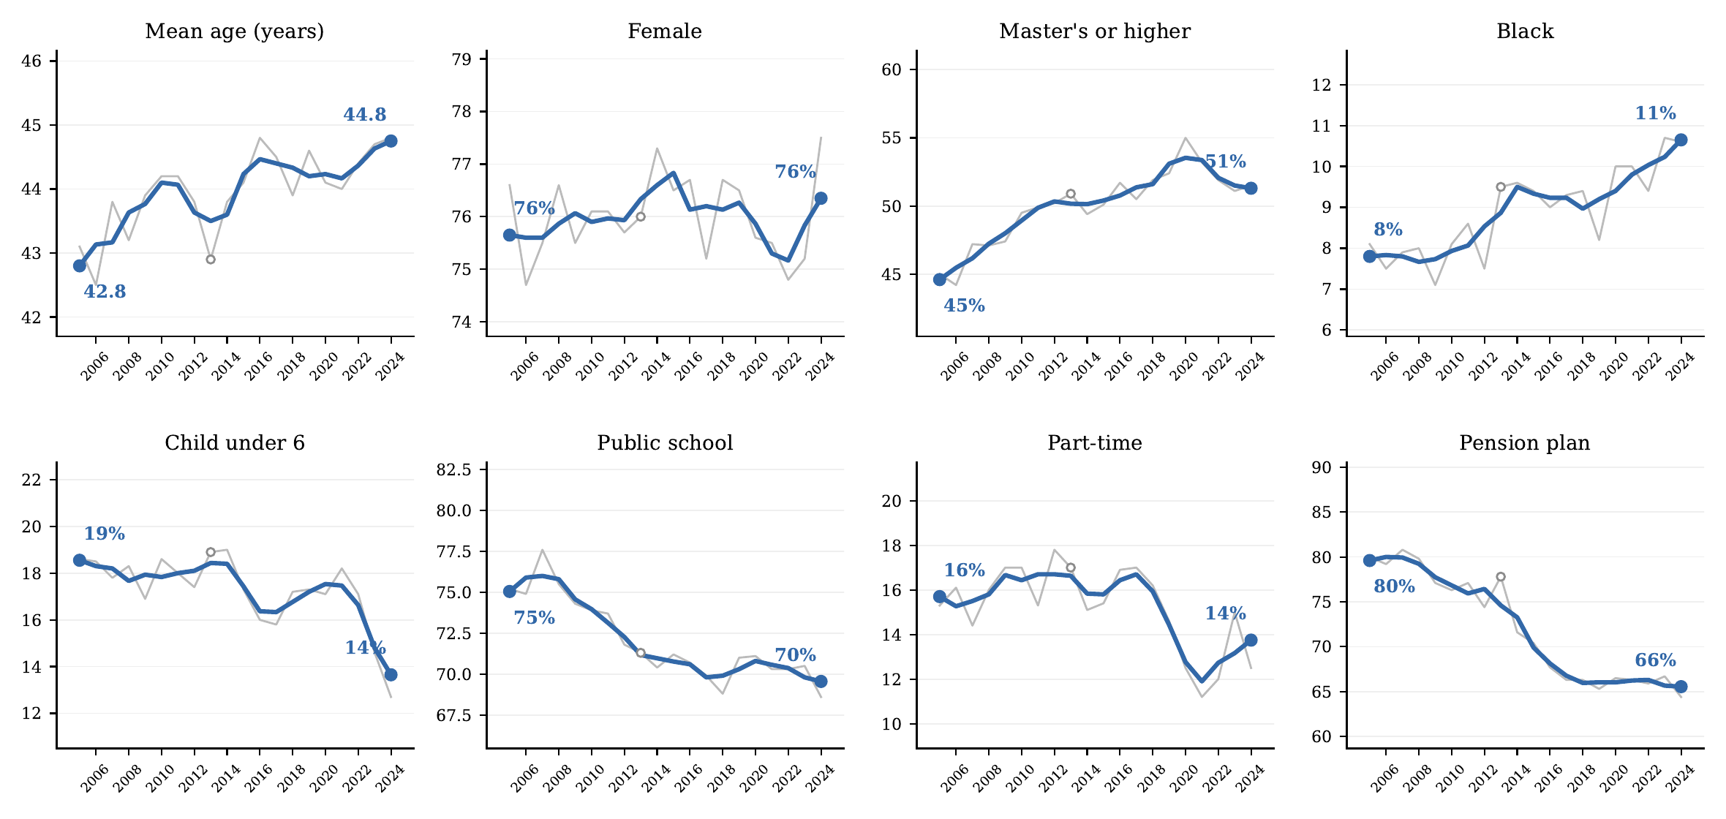
Figure 1. Composition of the Teaching Workforce, 2005–2024
Notes: College-graduate teachers aged 18+ whose longest job last year was K–12 teaching; ASEC supplement weights. Thin gray lines are annual values; blue lines are centered 3-year averages, with endpoint values printed. “Public school,” “part-time,” and “pension plan” refer to the longest job held last year; the open circle marks 2013, a year with a reduced sample due to the ASEC redesign. Source: author’s calculations from March CPS supplements, survey years 2006–2025.
Notes:
The workforce is aging and its pension coverage has fallen from 80 to 66 percent. The contract is deteriorating on exactly the margin that predicts exit.

Slide 5
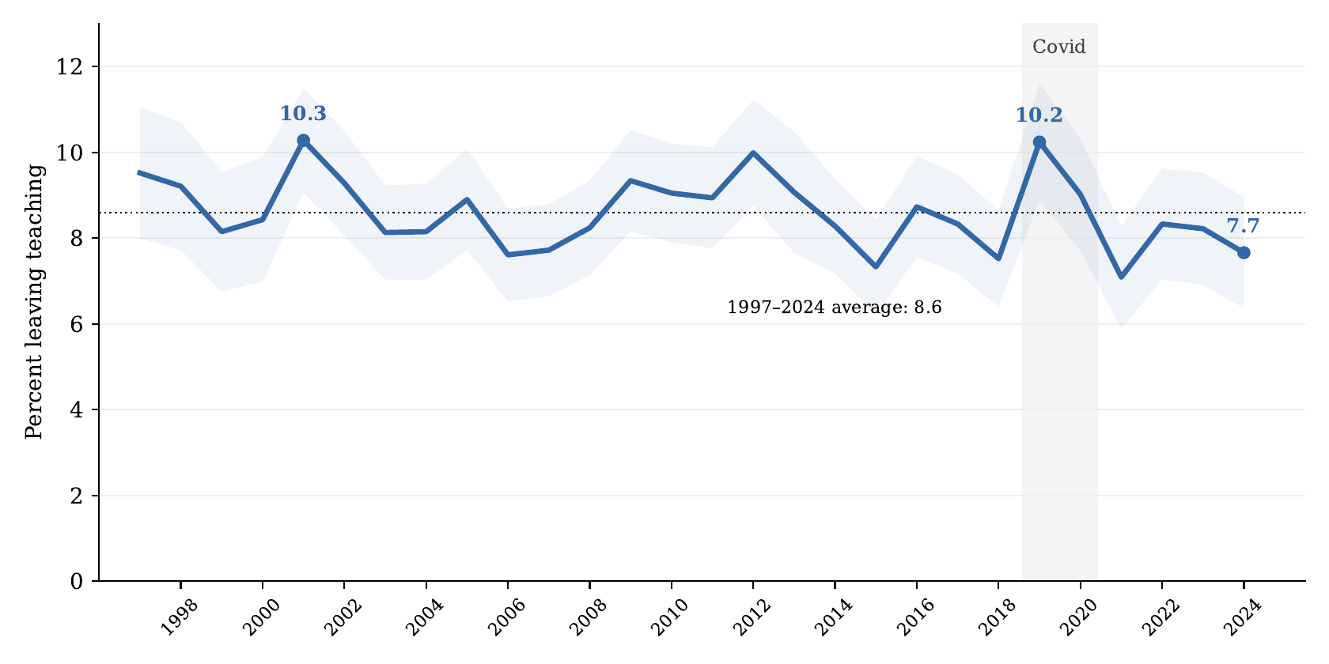
Figure 2. Leaving Teaching, 1997–2024
Notes: Share of college-graduate teachers (longest job last calendar year) not employed in a teaching occupation the following March; ASEC weights. Shaded band: 95 percent confidence interval using a design factor of 1.5. Dotted line: the 1997–2024 mean (8.6). The gray band marks the Covid supplements. Source: author’s calculations from March CPS supplements, survey years 1998–2025.
Notes:
Twenty-eight years, no trend. The two worst years are 2001 and 2019, a generation apart. Any exodus narrative starts from a fact this series does not contain.

Slide 6
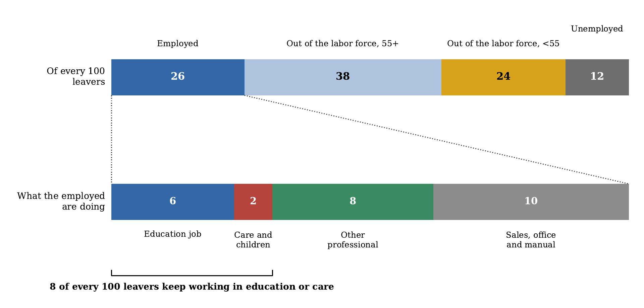
Figure 3. Destinations of Teachers Who Leave the Profession
Notes: College-graduate leavers pooled over calendar 2015–2024, ASEC weights. Top bar: labor force status the March after the teaching year; “out of the labor force” is split at age 55. Bottom bar: the occupational destination of the 26 employed leavers, rescaled to sum to their total. Source: author’s calculations from March CPS supplements.
Notes:
Of every 100 leavers, only 26 hold another job the next March. The exodus scenario, a working-age teacher productively employed elsewhere, is barely one leaver in six.

Slide 7
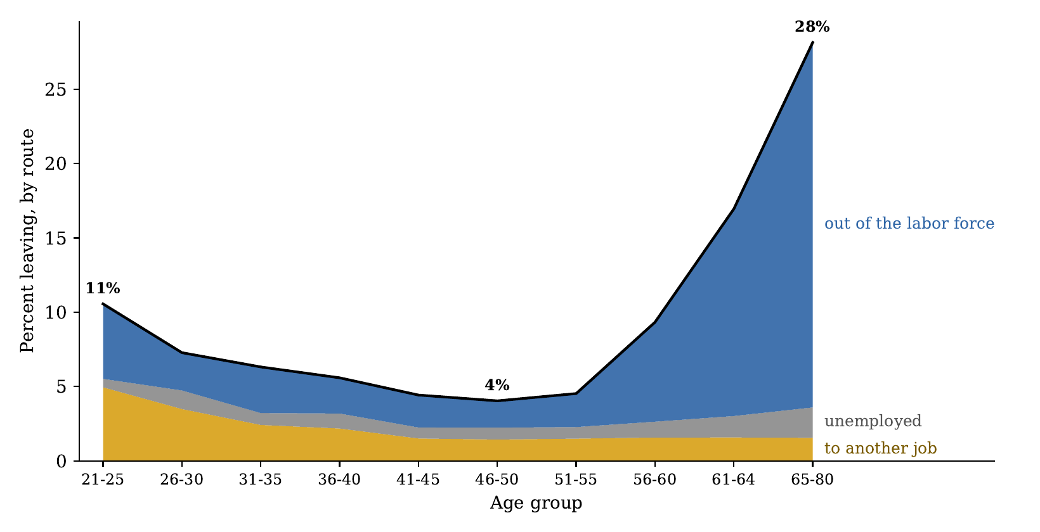
Figure 4. Leaving Teaching by Age and Route
Notes: College-graduate teachers pooled over calendar 2015–2024, ASEC weights; ten age groups. The black line is the total leaving rate; stacked areas decompose it into exits to another job, unemployment, and out of the labor force. Source: author’s calculations from March CPS supplements.
Notes:
The age profile is a U. The left arm is career search, the right arm is retirement. Mid-career teachers, the ones schools most need to keep, are the least mobile workers in the figure.

Slide 8
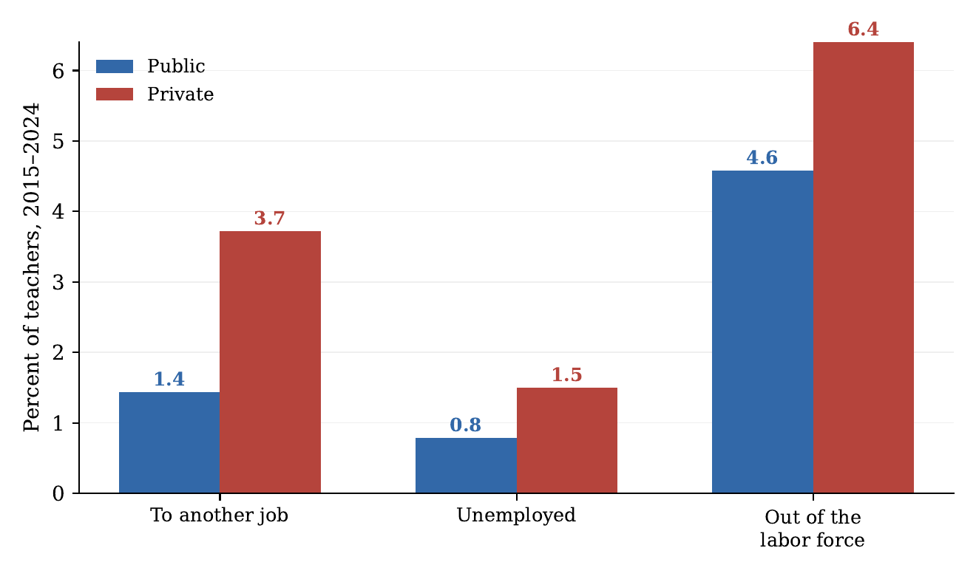
Figure 5. Exit Routes by School Sector
Notes: Route-specific annual exit rates of college-graduate teachers by sector of the last-year job (class of worker: government vs. private), pooled 2015–2024, ASEC weights. A private-school teacher who moves to a public school—or vice versa—remains a teacher and is not a leaver here. Source: author’s calculations from March CPS supplements.
Notes:
Private schools lose teachers at twice the public rate, through every route. Tenure, salary schedules and pensions are retention policy that already works.

Slide 9
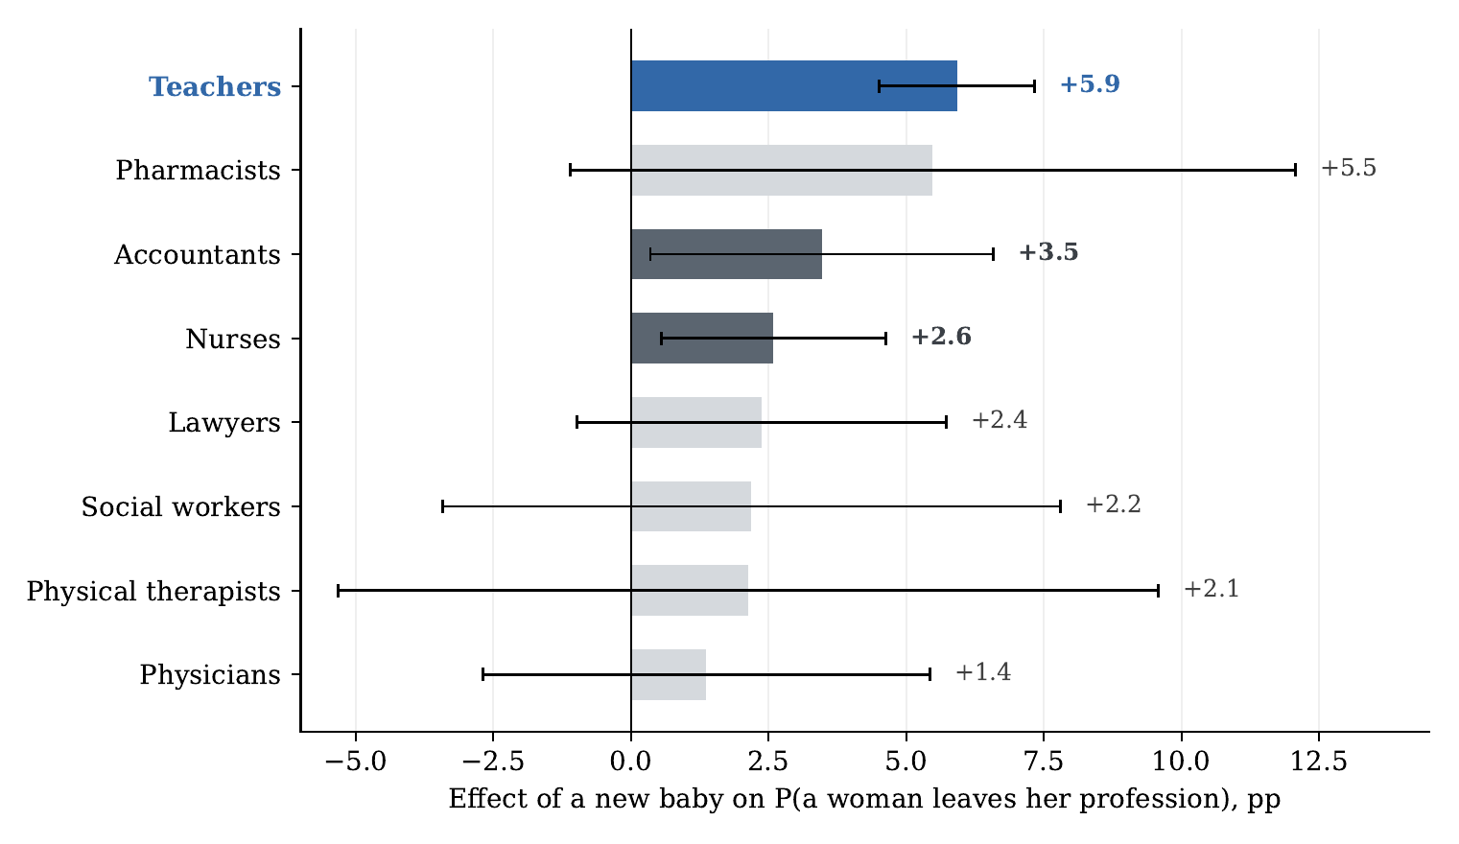
Figure 6. The Effect of a New Baby on Leaving, by Profession
Notes: Average marginal effect of a new baby (own child aged 0 in the household) on the probability that a woman leaves each profession, from profession-specific probits with age, age squared, marital status, education, and year effects; whiskers are 95 percent confidence intervals. Solid bars are significant at 5 percent; light bars are not. Samples pool 2010–2024. Source: author’s calculations from March CPS supplements.
Notes:
A birth raises a teacher's exit by twice as much as a nurse's. Teaching is the college profession where a classroom cannot be covered part time.

Slide 10
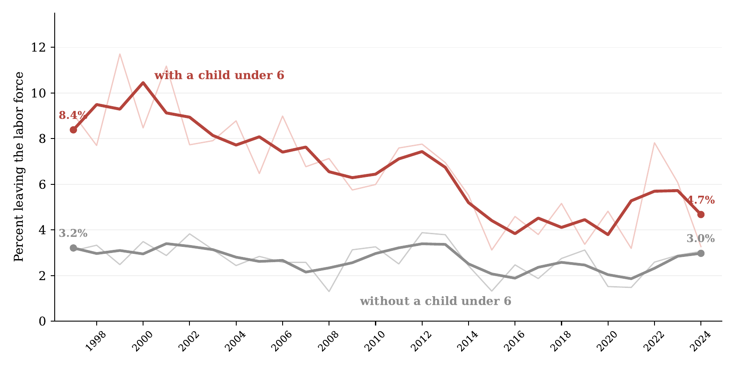
Figure 7. Labor Force Exit of Women Teachers, With and Without Young Children
Notes: Women teachers aged 22–45, college graduates; annual probability of leaving the labor force (thin lines) and centered 3-year averages (bold), separately for those with and without an own child under 6 at home. Endpoint values printed. Source: author’s calculations from March CPS supplements, survey years 1998–2025.
Notes:
The classic exit to home is disappearing. The gap between mothers and other young women teachers went from seven points to under two in twenty-five years.

Slide 11
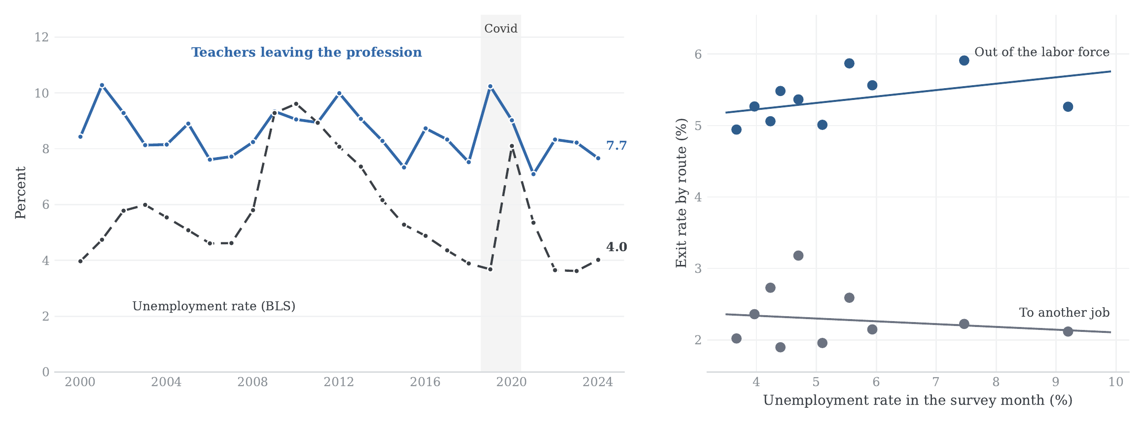
Figure 8. Leaving Teaching and the Unemployment Rate, 1997–2024
Notes: Left: the leaving series (annual, from calendar 2000) against the BLS national unemployment rate (annual average). Right: binned scatter (deciles of the unemployment rate in the survey month, March of t+1, when the exit is observed) of the two labor-market routes, with OLS fits on the underlying annual data; correlations are −0.16 (to another job) and +0.29 (out of the labor force). Unemployment: BLS via FRED (UNRATE). Source: author’s calculations from March CPS supplements.
Notes:
Booms do not poach teachers. Where exits respond to the cycle at all, recessions push them out. The poaching story has no support in the data.

Slide 12
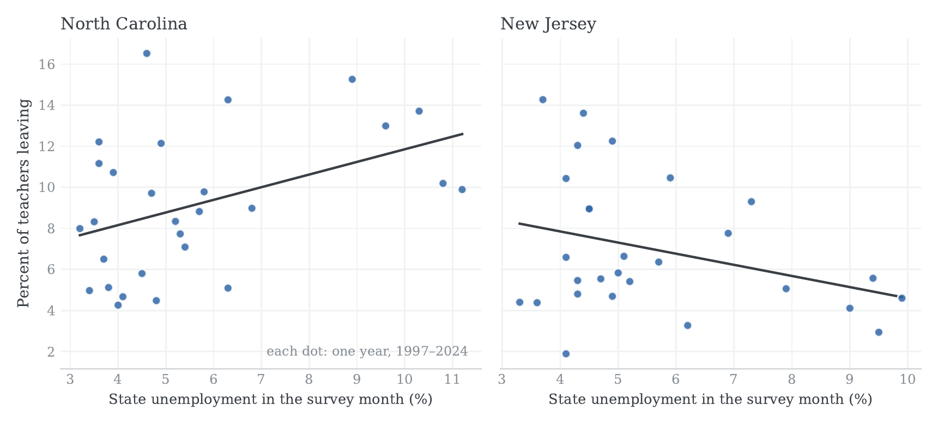
Figure 9. Leaving and State Unemployment: Two Examples
Notes: Annual state leaving rates of college-graduate teachers (dots; one per year, 1997–2024) against the state unemployment rate in the survey month (BLS Local Area Unemployment Statistics), with OLS fits. North Carolina and New Jersey are shown as examples of the two signs. State of residence is recovered from the household records of the raw files. Source: author’s calculations from March CPS supplements.
Notes:
Fifty-one regressions, three significant slopes. Mississippi and Pennsylvania say recessions push exits up, New Jersey says the opposite, and the large states are precise zeros. No systematic poaching anywhere.

Slide 13
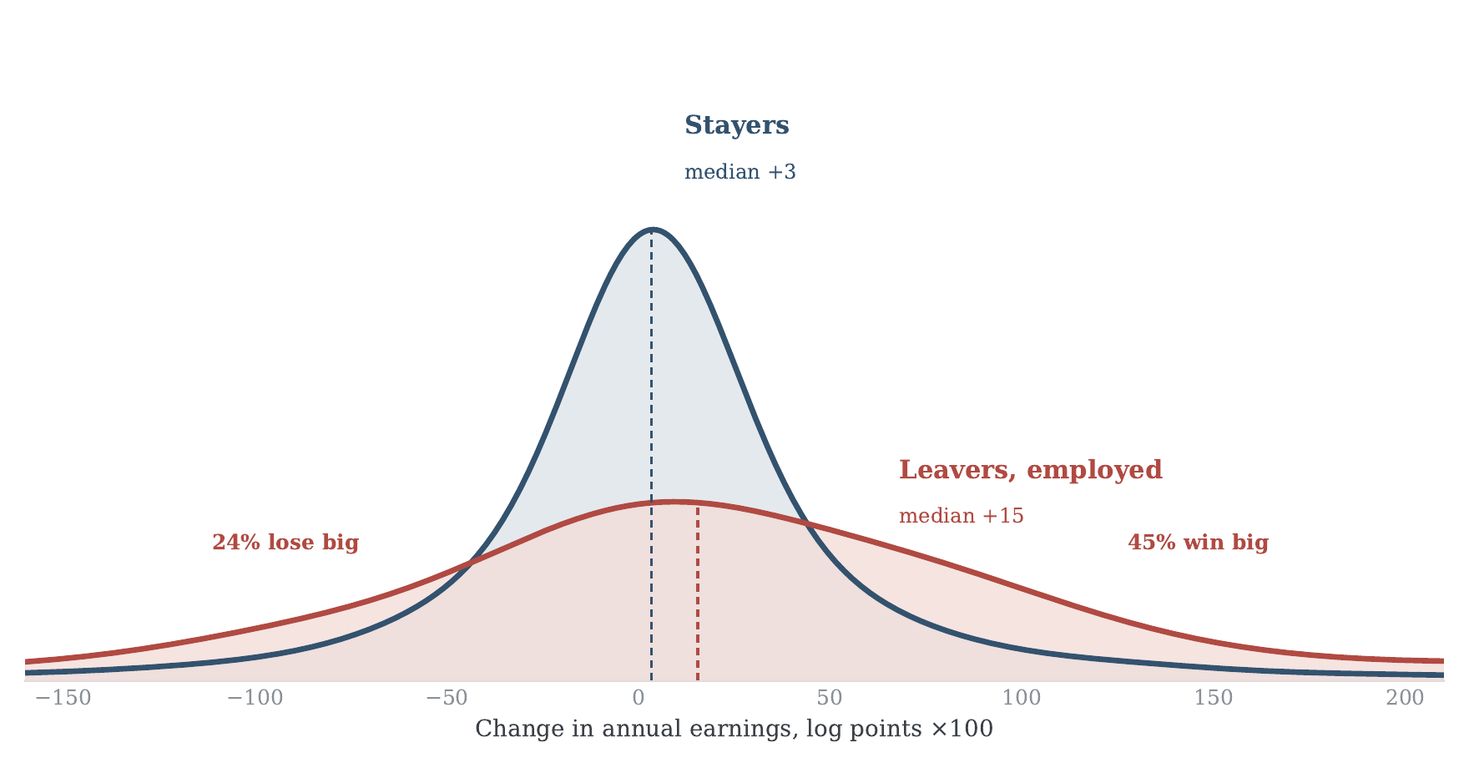
Figure 10. The Distribution of Earnings Changes: Stayers and Leavers
Notes: Kernel densities of the person-level change in annual wage and salary earnings (log points ×100) between the teaching year and the next, for teachers linked across consecutive supplements (rotation-group links, survey years 2011–2025; identity validated on sex and age). Navy: stayers (12,195 links; median +3). Red: leavers employed the following year (225 links; median +15). “Lose big”/“win big” denote changes beyond ±30 log points. The sample conditions on positive earnings in both years; 47 percent of all leavers report zero earnings the following year. Bandwidth 0.25. Source: author’s calculations from March CPS supplements.
Notes:
Switching pays a median of 15 log points, with enormous tails. A quarter lose big, and 47 percent of all leavers earn nothing at all. Leaving is a gamble, and teachers act accordingly.

Slide 14
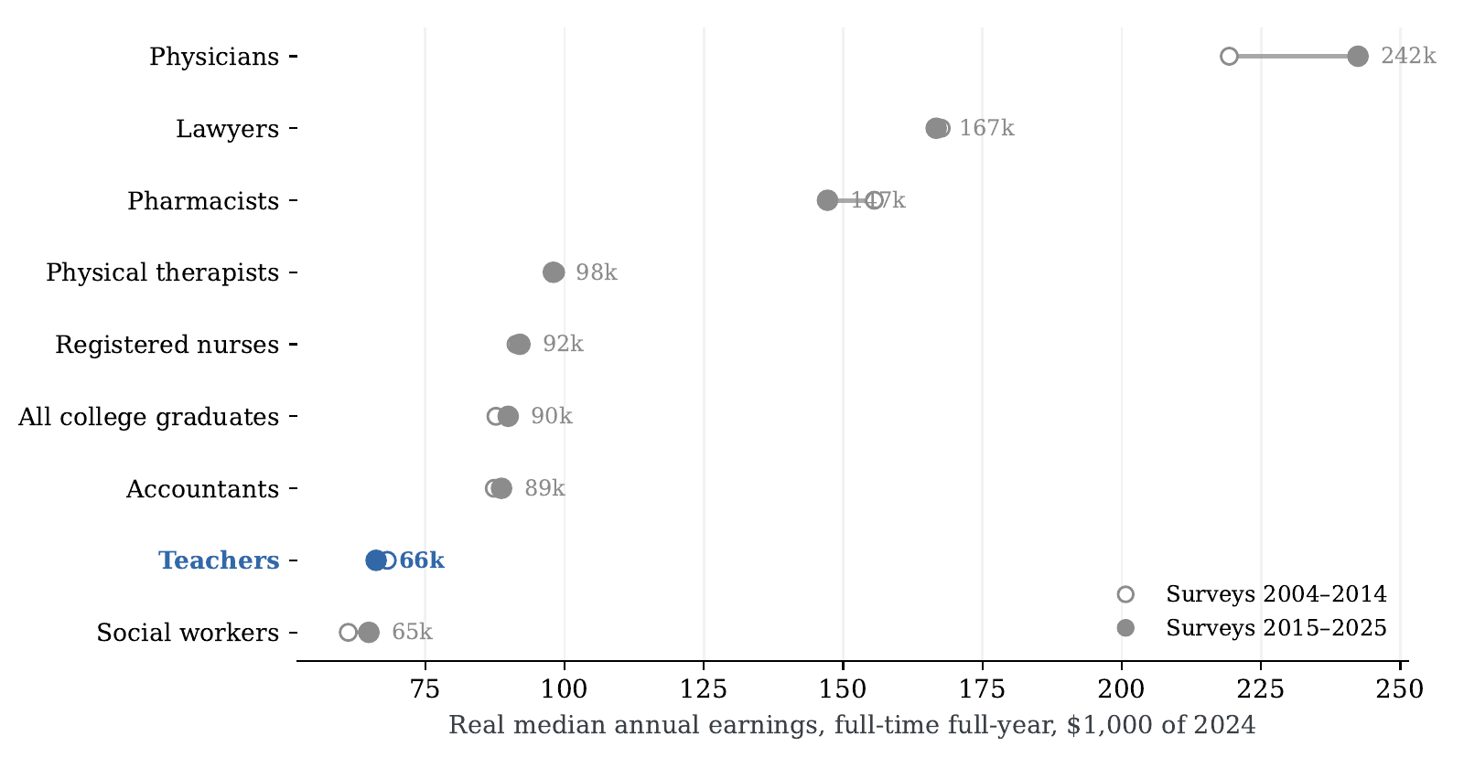
Figure 11. Real Median Earnings by Profession, 2004–2014 and 2015–2025
Notes: Weighted median annual wage and salary earnings of full-time, full-year college graduates aged 25–60, in each profession and overall, deflated to 2024 dollars with the CPI-U; the two windows pool survey years 2004–2014 and 2015–2025. Filled dots (with values): recent window. Source: author’s calculations from March CPS supplements; CPI: BLS via FRED.
Notes:
Teacher real pay slipped from 68,000 to 66,000 dollars while the college median rose to 90,000. The penalty now stands at 28 percent.

Slide 15
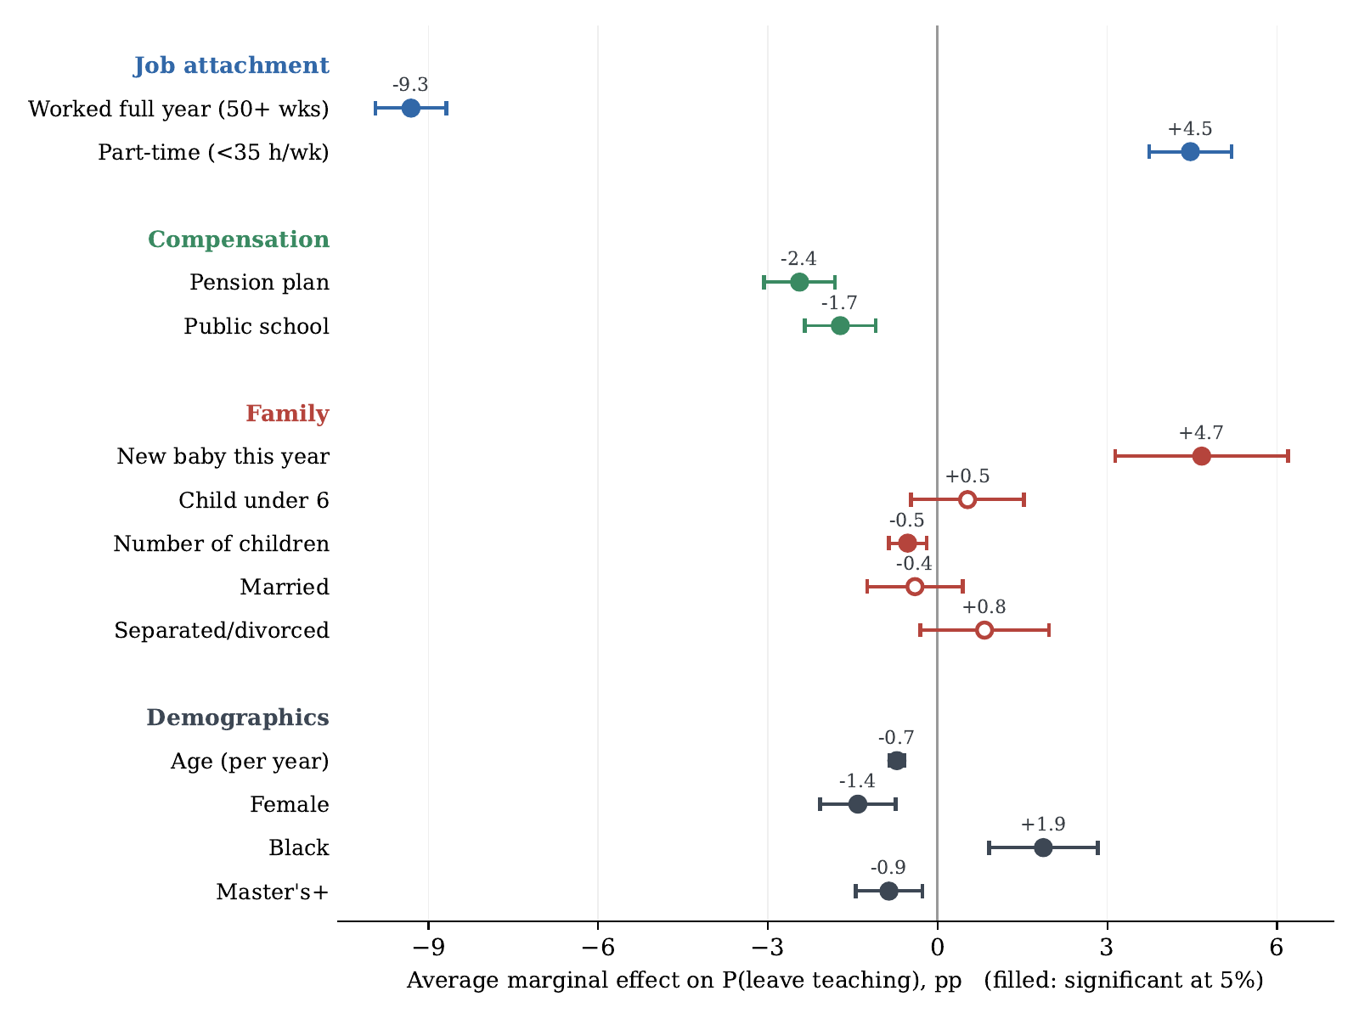
Figure 12. Average Marginal Effects on the Probability of Leaving Teaching
Notes: Average marginal effects (percentage points) on the probability of leaving teaching, from a probit on college-graduate teachers pooled over calendar 2015–2024 with year effects; whiskers are 95 percent confidence intervals; filled markers are significant at 5 percent. “Worked full year” is 50+ weeks at the last-year job; “part-time” is under 35 weekly hours. n = 28,900. Source: author’s calculations from March CPS supplements.
Notes:
The contract predicts exit, the person barely does. Full-year work, hours and pension coverage dwarf every demographic. The one personal event that matters is a birth.

Slide 16
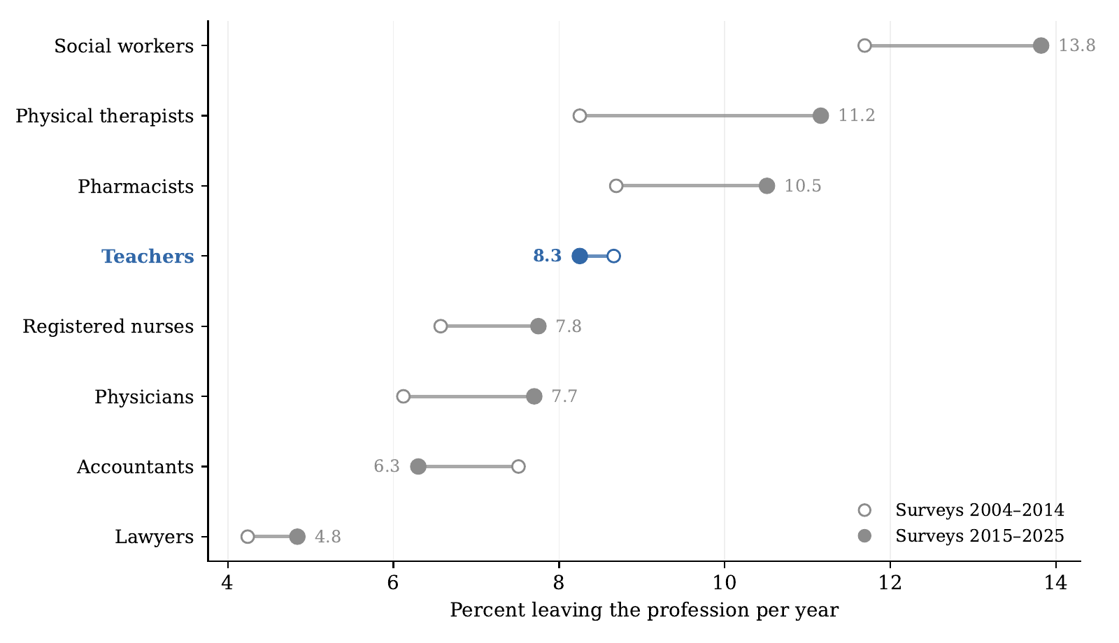
Figure 13. Rates of Leaving by Profession, 2004–2014 and 2015–2025
Notes: Annual rate of leaving each profession (same route-based definition as for teachers, college graduates, ASEC weights), pooled over survey years 2004–2014 (open) and 2015–2025 (filled, with values). Occupation codes harmonized across the 2002, 2010, and 2018 Census classification regimes. Source: author’s calculations from March CPS supplements.
Notes:
Teaching and accounting are the only professions here whose attrition fell across decades. Every health and social profession rose. Whatever pushes pharmacists and therapists up is economy wide, not a crisis of schools.

