Slide 1
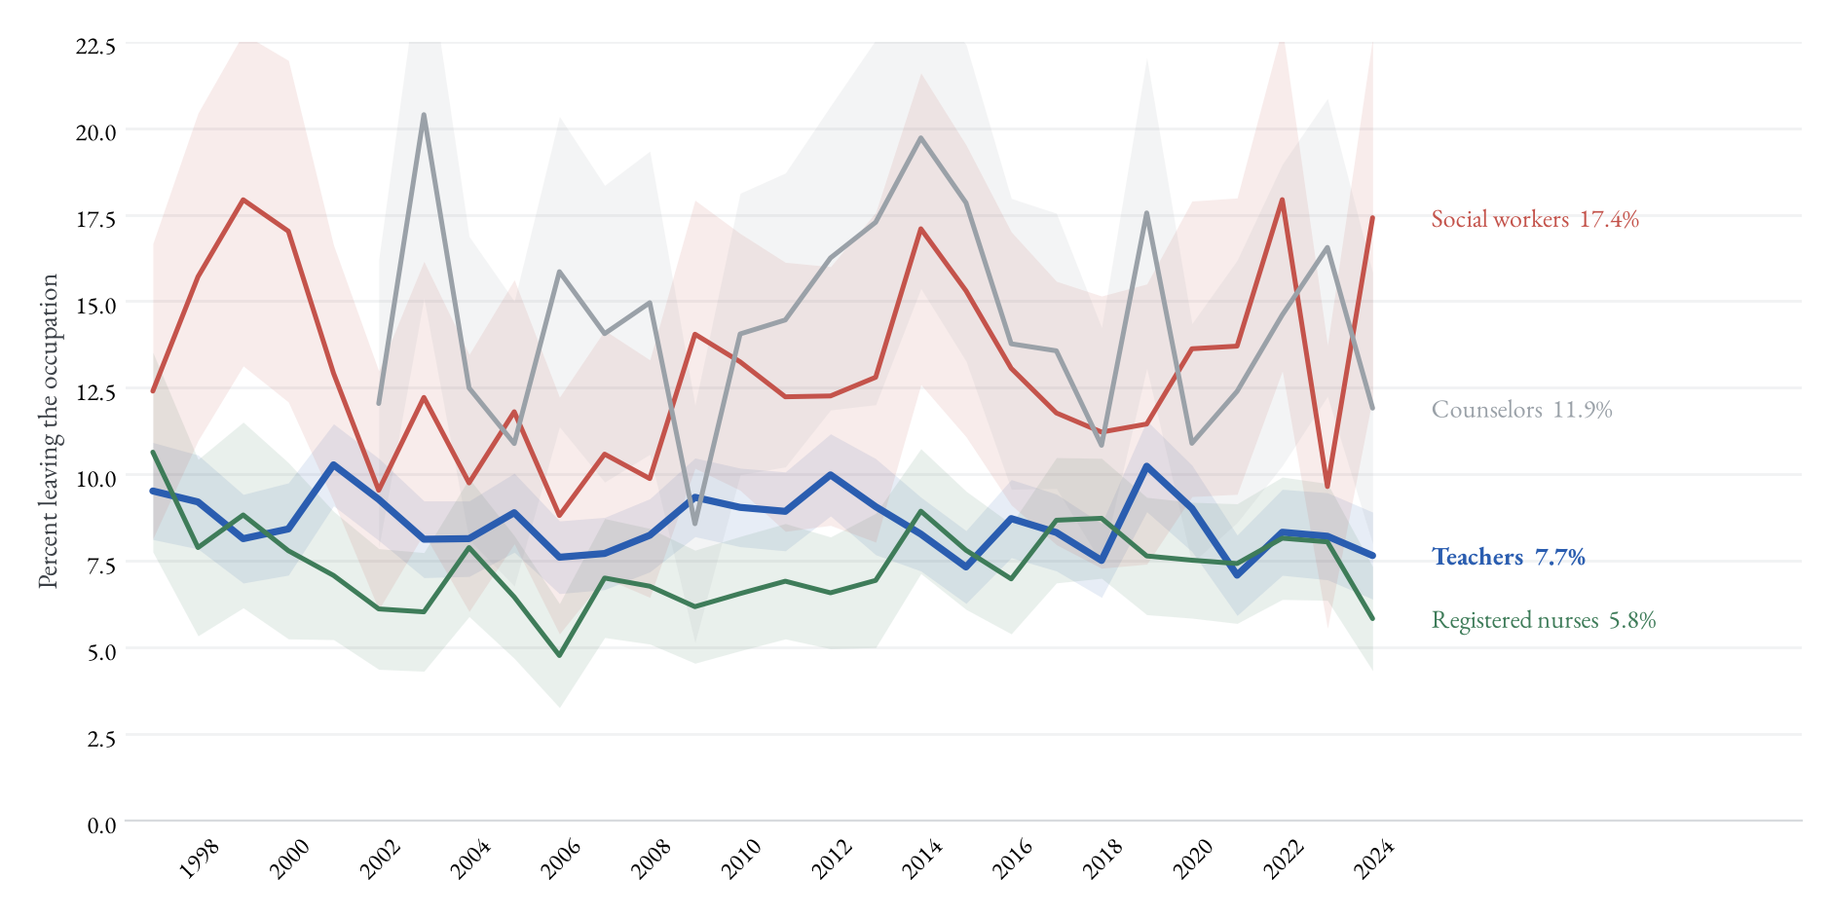
Leaving by profession, annual rates (no smoothing)
☞ Annual rates
(copy this button to the main deck)
Raw annual rates with 95% bands; the main-deck version shows 3-year moving averages of these same series.
☞ Back

