Slide 1

Measuring Teacher Attrition with Labour Force Survey Data
The Case of the United States
José Elías Durán Roa
Data Cluster · Directorate for Education and Skills

Slide 2
Why this project
• Which of the factors we can observe correlate most strongly with the decision to leave teaching?
• Re-estimate the teacher leaving rate against the published figures of the official surveys.

Slide 3
Contribution
1. A new series. The longest continuous series of teacher attrition to reach the present: one estimate for every year from 1997 to 2024, constructed from twenty-eight consecutive supplements of the Current Population Survey.
2. A measurement discussion. A systematic treatment of the ways a longitudinal household survey identifies leaving: the linking of individuals across interviews, the alternative definitions of a leaver, and the assumptions each definition entails.
3. Substantive evidence. A characterization of who leaves teaching and of the observed factors most strongly associated with leaving, together with the destinations of leavers and the heterogeneity of attrition across states.

Slide 4
The CPS replicates the official picture, every year
CPS
NTPS (official)
Difference
Measurement
every year, 1997–2024
occasional waves
Example wave: 2020–21, the latest NTPS
Female (%)
75.5
76.8
−1.3
Master’s degree or higher (%)
57.0
61.0
−4.0 ***
Average age (years)
44.0
42.9
+1.1 ***
Teachers observed in the wave
3,855
39,633
Public school teachers. CPS: supplements of 2021–2022, weighted. NTPS 2020–21 (NCES 2022-113; Digest of Education Statistics, table 209.10; respondent count from NCES 2024-024). Stars test the CPS mean against the published NTPS estimate, design-adjusted standard errors: *** p<0.001; the female share does not differ significantly.
Full sample: 5.0 million person-year records, 1998–2025; 104,545 teacher observations; 48,842 teachers followed in the linked panel.

Slide 5
interviewed 4 months
8 months out of the sample
interviewed 4 months
1
2
3
4
5
6
7
8
Mar
Jun
Mar
Jun
year 1
year 2
the same interview, exactly twelve months later

Slide 6
The March supplement (ASEC)
• The largest supplement of the CPS: the March sample is expanded to roughly 90,000 households.
• Every adult reports on the previous calendar year: longest job held, weeks worked, earnings, benefits.
• We use it to reconstruct the leaving rate.

Slide 7
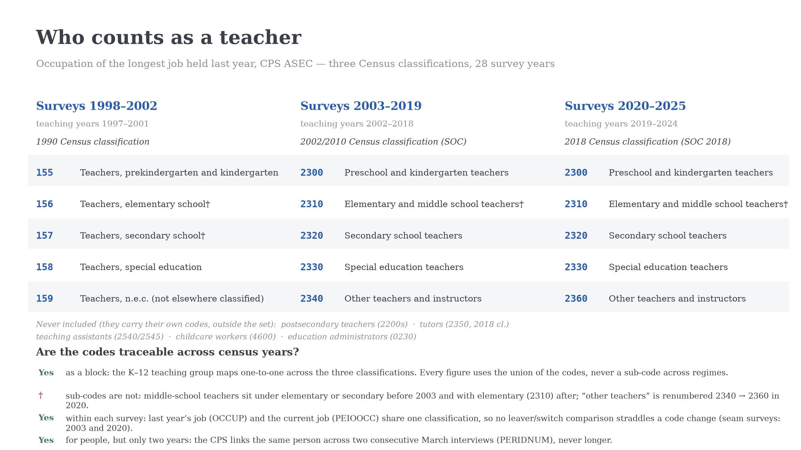

Slide 8
Two ways to measure the leaving rate
Follow the person, year to year
Ask about last year, each March
The rotation shows the same individual twelve months apart. The CPS has no person identifier, so records are linked on fields common to both years:
The supplement’s retrospective question. Whoever reports teaching as last year’s longest job, and no longer teaches at the March interview, left within the year.
The measure used in the literature so far.
household identifier
dwelling identifier
person line number within the household
validated on sex, race, and age advancing 0–2 years

Slide 9
Measuring the leaving rate: the alternatives, side by side
Measure
A teacher is…
A leaver is…
Rests on…
Annual recall
whoever taught as last year’s longest job
no longer teaching at the March interview
accurate recall of the previous year
Occupation pair
a teaching occupation code one year ago
a different occupation code today
a current code existing; fails for the non-employed
Panel (benchmark)
teaching in two or more year-1 interviews
never teaching in year 2, given two or more interviews, one outside the summer
correct linkage of persons across waves
Month pairs, any sighting
every teaching month, or a single sighting
not teaching twelve months after each month
one person counting several times; admits one-month spells
Same records throughout; only the definition changes. Each row answers the same three questions.

Slide 10
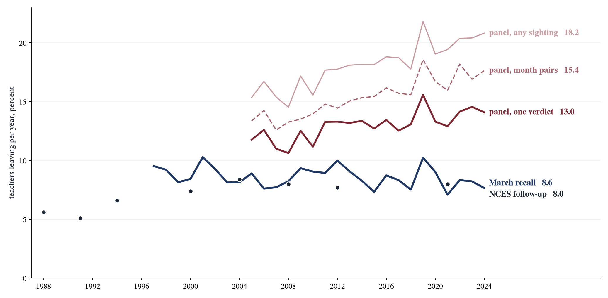
One dataset, one rate per definition
Message. The definition of a leaver moves the measured rate by a factor of nearly four.
Policy. Comparisons across studies and countries must hold the definition fixed.

Slide 11
Why teachers leave: what the CPS can and cannot see
Reasons identified in the literature
Observed in the CPS?
Working conditions
no
Organizational support (mentoring, leadership)
no
Autonomy and intrinsic motives
no
Financial factors
yes
Personal life-cycle motives
yes
Sociodemographic characteristics
yes
Five broad families of reasons from our review of the literature. The CPS covers the economic and life-cycle margins.

Slide 12
Five messages
1. Economic and employment conditions correlate with leaving far more than demographics.
2. Exits concentrate where attachment and annual pay are lowest: part-time and part-year teachers in the bottom of the earnings distribution.
3. Those same exits lead out of employment, not to better-paid jobs: two thirds of bottom-quintile leavers exit the labor force. Low pay and non-employment destinations are one phenomenon, not two.
4. Life-cycle events are the largest single trigger: childbirth raises a woman’s exit probability by about six points, more than in comparable professions.
5. Pension coverage retains, and attrition differs widely across states: the actionable margins are contractual and institutional.

Slide 13
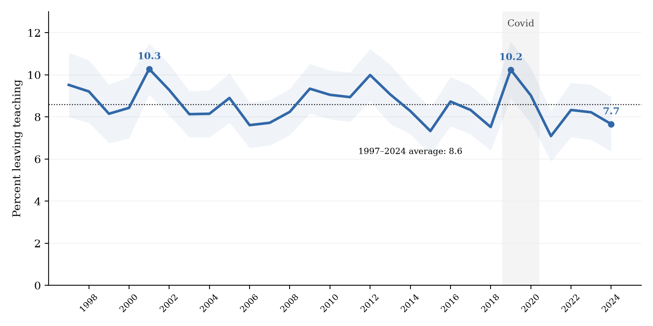
Leaving teaching, 1997–2024
Message. The rate fluctuates around 8.6 percent with no trend: a persistent outflow, not a mounting exodus.
Policy. Retention faces a steady-state cost, not an emergency spike.

Slide 14
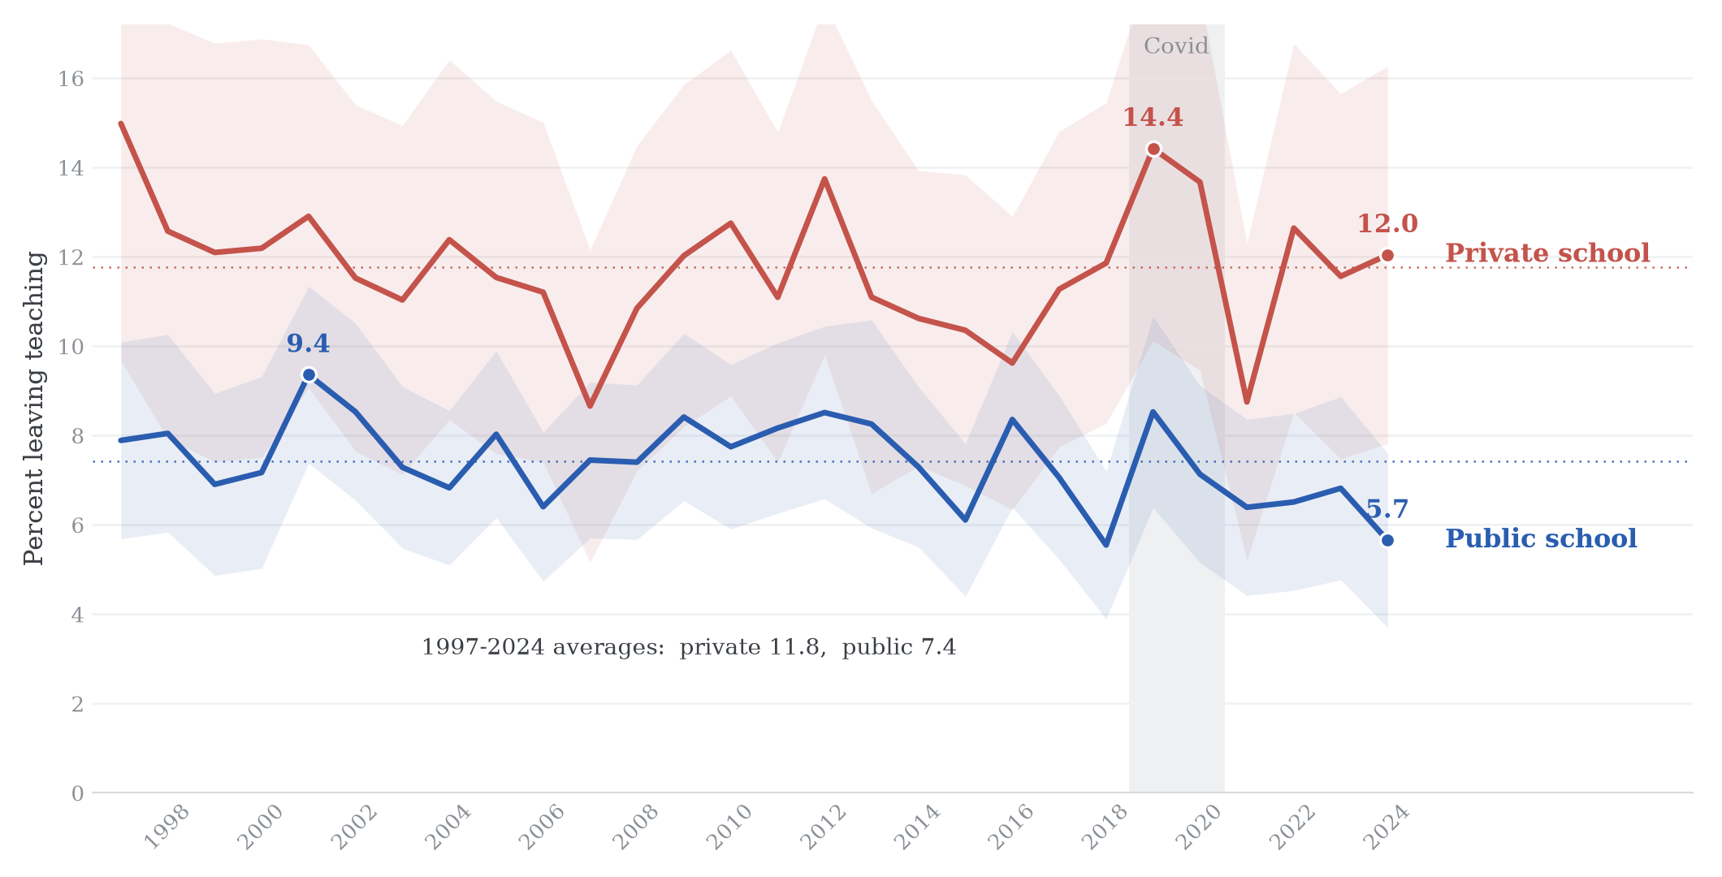
Leaving teaching, by school sector
Message. Private schools lose teachers at roughly twice the public rate.
Policy. Retention tracks contract structure, pay and pensions, not classroom conditions alone.

Slide 15
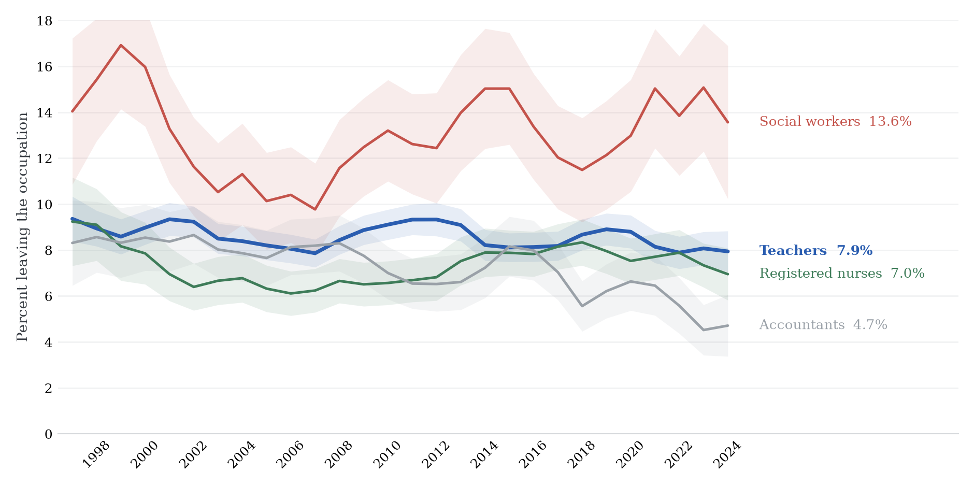
Leaving the occupation, by profession
Message. Teacher attrition is unexceptional next to comparable professions: above nurses and accountants, well below social workers.
Policy. Benchmarks from other professions discipline how alarming any teacher figure should be.

Slide 16
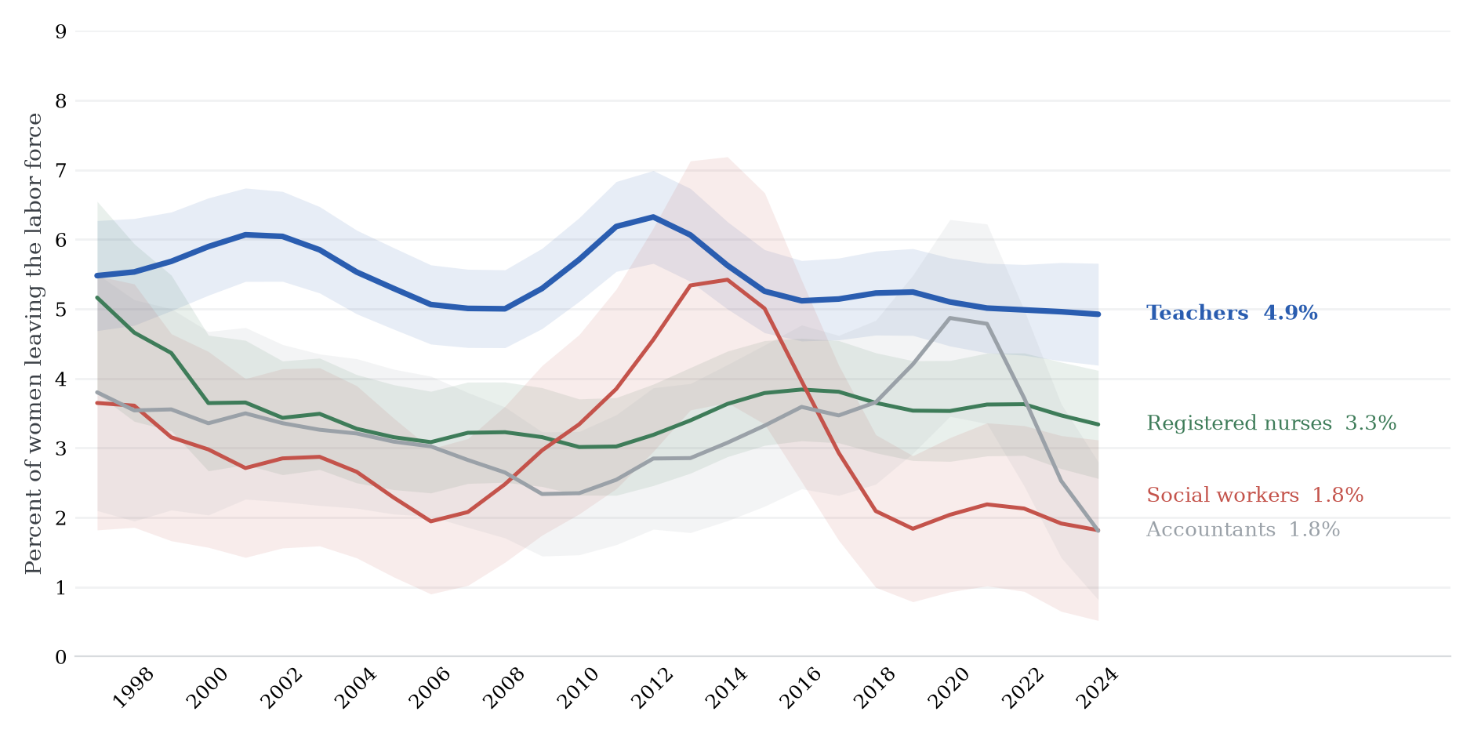
Labor force exit of women, by profession
Message. Women teachers exit the labor force at about five percent a year, well above nurses, social workers and accountants.
Policy. The family-compatibility margin is specific to teaching, not to professional work in general.

Slide 17
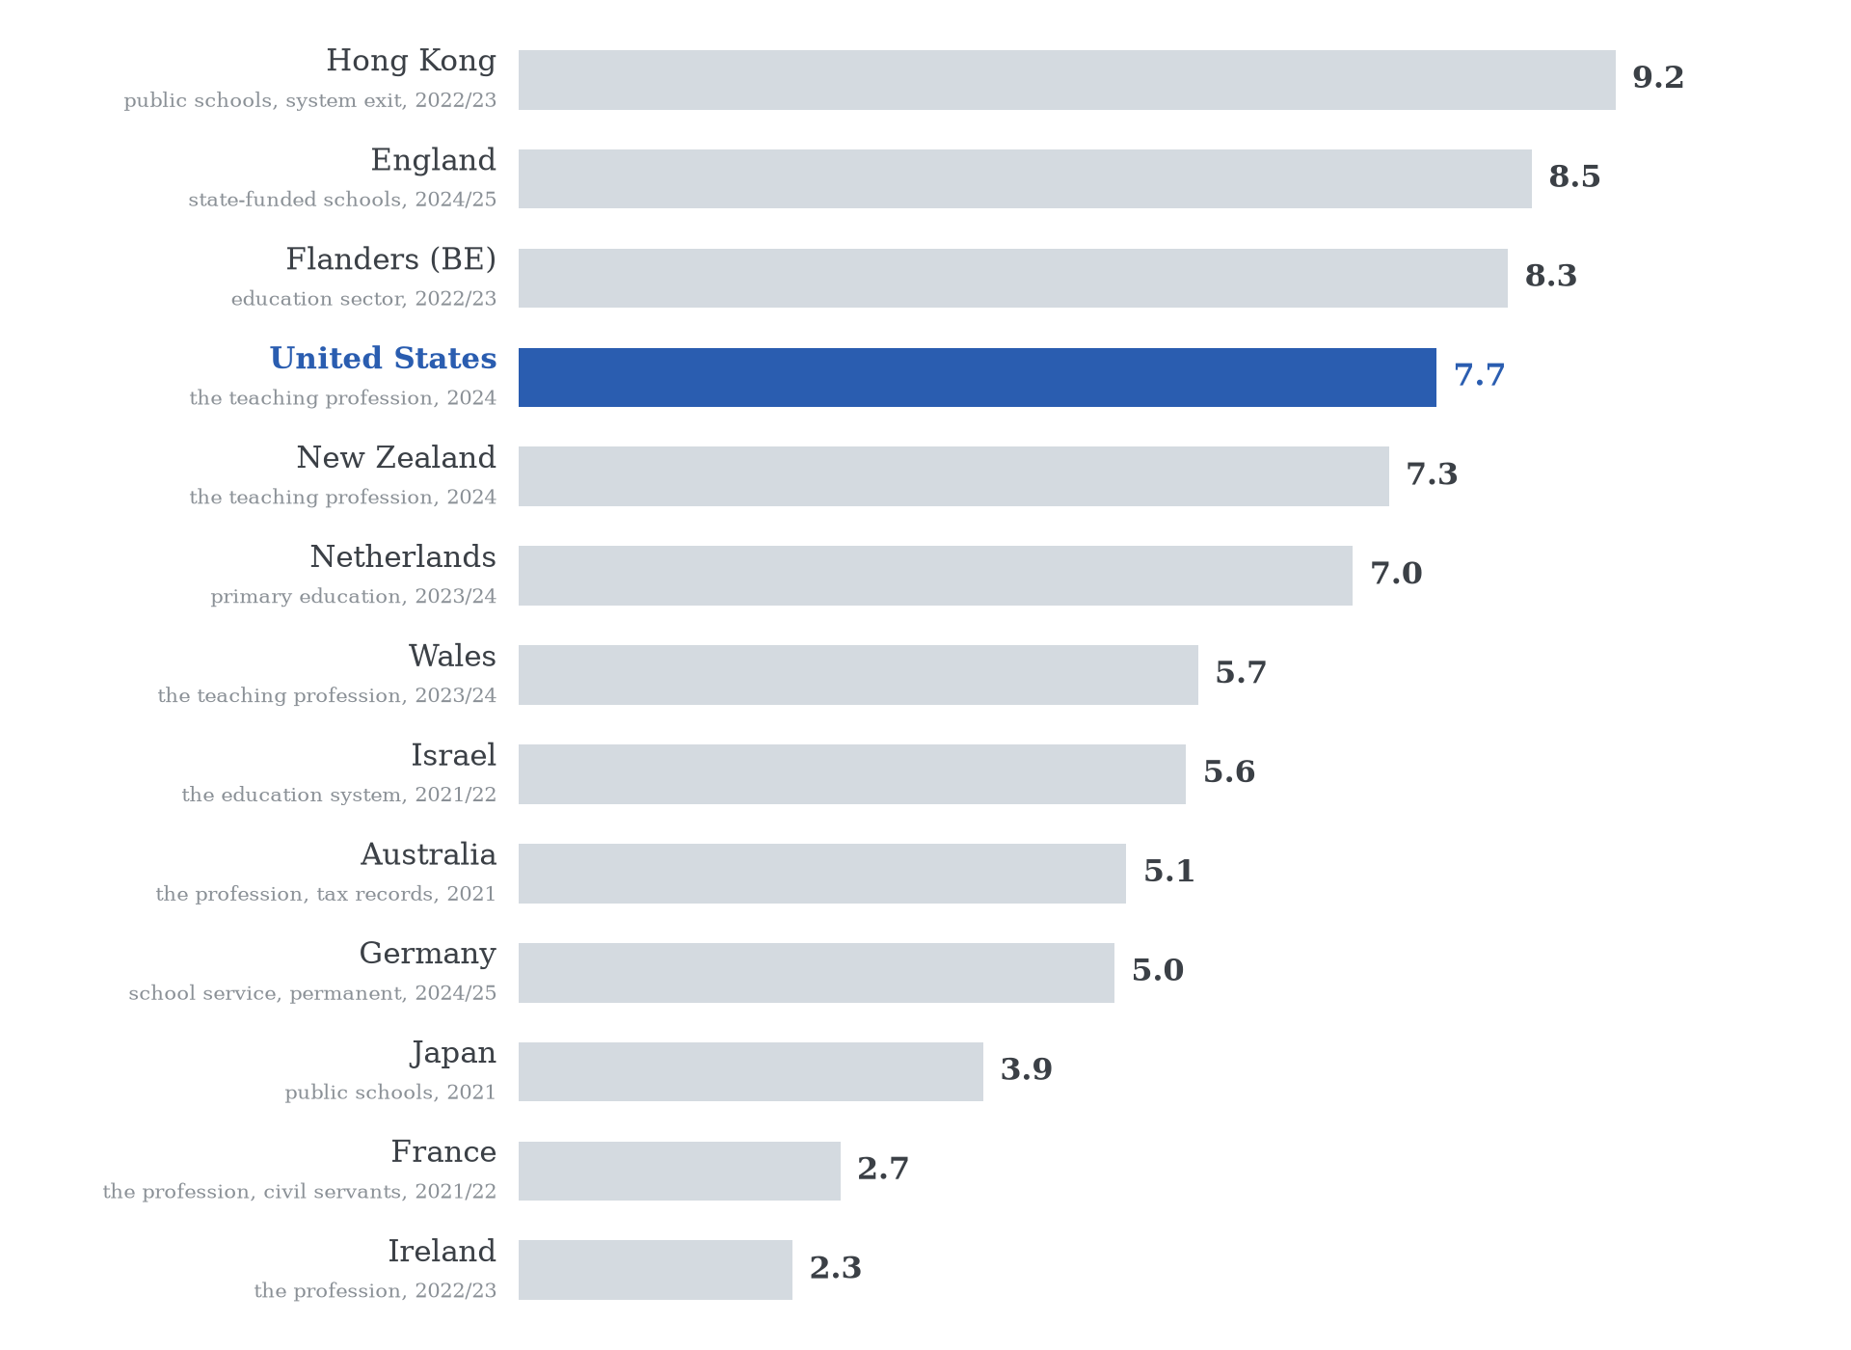
Teachers leaving per year, across countries
Message. The US sits in the upper range of the school systems that publish a rate.
Policy. Comparable, survey-based measurement is what makes this ranking possible.

Slide 18
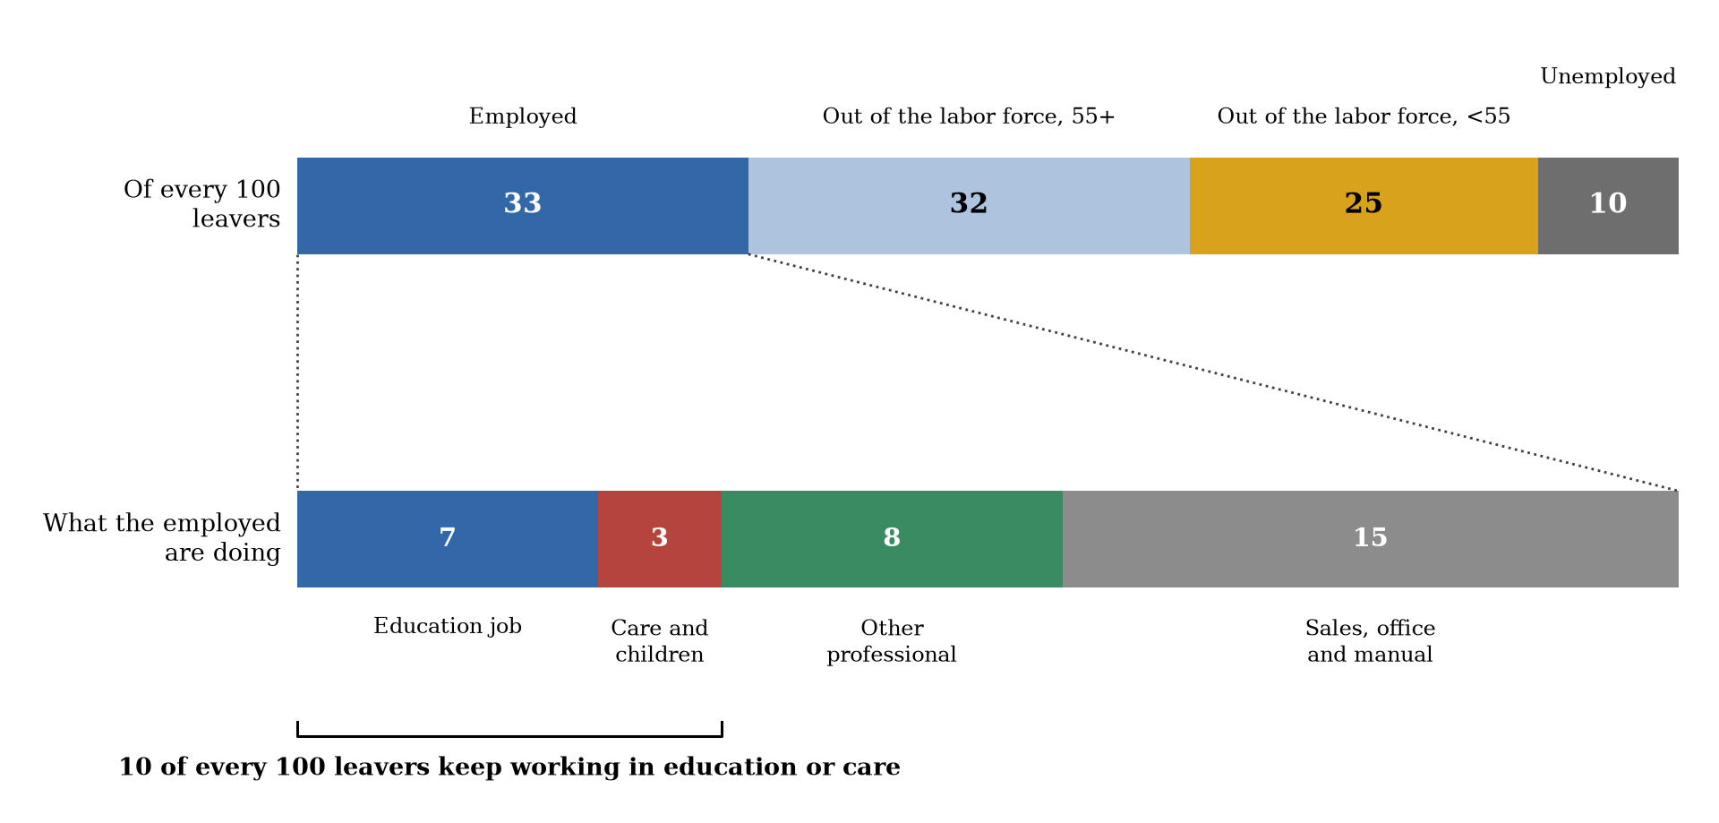
Destinations of teachers who leave, 2024
Message. Of every hundred leavers, about a third take another job; most exit employment altogether.
Policy. Competing employers are not the main counterfactual; retirement and care are.

Slide 19
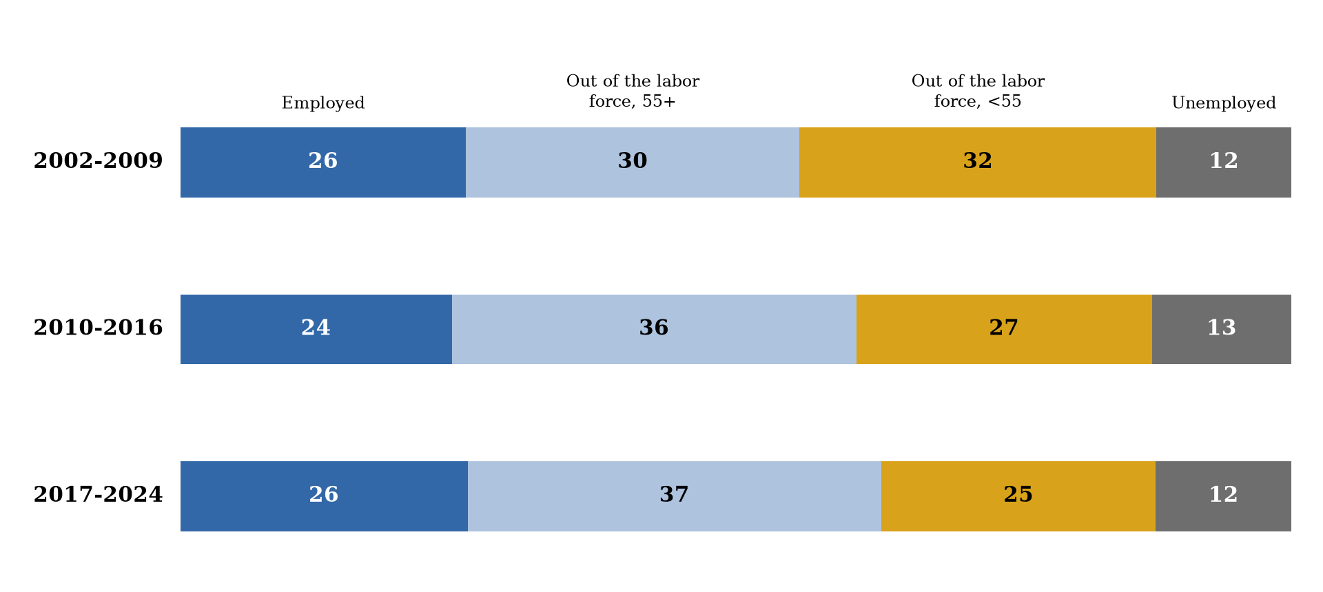
The routes out of teaching, 2002–2024
Message. The destination mix has been essentially stable for two decades.
Policy. The composition of the outflow is structural, not cyclical noise.

Slide 20
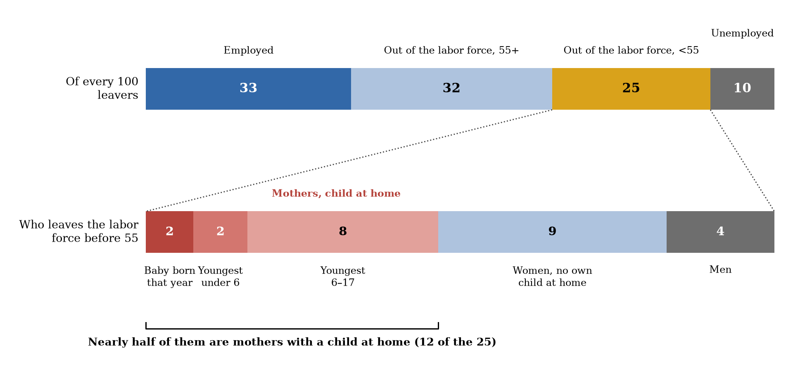
Who leaves the labor force before 55
Message. Nearly half of the pre-55 labor-force exits are mothers with a child at home.
Policy. Childcare and parental-leave policy are retention policy.

Slide 21
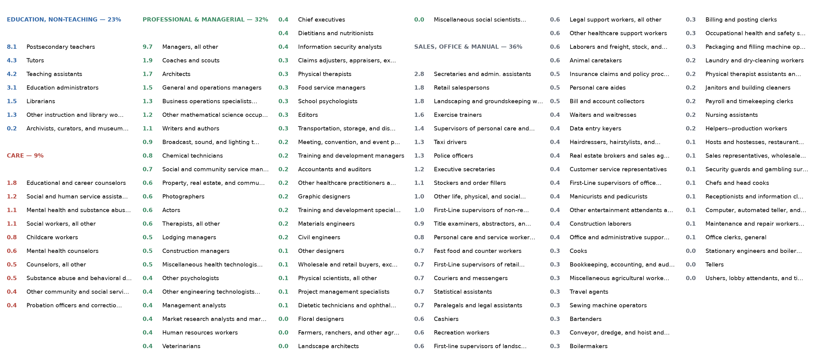
Where the employed leavers go: every occupation
Message. Employed leavers scatter widely; the largest block stays in education outside the classroom.
Policy. Skills remain in the education orbit, so re-entry is a realistic margin.

Slide 22
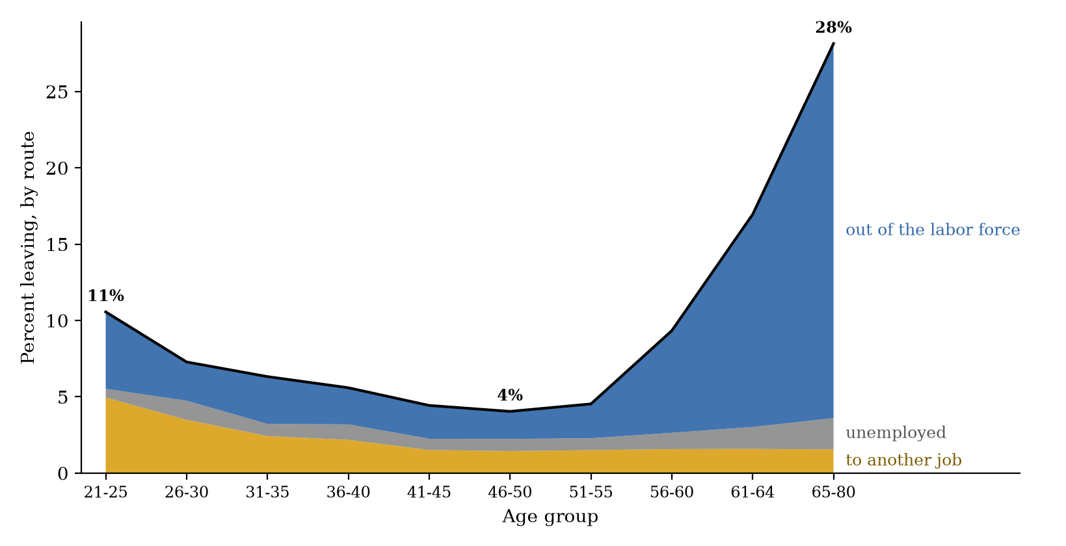
Leaving teaching, by age and route
Message. Leaving is U-shaped in age, and non-employment dominates both ends of the career.
Policy. Early-career and pre-retirement exits call for different instruments.

Slide 23
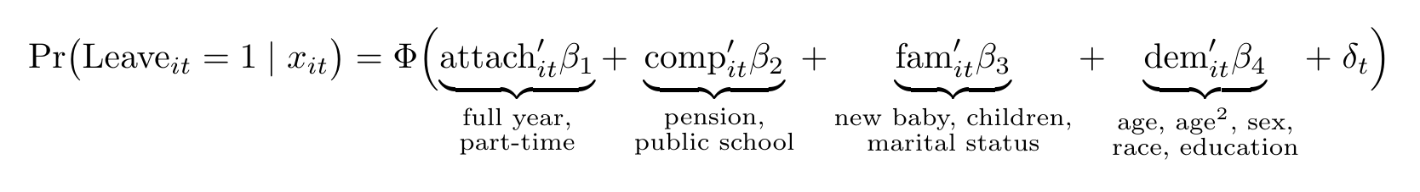
The econometric specification
• Probit on college-graduate teachers, pooled 2015–2024, with calendar-year effects; n = 28,900.
• Average marginal effects reported, in percentage points.
• Robust to logit and weighted LPM, state and year fixed effects, the full 1997–2024 window (n = 85,430), and the occupation-pair definition of leaving.

Slide 24
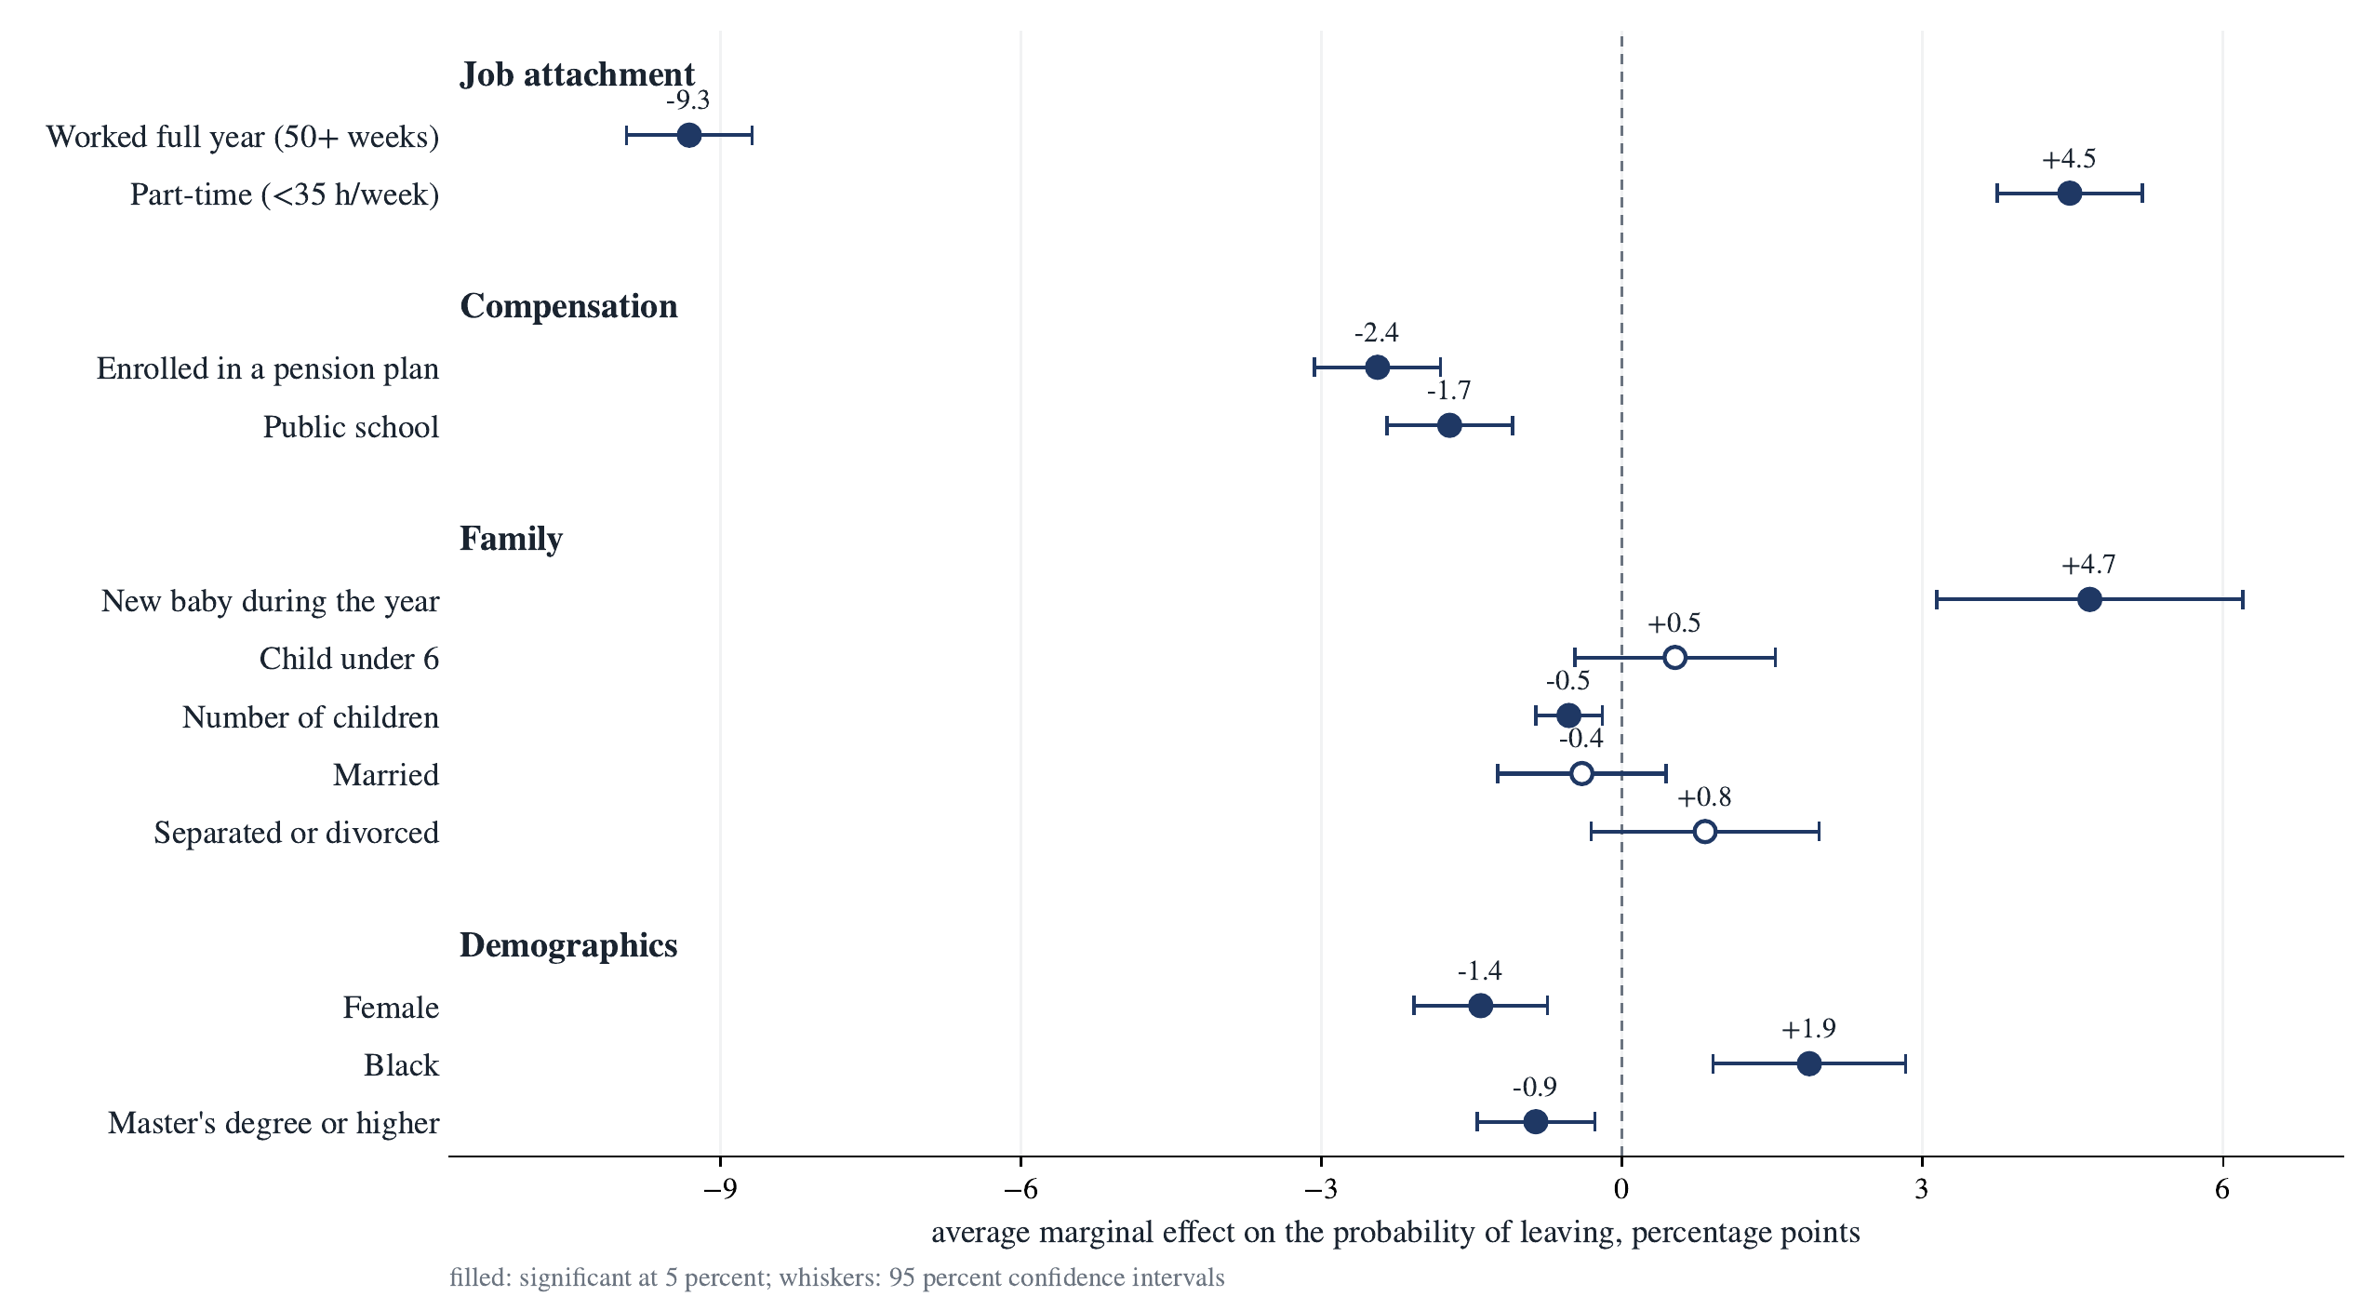
Average marginal effects on the probability of leaving
Message. Job attachment and compensation dominate; demographic differences are small.
Policy. The actionable levers are contractual: full-year contracts, pension coverage.

Slide 25
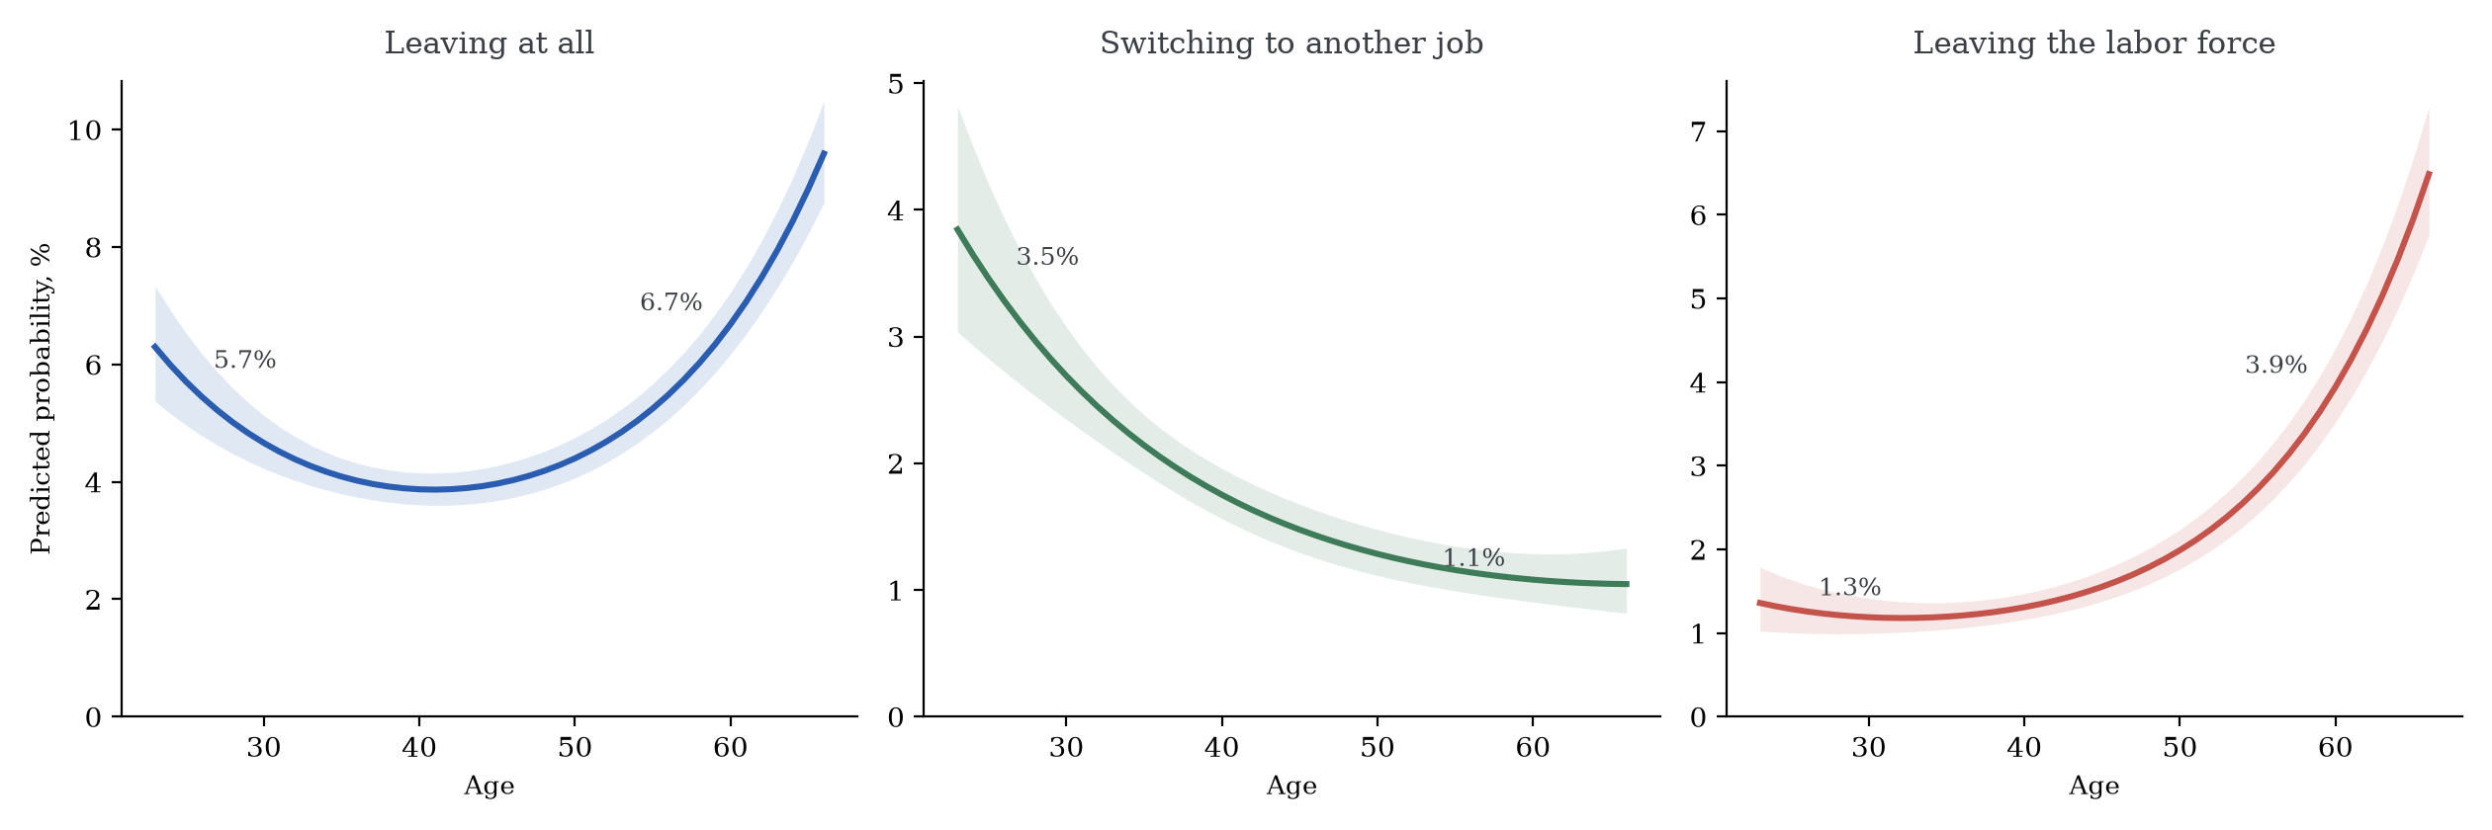
The age profile of leaving, by route
Message. Young teachers switch to other jobs; older teachers leave the labor force.
Policy. The two peaks of the U respond to different policies.

Slide 26
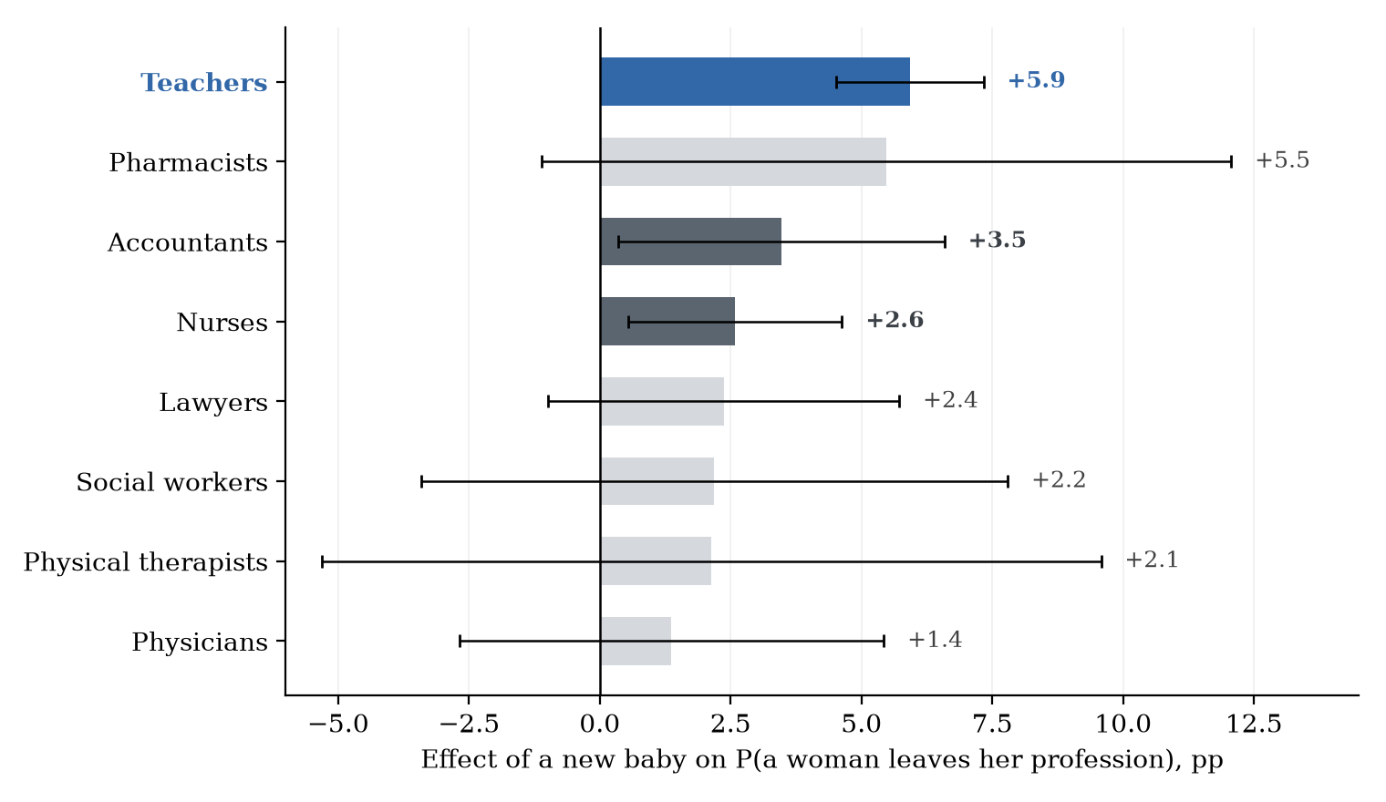
The effect of a new baby, by profession
Message. A new baby raises a woman teacher’s exit probability by 5.9 points, the largest effect among comparable professions.
Policy. Parental leave and childcare support target the largest single observable trigger.

Slide 27
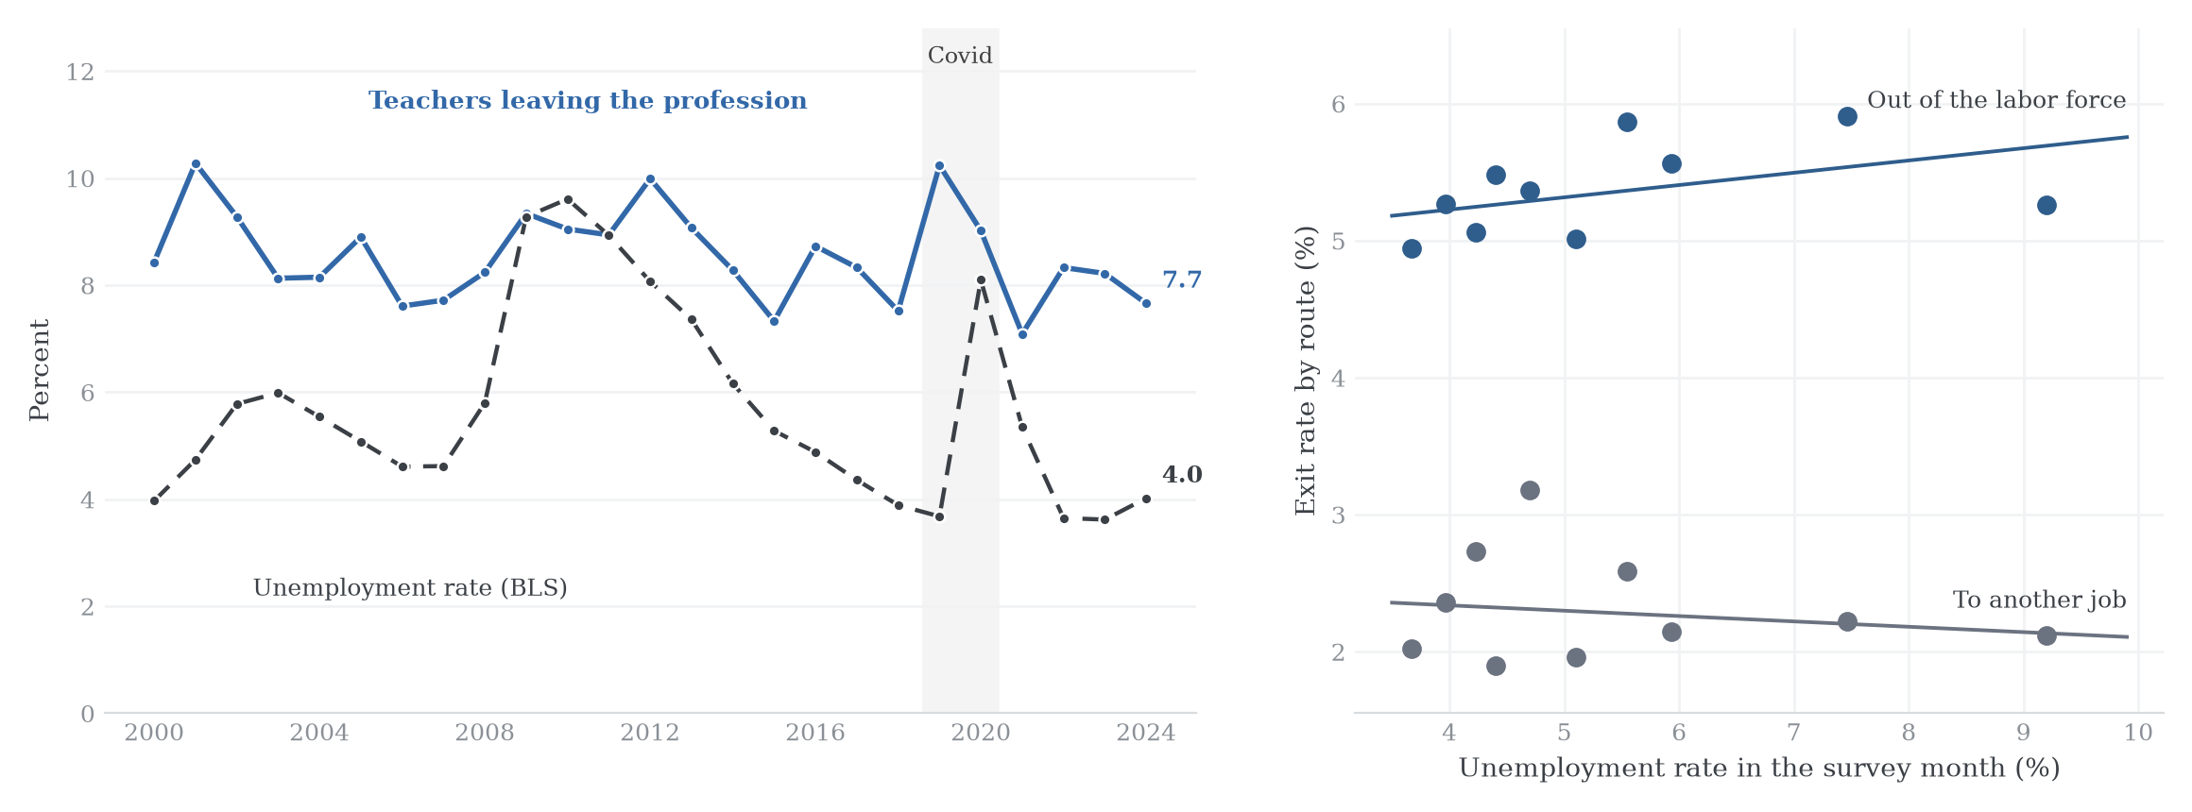
Leaving teaching and the unemployment rate
Message. Exits into non-employment rise with unemployment; job-to-job exits do not.
Policy. Downturns intensify the non-employment route; support should be countercyclical.

Slide 28
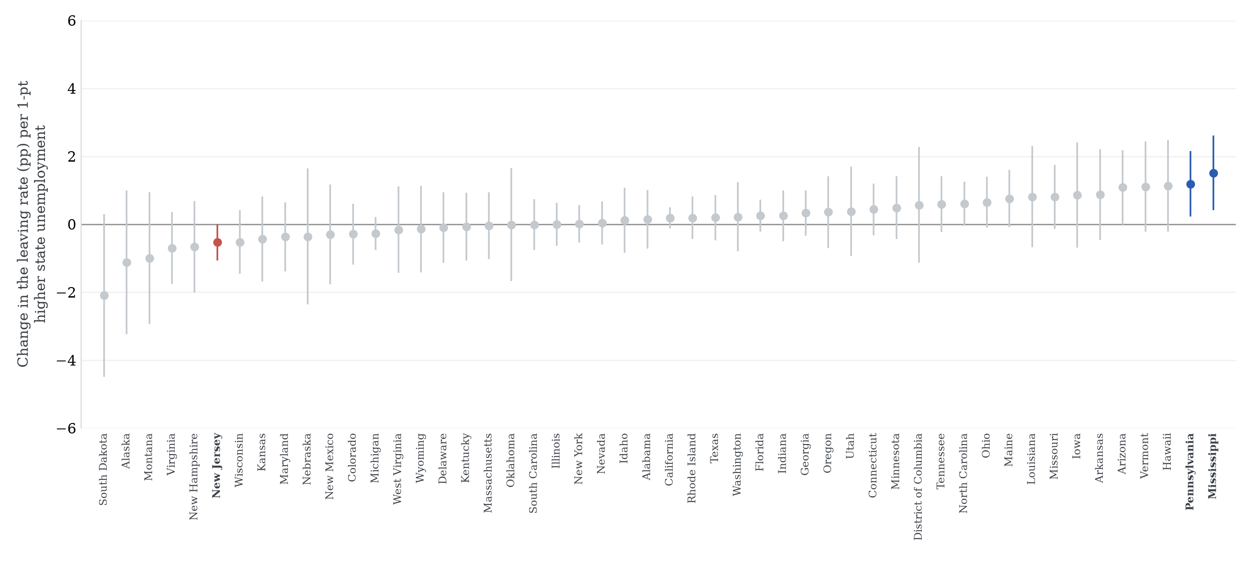
State-level cyclicality of leaving
Message. States differ in how strongly teacher exits respond to the local cycle.
Policy. National averages hide state-level exposure to downturns.

Slide 29
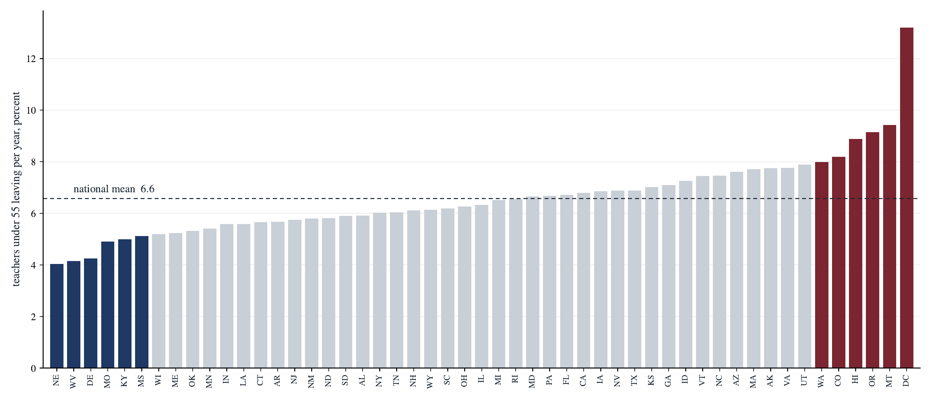
Attrition levels across states
Message. Mean attrition of teachers under 55 ranges from about 4 to 13 percent across jurisdictions.
Policy. State pay scales, pensions and institutions are first-order.

Slide 30
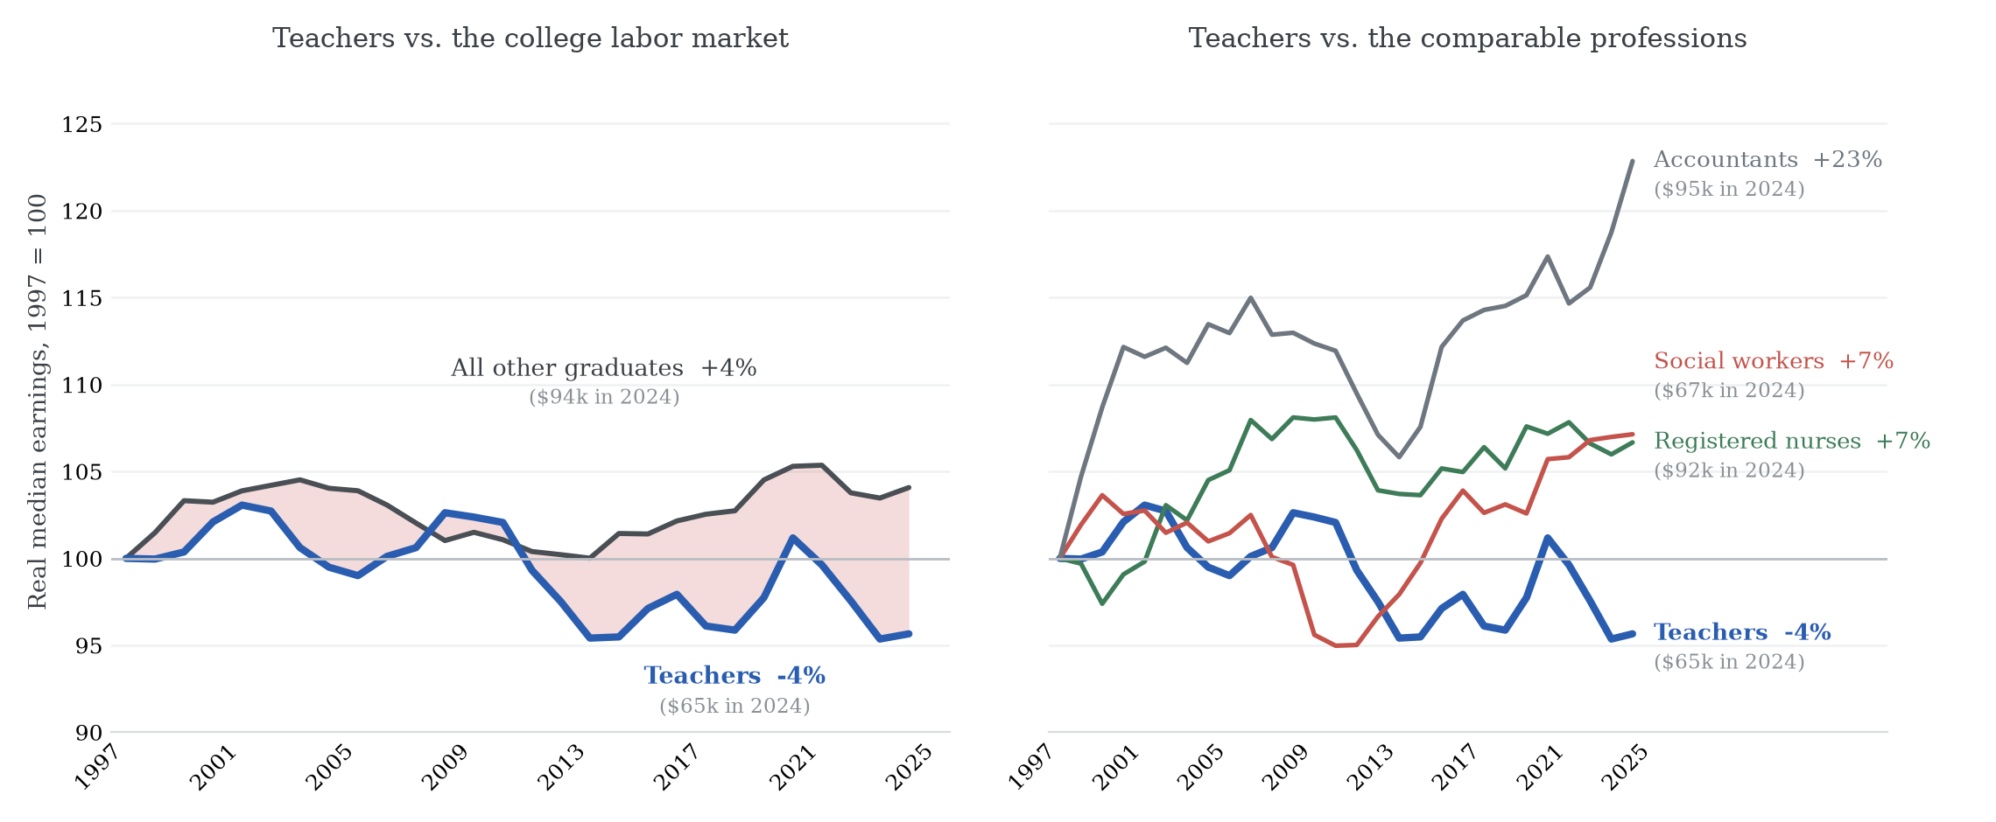
Real earnings growth by profession since 1997
Message. Teachers’ real median earnings fell 4 percent since 1997 while other graduates gained.
Policy. The relative-pay gap compounds slowly; it is a stock, not a shock.

Slide 31
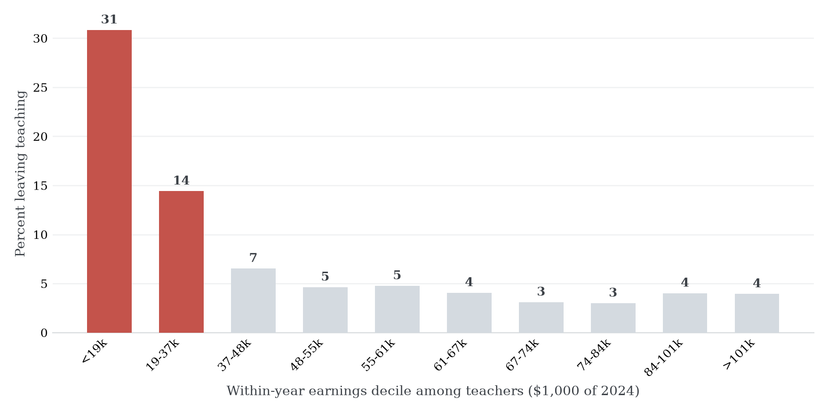
Leaving, by position in the teacher pay distribution
Message. Leaving concentrates sharply in the lowest earnings deciles, mostly part-year teachers.
Policy. Stabilizing the bottom of the distribution buys the most retention.

Slide 32
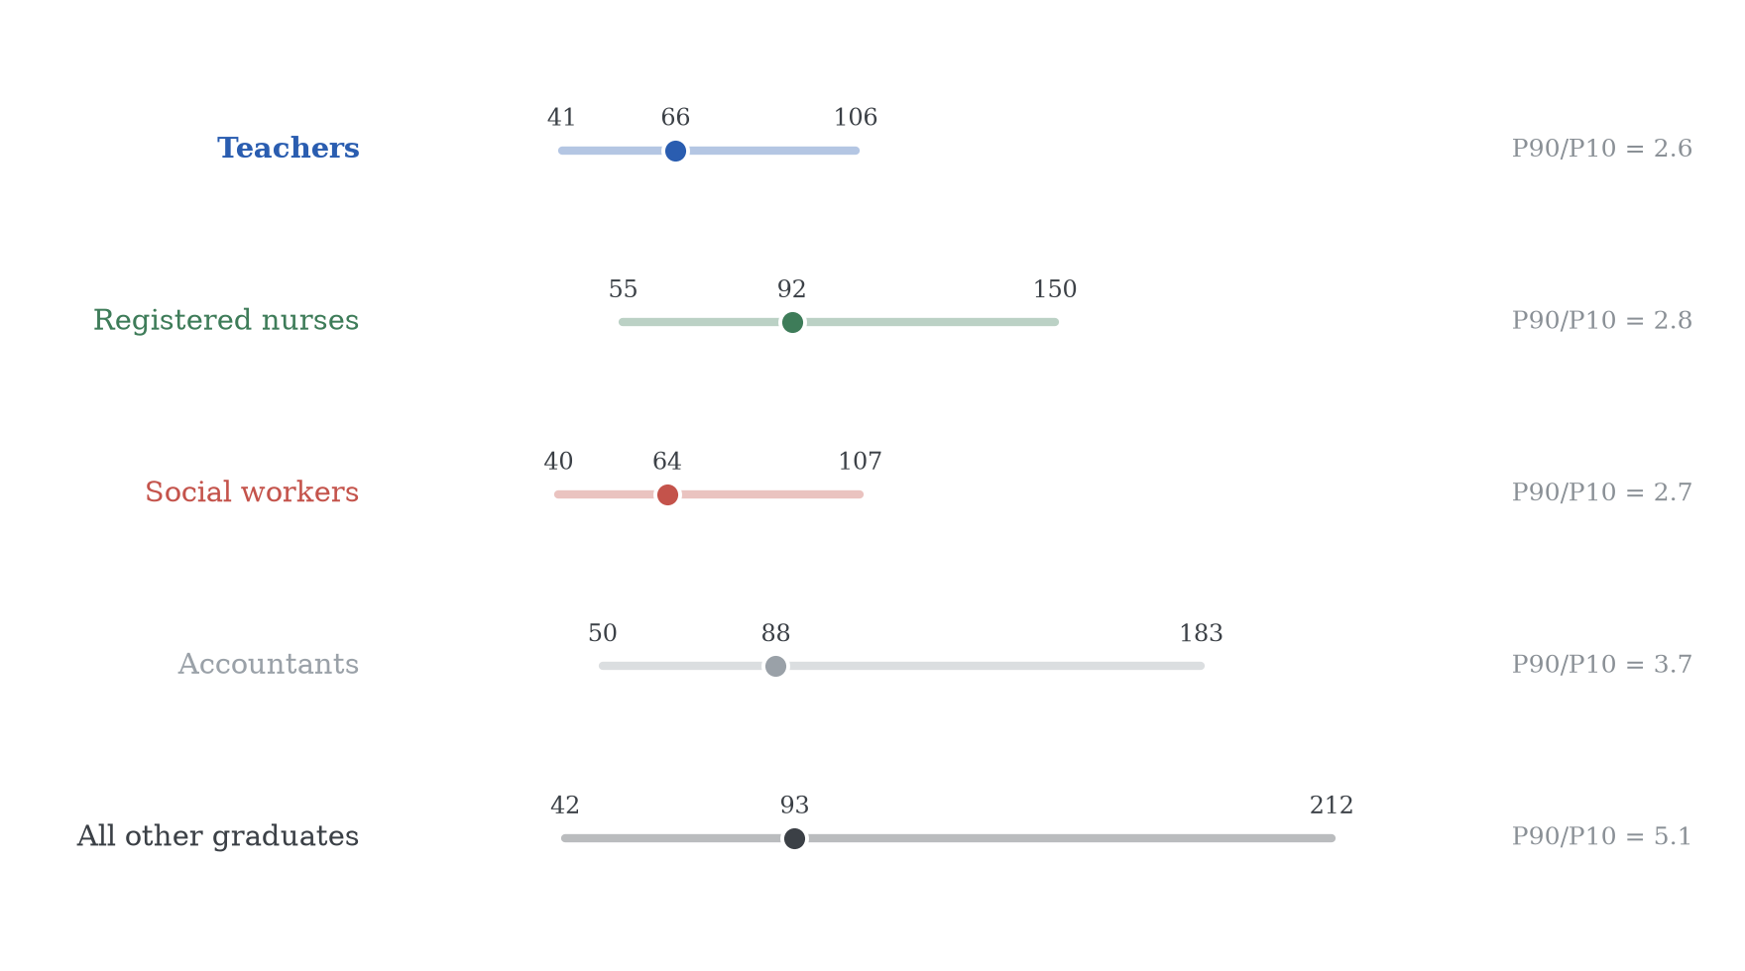
Pay compression: teachers and comparable professions
Message. Teacher pay is compressed: a 90/10 ratio of 2.6 against 5.1 for all other graduates.
Policy. Staying offers little earnings upside; career ladders would widen the right tail.

Slide 33
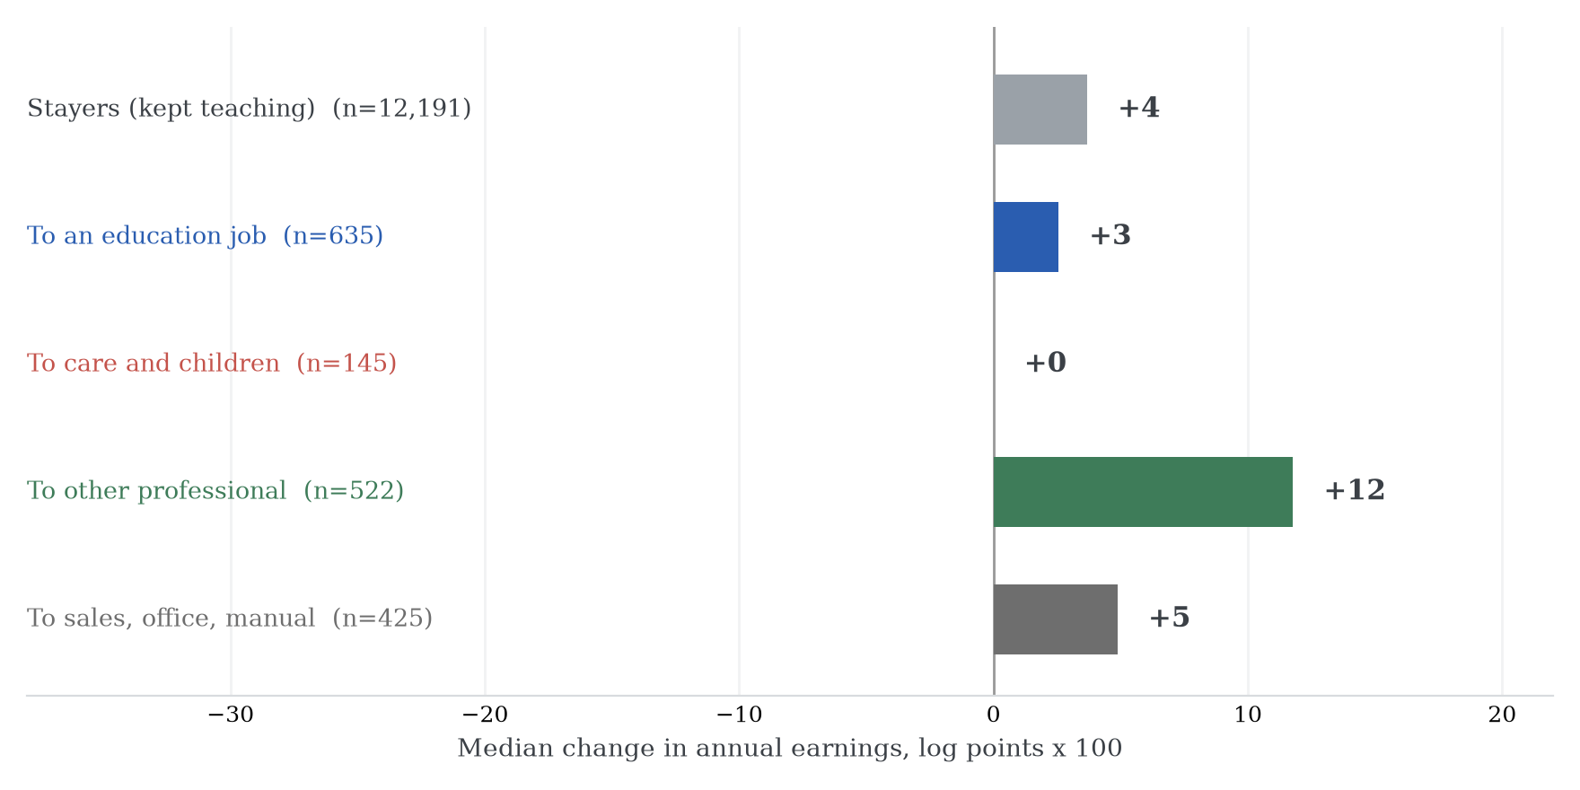
The earnings change of leaving, by destination
Message. Leavers who move to other professional jobs gain about 12 log points; moves near education gain little.
Policy. The outside option is real for those able to take it.

Slide 34
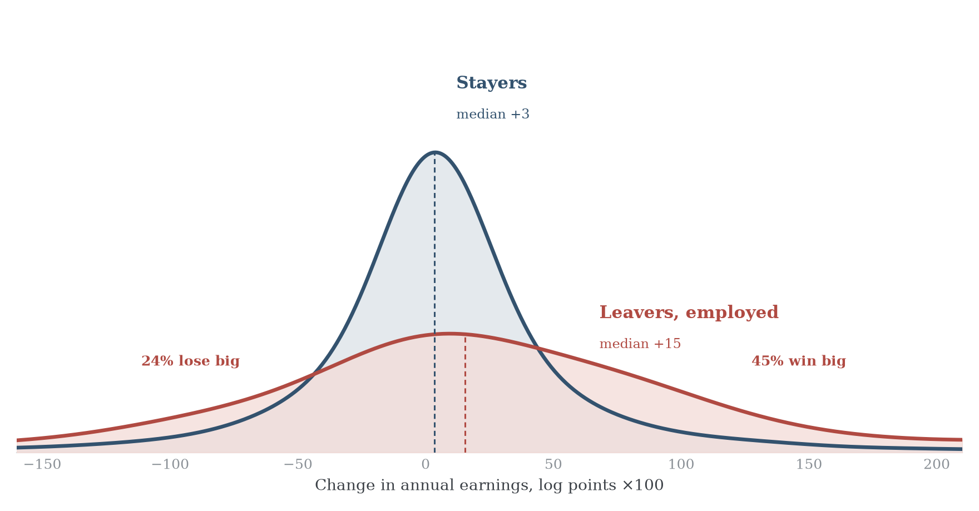
Earnings changes: stayers and leavers
Message. For employed leavers the earnings change is a gamble: a quarter lose big, nearly half win big.
Policy. Leaving buys risk, not a sure raise.

Slide 35
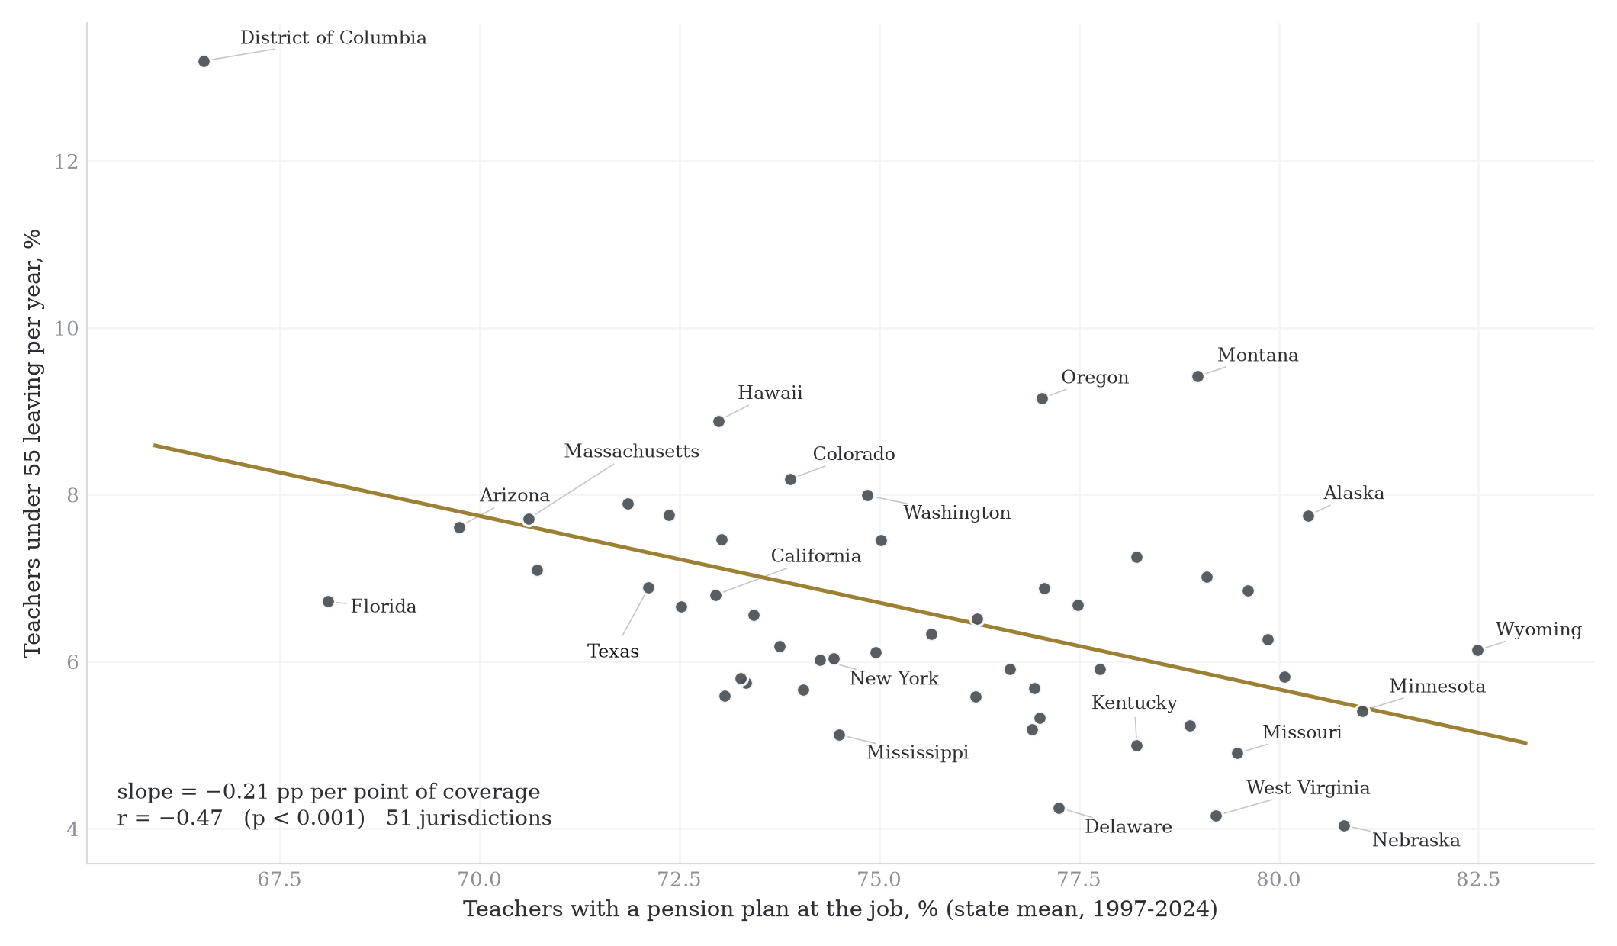
Pension coverage and leaving, across states
Message. Where pension coverage is higher, fewer teachers under 55 leave: 0.21 points per point of coverage.
Policy. Pension design is a measurable retention margin.

Slide 36
Conclusion
• A labour force survey can measure teacher attrition at the person level, yearly, over three decades, and it replicates the official picture of the workforce.
• The definition of a leaver is a first-order choice: the same records yield rates from 5 to 19 percent per year.
• What the data say: attachment, pay and pensions, and life-cycle events correlate with leaving; demographics much less.
• The design travels: the same construction is feasible in the labour force surveys of Italy, Germany, the UK, France, Spain, Brazil and Mexico.

